Slide 1
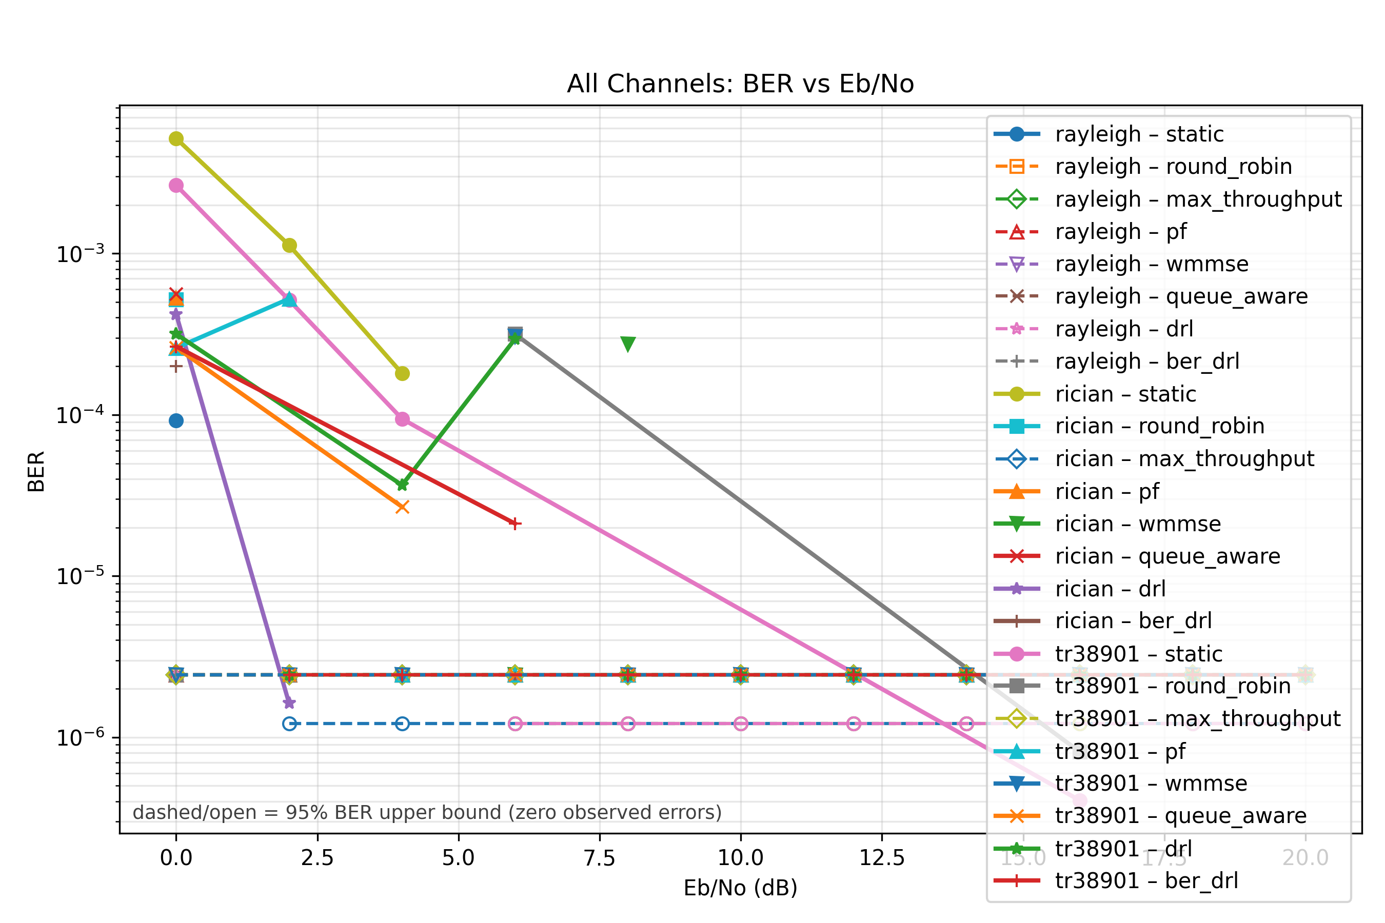
Cross-channel resource-manager screening completed
Factory6G
Weekly evidence
23 May 2026
The benchmark now compares the BER-first trained policy against all baseline schedulers under Rayleigh, Rician, and UMI/TR38901 channels.
3
8
20
Real overview BER proof
channel environments
resource managers
batches per Eb/No point
run id
20260523_173452
methods
static, round_robin, max_throughput, pf, wmmse, queue_aware, drl, ber_drl
evidence
stage_results_v2 + summary_v2 from the completed Docker simulation run
caution
short screening run; zero-error points are interpreted through BER upper confidence
Proof: Completed run directory, overview BER plot, and resource-manager stage outputs.

Slide 2
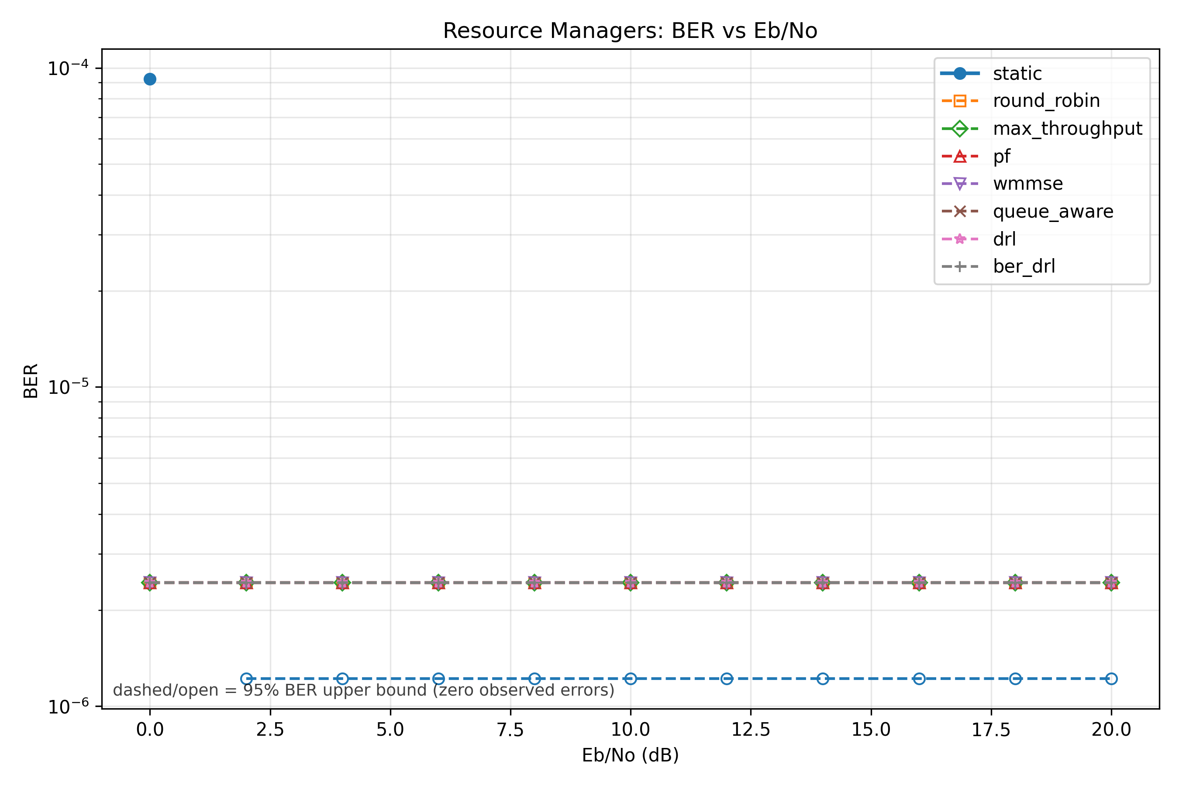
Rayleigh screening: ber_drl matched the zero-error group
Factory6G
Weekly evidence
23 May 2026
The trained BER-first policy reached mean BER 0 in the short run, matching the best baseline by BER and upper-confidence bound.
Rayleigh BER proof
0
2.4379e-06
ber_drl mean BER
BER upper bound
Metric
ber_drl
best baseline
BER
0
queue_aware: 0
BER upper
2.4379e-06
2.4379e-06
rank
#4 of 8
#1 queue_aware
runtime
66.95 s
65.89 s
Interpretation: Rayleigh is operationally stable for ber_drl, but the short run cannot prove a true zero-BER improvement.
Proof: Rayleigh resource_manager BER plot and 23 May resource_manager_ber_comparison.csv.

Slide 3
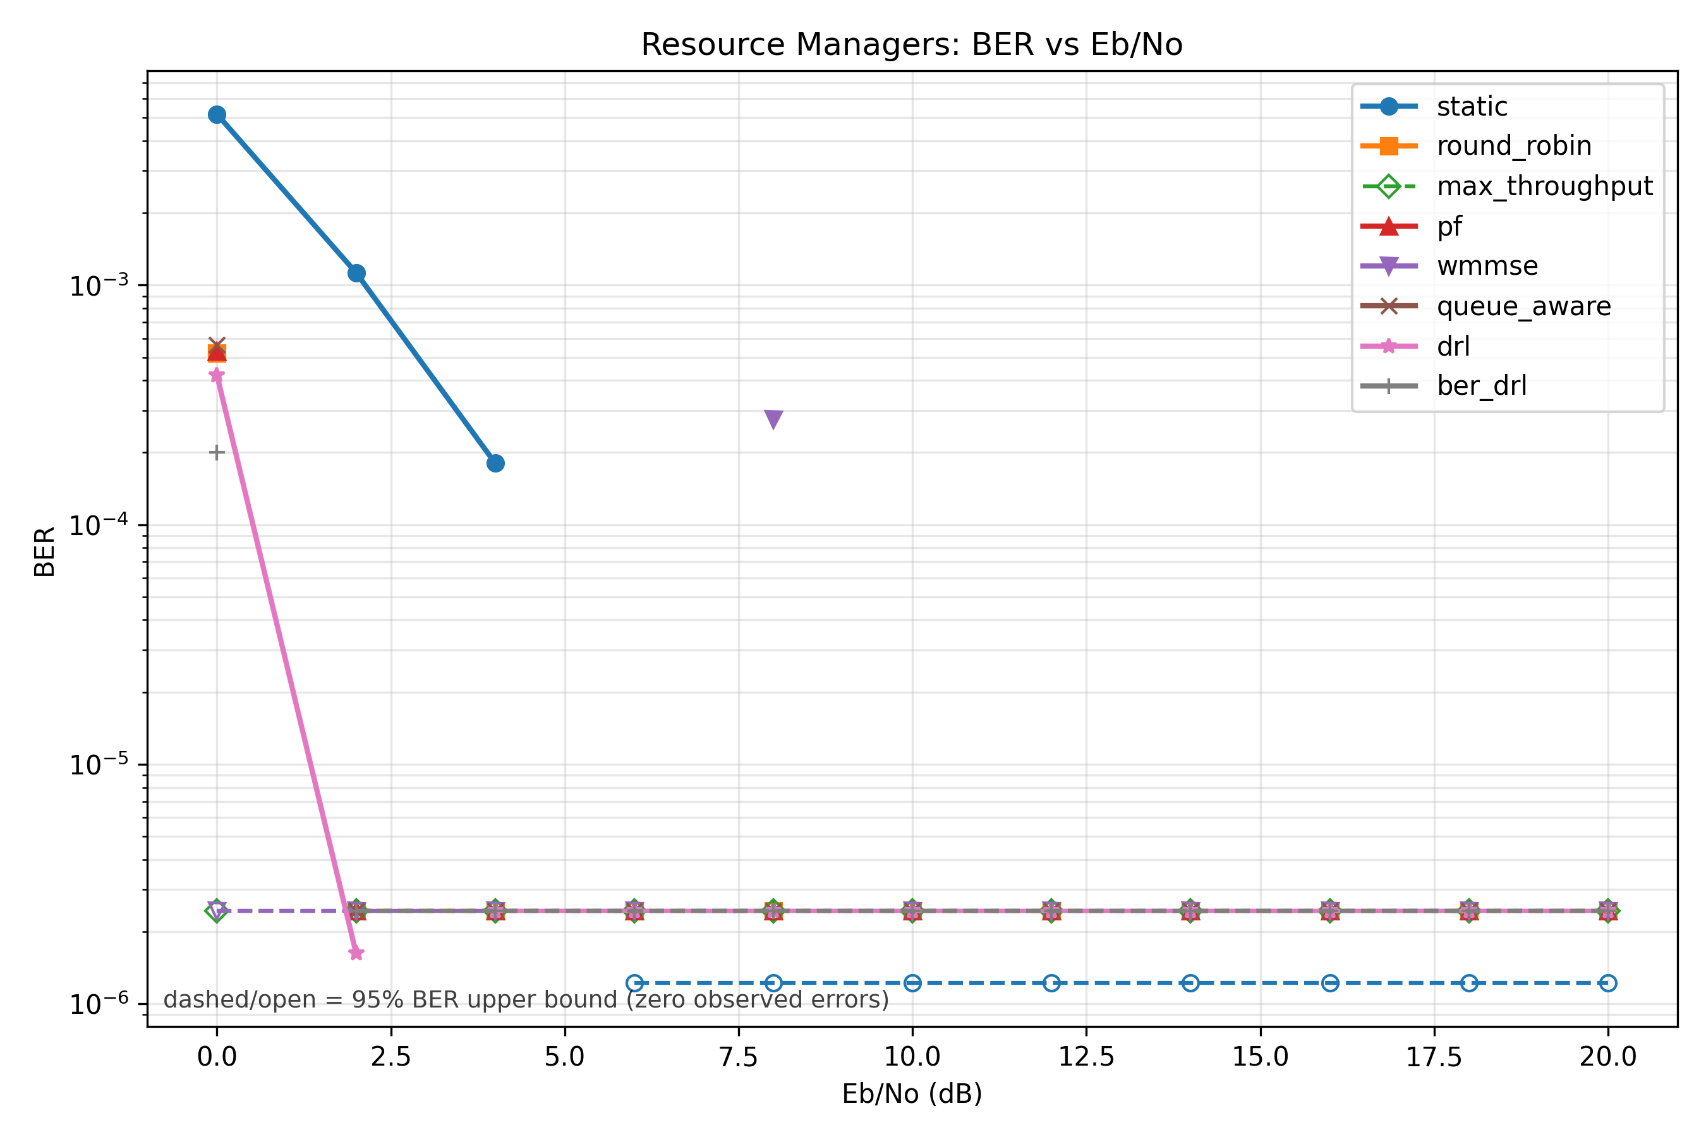
Rician screening: ber_drl ranked second behind max_throughput
Factory6G
Weekly evidence
23 May 2026
The Rician channel is the clearest near-term target for the next BER-first policy tuning pass.
Rician BER proof
1.8200e-05
#2
ber_drl mean BER
rank of 8
Metric
ber_drl
best baseline
BER
1.8200e-05
max_throughput: 0
BER upper
2.2427e-05
2.4379e-06
latency
275.60 ms
276.11 ms
runtime
66.53 s
65.61 s
Interpretation: ber_drl is competitive on latency, but reliability still needs tuning against the zero-error baseline.
Proof: Rician resource_manager BER plot and 23 May resource_manager_ber_comparison.csv.

Slide 4
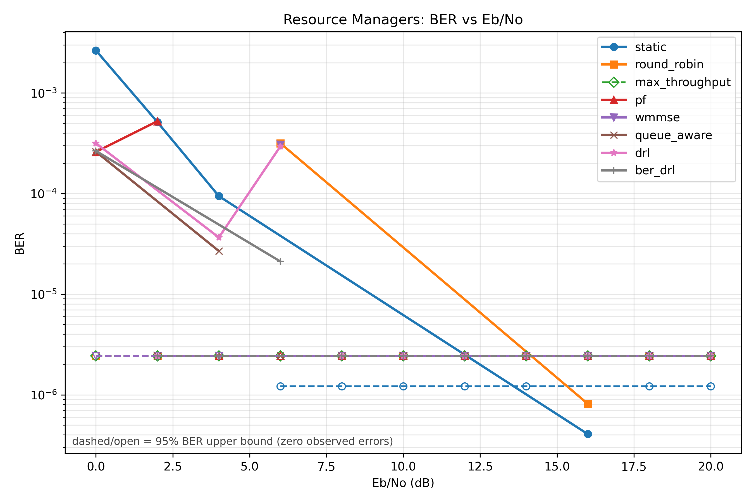
UMI/TR38901: ber_drl is close to queue_aware but not max_throughput
Factory6G
Weekly evidence
23 May 2026
In the 3GPP factory-like channel, the BER-first policy is near the strongest non-zero baseline but still behind the zero-error scheduler.
UMI/TR38901 BER proof
2.6042e-05
2.6190e-05
ber_drl mean BER
queue_aware BER
Metric
ber_drl
comparison
BER
2.6042e-05
queue_aware: 2.6190e-05
BER upper
3.1064e-05
queue_aware: 3.1273e-05
rank
#2 of 8
max_throughput is #1
latency
275.90 ms
queue_aware: 275.10 ms
Interpretation: UMI/TR38901 is close enough to justify a longer benchmark and policy retuning before making an improvement claim.
Proof: TR38901 resource_manager BER plot and 23 May resource_manager_ber_comparison.csv.

Slide 5
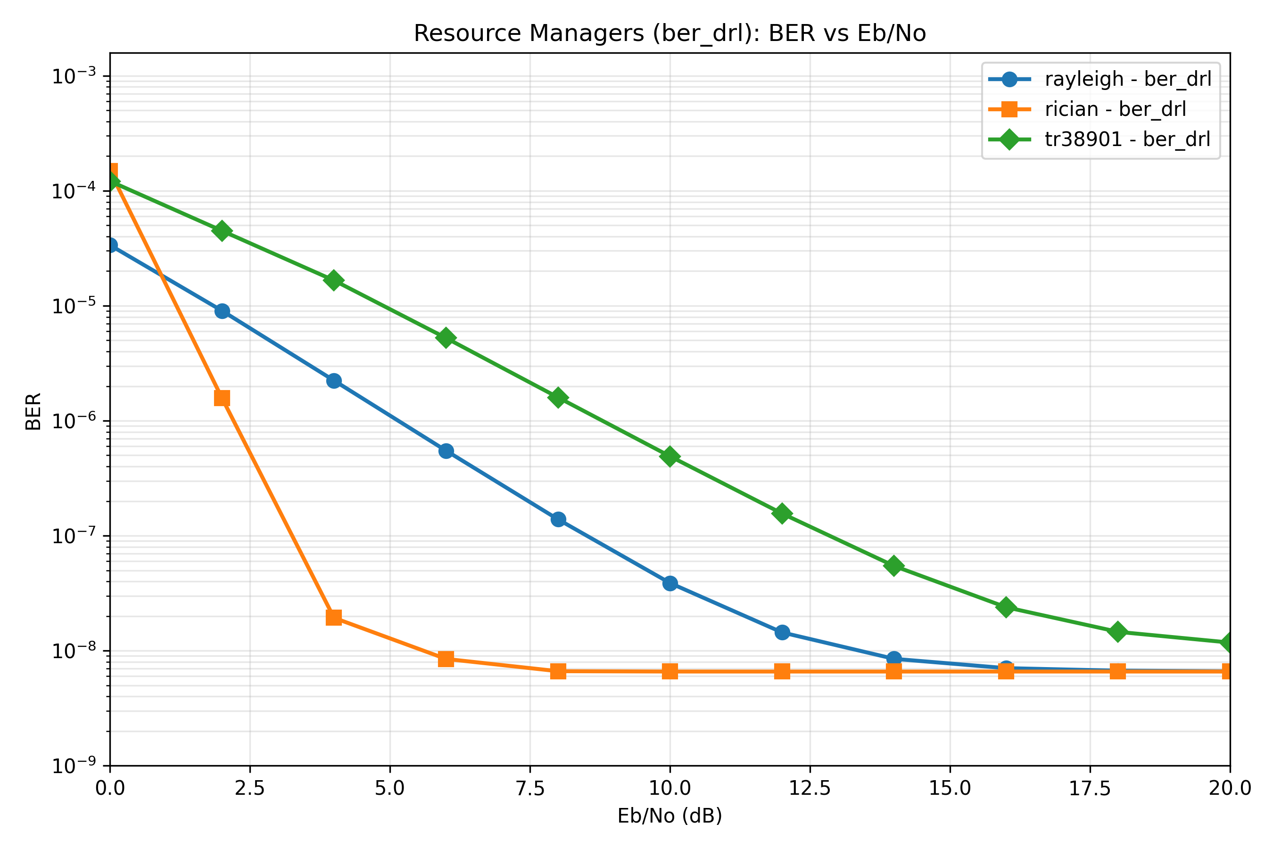
23 May report package is ready for review
Factory6G
Weekly evidence
23 May 2026
The folder now contains only the report bundle files: messages, evidence deck, previews, BER report, and CSV data.
Presentation curve proof
Deliverables
messages
factory6g_weekly_messages.md
slides
factory6g_weekly_evidence.pptx + previews/
report data
resource_manager_ber_comparison.md + .csv
Next plan
1. Re-run the cross-channel benchmark with longer Monte Carlo settings.
2. Tune ber_drl against the Rician and UMI/TR38901 reliability gaps.
3. Update the thesis evidence only after longer-run confirmation.
Proof: Clean report folder, synthetic presentation curve, and generated weekly message drafts.

