Slide 1
Factory6G weekly evidence
2026-03-27
March PHY benchmark identifies the practical estimator path
Benchmark covered estimators, channels, modulation, factory scaling, and JIDD-SCMA reliability.
6
3-4e-5
14x
0 BER
estimators compared
best BER floor
PSO runtime penalty
JIDD above 9 dB
LS, PSO, Adaptive, ISTA, Neural, DFT
Adaptive and PSO on TR 38.901 UMi
Adaptive gives near-PSO BER with lower cost
after fixing high-SNR numerical issue
Research reading
Adaptive is the strongest practical classical estimator for the current TR 38.901 UMi setup. PSO reaches similar reliability but is too expensive for repeated sweeps.
Evidence source: reports/simulation_report.md generated 2026-03-27 plus reports/plots benchmark figures.
March simulation report converted into weekly evidence format
Factory6G

Slide 2
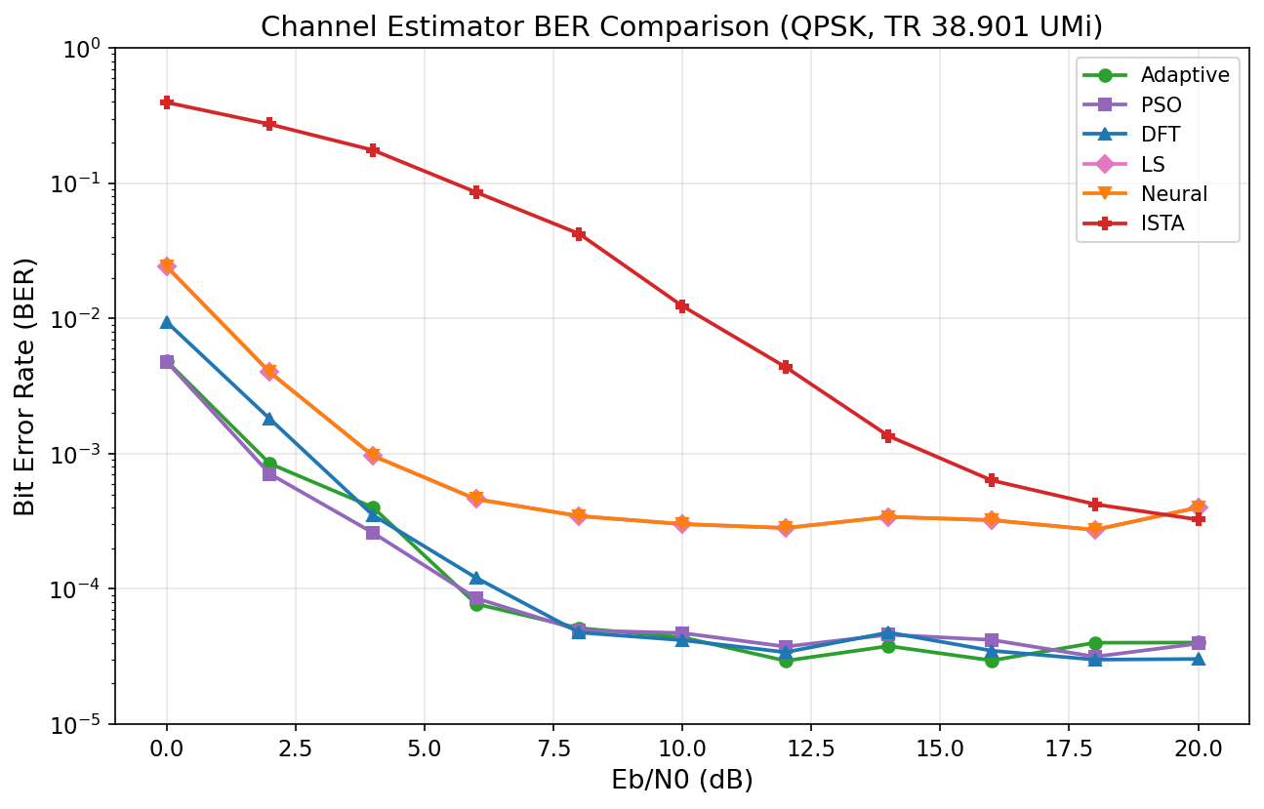
Estimator evidence
2026-03-27
Adaptive and PSO reduce the realistic-channel BER floor by about one order
The plot isolates estimator behavior under the same simulation harness.
Estimator BER vs Eb/No
Adaptive and PSO reach BER floors around 3-4 x 10^-5.
LS remains around 3 x 10^-4 on TR 38.901 UMi.
Neural still follows LS in the March report, so retraining is required.
Adaptive is the practical choice because PSO is much slower.
Adaptive and PSO sit below LS on the realistic TR 38.901 UMi channel.
Decision: keep Adaptive as the classical estimator baseline before retraining Neural.
Estimator evidence from reports/plots/estimator_ber_vs_ebno.png
Factory6G

Slide 3
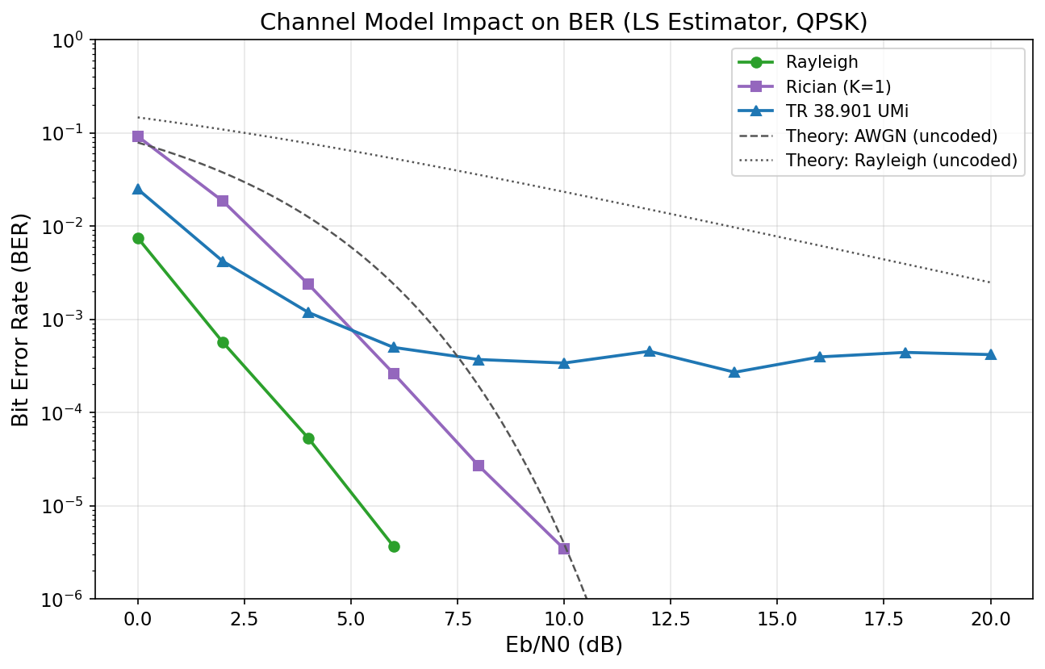
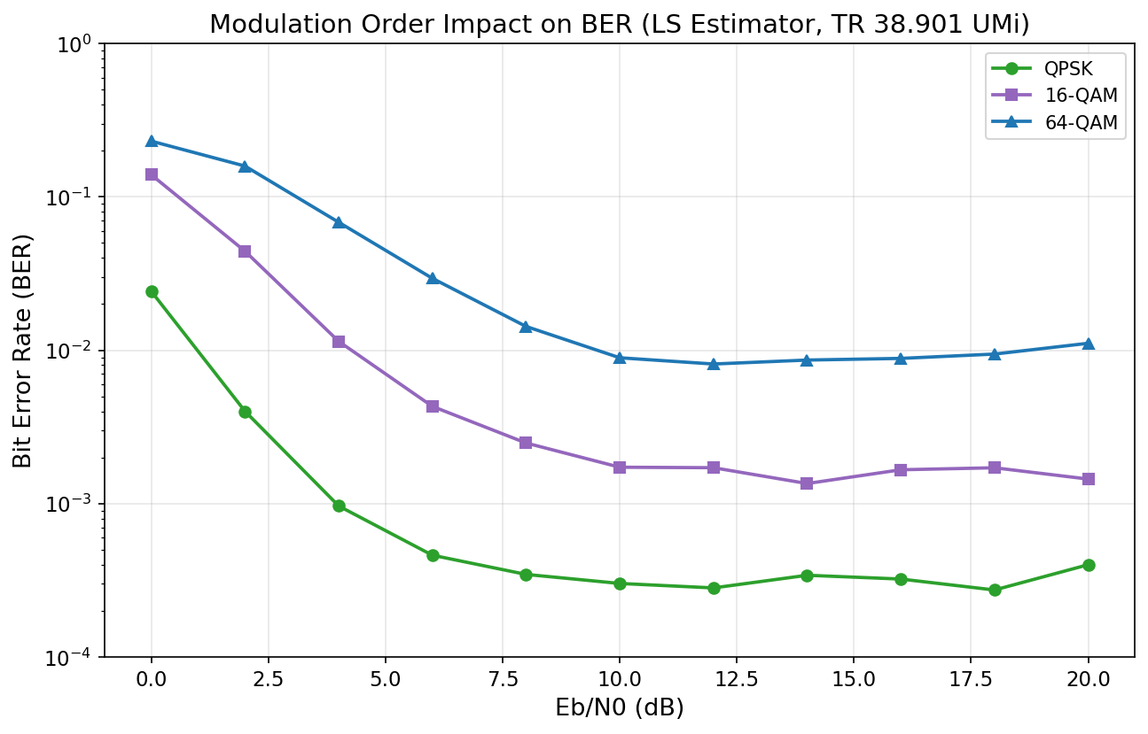
Channel and modulation stress
2026-03-27
TR 38.901 UMi and 64-QAM expose the current reliability limits
The March benchmark separates channel-model difficulty from modulation sensitivity.
Channel-model impact
Modulation impact
Rayleigh and Rician reach zero BER at high SNR; TR 38.901 UMi keeps a BER floor.
64-QAM is not reliable with the current LS-based setup; QPSK is the stable baseline.
Reading: LDPC coding is not the only bottleneck; channel estimation and channel realism drive the floor.
Plots: channel_model_ber_vs_ebno.png and modulation_ber_vs_ebno.png
Factory6G

Slide 4
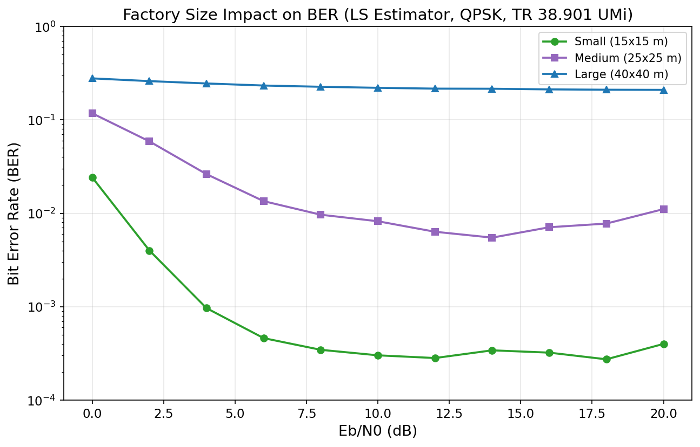
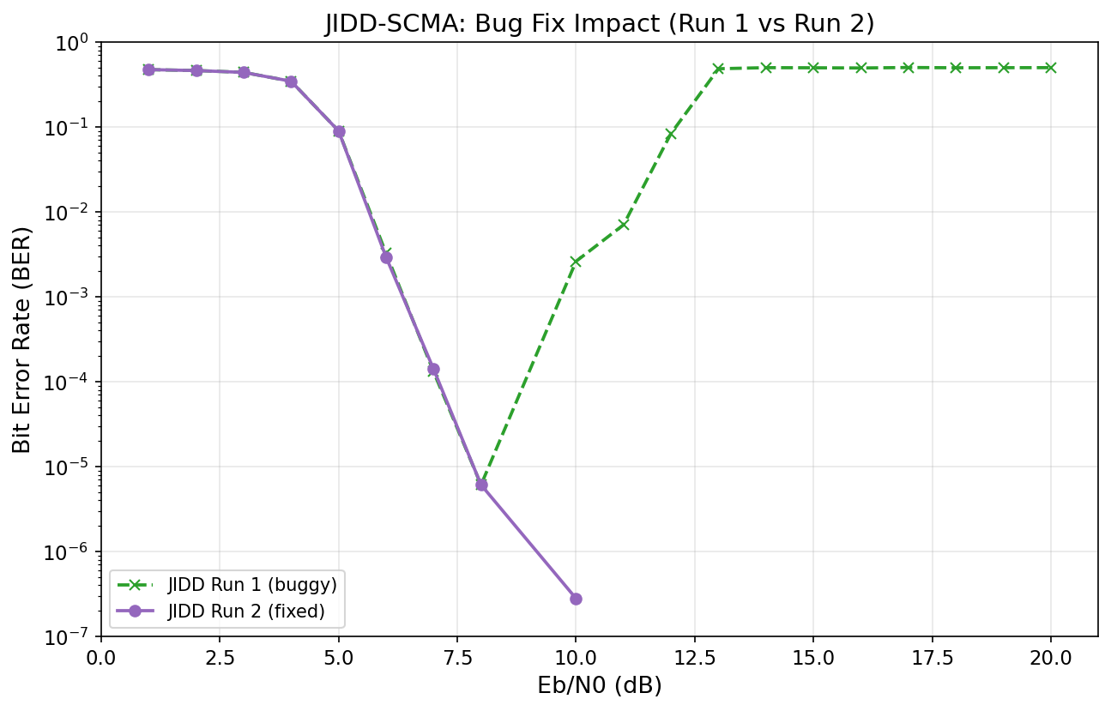
Factory scaling and JIDD-SCMA
2026-03-27
The system has one reliability fix completed and one architecture issue still open
JIDD-SCMA improved after the numerical fix, while large-factory BER remains high.
Factory-size scaling
JIDD-SCMA corrected run
Large factory remains around BER 0.21, which suggests an architecture-level limitation.
Corrected JIDD-SCMA reaches zero BER above 9 dB after the high-SNR fix.
Large factory needs scheduling, more antennas, or distributed MIMO; JIDD is ready for stronger-estimator tests.
Plots: factory_size_ber_vs_ebno.png and jidd_ber_comparison.png
Factory6G

Slide 5
Next research plan
2026-03-27
Use the March benchmark to tighten estimator learning and resource allocation
The next run should keep Docker-only reproducibility and avoid full sweeps unless needed.
1.
Retrain or redesign the Neural estimator because March Neural behaves like LS.
2.
Re-run DFT on the same small-factory setup for a fair classical comparison.
3.
Test Adaptive under 16-QAM and 64-QAM for higher-throughput factory links.
4.
Investigate large-factory reliability with scheduling, extra antennas, or distributed MIMO.
5.
Run fresh resource-manager benchmarks using the current Factory6G configuration.
Priority: realistic-channel BER floor first, then high-throughput modulation and resource-manager benchmarking.
Weekly-style follow-up plan distilled from simulation_report.md
Factory6G

