Slide 1
Factory6G weekly evidence
2026-04-20
Retrained Neural estimator now beats LS on Rayleigh
April evidence corrects the March neural conclusion and keeps TR 38.901 as the next target.
160x
2 dB
0.3%
3-5e-5
QPSK BER reduction
earlier zero BER
latency difference
TR 38.901 tier
Neural vs LS at 0 dB on Rayleigh
across QPSK, 16-QAM, and 64-QAM
effectively no per-batch overhead
Adaptive, PSO, and DFT BER floor range
Updated finding
Neural is now useful on Rayleigh after retraining. The unresolved question is whether the same learning benefit transfers to realistic TR 38.901 UMi.
Evidence source: reports/simulation_report_v2.md generated 2026-04-20 plus reports/plots neural figures.
April simulation report converted into weekly evidence format
Factory6G

Slide 2
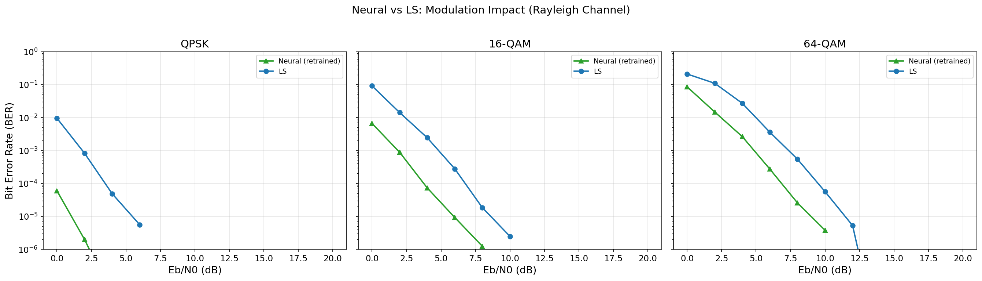
Neural-vs-LS evidence
2026-04-20
Retraining turns Neural from an LS copy into a useful Rayleigh estimator
The strongest April evidence is the modulation sweep plus latency check.
Neural vs LS across modulation
Up to 160x lower BER at QPSK 0 dB.
Zero BER about 2 dB earlier than LS.
No meaningful per-batch latency overhead.
Result is Rayleigh-specific; TR 38.901 training is still required.
Neural reaches zero BER earlier than LS across QPSK, 16-QAM, and 64-QAM.
Decision: keep Neural in the pipeline, but move the next training run to realistic TR 38.901 UMi.
Plot: reports/plots/neural_vs_ls_modulation_ber.png
Factory6G

Slide 3
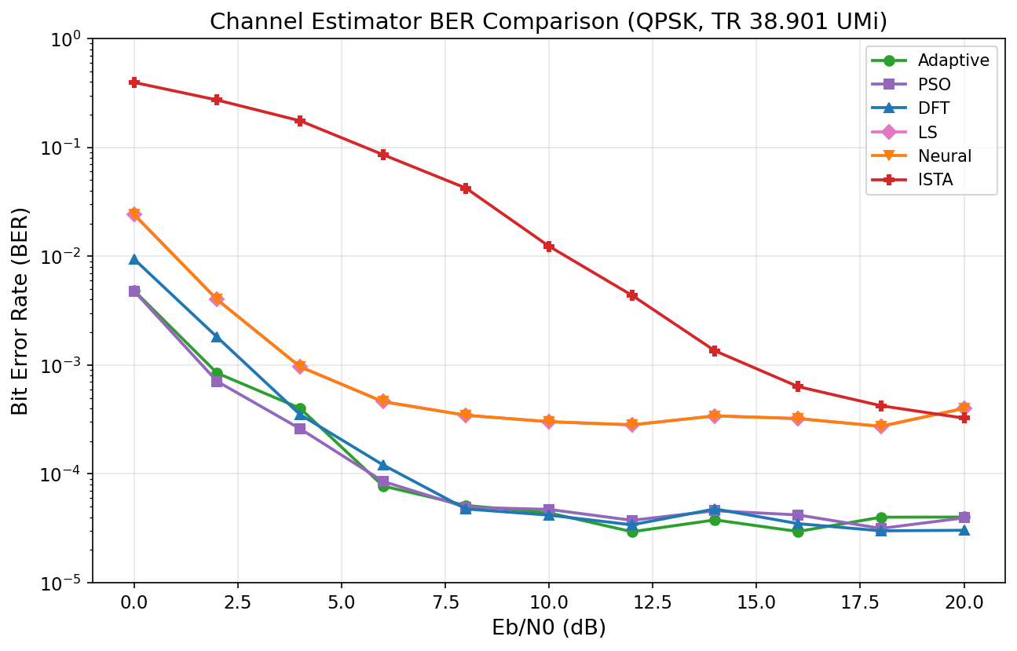
TR 38.901 estimator tier
2026-04-20
Adaptive, DFT, and PSO remain the strongest classical realistic-channel options
The April update corrects DFT by comparing it on the small-factory setup.
Estimator BER evidence
Method
BER floor
Runtime
Use
Adaptive
3-5 x 10^-5 tier
Practical baseline
Primary classical comparator
DFT
3-5 x 10^-5 tier
6.3x slower than LS
Fair after small-factory rerun
PSO
3-5 x 10^-5 tier
Very high runtime
Research reference only
LS
around 3 x 10^-4
Fast
Baseline floor remains
TR 38.901 keeps LS near 3 x 10^-4 while the top tier approaches 3-5 x 10^-5.
Reading: Neural must beat this top classical tier on TR 38.901 before claiming realistic-channel improvement.
Estimator table distilled from simulation_report_v2.md
Factory6G

Slide 4
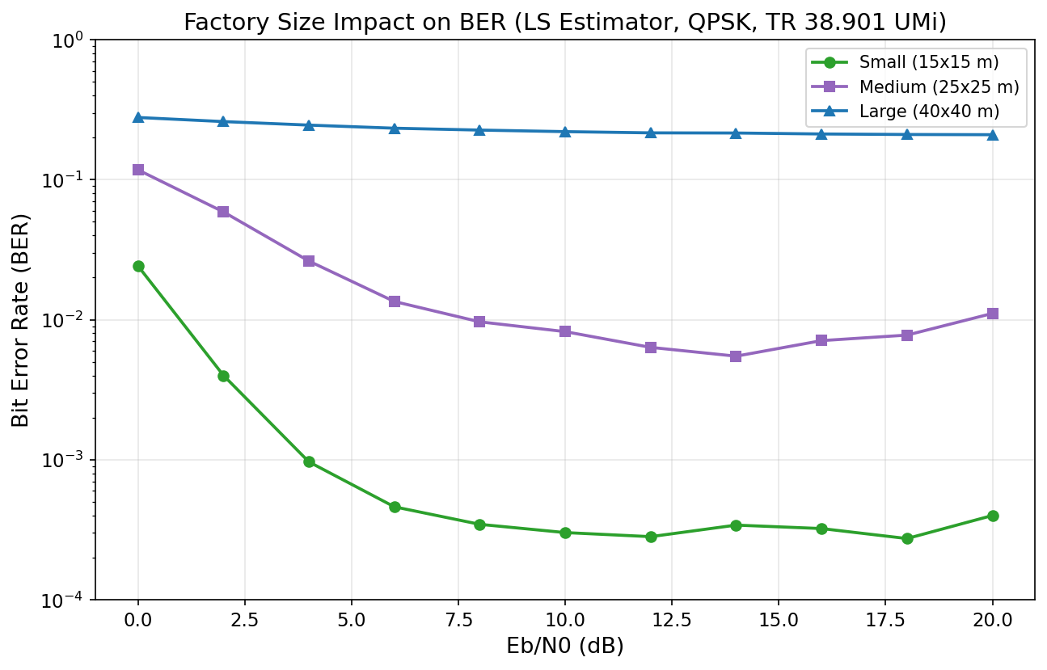
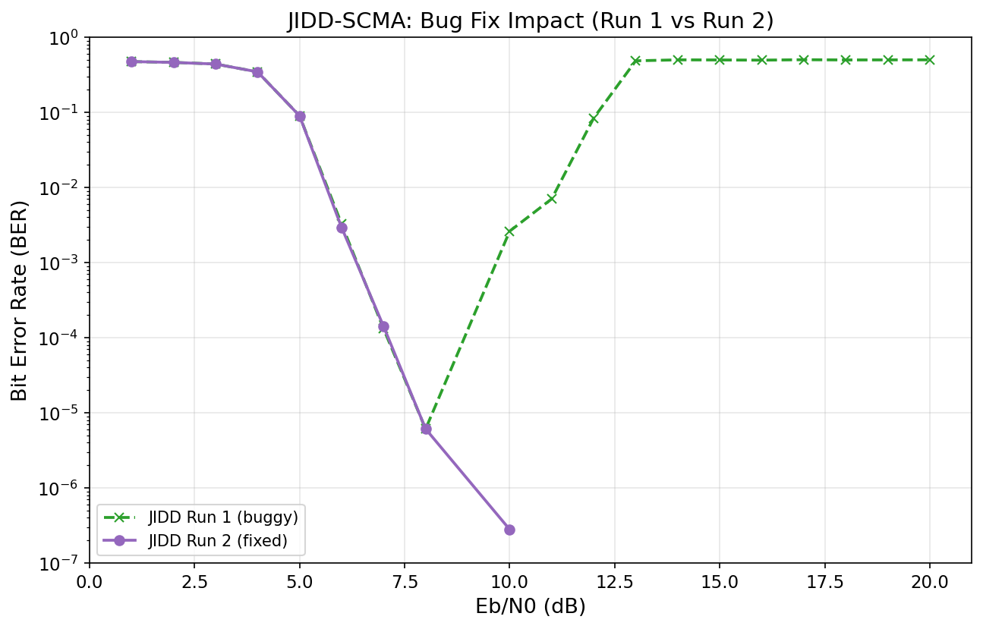
Unresolved system findings
2026-04-20
Large-factory BER and JIDD runtime remain the main blockers after the Neural update
The April report keeps the earlier JIDD evidence and narrows the open engineering questions.
Factory-size issue
JIDD-SCMA evidence
Large factory remains around BER 0.21 across SNR.
Corrected JIDD reaches zero BER above 9 dB, but computational cost is high.
Next comparison should test Neural, Adaptive, and DFT under identical TR 38.901 and factory-size settings.
Plots: factory_size_ber_vs_ebno.png and jidd_ber_comparison.png
Factory6G

Slide 5
Next research plan
2026-04-20
Move from Rayleigh learning proof to realistic-channel validation
April evidence supports Neural, but the research claim still depends on TR 38.901.
1.
Train and test Neural on TR 38.901 UMi to target the realistic-channel BER floor.
2.
Compare Neural, Adaptive, and DFT with the same channel, factory size, and modulation.
3.
Expand training across Rayleigh, Rician, and TR 38.901 using curriculum-style data.
4.
Investigate large-factory reliability with scheduling, more antennas, or distributed MIMO.
5.
Test Adaptive or Neural with higher-order modulation for high-throughput factory links.
Priority: prove realistic-channel Neural gain before extending the result family.
Weekly-style follow-up plan distilled from simulation_report_v2.md
Factory6G

