Slide 1
Factory6G Weekly Progress Evidence
Focus: AI-enabled resource allocation for smart-factory 6G networks
Reporting window: April 20-26, 2026 | Evidence finalized: April 27, 2026
Completed proof: AI resource-manager reliability restored and Rayleigh benchmark completed
Next step: finish UMi benchmark and compare channel scenarios

Slide 2
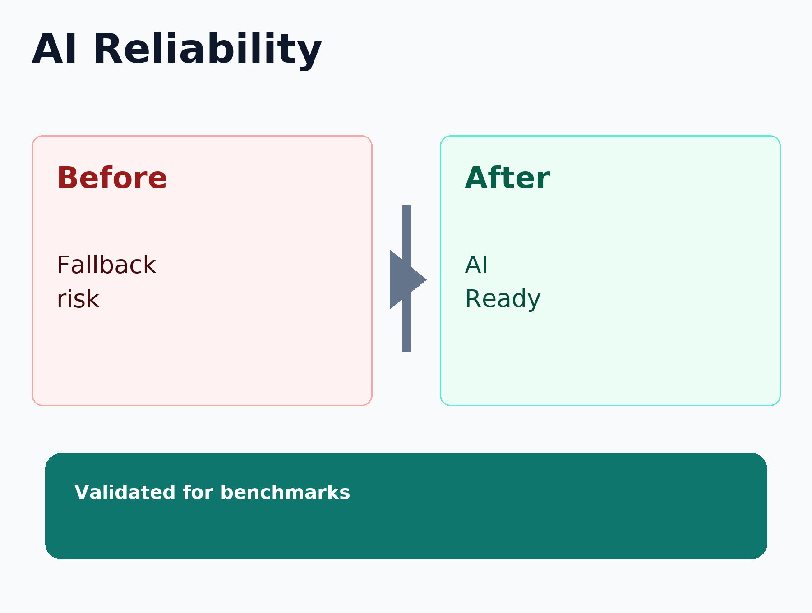
AI Resource-Manager Reliability Restored
Completed
Research value
The trained AI scheduler is now usable in the simulation workflow, so resource-allocation comparisons reflect the intended DRL behavior rather than a fallback strategy.
Proof outcome
AI-based allocation is available for completed Rayleigh and future UMi benchmark analysis.

Slide 3
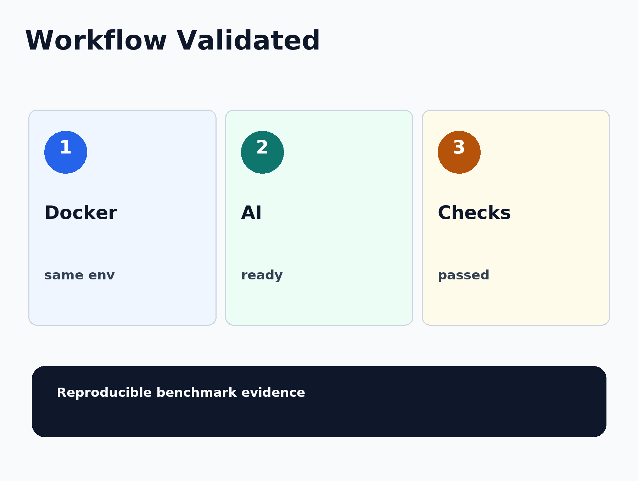
Simulation Workflow Validated
Completed
Why it matters
The experiment workflow was validated in the same containerized environment used for Factory6G simulations. This supports reproducibility and confidence in the benchmark evidence.
Completion signal
Trained AI policy available; targeted validation checks passed.

Slide 4
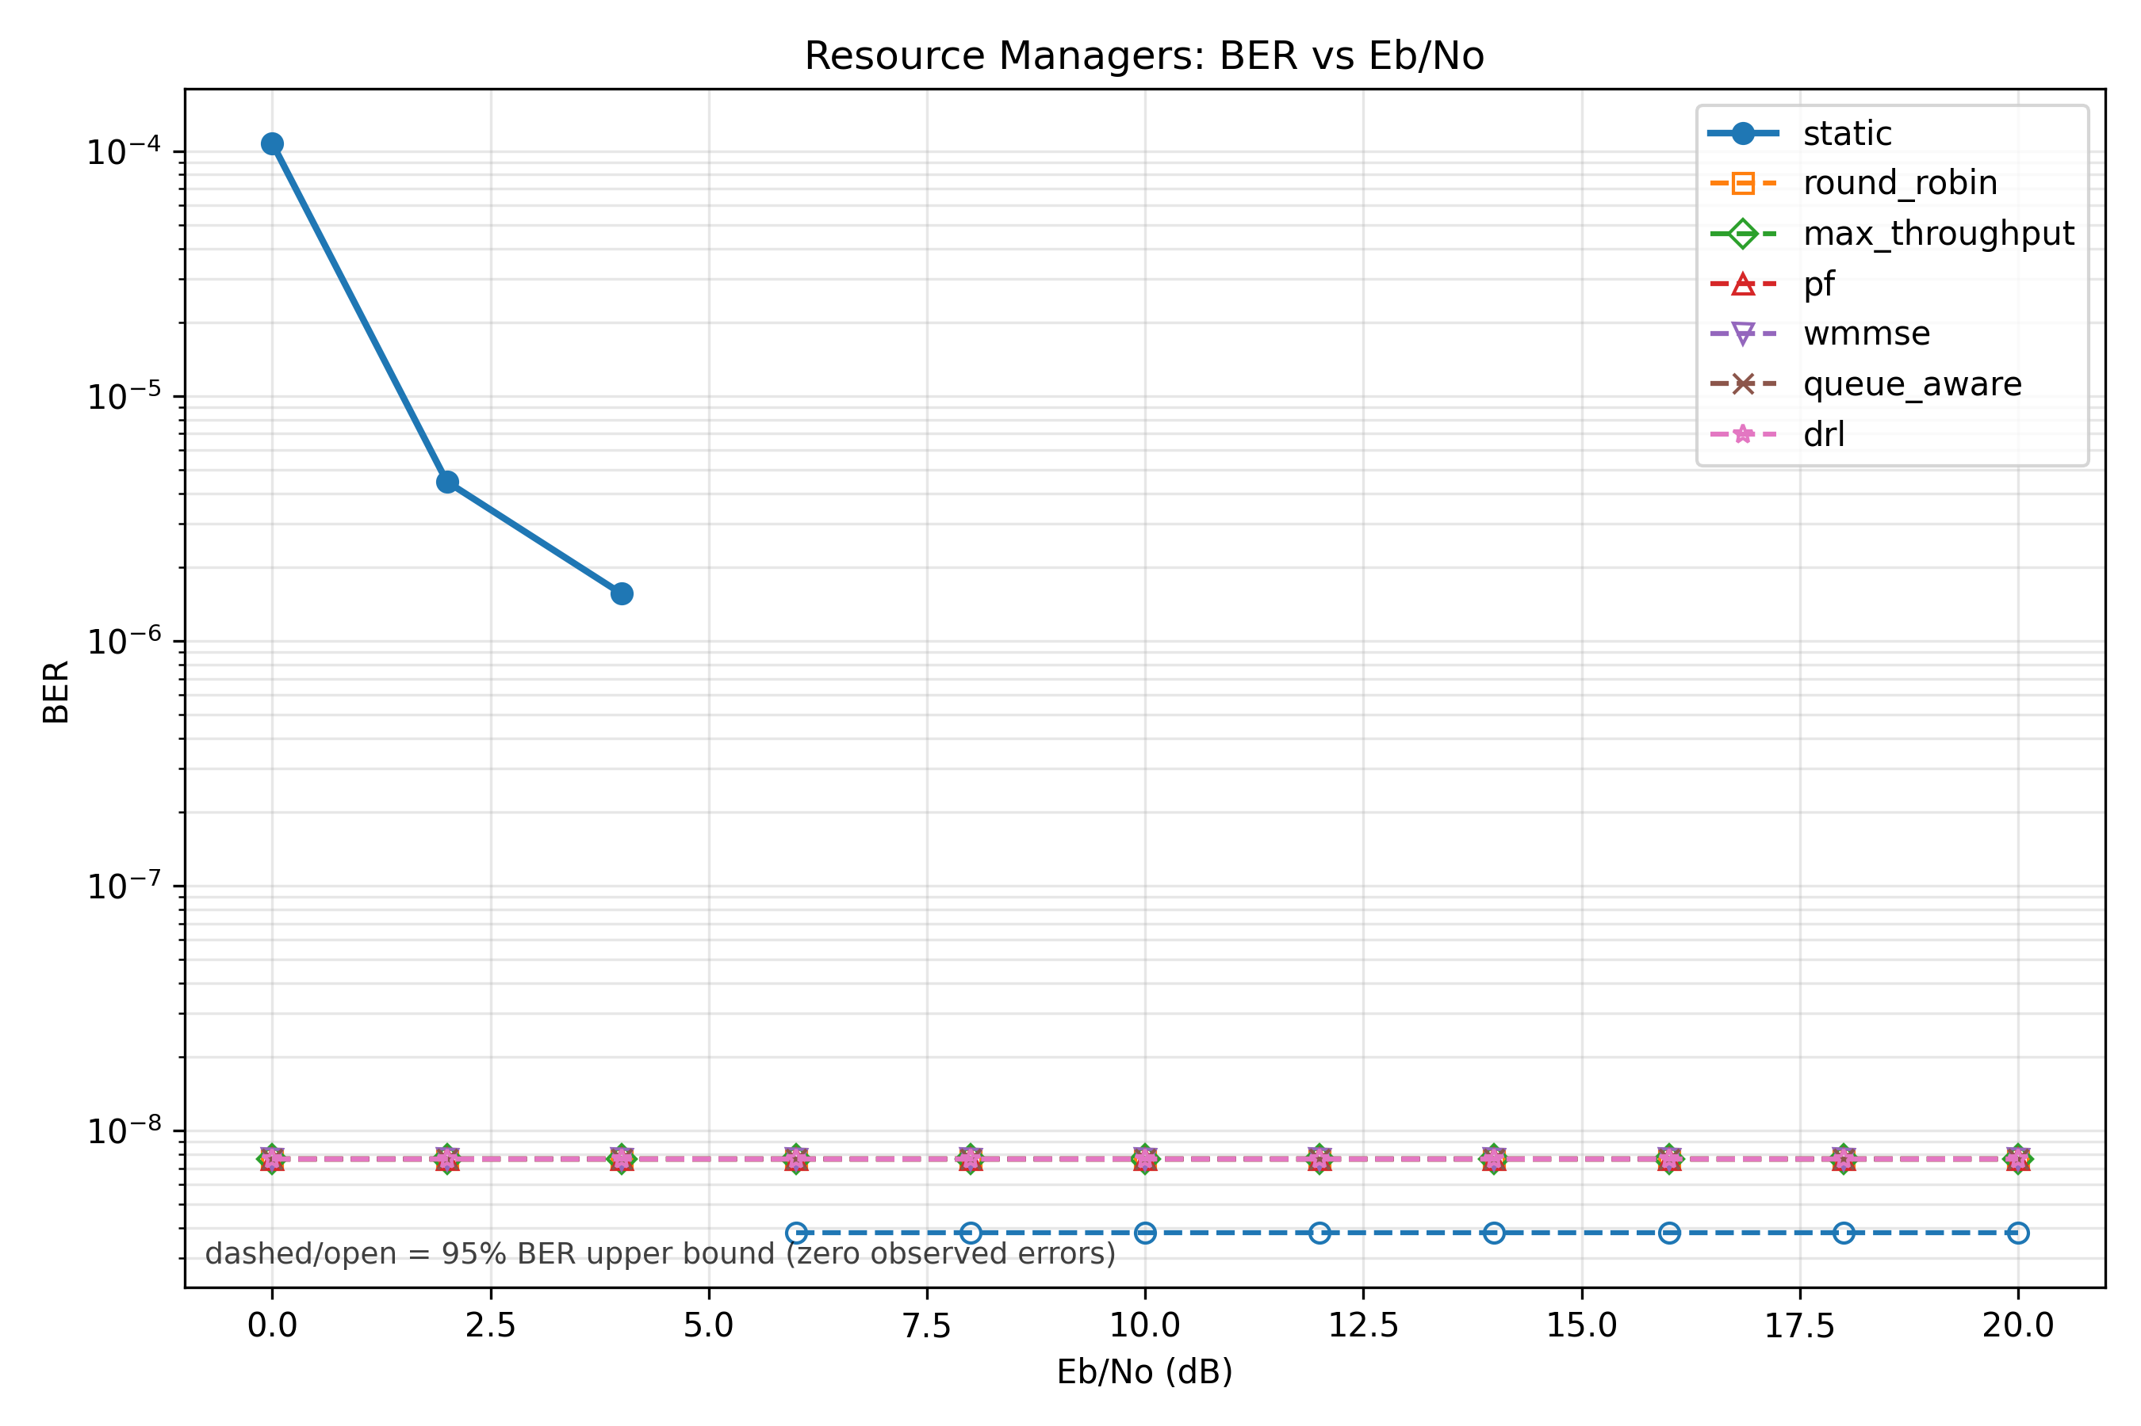
Rayleigh Resource-Management Benchmark
Completed
Scientific evidence
The BER curve shows how each resource-allocation method behaves as link quality improves. This is the main reliability view for the Rayleigh benchmark.
Completed run
Rayleigh QPSK smart-factory scenario reached 2000/2000 batches and produced final graph outputs.

Slide 5
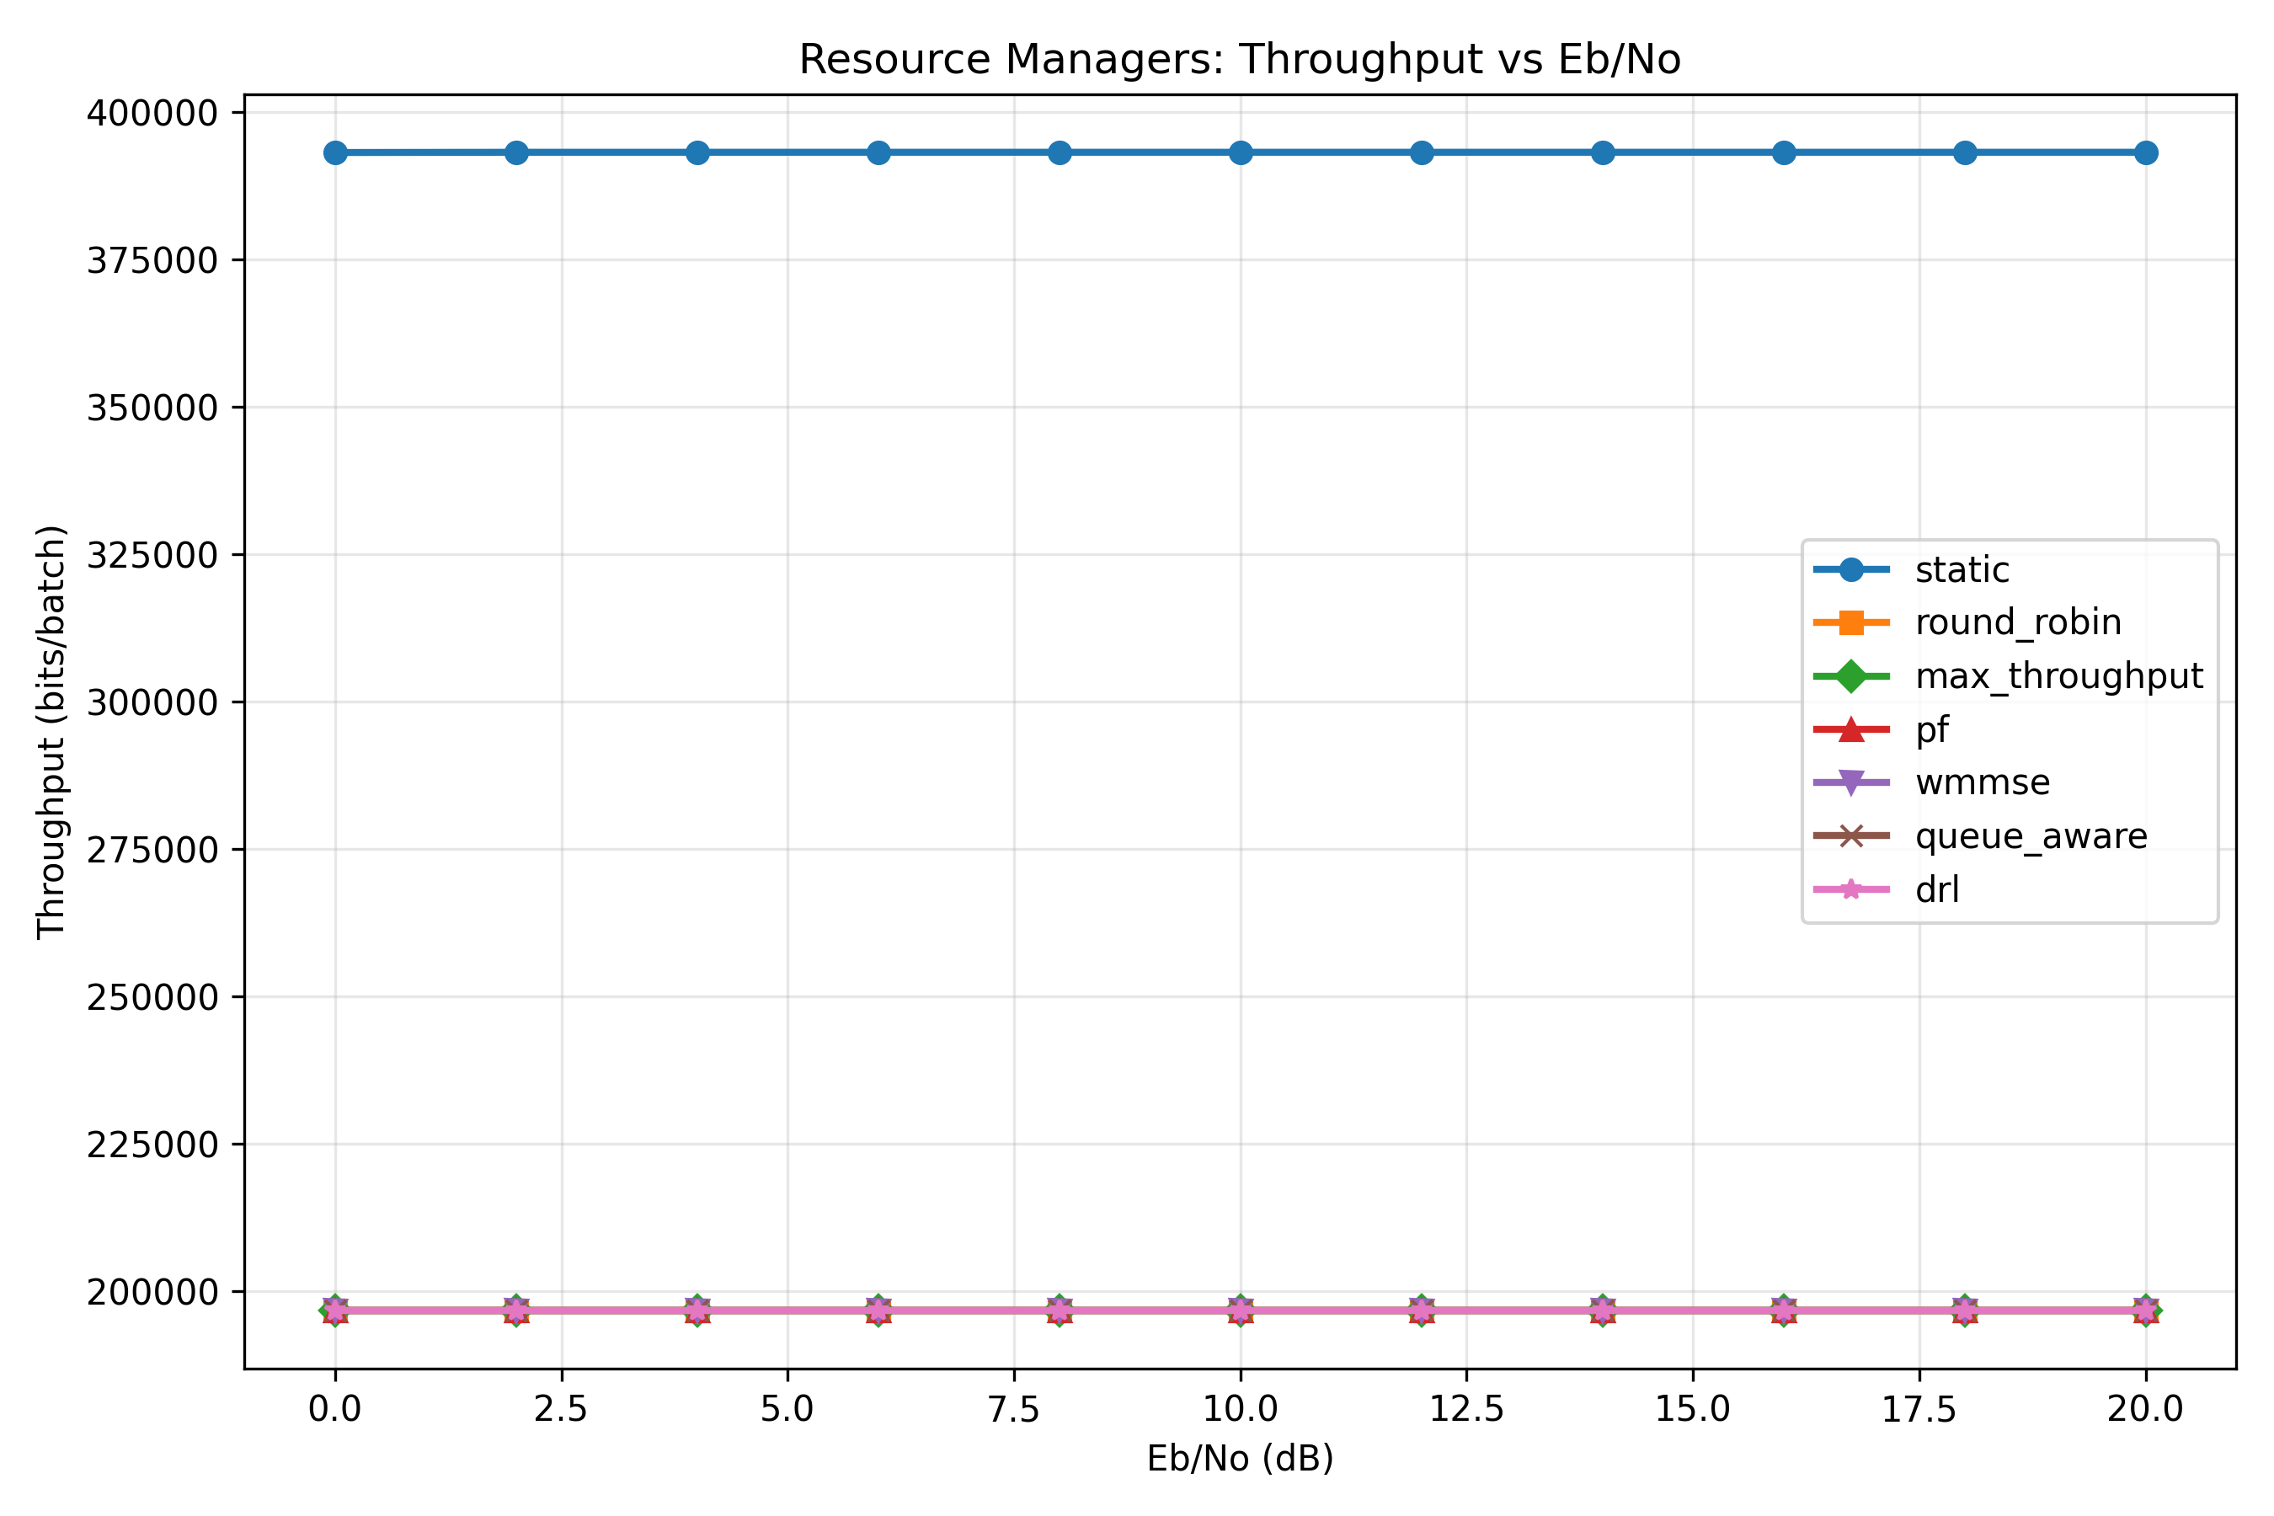
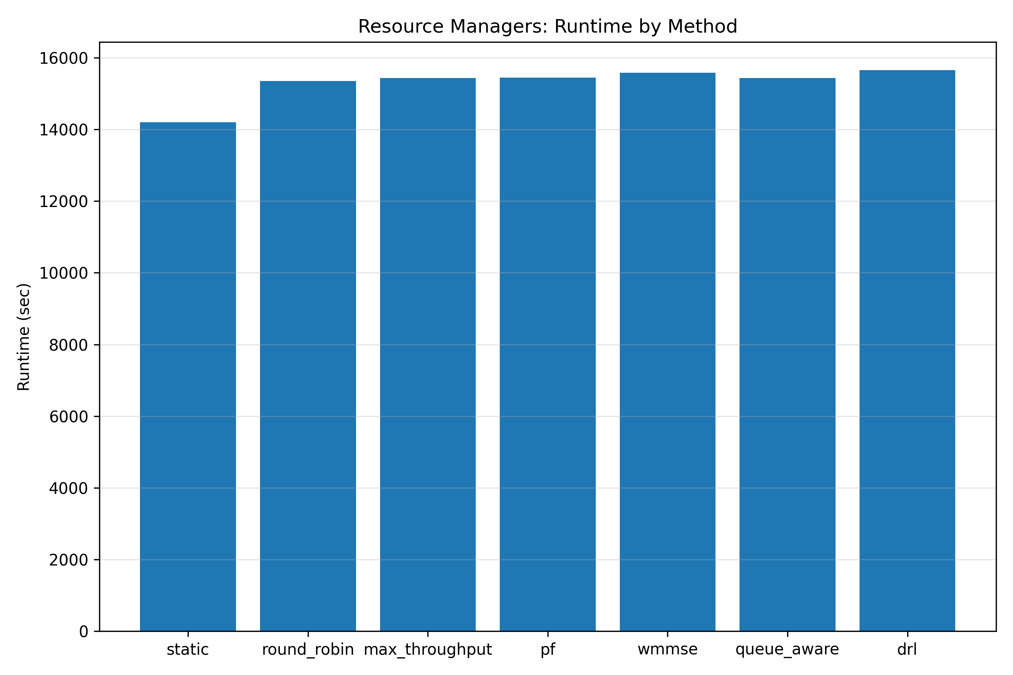
Rayleigh Performance Evidence
Completed
Throughput: service-capacity view across channel quality.
Runtime: computational cost view by resource-management method.

Slide 6
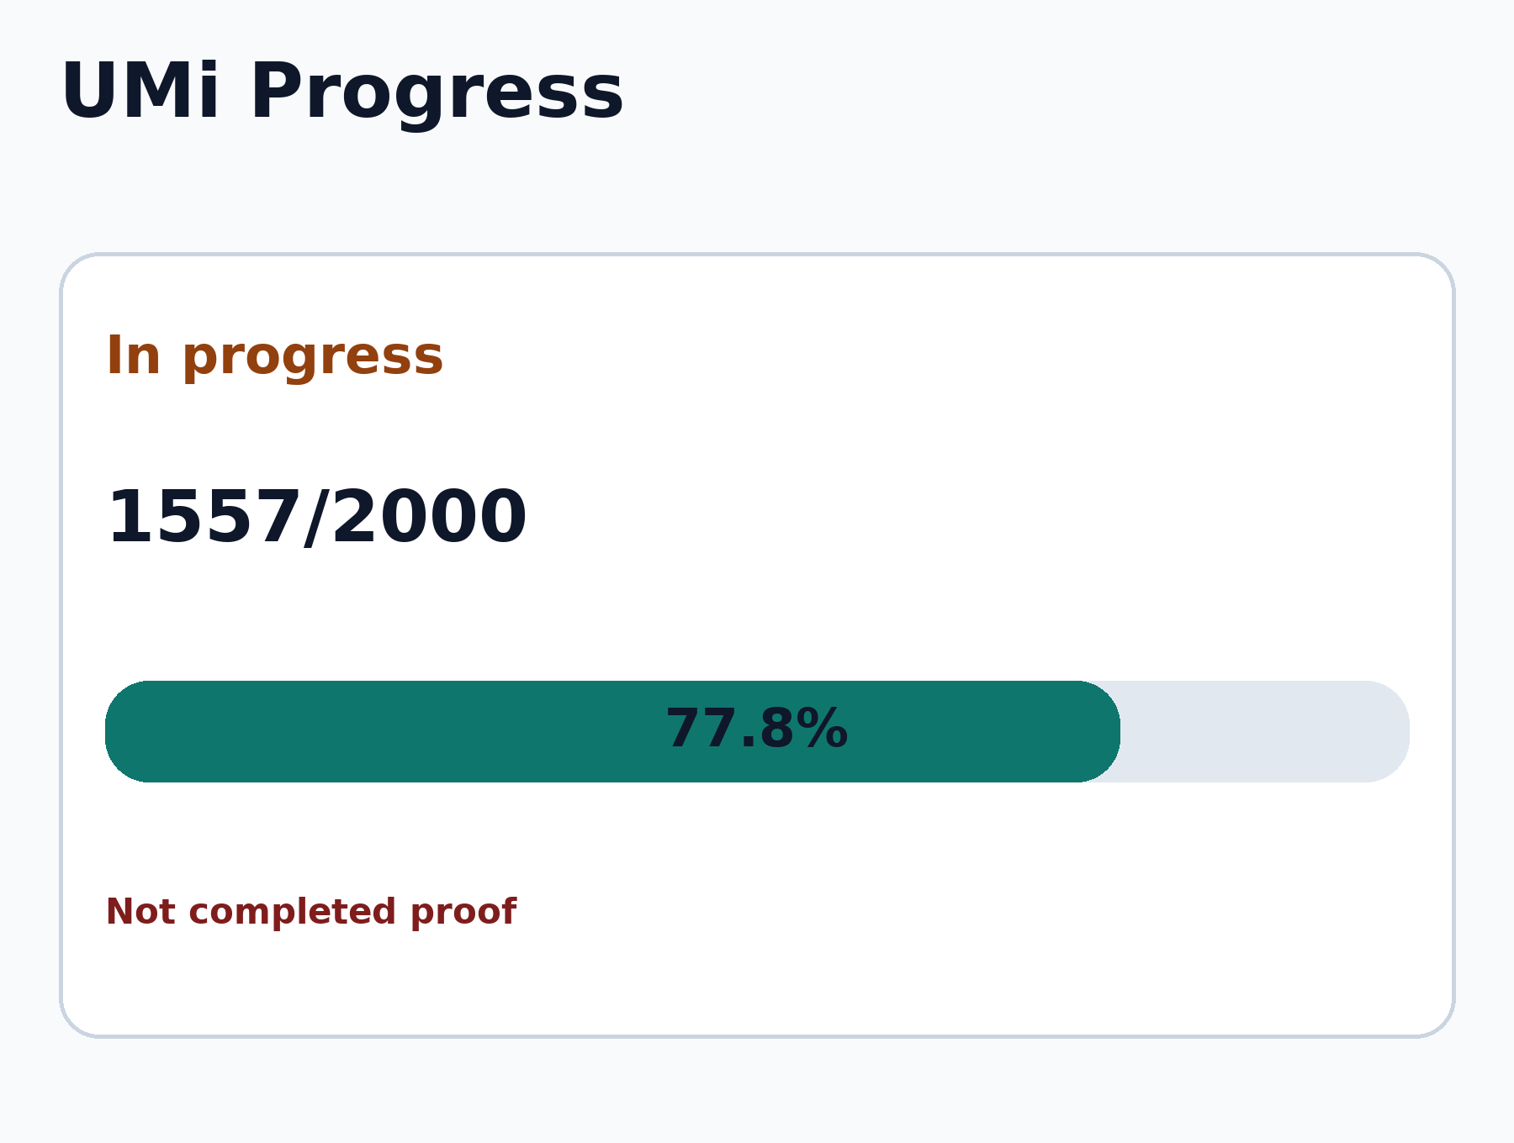
UMi Benchmark Continuing
In progress
Next comparison scenario
The UMi run extends the evidence from Rayleigh to a 3GPP urban microcell channel model. It is tracked as future work until final graphs are generated.
Progress snapshot
Current checkpoint: 1557/2000 batches
Final UMi graphs are not claimed as completed proof.

