Slide 1
BER-first DRL resource manager is now a separate experiment path
Factory6G
Weekly evidence
01 May 2026
The workflow can train a reliability-focused policy and benchmark it independently from the existing DRL baseline.
110
130
9
Training loss proof
training samples
state dimension
epochs run
checkpoint
models/ber_drl_resource_manager_policy
target
BER log reliability with confidence weighting
policy heads
schedule, power, value
created
2026-04-29 06:50:22 UTC
Proof: BER-first checkpoint metadata and training history from models/ber_drl_resource_manager_policy/.

Slide 2
Container validation passed for the BER-first workflow
Factory6G
Weekly evidence
01 May 2026
The tests covered dataset labels, DRL checkpoint loading/projection, and comparison-report generation.
14 passed
3.22 s
Docker command
pytest result
runtime
docker compose run --rm --entrypoint python -v /Users/.../Factory6G:/app simulation -m pytest tests/test_dataset_generation.py tests/test_drl_policy_pipeline.py tests/test_rm_ber_report.py -q
dataset tests
BER-first sorting, active-UT masking, and parquet schema
policy tests
checkpoint round trip, Keras compatibility fallback, ber_drl projection
.............. [100%]
14 passed in 3.22s
report tests
explicit stage inputs and ranking/report output behavior
environment
Docker Compose simulation service with repo bind mount
Proof: Docker pytest output from 2026-05-01 validation run.

Slide 3
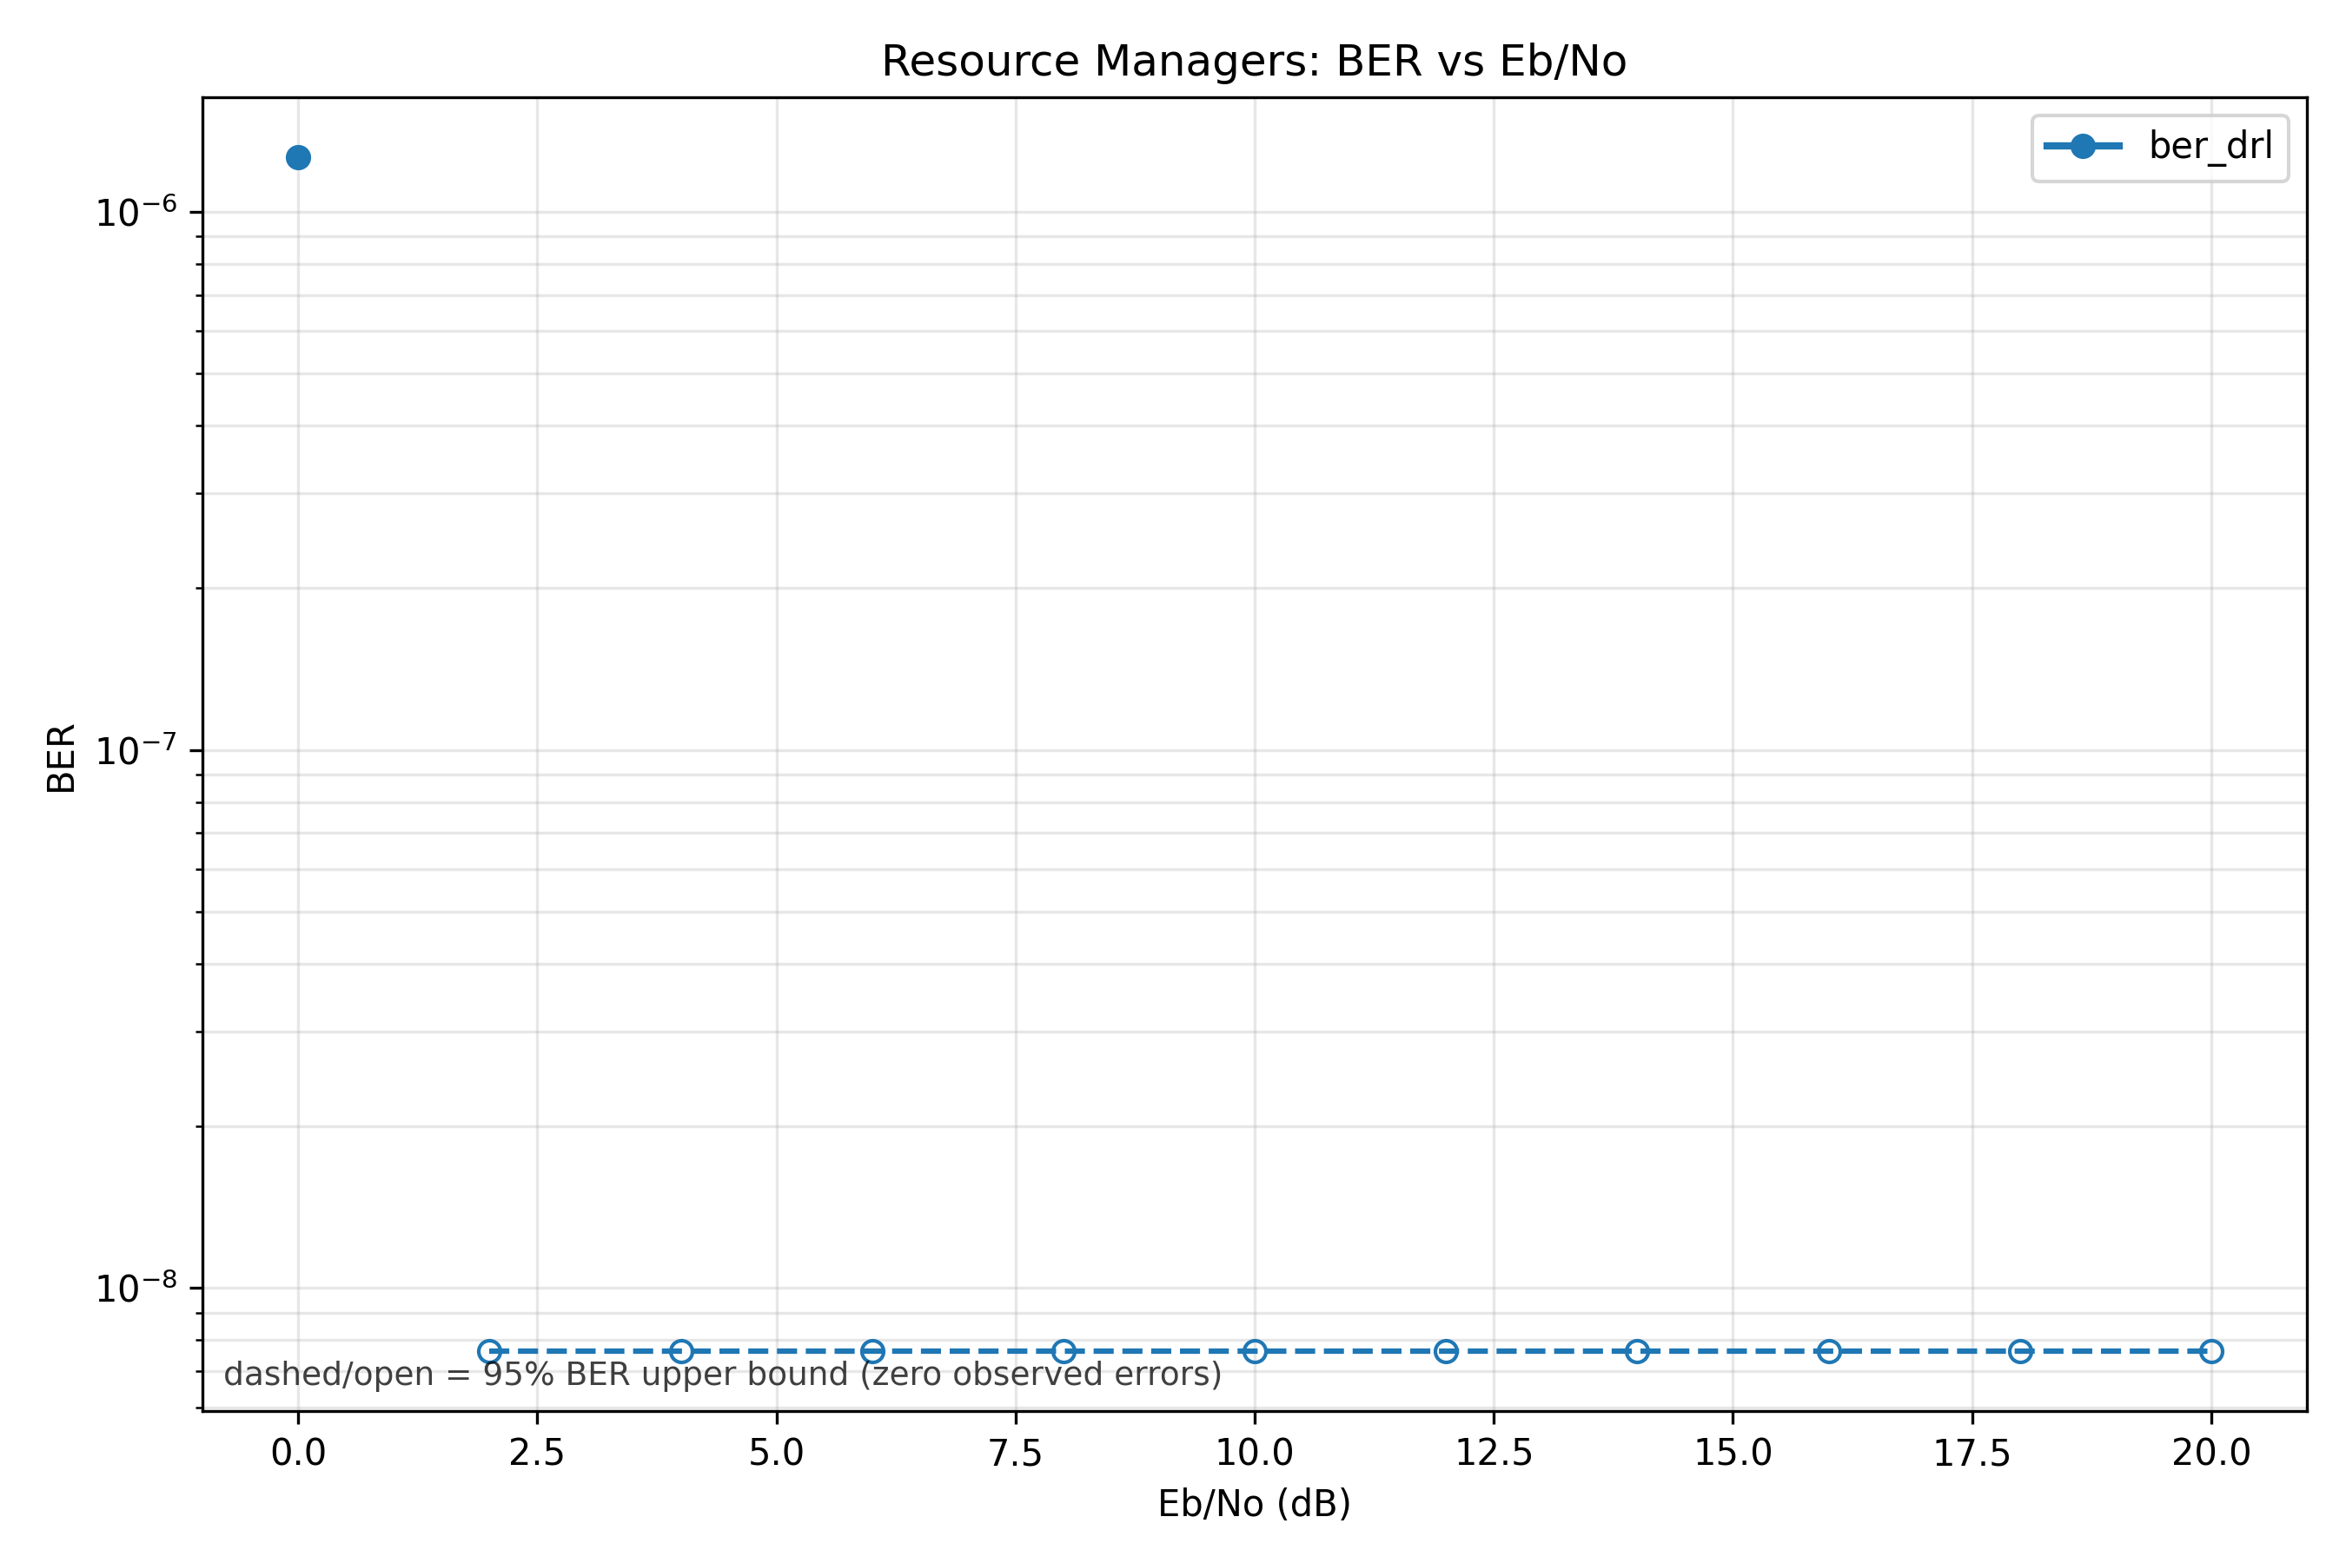
Rayleigh benchmark completed: reliable, but not yet better than the top baseline
Factory6G
Weekly evidence
01 May 2026
ber_drl finished the Rayleigh run and produced BER/latency/throughput/power proof plots.
1.149e-7
507.0 ms
ber_drl mean BER
latency
Metric
ber_drl
best baseline
BER
1.149e-7
drl: 0
BER upper
1.306e-7
7.619e-9
rank
#7 of 8
#1 drl
batches
2000
2000
Interpretation: the trained BER-first path is operational and close to zero-BER behavior, but the benchmark should not be reported as an improvement yet.
Proof: results/20260428_144330_ber_drl_rayleigh_qpsk_s and weekly BER comparison CSV.

Slide 4
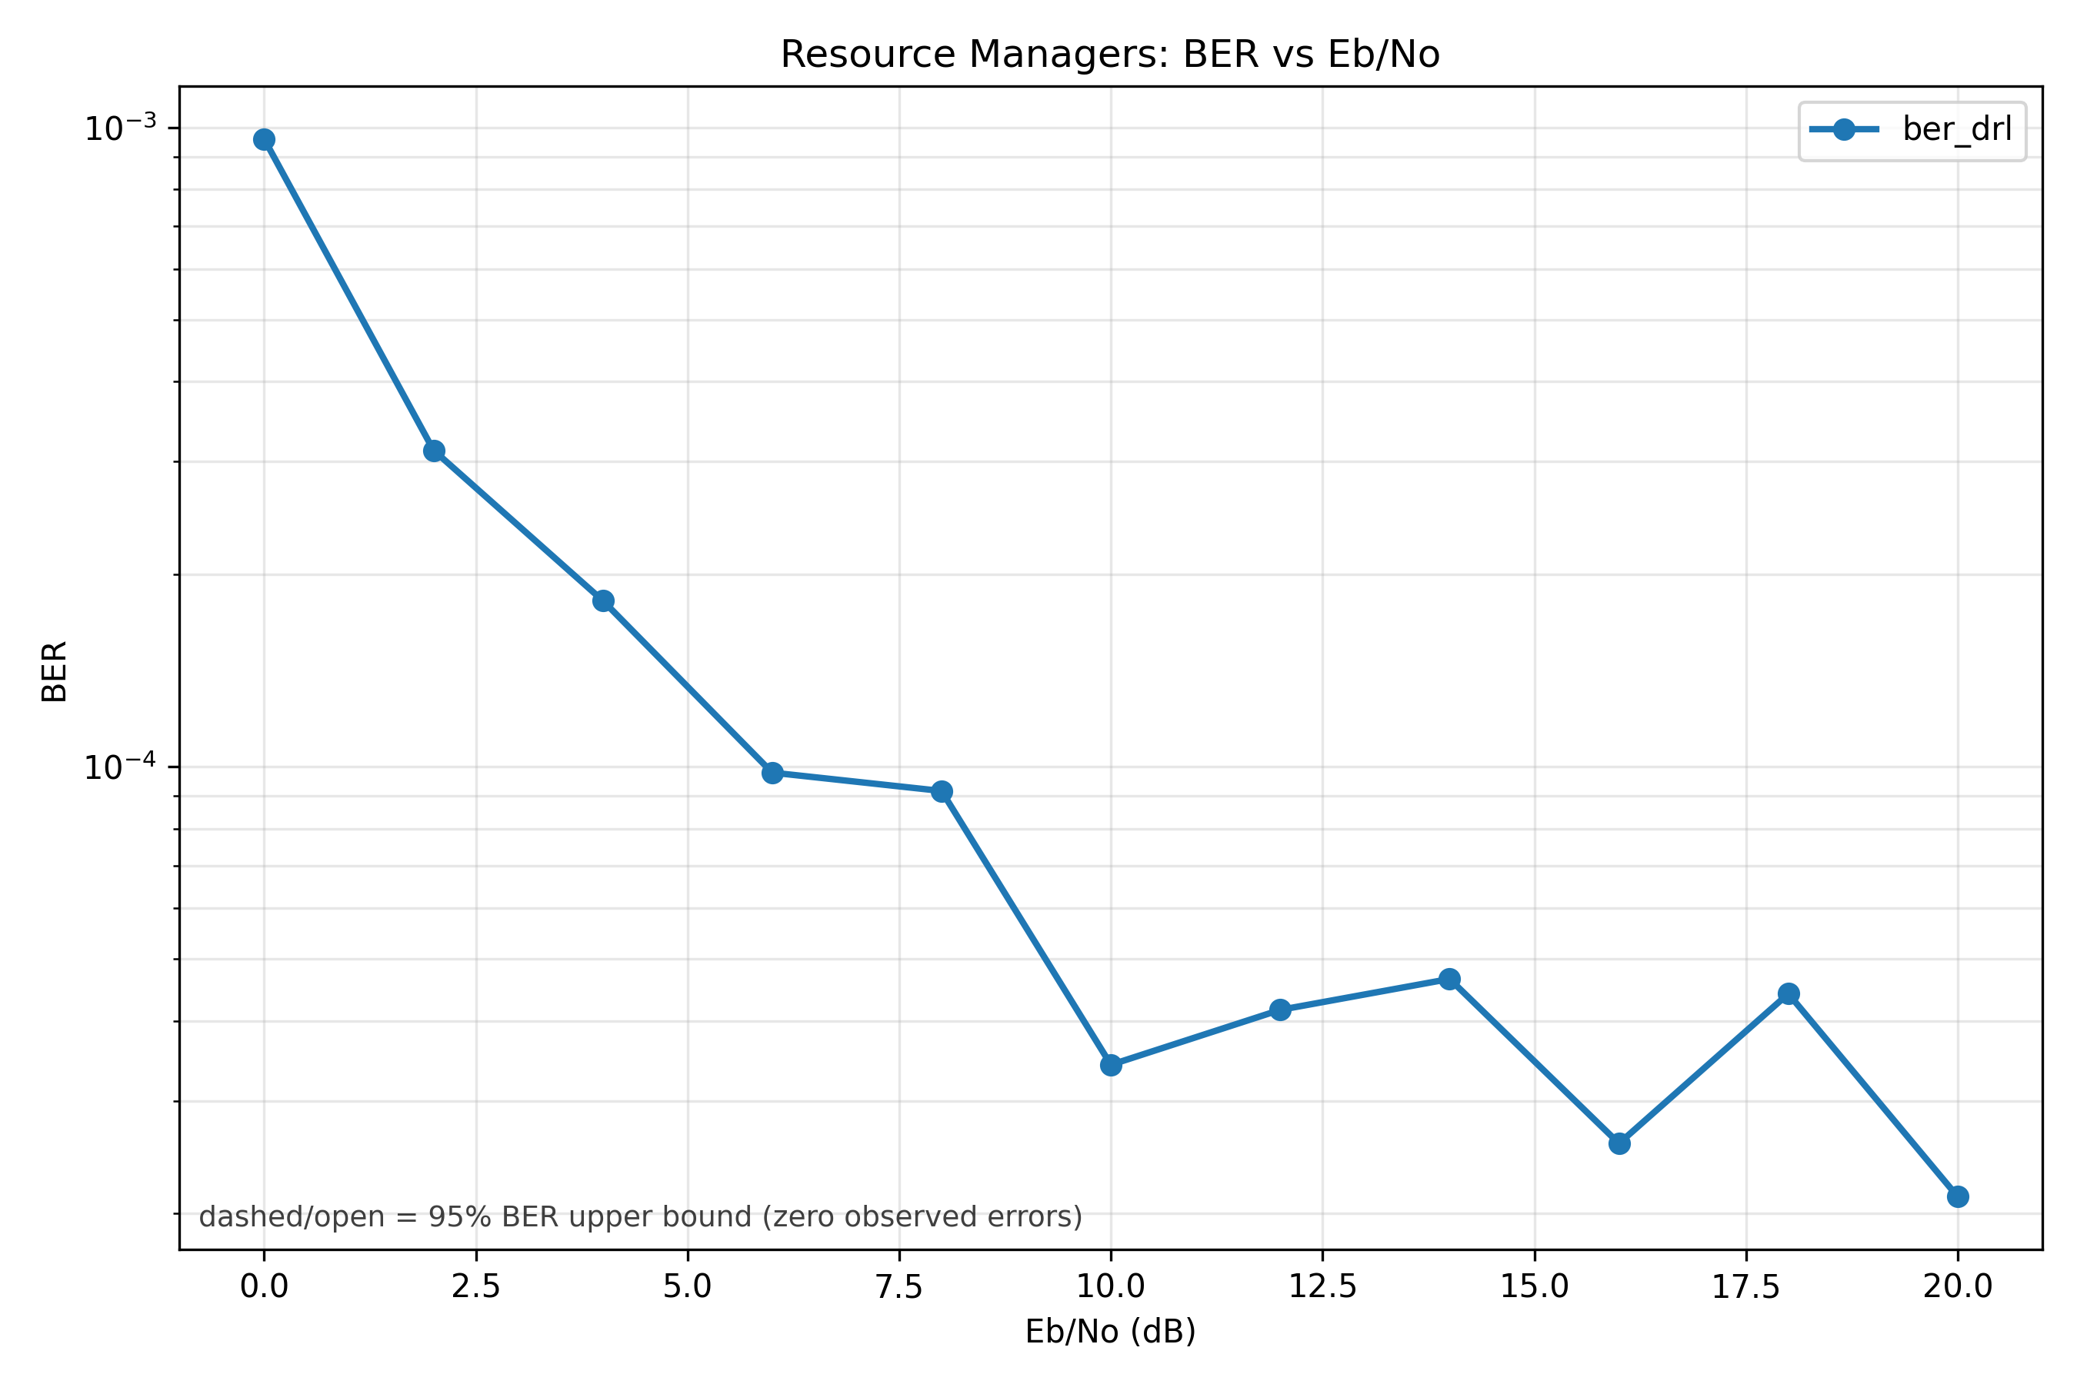
UMI/TR38901 benchmark completed: close to DRL, behind max-throughput
Factory6G
Weekly evidence
01 May 2026
The trained ber_drl policy completed the UMI/TR38901 benchmark and produced the same evidence graph set.
1.687e-4
508.8 ms
ber_drl mean BER
latency
Metric
ber_drl
best baseline
BER
1.687e-4
max throughput: 9.807e-5
BER upper
1.704e-4
9.915e-5
rank
#4 of 8
#1 max throughput
runtime
10089 s
13819 s
Interpretation: UMI is the harder channel; ber_drl is near the original DRL baseline but still needs more training data and tuning to pass max-throughput on BER.
Proof: results/20260428_103926_ber_drl_umi_qpsk_s and weekly BER comparison CSV.

Slide 5
Next step: scale labels, tune policy projection, then re-run both channels
Factory6G
Weekly evidence
01 May 2026
The evidence now separates completed implementation from the remaining research optimization target.
110 samples
Cross-channel result snapshot
current training set
Metric
ber_drl
best baseline
1
Expand BER-first TR38901/Rayleigh data beyond the small training run.
Rayleigh BER
1.149e-7
drl: 0
#7 of 8
#1 drl
2
Tune reliability targets, active-user labels, and channel-gain projection.
Rayleigh rank
1.687e-4
max throughput: 9.807e-5
3
Re-run the same explicit comparison report and update thesis evidence.
UMI BER
UMI rank
#4 of 8
#1 max throughput
4
Claim improvement only after ber_drl beats or matches the best BER baseline.
Conclusion: the BER-first path is ready for research iteration, but the current model is not yet the strongest BER performer.
Proof: reports/weekly/2026-05-01_resource_manager_ber_comparison.csv.

