Slide 1


M.Tech Program
Advanced Industry Integrated Programs
Jointly offered by VIT Vellore and LTM
Review – 3
Project Title
RAG-Powered Vendor Compliance Auditor
Team Member
Daniel Robin – T9925
Knowledge partner | Implementation partner

Slide 2
RAG-Powered Vendor Compliance Auditor
Introduction
The RAG-Powered Vendor Compliance Auditor analyzes vendor contracts against predefined compliance policies.
It uses RAG to retrieve relevant contract evidence and generate compliance findings, while PII redaction protects sensitive information during processing.

Slide 3
RAG-Powered Vendor Compliance Auditor
Problem Statement
Vendor contracts such as SLAs contain important security, privacy, and compliance commitments.
Manual review of these documents is time-consuming and repetitive, and relevant clauses or missing requirements can be difficult to identify.
There is a need for a more efficient way to retrieve relevant contract evidence and assist with compliance assessment.

Slide 4
RAG-Powered Vendor Compliance Auditor
Project Objectives
Upload and process vendor contract documents.
Extract contract text and relevant document information.
Detect and redact sensitive information before further processing.
Process and store contract content for semantic retrieval.
Retrieve relevant clauses based on predefined compliance policies.
Use a local LLM to evaluate retrieved evidence and generate compliance findings.
Present findings with supporting evidence and remediation recommendations.

Slide 5
RAG-Powered Vendor Compliance Auditor
Module Name and Components
Document Extraction: PDF validation and page-level text extraction
PII Redaction: Presidio and spaCy
Chunking: Paragraph-based sanitized chunks
Embedding: Ollama granite-embedding:30m
Vector Storage: ChromaDB
Retrieval: Top-three policy-relevant chunks
Compliance Analysis: Ollama granite4.1:8b
Validation and UI: Pydantic and Streamlit

Slide 6
RAG-Powered Vendor Compliance Auditor
Methodology/RAG Workflow
Upload and validate a text-based PDF
Extract text with page metadata
Detect and redact approved PII types
Divide sanitized text into paragraph-based chunks
Generate embeddings using Ollama Granite Embedding
Store sanitized chunks in ChromaDB
Retrieve the top 3 relevant chunks for each policy
Generate a structured compliance finding using a local LLM
Validate the finding using Pydantic
Flag uncertain findings for human review

Slide 7
RAG-Powered Vendor Compliance Auditor
Tools
Python 3.12 – Development language
Streamlit – User interface
pypdf – PDF text extraction
Presidio + spaCy – PII detection and redaction
Ollama – Local AI model execution
granite-embedding:30m – Embedding generation
ChromaDB – Vector storage and retrieval
Pydantic – Structured output validation
Pytest – Testing

Slide 8
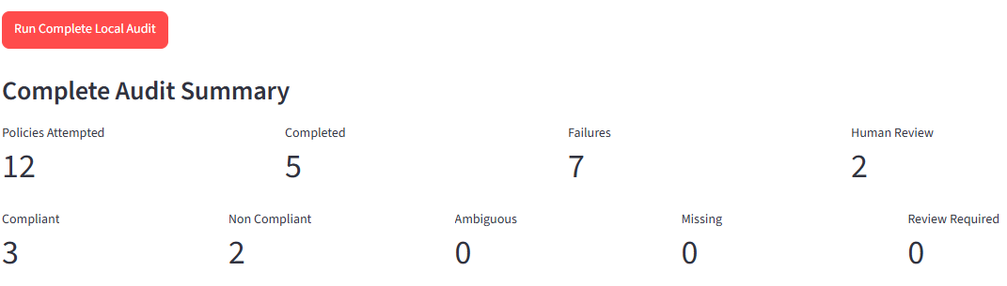
RAG-Powered Vendor Compliance Auditor
Results
Relevant clauses were retrieved from vendor documents.
Compliance risks were identified and categorized.
Findings were supported by extracted evidence.
Structured reports and artifacts were generated automatically.

Slide 9
RAG-Powered Vendor Compliance Auditor
Conclusion & Future Work
Conclusion
The project demonstrates how Retrieval-Augmented Generation (RAG) can assist vendor compliance auditing by combining document retrieval, privacy protection, and AI-based analysis.
Future Work
Support additional document formats such as DOCX and TXT
Expand the policy library and compliance coverage
Improve retrieval quality and evaluation
Enhance reporting and audit history
Extend the system for larger-scale and production environments

Slide 10
RAG-Powered Vendor Compliance Auditor
Acknowledgements
I sincerely thank my Project Mentor for the guidance and support provided throughout the project.
I would also like to thank the Classroom Coordinators, Faculty Members, and the institution for their valuable support and encouragement.
Thank You

Slide 11
RAG-Powered Vendor Compliance Auditor
Reference
Lewis, P. et al. (2020). Retrieval-Augmented Generation for Knowledge-Intensive NLP Tasks. NeurIPS 2020.
Gao, Y. et al. (2023/2024). Retrieval-Augmented Generation for Large Language Models: A Survey.
Shi, W. et al. (2023). REPLUG: Retrieval-Augmented Black-Box Language Models.
Jiang, Z. et al. (2023). Active Retrieval Augmented Generation. EMNLP 2023.
Asai, A. et al. (2023). Self-RAG: Learning to Retrieve, Generate, and Critique through Self-Reflection.

Slide 12
RAG-Powered Vendor Compliance Auditor
Reference
Yan, S.-Q. et al. (2024). Corrective Retrieval Augmented Generation.
Wang, X. et al. (2024). Searching for Best Practices in Retrieval-Augmented Generation. EMNLP 2024.
Es, S., James, J., Espinosa-Anke, L., & Schockaert, S. (2024). RAGAs: Automated Evaluation of Retrieval Augmented Generation. EACL 2024.
Saad-Falcon, J., Khattab, O., Potts, C., & Zaharia, M. (2024). ARES: An Automated Evaluation Framework for Retrieval-Augmented Generation Systems. NAACL 2024.
Ru, D. et al. (2024). RAGChecker: A Fine-grained Framework for Diagnosing Retrieval-Augmented Generation.

Slide 13
RAG-Powered Vendor Compliance Auditor
Reference
Pipitone, N. & Houir Alami, G. (2024). LegalBench-RAG: A Benchmark for Retrieval-Augmented Generation in the Legal Domain.
Guha, N. et al. (2023). LegalBench: A Collaboratively Built Benchmark for Measuring Legal Reasoning in Large Language Models.
Liu, N. F. et al. (2023). Lost in the Middle: How Language Models Use Long Contexts. TACL.
Huang, L. et al. (2023/2024). A Survey on Hallucination in Large Language Models: Principles, Taxonomy, Challenges, and Open Questions.
Park, M., Oh, H., Choi, E., & Hwang, W. (2025). LRAGE: Legal Retrieval Augmented Generation Evaluation Tool.

Slide 14
M.Tech Program
Advanced Industry Integrated Programs
Jointly offered by VIT Vellore and LTM
Project Title
Autonomous Cloud FinOps Remediation Agent
Team Member
Daniel Robin – T9925
Knowledge partner | Implementation partner

Slide 15
Autonomous Cloud FinOps Remediation Agent
Introduction
The Autonomous Cloud FinOps Remediation Agent identifies inefficient cloud resources and recommends suitable cost-saving actions.
It uses synthetic AWS and Azure data to estimate potential savings and generate safe, reviewable remediation proposals.

Slide 16
Autonomous Cloud FinOps Remediation Agent
Problem Statement
Organizations may incur unnecessary cloud costs from:
Idle compute resources
Unattached storage volumes
Old snapshots
Missing ownership or governance tags
Oversized cloud resources
Manually identifying these issues across a cloud environment can be time-consuming, inconsistent, and difficult to track.

Slide 17
Autonomous Cloud FinOps Remediation Agent
Project Objectives
Analyze synthetic AWS and Azure cloud resource data
Identify underutilized or unnecessary cloud resources
Protect critical, production, and uncertain resources
Estimate potential monthly and annual cost savings
Prioritize clear optimization recommendations
Generate safe remediation proposals for human review
Safety-first approach: No live cloud resources are accessed or modified.

Slide 18
Autonomous Cloud FinOps Remediation Agent
Key System Components
Data Validation – Organizes and verifies cloud resource data
Safety Checks – Protects critical and uncertain resources
Policy Analysis – Identifies waste and recommends suitable actions
Savings Estimation – Calculates monthly and annual savings
Portfolio Reporting – Summarizes and prioritizes opportunities
Remediation Proposals – Creates safe proposals for human review
Streamlit Dashboard – Displays findings, reports, and results

Slide 19
Autonomous Cloud FinOps Remediation Agent
Methodology/Modeling Plan
Collect synthetic AWS and Azure resource data
Standardize the data into a common format
Validate the telemetry and optimization policies
Apply safety checks to protect critical resources
Analyze resources for potential cloud waste
Estimate savings and prioritize recommendations
Generate reports for clear decision-making
Create safe remediation proposals for human review

Slide 20
Autonomous Cloud FinOps Remediation Agent
Approach
Safety checks
↓
Policy analysis
↓
Savings estimation
↓
Action recommendation
↓
Reporting and human review
Safety rules always run before optimization
Protected resources receive NO_ACTION
Missing ownership or unclear environments produce REVIEW_REQUIRED
Only confirmed WASTE_DETECTED findings are eligible for remediation

Slide 21
Autonomous Cloud FinOps Remediation Agent
Tools
Python 3.12 – Core application and policy logic
Pydantic – Data and policy validation
JSON and YAML – Telemetry and policy storage
Streamlit – Interactive dashboard and reporting
Jinja2 – Safe proposal template generation
Terraform and TFLint – Proposal formatting and validation
Pytest and Ruff – Testing and code-quality checks

Slide 22
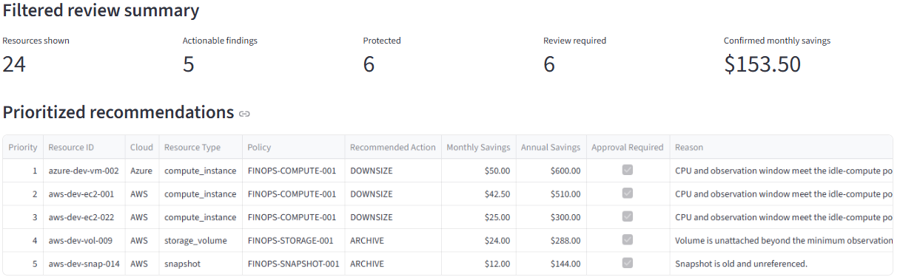
Autonomous Cloud FinOps Remediation Agent
Results
• Detected actionable optimization opportunities.
• Protected sensitive resources from remediation.
• Escalated findings for human review.
• Generated prioritized findings and downloadable reports.
• Produced validated, review-only Terraform proposals.

Slide 23
Autonomous Cloud FinOps Remediation Agent
Conclusion & Future Work
Conclusion
The project demonstrates how a deterministic, safety-constrained FinOps agent can analyze multi-cloud telemetry, protect critical resources, prioritize savings opportunities, and produce validated remediation proposals for human review.
Future Work
• Connect to live read-only AWS and Azure data sources.
• Improve pricing accuracy and policy coverage.
• Add more cloud resource types and optimization rules.
• Integrate organizational approval workflows.
• Containerize and deploy the Streamlit application.
• Add CI validation using GitHub Actions.
• Evaluate controlled AI summaries for explainability.

Slide 24
Autonomous Cloud FinOps Remediation Agent
Acknowledgements
I sincerely thank my Project Mentor for the guidance and support provided throughout the project.
I would also like to thank the Classroom Coordinators, Faculty Members, and the institution for their valuable support and encouragement.
Thank You

Slide 25
Autonomous Cloud FinOps Remediation Agent
Reference
S. Deochake, “Cloud Cost Optimization: A Comprehensive Review of Strategies and Case Studies,” 2023. DOI: 10.2139.
S. Deochake, “ABACUS: A FinOps Service for Cloud Cost Optimization,” 2024. DOI: 10.48550.
N. P. A. Vo, M. Kesarwani, R. Mahindru, and C. Narayanaswami, “FinOps Agent: A Use-Case for IT Infrastructure and Cost Optimization,” 2025. DOI: 10.48550.
V. Sivakumaran, “FinOps and Observability: Optimizing Cloud Resource Management for Cost Efficiency,” International Journal of Research in Computer Applications and Information Technology, vol. 8, no. 1, pp. 368–382, 2025. DOI: 10.34218.

Slide 26
Autonomous Cloud FinOps Remediation Agent
Reference
M. Upreti and O. Oteri, “Analytical Model for Optimizing Cloud Resource Allocation through Rightsizing and Long-Term Usage Forecasting,” Gyanshauryam International Scientific Refereed Research Journal, 2023.
I. Pintye, J. Kovács, and R. Lovas, “Enhancing Machine Learning-Based Autoscaling for Cloud Resource Orchestration,” Journal of Grid Computing, 2024. DOI: 10.1007.
S. Ponnusamy and M. Khoje, “Optimizing Cloud Costs with Machine Learning: Predictive Resource Scaling Strategies,” in 2024 5th International Conference on Innovative Trends in Information Technology, 2024. DOI: 10.1109.

Slide 27
Autonomous Cloud FinOps Remediation Agent
Reference
N. K and G. A. Kumar, “Recent Improvements in Cloud Resource Optimization with Dynamic Workloads using Machine Learning,” in Proceedings of the 5th International Conference on Communication and Information Processing, 2023.
P. Gaba, Himanshu, Preetitanya, and Y. Gupta, “Unlocking Efficiency: Multidimensional Cost Optimization Strategies for Cloud Infrastructure in Small and Medium-Sized Organizations,” 2023. DOI: 10.1109.
“Cost Modelling and Optimisation for Cloud: A Graph-Based Approach,” 2024. DOI: 10.1186.
A. Verdet, M. Hamdaqa, L. Da Silva, and F. Khomh, “Exploring Security Practices in Infrastructure as Code: An Empirical Study,” 2023, associated journal DOI: 10.1007.

Slide 28
Autonomous Cloud FinOps Remediation Agent
Reference
M. Caracciolo, “Policy as Code: How to Automate Cloud Compliance Verification with Open-Source Tools,” Master’s thesis, Politecnico di Torino, 2023.
F. Romeo et al., “ARPaCCino: An Agentic-RAG for Policy as Code Compliance,” arXiv, 2025.
D. Saxena and A. K. Singh, “A Comprehensive Survey on Sustainable Resource Management in Cloud Computing Environments,” 2024.

