Slide 1
Random Variate Generation
It is assumed that a distribution is completely specified and we wish to generate samples from this distribution as input to a simulation model.
Techniques
Inverse Transformation*
Acceptance-Rejection
Convolution
will emphasize
Notes:
30

Slide 2
Random Variate Generation (cont.)
All these techniques assume that a source of uniform (0, 1) random numbers is available; R₁, R₂,..., where each R_{i} has:
⎧1 , 0 ≤ x ≤ 1
pdf: f_{R}(x) = ⎨
⎩0 , otherwise and
⎧0 , x < 0
cdf: F_{R}(x) = ⎨x , 0 ≤ x ≤ 1
⎩1 , x > 1
Note: The random variable may be either discrete or continuous.
Notes:
30

Slide 3
Random Variate Generation (cont.)
If the random variable is discrete, ==>
x take on a specific value, and F(x) is a step F^{n}
If F(x) is continuous over the domain x, ==>
f(x) = dF(x) / dx and
the derivative f(x) is called the pdf.
Mathematically, the cdf is:
F(x) = P(X ≤ x) = , where F(x) is defined over the range 0 ≤ F(x) ≤ 1, and f(t) represents the value of the pdf of the variable x, when X = t.
Notes:
30

Slide 4
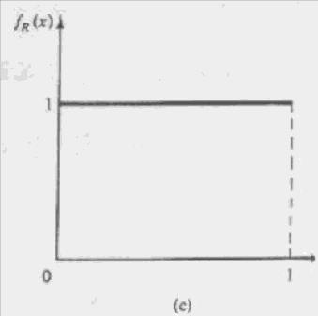
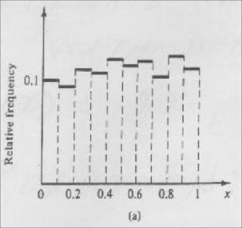
Random Variate Generation (cont.)
Empirical histogram of 200
uniform random numbers
Theoretical uniform
density on (0, 1)
Notes:
30

Slide 5
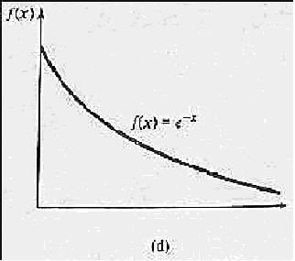
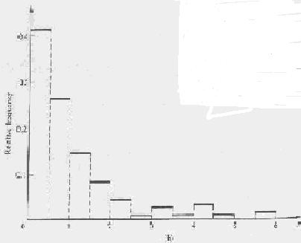
Random Variate Generation (cont.)
Empirical histogram of
200 exponential variates
Theoretical exponential
density with mean 1
Notes:
30

Slide 6
Random Variate Generation (cont.)
Example #1
Generate random variates x with density function f(x) = 2x, 0 ≤ x ≤ 1
Solution:
F(x) = = x² , 0 ≤ x ≤ 1
Now set F(x) = R ==> R = x²
Next, solve for x, ==> x = F⁻¹(R) = √R, 0 ≤ r ≤ 1
∴Values of x with pdf f(x) = 2x can be generated by taking the square root of the random, R.
Notes:
30

Slide 7
Random Variate Generation (cont.)
Example #2
Generate random variates x with density function
⎧ λe^{-λx} , 0 ≤ x f(x) = ⎨
⎩ 0 , x < 0
Solution:
F(x) = f(t) dt
⎧ 1 - e^{-λx} , 0 ≤ x
= ⎨
⎩ 0 , x < 0
Notes:
30

Slide 8
Random Variate Generation (cont.)
Now set F(x) = R
Next solve for x, ==>
1 - e^{-λx} = R
e^{-λx} = 1 - R
- λx = ln(1 - R)
x = - {ln(1 - R)} / λ
or = - {ln(R)} / λ
Notes:
30

Slide 9
Random Variate Generation (cont.)
Another way of writing this:
F(x) = 1 - e^{-λx} = R
Because of symmetry, F(x) and 1 - F(x) are interchangeable, so,
e^{-λx} = R
and - λx = ln(R)
x = - {ln(R)} / λ
Note λ = 1 / E(x), so
x = - E(x) ln(R)
Notes:
30

Slide 10
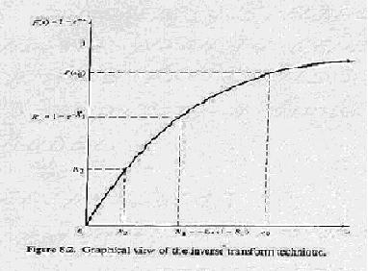
Random Variate Generation (cont.)
R₁ = 1-e^{-x1}
X₁ = -ln(1-R₁)
Graphical view of the inverse transform technique
Notes:
30

Slide 11
Random Variate Generation (cont.)
Weibull Distribution - good for modeling “Time to Failure” for machines, components, etc.
pdf:
Note α is the shape parameter and β is the scale parameter.
Notes:
30

Slide 12
Random Variate Generation (cont.)
Now, to generate Weibull variates:
Step 1. cdf: F(x) = 1 - , x ≥ 0
Step 2. 1 - = R
Step 3. X = α [-ln(1-R)] ^{1/β}
or X = α [-ln(R)] ^{1/β}
Note: The density function f(x) of a continuous random variable may be interpreted as the relative chance of observing variates on different parts of the range
Notes:
30

Slide 13
Random Variate Generation (cont.)
On regions of the x axis above which f(x) is high, we expect to observe a lot of variates, and where f(x) is low we should find only a few.
We can view f(x) as the slope function of F at x.
Notes:
30

Slide 14
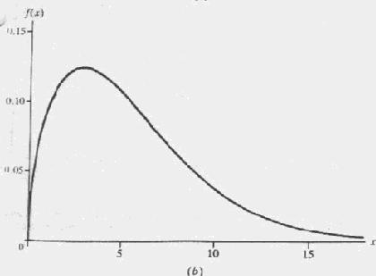
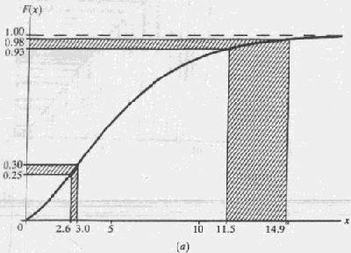
Random Variate Generation (cont.)
Example: Weibull Distribution
Intervals for U and X, inverse
transform for Weibull(1.5, 6) distribution
Notes:
30

Slide 15
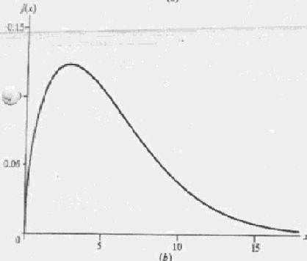
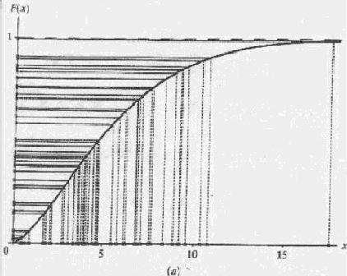
Random Variate Generation (cont.)
Sample of 50 U’s and X’s, inverse
transform for Weibull(1.5, 6) Distribution
Density for Weibull
(1.5, 6) distribution
Notes:
30

Slide 16
Random Variate Generation (cont.)
Uniform Distribution
Consider a random variable X that is uniformly distributed on the interval [a, b]
⎧ 1 / (b-a) , a ≤ x ≤ b pdf: f(x) = ⎨
⎩ 0 , otherwise
Notes:
30

Slide 17
Random Variate Generation (cont.)
To generate random variates:
Step 1. ⎧ 0 , x < a F(x) = ⎨ (x - a) / (b - a) , a ≤ x ≤ b
⎩ 1 , x > b
Step 2. F(x) = (x - a) / (b - a) = R
Step 3. X = a + (b - a) R
Notes:
30

Slide 18
Random Variate Generation (cont.)
If the modeler has been unable to find a theoretical distribution that provides a good model for the input data, it may be necessary to use the empirical distribution of the data.
Example:
Suppose that 100 broken widget repair times have been collected. The data are summarized in the next slide in terms of the number of observations in various intervals. For example, there were 31 observations between 0 and 0.5 hour, 10 between
Notes:
30

Slide 19
Random Variate Generation (cont.)
0.5 and 1 hour, and so on.
Interval Relative Cumulative
(Hours) Frequency Frequency Frequency
0 ≤ x ≤ 0.5 31 0.31 0.31
0.5 ≤ x ≤ 1.0 10 0.10 0.41
1.0 ≤ x ≤ 1.5 25 0.25 0.66
1.5 ≤ x ≤ 2.0 34 0.34 1.00
The true underlying distribution, F(x), of repair times (the curve in next slide) can be estimated by the empirical cdf, F(x)(the piecewise linear curve)
Notes:
30

Slide 20
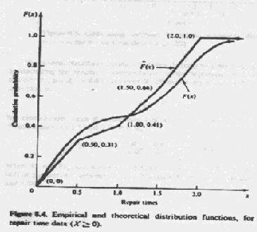
Random Variate Generation (cont.)
Empirical and theoretical distribution functions,
for repair time data (X ≥ 0)
Notes:
30

Slide 21
Random Variate Generation (cont.)
The inverse transform technique applies directly to generating repair time variates, X. Recalling the graphical interpretation of the technique, first generate a random number R₁, say R₁ = 0.83, and read X₁ off the graph of next slide. Symbolically, this is written as X₁ = F⁻¹(R₁) but algebraically, since R₁ is between 0.66 and 1.00, X₁ is computed by a linear interpolation between 1.5 and 2.0; that is
Notes:
30

Slide 22
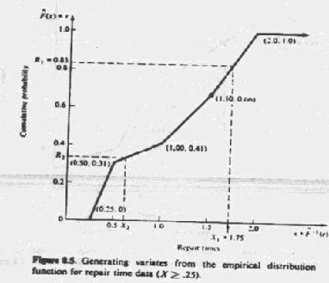
Random Variate Generation (cont.)
Generating variates from the empirical distribution
function for repair time data (X ≥ 0.25)
Notes:
30

Slide 23
Random Variate Generation (cont.)
X₁ = 1.5 + {(R₁ - 0.66) / (1 - 0.66)} ⋅ (2.0 - 1.5)
= 1.75
When R₁ = 0.83, note that (R₁ - 0.66) / (1 - 0.66) = 0.5, so that X₁ will be one-half of the distance between 1.5 and 2.0 since R₁ is one-half of the way between 0.66 and 1.00
Notes:
30

Slide 24
Random Variate Generation (cont.)
The slopes of the four line segments are given in the next slide and in the following table, which can be used to generate variates, X, as follows.
i Input, r_{i} Outut, x_{i} Slope, a_{i}
1 0 0.25 0.81
2 0.31 0.5 5.0
3 0.41 1.0 2.0
4 0.66 1.5 1.47
5 1.00 2.0 ---
Intervals and Slopes for generating repair times, X
Notes:
30

Slide 25
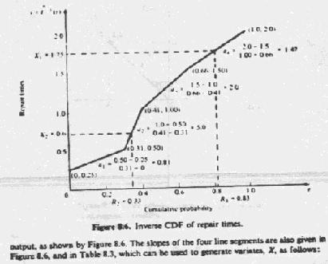
Random Variate Generation (cont.)
Inverse CDF of repair times
Notes:
30

Slide 26
Random Variate Generation (cont.)
Step 1. Generate R
Step 2. Find the interval i in which R lies; that is, find i so that r_{i} ≤ R ≤ r_{i+1}
Step 3. Compute X by
X = x_{i} + a_{i} (R - r_{i})
Notes:
30

Slide 27
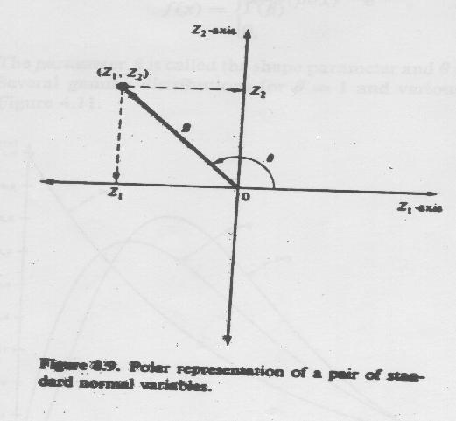
Direct Transformation for the Normal Distribution
Standard Normal Distribution
Φ(x) = ∫^{x}_{-∞} {1/ (√2π)} ⋅ dt, -∞ < x < ∞
Polar representation of a pair of standard normal variables
Notes:
30

Slide 28
Direct Transformation for the Normal Distribution (cont.)
Z₁ = B cosθ and Z₂ = B sinθ.
It is known that B² = + has the chi-square distribution with 2 degree of freedom, which is equivalent to an exponential distribution with mean 2. Thus, the radius, B, can be generated by
B = (-2 lnR)^{1/2}
By the symmetry of the normal distribution, it seems reasonable to suppose, and indeed it is the case, that the angle θ is uniformly distributed between 0 and 2π radians.
Notes:
30

Slide 29
Direct Transformation for the Normal Distribution (cont.)
In addition, the radius, B, and the angle, θ, are mutually independent. Combining previous two equations gives a direct method for generating two independent standard normal variates, Z₁ and Z₂, from two independent random numbers R₁ and R₂ Z₁ = (-2lnR₁)^{1/2} cos(2π R₂) and Z₂ = (-2lnR₁)^{1/2} sin(2π R₂).
To obtain normal variates X_{i} with mean μ and variance σ² , X_{i} = μ + σ Z_{i}
Notes:
30

Slide 30
Direct Transformation for the Normal Distribution (cont.)
Example:
Given that R₁ = 0.1758 and R₂ = 0.1489.
Two standard normal random variates are generated as follows:
Z₁ = [-2ln(0.1758)]^{1/2} cos(2π 0.1489) = 1.11 Z₂ = [-2ln(0.1758)]^{1/2} sin(2π 0.1489) = 1.50
To transform the two standard normal variates into normal variates with mean μ = 10 and variance σ² = 4, X₁ = 10 + 2(1.11) = 12.22
X₂ = 10 + 2(1.50) = 13.00
Notes:
30

Slide 31
Random Variate Generation (cont.)
Rejection Method:
Use when it is either impossible or extremely difficult to express x in terms of the inverse transformation F⁻¹(r).
Steps:
Normalize the range of f by a scale factor c such that c⋅f(x) ≤ 1, a ≤ x ≤ b
Define a linear function of r, x = a + (b-a) r
Notes:
30

Slide 32
Random Variate Generation (cont.)
Generate a pair of random numbers (r₁, r₂)
If r₂ ≤ c⋅f[a + (b-a) r₁], then accept the pair and use x = a + (b - a) r₁ as the random variate generated.
Return to step 3.
f(x)
c
a
x
b
Notes:
30

Slide 33
Random Variate Generation (cont.)
P{successful pair}
= P{first number takes a value of x and the second number is less than f(x)/c}
= {1/(b-a)} ⋅ {f(x)/c} dx
= {1/c(b-a)} f(x) dx
= 1 / c(b-a)
Notes:
30

Slide 34
Random Variate Generation (cont.)
Example #1:
Use the rejection method to generate random variates x with density function f(x) = 2x, 0 ≤ x ≤ 1
2
f(x)
g(x)
1
1
1
1
Before scaling
After scaling
Notes:
30

Slide 35
Random Variate Generation (cont.)
Note: x = 0 + (1) r = r,
Note: let g(r) = (1/2) ⋅ f(r) = (1/2) ⋅ (2r) = r
So, the steps for this example are now summarized.
Generate r₁ and calculate g(r₁).
Generate r₂ and compare it with g(r₁).
If r₂ ≤ g(r₁), accept r₁ as x from f(x). If r₂ > g(r₁) then reject r₁ and repeat step 1.
Notes:
30

Slide 36
Random Variate Generation (cont.)
Example #2:
Compute the area of the first quadrant of a unit circle with coordinate axes r₁ and r₂ respectively.
r₂
1
points lie on
the circle
0
r₁
1
Numerical Integration
Notes:
30

Slide 37
Random Variate Generation (cont.)
Let g(r₁) = √1 - , if g( ) ≥ for the generated random numbers ( , ), then ( , ) is a random point under the curve; otherwise the point. lies above the curve. So, accepting and counting random occurrences and dividing by the total number of pairs generated → a ratio corresponding to the proportion of the area of the unit square lying under the curve.
Notes:
30

Slide 38
Random Variate Generation (cont.)
Note: The rejection method is very inefficient when c ⋅ (b-a) becomes large, since a large number of random numbers would have to be generated for every random variate produced.
Example:
Distribution is broken into
pieces and the pieces are
sampled in proportion to
the amount of distributional
area each contains
Notes:
30

Slide 39
Random Variate Generation (cont.)
A random variable X is gamma distributed with parameters β and θ if its pdf is given by
⎧ {βθ / Γ(β)} ⋅ (βθx)^{β−1} e^{−βθx} , x > 0 f(x) = ⎨ ⎩ 0 , otherwise
The parameter β is called the shape parameter and θ is called the scale parameter. Several gamma distributions for θ = 1 and various values of β are shown in the next slide.
Notes:
30

Slide 40
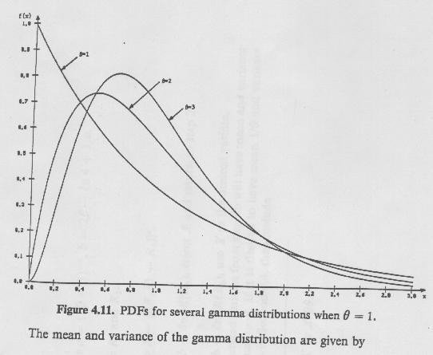
Random Variate Generation (cont.)
β=1
β=2
β=3
PDFs for severa gamma distributions when θ = 1
Notes:
30

Slide 41
Random Variate Generation (cont.)
The mean and variance of the gamma distribution are given by
E(X) = 1 / θ and
V(X) = 1 / (βθ²)
The cdf of X is given by
⎧
∫
∞
⎪
1
−
{
βθ
/
Γ
(
β
)}
⋅
(
βθ
t
)
β
−
1
e
βθ
t
dt
,
x
>
0
F
(
x
)
=
⎨
x
⎪
0
,
x
≤
0
⎩
Notes:
30

Slide 42
Random Variate Generation (cont.)
Step1. Compute a = (2β - 1)^{1/2}, b = 2β -ln4 + 1/a
Step2. Generate R₁ and R₂
Step3. Compute X = β[R₁ / (1 - R₁)]ª.
Step4a. If X > b - ln( R₂), reject X and return to step 2.
Step4b. If X ≤ b - ln( R₂), use X as the desired variate. The generated variates from step4b will have mean and variance both equal to β. If it is desired to have mean 1/θ and variance 1/βθ² ,then
Step5. Replace X by X/βθ.
Notes:
30

Slide 43
Random Variate Generation (cont.)
Example:
Downtimes for a high-production candy-making machine have been found to be gamma distributed with mean 2.2 minutes and variance 2.1 minutes². Thus, 1/θ = 2.2 and 1/βθ² = 2.10, which implies that β =2.30 and θ = 0.4545.
Step1. a = 1.90, b = 3.74
Step2. Generate R₁ = 0.832 and R₂= 0.021
Step3. Compute X = 2.3[0.832 / 0.168]^{1.9} = 48.1
Step4. X = 48.1 > 3.74 - ln[(0.832)²(0.021)] = 7.97 , so reject X and return to step 2.
Notes:
30

Slide 44
Random Variate Generation (cont.)
Step2. Generate R₁ = 0.434, and R₂ = 0.716.
Step3. Compute X = 2.3(0.434/0.566]^{1.9} = 1.389.
Step4. Since X = 1.389 ≤ 3.74 - ln[(0.434)² 0.716] = 5.74, accept X.
Step5. Divide X by βθ = 1.045 to get X = 1.329.
Notes:
30

