Slide 1

What is a block cipher?
Online Cryptography Course Dan Boneh
Block ciphers

Slide 2
Block ciphers: crypto work horse
n bits
n bits
E, D
PT Block
CT Block
Key
k bits
Canonical examples:
3DES: n= 64 bits, k = 168 bits
AES: n=128 bits, k = 128, 192, 256 bits

Slide 3
Block Ciphers Built by Iteration
key k
key expansion
k₁
k₂
k₃
k_{n}
m
R(k₁, ⋅)
R(k₂, ⋅)
R(k₃, ⋅)
R(k_{n}, ⋅)
c
R(k,m) is called a round function
for 3DES (n=48), for AES-128 (n=10)

Slide 4
Performance: Crypto++ 5.6.0 [ Wei Dai ]
AMD Opteron, 2.2 GHz ( Linux)
Cipher Block/key size Speed (MB/sec)
RC4 126
Salsa20/12 643
Sosemanuk 727
3DES 64/168 13
AES-128 128/128 109
stream
block

Slide 5
Abstractly: PRPs and PRFs
Pseudo Random Function (PRF) defined over (K,X,Y):
F: K × X → Y
such that exists “efficient” algorithm to evaluate F(k,x)
Pseudo Random Permutation (PRP) defined over (K,X):
E: K × X → X
such that: 1. Exists “efficient” deterministic algorithm to evaluate E(k,x)
2. The function E( k, ⋅ ) is one-to-one
3. Exists “efficient” inversion algorithm D(k,y)

Slide 6
Running example
Example PRPs: 3DES, AES, …
AES: K × X → X where K = X = {0,1}¹²⁸
3DES: K × X → X where X = {0,1}⁶⁴ , K = {0,1}¹⁶⁸
Functionally, any PRP is also a PRF.
A PRP is a PRF where X=Y and is efficiently invertible.

Slide 7
Secure PRFs
Let F: K × X → Y be a PRF
Funs[X,Y]: the set of all functions from X to Y
S_{F} = { F(k,⋅) s.t. k ∈ K } ⊆ Funs[X,Y]
Intuition: a PRF is secure if a random function in Funs[X,Y] is indistinguishable from a random function in S_{F}
Funs[X,Y]
S_{F}
Size |Y|^{|X|}
Size |K|

Slide 8
Secure PRFs
Let F: K × X → Y be a PRF
Funs[X,Y]: the set of all functions from X to Y
S_{F} = { F(k,⋅) s.t. k ∈ K } ⊆ Funs[X,Y]
Intuition: a PRF is secure if a random function in Funs[X,Y] is indistinguishable from a random function in S_{F}
f ← Funs[X,Y]
x ∈ X
???
k ← K
f(x) or F(k,x) ?

Slide 9
Secure PRPs (secure block cipher)
Let E: K × X → Y be a PRP
Perms[X]: the set of all one-to-one functions from X to Y
S_{F} = { E(k,⋅) s.t. k ∈ K } ⊆ Perms[X,Y]
Intuition: a PRP is secure if a random function in Perms[X] is indistinguishable from a random function in S_{F}
π ← Perms[X]
x ∈ X
???
k ← K
π(x) or E(k,x) ?

Slide 10
Let F: K × X → {0,1}¹²⁸ be a secure PRF.
Is the following G a secure PRF?
G(k, x) =
0 ¹²⁸ if x=0
F(k,x) otherwise
No, it is easy to distinguish G from a random function
Yes, an attack on G would also break F
It depends on F

Slide 11
An easy application: PRF ⇒ PRG
Let F: K × {0,1}^{n} → {0,1}^{n} be a secure PRF.
Then the following G: K → {0,1}^{nt} is a secure PRG:
G(k) = F(k,0) ll F(k,1) ll ⋯ ll F(k,t-1)
Key property: parallelizable
Security from PRF property: F(k, ⋅) indist. from random function f(⋅)

Slide 12
End of Segment

Slide 13
The data encryption standard (DES)
Online Cryptography Course Dan Boneh
Block ciphers

Slide 14
Block ciphers: crypto work horse
n bits
n bits
E, D
PT Block
CT Block
Key
k Bits
Canonical examples:
3DES: n= 64 bits, k = 168 bits
AES: n=128 bits, k = 128, 192, 256 bits

Slide 15
Block Ciphers Built by Iteration
key k
key expansion
k₁
k₂
k₃
k_{n}
m
R(k₁, ⋅)
R(k₂, ⋅)
R(k₃, ⋅)
R(k_{n}, ⋅)
c
R(k,m) is called a round function
for 3DES (n=48), for AES-128 (n=10)
Notes:
To specify the block cipher, need to specify: The key expansion process and the round function.
Many round functions give PRPs after sufficiently many iterations The challenge is to design a round function that quickly becomes a PRP.

Slide 16
The Data Encryption Standard (DES)
Early 1970s: Horst Feistel designs Lucifer at IBM
key-len = 128 bits ; block-len = 128 bits
1973: NBS asks for block cipher proposals. IBM submits variant of Lucifer.
1976: NBS adopts DES as a federal standard
key-len = 56 bits ; block-len = 64 bits
1997: DES broken by exhaustive search
2000: NIST adopts Rijndael as AES to replace DES
Widely deployed in banking (ACH) and commerce

Slide 17
DES: core idea – Feistel Network
Given functions f₁, …, f_{d}: {0,1}^{n} ⟶ {0,1}^{n}
Goal: build invertible function F: {0,1}^{2n} ⟶ {0,1}^{2n}
R₀
R₁
R₂
R_{d-1}
R_{d}
n-bits
f₁
f₂
⋯
f_{d}
L₀
L₁
L₂
L_{d-1}
L_{d}
n-bits
⊕
⊕
⊕
input
output
In symbols:

Slide 18
R₀
R₁
R₂
R_{d-1}
R_{d}
n-bits
f₁
f₂
⋯
f_{d}
L₀
L₁
L₂
L_{d-1}
L_{d}
n-bits
⊕
⊕
⊕
input
output
Claim: for all f₁, …, f_{d}: {0,1}^{n} ⟶ {0,1}^{n}
Feistel network F: {0,1}^{2n} ⟶ {0,1}^{2n} is invertible
Proof: construct inverse
R_{i-1}
R_{i}
R_{i-1} = L_{i}
L_{i-1} = f_{i}(L_{i}) ⨁ R_{i}
inverse
f_{i}
L_{i-1}
L_{i}
⊕

Slide 19
R₀
R₁
R₂
R_{d-1}
R_{d}
n-bits
f₁
f₂
⋯
f_{d}
L₀
L₁
L₂
L_{d-1}
L_{d}
n-bits
⊕
⊕
⊕
input
output
Claim: for all f₁, …, f_{d}: {0,1}^{n} ⟶ {0,1}^{n}
Feistel network F: {0,1}^{2n} ⟶ {0,1}^{2n} is invertible
Proof: construct inverse
R_{i-1}
R_{i}
R_{i}
⊕
R_{i-1}
inverse
f_{i}
L_{i}
f_{i}
L_{i-1}
L_{i-1}
L_{i}
⊕

Slide 20
Decryption circuit
R_{d}
⊕
⊕
⊕
n-bits
R_{d-1}
R_{d-2}
R₁
R₀
⋯
f_{d}
f_{d-1}
f₁
L_{d}
L_{d-1}
L_{d-2}
L₁
L₀
n-bits
Inversion is basically the same circuit, with f₁, …, f_{d} applied in reverse order
General method for building invertible functions (block ciphers) from arbitrary functions.
Used in many block ciphers … but not AES

Slide 21
“Thm:” (Luby-Rackoff ‘85):
f: K × {0,1}^{n} ⟶ {0,1}^{n} a secure PRF
⇒ 3-round Feistel F: K³ × {0,1}^{2n} ⟶ {0,1}^{2n} a secure PRP
R₀
R₁
R₂
R₃
f
f
f
L₀
L₁
L₂
L₃
⊕
⊕
⊕
input
output

Slide 22
DES: 16 round Feistel network
f₁, …, f₁₆: {0,1}³² ⟶ {0,1}³² , f_{i}(x) = F( k_{i}, x )
k
key expansion
⋯
k₁
k₂
k₁₆
16 round Feistel network
IP
IP⁻¹
64 bits
64 bits
input
output
To invert, use keys in reverse order

Slide 23
The function F(k_{i}, x)
S-box: function {0,1}⁶ ⟶ {0,1}⁴ , implemented as look-up table.
Notes:
E box: bit 1 → bit 2 and 48, bit 2 → bit 3
P Box: bit 1 → bit 9, bit 2 → bit 15

Slide 24
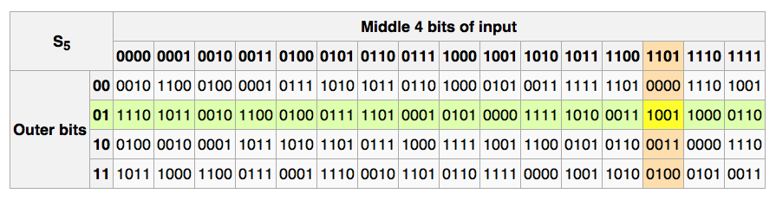
The S-boxes
S_{i}: {0,1}⁶ ⟶ {0,1}⁴

Slide 25
Example: a bad S-box choice
Suppose:
S_{i}(x₁, x₂, …, x₆) = ( x₂⨁x₃, x₁⨁x₄⨁x₅, x₁⨁x₆, x₂⨁x₃⨁x₆ )
or written equivalently: S_{i}(x) = A_{i}⋅x (mod 2)
We say that S_{i} is a linear function.
0 1 1 0 0 0
1 0 0 1 1 0
1 0 0 0 0 1
0 1 1 0 0 1
x₁
x₂
x₃
x₄
x₅
x₆
x₂⨁x₃
x₁⨁x₄⨁x₅
x₁⨁x₆
x₂⨁x₃⨁x₆
.
=

Slide 26
Example: a bad S-box choice
Then entire DES cipher would be linear: ∃fixed binary matrix B s.t.
But then: DES(k,m₁) ⨁ DES(k,m₂) ⨁ DES(k,m₃)
832
B
m
k₁
k₂
k₁₆
c
DES(k,m) =
64
.
=
(mod 2)
⋮
= DES(k, m₁⨁m₂⨁m₃)
m₁
k
m₂
k
m₃
k
m₁⨁m₂⨁m₃
k⨁k⨁k
B ⨁ B ⨁ B = B
Notes:
832 = 64 + 16*48

Slide 27
Choosing the S-boxes and P-box
Choosing the S-boxes and P-box at random would result in an insecure block cipher (key recovery after ≈2²⁴ outputs) [BS’89]
Several rules used in choice of S and P boxes:
No output bit should be close to a linear func. of the input bits
S-boxes are 4-to-1 maps
⋮

Slide 28
End of Segment

Slide 29
Exhaustive Search Attacks
Online Cryptography Course Dan Boneh
Block ciphers

Slide 30
Exhaustive Search for block cipher key
Goal: given a few input output pairs (m_{i}, c_{i} = E(k, m_{i})) i=1,..,3 find key k.
Lemma: Suppose DES is an ideal cipher
( 2⁵⁶ random invertible functions )
Then ∀ m, c there is at most one key k s.t. c = DES(k, m)
Proof:
with prob. ≥ 1 – 1/256 ≈ 99.5%

Slide 31
Exhaustive Search for block cipher key
For two DES pairs (m₁, c₁=DES(k, m₁)), (m₂, c₂=DES(k, m₂))
unicity prob. ≈ 1 - 1/2⁷¹
For AES-128: given two inp/out pairs, unicity prob. ≈ 1 - 1/2¹²⁸
⇒ two input/output pairs are enough for exhaustive key search.

Slide 32
DES challenge
msg = “The unknown messages is: XXXX … “
CT = c₁ c₂ c₃ c₄
Goal: find k ∈ {0,1}⁵⁶ s.t. DES(k, m_{i}) = c_{i} for i=1,2,3
1997: Internet search -- 3 months
1998: EFF machine (deep crack) -- 3 days (250K $)
1999: combined search -- 22 hours
2006: COPACOBANA (120 FPGAs) -- 7 days (10K $)
⇒ 56-bit ciphers should not be used !! (128-bit key ⇒ 2⁷² days)

Slide 33
Strengthening DES against ex. search
Method 1: Triple-DES
Let E : K × M ⟶ M be a block cipher
Define 3E: K³ × M ⟶ M as
For 3DES: key-size = 3×56 = 168 bits. 3×slower than DES.
(simple attack in time ≈2¹¹⁸ )
3E( (k₁,k₂,k₃), m) =

Slide 34
Why not double DES?
Define 2E( (k₁,k₂), m) = E(k₁ , E(k₂ , m) )
Attack: M = (m₁,…, m₁₀) , C = (c₁,…,c₁₀).
step 1: build table.
sort on 2nd column
key-len = 112 bits for DES
E(k₂,⋅)
E(k₁,⋅)
m
c
k⁰ = 00…00
k¹ = 00…01
k² = 00…10
⋮
k^{N} = 11…11
E(k⁰ , M)
E(k¹ , M)
E(k² , M)
⋮
E(k^{N} , M)
2⁵⁶
entries

Slide 35
Meet in the middle attack
E(k₂,⋅)
E(k₁,⋅)
m
c
k⁰ = 00…00
k¹ = 00…01
k² = 00…10
⋮
k^{N} = 11…11
E(k⁰ , M)
E(k¹ , M)
E(k² , M)
⋮
E(k^{N} , M)
Attack: M = (m₁,…, m₁₀) , C = (c₁,…,c₁₀)
step 1: build table.
Step 2: for all k∈{0,1}⁵⁶ do:
test if D(k, C) is in 2nd column.
if so then E(k^{i},M) = D(k,C) ⇒ (k^{i},k) = (k₂,k₁)

Slide 36
Meet in the middle attack
E(k₂,⋅)
E(k₁,⋅)
m
c
Time = 2⁵⁶log(2⁵⁶) + 2⁵⁶log(2⁵⁶) < 2⁶³ << 2¹¹² , space ≈ 2⁵⁶
Same attack on 3DES: Time = 2¹¹⁸ , space ≈ 2⁵⁶
E(k₃,⋅)
E(k₂,⋅)
E(k₁,⋅)
m
c

Slide 37
Method 2: DESX
E : K × {0,1}^{n} ⟶ {0,1}^{n} a block cipher
Define EX as EX( (k₁,k₂,k₃), m) = k₁ ⨁ E(k₂, m⨁k₃ )
For DESX: key-len = 64+56+64 = 184 bits
… but easy attack in time 2⁶⁴⁺⁵⁶ = 2¹²⁰ (homework)
Note: k₁ ⨁ E(k₂, m) and E(k₂, m⨁k₁) does nothing !!

Slide 38
End of Segment

Slide 39
More attacks on block ciphers
Online Cryptography Course Dan Boneh
Block ciphers

Slide 40
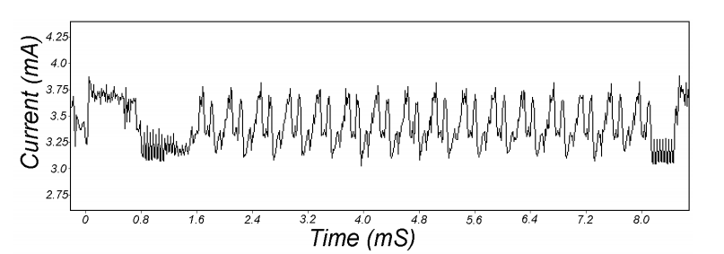
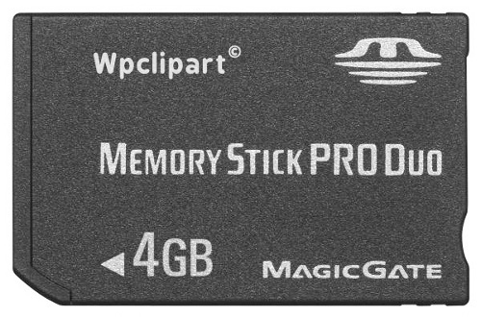
Attacks on the implementation
1. Side channel attacks:
Measure time to do enc/dec, measure power for enc/dec
2. Fault attacks:
Computing errors in the last round expose the secret key k
⇒ do not even implement crypto primitives yourself …
smartcard
[Kocher, Jaffe, Jun, 1998]
Notes:
Many timing attacks: cache timing, multi-core attacks, smartcard attacks

Slide 41
Linear and differential attacks [BS’89,M’93]
Given many inp/out pairs, can recover key in time less than 2⁵⁶ .
Linear cryptanalysis (overview) : let c = DES(k, m)
Suppose for random k,m :
Pr[ m[i₁]⨁⋯⨁m[i_{r}] ⨁ c[j_{j}]⨁⋯⨁c[j_{v}] = k[l₁]⨁⋯⨁k[l_{u}] ] = ½ + ε
For some ε. For DES, this exists with ε = 1/2²¹ ≈ 0.0000000477
Notes:
If S-boxes were random, then ε = 1/2¹⁰

Slide 42
Linear attacks
Pr[ m[i₁]⨁⋯⨁m[i_{r}] ⨁ c[j_{j}]⨁⋯⨁c[j_{v}] = k[l₁]⨁⋯⨁k[l_{u}] ] = ½ + ε
Thm: given 1/ε² random (m, c=DES(k, m)) pairs then
k[l₁,…,l_{u}] = MAJ [ m[i₁,…,i_{r}] ⨁ c[j_{j},…,j_{v}] ]
with prob. ≥ 97.7%
⇒ with 1/ε² inp/out pairs can find k[l₁,…,l_{u}] in time ≈1/ε² .

Slide 43
Linear attacks
For DES, ε = 1/2²¹ ⇒
with 2⁴² inp/out pairs can find k[l₁,…,l_{u}] in time 2⁴²
Roughly speaking: can find 14 key “bits” this way in time 2⁴²
Brute force remaining 56−14=42 bits in time 2⁴²
Total attack time ≈2⁴³ ( << 2⁵⁶ ) with 2⁴² random inp/out pairs

Slide 44
Lesson
A tiny bit of linearly in S₅ lead to a 2⁴² time attack.
⇒ don’t design ciphers yourself !!

Slide 45
Quantum attacks
Generic search problem:
Let f: X ⟶ {0,1} be a function.
Goal: find x∈X s.t. f(x)=1.
Classical computer: best generic algorithm time = O( |X| )
Quantum computer [Grover ’96] : time = O( |X|^{1/2} )
Can quantum computers be built: unknown

Slide 46
Quantum exhaustive search
Given m, c=E(k,m) define
Grover ⇒ quantum computer can find k in time O( |K|^{1/2} )
DES: time ≈2²⁸ , AES-128: time ≈2⁶⁴
quantum computer ⇒ 256-bits key ciphers (e.g. AES-256)
if E(k,m) = c
0 otherwise
f(k) =

Slide 47
End of Segment

Slide 48
The AES block cipher
Online Cryptography Course Dan Boneh
Block ciphers

Slide 49
The AES process
1997: NIST publishes request for proposal
1998: 15 submissions. Five claimed attacks.
1999: NIST chooses 5 finalists
2000: NIST chooses Rijndael as AES (designed in Belgium)
Key sizes: 128, 192, 256 bits. Block size: 128 bits

Slide 50
AES is a Subs-Perm network (not Feistel)
k_{n}
k₁
k₂
S₁
S₁
S₁
S₂
S₂
S₂
S₃
S₃
S₃
⋯
⨁
input
⨁
output
⨁
⋯
⋯
⋯
S₈
S₈
S₈
subs.
layer
perm.
layer
inversion

Slide 51
AES-128 schematic
10 rounds
4
ByteSub
ShiftRow
MixColumn
ByteSub
ShiftRow
MixColumn
ByteSub
ShiftRow
input
⋯
4
⨁
⨁
⨁
⨁
invertible
k₀
k₁
k₂
k₉
⨁
k₁₀
key
output
4
key expansion:
16 bytes
16 bytes ⟶176 bytes
4

Slide 52
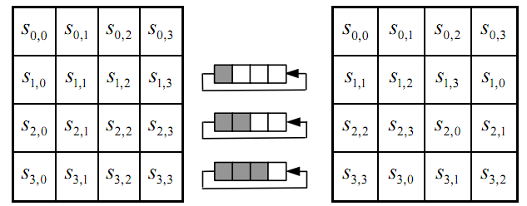
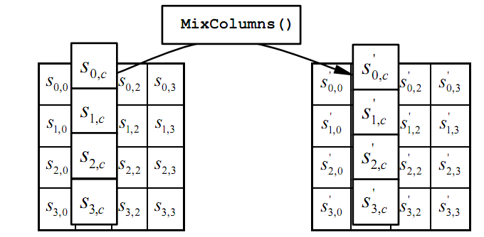
The round function
ByteSub: a 1 byte S-box. 256 byte table (easily computable)
ShiftRows:
MixColumns:
Notes:
S-box is easily computable with little code. All three steps can be combined and accelerated with pre-computed tables.

Slide 53
Code size/performance tradeoff
 | Code size | Performance
Pre-compute round functions (24KB or 4KB) | largest | fastest: table lookups and xors
Pre-compute S-box only (256 bytes) | smaller | slower
No pre-computation | smallest | slowest

Slide 54

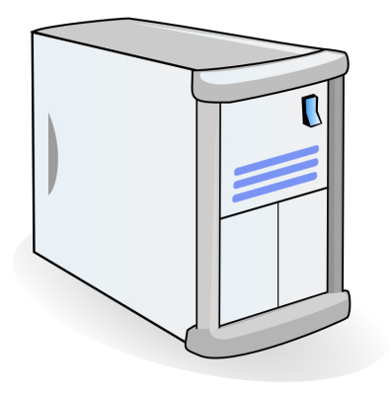
Example: Javascript AES
AES in the browser:
AES library (6.4KB)
no pre-computed tables
Prior to encryption: pre-compute tables
Then encrypt using tables
http://crypto.stanford.edu/sjcl/
Notes:
http://crypto.stanford.edu/sjcl/

Slide 55
AES in hardware
AES instructions in Intel Westmere:
aesenc, aesenclast: do one round of AES
128-bit registers: xmm1=state, xmm2=round key
aesenc xmm1, xmm2 ; puts result in xmm1
aeskeygenassist: performs AES key expansion
Claim 14 x speed-up over OpenSSL on same hardware
Similar instructions on AMD Bulldozer
Notes:
To implement AES called aesenc 9 times and then call aesenclast.

Slide 56
Attacks
Best key recovery attack: four times better than ex. search [BKR’11]
Related key attack on AES-256: [BK’09]
Given 2⁹⁹ inp/out pairs from four related keys in AES-256
can recover keys in time ≈2⁹⁹

Slide 57
End of Segment

Slide 58
Block ciphers from PRGs
Online Cryptography Course Dan Boneh
Block ciphers

Slide 59
Can we build a PRF from a PRG?
Let G: K ⟶ K² be a secure PRG
Define 1-bit PRF F: K × {0,1} ⟶ K as
F(k, x∈{0,1} ) = G(k)[x]
Thm: If G is a secure PRG then F is a secure PRF
Can we build a PRF with a larger domain?
k
G
G(k)[0]
G(k)[1]

Slide 60
Extending a PRG
Let G: K ⟶ K² .
define G₁: K ⟶ K⁴ as G₁(k) = G(G(k)[0]) ll G(G(k)[1])
k
G
We get a 2-bit PRF:
F(k, x∈{0,1}² ) = G₁(k)[x]
G(k)[0]
G(k)[1]
G
G
00
01
10
11
G₁(k)

Slide 61
G₁ is a secure PRG
k
G
G(k)[0]
G(k)[1]
r₀
r₁
G
G
G
G
≈_{p}
00
01
10
11
≈_{p}
G₁(k)
r₁
G
≈_{p}
random in K⁴
r₀₁
r₀₀

Slide 62
Extending more
Let G: K ⟶ K² .
define G₂: K ⟶ K⁸ as G₂(k) =
k
G
G(k)[0]
G(k)[1]
We get a 3-bit PRF
G
G
G
G
G
G
000
001
010
011
100
101
110
111
G₂(k)
Notes:
Show to evaluate for x=101

Slide 63
Extending even more: the GGM PRF
Let G: K ⟶ K² . define PRF F: K × {0,1}^{n} ⟶ K as
For input x = x₀ x₁ … x_{n-1} ∈ {0,1}^{n} do:
k
k₁
k₂
k₃
k_{n}
G(k)[x₀]
G(k₁)[x₁]
G(k₂)[x₂]
⋯
G(k_{n-1})[x_{n-1}]
Security: G a secure PRG ⇒ F is a secure PRF on {0,1}^{n} .
Not used in practice due to slow performance.

Slide 64
Secure block cipher from a PRG?
Can we build a secure PRP from a secure PRG?
No, it cannot be done
Yes, just plug the GGM PRF into the Luby-Rackoff theorem
It depends on the underlying PRG

Slide 65
End of Segment

