Slide 1
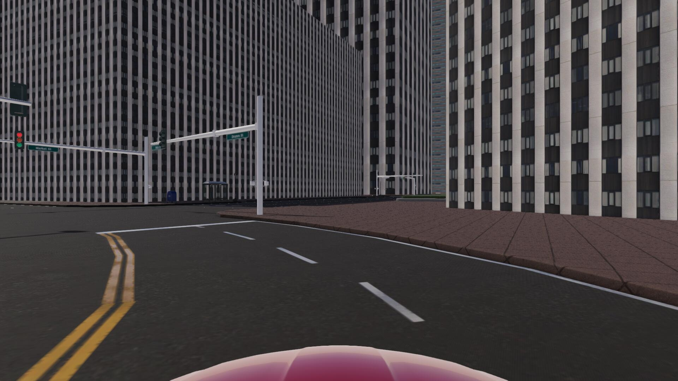
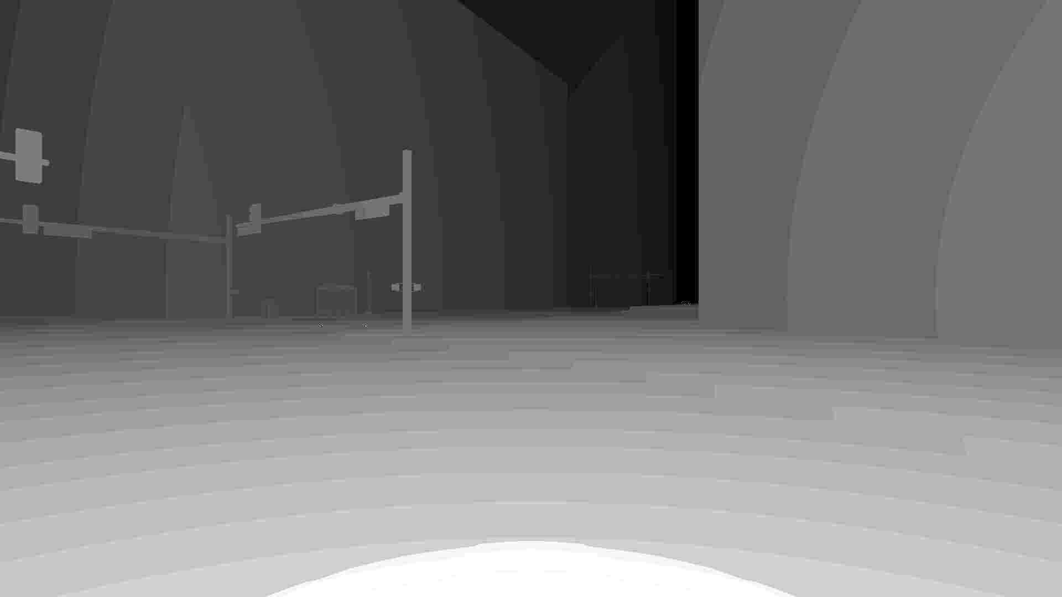
8.6
8.6
8.6
8.6
8.6
8.6
8.6
160,70, 4
160,70,16
80,70,16
80,70,32
40,35,32
40,35,64
20,17,64

Slide 2
8.6
8.6
8.6
8.6
8.6
8.6
8.6
8.6
8.6

