Slide 1
Question Answering Model of Bert
Dr Ali Mollaei

Slide 2
Topics
Dataset
Tokenizer && vocab
Data preparation
Training Arguments
Fine tuning
Deploy

Slide 3
Review last concept s
LLMs
Transformers
Batch size
Encoder
Decoder
Attention
Data loader

Slide 4
Why Bert vs MLP as a classic NN
موازی سازی فرآیند آموزش و افزایش سرعت
بهبود گرادیان کاهشی
توجه بهتر به کلمات قبل و بعد از یک توکن هدف

Slide 5
Bert tasks
Text Classification
Token Classification
Fill-Mask
Question Answering

Slide 6
Special tokens
# Display special tokens
special_tokens = {
"bos_token": tokenizer.bos_token,
"eos_token": tokenizer.eos_token,
"unk_token": tokenizer.unk_token,
"sep_token": tokenizer.sep_token,
"pad_token": tokenizer.pad_token,
"cls_token": tokenizer.cls_token,
"mask_token": tokenizer.mask_token
}

Slide 7
Special Tokens in BERT for Question Answering
[CLS] (Classification Token):
  Used at the beginning of every input sequence.
  For classification tasks, the final hidden state corresponding to this token is used as the aggregate sequence representation.
[SEP] (Separator Token):
  Used to separate different parts of the input, such as the question and the context in a QA task.
  Placed between the question and the context and at the end of the input sequence.
[PAD] (Padding Token):
  Used to pad sequences to ensure uniform length within a batch.
  Does not carry any meaningful information and is typically ignored by the model during training.
[UNK] (Unknown Token):
  Represents tokens that are not in the tokenizer's vocabulary.
[MASK] (Masking Token):
  Used in masked language modeling tasks (e.g., during pre-training of BERT).
  Not typically used in fine-tuning for QA tasks.
[BOS] (Beginning of Sequence Token):
  Represents the beginning of a sequence.
  Not used in standard BERT models but may be present in other transformer models.
[EOS] (End of Sequence Token):
  Represents the end of a sequence.
  Not used in standard BERT models but may be present in other transformer models.

Slide 8
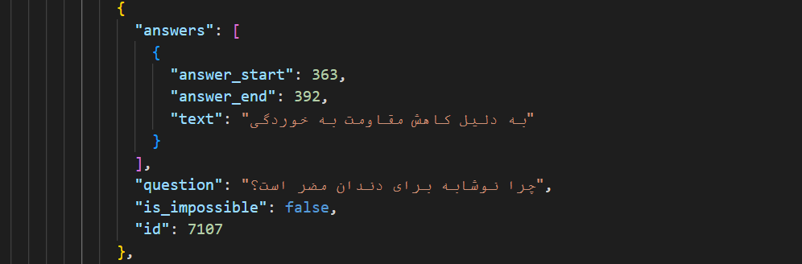
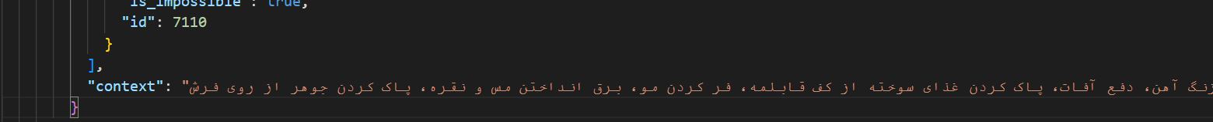
Train Dataset
برشی از داده

Slide 9
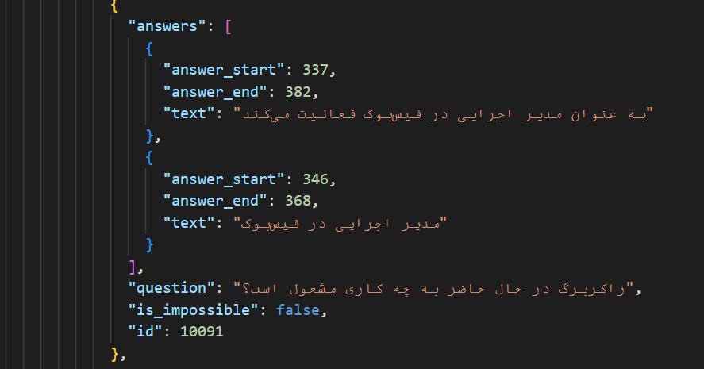
Test Dataset

Slide 10
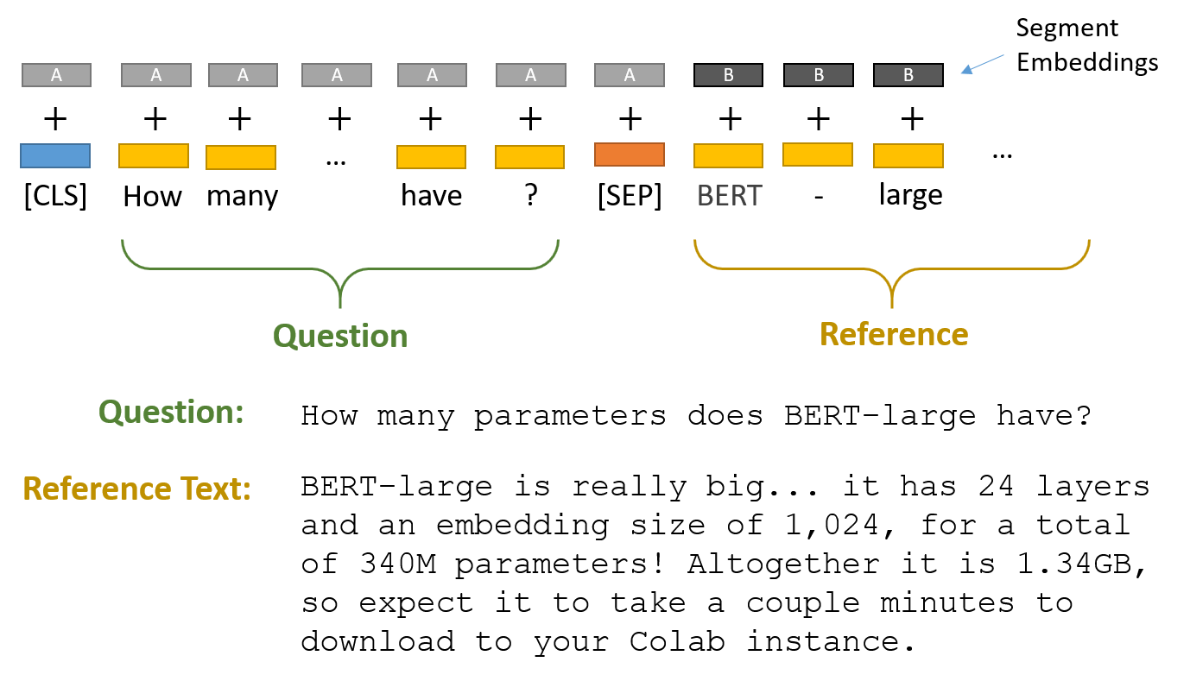
Bert input format
Segment embedding to distinguish between Question and Answer

Slide 11
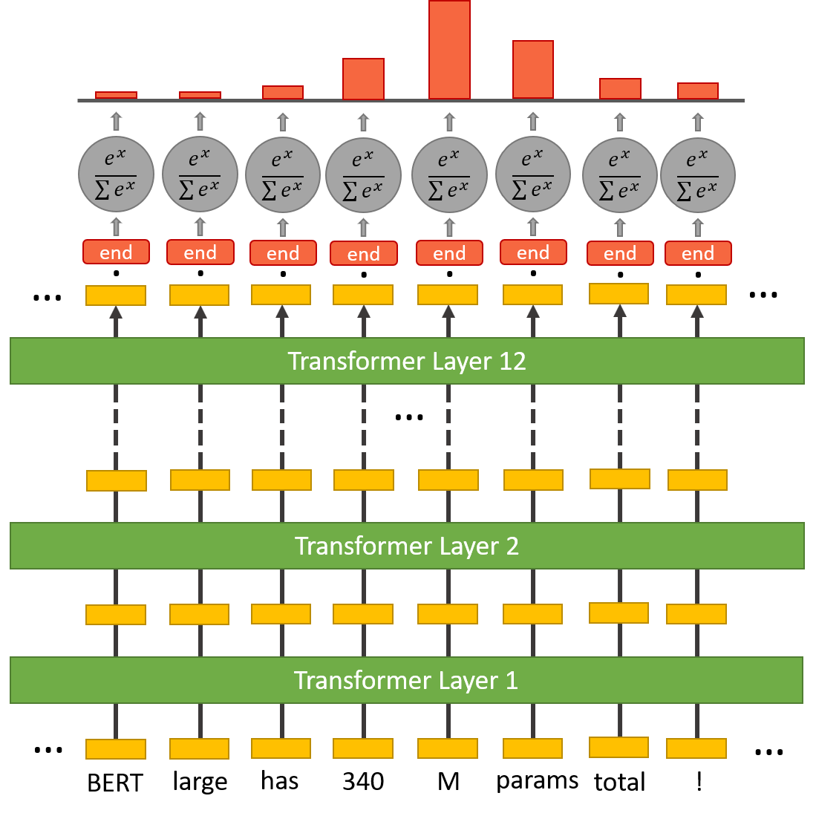
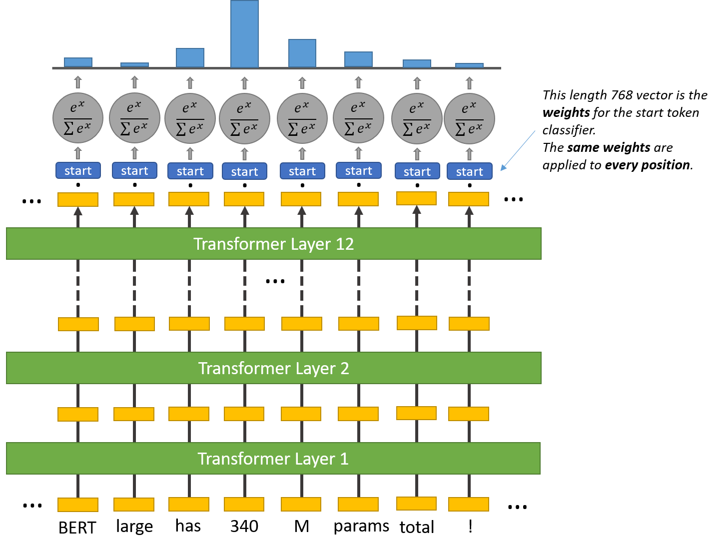
Predicting of start and end token for answer

Slide 12
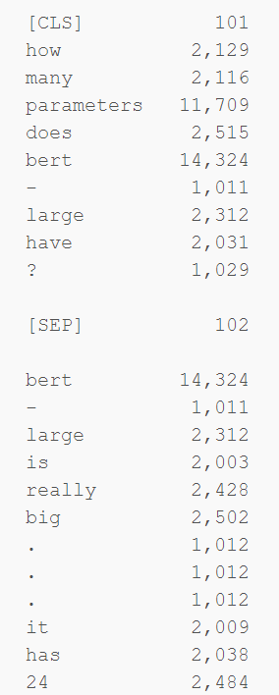
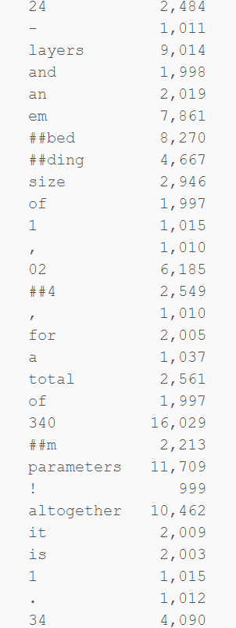
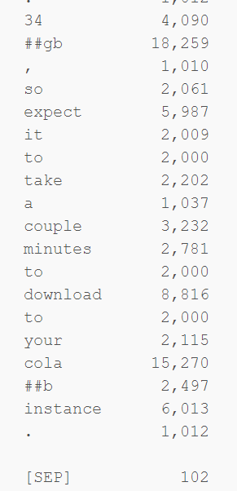
Output tokenizer

Slide 13
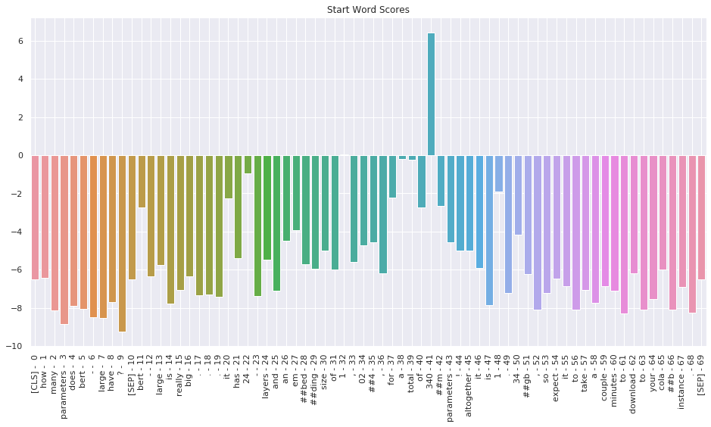
Visualizing Scores (start word scores)

Slide 14
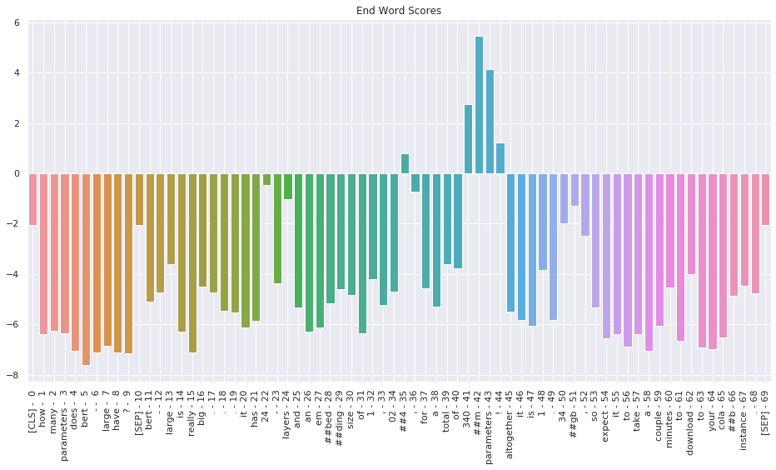
Visualizing Scores (End word Scores)

Slide 15
Input of QA bert Model tokenization
text = r"""سلام دوره علم داده با پایتون در کارخانه نوآوری مشهد برگزار میگردد با تدریس دکتر علی ملایی در روز های یکشنبه و سه شنبه در ساعت های شانزده الی بیست """
questions = [
  "مکان برگزاری دوره کجاست؟“
  , "دوره در چه روزهایی برگزار می شود؟“
  , "کارخانه نوآوری کجاست؟“
]

Slide 16
output of QA Bert Model tokenization
Question:مکان برگزاری دوره کجاست؟
Tokenized input IDs:
tensor([[ 2, 4586, 5003, 3511, 13558, 1350, 4, 4285, 3511, 5120, 3171, 2799, 22504, 2786, 6307, 8524, 6187, 4004, 4687, 2799,6692, 4283, 3366, 56258, 2786, 2991, 6343, 6368, 1379, 3140,
4815, 2786, 3551, 6343, 13457, 4527, 5687, 4]])
Tokens:
['[CLS]', 'مکان', 'برگزاری', 'دوره', 'کجاست', '؟', '[SEP]', 'سلام', 'دوره', 'علم', 'داده', 'با', 'پایتون', 'در', 'کارخانه', 'نواوری', 'مشهد', 'برگزار', 'میگردد', 'با', 'تدریس', 'دکتر', 'علی', 'ملایی', 'در', 'روز', 'های', 'یکشنبه', 'و', 'سه', 'شنبه', 'در', 'ساعت', 'های', 'شانزده', 'الی', 'بیست', '[SEP]']

Slide 17
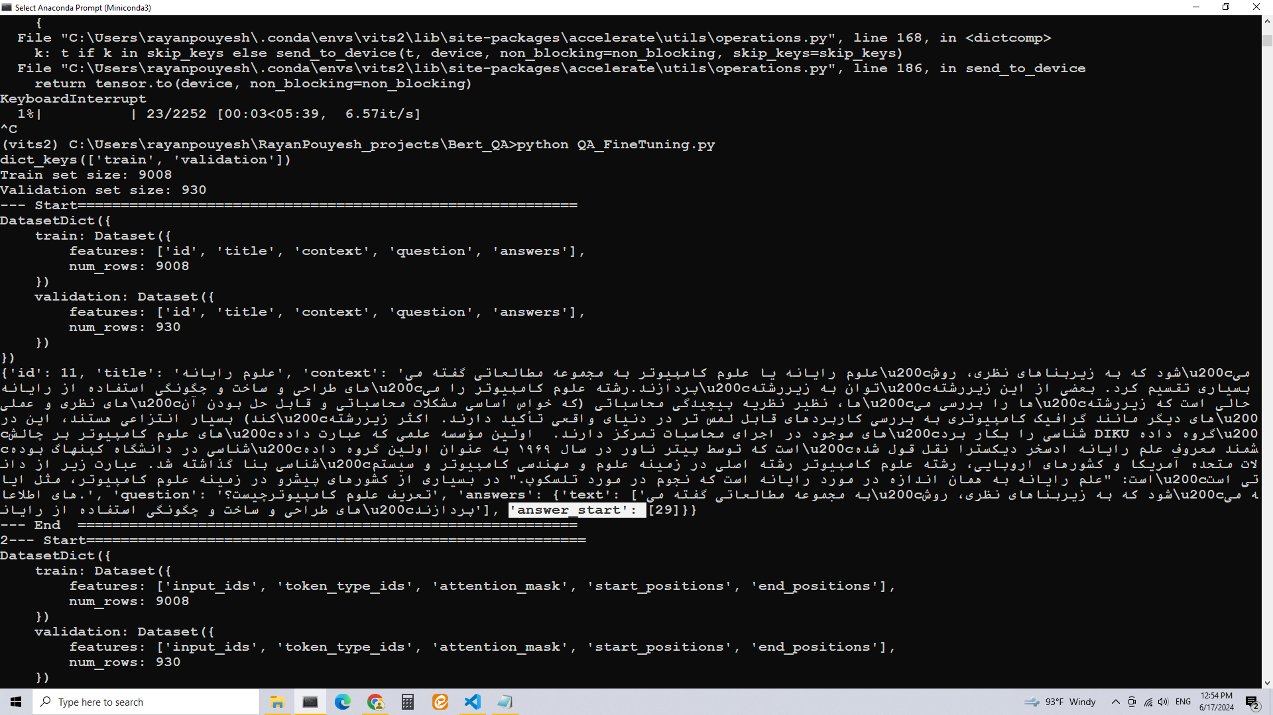
Data before Preparation for QA Bert Model

Slide 18
Tokenizer keys
'input_ids’:
  The tokenized input sequences converted to numerical ids for the model to process.
'token_type_ids’:
  Identifies which part of the input sequence corresponds to the question and which part to the context.
'attention_mask’:
  Denotes which tokens should be attended to by the model during processing.
'offset_mapping’:
  Provides the mapping of tokens to their corresponding character offsets in the original text.
'overflow_to_sample_mapping’:
- Maps overflowed tokenized examples back to the original examples they originated from.

Slide 19
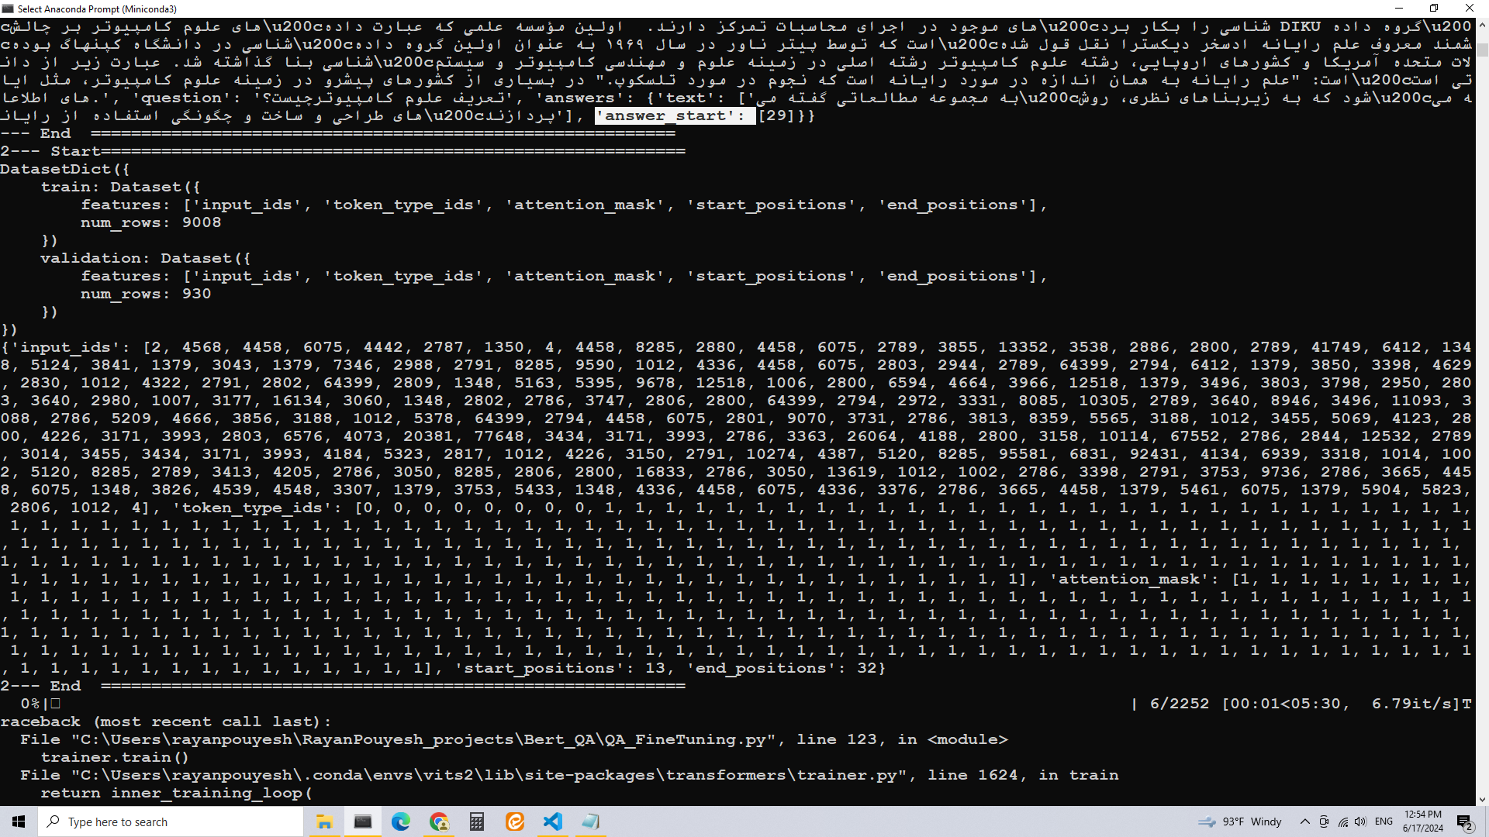
Data after Preparation for QA Bert Model

Slide 20
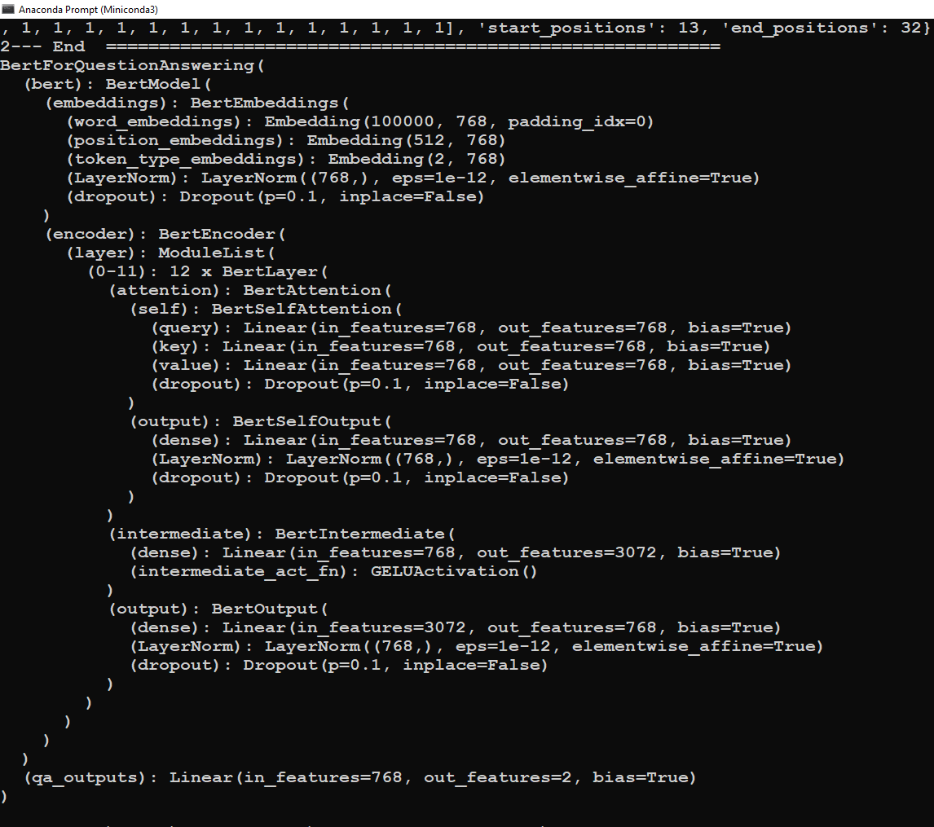
Model Summery
162,252,290 Bert parameters

Slide 21

Models size

Slide 22
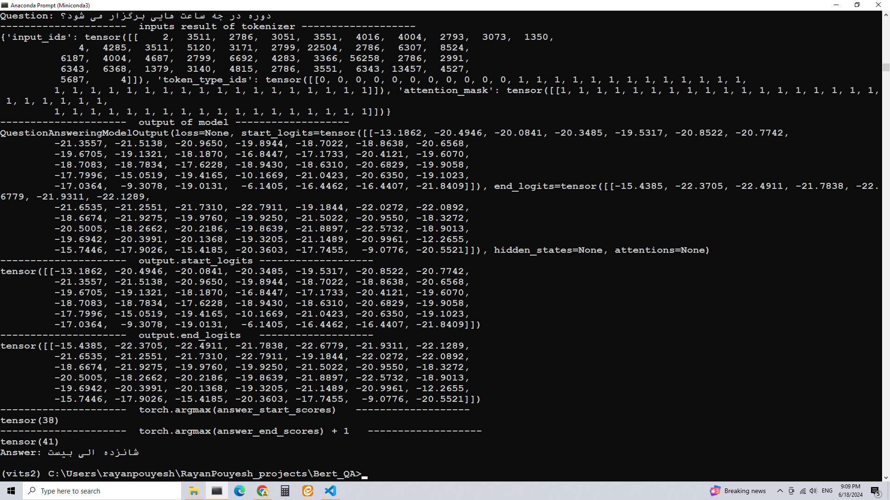
Output of QA Bert Model

Slide 23
Bert QA vs GPT QA
Bert finds answers from reference text
  But GPT try to generate Preferred answers
Bert have been trained with dataset include the question, answer and context text
  But GPT have been trained on continouse words.
ERT uses a bidirectional approach
  GPT uses a unidirectional approach

Slide 24
Distillation
Knowledge distillation is a technique that enables knowledge transfer from large, computationally expensive models to smaller ones without losing validity. This allows for deployment on less powerful hardware, making evaluation faster and more efficient.

Slide 25
Training Arguments
Number of parameters in TrainingArguments class: 129
evaluation_strategy = "epoch",
logging_strategy="steps",
learning_rate=lr,
per_device_train_batch_size=batch_size,
per_device_eval_batch_size=batch_size,
num_train_epochs=epoch,
weight_decay=0.0001,
save_total_limit=2
load_best_model_at_end

Slide 26
Trainer parameters
1. model - The model to be trained.
2. args - Training arguments containing settings such as batch size, learning rate, and number of epochs.
3. data_collator - Data collator used for batching and creating batches of input data.
4. train_dataset - Dataset containing the training data.
5. eval_dataset - Dataset containing the evaluation data.
6. tokenizer - Tokenizer used for tokenizing input data.
7. compute_metrics - Function used for calculating evaluation metrics.
8. callbacks - List of callbacks to be called during training.
9. model_init - Callback function used to perform model initialization.
10. optimizers - Optimizers used for updating model parameters during training.
11. scheduler - Learning rate scheduler used for adjusting learning rates during training.
12. device - Device used for training (e.g. "cuda" for GPU training).
13. data_collator - The function to use to create the data collator that will be used for training. If None, data collator will be generated using default settings.

Slide 27
which parameters of Transformers TrainingArguments class is for enabling create check point of model?
`save_strategy`: This parameter specifies the strategy used to save checkpoints during training.
The possible values for save_strategy are
`no`, `steps`, `epoch`, `steps+percentage`, `epoch+percentage`, or a custom implementation of `torch.optim.lr_scheduler.LambdaLR`.
By default, the save_strategy is set to `steps`.
save_total_limit = 2 # Save the last 2 checkpoints)

Slide 28
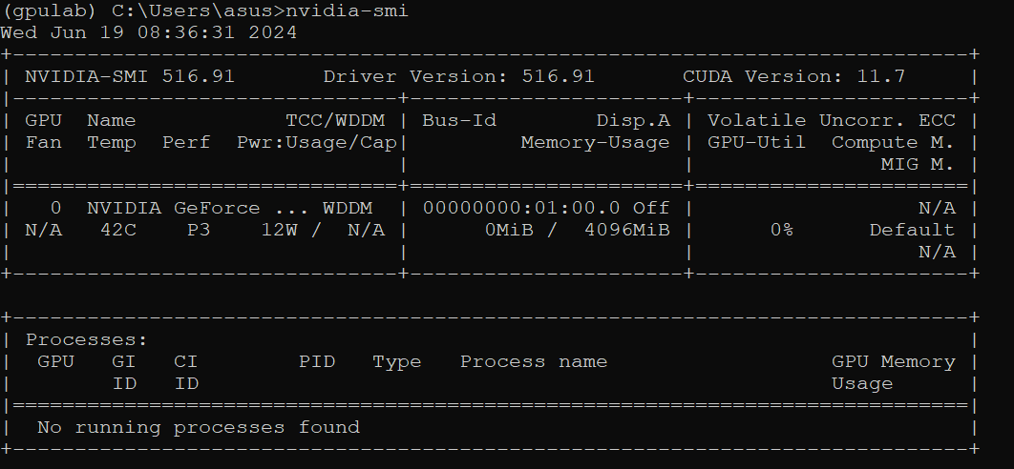
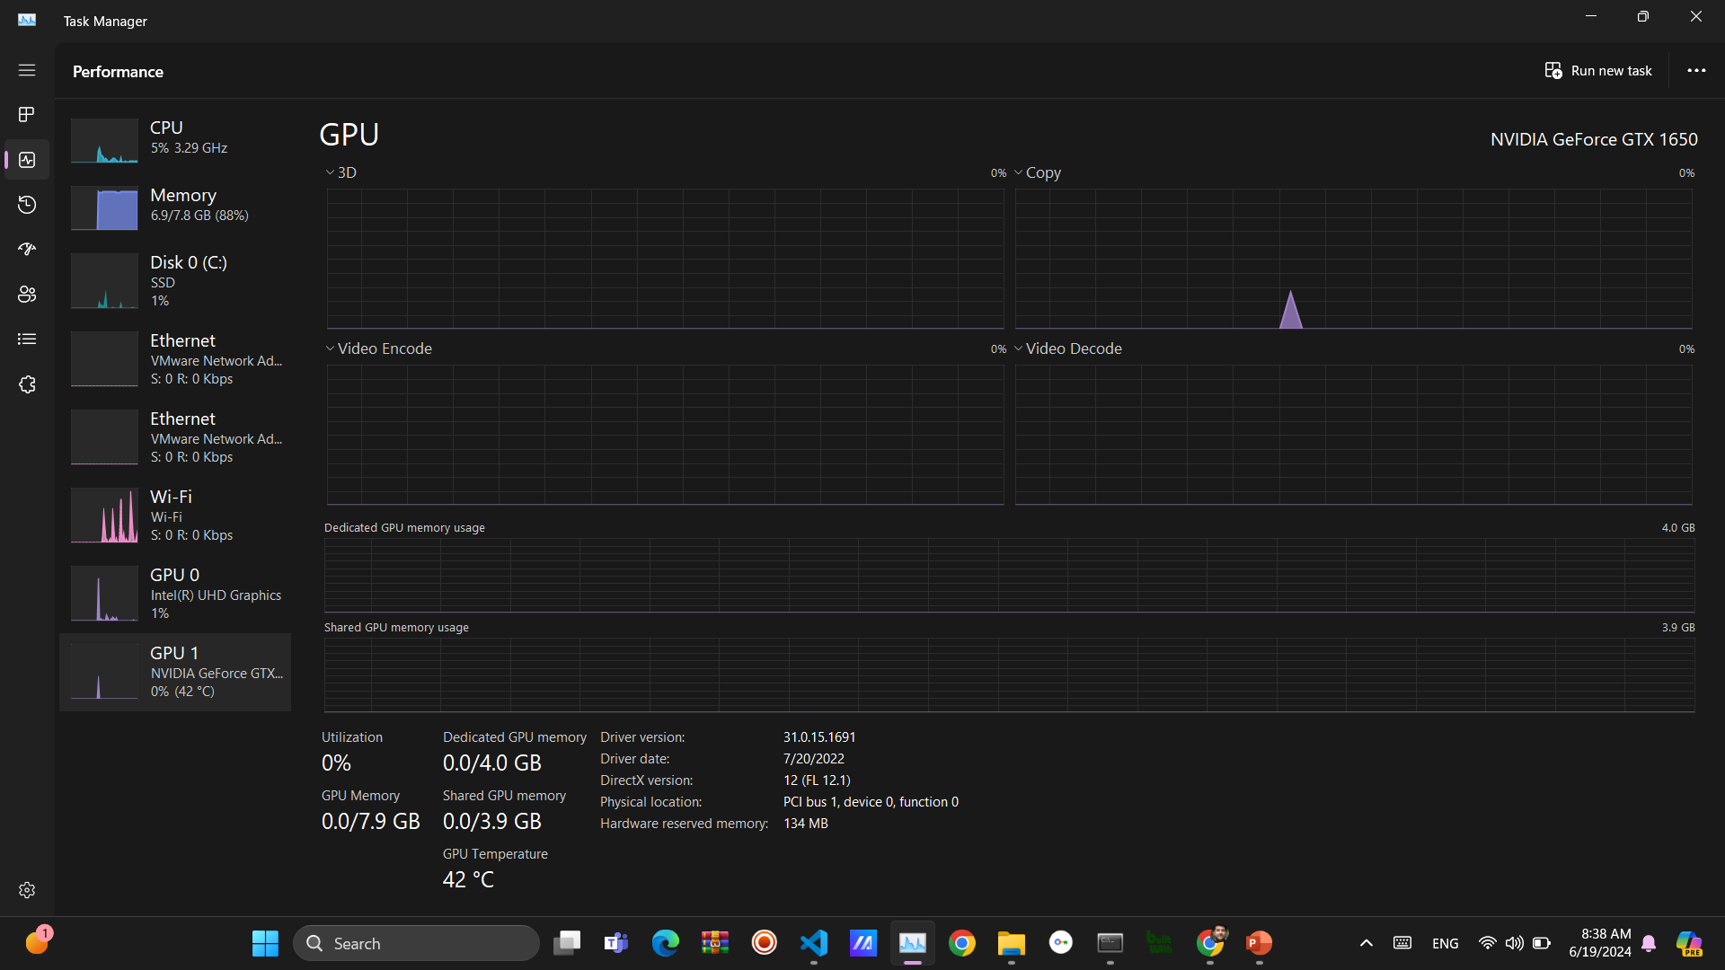
Nvidia-smi and task manager for GPU monitoring (RAM, Temperature, …)

Slide 29
GPU installation
نصب آناکاندا با دسترسی ادمین
ایجاد یک محیط مجازی با پایتون 3.8 یا بالاتر
فعال سازی محیط مجازی
دانلود CUDA v11
دانلود Microsoft Visual Studio version for C++
نصب کننده CUDA v11 را اجرا کنید.
از مسیر زیر cuDNN را دانلود کنید
تعریف متغیرهای ویندوزی با توجه به مراحل زیر :

Slide 30
Useful command
NVIDIA-smi
Conda info –envs
Conda activate
Conda clone

Slide 31
Common Scenarios Leading to "CUDA Out of Memory" Error
Large Batch Size:
  The batch size is too large, consuming too much GPU memory.
  Solution: Reduce the batch size. For example, if you are using a batch size of 32, try reducing it to 16 or 8.
Large Model:
  The model is too large to fit into the GPU memory, especially for deep networks with many layers.
  Solution: Use a smaller model or apply model pruning techniques to reduce the model size.
High-Resolution Input Data:
  The input data (e.g., images, sequences) is of very high resolution.
  Solution: Resize or crop the input data to a smaller resolution that still retains necessary information.
Memory Leaks:
  Inefficient code that retains unnecessary references to large tensors.
  Solution: Ensure that you delete unnecessary tensors and use torch.cuda.empty_cache() to free up unused memory.
Accumulating Gradients:
  When performing operations like gradient accumulation, which hold gradients in memory over multiple batches.
  Solution: Clear gradients more frequently using optimizer.zero_grad().
Simultaneous Processes:
  Multiple processes or applications using the GPU simultaneously.
  Solution: Close other applications or processes that are using the GPU.

Slide 32
How can add new model to transformers library
https://huggingface.co/docs/transformers/en/add_new_model

Slide 33
exercises
Fine tuning Bert model by new dataset.
Writing a compute metrics function
How work data preparation function
Change batch size

