Slide 1
Transformers
Ali Mollaei

Slide 2
Transformers
🤗 Transformers provides APIs and tools to easily download and train state-of-the-art pretrained models. Using pretrained models can reduce your compute costs, carbon footprint, and save you the time and resources required to train a model from scratch. These models support common tasks in different modalities, such as:
📝 Natural Language Processing: text classification, named entity recognition, question answering, language modeling, summarization, translation, multiple choice, and text generation.
🖼️ Computer Vision: image classification, object detection, and segmentation.
🗣️ Audio: automatic speech recognition and audio classification.
🐙 Multimodal: table question answering, optical character recognition, information extraction from scanned documents, video classification, and visual question answering.

Slide 3
Transformers
NLP Natural language processing
  tokenization
  text pre-processing
  language modeling
Encoder and Decoder
Attention mechanism (self, multi heat, cross)
Transformers architecture
Fine tuning

Slide 4
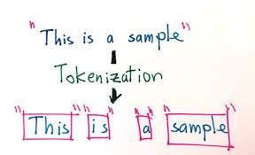
tokenization

Slide 5
Tokenizer
various types
1. Word Tokenizer: This type of tokenizer breaks text into individual words or tokens. It usually separates words based on spaces or punctuation marks.
2. Byte Pair Encoding Tokenizer (BPE Tokenizer): BPE tokenizer is a subword tokenizer that breaks down words into subword units. It merges the most frequent character sequences iteratively to form subwords.
3. Sentence Tokenizer: This type of tokenizer breaks text into sentences. It uses language-specific rules and heuristics to identify sentence boundaries.
4. Character Tokenizer: Character tokenizer treats each character as a separate token. It is useful in scenarios where character-level analysis is required.
5. WordPiece Tokenizer: Similar to BPE tokenizer, the WordPiece tokenizer also breaks words into subword units. It utilizes a fixed-size vocabulary and maximizes the likelihood of the overall corpus.
6. Tokenizer with Part-of-Speech Tags: Some tokenizers provide additional information, such as part-of-speech tags, alongside the tokens.
7. Custom Tokenizers: Transformers allow users to create and use custom tokenizers specific to their requirements. These can handle domain-specific tokenization or combine different tokenization approaches.

Slide 6
Common Text Preprocessing Techniques
Tokenization: Splitting the text into smaller units of meaning, typically words or sentences. This makes it easier for the computer to process the data.
Normalization:
  Lowercasing: Converting all text to lowercase to avoid treating "Hello" and "hello" as different entities.
  Punctuation Removal: Removing punctuation marks like commas, periods, and exclamation points as they often don't carry significant meaning for NLP tasks.
  Stop Word Removal: Removing common words that don't contribute much to the meaning of a sentence (e.g., "the," "a," "an").
Text Cleaning:
  Special Character Removal: Removing special characters like @, #, &, etc., unless they hold specific meaning in the context of your task.
  Spelling Correction: Fixing typos or grammatical errors if necessary for your task. (This can be a complex step.)
  Normalization of Numbers: Deciding how to handle numbers (e.g., converting them to text or keeping them as numerals).
Advanced Techniques:
  Stemming: Reducing words to their root form (e.g., "running" -> "run"). This can be helpful for tasks like document clustering.
  Lemmatization: Reducing words to their dictionary form (e.g., "running" -> "run"). This is often preferred over stemming as it preserves more information about the word's part of speech.
  N-grams: Creating features based on sequences of words (e.g., bigrams like "natural language").

Slide 7
Transformers are language models ??
All the Transformer models mentioned above (GPT, BERT, BART, T5, etc.) have been trained as language models.
Large Language models (LLMs) features
  have been trained on large amounts of raw text in a self-supervised fashion
  the general pretrained model then goes through a process called transfer learning.
  Nowadays LLMS implemented in transformers architecture
  the limitations of recurrent neural networks (RNNs) for long sequences, such as vanishing gradients
  including parallelization and handling long sequences effectively.

Slide 8
Self-supervised learning
Self-supervised learning is a type of training in which the objective is automatically computed from the inputs of the model. That means that humans are not needed to label the data!

Slide 9
Introducing transformers
ترانسفورماتورها مدل‌های دنباله‌ای هستند که ساختار متوالی RNN و LSTM را کنار می‌گذارند و یک رویکرد کاملاً مبتنی بر توجه را اتخاذ می‌کنند. ترانسفورماتورها در ابتدا برای پردازش متن توسعه داده شدند و تقریباً برای تمام شبکه‌های عصبی پیشرفته NLP امروزی مرکزی هستند، اما می‌توانند با تصویر، ویدئو، صدا یا تقریباً هر داده متوالی دیگری نیز استفاده شوند.
احتمالاً نام مدل های زبان بزرگ LLMمانند ChatGPT یا LLaMA را شنیده اید. معماری ترانسفورماتور یک بلوک ساختمانی اساسی از LLM ها است که از یادگیری خود نظارتی بر روی مقادیر وسیعی از داده های بدون برچسب استفاده می کنند. این مدل‌ها گاهی اوقات به‌عنوان «مدل‌های پایه» نیز شناخته می‌شوند، زیرا تمایل دارند به‌خوبی به طیف وسیعی از وظایف تعمیم دهند، و در برخی موارد برای تنظیم دقیق‌تر نیز در دسترس هستند.
BERT نمونه ای از این دسته از مدل ها است.

Slide 10
the core architecture of the Transformer model
encoder-decoder structure
self-attention mechanism
positional encoding

Slide 11
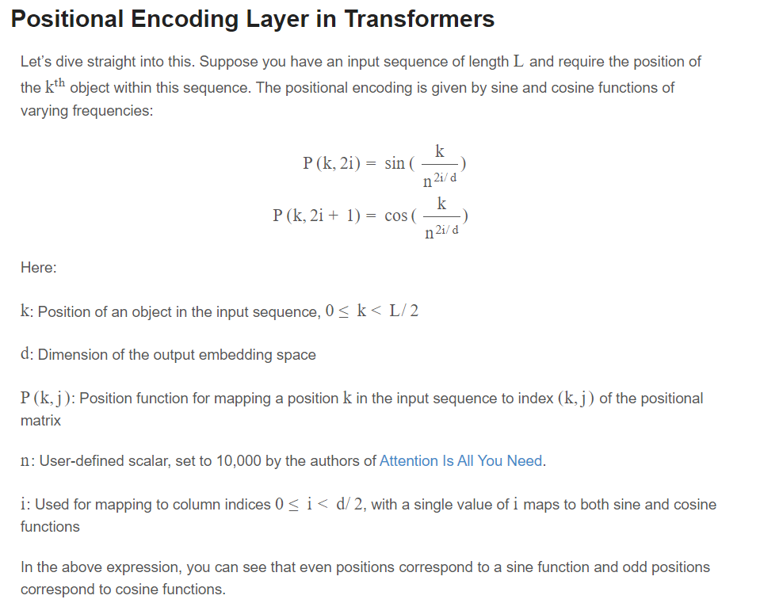
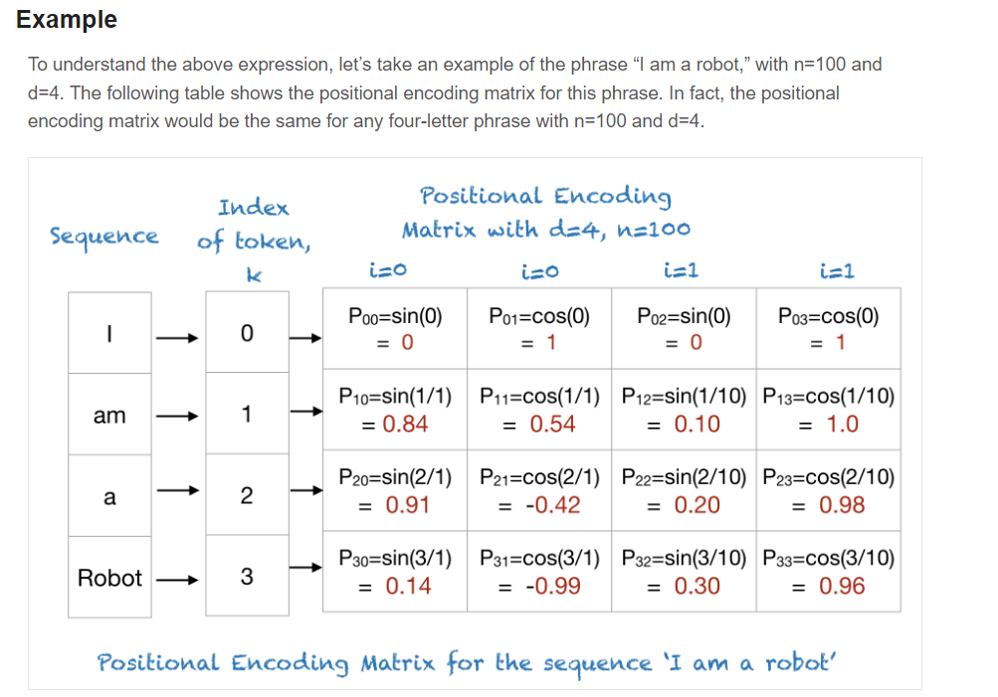
Positional encoding

Slide 12
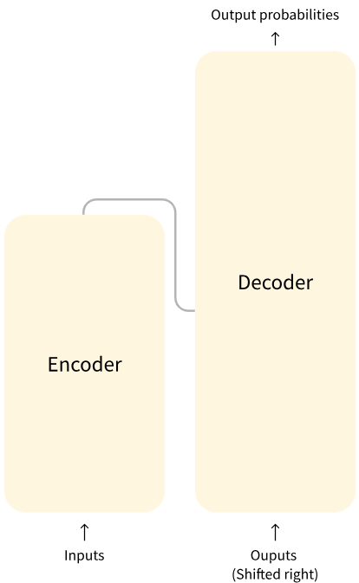
the general architecture of the Transformer model.
Encoder (left): The encoder receives an input and builds a representation of it (its features). This means that the model is optimized to acquire understanding from the input.
Each of these parts can be used independently, depending on the task:
Encoder-only models: Good for tasks that require understanding of the input, such as sentence classification and named entity recognition.
Decoder-only models: Good for generative tasks such as text generation.
Encoder-decoder models or sequence-to-sequence models: Good for generative tasks that require an input, such as translation or summarization.
We will dive into those architectures independently in later sections.
Decoder (right): The decoder uses the encoder’s representation (features) along with other inputs to generate a target sequence. This means that the model is optimized for generating outputs.

Slide 13
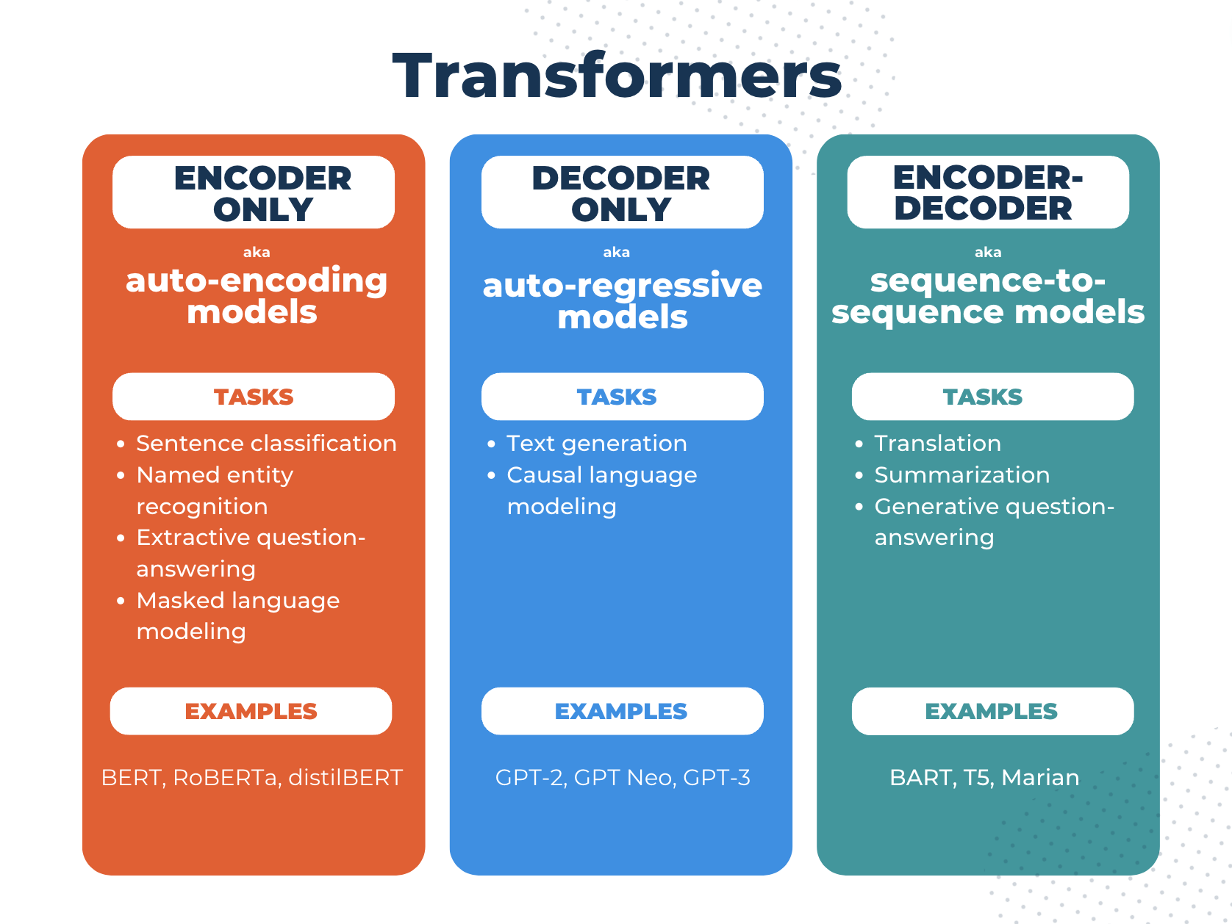
ترانسفورماتورها از رمزگذارها و رمزگشاها تشکیل شده‌اند و کارهایی که می‌توانیم با آن‌ها انجام دهیم به این بستگی دارد که از یکی یا هر دوی این اجزا استفاده کنیم

Slide 14
Encoder models
Encoder models are best suited for tasks requiring an understanding of the full sentence,
such as sentence classification, named entity recognition (and more generally word classification), and extractive question answering.
ALBERT
BERT
DistilBERT
ELECTRA
RoBERTa

Slide 15
Decoder models
These models are best suited for tasks involving text generation.
CTRL
GPT
GPT-2
Transformer XL

Slide 16
Sequence-to-sequence models sequence-to-sequence-models
Sequence-to-sequence models are best suited for tasks revolving around generating new sentences depending on a given input, such as summarization, translation, or generative question answering.
BART
mBART
Marian
T5

Slide 17
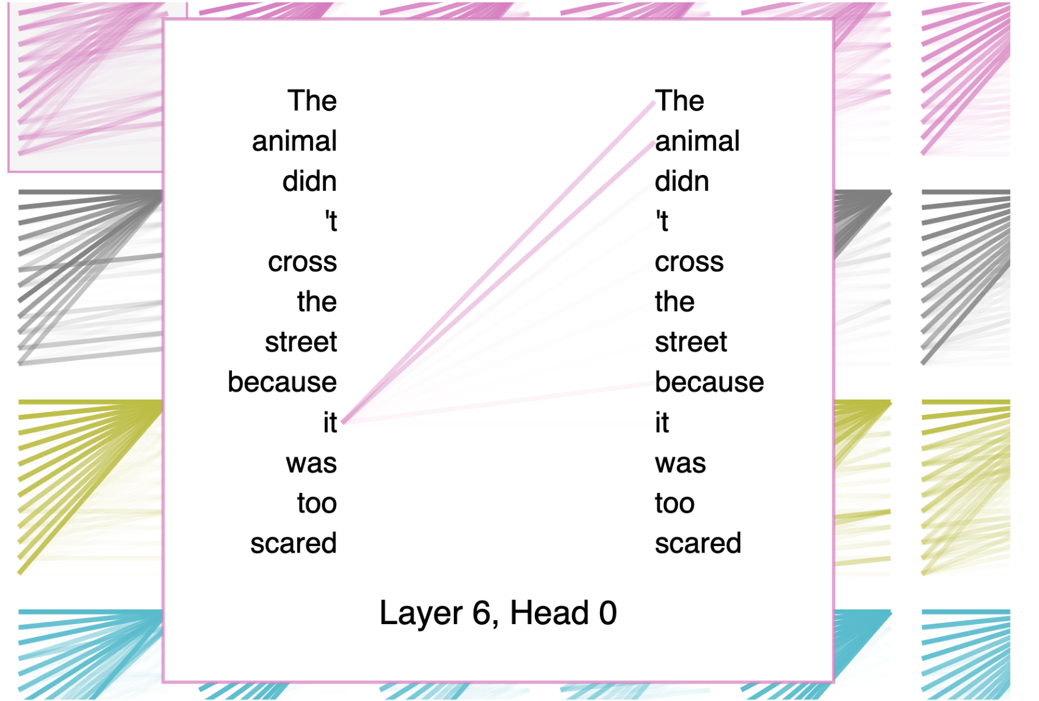
attention
Self-attention refers to the fact that every node produces a key, query, and a value from that individual node.
Multi-headed attention is just self-attention that is applied multiple times in parallel with different initialized weights.
Cross-attention means that the queries are still produced from a given decoder node, but the keys and the values are produced as a function of the nodes in the encoder.
به طور کلی، توجه توانایی یک مدل را برای توجه به بخش های مهم جمله (یا تصویر یا هر ورودی متوالی دیگری) توصیف می کند. این کار را با اختصاص وزن به ویژگی های ورودی بر اساس اهمیت و موقعیت آنها در دنباله انجام می دهد.

Slide 18
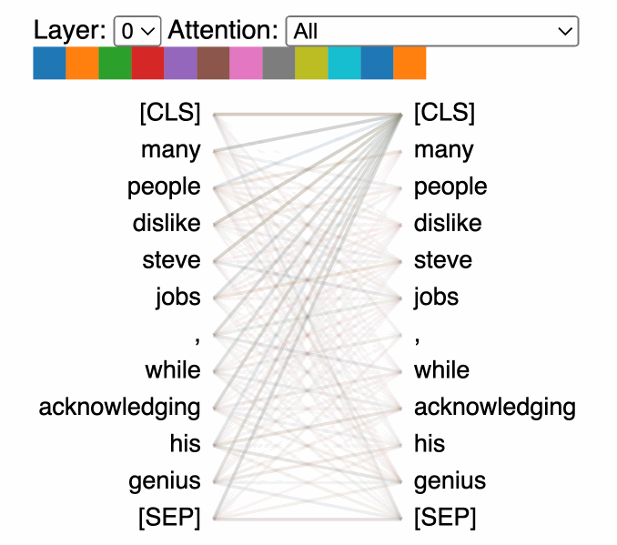
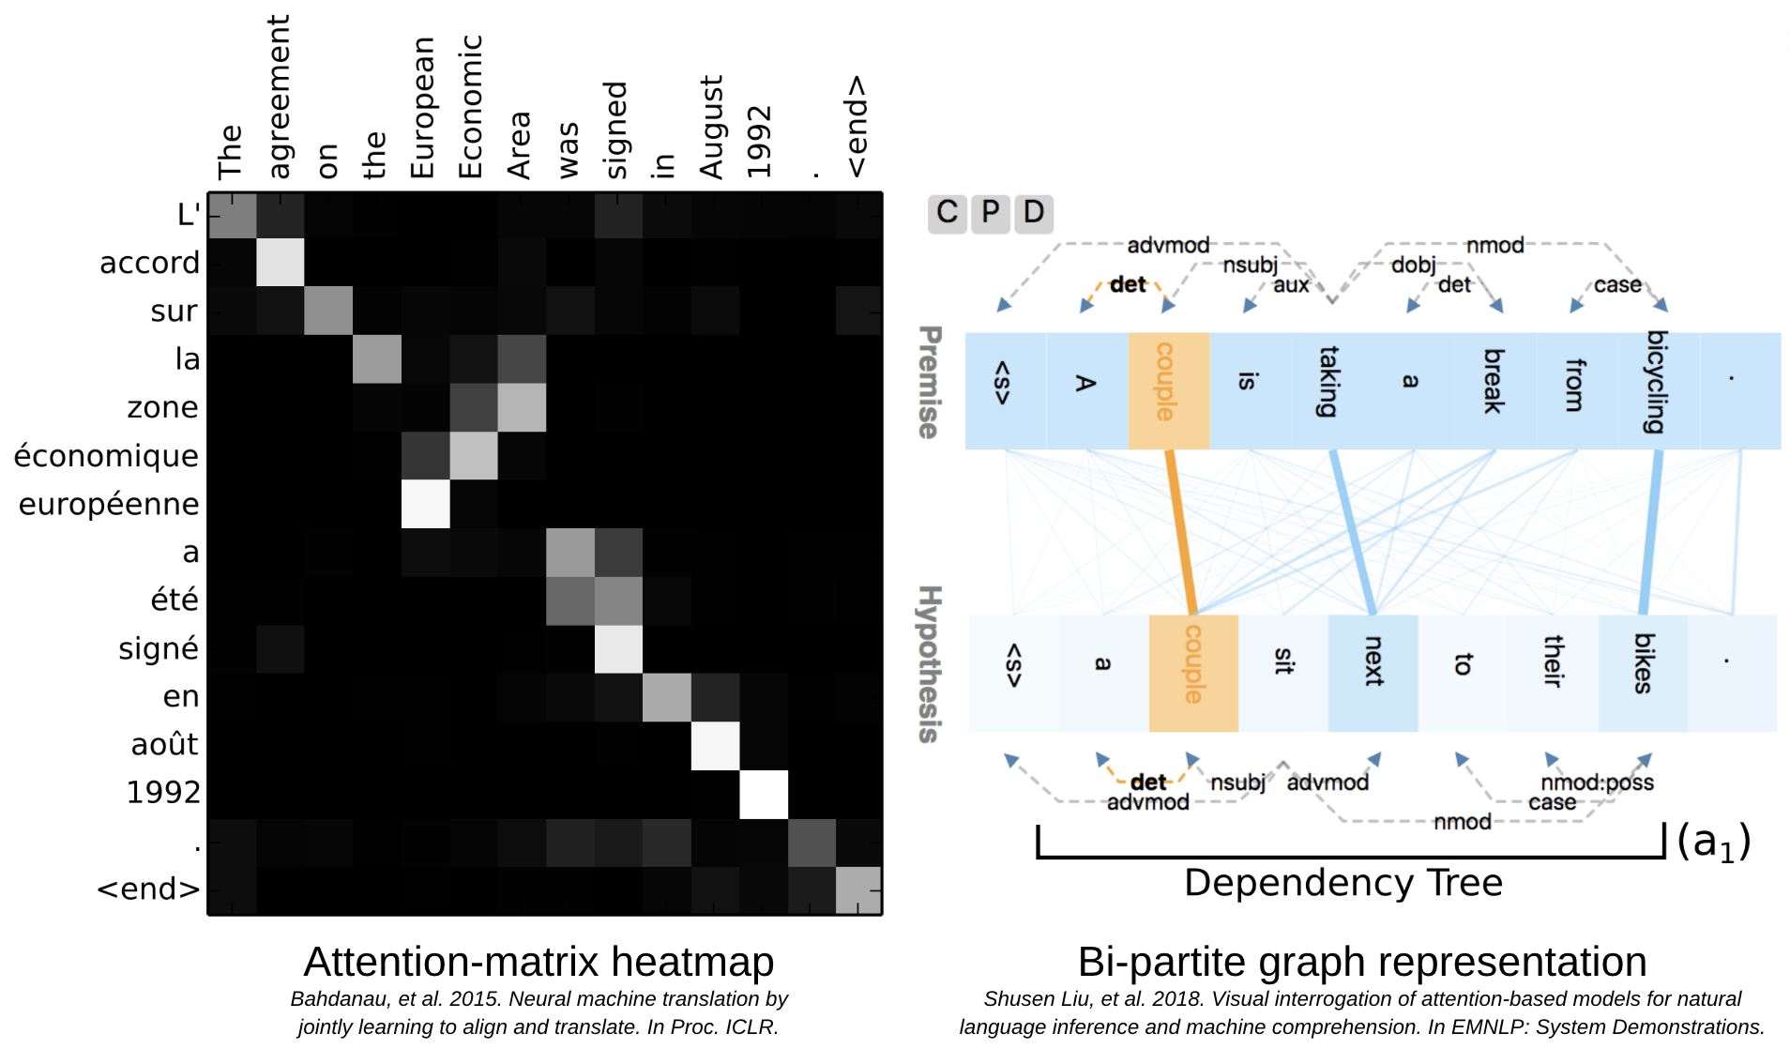

Slide 19
Self attention
در ترانسفورماتورها، هر گره (یا توکن) سه بردار به نام "کلید" (Key)، "پرس‌وجو" (Query) و "مقدار" (Value) تولید می‌کند
در خود-توجه، تمام بردارها از همان مجموعه کلمات (جمله ورودی) می‌آیند.
مدل به تمام کلمات در جمله توجه می‌کند، اما به برخی کلمات بیشتر از بقیه توجه می‌کند.

Slide 20
Multi head attention
مدل توجه چند سر همان خودتوجه است که چند بار به صورت موازی با وزن های مختلف بارگذاری می شود.
توجه چندسر کمک می کنند تا مدل روابط مختلف بین کلمات را در سطوح مختلف معنایی مانند روابط نحوی بین کلمات و روابط معنایی بین کلمات و روابط زمانی بین کلمات و ... را یاد بگیرد.
در توجه چند-سر، به جای محاسبه یک بردار زمینه واحد برای هر کلمه، H بردار زمینه مختلف برای هر کلمه محاسبه می‌شود. هر بردار زمینه توسط یک "سر" (Head) جداگانه از توجه محاسبه می‌شود.

Slide 21
Cross attention
در این مکانیزم پرسش ها از دیکدر تولید می شوند اما کلید و مقدارها از تابعی از نودهای انکدر (رمگذار) تولید می شود.
توجه متقابل به مدل اجازه می‌دهد تا بین کلمات در جمله ورودی و کلمات در جمله خروجی ارتباط برقرار کند.

Slide 22
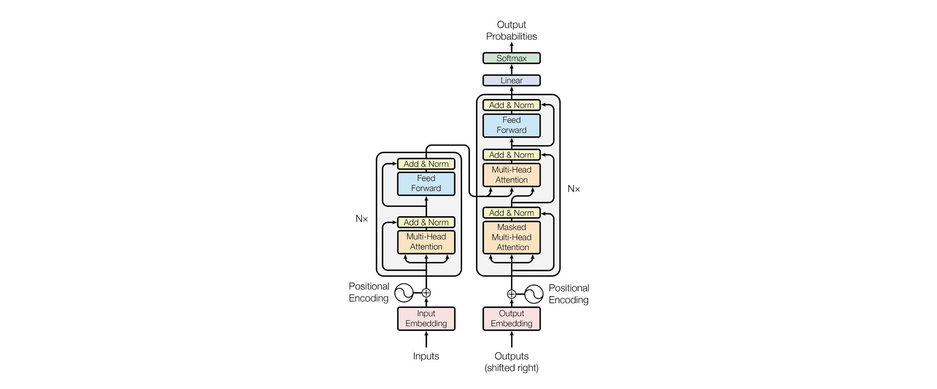
The original architecture
معماری اصلی ترانسفور، همانطور که در مقاله 2017 که آنها را به شهرت رساند، به تصویر کشیده شده است،
Attention
Is All You Need.
کمک می کند مدل در تولید محتوی آینده فقط به داده فعلی و گذشته توجه کند و از داده های آینده تقلب نکند.
این منجر به قابلیت‌های تولید متن واقعی‌تر و قوی‌تر می‌شود.
موقعیت توکن و ترتیب آنها را درنظر می گیرد.

Slide 23
Pre-trained Transformers
PTLMs (pre-trained language models) like BERT, GPT-2, and T5.
Emphasize the power of transfer learning from these models for various NLP tasks.

Slide 24

hugging face

Slide 25
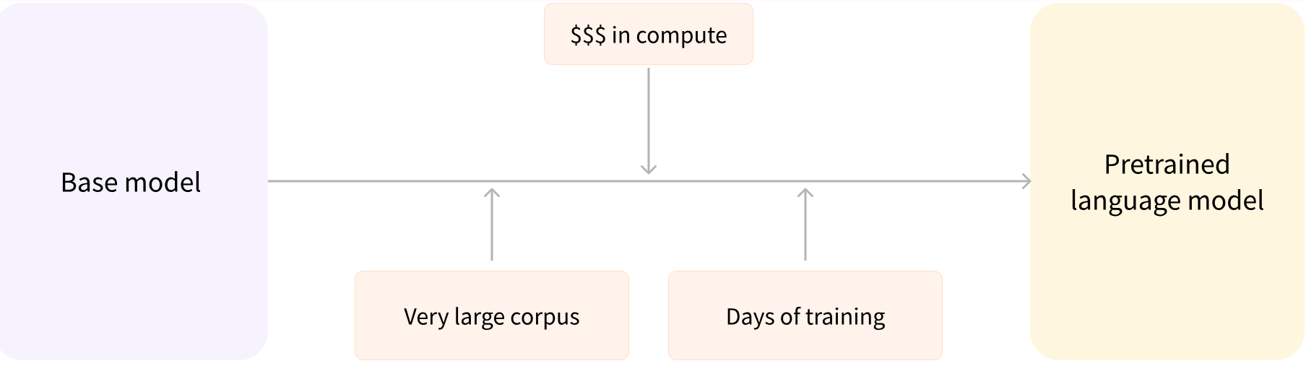
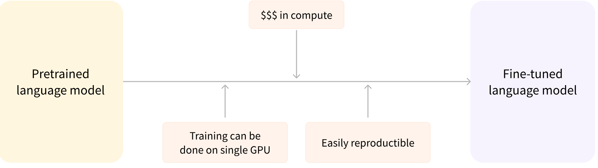
Pretrained vs fine tuned model

Slide 26
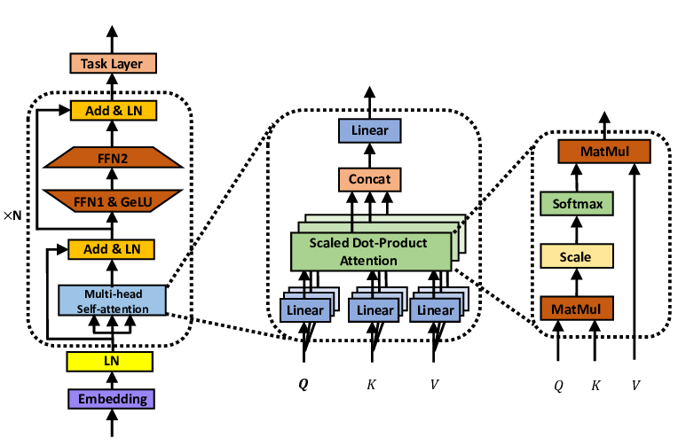
Bert
Left: the overall BERT architecture; middle: the architecture of multi-head self-attention module; right: the architecture of scaled dot-product attention layer.

Slide 27
RoBERTa
The RoBERTa model was proposed in RoBERTa: A Robustly Optimized BERT Pretraining Approach by Yinhan Liu, Myle Ott, Naman Goyal, Jingfei Du, Mandar Joshi, Danqi Chen, Omer Levy, Mike Lewis, Luke Zettlemoyer, Veselin Stoyanov. It is based on Google’s BERT model released in 2018

Slide 28
architecture
RoBERTa has the same architecture as BERT, but uses a byte-level BPE as a tokenizer (same as GPT-2) and uses a different pretraining scheme.

