Slide 1
INTRODUCTION
From Triton to GPU instructions
Today: understand the compilation pipeline
Triton Python
TTIR
TTGIR
LLIR
Device binary
→
→
→
→
Kernel source
What to compute
Threads & data
Lower-level ops
Executable
Two kernels · three configuration parameters · correctness first
TRITON OPTIMIZATION PASS LAB • ILUVATAR BI-V150
01
Notes:
Hi everyone! Today we will explore how Triton kernels are compiled for the Iluvatar BI-V150. We will follow the compiler output at a few stages and compare different configurations. You do not need to understand every low-level instruction. Please follow the README for all commands.

Slide 2
OVERVIEW
Two kernels, two patterns
Matmul / GEMM
Softmax
C = A × B
exp(x − max(x)) / Σ exp(x − max(x))
Tiled multiplication + accumulation
Elementwise operations + reductions
TRITON OPTIMIZATION PASS LAB • ILUVATAR BI-V150
02
Notes:
We will use matrix multiplication and softmax. GEMM multiplies matrix tiles and accumulates results. Softmax uses maximum and sum reductions together with elementwise operations. They illustrate different patterns while going through the same general compiler pipeline.

Slide 3
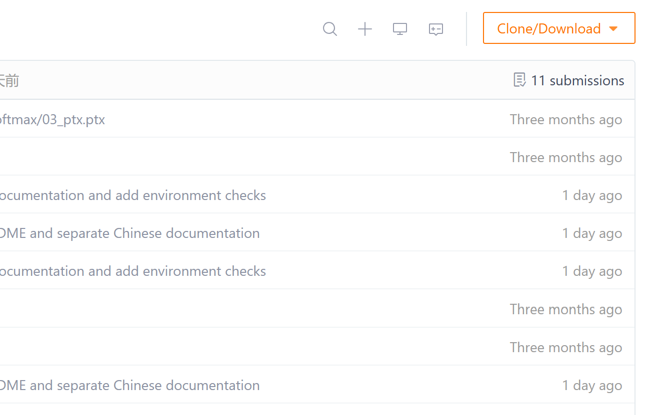
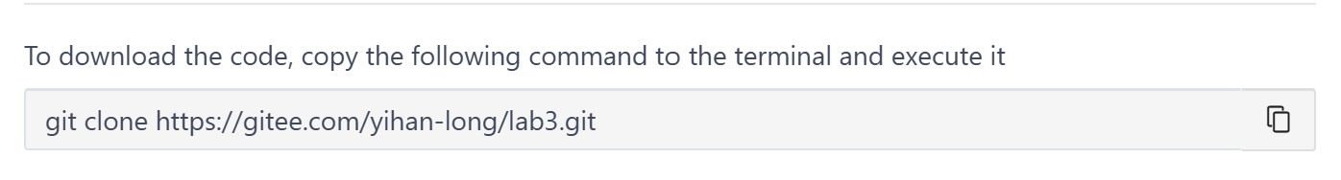
GETTING STARTED
Clone the repository
Open the Gitee repository
Copy the clone command and run it
Enter lab3 and confirm the files exist
gitee.com/yihan-long/lab3
TRITON OPTIMIZATION PASS LAB • ILUVATAR BI-V150
03
Notes:
First, open the repository link shown here. Use the Clone button to copy its URL and run git clone in a convenient working directory, such as your home directory. Then change into lab3. You should see check_env.py and run_lab.py. The README contains the exact commands.

Slide 4
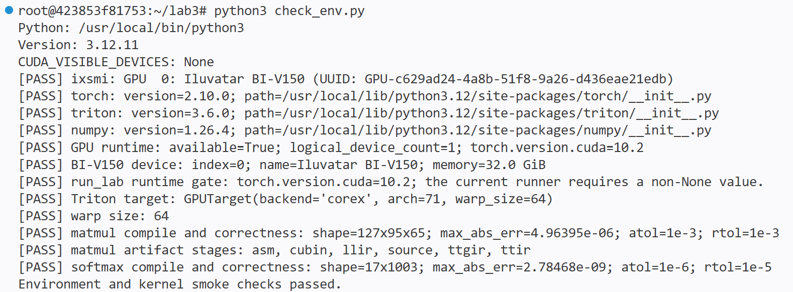
README §1
Verify the environment
Run the environment checker from lab3
Confirm GPU, backend and numerical checks pass
No new dependencies should be needed
python3 check_env.py
TRITON OPTIMIZATION PASS LAB • ILUVATAR BI-V150
04
Notes:
Now run python3 check_env.py. It verifies the active GPU backend and checks the existing kernels. A successful process should exit with code zero, and the numerical checks should pass. The platform already has the dependencies. Do not use skip-smoke as a correctness check.

Slide 5
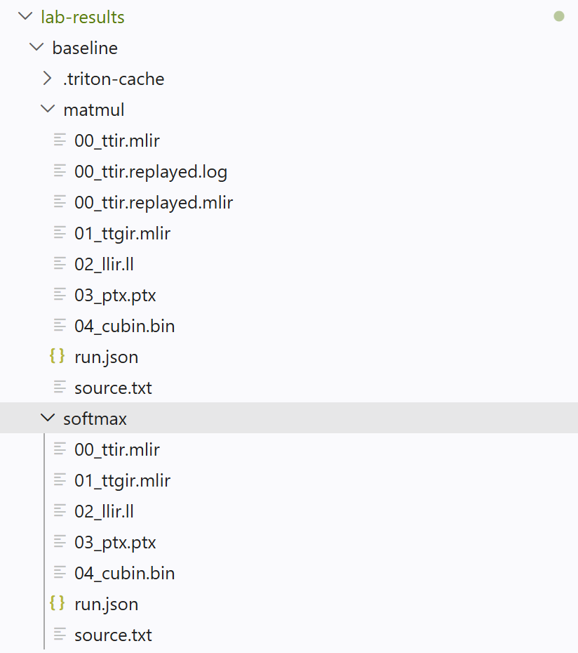
README §2
Run the baseline
Create the results directory as shown in README
Run both existing kernels
Keep the output for later comparisons
python3 run_lab.py --kernel all --device-index 0 --dump-dir "$V150_RUN_DIR/baseline" 2>&1 | tee "$V150_RUN_DIR/baseline.log"
cat "$V150_RUN_DIR/baseline/matmul/run.json"
cat "$V150_RUN_DIR/baseline/softmax/run.json"
TRITON OPTIMIZATION PASS LAB • ILUVATAR BI-V150
05
Notes:
Please follow Section 2 of the README to initialize the results directory, and use the same terminal. Run both kernels and inspect the generated matmul and softmax directories. Check run.json for the device, exported files, and numerical errors. This is our baseline for the experiments.

Slide 6
README §3
TTIR: what are we computing?
Softmax
Matmul
Load → Max → Subtract
→ Exp → Sum → Divide → Store
Program ID → Load → K loop
→ Dot → Store
Find the main operations in the newly generated TTIR; exact code can differ.
TRITON OPTIMIZATION PASS LAB • ILUVATAR BI-V150
06
Notes:
TTIR is close to the original calculation. In softmax, find the maximum and sum reductions. In matmul, identify program IDs, tile loads, the loop along K, the dot operation, and the store. Ignore detailed address calculations at first. Let students inspect their own generated TTIR rather than matching every line.

Slide 7
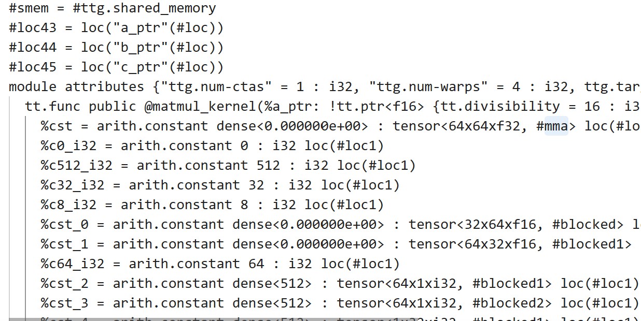
README §4
TTGIR: how is work distributed?
blocked: distribute tensor elements across threads
shared: CTA(thread block)-local temporary storage
matrix operand layouts: prepare data for dot
Example layout
1 warp = 64 threads on BI-V150
TRITON OPTIMIZATION PASS LAB • ILUVATAR BI-V150
07
Notes:
TTGIR shows the mapping from tensor elements to GPU threads and their on-chip storage. A warp contains 64 threads on this platform. Blocked layouts describe element distribution, and shared layouts describe temporary storage within a CTA. Do not worry about the exact naming or factors if the backend generates different output.

Slide 8
README §§5–7
Pipeline and low-level IR
Software pipelining
LLIR
Prepare future tiles while
computing the current tile
Low-level operations for
the active GPU backend
num_stages = buffering depth
Exact instructions may differ by target
TRITON OPTIMIZATION PASS LAB • ILUVATAR BI-V150
08
Notes:
Software pipelining tries to overlap loading future tiles with computing the current tile. Increasing num_stages may help with waiting, but uses extra resources. LLIR is a lower-level representation. Different GPUs and compiler backends use different instructions. We will only identify broad categories such as data movement, synchronization, and computation, not insist on any exact instruction name.

Slide 9
README §§8, 11
Hands-on: compare configurations
Tile size
Warp count
Pipeline depth
BLOCK_M / BLOCK_N / BLOCK_K
num_warps = 2 / 4 / 8
num_stages = 1 / 3 / 5
Tile dimensions & reuse
Thread participation & layout
Buffering & prefetch
Run the provided README commands; compare each configuration with baseline.
TRITON OPTIMIZATION PASS LAB • ILUVATAR BI-V150
09
Notes:
Now the main hands-on part. Run the commands already provided in Section 11. First, change the tile size; next, the number of warps; finally, the pipeline stages. Compare each generated result against the baseline. Larger values are not automatically faster or better. Unsupported configurations may fail: preserve the error and continue with a supported one.

Slide 10
WRAP-UP
Validate results & takeaways
Did the command run or report a useful error?
TTIR
What is computed?
Are the numerical results acceptable?
TTGIR
Who computes, where data lives?
What changed in the IR or benchmark?
LLIR
Lower-level GPU operations
Correctness and interpretation matter more than speedups.
TRITON OPTIMIZATION PASS LAB • ILUVATAR BI-V150
10
Notes:
To finish, first confirm that the kernel compiled and its numerical results are acceptable. Then explain what changed in the generated IR and, if benchmarking was enabled, compare the timings. Remember: TTIR tells us what is computed, TTGIR shows work distribution and storage, and LLIR expresses the lower-level operations. That is all for today; feel free to ask questions.

