Slide 1
MotionTracking
Asbóth Árpád
2018.12.17.

Slide 2
Basic info, used SW tools
OS: Windows
Language: C++
IDE: Visual Studio 2017
Image processing backend: OpenCV v3.4.3
Version tracking: GitHub + GitKraken

Slide 3
Architecture or calib module
Input:
Source: (webcam / video file)
Used marker for calibration: balck and white chessboard
Required information about the board
Number of black and white transitions
Diameter of squares
Skip: if you give a video file as source, you are able to specify, hogy many frame will be skipped
Path to the output calibration file (txt)
Output:
Camera matrix (3x3)
Distance coefficients(5)

Slide 4
Architecture of TrackingMotion module
Input:
Source: (webcam / video file)
Required parameters of the Marker
Number of black and white transitions
Diameter of squares
Calibration results: camera matrix and distance coefficients
Path of the output video

Slide 5
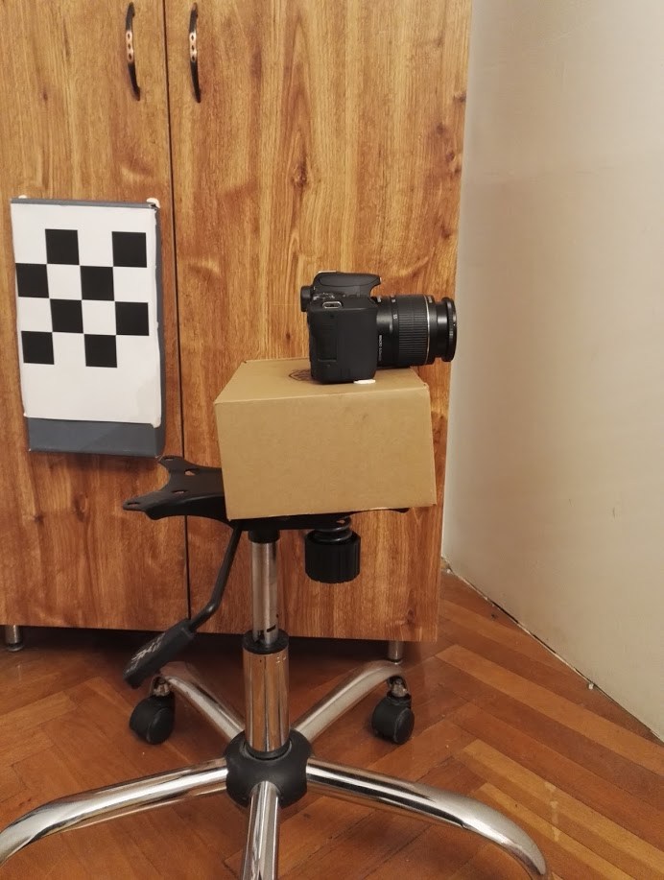
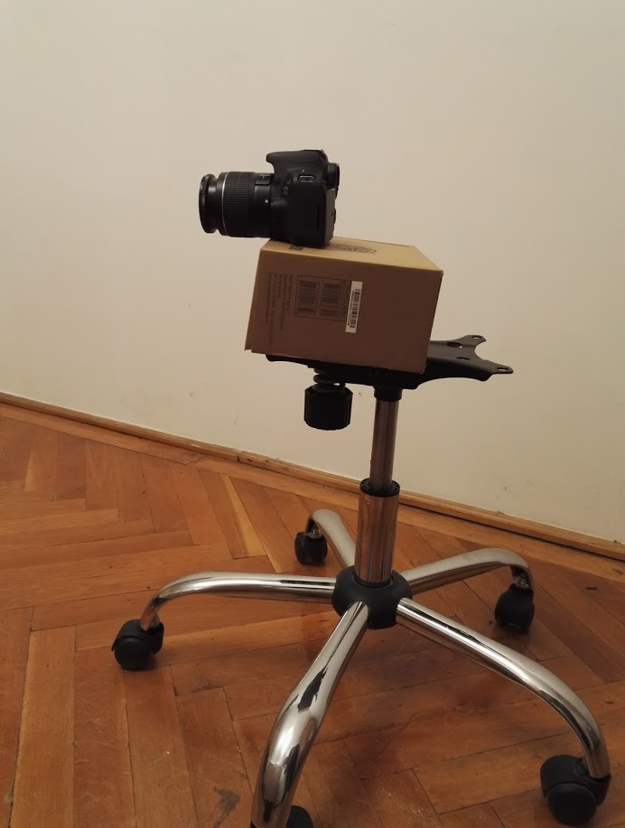
Test environment
Recording setup
webcam: Trust HD720p
DSLR cam: Canon 200D (18-55mm lens)
Vertical layout:
Tests: 83 cm
Final measurements: 60 cm

Slide 6
Test cases and links for results
HD record
Video
Output video
VGA record
Video
Output video
VGA “long-run”
Video
Output video

Slide 7
Source code, built version, usage
GitHub
Release in DropBox
Calib
Calib.exe
You can found some videos used for calibration
openCV.dll (it is required for running. Contains the necessary libraries from OpenCV)
MotionTracking
TrackingMotion.exe
3 measurements + 3 results
You can found some calibration results for different cameras/resolutions/chessboards
Sytanx of a calibration result: <kamera>_<felbontás>_<sakktábla méret>_<verzió>.txt
openCV.dll (it is required for running. Contains the necessary libraries from OpenCV)
You can run a calibration and a motion tracking with this example (in Windows from console)
calib -source=calib_VGA_4x4_3.MP4 -skip=10
TrackingMotion -source=MVI_7648_hd_3x3.MP4 -output=out_hd_3x3.mp4 -calibPath=canon_cam_calib_pars_hd_3x3.txt

Slide 8
Problems + possible solutions
I experienced that the orientation information given by the built-in function is inaccurate → therefore, I used only the position information → the change of the object’s orientation spoils the results
In short range, you can track the motion
In longer range (>4m), the result is inaccurate (integrated error)
Possible solutions:
New marker:
Bigger (easy to detect)
A unique pattern, not a chessboard (the orientation during the detection is unequivocal)
Using new approaches:
Detecting other moving objects on frames

