Slide 1

Image Super-Resolution using Enhanced Sub-Pixel Convolutional Networks (ESPCN)

Slide 2
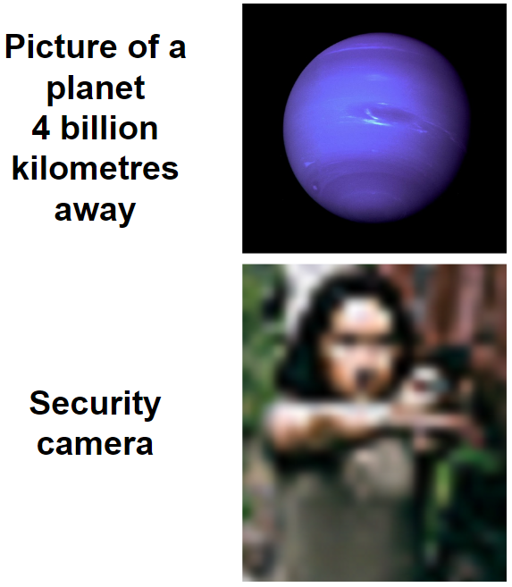
Abstract
Problem Statement: Super-resolution is crucial in enhancing image quality for applications like medical imaging, satellite photos, and security.
Existing Methods:
Traditional Interpolation: Bicubic, Bilinear – Fast but poor quality.
State-of-the-Art (e.g., Real-ESRGAN): High quality but computationally expensive.
Our Approach:
We implement Efficient ESPCN, which balances performance and speed.
We compare results across different scaling factors (2x, 3x, 4x).
Also compare with and without augmentation for scale=2.

Slide 3

1. Introduction
Existing Methods:
Bicubic/Bilinear → Simple but low-quality
Real-ESRGAN / EDSR → High quality, high cost
ESPCN Motivation:
Lightweight, real-time
PixelShuffle-based upsampling
Great for mobile, video,embedded or web use-cases.

Slide 4
2. Dataset – DIV2K (from Kaggle)
DIV2K Dataset: Large, diverse collection of 2K resolution RGB images
Train set: 800 HR images → LR pairs for ×2, ×3, ×4
Validation set: 100 HR images, for feedback evaluation
Test set: 100 diverse images (HR released post-challenge)
Use case in this project:
Only the training HR images used to synthesize LR-HR pairs
Enables training of SR models on a wide variety of natural scenes

Slide 5
3. Proposed Methodology
Preprocessing & Augmentation
Bicubic downsampling to create LR images from HR
Augmentation:
• HorizontalFlip (p=0.5) → Flips the image horizontally with 50% probability.
• RandomBrightnessContrast (p=0.3) → Randomly adjusts image brightness and contrast (30% chance).
• GaussNoise (var_limit=(5.0, 20.0), p=0.3) → Adds Gaussian noise with variance between 5–20 (30% chance).
• ImageCompression (quality_lower=85, quality_upper=100, p=0.4) → Simulates JPEG compression artifacts with 85–100% quality (40% chance).
• RandomGamma (p=0.3) → Applies gamma correction to change brightness non-linearly (30% chance).
• HueSaturationValue (p=0.3) → Randomly modifies hue, saturation, and value (HSV) channels (30% chance).

Slide 6
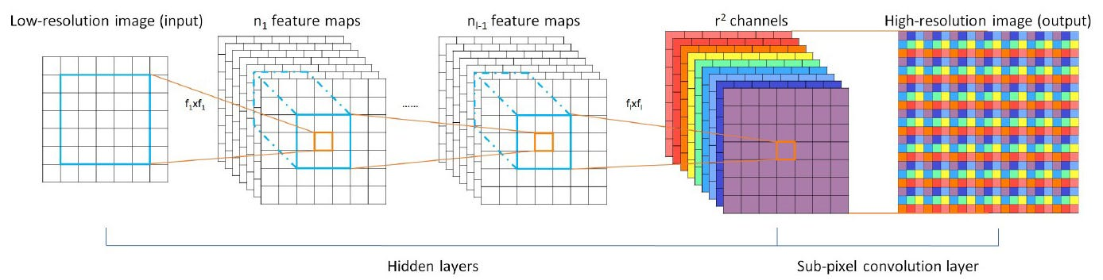
3. Proposed Methodology
ESPCN Model Architecture
Input → Conv (ReLU) → Conv (ReLU) → Conv → Pixel Shuffle
Uses depth-to-space rearrangement (efficient upscaling)
Trained separately for scale=2, 3, 4
Optimized using Adam, Loss: MSE

Slide 7
4. Evaluation Metrics
PSNR (Peak Signal-to-Noise Ratio)
PSNR measures the pixel-level fidelity between the original (ground truth) and a distorted (processed) image. It's based on the Mean Squared Error (MSE) between the two images.
A higher PSNR generally indicates that the reconstructed image is closer to the original.
Characteristics:
Range: Typically between 20 and 50 dB for lossy image compression.
Higher is better: PSNR ≥ 30 dB is considered good.
Limitations:
Doesn’t consider human visual perception.
Sensitive to small pixel-level changes.
Two images may have high PSNR but look perceptually very different.

Slide 8
4. Evaluation Metrics
SSIM (Structural Similarity Index Measure)
SSIM evaluates the perceptual similarity between two images by considering:
Luminance (brightness)
Contrast
Structure
Unlike PSNR, it aligns more closely with how humans perceive image quality.
Characteristics:
Range: [-1, 1] (Usually reported between 0 and 1)
Higher is better: SSIM = 1 means perfect structural similarity.
More perceptually aligned than PSNR.

Slide 9
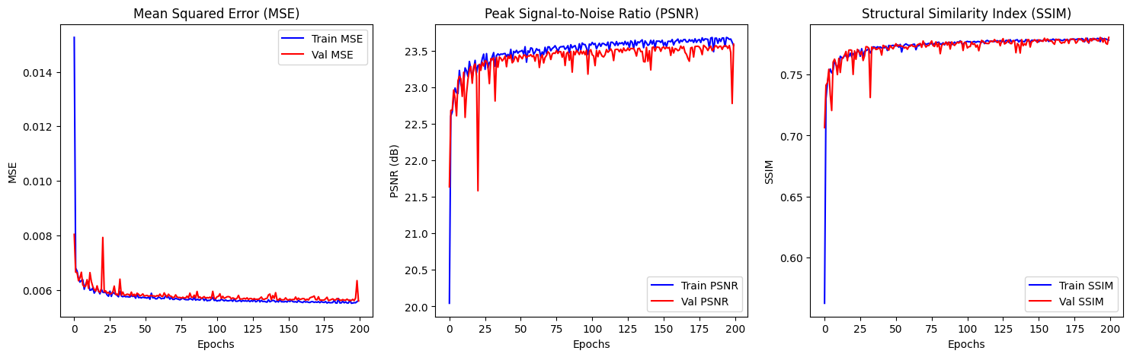
5. Results and Comparison
Without Augmentation:

Slide 10
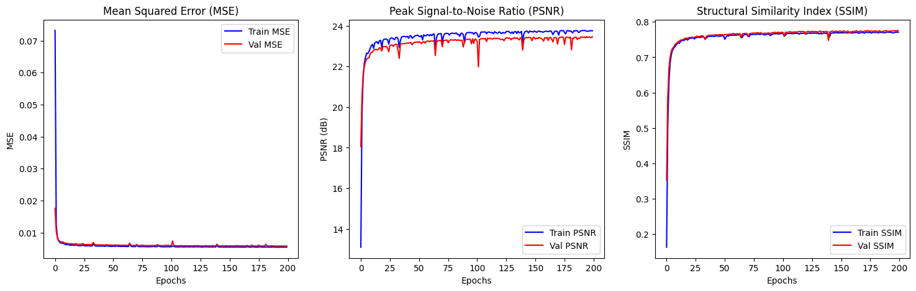
5. Results and Comparison
With Augmentation:

Slide 11
5. Verdict
Metric | Before Augmentation | After Augmentation | Verdict
MSE | Low, stable | Low, slightly smoother | Equal / Slightly better
PSNR | Slightly noisy, larger gap | Smoother, reduced gap | Improved generalization
SSIM | More variance, lower early on | Smoother, higher convergence | Improved structural quality

Slide 12
THANK YOU
Project Presentation
by
R. Jawahar (2448540)
Guide
Dr. Sandhiya B
Department of Computer Science
CHRIST(Deemed to be University), Bengaluru-29

