Slide 1


Patterns of Influence in a Recommendation Network
School of Computer Science
Carnegie Mellon
Jure Leskovec, CMU
Ajit Singh, CMU
Jon Kleinberg, Cornell

Slide 2
Spread of information
Social network plays fundamental role in spread of information or influence
Viral marketing (Word of mouth)
  An idea gets a sudden widespread popularity
Example:
  GMail achieved wide popularity and the only way to obtain an account was through referral
  In blogs a piece of information spreads rapidly before eventually picked by mass media

Slide 3
Information cascades
Cascades are phenomena in which an action or idea becomes widely adopted due to influence by others
Traditionally sociologists studied the diffusion of innovation:
  Hybrid corn (Ryan and Gross, 1943)
  Prescription drugs (Coleman et al. 1957)

Slide 4
Cascade formation process
Time: t₁ < t₂ < … < t_{n}
t₃
legend
t₄
received recommendation and propagated it forward
t₁
received a recommendation
but didn’t propagate
t₂
t₅
t₆

Slide 5
Work on information cascades
Cascades have also been studied to:
  Select trendsetters for viral marketing (Kempe et al. 2003, Richardson et al. 2002)
  Find inoculation targets in epidemiology (Newman 2002)
  Explain trends in blogspace (Adar and Adamic 2005, Gruhl et al. 2004)
Since it is hard to obtain reliable data on cascades, previous studies were primarily focused on large-scale (coarse) analysis

Slide 6
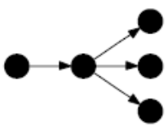

Our work
We look at the fine-grained patterns of influence in a large-scale, real recommendation network
Given a directed who-influences-whom graph
Find cascades
And examine their topological structure:
  What kinds of cascades arise frequently in real life?
  Are they like trees, stars, or something else?
  What is the distribution of cascade sizes (all same size / exponential tail / heavy-tailed)?

Slide 7
Roadmap
The recommendation network dataset
Proposed method:
  Indentifing cascades
  Enumerating cascades
  Counting cascades (approximate graph isomorphism)
Experimental results:
  Distribution of cascade sizes
  Frequent cascade subgraphs
Conclusion

Slide 8
Roadmap
The recommendation network dataset
Proposed method:
  Indentifing cascades
  Enumerating cascades
  Counting cascades (approximate graph isomorphism)
Experimental results:
  Distribution of cascade sizes
  Frequent cascade subgraphs
Conclusion

Slide 9
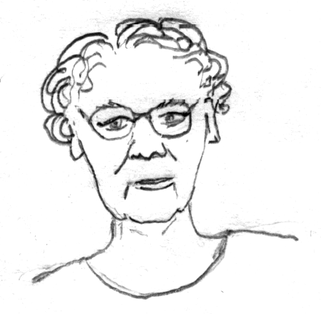


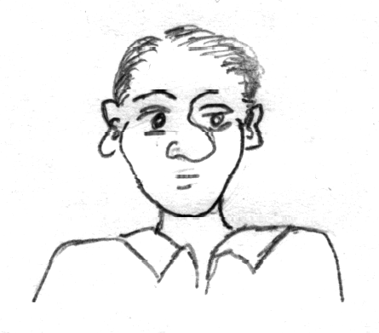
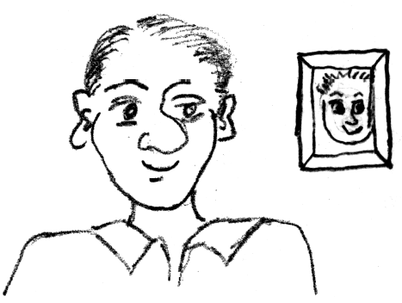
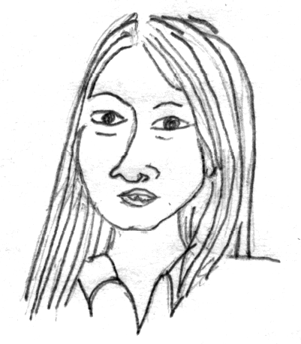
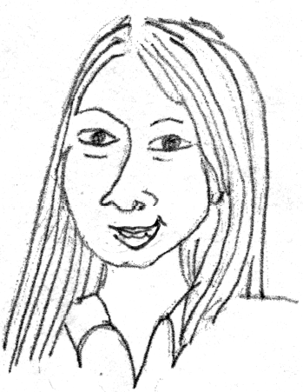
The data – recommendation network
Senders and followers of recommendations receive discounts on products
10% credit
10% off
Recommendations are made to any number of people at the time of purchase

Slide 10
The data – recommendations
For each recommendation we have:
  sender ID
  recipient ID
  recommendation time
  response (buy / no buy)
  purchase time

Slide 11
The data – description
A large online retailer (June 2001 to May 2003)
Over a gigabyte in size
15,646,121 recommendations
3,943,084 distinct customers
548,523 products recommended
99% of them belonging 4 main product groups:
  books
  DVDs
  music CDs
  VHS

Slide 12
The data – statistics
high
low
 | products | customers | recommendations | edges | purchases | responses
Book | 103,161 | 2,863,977 | 5,741,611 | 2,097,809 | 2,859,096 | 83,113
DVD | 19,829 | 805,285 | 8,180,393 | 962,341 | 837,300 | 75,421
Music | 393,598 | 794,148 | 1,443,847 | 585,738 | 721,673 | 10,576
Video | 26,131 | 239,583 | 280,270 | 160,683 | 165,109 | 1,376
Full | 542,719 | 3,943,084 | 15,646,121 | 3,153,676 | 4,574,178 | 170,486
Networks are very sparsely connected (low average degree)
9% of DVD purchases are due to recommendations
Book recommendations are influential

Slide 13
Roadmap
The recommendation network dataset
Proposed method:
  Indentifing cascades
  Enumerating cascades
  Counting cascades (approximate graph isomorphism)
Experimental results:
  Distribution of cascade sizes
  Frequent cascade subgraphs
Conclusion

Slide 14
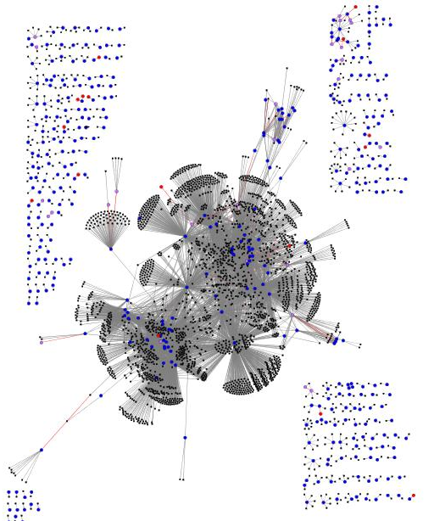
Product recommendation network
Majority of recommendations do not cause purchases nor propagation
Notice many star-like patterns
Many disconnected components

Slide 15
Identifying cascades
Given a set of recommendations find cascades
We use the following approach
  Create a separate graph for each product
  Delete late recommendations:
    Delete recommendations that happened after the first purchase of the product
    We get time-increasing graph
  Delete no-purchase nodes:
    We find many star-like patterns, no propagation of influence
    Delete nodes that did not purchase a product
  Now connected components correspond to maximal cascades

Slide 16
Cascade enumeration
Maximal cascades do not reveal what are the cascade building blocks (local structures)
Given a maximal cascade we want to enumerate all local cascades:
  For every node we explore the cascade in the neighborhood up to 1, 2, 3,… steps away
  This way we capture the local structure of the cascade around the node
source node
1 step away
2 steps away

Slide 17
Counting cascades (graph isomorphism)
To count cascades we need to determine whether a new cascade is isomorphic to already seen one:
No polynomial graph isomorphism algorithm is known, so we reside to approximate solution
?
==
Graphs are isomorphic if there exists a node mapping
so that nodes have same neighbors
Notes:
DRAWING OF GRAPH ISOMORPHISM PROBLEM (2 GRAPHS)
Find if node mapping exists

Slide 18
Graph isomorphism
Do not compare the graphs directly, but
For each graph we create a signature
A good signature is one where isomorphic graphs have the same signature, but few non-isomorphic graphs share the same signature
Compare the graph signatures

Slide 19
Creating a signature
We propose multilevel approach
  Complexity (and accuracy) depends on the size of the graph
Different levels of the signature
  Number of nodes, number of edges
  Sorted in- and out- degree sequence
  Singular values of graph adjacency matrix
  For small graphs (n < 9) we perform exact isomorphism test
simple
(fast/inaccurate)
complex
(slow/accurate)

Slide 20
Comparing signatures
First compare simple signatures
Compare the graphs with the same simple signature using more and more complicated (expensive/accurate) signatures
At the end (for small graphs) we perform exact isomorphism resolution
Since we are interested in building blocks of cascades which are generally small, the precision for small graphs is more important

Slide 21
Comparing signatures – Example
Compare simple signature
(number of nodes/edges)
Compare simple signature
(degree sequence)
Compare simple signature
(Singular values)

Slide 22
Counting subgraphs – related work
Work on frequent subgraph mining:
  Apriori-based algorithm (Inokuchi et al. 2000)
  G-span (Yan and Han, 2002)
  Kuramochi and Karypis 2004; Pei, Jiang and Zhang 2005; and many more
It mainly focuses on richly labeled undirected graphs (e.g. chemical compounds)
We are interested in enumerating subgraphs based only on their structures
We have no labels on nodes and edges
So heuristics for pruning the search space using node and edge labels cannot be applied

Slide 23
Roadmap
The recommendation network dataset
Proposed method:
  Indentifing cascades
  Enumerating cascades
  Counting cascades (approximate graph isomorphism)
Experimental results:
  Distribution of cascade sizes
  Frequent cascade subgraphs
Conclusion

Slide 24
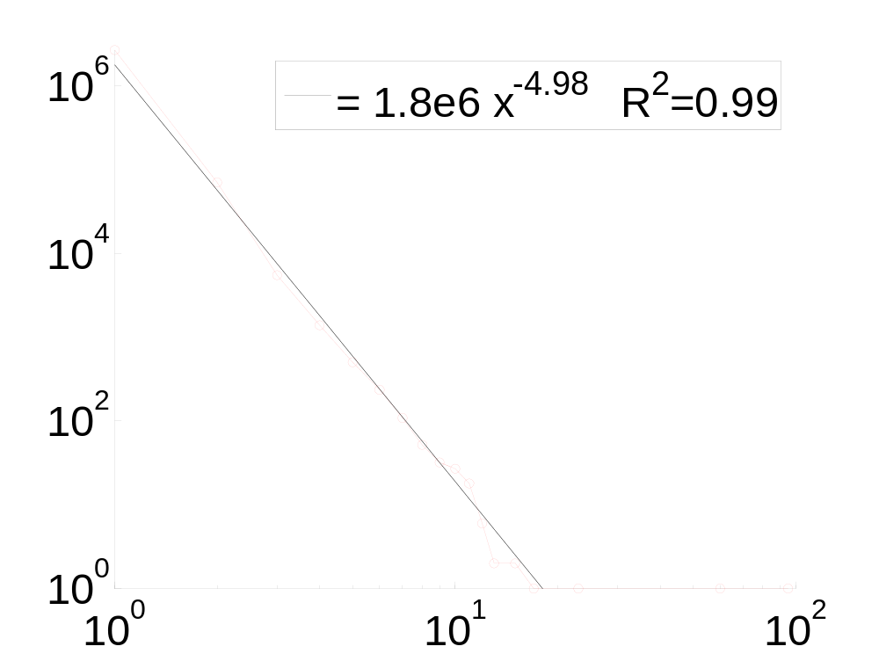
Measuring maximal cascade sizes
Count how many people are in a single cascade
We observe a heavy tailed distribution which can not be explained by a simple branching process
steep drop-off
books
very few large cascades

Slide 25
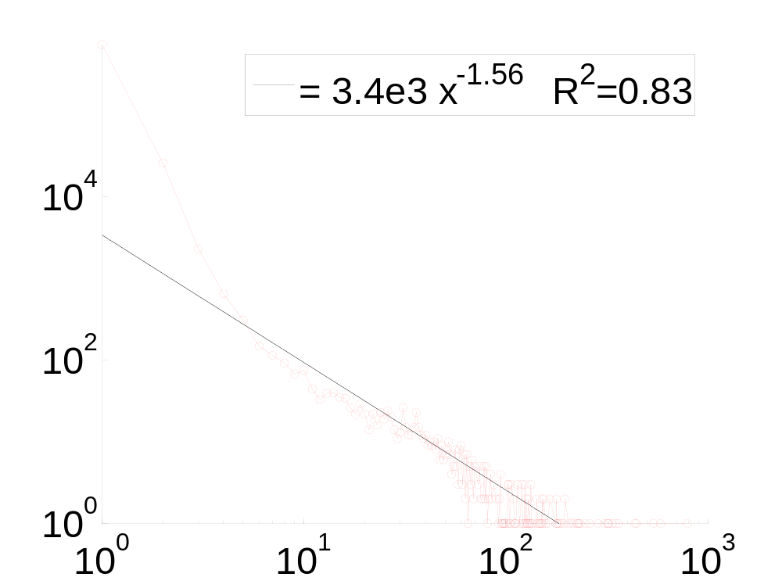
Cascade sizes for DVDs
DVD cascades can grow large
possibly a product of websites where people sign up to exchange recommendations
shallow drop off – fat tail
DVD
a number of large cascades

Slide 26
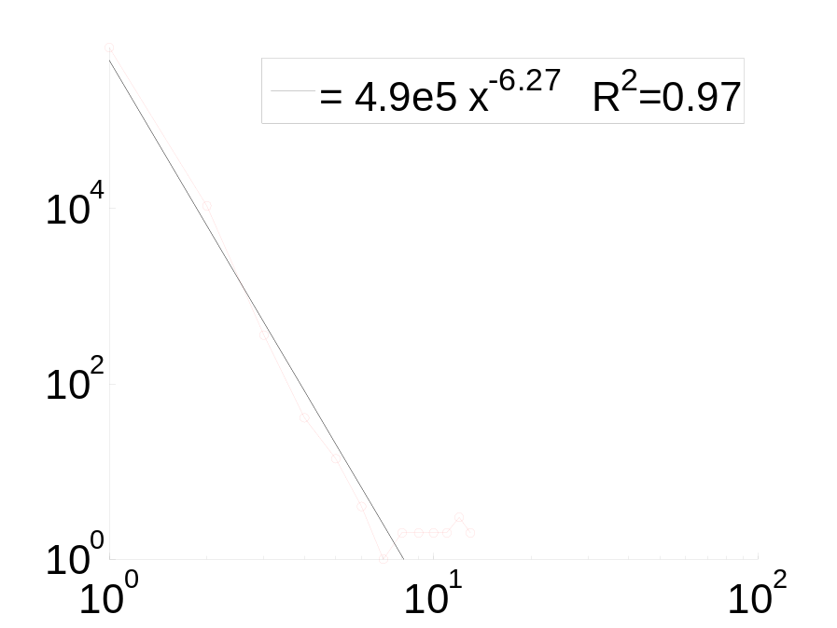
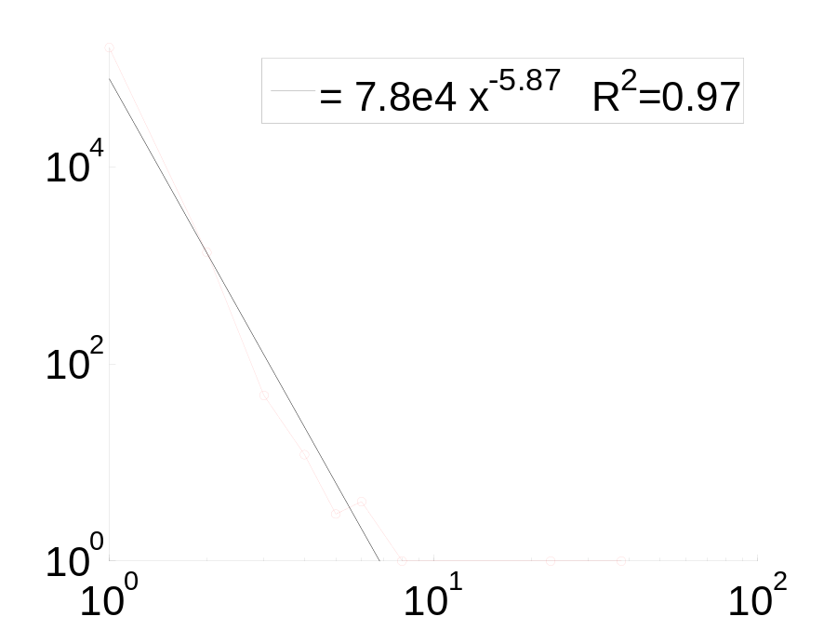
Music CD and VHS cascades
Music and VHS cascades don’t grow large
music
VHS

Slide 27
Frequent cascade subgraphs (1)
high
low
General observations:
  DVDs have the richest cascades (most recommendations, most densely linked)
  Books have small cascades
  Music is 3 times larger than video but does not have much variety in cascades
 | cascades | different
Book | 122,657 | 959
DVD | 289,055 | 87,614
Music | 13,330 | 158
Video | 1,928 | 109
number of all “words”
vocabulary size

Slide 28

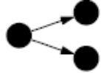

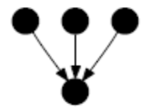


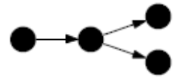
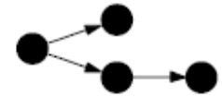
Frequent cascade subgraphs (2)
is the most common cascade subgraph
It accounts for ~75% cascades in books, CD and VHS, only 12% of DVD cascades
is 6 (1.2 for DVD) times more frequent than
For DVDs is more frequent than
Chains ( ) are more frequent than
is more frequent than a collision ( ) (but collision has less edges)
Late split ( ) is more frequent than

Slide 29
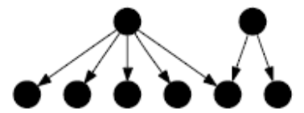
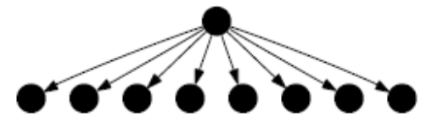
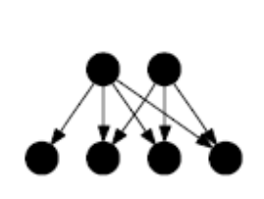

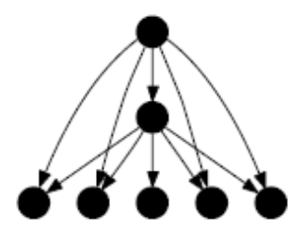
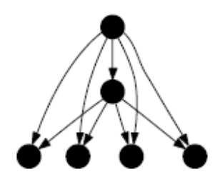
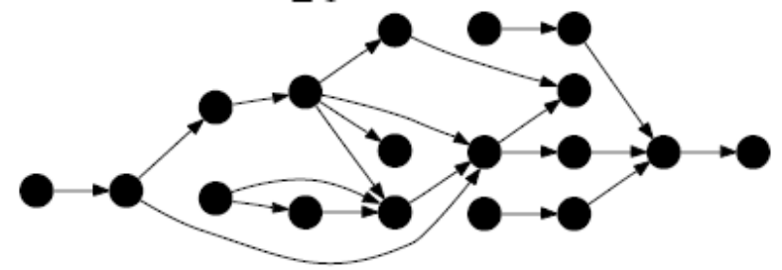
Typical classes of cascades
No propagation
Common friends
Nodes having same friends
A complicated cascade

Slide 30
Conclusion (1)
Cascades are a form of collective behavior
We developed a scalable algorithm for indentifing and counting cascades (approximate graph isomorphism)
We illustrate the existence of cascades, and measure their frequencies in a large real-world dataset

Slide 31
Conclusion (2)
From our experiments we found:
  Most cascades are small, but large bursts can occur
  Cascade sizes follow a heavy-tailed distribution
  Frequency of different cascade subgraphs depends on the product type
  Cascade frequencies do not simply decrease monotonically for denser subgraphs
  But reflect more subtle features of the domain in which the recommendations are operating

Slide 32


Thank you!
Questions?
jure@cs.cmu.edu

