Slide 1



Cost-effective Outbreak Detection in Networks
Jure Leskovec, Andreas Krause, Carlos Guestrin, Christos Faloutsos, Jeanne VanBriesen, Natalie Glance

Slide 2
Scenario 1: Water network
Given a real city water distribution network
And data on how contaminants spread in the network
Problem posed by US Environmental Protection Agency
On which nodes should we place sensors to efficiently detect the all possible contaminations?
S
S

Slide 3
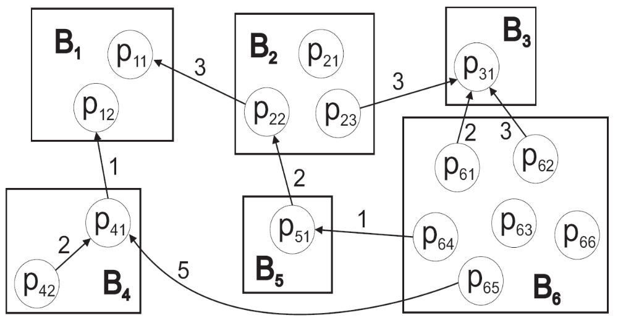
Scenario 2: Cascades in blogs
Posts
Which blogs should one read to detect cascades as effectively as possible?
Blogs
Time ordered hyperlinks
Information cascade
Notes:
J: Make the animation

Slide 4
General problem
Given a dynamic process spreading over the network
We want to select a set of nodes to detect the process effectively
Many other applications:
  Epidemics
  Influence propagation
  Network security

Slide 5
Two parts to the problem
Reward, e.g.:
  1) Minimize time to detection
  2) Maximize number of detected propagations
  3) Minimize number of infected people
Cost (location dependent):
  Reading big blogs is more time consuming
  Placing a sensor in a remote location is expensive

Slide 6
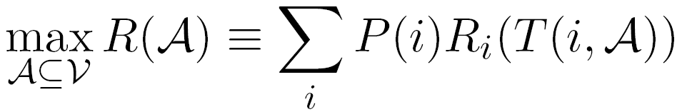
Problem setting
S
S
Given a graph G(V,E)
and a budget B for sensors
and data on how contaminations spread over the network:
  for each contamination i we know the time T(i, u) when it contaminated node u
Select a subset of nodes A that maximize the expected reward
subject to cost(A) < B
Reward for detecting contamination i

Slide 7
Overview
Problem definition
Properties of objective functions
  Submodularity
Our solution
  CELF algorithm
  New bound
Experiments
Conclusion

Slide 8
Solving the problem
Solving the problem exactly is NP-hard
Our observation:
  objective functions are submodular, i.e. diminishing returns
S₁
New sensor:
S₁
S’
S’
Adding S’ helps very little
Adding S’ helps a lot
S₃
S₂
S₂
S₄
Placement A={S₁, S₂}
Placement A={S₁, S₂, S₃, S₄}

Slide 9
Result 1: Objective functions are submodular
Objective functions from Battle of Water Sensor Networks competition [Ostfeld et al]:
  1) Time to detection (DT)
    How long does it take to detect a contamination?
  2) Detection likelihood (DL)
    How many contaminations do we detect?
  3) Population affected (PA)
    How many people drank contaminated water?
Our result: all are submodular
Notes:
We consider 3 different objective functions defined by the

Slide 10
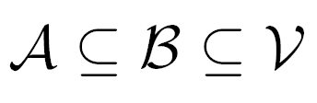
Background: Submodularity
Submodularity:
  For all placement s it holds
Even optimizing submodular functions is NP-hard [Khuller et al]
Benefit of adding a sensor to a small placement
Benefit of adding a sensor to a large placement

Slide 11
Background: Optimizing submodular functions
How well can we do?
A greedy is near optimal
  at least 1-1/e (~63%) of optimal [Nemhauser et al ’78]
But
  1) this only works for unit cost case (each sensor/location costs the same)
  2) Greedy algorithm is slow
    scales as O(|V|B)
Greedy algorithm
reward
a
d
b
b
a
c
e
c
d
e

Slide 12
Result 2: Variable cost: CELF algorithm
For variable sensor cost greedy can fail arbitrarily badly
We develop a CELF (cost-effective lazy forward-selection) algorithm
  a 2 pass greedy algorithm
Theorem: CELF is near optimal
    CELF achieves ½(1-1/e) factor approximation
  CELF is much faster than standard greedy

Slide 13
Result 3: tighter bound
We develop a new algorithm-independent bound
  in practice much tighter than the standard (1-1/e) bound
Details in the paper
Notes:
That tells us how far is our solution from optimal

Slide 14
Scaling up CELF algorithm
Submodularity guarantees that marginal benefits decrease with the solution size
Idea: exploit submodularity, doing lazy evaluations!
  (considered by Robertazzi et al for unit cost case)
reward
d

Slide 15
Result 4: Scaling up CELF
CELF algorithm:
  Keep an ordered list of marginal benefits b_{i} from previous iteration
  Re-evaluate b_{i} only for top sensor
  Re-sort and prune
reward
a
d
b
b
a
c
e
c
d
e

Slide 16
Result 4: Scaling up CELF
CELF algorithm:
  Keep an ordered list of marginal benefits b_{i} from previous iteration
  Re-evaluate b_{i} only for top sensor
  Re-sort and prune
reward
a
d
b
b
a
c
e
c
d
e

Slide 17
Result 4: Scaling up CELF
CELF algorithm:
  Keep an ordered list of marginal benefits b_{i} from previous iteration
  Re-evaluate b_{i} only for top sensor
  Re-sort and prune
reward
a
d
b
d
a
b
e
c
e
c
Notes:
If that removes it from the top, pick next sensor
Continue until top remains unchanged

Slide 18
Overview
Problem definition
Properties of objective functions
  Submodularity
Our solution
  CELF algorithm
  New bound
Experiments
Conclusion

Slide 19
Experiments: Questions
Q1: How close to optimal is CELF?
Q2: How tight is our bound?
Q3: Unit vs. variable cost
Q4: CELF vs. heuristic selection
Q5: Scalability

Slide 20
Experiments: 2 case studies
We have real propagation data
  Blog network:
    We crawled blogs for 1 year
    We identified cascades – temporal propagation of information
  Water distribution network:
    Real city water distribution networks
    Realistic simulator of water consumption provided by US Environmental Protection Agency

Slide 21
Case study 1: Cascades in blogs
We crawled 45,000 blogs for 1 year
We obtained 10 million posts
And identified 350,000 cascades

Slide 22
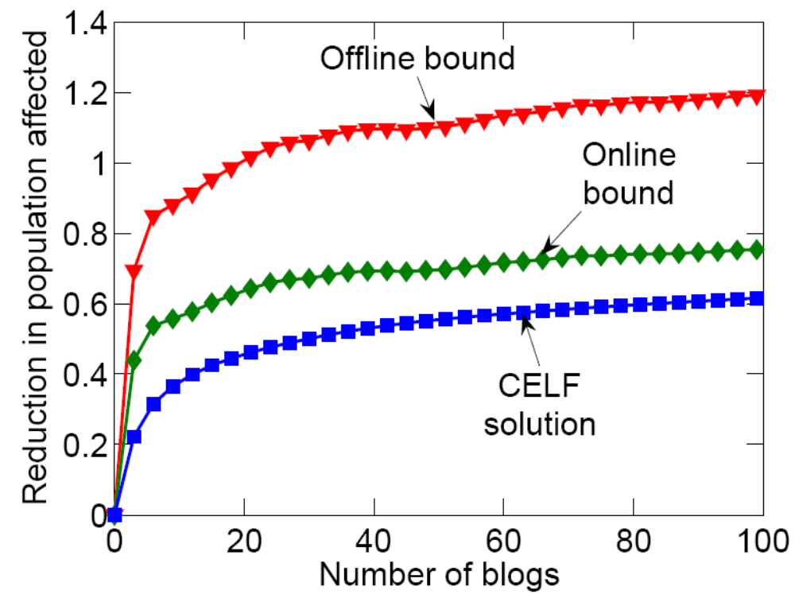
Q1: Blogs: Solution quality
Our bound is much tighter
  13% instead of 37%
Old bound
Our bound
CELF

Slide 23
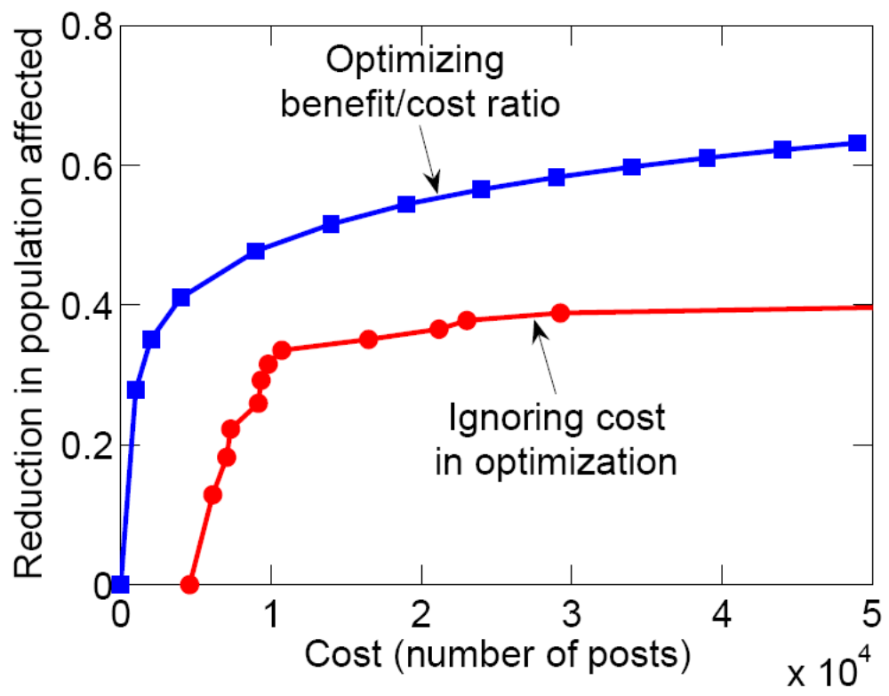
Q2: Blogs: Cost of a blog
Unit cost:
  algorithm picks large popular blogs: instapundit.com, michellemalkin.com
Variable cost:
  proportional to the number of posts
We can do much better when considering costs
Variable cost
Unit cost

Slide 24
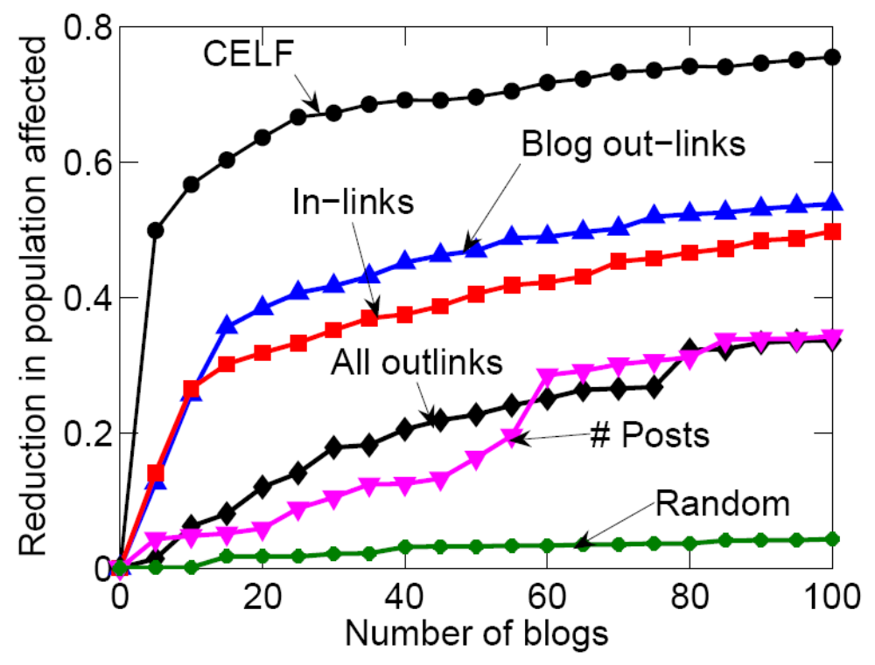
Q4: Blogs: Heuristics
CELF wins consistently

Slide 25
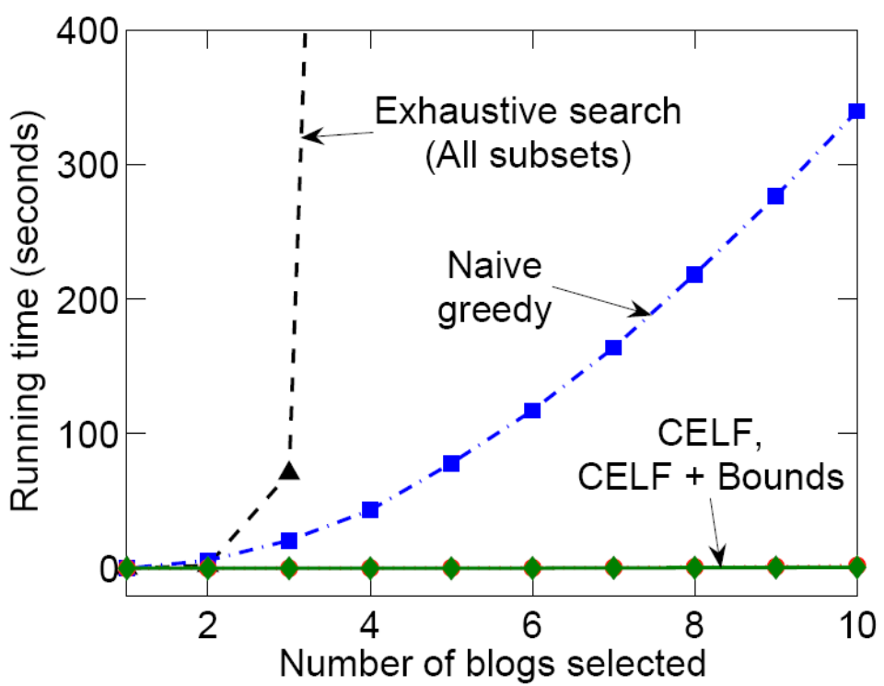
Q5: Blogs: Scalability
CELF runs 700 times faster than simple greedy algorithm

Slide 26
Case study 2: Water network
Real metropolitan area water network (largest network optimized):
  V = 21,000 nodes
  E = 25,000 pipes
3.6 million epidemic scenarios
(152 GB of epidemic data)
By exploiting sparsity we fit it into main memory (16GB)

Slide 27
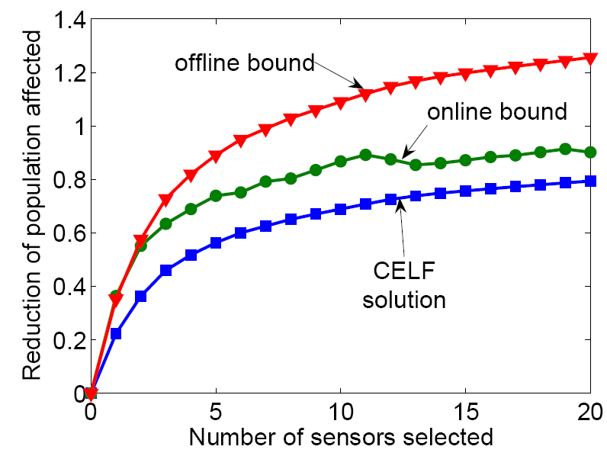
Q1: Water: Solution quality
Old bound
Our bound
CELF
Again our bound is much tighter

Slide 28
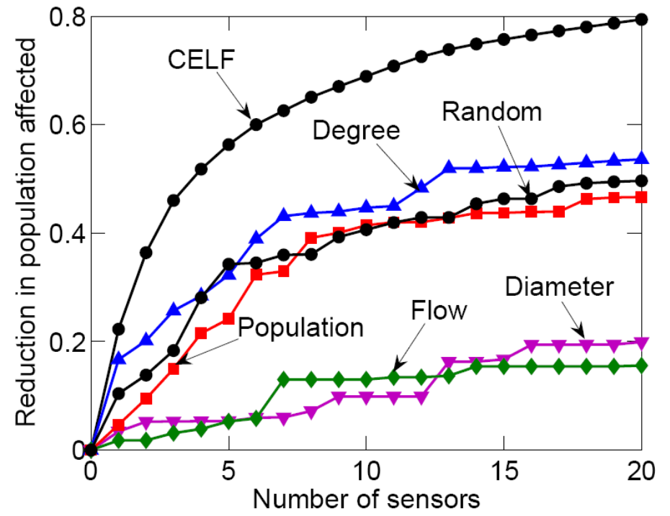
Q3: Water: Heuristic placement
Again, CELF consistently wins

Slide 29
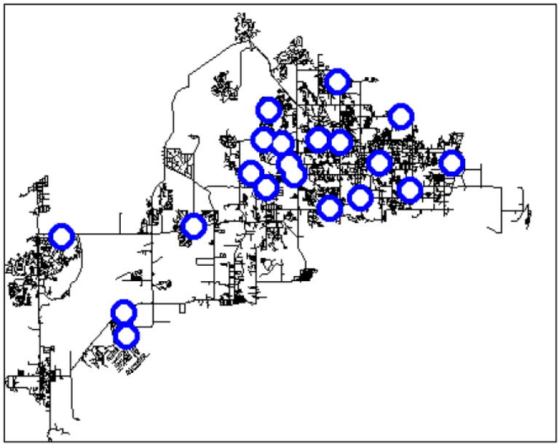
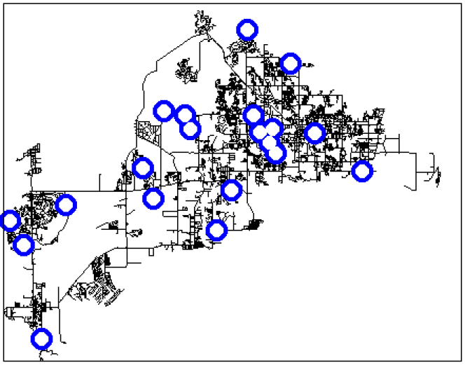
Water: Placement visualization
Different objective functions give different sensor placements
Population affected
Detection likelihood

Slide 30
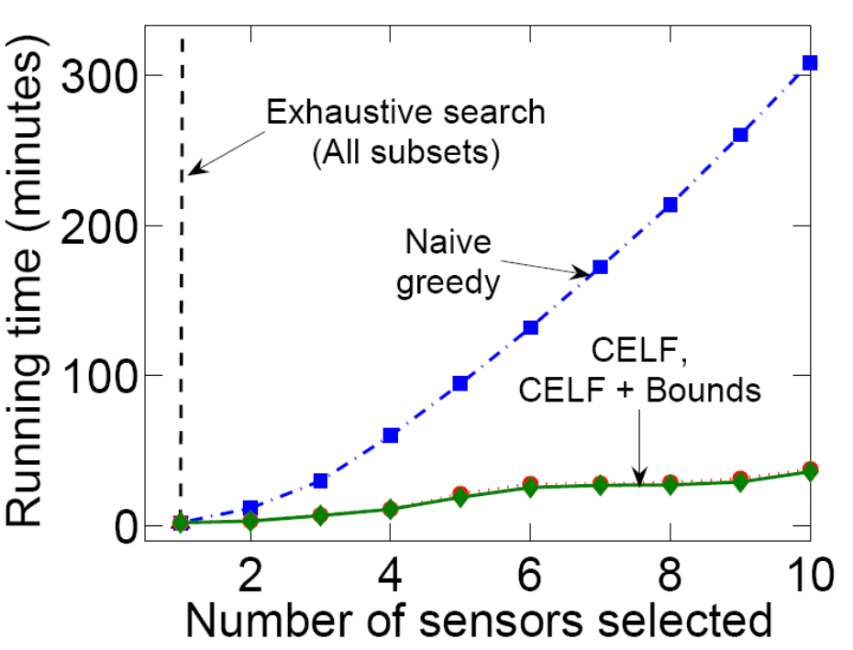
Q5: Water: Scalability
CELF is 10 times faster than greedy

Slide 31
Results of BWSN competition
Author | #non- dominated (out of 30)
CELF | 26
Berry et. al. | 21
Dorini et. al. | 20
Wu and Walski | 19
Ostfeld et al | 14
Propato et. al. | 12
Eliades et. al. | 11
Huang et. al. | 7
Guan et. al. | 4
Ghimire et. al. | 3
Trachtman | 2
Gueli | 2
Preis and Ostfeld | 1
Battle of Water Sensor Networks competition
[Ostfeld et al]:
count number of non-dominated solutions
Notes:
A: We might want to mention the results of the competition, independently evaluated by the organizers :)

Slide 32
Conclusion
General methodology for selecting nodes to detect outbreaks
Results:
  Submodularity observation
  Variable-cost algorithm with optimality guarantee
  Tighter bound
  Significant speed-up (700 times)
Evaluation on large real datasets (150GB)
  CELF won consistently

Slide 33
Other results – see our poster
Many more details:
  Fractional selection of the blogs
  Generalization to future unseen cascades
  Multi-criterion optimization
  We show that triggering model of Kempe et al is a special case of out setting
Thank you!
Questions?

Slide 34
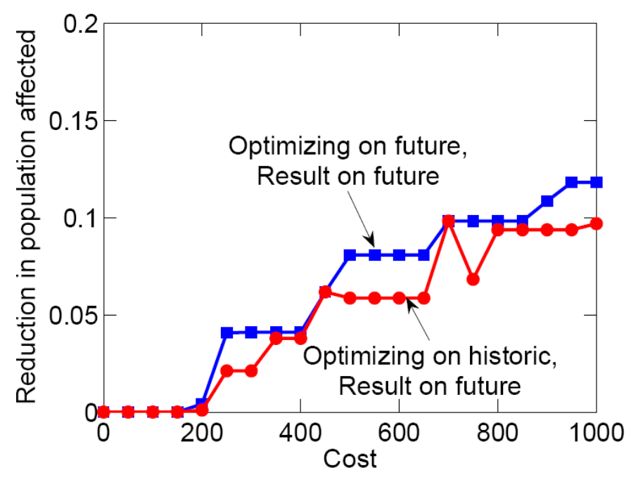
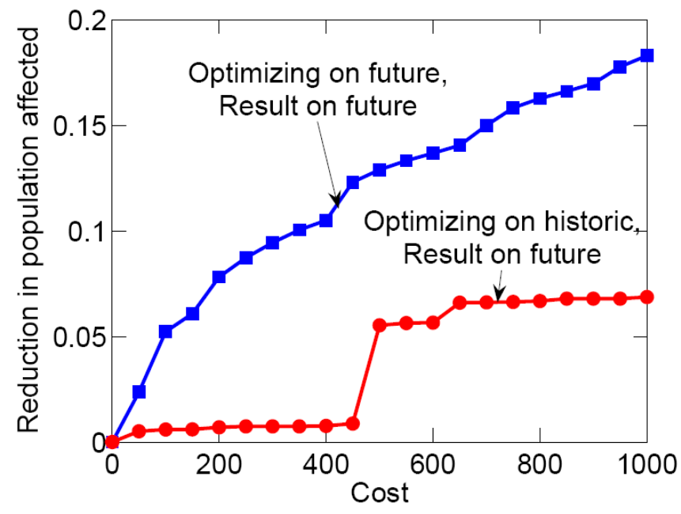
Blogs: generalization

Slide 35
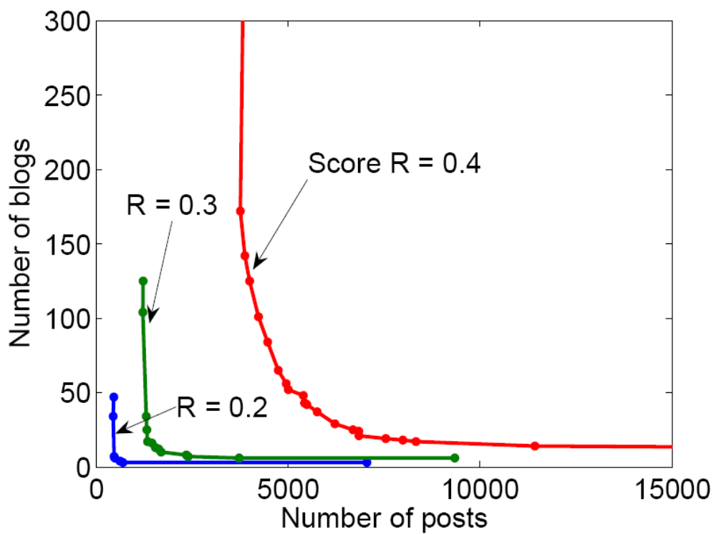
Blogs: Cost of a blog (2)
But then algorithm picks lots of small blogs that participate in few cascades
We pick best solution that interpolates between the costs
We can get good solutions with few blogs and few posts
Each curve represents solutions with the same score

