Slide 1
Data Association for Topic Intensity Tracking
Andreas Krause
Jure Leskovec
Carlos Guestrin
School of Computer Science,
Carnegie Mellon University

Slide 2
Document classification
Two topics: Conference and Hiking
Will you go to
ICML too?
Let’s go hiking
on Friday!
P(C | words) = .9
P(C | words) = .1
➔ Conference
➔ Hiking

Slide 3
A more difficult example
Two topics: Conference and Hiking
What if we had temporal information?
How about modeling emails as HMM?
2:00 pm
2:03 pm
Let’s have dinner
after the talk.
Should we go on
Friday?
P(C | words) = .7
P(C | words) = .5
➔ Conference
Could refer to both topics! ☹
C₁
C₂
C_{t}
C_{t+1}
Assumes equal time steps,
“smooth” topic changes.
Valid assumptions?
D₁
D₂
D_{t}
D_{t+1}
Notes:
Remove HMM?

Slide 4
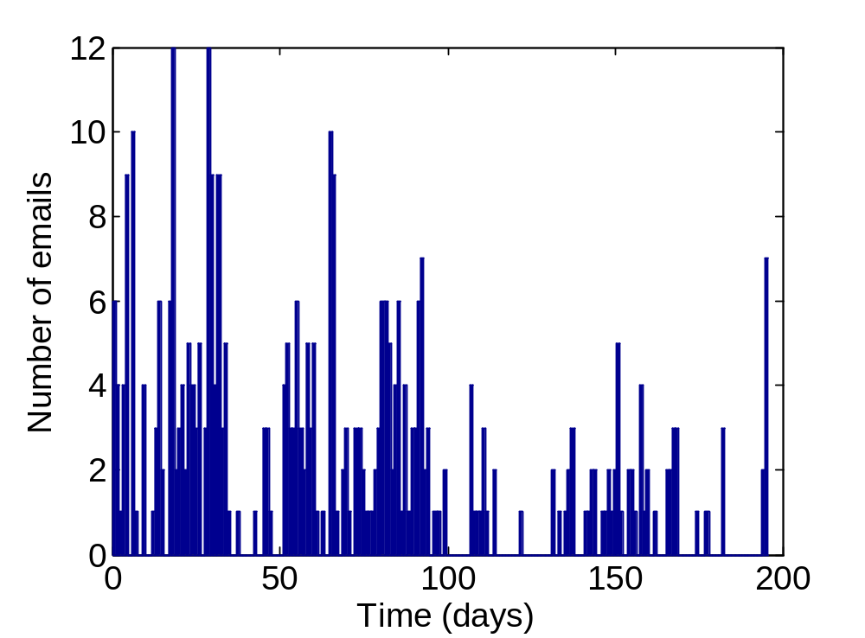
Typical email traffic
Email traffic very bursty
Cannot model with uniform time steps! ☹
Bursts tell us, how intensely a topic is pursued
➔ Bursts are potentially very interesting!

Slide 5
Identifying both topics and bursts
Given:
  A stream of documents (emails):
  d₁, d₂, d₃, …
  and corresponding document inter-arrival times (time between consecutive documents):
  Δ₁, Δ₂, Δ₃, ...
Simultaneously:
  Classify (or cluster) documents into K topics
  Predict the topic intensities – predict time between consecutive documents from the same topic

Slide 6
Data association problem
Conference
Hiking
If we know the email topics, we can identify bursts
If we don’t know the topics, we can’t identify bursts!
Naïve solution: First classify documents, then identify bursts
Can fail badly! ☹
This paper:
Simultaneously identify topics and bursts! ☺
time
High intensity for “Conference”,
Low intensity for “Hiking”
Intensity for “Conference” ???
Intensity for “Hiking” ???
Low intensity for “Conference”,
High intensity for “Hiking”
Notes:
Add legend

Slide 7
The Task
Have to solve a data association problem:
We observe:
  Message Deltas – time between the arrivals of consecutive documents
We want to estimate:
  Topic Deltas – time between messages of the same topic
  We can then compute the topic intensity L = E[ 1/Δ ]
  Therefore, need to associate each document with a topic
Need topics to
identify intensity
Chicken and Egg
problem:
Need intensity to
classify (better)
Notes:
Chicken egg problem

Slide 8
How to reason about topic deltas?
Associate with each email timestamps vectors τ for topic arrivals
τ₁
τ₂
τ₃
Email 1,
Conference
At 2:00 pm
Email 2,
Hiking
At 2:30 pm
Email 3,
Conference
At 4:15 pm
Next arrival
of email from
Conference,
Hiking
C: 2:00 pm
C: 4:15pm
C: 4:15 pm
H: 2:30 pm
H: 2:30 pm
H: 7:30 pm
Timestamp vector
[τ_{t}(C),τ_{t}(H)]
Message Δ = 30min
(betw. consecutive
messages)
Topic Δ = 2h 15min
(consecutive msg.
of same topic)

Slide 9
Generative Model (conceptual)
Intensity for
“Hiking”
(parameter for
exponential d.)
L^{(C)}_{t-1}
L^{(C)}_{t}
L^{(C)}_{t+1}
Intensity for
“Conference”
(parameter for
exponential d.)
L^{(H)}_{t-1}
L^{(H)}_{t}
L^{(H)}_{t+1}
τ_{t-1}
τ_{t}
τ_{t+1}
τ_{t} = [τ_{t}^{(C)},τ_{t}^{(H)}]
Time for next email from topic
(exponential dist.)
Problem:
Need to reason about entire history of timesteps τ_{t}!
Makes inference intractable, even for few topics!
Δ_{t}
C_{t}
D_{t}
Time between
subsequent emails
Topic indicator
(i.e., = “Conference”)
Document
(e.g., bag of words)
Notes:
Change W to D everywhere

Slide 10
Key observation:
If topic Δ follow exponential distribution:
P(τ_{t+1}^{(C)} > 4pm | τ_{t} ^{(C)} = 2pm, it’s now 3pm) =
P(τ_{t+1}^{(C)} > 4pm | τ_{t} ^{(C)} = 3pm, it’s now 3pm)
Exploit memorylessness to discard timestamps τ_{t}
Exponential distribution appropriate:
  Previous work on document streams (E.g., Kleinberg ‘03)
  Frequently used to model transition times
  When adding hidden variables, can model arbitrary transition distributions (cf., Nodelman et al)
Last arrival time irrelevant!

Slide 11
Generative Model (conceptual)
Implicit Data Association (IDA) Model
Intensity for
“Hiking”
L^{(C)}_{t-1}
L^{(C)}_{t}
L^{(C)}_{t+1}
Intensity for
“Conference”
L^{(H)}_{t-1}
L^{(H)}_{t}
L^{(H)}_{t+1}
τ_{t-1}
τ_{t}
τ_{t+1}
τ_{t} = [τ_{t}^{(C)},τ_{t}^{(H)}]
Time for next email from topic
(exponential dist.)
Δ_{t}
C_{t}
D_{t}
Time between
Subsequent emails
Topic indicator
(i.e., = “Conference”)
Document
Representation
(words)

Slide 12
Implicit Data Association (IDA) Model
Intensity for
“Hiking”
L^{(C)}_{t-1}
L^{(C)}_{t}
L^{(C)}_{t+1}
Intensity for
“Conference”
L^{(H)}_{t-1}
L^{(H)}_{t}
L^{(H)}_{t+1}
CPD P(C_{t}| L_{t}) is
argmin of
exponential
distributions
CPD P(Δ_{t} | L_{t}) is
minimum of
exponential
distributions
Δ_{t}
C_{t}
D_{t}
Time between
Subsequent emails
Topic indicator
(i.e., = “Conference”)
Document
Representation
(words)

Slide 13
Key modeling trick
L^{(C)}_{t}
L^{(H)}_{t}
Implicit data association (IDA) via
exponential order statistics
P(Δ_{t} | L_{t}) = min { Exp(L_{t}^{(C)}), Exp(L_{t}^{(H)}) }
P(C_{t} | L_{t}) = argmin { Exp(L_{t}^{(C)}), Exp(L_{t}^{(H)}) }
Simple closed form for these order statistics!
Quite general modeling idea
Turns model (essentially) into Factorial HMM
Many efficient inference techniques available! ☺
Δ_{t}
C_{t}
D_{t}
Email 1,
Conference
At 2:00 pm
Email 2,
Hiking
At 2:30 pm
Email 3,
Conference
At 4:15 pm
C: 2:00 pm
C: 4:15pm
C: 4:15 pm
H: 2:30 pm
H: 2:30 pm
H: 7:30 pm
Notes:
Remind min argmin (picture)

Slide 14
Inference Procedures
We consider:
  Full (conceptual) model:
    Particle filter
  Simplified Model:
    Particle filter
    Fully factorized mean field
    Extract inference
Comparison to a Weighted Automaton Model for single topics, proposed by Kleinberg
(first classify, then identify bursts)

Slide 15
Results (Synthetic data)
Periodic message arrivals (uninformative Δ) with noisy class assignments: ABBBABABABBB…
Misclassification Noise
30
Topic Δ
25
20
Topic delta
15
10
5
0
0
20
40
60
80
Message number

Slide 16
Results (Synthetic data)
Periodic message arrivals (uninformative Δ) with noisy class assigments: ABBBABABABBB…
Misclassification Noise
30
Topic Δ
Part. Filt.
(Full model)
25
20
Topic delta
15
0
0
20
40
60
80
Message number

Slide 17
Results (Synthetic data)
Periodic message arrivals (uninformative Δ) with noisy class assigments: ABBBABABABBB…
Misclassification Noise
30
Topic Δ
Exact
inference
Part. Filt.
(Full model)
25
20
Topic delta
15
0
0
20
40
60
80
Message number
Notes:
Full model (no memorylessness), Exact inference (exploits memorylessness)

Slide 18
Results (Synthetic data)
Periodic message arrivals (uninformative Δ) with noisy class assigments: ABBBABABABBB…
Misclassification Noise
Implicit Data Association get’s both topics and frequencies right, inspite severe (30%) label noise.
Memorylessness trick doesn’t hurt
Separate topic and burst identification fails badly.
30
Topic Δ
Exact
inference
Part. Filt.
(Full model)
25
20
Topic delta
15
10
5
Weighted automaton
(first classify, then bursts)
0
0
20
40
60
80
Message number

Slide 19
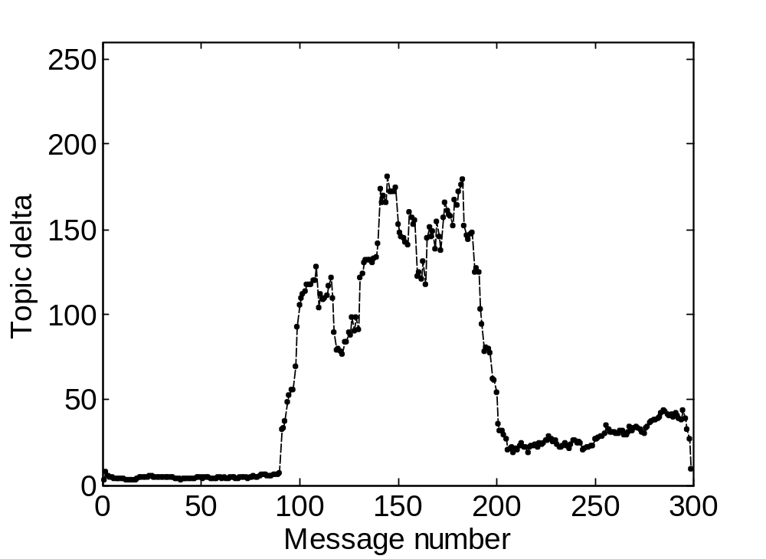
Inference comparison (Synthethic data)
Two topics, with different frequency pattern
Topic Δ

Slide 20
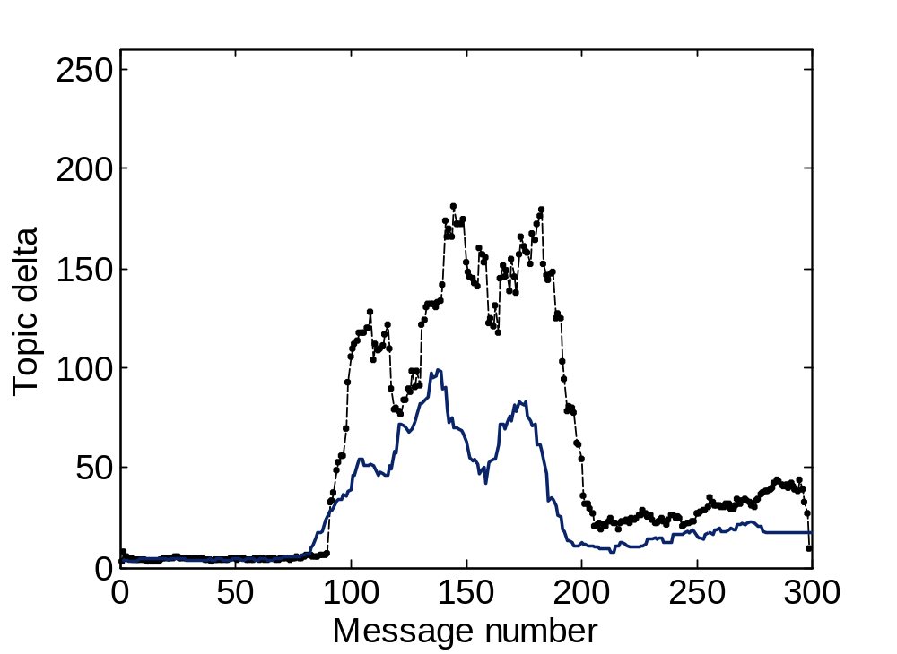
Inference comparison (Synthethic data)
Two topics, with different frequency pattern
Topic Δ
Message Δ

Slide 21
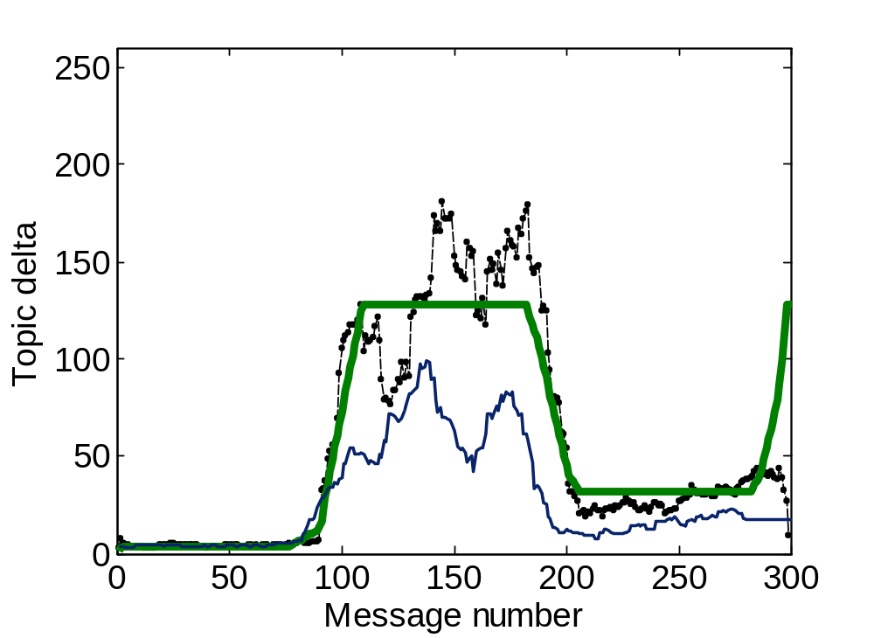
Inference comparison (Synthethic data)
Two topics, with different frequency pattern
Exact
inference
Topic Δ
Message Δ
Notes:
What i’d like to see / model

Slide 22
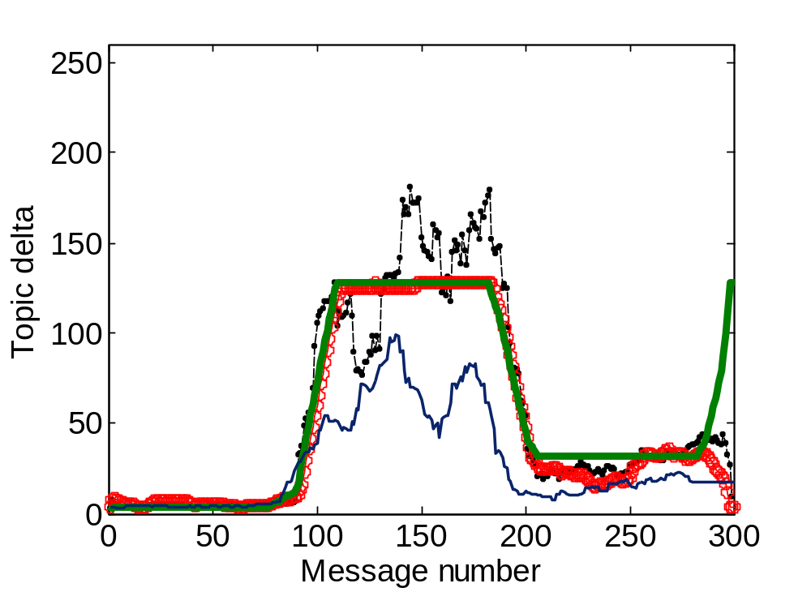
Inference comparison (Synthethic data)
Two topics, with different frequency pattern
Particle
filter
Exact
inference
Topic Δ
Message Δ

Slide 23
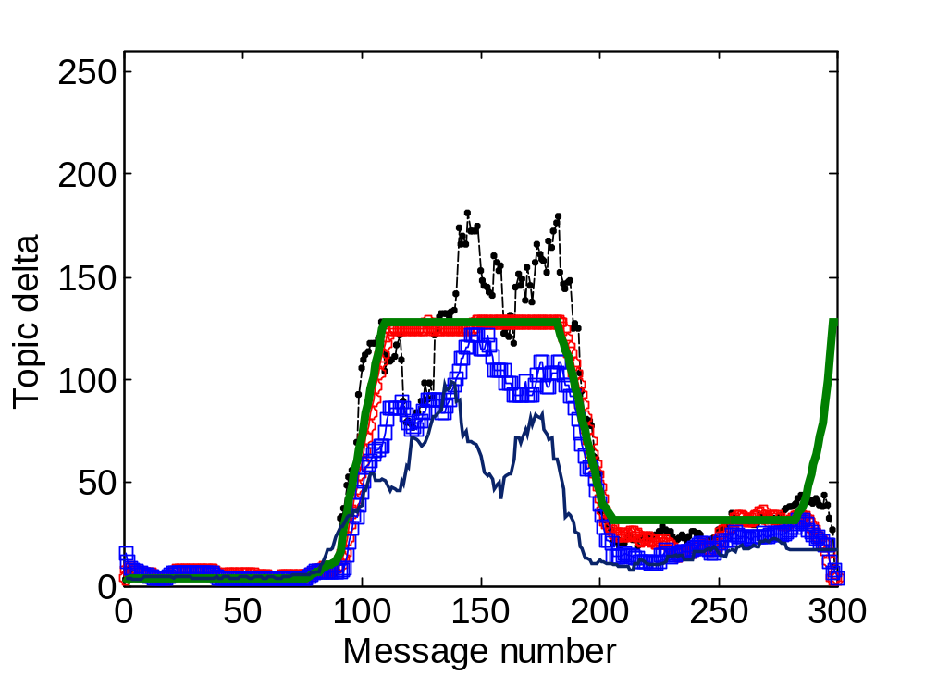
Inference comparison (Synthethic data)
Two topics, with different frequency pattern
Particle
filter
Mean-
field
Exact
inference
Topic Δ
Implicit Data Association identifies true frequency parameters (does not get distracted by observed Δ)
In addition to exact inference (for few topics),
several approximate inference techniques perform well.
Message Δ
Notes:
True -> Topic delta; Little box explanation
Observed -> Message delta;

Slide 24
Experiments on real document streams
ENRON Email corpus
  517,431 emails from 151 employees
  Selected 554 messages from tech-memos and universities folders of Kaminski
  Stream between December 1999 and May 2001
Reuters news archive
  Contains 810,000 news articles
  Selected 2,303 documents from four topics: wholesale prices, environment issues, fashion and obituaries

Slide 25
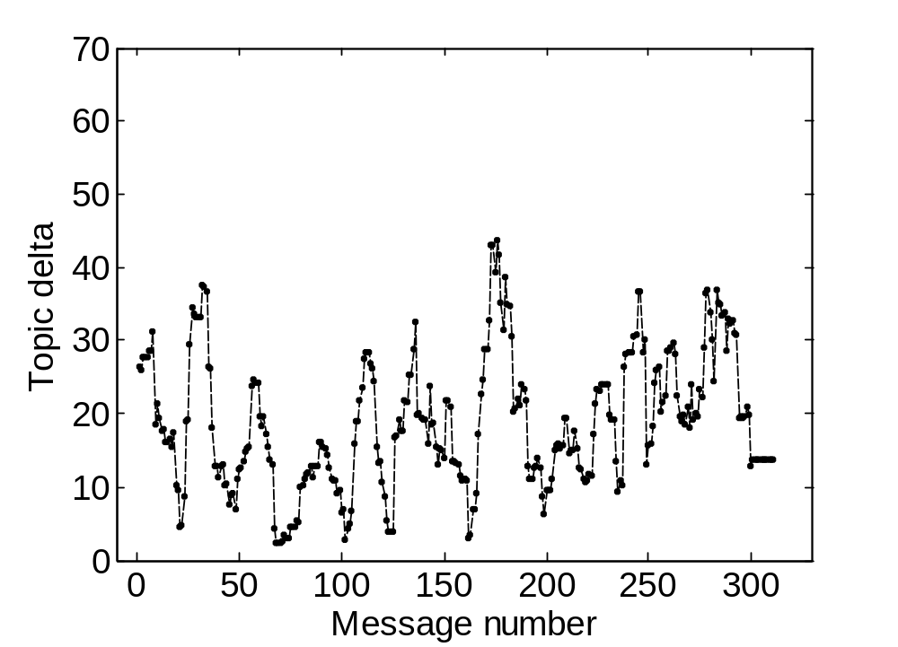
Intensity identification for Enron data
Topic Δ

Slide 26
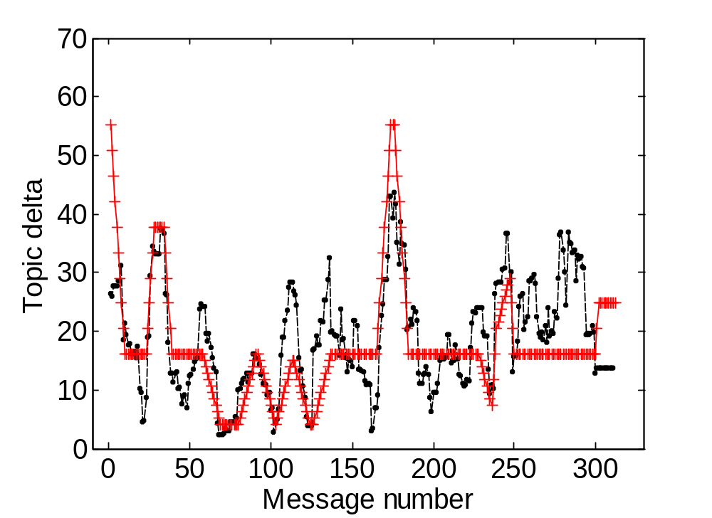
Enron data
Topic Δ
WAM

Slide 27
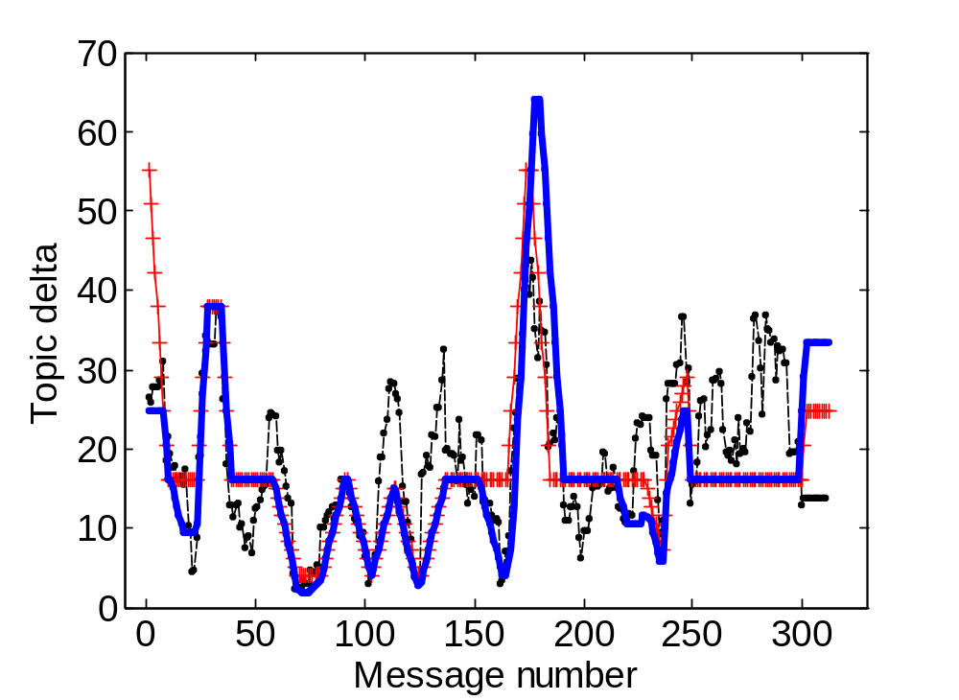
Enron data
Topic Δ
WAM
IDA-IT

Slide 28
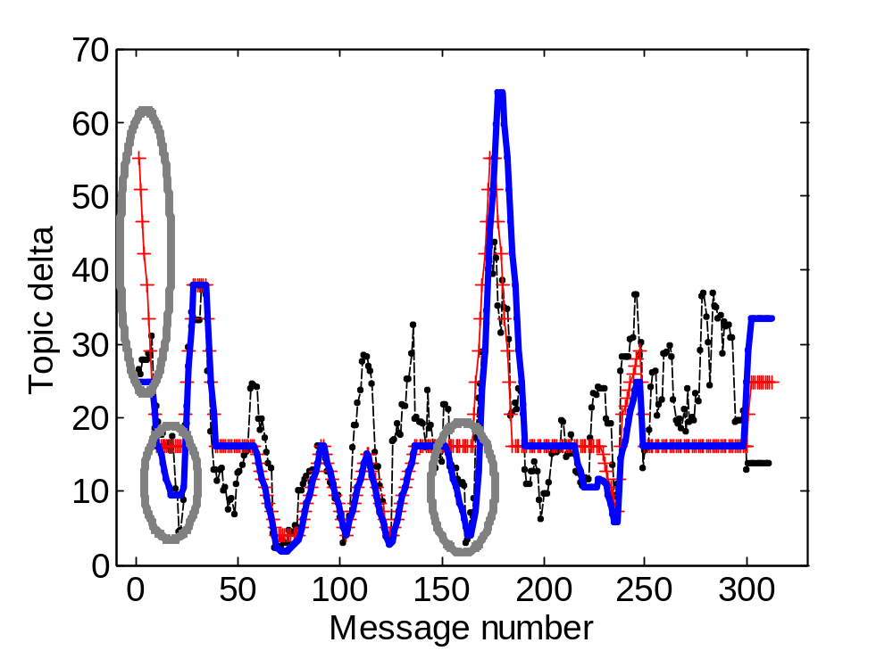
Enron data
Topic Δ
WAM
IDA-IT
Implicit Data Association identifies bursts which
are missed by Weighted Automaton Model
(separate approach)
Notes:
Add legend; add arrow (less / more frequent); indicate bursts

Slide 29
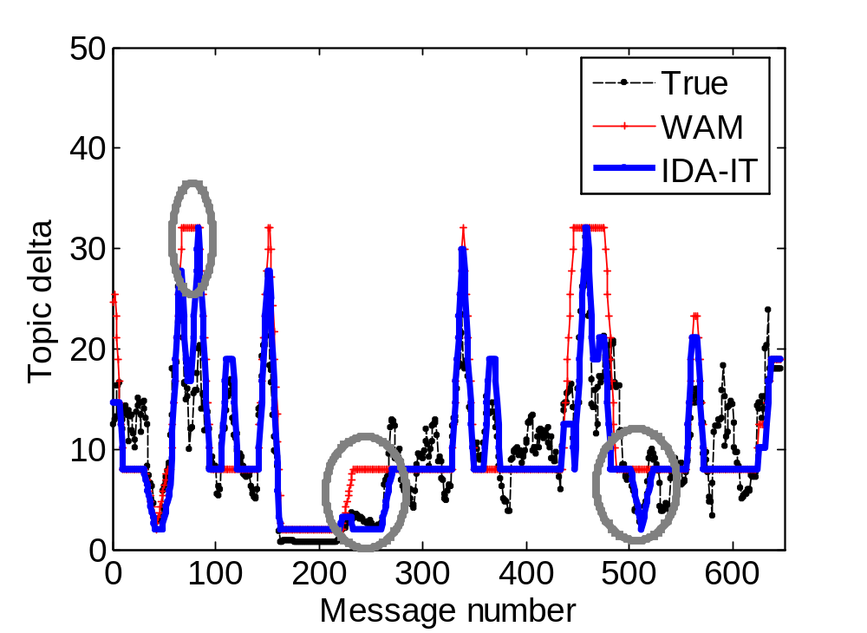
Reuters news archive
50
40
30
20
10
0
0
100
200
300
400
500
600
700
Again, simultaneous topic and burst identification outperforms separate approach

Slide 30
What about classification?
Temporal modeling effectively changes class prior over time.
Impact on classification accuracy?

Slide 31
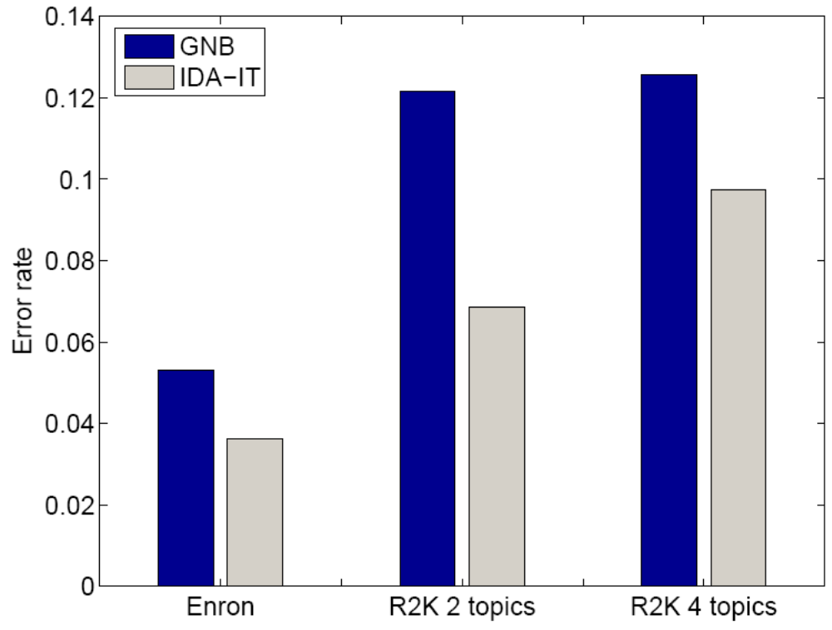
Classification performance
IDA
Model
Naïve
Bayes
Modeling intensity leads to improved
classification accuracy ☺

Slide 32
Generalizations
Learning paradigms
  Not just supervised setting, but also:
  Unsupervised- / semisupervised learning
  Active learning (select most informative labels)
  See paper for details.
Other document representations
Other applications
  Fault detection
  Activity recognition
  …

Slide 33
Topic tracking
Intensity for
“Conference”
Intensity for
“Hiking”
L^{(C)}_{t-1}
L^{(C)}_{t}
L^{(C)}_{t+1}
Topic param.
(Mean for LSI representation)
L^{(H)}_{t-1}
L^{(H)}_{t}
L^{(H)}_{t+1}
μ_{t} tracks topic means (Kalman Filter)
μ_{t-1}
μ_{t}
μ_{t+1}
Δ_{t}
C_{t}
D_{t}
Time between
Subsequent emails
Topic indicator
(i.e., = “Conference”)
Document
Representation
(LSI)

Slide 34
Conclusion
General model for data association in
data streams
A principled model for “changing class priors”
over time
Can be used in supervised, unsupervised and (semisupervised) active learning setting

Slide 35
Conclusion
Surprising performance of simplified IDA model
Exponential order statistics enable implicit data association and tractable exact inference
Synergetic effect between intensity estimation and classification on several real-world data sets
Notes:
Remove “investigated…”?

Slide 36
The Task
Our task is data association in a continuous time probabilistic graphical model
  We observe Message Deltas – the times between the arrivals of consecutive documents
  Associate the document with a topic to find the Topic Deltas – time between messages of the same class
  Determine intensity L = 1/Δ
We model the inter-arrival times with exponential distribution
  The parameter of the exponential distribution is the intensity – expected time between the messages from the same topic. Intensities follow Markov process.

Slide 37
Motivating Example
A person is receiving email
At each time point we would like to answer the following questions:
  On what topics (tasks) is the person working on?
  With what intensity is he working on topic A?
  When do we expect next email on topic A to arrive?

Slide 38
Generative Model (conceptual)
L^{(k)}_{t-1}
L^{(k)}_{t}
L^{(k)}_{t+1}
K
τ_{t-1}
τ_{t}
τ_{t+1}
Δ_{t}
C_{t}
W_{t,n}
N
We have K topics
L … intensity level
C … topic
τ … topic last access times
Δ … time between messages
W… message (words)

Slide 39
Full Model (implemented)
L^{(k)}_{t-1}
L^{(k)}_{t}
L^{(k)}_{t+1}
τ^{(k)}_{t-1}
τ^{(k)}_{t}
τ^{(k)}_{t+1}
K
Reversal makes
Particle Filter work better.
Δ_{t}
C_{t}
W_{t,n}
N
Properties:
  Exact inference hard (τ_{t} continuous, non-Gaussian)
  Lots of determinism
  Small “effective” dimension ➔ Particle filter works well

Slide 40
Simplified Model
L^{(k)}_{t-1}
L^{(k)}_{t}
L^{(k)}_{t+1}
K
C_{t}
Δ_{t}
W_{t,n}
N
If rates are constant, we do not need to remember last access times (memorylessness of exponential distribution!)
Approximation: Implicit data association through exponential order statistics

Slide 41
Generalizations
Other applications
  Fault diagnosis
  Activity recognition

Slide 42
Results (Synthetic data)
periodic message arrivals (uninformative Δ) with noisy class assigments: ABBBABABABBB…
Misclassification Noise
30
25
20
Topic delta
15
10
5
0
0
20
40
60
80
Message number

Slide 43
Experimental Setup
Datasets
  Synthetic 1: 2 topics, 3 different intensity levels
  Synthetic 2: periodic message arrivals (uninformative Δ) with noisy class assigments: ABBBABABABBB…
  ENRON email dataset
  Reuters news corpus
Model parameters
  Given topic intensity levels:
  [4, 16, 32, 128, 256]
  Topic intensity transition probability: 0.3
Misclassification Noise

Slide 44
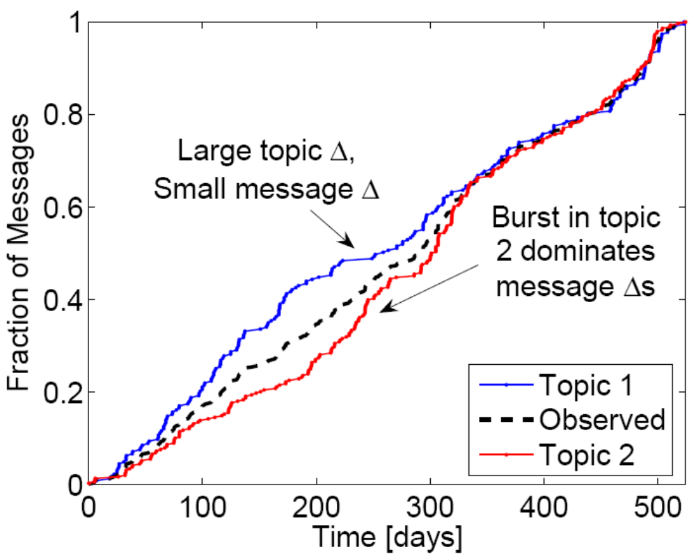

Slide 45
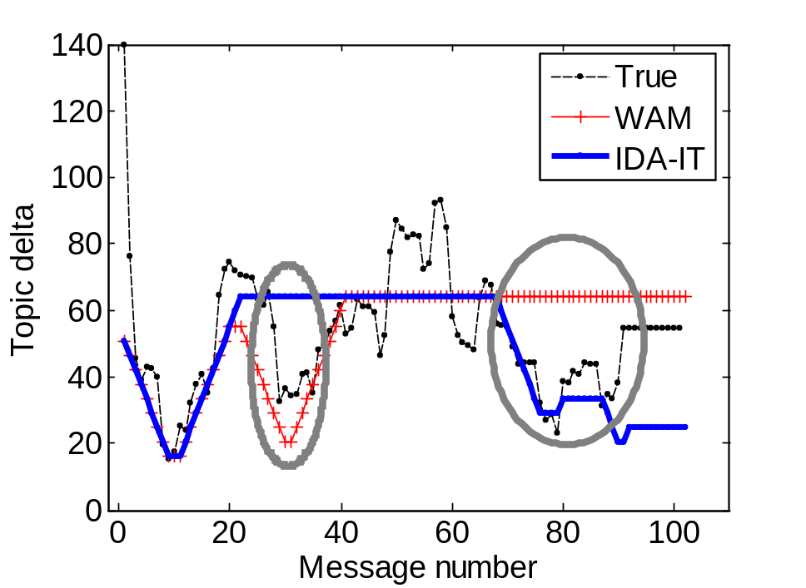

Slide 46
