Slide 1


Modeling Real Graphs using Kronecker Multiplication
Jure Leskovec, Christos Faloutsos
Machine Learning Department

Slide 2
Modeling large networks
Large networks (e.g., web, internet, on-line social networks) with millions of nodes
Need statistical methods and models to quantify large networks

Slide 3
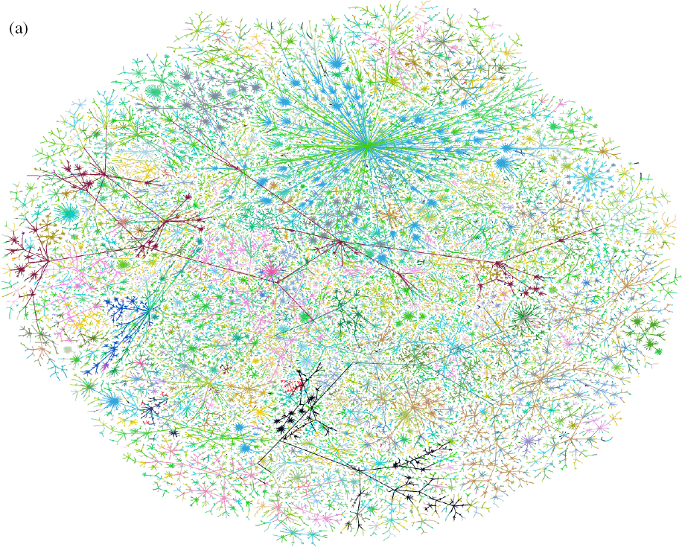
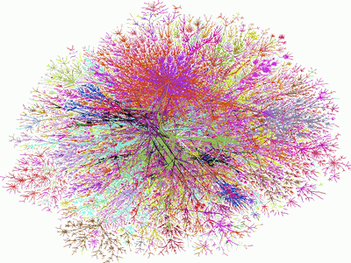
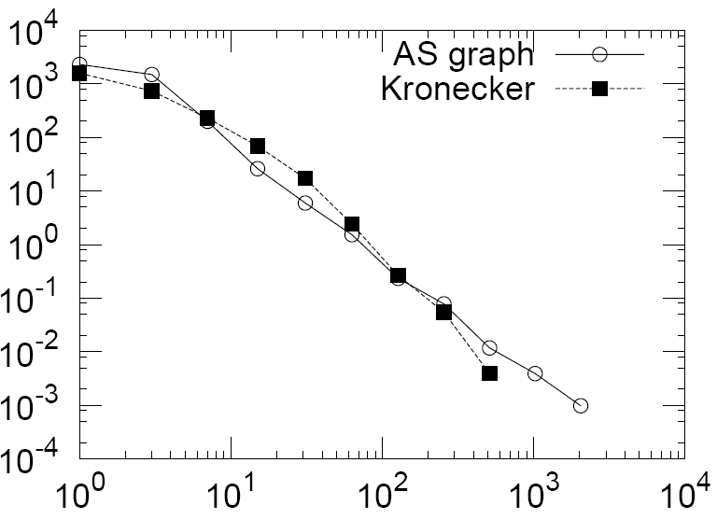
The problem
We want to generate realistic networks
  What are the relevant properties?
  What is a good analytically tractable model?
  How can we fit the model (estimate parameters)?
Given a large
real network
Generate a
synthetic network
Some statistical property, e.g., degree distribution
this talk

Slide 4
Why is this important?
Gives insight into the graph formation process
Anomaly detection – abnormal behavior, evolution
Predictions – predicting future from the past
Simulations of new algorithms where real graphs are hard/impossible to collect
Graph sampling – many real world graphs are too large to deal with
“What if” scenarios

Slide 5
Statistical properties of networks
Features that are common to networks of different types:
  Small-world effect [Milgram, Watts&Strogatz]
  Degree distributions [Faloutsos et al]
  Spectral properties [Chakrabarti et al]
  Transitivity or clustering [Watts&Strogatz]
  Community structure [Girvan&Newman, and others]
These properties are shared across many real world networks:
  World wide web [Barabasi]
  On-line communities [Holme, Edling, Liljeros]
  Who call whom telephone networks [Cortes]
  Internet backbone – routers [Faloutsos et al]
  …

Slide 6
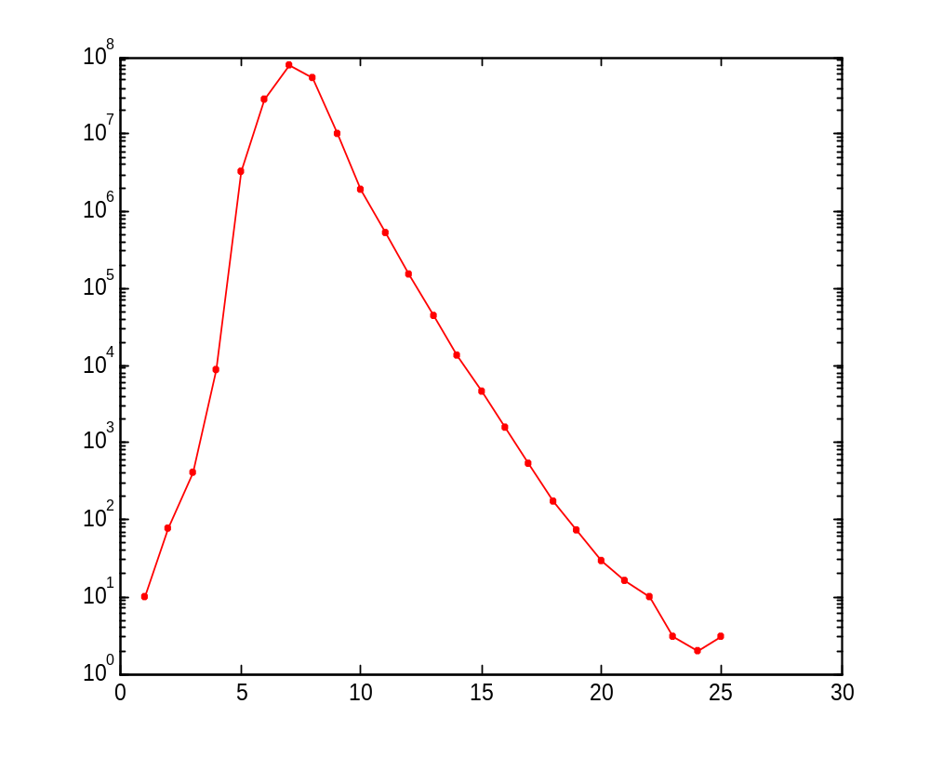
Small-world effect
Distances in MSN messenger network
Distribution of shortest path lengths
Microsoft Messenger network
  180 million people
  1.3 billion edges
  Edge if two people exchanged at least one message in one month period
Pick a random node, count how many nodes are at distance 1,2,3... hops
log Number of nodes
7
Distance (Hops)

Slide 7
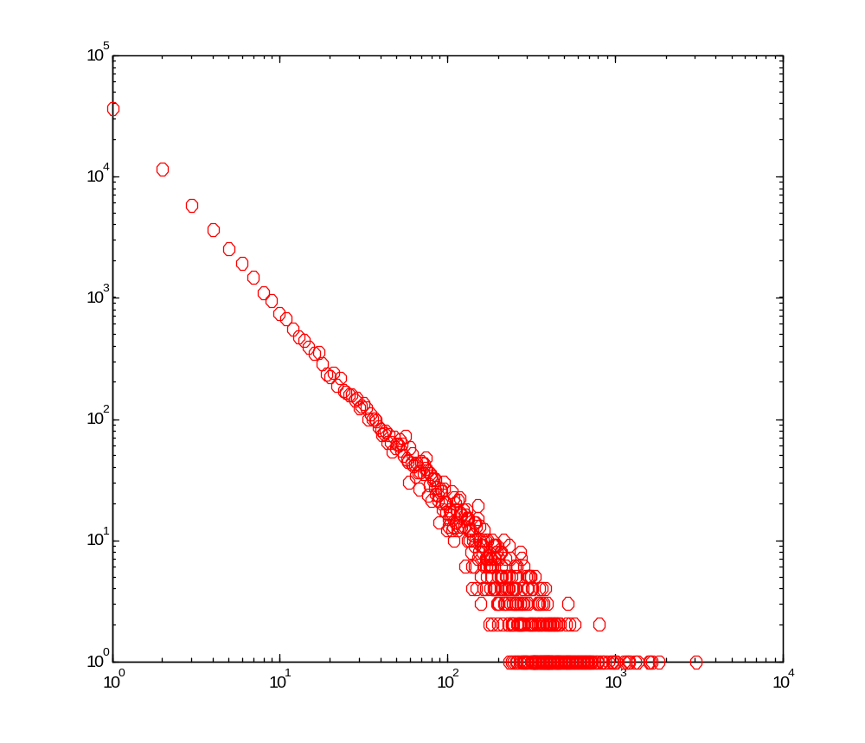
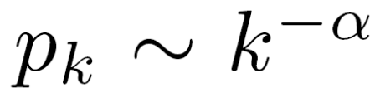
Heavy-tailed degree distributions
Degree distribution of a blog network
Let p_{k} denote a number (fraction) of nodes with degree k
We can plot a histogram of p_{k} vs. k
Degrees in real networks are heavily skewed to the right
Distribution has a long tail of values that are far above the mean
Power law:
log(p_{k})
log(k)

Slide 8
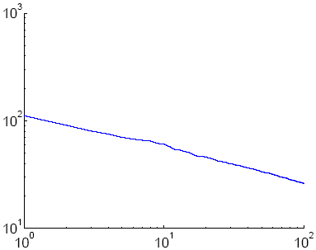
Spectral properties
Eigenvalue distribution in online social network
Eigenvalues of graph adjacency matrix follow a power law
Network values (components of principal eigenvector) also follow a power-law
log Eigenvalue
log Rank

Slide 9
Models of graph generation
Given graph properties
How can we design generative models that explain them?
Lots of work:
  Random graph [Erdos and Renyi, 60s]
  Preferential Attachment [Albert and Barabasi, 1999]
  Copying model [Kleinberg et al, 1999]
  Forest Fire model [Leskovec et al, 2005]
But all of these:
  Do not obey all the properties (aim to model (explain) just one of the properties at a time)
  Or are analytically intractable

Slide 10
The model: Kronecker graphs
Kronecker graphs are analytically tractable
We prove [with Chakrabarti, Kleinberg Kleinberg, Faloutsos in PKDD’05] that Kronecker graphs have rich properties:
  Static Patterns
    Power Law Degree Distribution
    Small Diameter
    Power Law Eigenvalue and Eigenvector Distribution
  Temporal Patterns
    Densification Power Law
    Shrinking/Constant Diameter

Slide 11
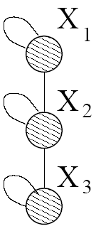
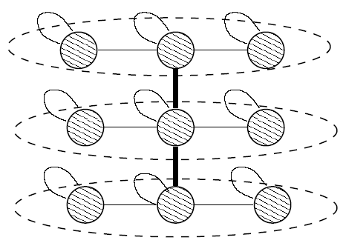
Idea: Recursive graph generation
Intuition: self-similarity leads to power-laws
Try to mimic recursive graph / community growth
There are many obvious (but wrong) ways:
Kronecker Product is a way of generating self-similar matrices
Initial graph
Recursive expansion

Slide 12
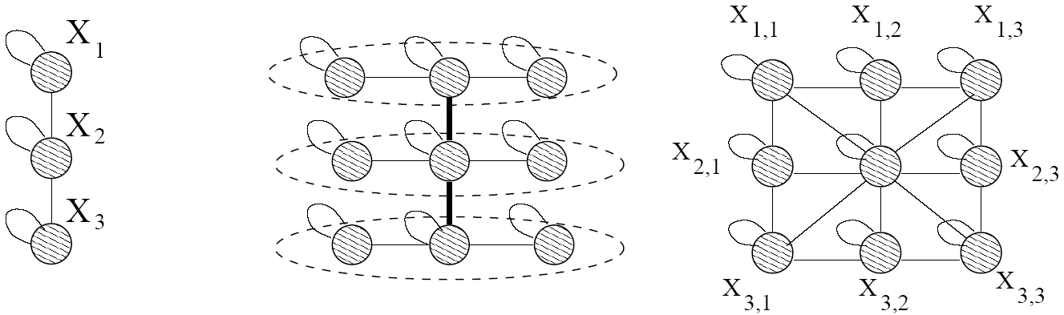
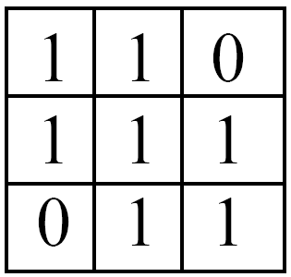
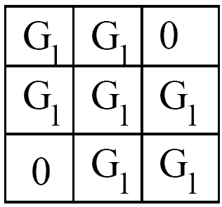


Kronecker product: Graph
Intermediate stage
(3x3)
(9x9)
Adjacency matrix
Adjacency matrix

Slide 13
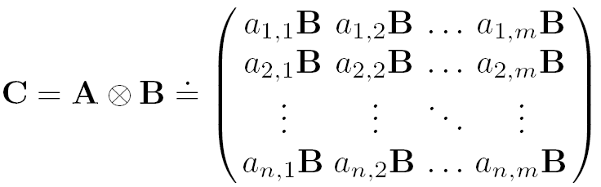
Kronecker product: Definition
The Kronecker product of matrices A and B is given by
We define a Kronecker product of two graphs as a Kronecker product of their adjacency matrices
N x M
K x L
N*K x M*L

Slide 14
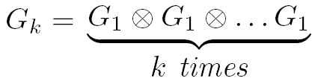
Kronecker graphs
We create the self-similar graphs recursively
  Start with a initiator graph G₁ on N₁ nodes and E₁ edges
  The recursion will then product larger graphs G₂, G₃, …G_{k} on N₁^{k} nodes
We obtain a growing sequence of graphs by iterating the Kronecker product

Slide 15
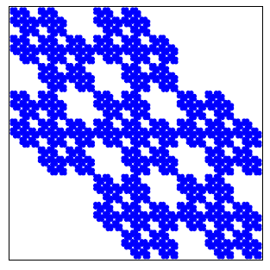
Kronecker product: Graph
Continuing multypling with G₁ we obtain G₄ and so on …
G₄ adjacency matrix

Slide 16
Stochastic Kronecker graphs
Create N₁×N₁ probability matrix Θ₁
Compute the k^{th} Kronecker power Θ_{k}
For each entry p_{uv} of Θ_{k} include an edge (u,v) with probability p_{uv}
Probability of edge p_{uv}
Kronecker
multiplication
0.25 | 0.10 | 0.10 | 0.04
0.05 | 0.15 | 0.02 | 0.06
0.05 | 0.02 | 0.15 | 0.06
0.01 | 0.03 | 0.03 | 0.09
0.5 | 0.2
0.1 | 0.3
Instance
matrix K₂
Θ₁
For each p_{uv} flip Bernoulli coin
Θ₂=Θ₁⊗Θ₁

Slide 17
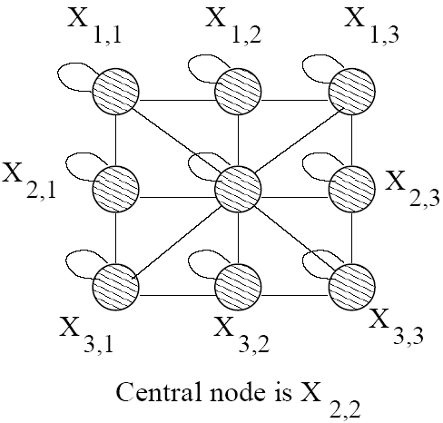
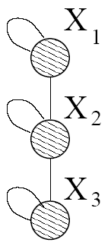
Kronecker graphs: Intuition
1) Recursive growth of graph communities
  Nodes get expanded to micro communities
  Nodes in sub-community link among themselves and to nodes from different communities
2) Node attribute representation
  Nodes are described by features
    [likes ice cream, likes chocolate]
    u=[1,0], v=[1, 1]
  Parameter matrix gives the linking probability
    p(u,v) = 0.5 * 0.1 = 0.05
1 0
1
0
0.5 | 0.2
0.1 | 0.3
Θ₁
Notes:
Little graph, super-graph (g1, g2)

Slide 18
Properties of Kronecker graphs
We prove that Kronecker multiplication generates graphs that obey [PKDD’05]
  Properties of static networks
    Power Law Degree Distribution
    Power Law eigenvalue and eigenvector distribution
    Small Diameter
  Properties of dynamic networks
    Densification Power Law
    Shrinking/Stabilizing Diameter
Good news: Kronecker graphs have the necessary expressive power
But: How do we choose the parameters to match all of these at once?
✓
✓
✓
✓
✓

Slide 19
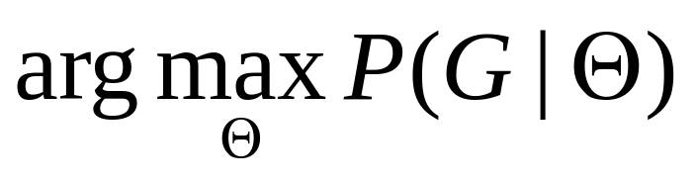
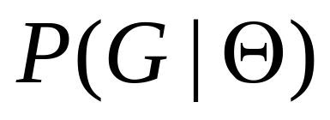
Model estimation: approach
Maximum likelihood estimation
  Given real graph G
  Estimate Kronecker initiator graph Θ (e.g., ) which
We need to (efficiently) calculate
And maximize over Θ (e.g., using gradient descent)

Slide 20
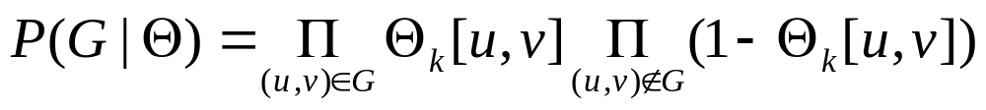
Fitting Kronecker graphs
G
Given a graph G and Kronecker matrix Θ we calculate probability that Θ generated G P(G|Θ)
0.25 | 0.10 | 0.10 | 0.04
0.05 | 0.15 | 0.02 | 0.06
0.05 | 0.02 | 0.15 | 0.06
0.01 | 0.03 | 0.03 | 0.09
1 | 0 | 1 | 1
0 | 1 | 0 | 1
1 | 0 | 1 | 1
1 | 1 | 1 | 1
0.5 | 0.2
0.1 | 0.3
Θ
Θ_{k}
G
P(G|Θ)

Slide 21
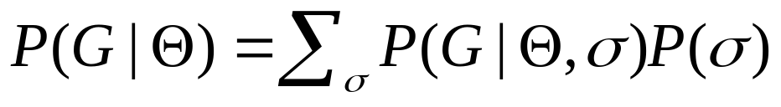
Challenge 1: Node correspondence
Θ_{k}
Θ
0.25 | 0.10 | 0.10 | 0.04
0.05 | 0.15 | 0.02 | 0.06
0.05 | 0.02 | 0.15 | 0.06
0.01 | 0.03 | 0.03 | 0.09
Nodes are unlabeled
Graphs G’ and G” should have the same probability
P(G’|Θ) = P(G”|Θ)
One needs to consider all node correspondences σ
All correspondences are a priori equally likely
There are O(N!) correspondences
0.5 | 0.2
0.1 | 0.3
σ
G’
1
1 | 0 | 1 | 0
0 | 1 | 1 | 1
1 | 1 | 1 | 1
0 | 0 | 1 | 1
3
2
4
G”
2
1 | 0 | 1 | 1
0 | 1 | 0 | 1
1 | 0 | 1 | 1
1 | 1 | 1 | 1
4
1
3
P(G’|Θ) = P(G”|Θ)

Slide 22
Challenge 2: calculating P(G|Θ,σ)
Assume we solved the correspondence problem
Calculating
Takes O(N²) time
Infeasible for large graphs (N ~ 10⁵)
σ… node labeling
0.25 | 0.10 | 0.10 | 0.04
0.05 | 0.15 | 0.02 | 0.06
0.05 | 0.02 | 0.15 | 0.06
0.01 | 0.03 | 0.03 | 0.09
1 | 0 | 1 | 1
0 | 1 | 0 | 1
1 | 0 | 1 | 1
0 | 0 | 1 | 1
σ
Θ_{kc}
G
P(G|Θ, σ)

Slide 23
Model estimation: solution
Naïvely estimating the Kronecker initiator takes O(N!N²) time:
  N! for graph isomorphism
    Metropolis sampling: N! → (big) const
  N² for traversing the graph adjacency matrix
    Properties of Kronecker product and sparsity (E << N²): N²→ E
We can estimate the parameters of Kronecker graph in linear time O(E)

Slide 24

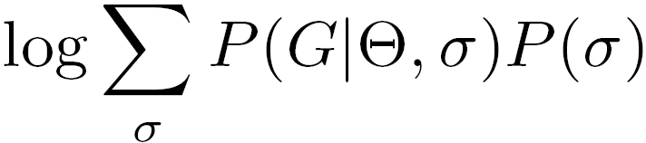

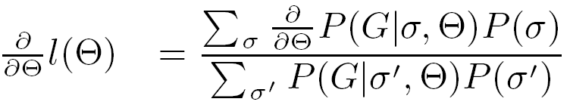
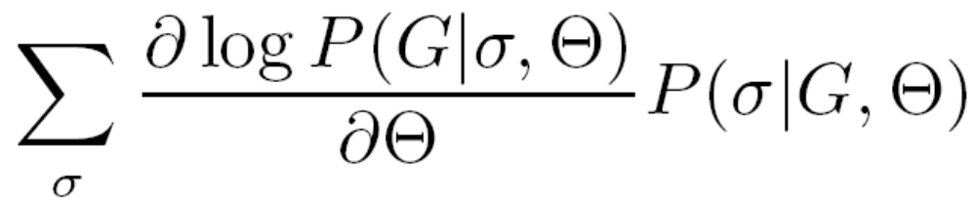
Solution 1: Node correspondence
Log-likelihood
Gradient of log-likelihood
Sample the permutations from P(σ|G,Θ) and average the gradients

Slide 25
Sampling node correspondences
Metropolis sampling:
  Start with a random permutation
  Do local moves on the permutation
  Accept the new permutation
    If new permutation is better (gives higher likelihood)
    If new is worse accept with probability proportional to the ratio of likelihoods
1
Swap node labels 1 and 4
4
Re-evaluate the likelihood
3
3
2
2
4
1
Can compute efficiently:
Only need to account for changes in 2 rows / columns
1
2
3
4
1 | 0 | 1 | 0
0 | 1 | 1 | 1
1 | 1 | 1 | 1
0 | 1 | 1 | 1
4
2
3
1
1 | 1 | 1 | 0
1 | 1 | 1 | 0
1 | 1 | 1 | 1
0 | 0 | 1 | 1

Slide 26
Solution 2: Calculating P(G|Θ,σ)
Calculating naively P(G|Θ,σ) takes O(N²)
Idea:
  First calculate likelihood of empty graph, a graph with 0 edges
  Correct the likelihood for edges that we observe in the graph
By exploiting the structure of Kronecker product we obtain closed form for likelihood of an empty graph

Slide 27
Solution 2: Calculating P(G|Θ,σ)
We approximate the likelihood:
The sum goes only over the edges
Evaluating P(G|Θ,σ) takes O(E) time
Real graphs are sparse, E << N²
Empty graph
No-edge likelihood
Edge likelihood
Notes:
ADD ANIMATION

Slide 28
Experiments: synthetic data
Can gradient descent recover true parameters?
Optimization problem is not convex
How nice (without local minima) is optimization space?
  Generate a graph from random parameters
  Start at random point and use gradient descent
  We recover true parameters 98% of the times

Slide 29
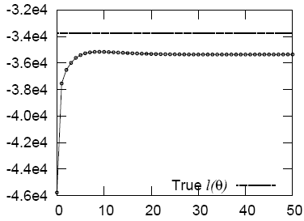
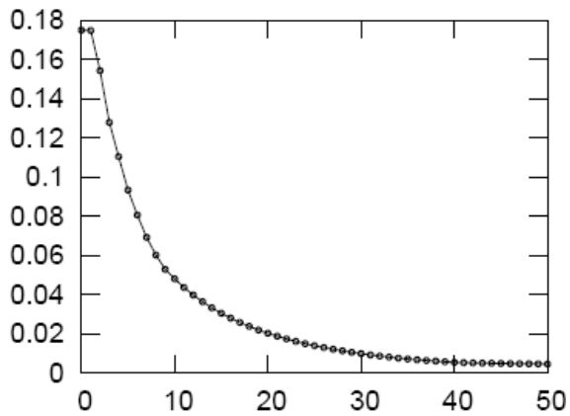
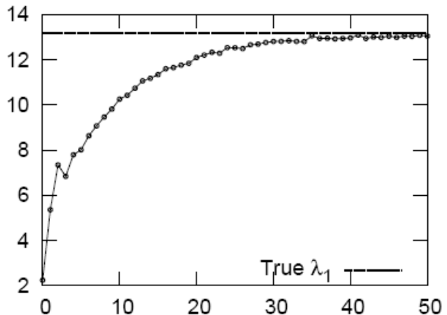
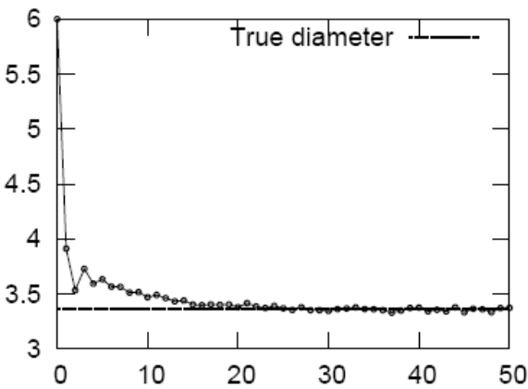
Convergence of properties
How does algorithm converge to true parameters with gradient descent iterations?
Log-likelihood
Avg abs error
Gradient descent iterations
Gradient descent iterations
1st eigenvalue
Diameter

Slide 30
Experiments: real networks
Experimental setup:
  Given real graph
  Stochastic gradient descent from random initial point
  Obtain estimated parameters
  Generate synthetic graphs
  Compare properties of both graphs
We do not fit the properties themselves
We fit the likelihood and then compare the graph properties

Slide 31
AS graph (N=6500, E=26500)
Autonomous systems (internet)
We search the space of ~10^{50,000} permutations
Fitting takes 20 minutes
AS graph is undirected and estimated parameter matrix is symmetric:
0.98 | 0.58
0.58 | 0.06

Slide 32
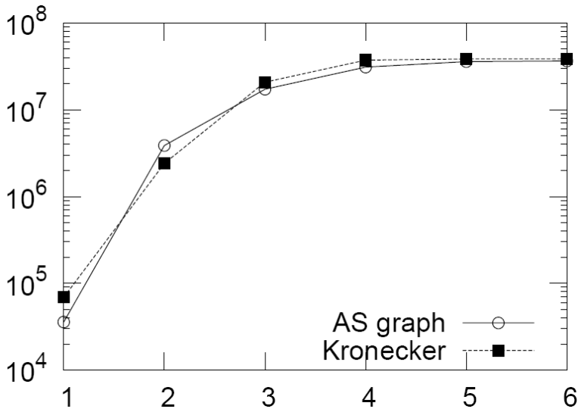
AS: comparing graph properties
Generate synthetic graph using estimated parameters
Compare the properties of two graphs
Degree distribution
Hop plot
log # of reachable pairs
diameter=4
log count
log degree
number of hops

Slide 33
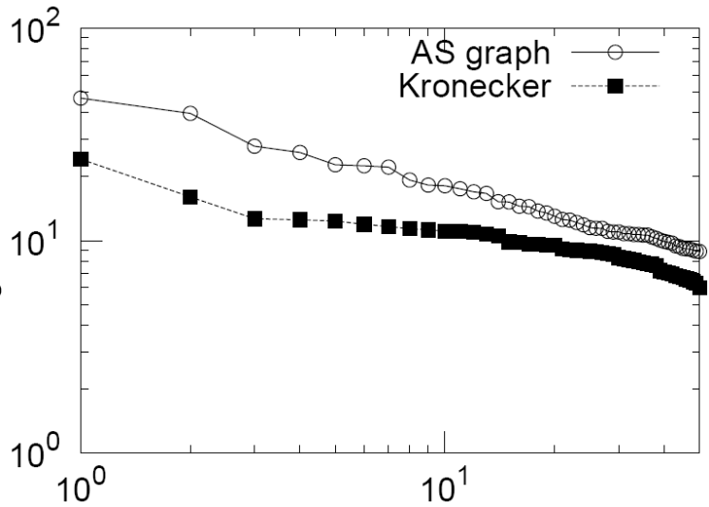
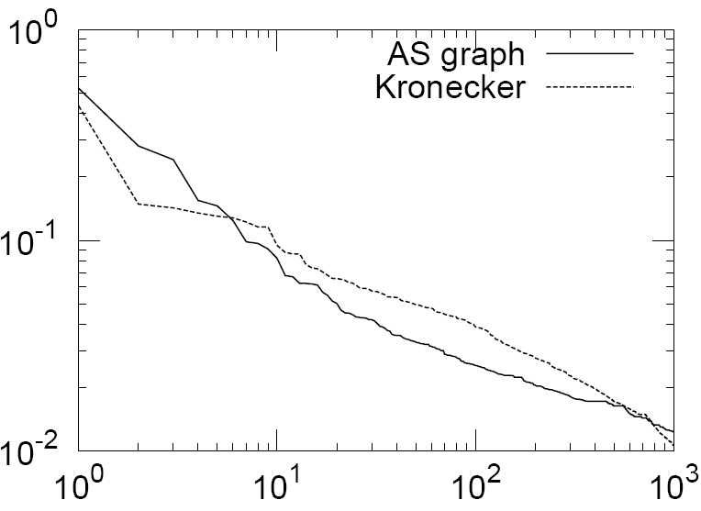
AS: comparing graph properties
Spectral properties of graph adjacency matrices
Scree plot
Network value
log eigenvalue
log value
log rank
log rank

Slide 34
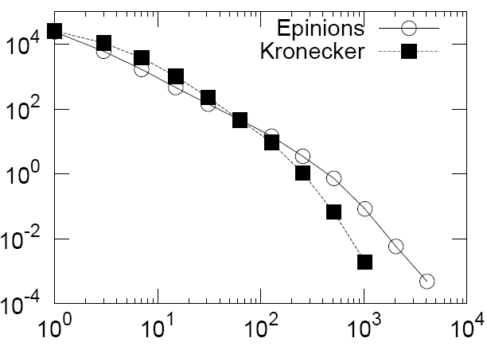
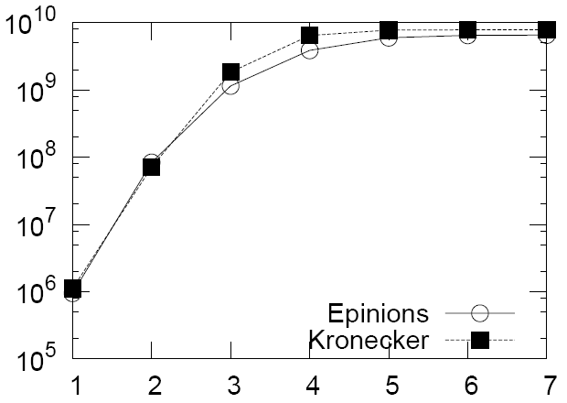
Epinions graph (N=76k, E=510k)
We search the space of ~10^{1,000,000} permutations
Fitting takes 2 hours
The structure of the estimated parameter gives insight into the structure of the graph
0.99 | 0.54
0.49 | 0.13
Degree distribution
Hop plot
log count
log # of reachable pairs
log degree
number of hops

Slide 35
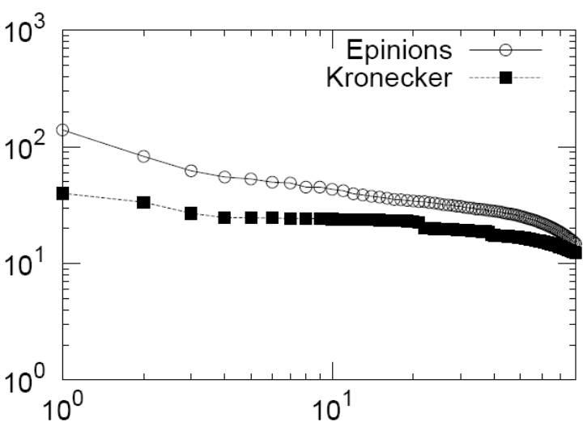
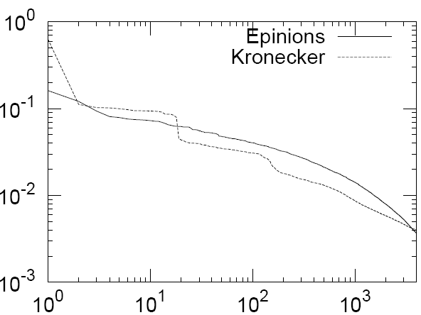
Epinions graph (N=76k, E=510k)
Scree plot
Network value
log eigenvalue
log rank
log rank

Slide 36
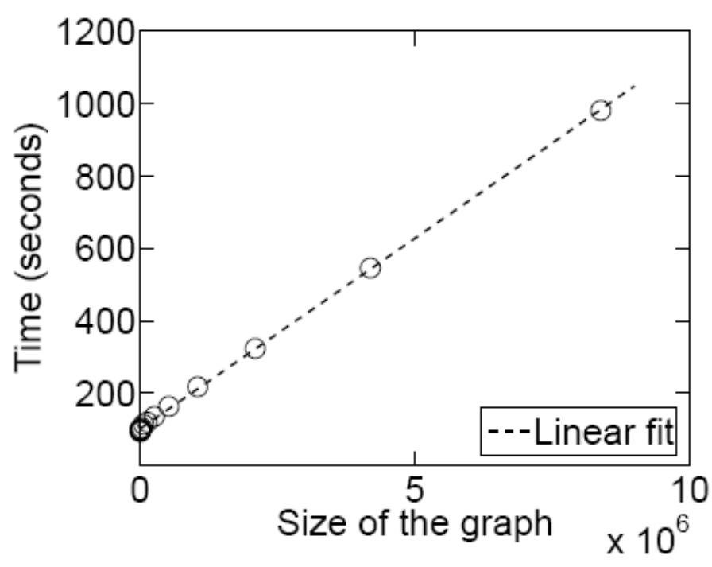
Scalability
Fitting scales linearly with the number of edges

Slide 37
Conclusion
Kronecker Graph model has
  provable properties
  small number of parameters
We developed scalable algorithms for fitting Kronecker Graphs
We can efficiently search large space (~10^{1,000,000}) of permutations
Kronecker graphs fit well real networks using few parameters
We match graph properties without a priori deciding on which ones to fit

Slide 38
References
  Graphs over Time: Densification Laws, Shrinking Diameters and Possible Explanations, by Jure Leskovec, Jon Kleinberg, Christos Faloutsos, ACM KDD 2005
  Graph Evolution: Densification and Shrinking Diameters, by Jure Leskovec, Jon Kleinberg and Christos Faloutsos, ACM TKDD 2007
  Realistic, Mathematically Tractable Graph Generation and Evolution, Using Kronecker Multiplication, by Jure Leskovec, Deepay Chakrabarti, Jon Kleinberg and Christos Faloutsos, PKDD 2005
  Scalable Modeling of Real Graphs using Kronecker Multiplication, by Jure Leskovec and Christos Faloutsos, ICML 2007
Acknowledgements: Christos Faloutsos, Jon Kleinberg, Zoubin Gharamani, Pall Melsted, Alan Frieze, Larry Wasserman, Carlos Guestrin, Deepay Chakrabarti

