Slide 1
Realistic Graph Generation and Evolution Using
Kronecker Multiplication
Jurij Leskovec, CMU
Deepay Chakrabarti, CMU/Yahoo
Jon Kleinberg, Cornell
Christos Faloutsos, CMU

Slide 2
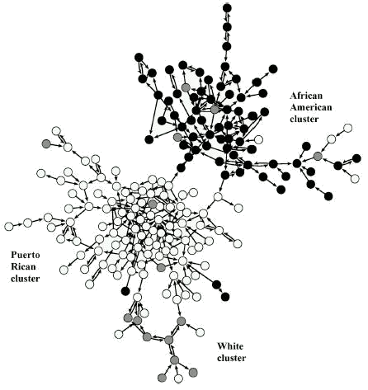
Introduction
Graphs are everywhere
What can we do with graphs?
  What patterns or “laws” hold for most real-world graphs?
  Can we build models of graph generation and evolution?
“Needle exchange” networks of drug users

Slide 3
Outline
Introduction
Static graph patterns
Temporal graph patterns
Proposed graph generation model
  Kronecker Graphs
Properties of Kronecker Graphs
Stochastic Kronecker Graphs
Experiments
Observations and Conclusion

Slide 4
Outline
Introduction
Static graph patterns
Temporal graph patterns
Proposed graph generation model
  Kronecker Graphs
Properties of Kronecker Graphs
Stochastic Kronecker Graphs
Experiments
Observations and Conclusion

Slide 5
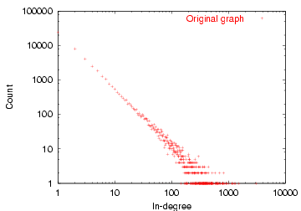
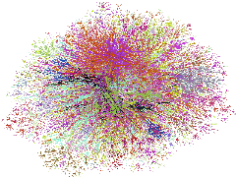
Static Graph Patterns (1)
Power Law degree distributions
Many low-degree nodes
log(Count)
Few high-degree nodes
log(Degree)
Internet in December 1998
Y=a*X^{b}

Slide 6
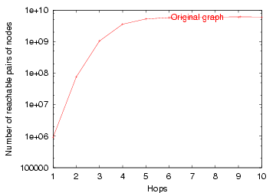
Static Graph Patterns (2)
Small-world
[Watts, Strogatz]++
  6 degrees of separation
  Small diameter
Effective diameter:
  Distance at which 90% of pairs of nodes are reachable
# Reachable pairs
Effective Diameter
Hops
Epinions who-trusts-whom social network

Slide 7
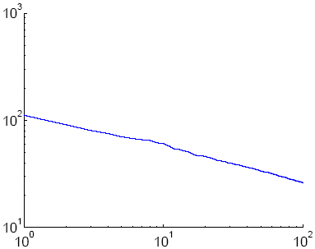
Static Graph Patterns (3)
Scree plot
[Chakrabarti et al]
  Eigenvalues of graph adjacency matrix follow a power law
  Network values (components of principal eigenvector) also follow a power-law
Scree Plot
Eigenvalue
Rank

Slide 8
Outline
Introduction
Static graph patterns
Temporal graph patterns
Proposed graph generation model
  Kronecker Graphs
Properties of Kronecker Graphs
Stochastic Kronecker Graphs
Observations and Conclusion

Slide 9
Temporal Graph Patterns
Conventional Wisdom:
  Constant average degree: the number of edges grows linearly with the number of nodes
  Slowly growing diameter: as the network grows the distances between nodes grow
Recently found [Leskovec, Kleinberg and Faloutsos, 2005]:
  Densification Power Law: networks are becoming denser over time
  Shrinking Diameter: diameter is decreasing as the network grows

Slide 10
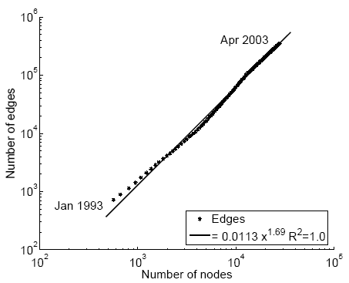
Temporal Patterns – Densification
Densification Power Law
  N(t) … nodes at time t
  E(t) … edges at time t
Suppose that
  N(t+1) = 2 * N(t)
Q: what is your guess for
  E(t+1) =? 2 * E(t)
A: over-doubled!
  But obeying the Densification Power Law
Densification Power Law
E(t)
1.69
N(t)

Slide 11

Temporal Patterns – Densification
Densification Power Law
  networks are becoming denser over time
  the number of edges grows faster than the number of nodes – average degree is increasing
Densification exponent a: 1 ≤ a ≤ 2:
  a=1: linear growth – constant out-degree
  (assumed in the literature so far)
  a=2: quadratic growth – clique

Slide 12
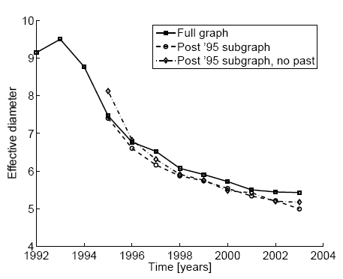
Temporal Patterns – Diameter
Prior work on Power Law graphs hints at Slowly growing diameter:
  diameter ~ O(log N)
  diameter ~ O(log log N)
Diameter Shrinks/Stabilizes over time
  As the network grows the distances between nodes slowly decrease
Diameter over time
diameter
time [years]

Slide 13
Patterns hold in many graphs
All these patterns can be observed in many real life graphs:
  World wide web [Barabasi]
  On-line communities [Holme, Edling, Liljeros]
  Who call whom telephone networks [Cortes]
  Autonomous systems [Faloutsos, Faloutsos, Faloutsos]
  Internet backbone – routers [Faloutsos, Faloutsos, Faloutsos]
  Movie – actors [Barabasi]
  Science citations [Leskovec, Kleinberg, Faloutsos]
  Co-authorship [Leskovec, Kleinberg, Faloutsos]
  Sexual relationships [Liljeros]
  Click-streams [Chakrabarti]
Notes:
Show plots of drawings

Slide 14
Problem Definition
Given a growing graph with nodes N₁, N₂, …
Generate a realistic sequence of graphs that will obey all the patterns
  Static Patterns
    Power Law Degree Distribution
    Small Diameter
    Power Law eigenvalue and eigenvector distribution
  Dynamic Patterns
    Growth Power Law
    Shrinking/Constant Diameters
  And ideally we would like to prove them

Slide 15
Graph Generators
Lots of work
  Random graph [Erdos and Renyi, 60s]
  Preferential Attachment [Albert and Barabasi, 1999]
  Copying model [Kleinberg, Kumar, Raghavan, Rajagopalan and Tomkins, 1999]
  Community Guided Attachment and Forest Fire Model [Leskovec, Kleinberg and Faloutsos, 2005]
  Also work on Web graph and virus propagation [Ganesh et al, Satorras and Vespignani]++
But all of these
  Do not obey all the patterns
  Or we are not able prove them

Slide 16
Why is all this important?
Simulations of new algorithms where real graphs are impossible to collect
Predictions – predicting future from the past
Graph sampling – many real world graphs are too large to deal with
What if scenarios

Slide 17
Outline
Introduction
Static graph patterns
Temporal graph patterns
Proposed graph generation model
  Kronecker Graphs
Properties of Kronecker Graphs
Stochastic Kronecker Graphs
Observations and Conclusion

Slide 18
Problem Definition
Given a growing graph with count of nodes N₁, N₂, …
Generate a realistic sequence of graphs that will obey all the patterns
Idea: Self-similarity
  Leads to power laws
  Communities within communities
  …

Slide 19
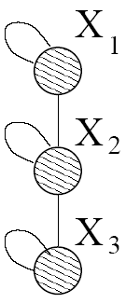
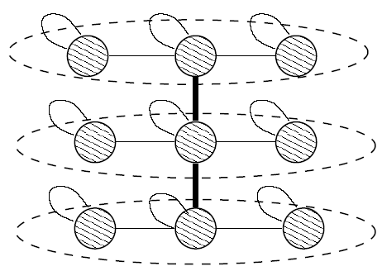
Recursive Graph Generation
There are many obvious (but wrong) ways
  Does not obey Densification Power Law
  Has increasing diameter
Kronecker Product is exactly what we need
There are many obvious (but wrong) ways
Initial graph
Recursive expansion

Slide 20
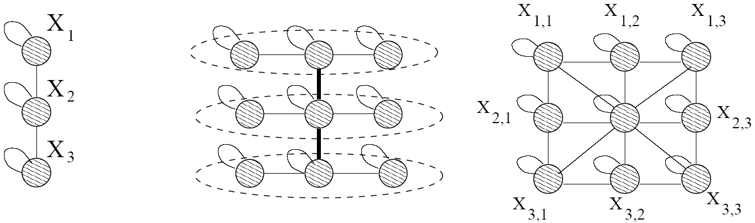
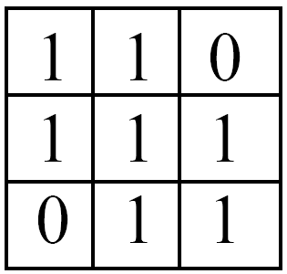
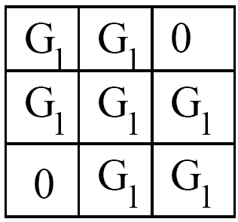


Kronecker Product – a Graph
Intermediate stage
Adjacency matrix
Adjacency matrix

Slide 21
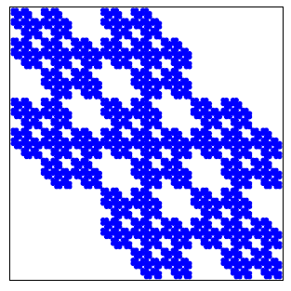
Kronecker Product – a Graph
Continuing multypling with G₁ we obtain G₄ and so on …
G₄ adjacency matrix

Slide 22
Kronecker Graphs – Formally:
We create the self-similar graphs recursively:
  Start with a initiator graph G₁ on N₁ nodes and E₁ edges
  The recursion will then product larger graphs G₂, G₃, …G_{k} on N₁^{k} nodes
  Since we want to obey Densification Power Law graph G_{k} has to have E₁^{k} edges

Slide 23
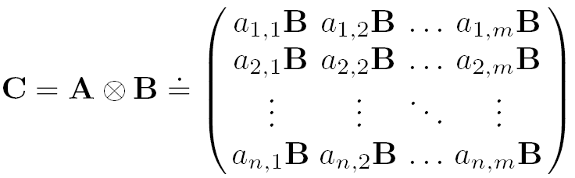
Kronecker Product – Definition
The Kronecker product of matrices A and B is given by
We define a Kronecker product of two graphs as a Kronecker product of their adjacency matrices
N x M
K x L
N*K x M*L

Slide 24
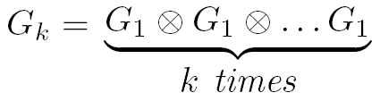
Kronecker Graphs
We propose a growing sequence of graphs by iterating the Kronecker product
Each Kronecker multiplication exponentially increases the size of the graph

Slide 25
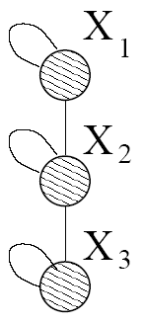
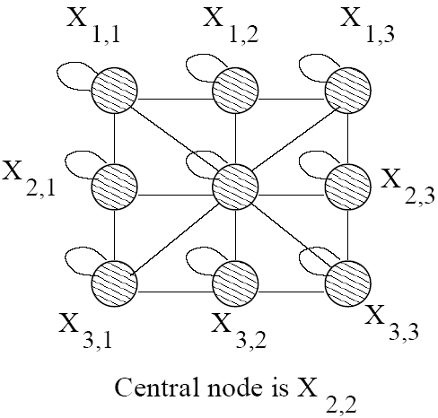
Kronecker Graphs – Intuition
Intuition:
  Recursive growth of graph communities
  Nodes get expanded to micro communities
  Nodes in sub-community link among themselves and to nodes from different communities
Notes:
Little graph, super-graph (g1, g2)

Slide 26
Outline
Introduction
Static graph patterns
Temporal graph patterns
Proposed graph generation model
  Kronecker Graphs
Properties of Kronecker Graphs
Stochastic Kronecker Graphs
Experiments
Conclusion

Slide 27
Problem Definition
Given a growing graph with nodes N₁, N₂, …
Generate a realistic sequence of graphs that will obey all the patterns
  Static Patterns
    Power Law Degree Distribution
    Power Law eigenvalue and eigenvector distribution
    Small Diameter
  Dynamic Patterns
    Growth Power Law
    Shrinking/stabilizing Diameters

Slide 28
Problem Definition
Given a growing graph with nodes N₁, N₂, …
Generate a realistic sequence of graphs that will obey all the patterns
  Static Patterns
    Power Law Degree Distribution
    Power Law eigenvalue and eigenvector distribution
    Small Diameter
  Dynamic Patterns
    Growth Power Law
    Shrinking/stabilizing Diameters

Slide 29
Properties of Kronecker Graphs
Theorem: Kronecker Graphs have Multinomial in- and out-degree distribution
  (which can be made to behave like a Power Law)
Proof:
  Let G₁ have degrees d₁, d₂, …, d_{N}
  Kronecker multiplication with a node of degree d gives degrees d∙d₁, d∙d₂, …, d∙d_{N}
  After Kronecker powering G_{k} has multinomial degree distribution

Slide 30
Eigen-value/-vector Distribution
Theorem: The Kronecker Graph has multinomial distribution of its eigenvalues
Theorem: The components of each eigenvector in Kronecker Graph follow a multinomial distribution
Proof: Trivial by properties of Kronecker multiplication

Slide 31
Problem Definition
Given a growing graph with nodes N₁, N₂, …
Generate a realistic sequence of graphs that will obey all the patterns
  Static Patterns
    Power Law Degree Distribution
    Power Law eigenvalue and eigenvector distribution
    Small Diameter
  Dynamic Patterns
    Growth Power Law
    Shrinking/Stabilizing Diameters
✓
✓
✓
Notes:
Lets prove it
FOR EVERY PROOF GET THIS SLIDE AND ADD CHECKAMRKS

Slide 32
Problem Definition
Given a growing graph with nodes N₁, N₂, …
Generate a realistic sequence of graphs that will obey all the patterns
  Static Patterns
    Power Law Degree Distribution
    Power Law eigenvalue and eigenvector distribution
    Small Diameter
  Dynamic Patterns
    Growth Power Law
    Shrinking/Stabilizing Diameters
✓
✓
✓

Slide 33

Temporal Patterns: Densification
Theorem: Kronecker graphs follow a Densification Power Law with densification exponent
Proof:
  If G₁ has N₁ nodes and E₁ edges then G_{k} has N_{k} = N₁^{k} nodes and E_{k} = E₁^{k} edges
  And then E_{k} = N_{k}ª
  Which is a Densification Power Law

Slide 34
Constant Diameter
Theorem: If G₁ has diameter d then graph G_{k} also has diameter d
Theorem: If G₁ has diameter d then q-effective diameter if G_{k} converges to d
  q-effective diameter is distance at which q% of the pairs of nodes are reachable

Slide 35

Constant Diameter – Proof Sketch
Observation: Edges in Kronecker graphs:
  where X are appropriate nodes
Example:

Slide 36
Problem Definition
Given a growing graph with nodes N₁, N₂, …
Generate a realistic sequence of graphs that will obey all the patterns
  Static Patterns
    Power Law Degree Distribution
    Power Law eigenvalue and eigenvector distribution
    Small Diameter
  Dynamic Patterns
    Growth Power Law
    Shrinking/Stabilizing Diameters
  First and the only generator for which we can prove all the properties
✓
✓
✓
✓
✓

Slide 37
Outline
Introduction
Static graph patterns
Temporal graph patterns
Proposed graph generation model
  Kronecker Graphs
Properties of Kronecker Graphs
Stochastic Kronecker Graphs
Experiments
Observations and Conclusion

Slide 38
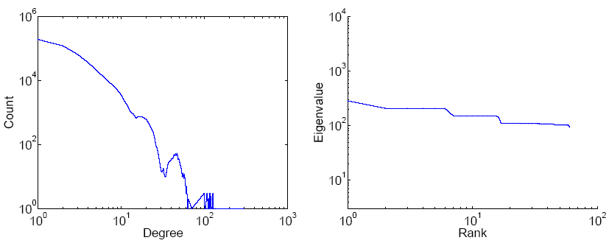
Kronecker Graphs
Kronecker Graphs have all desired properties
But they produce “staircase effects”
We introduce a probabilistic version
Stochastic Kronecker Graphs
Count
Eigenvalue
Degree
Rank

Slide 39
How to randomize a graph?
We want a randomized version of Kronecker Graphs
Obvious solution
  Randomly add/remove some edges
Wrong! – is not biased
  adding random edges destroys degree distribution, diameter, …
Want add/delete edges in a biased way
How to randomize properly and maintain all the properties?

Slide 40
Stochastic Kronecker Graphs
Create N₁×N₁ probability matrix P₁
Compute the k^{th} Kronecker power P_{k}
For each entry p_{uv} of P_{k} include an edge (u,v) with probability p_{uv}
Kronecker
multiplication
0.16 | 0.08 | 0.08 | 0.04
0.04 | 0.12 | 0.02 | 0.06
0.04 | 0.02 | 0.12 | 0.06
0.01 | 0.03 | 0.03 | 0.09
0.4 | 0.2
0.1 | 0.3
Instance
Matrix G₂
P₁
flip biased
coins
P_{k}

Slide 41
Outline
Introduction
Static graph patterns
Temporal graph patterns
Proposed graph generation model
  Kronecker Graphs
Properties of Kronecker Graphs
Stochastic Kronecker Graphs
Experiments
Conclusion

Slide 42
Experiments
How well can we match real graphs?
  Arxiv: physics citations:
    30,000 papers, 350,000 citations
    10 years of data
  U.S. Patent citation network
    4 million patents, 16 million citations
    37 years of data
  Autonomous systems – graph of internet
    Single snapshot from January 2002
    6,400 nodes, 26,000 edges
We show both static and temporal patterns

Slide 43
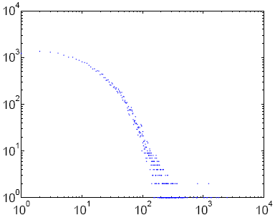
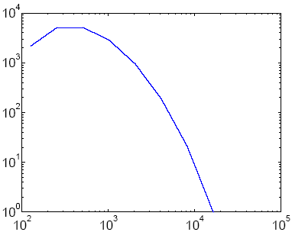
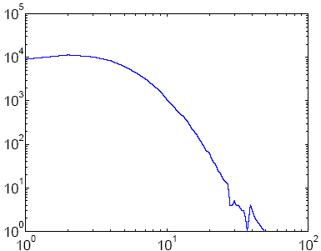
Arxiv – Degree Distribution
Real graph
Deterministic Kronecker
Stochastic Kronecker
Degree
Count
Count
Count
Notes:
Goes to 4 slides -- > each property is a separate slide

Slide 44
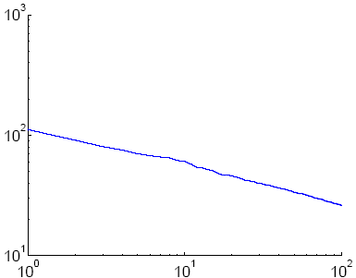
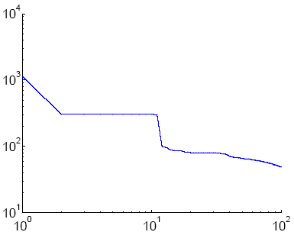
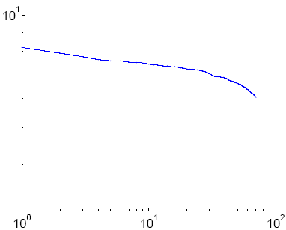
Arxiv – Scree Plot
Real graph
Deterministic Kronecker
Stochastic Kronecker
Eigenvalue
Rank
Rank
Rank
Notes:
Goes to 4 slides -- > each property is a separate slide

Slide 45
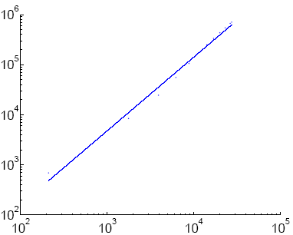
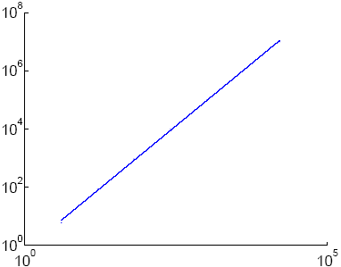
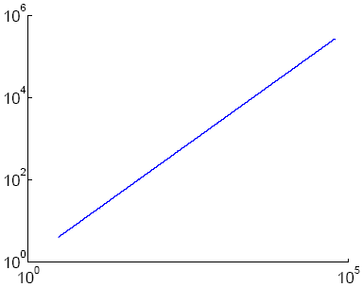
Arxiv – Densification
Real graph
Deterministic Kronecker
Stochastic Kronecker
Edges
Nodes(t)
Nodes(t)
Nodes(t)
Notes:
Goes to 4 slides -- > each property is a separate slide

Slide 46
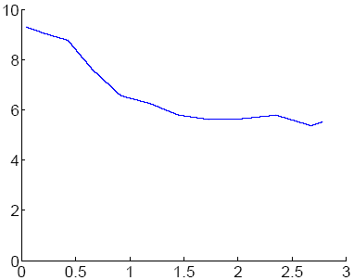
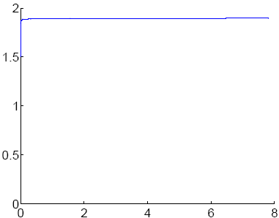
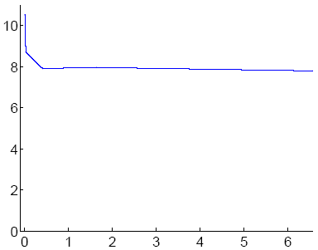
Arxiv – Effective Diameter
Real graph
Deterministic Kronecker
Stochastic Kronecker
Diameter
Nodes(t)
Nodes(t)
Nodes(t)
Notes:
Goes to 4 slides -- > each property is a separate slide

Slide 47
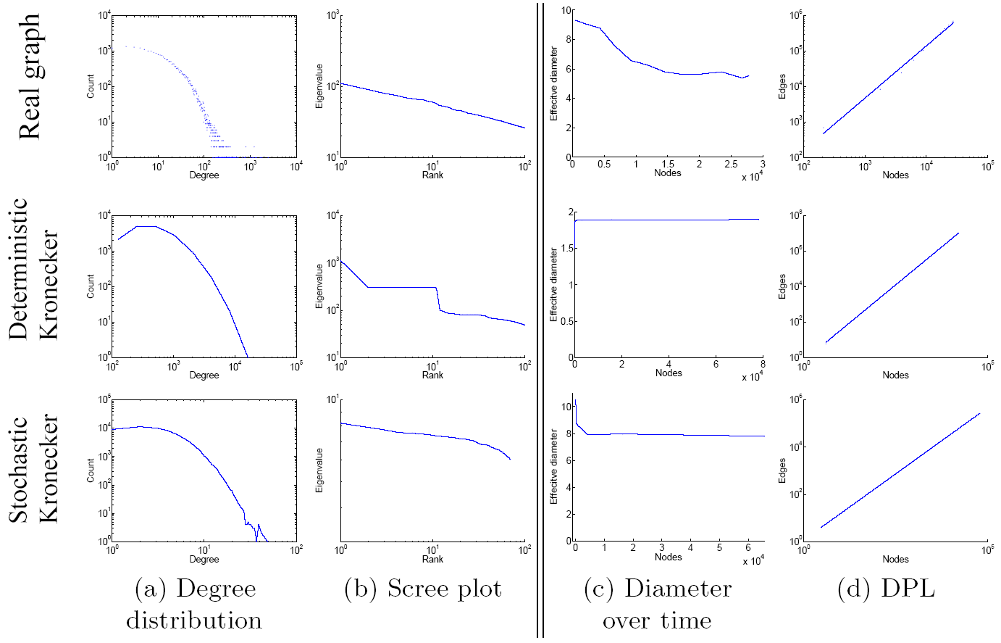
Arxiv citation network
Notes:
Goes to 4 slides -- > each property is a separate slide

Slide 48
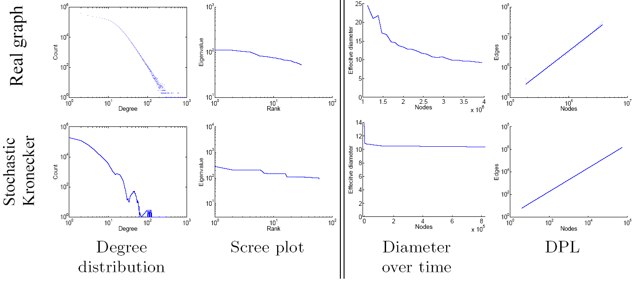
U.S. Patent citations
Static patterns
Temporal patterns

Slide 49
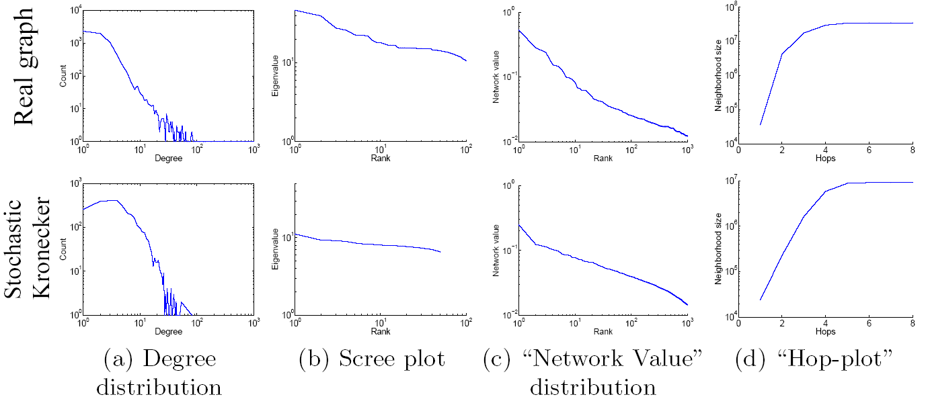
Autonomous Systems
Static patterns

Slide 50
How to choose initiator G₁?
Open problem
  Kronecker division/root
  Work in progress
We used heuristics
We restricted the space of all parameters
Details are in the paper

Slide 51
Outline
Introduction
Static graph patterns
Temporal graph patterns
Proposed graph generation model
  Kronecker Graphs
Properties of Kronecker Graphs
Stochastic Kronecker Graphs
Experiments
Observations and Conclusion

Slide 52
Observations
Generality
  Stochastic Kronecker Graphs include Erdos-Renyi model and RMAT graph generator as a special case
Phase transitions
  Similarly to Erdos-Renyi model Kronecker graphs exhibit phase transitions in the size of giant component and the diameter
We think
  additional properties will be easy to prove (clustering coefficient, number of triangles, …)

Slide 53
Conclusion (1)
We propose a family of Kronecker Graph generators
We use the Kronecker Product
We introduce a randomized version Stochastic Kronecker Graphs

Slide 54
Conclusion (2)
The resulting graphs have
  All the static properties
    Heavy tailed degree distributions
    Small diameter
    Multinomial eigenvalues and eigenvectors
  All the temporal properties
    Densification Power Law
    Shrinking/Stabilizing Diameters
  We can formally prove these results
✓
✓
✓
✓
✓
Notes:
CHECKMARKS

Slide 55
Thank you!
Questions? jure@cs.cmu.edu

Slide 56
Stochastic Kronecker Graphs
We define Stochastic Kronecker Graphs
  Start with N₁×N₁ probability matrix P₁
    where p_{ij} denotes probability that edge (i,j) is present
  Compute the k^{th} Kronecker power P_{k}
  For each entry p_{uv} of P_{k} we include an edge (u,v) with probability p_{uv}

