Slide 1
Impact of Linguistic Analysis on the Semantic Graph Coverage and Learning of Document Extracts
Document Summarization
AAAI Conference, Pittsburgh
July 11, 2005
Jurij Leskovec
Carnegie Mellon Univ.
Pittsburgh, PA
Natasa Milic-Frayling
Microsoft Research
Cambridge, UK
Marko Grobelnik
Jozef Stefan Institute
Ljubljana, Slovenia

Slide 2
Problem definition
Cracks Appear in U.N. Trade Embargo Against Iraq.
Cracks appeared Tuesday in the U.N. trade embargo against Iraq as Saddam Hussein sought to circumvent the economic noose around his country. Japan, meanwhile, announced it would increase its aid to countries hardest hit by enforcing the sanctions. Hoping to defuse criticism that it is not doing its share to oppose Baghdad, Japan said up to $2 billion in aid may be sent to nations most affected by the U.N. embargo on Iraq. President Bush on Tuesday night promised a joint session of Congress and a nationwide radio and television audience that ``Saddam Hussein will fail'' to make his conquest of Kuwait permanent. ``America must stand up to aggression, and we will,'' said Bush, who added that the U.S. military may remain in the Saudi Arabian desert indefinitely. ``I cannot predict just how long it will take to convince Iraq to withdraw from Kuwait,'' Bush said. More than 150,000 U.S. troops have been sent to the Persian Gulf region to deter a possible Iraqi invasion of Saudi Arabia. Bush's aides said the president would follow his address to Congress with a televised message for the Iraqi people, declaring the world is united against their government's invasion of Kuwait. Saddam had offered Bush time on Iraqi TV. The Philippines and Namibia, the first of the developing nations to respond to an offer Monday by Saddam of free oil _ in exchange for sending their own tankers to get it _ said no to the Iraqi leader. Saddam's offer was seen as a none-too-subtle attempt to bypass the U.N. embargo, in effect since four days after Iraq's Aug. 2 invasion of Kuwait, by getting poor countries to dock their tankers in Iraq. But according to a State Department survey, Cuba and Romania have struck oil deals with Iraq and companies elsewhere are trying to continue trade with Baghdad, all in defiance of U.N. sanctions. Romania denies the allegation. The report, made available to The Associated Press, said some Eastern European countries also are trying to maintain their military sales to Iraq. A well-informed source in Tehran told The Associated Press that Iran has agreed to an Iraqi request to exchange food and medicine for up to 200,000 barrels of refined oil a day and cash payments. There was no official comment from Tehran or Baghdad on the reported food-for-oil deal. But the source, who requested anonymity, said the deal was struck during Iraqi Foreign Minister Tariq Aziz's visit Sunday to Tehran, the first by a senior Iraqi official since the 1980-88 gulf war. After the visit, the two countries announced they would resume diplomatic relations. Well-informed oil industry sources in the region, contacted by The AP, said that although Iran is a major oil exporter itself, it currently has to import about 150,000 barrels of refined oil a day for domestic use because of damages to refineries in the gulf war. Along similar lines, ABC News reported that following Aziz's visit, Iraq is apparently prepared to give Iran all the oil it wants to make up for the damage Iraq inflicted on Iran during their conflict. Secretary of State James A. Baker III, meanwhile, met in Moscow with Soviet Foreign Minister Eduard Shevardnadze, two days after the U.S.-Soviet summit that produced a joint demand that Iraq withdraw from Kuwait. During the summit, Bush encouraged Mikhail Gorbachev to withdraw 190 Soviet military specialists from Iraq, where they remain to fulfill contracts. Shevardnadze told the Soviet parliament Tuesday the specialists had not reneged on those contracts for fear it would jeopardize the 5,800,
Produce a shorter version of the original document by selecting sentences from the text
  Hypothesis:
  Extracted summaries should capture prominent concepts and relations in the text.
  Structure of the semantic graph of a document could help identify the key concepts and relations for summarization.
Cracks appeared in the U.N. trade embargo against Iraq.
The State Department reports that Cuba and Romania have struck oil deals with Iraq as others attempt to trade with Baghdad in defiance of the sanctions.
Iran has agreed to exchange food and medicine for Iraqi oil.
Saddam has offered developing nations free oil if they send their tankers to pick it up.

Slide 3
Approach
Cracks Appear in U.N. Trade Embargo Against Iraq.
Cracks appeared Tuesday in the U.N. trade embargo against Iraq as Saddam Hussein sought to circumvent the economic noose around his country. Japan, meanwhile, announced it would increase its aid to countries hardest hit by enforcing the sanctions. Hoping to defuse criticism that it is not doing its share to oppose Baghdad, Japan said up to $2 billion in aid may be sent to nations most affected by the U.N. embargo on Iraq. President Bush on Tuesday night promised a joint session of Congress and a nationwide radio and television audience that ``Saddam Hussein will fail'' to make his conquest of Kuwait permanent. ``America must stand up to aggression, and we will,'' said Bush, who added that the U.S. military may remain in the Saudi Arabian desert indefinitely. ``I cannot predict just how long it will take to convince Iraq to withdraw from Kuwait,'' Bush said. More than 150,000 U.S. troops have been sent to the Persian Gulf region to deter a possible Iraqi invasion of Saudi Arabia. Bush's aides said the president would follow his address to Congress with a televised message for the Iraqi people, declaring the world is united against their government's invasion of Kuwait. Saddam had offered Bush time on Iraqi TV. The Philippines and Namibia, the first of the developing nations to respond to an offer Monday by Saddam of free oil _ in exchange for sending their own tankers to get it _ said no to the Iraqi leader. Saddam's offer was seen as a none-too-subtle attempt to bypass the U.N. embargo, in effect since four days after Iraq's Aug. 2 invasion of Kuwait, by getting poor countries to dock their tankers in Iraq. But according to a State Department survey, Cuba and Romania have struck oil deals with Iraq and companies elsewhere are trying to continue trade with Baghdad, all in defiance of U.N. sanctions. Romania denies the allegation. The report, made available to The Associated Press, said some Eastern European countries also are trying to maintain their military sales to Iraq. A well-informed source in Tehran told The Associated Press that Iran has agreed to an Iraqi request to exchange food and medicine for up to 200,000 barrels of refined oil a day and cash payments. There was no official comment from Tehran or Baghdad on the reported food-for-oil deal. But the source, who requested anonymity, said the deal was struck during Iraqi Foreign Minister Tariq Aziz's visit Sunday to Tehran, the first by a senior Iraqi official since the 1980-88 gulf war. After the visit, the two countries announced they would resume diplomatic relations. Well-informed oil industry sources in the region, contacted by The AP, said that although Iran is a major oil exporter itself, it currently has to import about 150,000 barrels of refined oil a day for domestic use because of damages to refineries in the gulf war. Along similar lines, ABC News reported that following Aziz's visit, Iraq is apparently prepared to give Iran all the oil it wants to make up for the damage Iraq inflicted on Iran during their conflict. Secretary of State James A. Baker III, meanwhile, met in Moscow with Soviet Foreign Minister Eduard Shevardnadze, two days after the U.S.-Soviet summit that produced a joint demand that Iraq withdraw from Kuwait. During the summit, Bush encouraged Mikhail Gorbachev to withdraw 190 Soviet military specialists from Iraq, where they remain to fulfill contracts. Shevardnadze told the Soviet parliament Tuesday the specialists had not reneged on those contracts for fear it would jeopardize the 5,800,
Create a graph that represents a semantic structure of the document
Train a machine learning model for selecting sentences which includes the properties of the semantic graph.
Cracks appeared in the U.N. trade embargo against Iraq.
The State Department reports that Cuba and Romania have struck oil deals with Iraq as others attempt to trade with Baghdad in defiance of the sanctions.
Iran has agreed to exchange food and medicine for Iraqi oil.
Saddam has offered developing nations free oil if they send their tankers to pick it up.

Slide 4
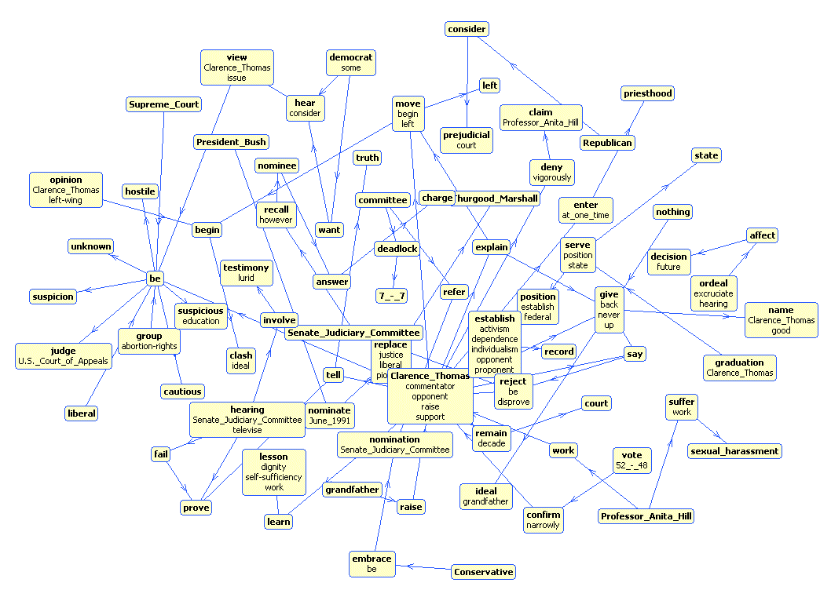
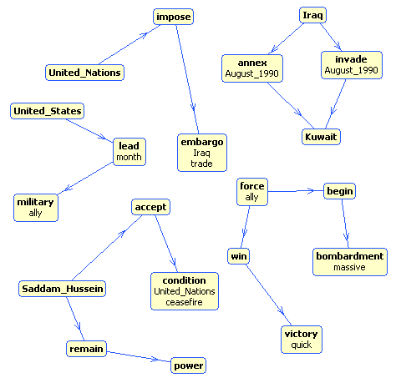
Original document
Cracks Appear in U.N. Trade Embargo Against Iraq.
Cracks appeared Tuesday in the U.N. trade embargo against Iraq as Saddam Hussein sought to circumvent the economic noose around his country. Japan, meanwhile, announced it would increase its aid to countries hardest hit by enforcing the sanctions. Hoping to defuse criticism that it is not doing its share to oppose Baghdad, Japan said up to $2 billion in aid may be sent to nations most affected by the U.N. embargo on Iraq. President Bush on Tuesday night promised a joint session of Congress and a nationwide radio and television audience that ``Saddam Hussein will fail'' to make his conquest of Kuwait permanent. ``America must stand up to aggression, and we will,'' said Bush, who added that the U.S. military may remain in the Saudi Arabian desert indefinitely. ``I cannot predict just how long it will take to convince Iraq to withdraw from Kuwait,'' Bush said. More than 150,000 U.S. troops have been sent to the Persian Gulf region to deter a possible Iraqi invasion of Saudi Arabia. Bush's aides said the president would follow his address to Congress with a televised message for the Iraqi people, declaring the world is united against their government's invasion of Kuwait. Saddam had offered Bush time on Iraqi TV. The Philippines and Namibia, the first of the developing nations to respond to an offer Monday by Saddam of free oil _ in exchange for sending their own tankers to get it _ said no to the Iraqi leader. Saddam's offer was seen as a none-too-subtle attempt to bypass the U.N. embargo, in effect since four days after Iraq's Aug. 2 invasion of Kuwait, by getting poor countries to dock their tankers in Iraq. But according to a State Department survey, Cuba and Romania have struck oil deals with Iraq and companies elsewhere are trying to continue trade with Baghdad, all in defiance of U.N. sanctions. Romania denies the allegation. The report, made available to The Associated Press, said some Eastern European countries also are trying to maintain their military sales to Iraq. A well-informed source in Tehran told The Associated Press that Iran has agreed to an Iraqi request to exchange food and medicine for up to 200,000 barrels of refined oil a day and cash payments. There was no official comment from Tehran or Baghdad on the reported food-for-oil deal. But the source, who requested anonymity, said the deal was struck during Iraqi Foreign Minister Tariq Aziz's visit Sunday to Tehran, the first by a senior Iraqi official since the 1980-88 gulf war. After the visit, the two countries announced they would resume diplomatic relations. Well-informed oil industry sources in the region, contacted by The AP, said that although Iran is a major oil exporter itself, it currently has to import about 150,000 barrels of refined oil a day for domestic use because of damages to refineries in the gulf war. Along similar lines, ABC News reported that following Aziz's visit, Iraq is apparently prepared to give Iran all the oil it wants to make up for the damage Iraq inflicted on Iran during their conflict. Secretary of State James A. Baker III, meanwhile, met in Moscow with Soviet Foreign Minister Eduard Shevardnadze, two days after the U.S.-Soviet summit that produced a joint demand that Iraq withdraw from Kuwait. During the summit, Bush encouraged Mikhail Gorbachev to withdraw 190 Soviet military specialists from Iraq, where they remain to fulfill contracts. Shevardnadze told the Soviet parliament Tuesday the specialists had not reneged on those contracts for fear it would jeopardize the 5,800,
Automatically generated
document summary
Linguistic processing and construction of the semantic graph
Cracks appeared in the U.N. trade embargo against Iraq.
The State Department reports that Cuba and Romania have struck oil deals with Iraq as others attempt to trade with Baghdad in defiance of the sanctions.
Iran has agreed to exchange food and medicine for Iraqi oil.
Saddam has offered developing nations free oil if they send their tankers to pick it up.
Sentence extraction based on the extracted sub- graph
Semantic graph of the original document
Sub-graph that characterizes extracted summaries
Learn the sub-graph selection model

Slide 5
Research Questions
How do the properties of the semantic graph influence summarization?
What are the important attributes for learning?
What role does linguistic analysis play in the summarization procedure?
Can we relax the complexity of linguistic analysis?

Slide 6

Summarization Procedure
Split text into sentences
Obtain logical form of each sentence using Microsoft NLPWin parser
Extract and link named entities
  ’George Bush’ linked with ‘Bush’ and ‘President’
Perform partial anaphora resolution
  Replace pronoun references to the objects by their name (for he, she, they, …)
Extract Subject-Predicate-Object triples (SPO)
Connect SPO triples from sentences to form the semantic graph of the document.
Tom went to town. In a bookstore he bought a large book.
Tom went to town. In a bookstore he [Tom] bought a large book.
Tom ← go → town
Tom ← buy → book

Slide 7
Summarization Procedure
Split text into sentences
Obtain logical form of each sentence using Microsoft NLPWin parser
Extract and link named entities
  ’George Bush’ linked with ‘Bush’ and ‘President’
Perform partial anaphora resolution
  Replace pronoun references to the objects by their name (for he, she, they, …)
Extract Subject-Predicate-Object triples (SPO)
Connect SPO triples from sentences to form the semantic graph of the document.
Tom went to town. In a bookstore he bought a large book.
Tom went to town. In a bookstore he [Tom] bought a large book.
Tom ← go → town
Tom ← buy → book

Slide 8
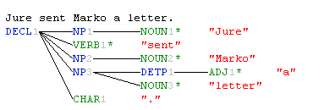
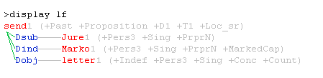
From Simple to Complex Linguistic Analysis
Syntactic parse trees are used to generate different linguistic representations sentences
Example:
“Jure sent Marko a letter”
Parse tree
  ANV: adjectives, nouns and verbs
  NPV: head nouns and verbs
  LF: logical form triples with syntactic and semantic tags
Logical form
Triples:
Jure → sent →Marko
Jure → sent → letter

Slide 9
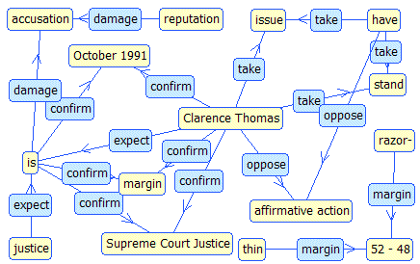
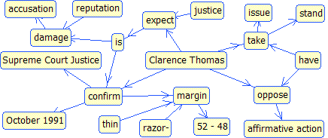
Creation of the Semantic Graphs
NamedLink representation:
  Link is labeled with a verb
take
Thomas
stand
Nodes representation:
  Each element is a node.
  Links connect elements from the same triple
Thomas
take
stand

Slide 10
Text coverage by the graph
Relaxing linguistic processing increases the coverage
Semantic Graph Structure | Covered Summary sentences [%] | Covered non-summary sentences [%]
ANV with Triples | 93.4 | 86.6
ANV with Triples + Pairs | 98.6 | 94.6
NPV with Triples | 73.4 | 63.6
NPV with Triples + Pairs | 94.0 | 83.3
LF with Triples | 80.0 | 69.8
LF with Triples + Pairs | 90.6 | 87.4
QUESTION
What is the impact of the document representation and coverage on summarization performance?

Slide 11
Learning sub-structure of the graph
Cracks Appear in U.N. Trade Embargo Against Iraq.
Cracks appeared Tuesday in the U.N. trade embargo against Iraq as Saddam Hussein sought to circumvent the economic noose around his country. Japan, meanwhile, announced it would increase its aid to countries hardest hit by enforcing the sanctions. Hoping to defuse criticism that it is not doing its share to oppose Baghdad, Japan said up to $2 billion in aid may be sent to nations most affected by the U.N. embargo on Iraq. President Bush on Tuesday night promised a joint session of Congress and a nationwide radio and television audience that ``Saddam Hussein will fail'' to make his conquest of Kuwait permanent. ``America must stand up to aggression, and we will,'' said Bush, who added that the U.S. military may remain in the Saudi Arabian desert indefinitely. ``I cannot predict just how long it will take to convince Iraq to withdraw from Kuwait,'' Bush said. More than 150,000 U.S. troops have been sent to the Persian Gulf region to deter a possible Iraqi invasion of Saudi Arabia. Bush's aides said the president would follow his address to Congress with a televised message for the Iraqi people, declaring the world is united against their government's invasion of Kuwait. Saddam had offered Bush time on Iraqi TV. The Philippines and Namibia, the first of the developing nations to respond to an offer Monday by Saddam of free oil _ in exchange for sending their own tankers to get it _ said no to the Iraqi leader. Saddam's offer was seen as a none-too-subtle attempt to bypass the U.N. embargo, in effect since four days after Iraq's Aug. 2 invasion of Kuwait, by getting poor countries to dock their tankers in Iraq. But according to a State Department survey, Cuba and Romania have struck oil deals with Iraq and companies elsewhere are trying to continue trade with Baghdad, all in defiance of U.N. sanctions. Romania denies the allegation. The report, made available to The Associated Press, said some Eastern European countries also are trying to maintain their military sales to Iraq. A well-informed source in Tehran told The Associated Press that Iran has agreed to an Iraqi request to exchange food and medicine for up to 200,000 barrels of refined oil a day and cash payments. There was no official comment from Tehran or Baghdad on the reported food-for-oil deal. But the source, who requested anonymity, said the deal was struck during Iraqi Foreign Minister Tariq Aziz's visit Sunday to Tehran, the first by a senior Iraqi official since the 1980-88 gulf war. After the visit, the two countries announced they would resume diplomatic relations. Well-informed oil industry sources in the region, contacted by The AP, said that although Iran is a major oil exporter itself, it currently has to import about 150,000 barrels of refined oil a day for domestic use because of damages to refineries in the gulf war. Along similar lines, ABC News reported that following Aziz's visit, Iraq is apparently prepared to give Iran all the oil it wants to make up for the damage Iraq inflicted on Iran during their conflict. Secretary of State James A. Baker III, meanwhile, met in Moscow with Soviet Foreign Minister Eduard Shevardnadze, two days after the U.S.-Soviet summit that produced a joint demand that Iraq withdraw from Kuwait. During the summit, Bush encouraged Mikhail Gorbachev to withdraw 190 Soviet military specialists from Iraq, where they remain to fulfill contracts. Shevardnadze told the Soviet parliament Tuesday the specialists had not reneged on those contracts for fear it would jeopardize the 5,800,
Label nodes and links that correspond to the summary sentences
LEARNING PROBLEM:
Given a semantic graph, learn to select parts that describe the document summary.
Binary classification problem:
  Positive examples are triples from the human selected sentences
  Negative examples are all other triples
Train the linear Support Vector classifier to detect ‘positive’ triples
→ To each triple from a document graph the classifier assigns a confidence score that the triple belongs to a summary sentence.

Slide 12
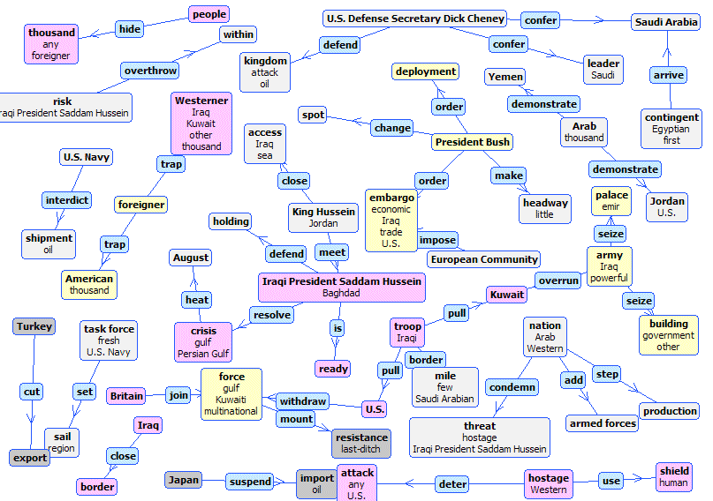
Learned summary graph (1):
War in Kuwait
Nodes like “Saddam Hussein”, “President Bush”, “gulf force” are central in the graph

Slide 13
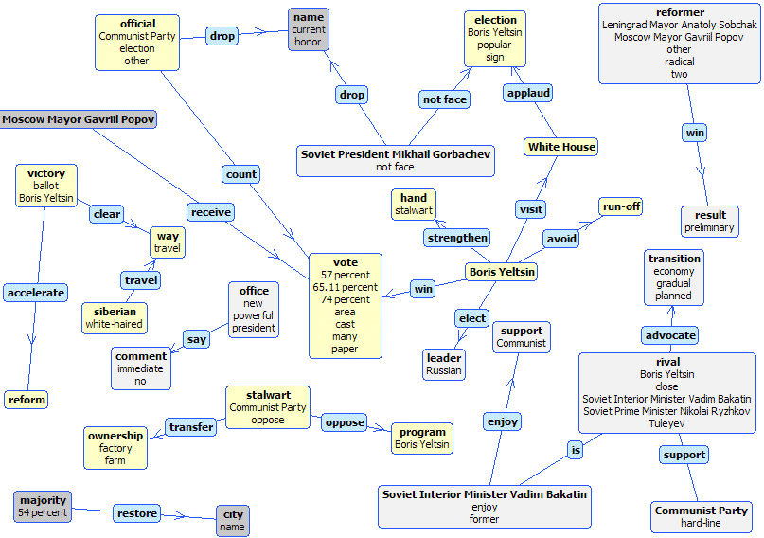
Learned summary graph (2)
Russian presidential election

Slide 14
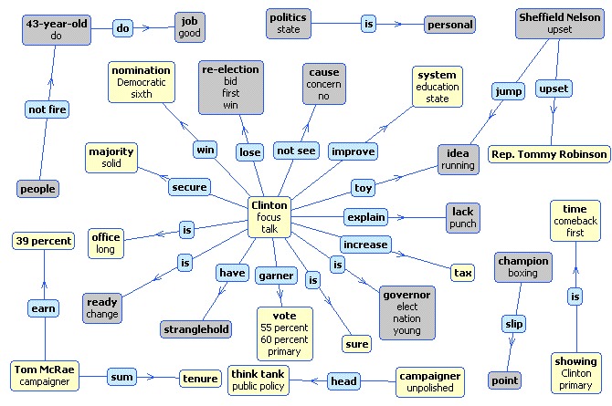
Learned summary graph (3):
Bill Clinton giving a talk

Slide 15
Attributes of triples used in learning
Positional information
  Of the sentence from which the triple was derived relative to the document text
  Of the triple relative to the beginning of the sentence
NLPWin linguistic attributes of the nodes in the triple:
  18 syntactic attributes
  100 semantic attributes
14 graph attributes: PageRank, In/Out Degree, reachable neighbours, etc.

Slide 16
Extract and evaluate summaries
SUMMARY EXTRACTION:
Score each sentence in the document as a sum of confidence scores associated with triples from the sub-graph
Include into the summary a pre-defined number of high scoring sentences from the document
EVALUATE SUMMARIES
Report microaveraged precision, recall, and F1 on the sentence level
Calculate ROUGE score to measure the coverage of concepts
Use node confidence scores to select sentences
Cracks appeared in the U.N. trade embargo against Iraq.
The State Department reports that Cuba and Romania have struck oil deals with Iraq as others attempt to trade with Baghdad in defiance of the sanctions.
Iran has agreed to exchange food and medicine for Iraqi oil.
Saddam has offered developing nations free oil if they send their tankers to pick it up.

Slide 17
Datasets
DUC2002 – Document Understanding Conference
  300 newspaper articles on 30 different topics: people, natural disasters, events, …
  Each topic has about 10 articles
  147 of these articles have document extracts
CAST Data
  Subset of 89 documents with marked by a single annotator
  2 levels of granularity:
    CAST-15%: 6 sentences marked as essential
    CAST-30%: additional 6 sentences marked as important

Slide 18
Influence of Linguistic Analysis
Experiment set up:
Graph created using triples and pairs.
Learning based on all the attributes
The Logical Form representation yields highest F1 of extracted sentences
Generally, SVM learns well from all levels of linguistic processing
By ROUGE the simplest linguistic analysis, with highest coverage, performs best
DUC 2002
Linguistic Units | Prec. | Recall | F1 | Rouge
ANV | 0.39 | 0.40 | 0.40 | 0.67
NPV | 0.37 | 0.39 | 0.38 | 0.65
LF | 0.40 | 0.40 | 0.40 | 0.64
CAST-30%
Linguistic Units | Prec. | Recall | F1 | Rouge
ANV | 0.43 | 0.57 | 0.49 | 0.67
NPV | 0.41 | 0.66 | 0.50 | 0.63
LF | 0.42 | 0.67 | 0.52 | 0.66

Slide 19
Semantic Graph representation
Increasing the coverage of sentences by including node pairs does not hurt the performance
The ROUGE score slightly improves
DUC 2002
Semantic Structure | Prec. | Recall | F1 | Rouge
ANV with Triples | 0.31 | 0.62 | 0.41 | 0.67
ANV with Triples+Pairs | 0.30 | 0.63 | 0.41 | 0.66
NPV with Triples | 0.29 | 0.62 | 0.40 | 0.65
NPV with Triples+Pairs | 0.30 | 0.64 | 0.41 | 0.67
LF with Triples | 0.39 | 0.39 | 0.39 | 0.64
LF with Triples+Pairs | 0.38 | 0.39 | 0.38 | 0.65

Slide 20
Influence of the attribute sets
For all levels of linguistic processing, the performance increases when we include graph attributes
Node Attributes | Prec. | Recall | F1 | Rouge
ANV: Pos + Ling | 0.27 | 0.58 | 0.37 | 0.65
ANV: Pos + Ling + Graph | 0.39 | 0.40 | 0.40 | 0.67
NPV: Pos + Ling | 0.37 | 0.35 | 0.36 | 0.62
NPV: Pos + Ling + Graph | 0.37 | 0.39 | 0.38 | 0.65
LF: Pos + Ling | 0.26 | 0.61 | 0.36 | 0.62
LF: Pos + Ling + Graph | 0.40 | 0.40 | 0.40 | 0.64

Slide 21
Conclusion
We investigated the impact of the level of linguistic analyses and attributes of the semantic graph on the SVM classifier for summary extraction
Relaxing the structure of individual sentence representation yields a wider text coverage
Using graph attributes yields better summary performance
Wider text coverage yields higher ROUGE scores

