Slide 1
Graphs over Time Densification Laws, Shrinking
Diameters and Possible Explanations
Jurij Leskovec, CMU
Jon Kleinberg, Cornell
Christos Faloutsos, CMU

Slide 2
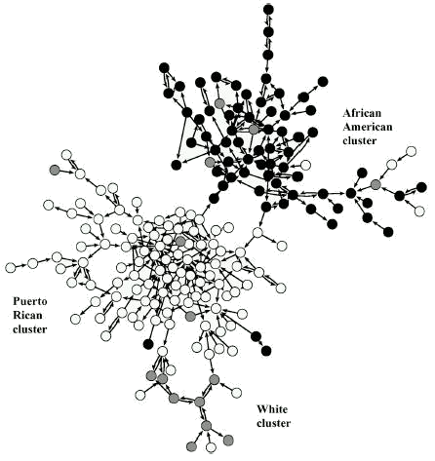
Introduction
What can we do with graphs?
  What patterns or “laws” hold for most real-world graphs?
  How do the graphs evolve over time?
  Can we generate synthetic but “realistic” graphs?
“Needle exchange” networks of drug users

Slide 3
Evolution of the Graphs
How do graphs evolve over time?
Conventional Wisdom:
  Constant average degree: the number of edges grows linearly with the number of nodes
  Slowly growing diameter: as the network grows the distances between nodes grow
Our findings:
  Densification Power Law: networks are becoming denser over time
  Shrinking Diameter: diameter is decreasing as the network grows

Slide 4
Outline
Introduction
General patterns and generators
Graph evolution – Observations
  Densification Power Law
  Shrinking Diameters
Proposed explanation
  Community Guided Attachment
Proposed graph generation model
  Forest Fire Model
Conclusion

Slide 5
Outline
Introduction
General patterns and generators
Graph evolution – Observations
  Densification Power Law
  Shrinking Diameters
Proposed explanation
  Community Guided Attachment
Proposed graph generation model
  Forest Fire Model
Conclusion

Slide 6
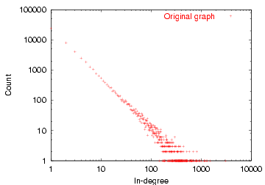
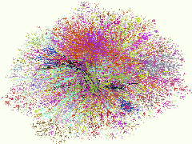
Graph Patterns
Power Law
Many low-degree nodes
Few high-degree nodes
log(Count) vs. log(Degree)
Internet in December 1998
Y=a*X^{b}

Slide 7
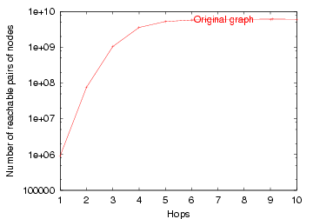
Graph Patterns
Small-world [Watts and Strogatz],++:
  6 degrees of
  separation
  Small diameter
(Community structure, …)
# reachable pairs
Effective Diameter
hops

Slide 8
Graph models: Random Graphs
How can we generate a realistic graph?
  given the number of nodes N and edges E
Random graph [Erdos & Renyi, 60s]:
  Pick 2 nodes at random and link them
  Does not obey Power laws
  No community structure

Slide 9
Graph models: Preferential attachment
Preferential attachment [Albert & Barabasi, 99]:
  Add a new node, create M out-links
  Probability of linking a node is proportional to its degree
Examples:
  Citations: new citations of a paper are proportional to the number it already has
Rich get richer phenomena
Explains power-law degree distributions
But, all nodes have equal (constant) out-degree

Slide 10
Graph models: Copying model
Copying model [Kleinberg, Kumar, Raghavan, Rajagopalan and Tomkins, 99]:
  Add a node and choose the number of edges to add
  Choose a random vertex and “copy” its links (neighbors)
Generates power-law degree distributions
Generates communities

Slide 11
Other Related Work
Huberman and Adamic, 1999: Growth dynamics of the world wide web
Kumar, Raghavan, Rajagopalan, Sivakumar and Tomkins, 1999: Stochastic models for the web graph
Watts, Dodds, Newman, 2002: Identity and search in social networks
Medina, Lakhina, Matta, and Byers, 2001: BRITE: An Approach to Universal Topology Generation
…

Slide 12
Why is all this important?
Gives insight into the graph formation process:
  Anomaly detection – abnormal behavior, evolution
  Predictions – predicting future from the past
  Simulations of new algorithms
  Graph sampling – many real world graphs are too large to deal with

Slide 13
Outline
Introduction
General patterns and generators
Graph evolution – Observations
  Densification Power Law
  Shrinking Diameters
Proposed explanation
  Community Guided Attachment
Proposed graph generation model
  Forest Fire Model
Conclusion

Slide 14
Temporal Evolution of the Graphs
N(t) … nodes at time t
E(t) … edges at time t
Suppose that
  N(t+1) = 2 * N(t)
Q: what is your guess for
  E(t+1) =? 2 * E(t)
A: over-doubled!
  But obeying the Densification Power Law

Slide 15

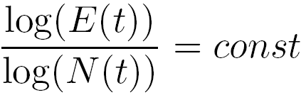
Temporal Evolution of the Graphs
Densification Power Law
  networks are becoming denser over time
  the number of edges grows faster than the number of nodes – average degree is increasing
a … densification exponent
or
equivalently

Slide 16
Graph Densification – A closer look
Densification Power Law
Densification exponent: 1 ≤ a ≤ 2:
  a=1: linear growth – constant out-degree (assumed in the literature so far)
  a=2: quadratic growth – clique
Let’s see the real graphs!

Slide 17
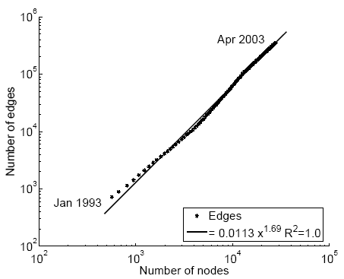
Densification – Physics Citations
Citations among physics papers
1992:
  1,293 papers,
  2,717 citations
2003:
  29,555 papers, 352,807 citations
For each month M, create a graph of all citations up to month M
E(t)
1.69
N(t)

Slide 18
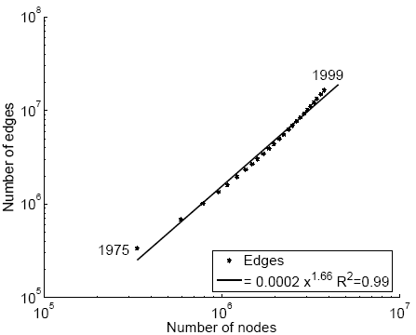
Densification – Patent Citations
Citations among patents granted
1975
  334,000 nodes
  676,000 edges
1999
  2.9 million nodes
  16.5 million edges
Each year is a datapoint
E(t)
1.66
N(t)

Slide 19
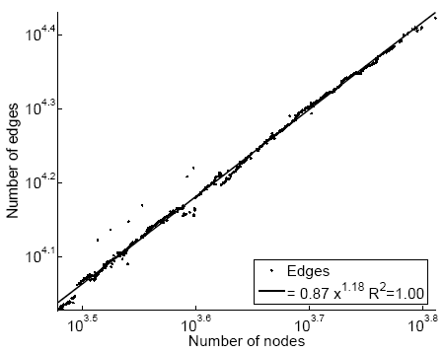
Densification – Autonomous Systems
Graph of Internet
1997
  3,000 nodes
  10,000 edges
2000
  6,000 nodes
  26,000 edges
One graph per day
E(t)
1.18
N(t)

Slide 20
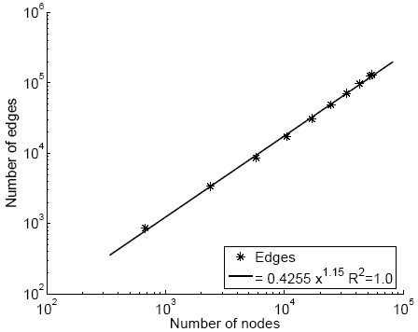
Densification – Affiliation Network
Authors linked to their publications
1992
  318 nodes
  272 edges
2002
  60,000 nodes
    20,000 authors
    38,000 papers
  133,000 edges
E(t)
1.15
N(t)

Slide 21
Graph Densification – Summary
The traditional constant out-degree assumption does not hold
Instead:
the number of edges grows faster than the number of nodes – average degree is increasing

Slide 22
Outline
Introduction
General patterns and generators
Graph evolution – Observations
  Densification Power Law
  Shrinking Diameters
Proposed explanation
  Community Guided Attachment
Proposed graph generation model
  Forest Fire Model
Conclusion

Slide 23
Evolution of the Diameter
Prior work on Power Law graphs hints at Slowly growing diameter:
  diameter ~ O(log N)
  diameter ~ O(log log N)
What is happening in real data?
Diameter shrinks over time
  As the network grows the distances between nodes slowly decrease
Notes:
Diameter first, DPL second
Check diameter formulas
As the network grows the distances between nodes slowly grow

Slide 24
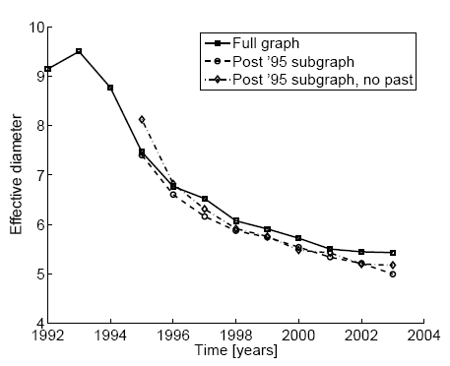
Diameter – ArXiv citation graph
diameter
Citations among physics papers
1992 –2003
One graph per year
time [years]

Slide 25
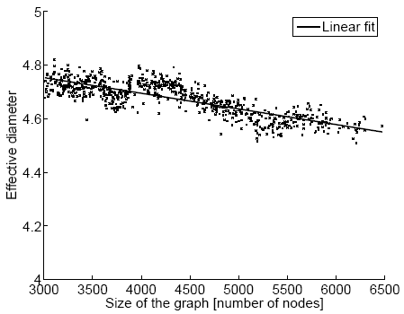
Diameter – “Autonomous Systems”
diameter
Graph of Internet
One graph per day
1997 – 2000
number of nodes

Slide 26
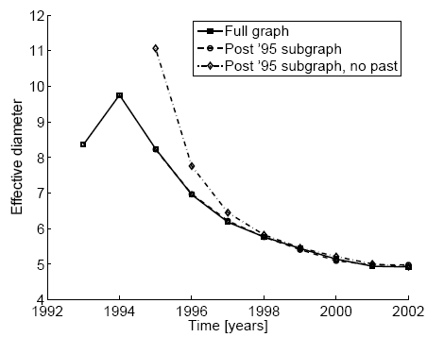
Diameter – “Affiliation Network”
diameter
Graph of collaborations in physics – authors linked to papers
10 years of data
time [years]

Slide 27
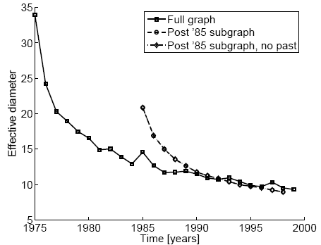
Diameter – “Patents”
diameter
Patent citation network
25 years of data
time [years]

Slide 28
Validating Diameter Conclusions
There are several factors that could influence the Shrinking diameter
  Effective Diameter:
    Distance at which 90% of pairs of nodes is reachable
  Problem of “Missing past”
    How do we handle the citations outside the dataset?
  Disconnected components
None of them matters

Slide 29
Outline
Introduction
General patterns and generators
Graph evolution – Observations
  Densification Power Law
  Shrinking Diameters
Proposed explanation
  Community Guided Attachment
Proposed graph generation model
  Forest Fire Mode
Conclusion

Slide 30
Densification – Possible Explanation
Existing graph generation models do not capture the Densification Power Law and Shrinking diameters
Can we find a simple model of local behavior, which naturally leads to observed phenomena?
Yes! We present 2 models:
  Community Guided Attachment – obeys Densification
  Forest Fire model – obeys Densification, Shrinking diameter (and Power Law degree distribution)

Slide 31
Community structure
Let’s assume the community structure
One expects many within-group friendships and fewer cross-group ones
How hard is it to cross communities?
University
Science
Arts
CS
Math
Drama
Music
Self-similar university
community structure
Notes:
Animation: first faces, then comminities, then edges

Slide 32

Fundamental Assumption
If the cross-community linking probability of nodes at tree-distance h is scale-free
We propose cross-community linking probability:
where: c ≥ 1 … the Difficulty constant
h … tree-distance
Notes:
Animation with communities: f(1), f(2), … f(h)

Slide 33

Densification Power Law (1)
Theorem: The Community Guided Attachment leads to Densification Power Law with exponent
a … densification exponent
b … community structure branching factor
c … difficulty constant
Notes:
Animation for a,b,c

Slide 34
Difficulty Constant
Theorem:
Gives any non-integer Densification exponent
If c = 1: easy to cross communities
  Then: a=2, quadratic growth of edges – near clique
If c = b: hard to cross communities
  Then: a=1, linear growth of edges – constant out-degree

Slide 35
Room for Improvement
Community Guided Attachment explains Densification Power Law
Issues:
  Requires explicit Community structure
  Does not obey Shrinking Diameters

Slide 36
Outline
Introduction
General patterns and generators
Graph evolution – Observations
  Densification Power Law
  Shrinking Diameters
Proposed explanation
  Community Guided Attachment
Proposed graph generation model
  “Forest Fire” Model
Conclusion

Slide 37
“Forest Fire” model – Wish List
Want no explicit Community structure
Shrinking diameters
and:
  “Rich get richer” attachment process, to get heavy-tailed in-degrees
  “Copying” model, to lead to communities
  Community Guided Attachment, to produce Densification Power Law
Notes:
Animation with people connected
New person
Add hierarchy
Connect
Remove hierarchy

Slide 38
“Forest Fire” model – Intuition (1)
How do authors identify references?
  Find first paper and cite it
  Follow a few citations, make citations
  Continue recursively
  From time to time use bibliographic tools (e.g. CiteSeer) and chase back-links

Slide 39
“Forest Fire” model – Intuition (2)
How do people make friends in a new environment?
  Find first a person and make friends
  Follow a of his friends
  Continue recursively
  From time to time get introduced to his friends
Forest Fire model imitates exactly this process

Slide 40
“Forest Fire” – the Model
A node arrives
Randomly chooses an “ambassador”
Starts burning nodes (with probability p) and adds links to burned nodes
“Fire” spreads recursively
Notes:
End the red line

Slide 41
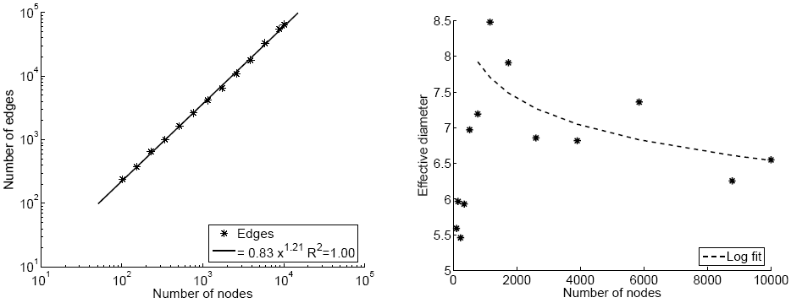
Forest Fire in Action (1)
Forest Fire generates graphs that Densify and have Shrinking Diameter
E(t)
densification
diameter
1.21
diameter
N(t)
N(t)

Slide 42
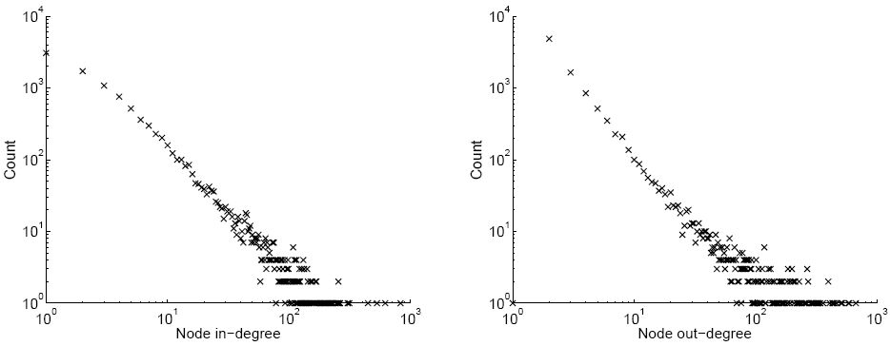
Forest Fire in Action (2)
Forest Fire also generates graphs with heavy-tailed degree distribution
in-degree
out-degree
count vs. in-degree
count vs. out-degree
Notes:
Label the axis

Slide 43
Forest Fire model – Justification
Densification Power Law:
  Similar to Community Guided Attachment
  The probability of linking decays exponentially with the distance – Densification Power Law
Power law out-degrees:
  From time to time we get large fires
Power law in-degrees:
  The fire is more likely to burn hubs

Slide 44
Forest Fire model – Justification
Communities:
  Newcomer copies neighbors’ links
Shrinking diameter

Slide 45
Conclusion (1)
We study evolution of graphs over time
We discover:
  Densification Power Law
  Shrinking Diameters
Propose explanation:
  Community Guided Attachment leads to Densification Power Law

Slide 46
Conclusion (2)
Proposed Forest Fire Model uses only 2 parameters to generate realistic graphs:
  Heavy-tailed in- and out-degrees
  Densification Power Law
  Shrinking diameter
✓
✓
✓

Slide 47
Thank you!
Questions? jure@cs.cmu.edu

Slide 48
Dynamic Community Guided Attachment
The community tree grows
  At each iteration a new level of nodes gets added
  New nodes create links among themselves as well as to the existing nodes in the hierarchy
Based on the value of parameter c we get:
  Densification with heavy-tailed in-degrees
  Constant average degree and heavy-tailed in-degrees
  Constant in- and out-degrees
But:
  Community Guided Attachment still does not obey the shrinking diameter property

Slide 49
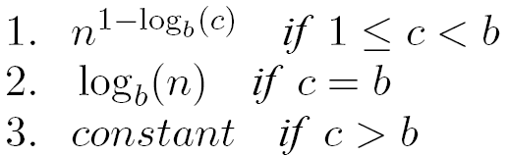
Densification Power Law (1)
Theorem: Community Guided Attachment random graph model, the expected out-degree of a node is proportional to

Slide 50
Forest Fire – the Model
2 parameters:
  p … forward burning probability
  r … backward burning ratio
Nodes arrive one at a time
New node v attaches to a random node – the ambassador
Then v begins burning ambassador’s neighbors:
  Burn X links, where X is binomially distributed
  Choose in-links with probability r times less than out-links
Fire spreads recursively
Node v attaches to all nodes that got burned

Slide 51
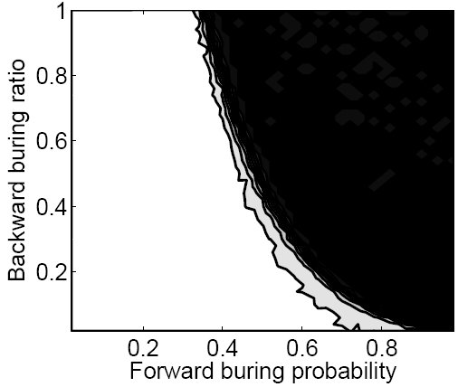
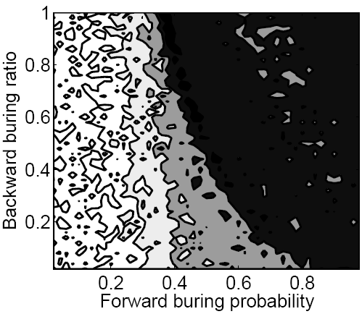
Forest Fire – Phase plots
Exploring the Forest Fire parameter space
Dense
graph
Increasing
diameter
Sparse
graph
Shrinking
diameter

Slide 52
Forest Fire – Extensions
Orphans: isolated nodes that eventually get connected into the network
  Example: citation networks
  Orphans can be created in two ways:
    start the Forest Fire model with a group of nodes
    new node can create no links
  Diameter decreases even faster
Multiple ambassadors:
  Example: following paper citations from different fields
  Faster decrease of diameter

Slide 53
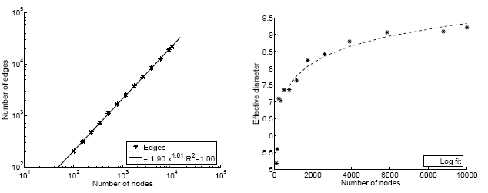
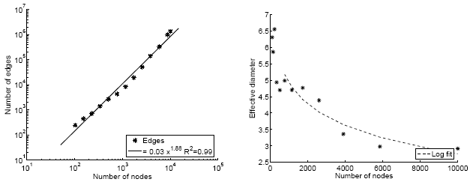
Densification and Shrinking Diameter
Are the Densification and Shrinking Diameter two different observations of the same phenomena?
No!
Forest Fire can generate:
  (1) Sparse graphs with increasing diameter
  Sparse graphs with decreasing diameter
  (2) Dense graphs with decreasing diameter
1
2

