Slide 1
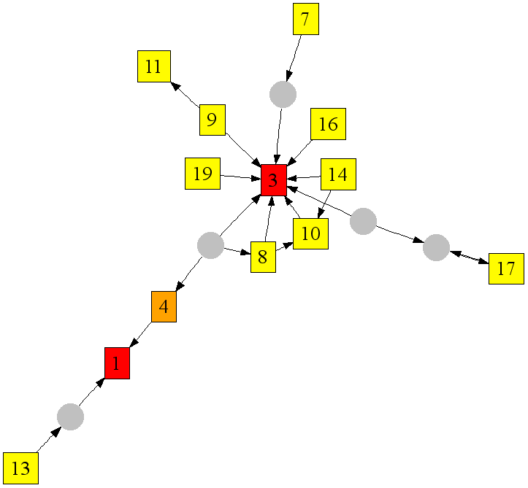
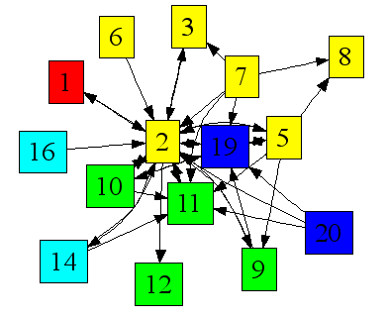



Web Projections
Learning from Contextual Subgraphs of the Web
Jure Leskovec, CMU
Susan Dumais, MSR
Eric Horvitz, MSR
Notes:
We are able to predict quality of a set of search results without looking at the webpage content.

Slide 2
Motivation
Information retrieval traditionally considered documents as independent
Web retrieval incorporates global hyperlink relationships to enhance ranking (e.g., PageRank, HITS)
  Operates on the entire graph
  Uses just one feature (principal eigenvector) of the graph
Our work on Web projections focuses on
  contextual subsets of the web graph; in-between the independent and global consideration of the documents
  a rich set of graph theoretic properties

Slide 3
Web projections
Web projections: How they work?
  Project a set of web pages of interest onto the web graph
  This creates a subgraph of the web called projection graph
  Use the graph-theoretic properties of the subgraph for tasks of interest
Query projections
  Query results give the context (set of web pages)
  Use characteristics of the resulting graphs for predictions about search quality and user behavior

Slide 4
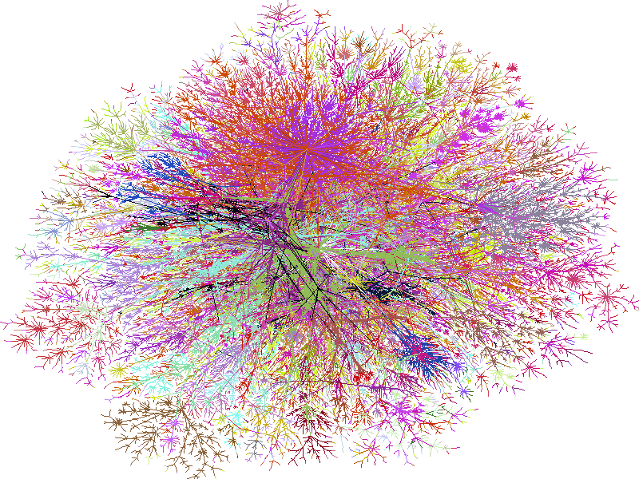
Query projections
Query
Results
Projection on the web graph
Q
-- -- ----
--- --- ----
------ ---
----- --- --
------ -----
------ -----
Query projection graph
Query connection graph
Generate graphical features
Construct case library
Predictions
Notes:
CHAGE ABCDE

Slide 5
Questions we explore
How do query search results project onto the underlying web graph?
Can we predict the quality of search results from the projection on the web graph?
Can we predict users’ behaviors with issuing and reformulating queries?

Slide 6
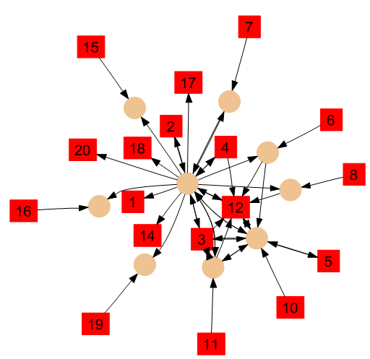
Is this a good set of search results?

Slide 7
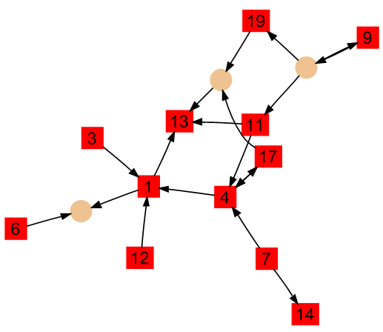
Will the user reformulate the query?

Slide 8
Resources and concepts
Web as a graph
  URL graph:
    Nodes are web pages, edges are hyper-links
    Data from March 2006
    Graph: 22 million nodes, 355 million edges
  Domain graph:
    Nodes are domains (cmu.edu, bbc.co.uk). Directed edge (u,v) if there exists a webpage at domain u pointing to v
    Data from February 2006
    Graph: 40 million nodes, 720 million edges
Contextual subgraphs for queries
  Projection graph
  Connection graph
Compute graph-theoretic features

Slide 9
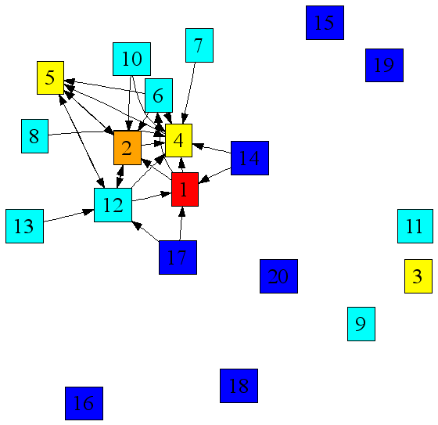
“Projection” graph
Example query: Subaru
Project top 20 results by the search engine
Number in the node denotes the search engine rank
Color indicates relevancy as assigned by human:
  Perfect
  Excellent
  Good
  Fair
  Poor
  Irrelevant

Slide 10
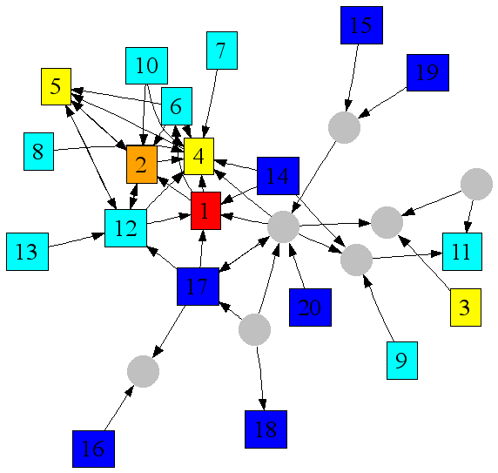
“Connection” graph
Projection graph is generally disconnected
Find connector nodes
Connector nodes are existing nodes that are not part of the original result set
Ideally, we would like to introduce fewest possible nodes to make projection graph connected
Connector nodes
Projection nodes

Slide 11
Finding connector nodes
Find connector nodes is a Steiner tree problem which is NP hard
Our heuristic:
  Connect 2nd largest connected component via shortest path to the largest
  This makes a new largest component
  Repeat until the graph is connected
2nd largest component
Largest component
2nd largest component

Slide 12
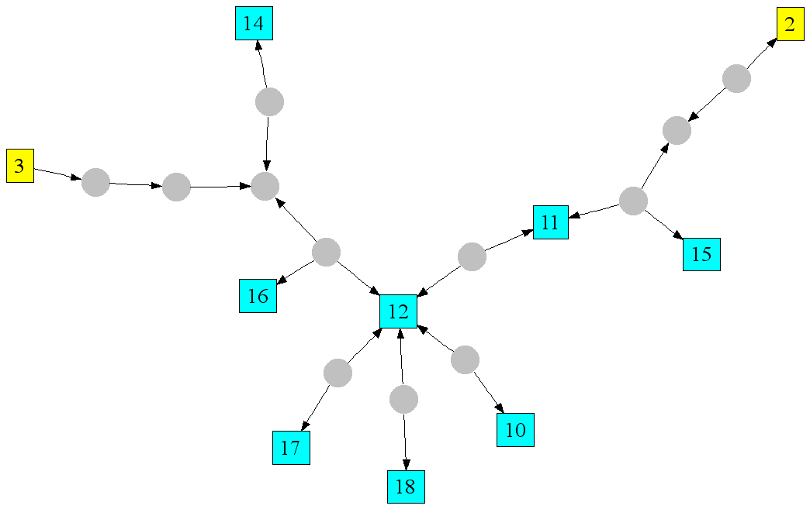
Extracting graph features
The idea
  Find features that describe the structure of the graph
  Then use the features for machine learning
Want features that describe
  Connectivity of the graph
  Centrality of projection and connector nodes
  Clustering and density of the core of the graph
vs.

Slide 13
Examples of graph features
Projection graph
  Number of nodes/edges
  Number of connected components
  Size and density of the largest connected component
  Number of triads in the graph
Connection graph
  Number of connector nodes
  Maximal connector node degree
  Mean path length between projection/connector nodes
  Triads on connector nodes
We consider 55 features total
vs.
Notes:
29927
30219

Slide 14
Experimental setup
Query
Results
Projection on the web graph
Q
-- -- ----
--- --- ----
------ ---
----- --- --
------ -----
------ -----
Query projection graph
Query connection graph
Generate graphical features
Construct case library
Predictions

Slide 15
Constructing case library for machine learning
Given a task of interest
Generate contextual subgraph and extract features
Each graph is labeled by target outcome
Learn statistical model that relates the features with the outcome
Make prediction on unseen graphs
Notes:
Machine learning

Slide 16
Experiments overview
Given a set of search results generate projection and connection graphs and their features
Predict quality of a search result set
  Discriminate top20 vs. top40to60 results
  Predict rating of highest rated document in the set
Predict user behavior
  Predict queries with high vs. low reformulation probability
  Predict query transition (generalization vs. specialization)
  Predict direction of the transition

Slide 17
Experimental details
Features
  55 graphical features
  Note we use only graph features, no content
Learning
  We use probabilistic decision trees (“DNet”)
Report classification accuracy using 10-fold cross validation
Compare against 2 baselines
  Marginals: Predict most common class
  RankNet: use 350 traditional features (document, anchor text, and basic hyperlink features)

Slide 18
Search results quality
Dataset:
  30,000 queries
  Top 20 results for each
    Each result is labeled by a human judge using a 6-point scale from "Perfect" to "Bad"
Task:
  Predict the highest rating in the set of results
    6-class problem
    2-class problem: “Good” (top 3 ratings) vs. “Poor” (bottom 3 ratings)

Slide 19
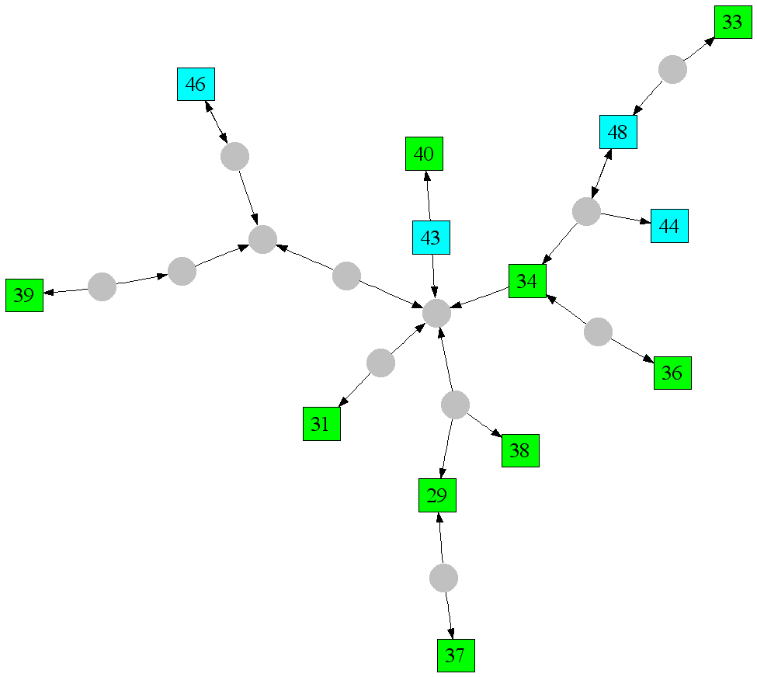
Search quality: the task
Predict the rating of the top result in the set
Predict “Good”
Predict “Poor”
Notes:
Subaru and Wisconsin

Slide 20
Search quality: results
Predict top human rating in the set
  Binary classification: Good vs. Poor
10-fold cross validation classification accuracy
Observations:
  Web Projections outperform both baseline methods
  Just projection graph already performs quite well
  Projections on the URL graph perform better
Attributes | URL Graph | Domain Graph
Marginals | 0.55 | 0.55
RankNet | 0.63 | 0.60
Projection | 0.80 | 0.64
Connection | 0.79 | 0.66
Projection + Connection | 0.82 | 0.69
All | 0.83 | 0.71

Slide 21
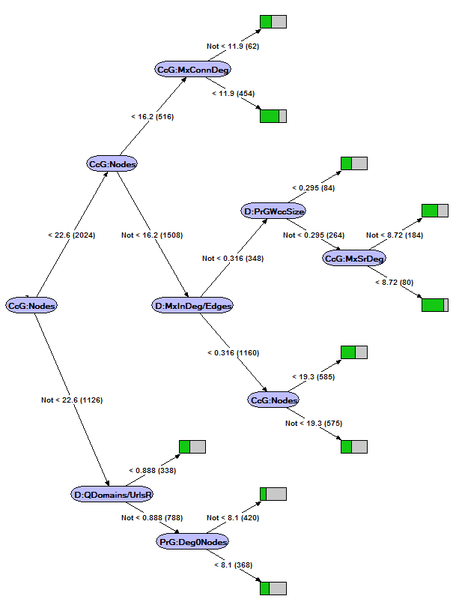
Search quality: the model
The learned model shows graph properties of good result sets
Good result sets have:
  Search result nodes are hub nodes in the graph (have large degrees)
  Small connector node degrees
  Big connected component
  Few isolated nodes in projection graph
  Few connector nodes
Notes:
Green is good (relevant), gray is bad (irrelevant)

Slide 22
Predict user behavior
Dataset
  Query logs for 6 weeks
  35 million unique queries, 80 million total query reformulations
  We only take queries that occur at least 10 times
  This gives us 50,000 queries and 120,000 query reformulations
Task
  Predict whether the query is going to be reformulated

Slide 23
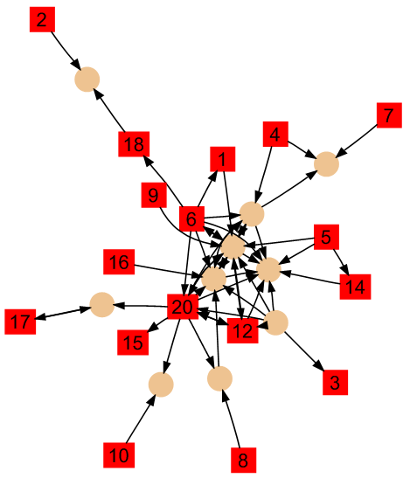
Query reformulation: the task
Given a query and corresponding projection and connection graphs
Predict whether query is likely to be reformulated
Query not likely to be reformulated
Query likely to be reformulated

Slide 24
Query reformulation: results
Observations:
  Gradual improvement as using more features
  Using Connection graph features helps
  URL graph gives better performance
We can also predict type of reformulation (specialization vs. generalization) with 0.80 accuracy
Attributes | URL Graph | Domain Graph
Marginals | 0.54 | 0.54
Projection | 0.59 | 0.58
Connection | 0.63 | 0.59
Projection + Connection | 0.63 | 0.60
All | 0.71 | 0.67
Notes:
HIDE

Slide 25
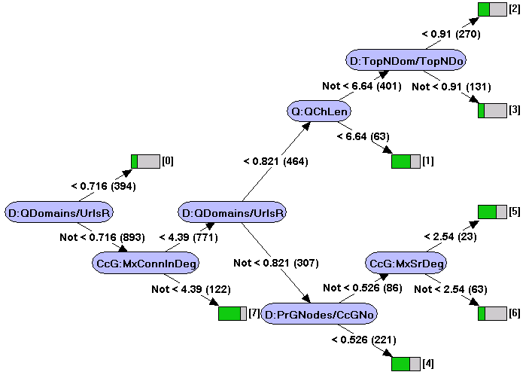
Query reformulation: the model
Queries likely to be reformulated have:
  Search result nodes have low degree
  Connector nodes are hubs
  Many connector nodes
  Results came from many different domains
  Results are sparsely knit

Slide 26
Conclusion
We introduced Web projections
  A general approach of using context-sensitive sets of web pages to focus attention on relevant subset of the web graph
  And then using rich graph-theoretic features of the subgraph as input to statistical models to learn predictive models
We demonstrated Web projections using search result graphs for
  Predicting result set quality
  Predicting user behavior when reformulating queries

Slide 27
Future directions
Combine with content and usage features
Explore other ways to define the context
  E.g., web pages that user recently visited
Explore the role of connector nodes
  Should they be included in the result set?
Move beyond set level prediction
  Characterize individual node’s position in the graph
  Use to enhance ranking, identify page properties
Characterize web and query dynamics
  Understand user’s search paths
  Model the evolution of communities and topics

Slide 28
Additional material

Slide 29
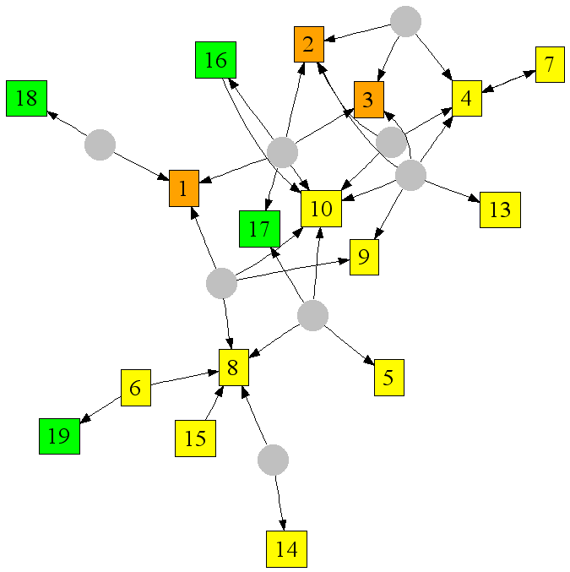
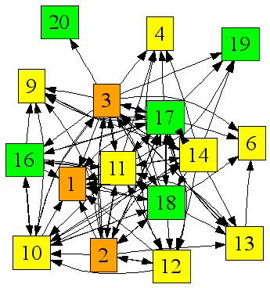
Projection on URL & Domain graph
Query: encyclopedia
URL graph
Domain graph
Domain graph projections are denser (better connected)
Notes:
HIDE?

Slide 30
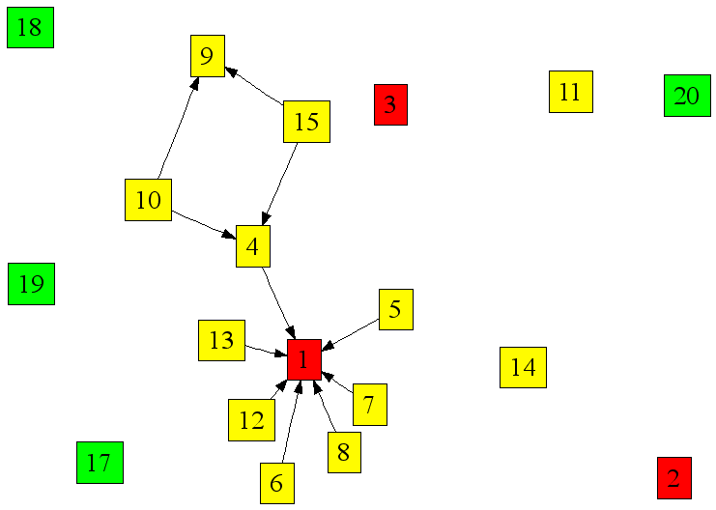
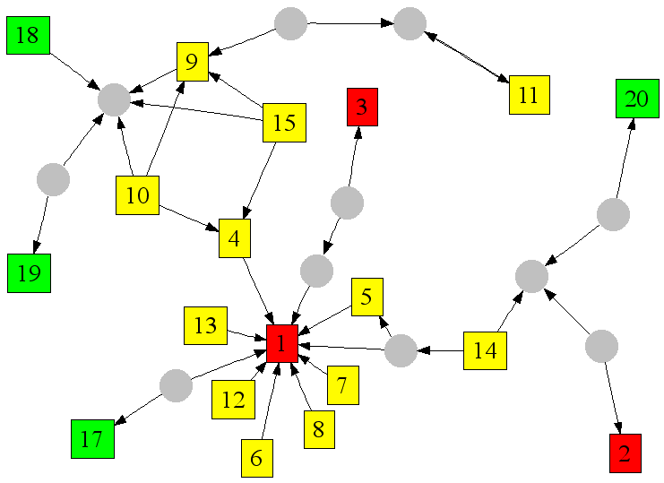
Projection and connection graphs
Query: Yahoo
Projection graph
Connection graph
Notes:
HIDE

Slide 31
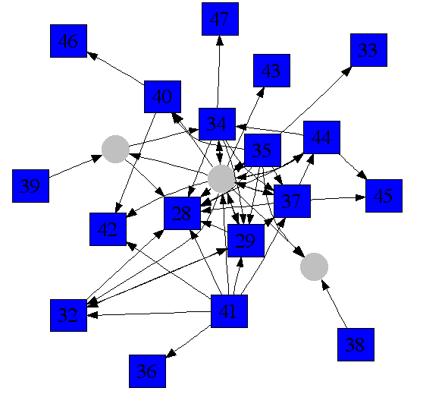
Good vs. Poor result set
Good (top20) vs. Poor (top 40 to 60)
Query medline
Domain graph projection
Good result set
(top 20)
Poor result set
(top 40 to 60)

Slide 32

Good vs. Poor: the task
Good (top20) vs. Poor (top 40 to 60)
Query Wisconsin
URL graph projection
Good result set
Poor result set

Slide 33
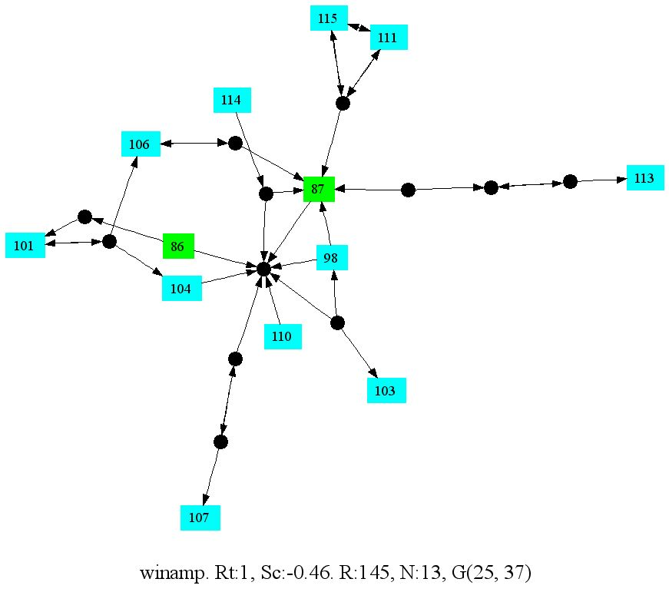
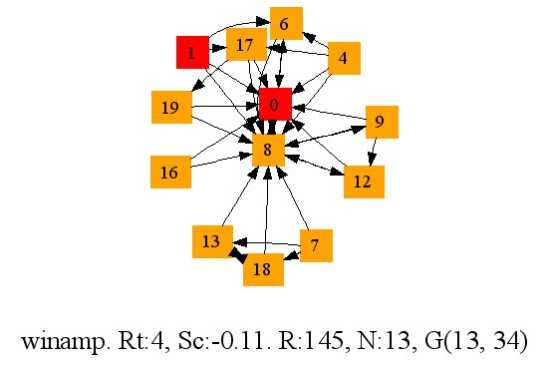
Good vs. Poor: performance
Project top20 and top40-60 results (ordered by human rating)
Predict whether a given graph is composed from top or bottom search results
Results:
  Gradual increase in performance
  Projections on the domain graph perform better
Attributes | URL Graph | Domain Graph
Marginals | 0.50 | 0.50
RankNet | 0.74 | 0.74
Projection | 0.62 | 0.82
Connection | 0.60 | 0.86
Projection + Connection | 0.87 | 0.90
All | 0.88 | 0.88
vs.
10-fold cross validation Classification Accuracy

Slide 34
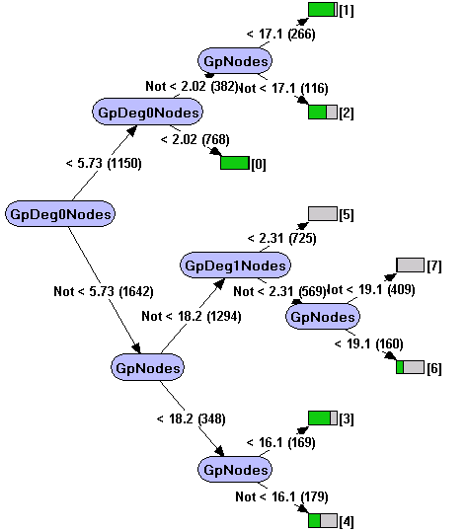
Good vs. Poor: the model
Good result sets have:
  Few isolated and dangling nodes
  Results are from fewer domains
Poor result sets are the opposite:
  Disconnected tree-like graphs with many connector nodes

Slide 35
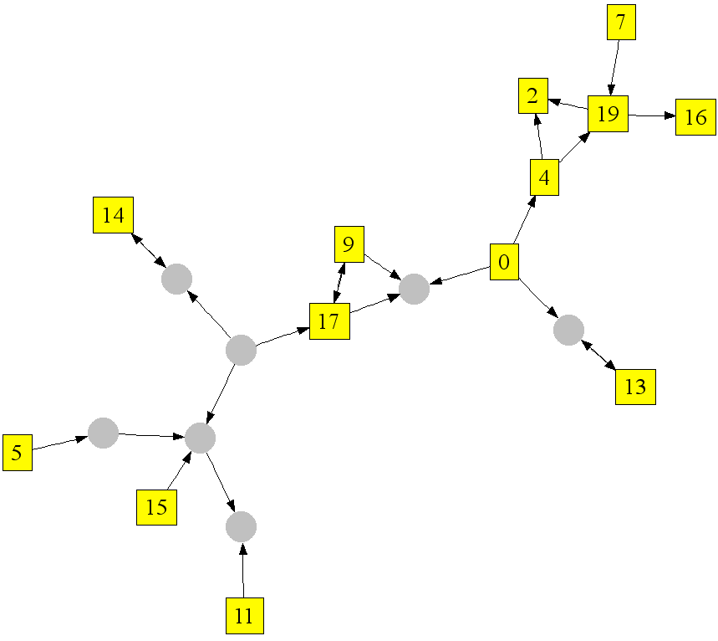
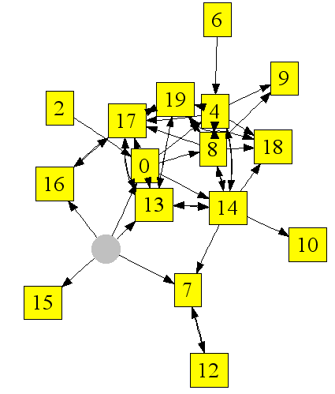
Specialization vs. Generalization
Given a query transition predict whether it is:
  Specialization (words were added)
  Generalization (words were removed)
Query transition
Q: free house plans
Q: house plans

Slide 36
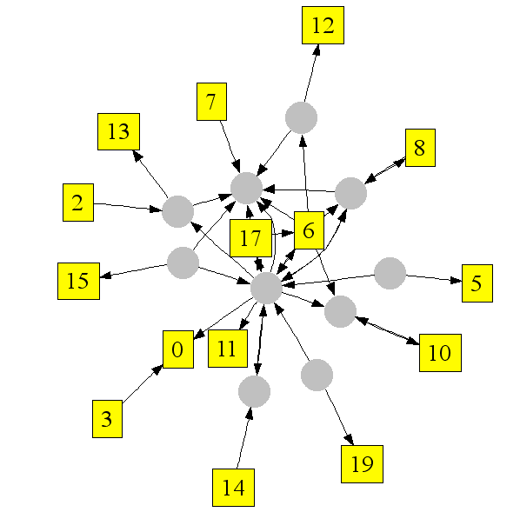
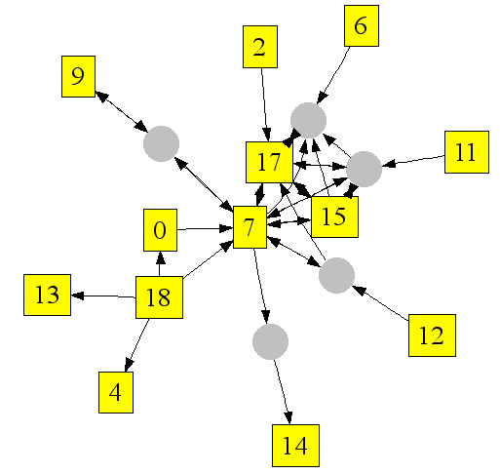
Predict type of query transition
Given graphs before and after transition predict the transition type
Query transition
Is transition specialization or generalization?
Q: strawberry shortcake
Q: strawberry shortcake pictures

Slide 37
Type of transition: task
Predict whether given transition was specialization or generalization
Gradual increase in performance as using richer attributes
Attributes | URL Graph | Domain Graph
Marginals | 0.50 | 0.50
Projection | 0.71 | 0.84
Connection | 0.69 | 0.83
Projection + Connection | 0.71 | 0.85
All | 0.80 | 0.87

Slide 38
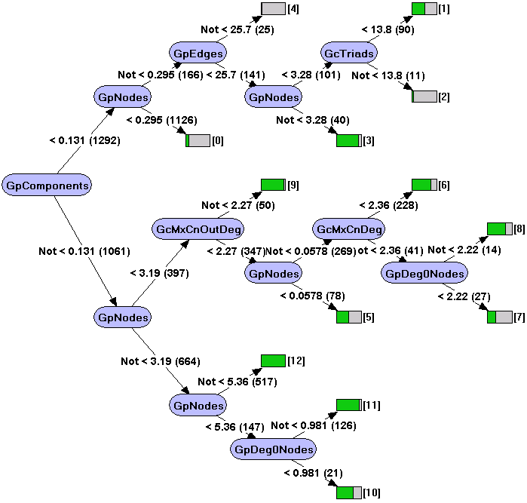
Type of transition: the model
Specializations:
  Decrease in number of connected components
  Decrease in number of isolated nodes
  Largest component increases
  Number of connector nodes decreases

Slide 39
Guess query reformulation
Given a query predict whether it is likely to get specialized or generalized.
Results show …
Attributes | URL Graph | Domain Graph
Marginals | 0.50 | 0.50
Projection | 0.71 | 0.68
Connection | 0.62 | 0.65
Projection + Connection | 0.70 | 0.68
All | 0.78 | 0.76
Notes:
HIDE

Slide 40
Impact and applications
Identify queries search engine does poorly on
Given query reformulation predictions we know whether the user will be happy or not
Use predictions on query reformulation for
  suggest alternative queries
  spot badly formulated queries

