Slide 1
Linear Programming
Boosting for Uneven
Datasets
Jurij Leskovec,
Jožef Stefan Institute, Slovenia
John Shawe-Taylor,
  Royal Holloway University of London, UK

Slide 2

Motivation
There are 800 million of Europeans and 2 million of them are Slovenians
Want to build a classifier to distinguish Slovenians from the rest of Europeans
A traditional unaware classifier (e.g. politician) would not even notice Slovenia as an entity
We don’t want that! ☺
Notes:
In real life there are many problems when we deal with unbalanced datasets. For instance one would like to train a classifier to predict whether a human is a Slovenian or not. It that case we have to deal with really unbalanced data set, since we Slovenians are a small nation.

Slide 3
Problem setting
Unbalanced Dataset
2 classes:
  positive (small)
  negative (large)
Train a binary classifier to separate highly unbalanced classes

Slide 4
Our solution framework
We will use Boosting
  Combine many simple and inaccurate categorization rules (weak learners) into a single highly accurate categorization rule
  The simple rules are trained sequentially; each rule is trained on examples which are most difficult to classify by preceding rules

Slide 5
Outline
Boosting algorithms
Weak learners
Experimental setup
Results
Conclusions

Slide 6
Related approaches: AdaBoost
given training examples (x₁,y₁),… (x_{m},y_{m})
initialize D₀(i) = 1/m y_{i} ∈ {+1, -1}
for t = 1…T
  pass distribution D_{t} to weak learner
  get weak hypothesis h_{t}: X → R
  choose α_{t} (based on performance of h_{t})
  update D_{t+1}(i) = D_{t}(i) exp(-α_{t} y_{i} h_{t}(x_{i})) / Z_{t}
final hypothesis: f(x) = ∑_{t} α_{t} h_{t}(x)

Slide 7
AdaBoost - Intuition
weak hypothesis h(x)
  sign of h(x) is the predicted binary label
  magnitude |h(x)| as a confidence
α_{t} controls the influence of each h_{t}(x)

Slide 8
More Boosting Algorithms
Algorithms differ in the way of initializing weights D₀(i) (misclassification costs) and updating them
4 boosting algorithms:
  AdaBoost – Greedy approach
  UBoost – Uneven loss function + greedy
  LPBoost – Linear Programming (optimal solution)
  LPUBoost – Our proposed solution (LP + uneven)

Slide 9
Boosting Algorithm Differences
given training examples (x₁,y₁),… (x_{m},y_{m})
initialize D₀(i) = 1/m y_{i} ∈ {+1, -1}
for t = 1…T
  pass distribution D_{t} to weak learner
  get weak hypothesis h_{t}: X → R
  choose α_{t}
  update D_{t+1}(i) = D_{t}(i) exp(-α_{t} y_{i} h_{t}(x_{i})) / Z_{t}
final hypothesis: f(x) = ∑_{t} α_{t} h_{t}(x)
Boosting
Algorithms differ
in these 2 lines

Slide 10
UBoost - Uneven Loss Function
set:
  D₀(i) so that D₀(positive) / D₀(negative) = β
update D_{t+1}(i):
  increase weight of false negatives more than on false positives
  decrease weight of true positives less than on true negatives
Positive examples maintain higher weight (misclassification cost)

Slide 11
LPBoost – Linear Programming
set:
  D₀(i) = 1/m
update D_{t+1}: solve LP:
  argmin LPBeta,
  s.t. ∑_{i} (D(i) y_{i} h_{k}(x_{i})) ≤ LPBeta; k = 1…t
  where 1 / A < D(i) < 1 / B
set α to Lagrangian multipliers
if ∑_{i} D(i) y_{i} h_{t}(x_{i}) < LPBeta, optimal solution

Slide 12
LPBoost – Intuition
Training Example Weights
 | D(1) | D(2) | D(3) | … | D(m)
h₁ | + | - | + |  | -
h₂ | - | - | + |  | + | ≤ LPBeta
… |  |  |  | …
h_{t} | + | - | + |  | +
argmin LPBeta
s.t. ∑_{i} (D(i) y_{i} h_{k}(x_{i})) ≤ LPBeta k = 1...t
where 1 / A < D(i) < 1 / B
Weak
Learners

Slide 13
LPBoost – Example
Training Example Weights
 | D(1) | D(2) | D(3)
h₁ | + 0.3 D(1) | + 0.7 D(2) | - 0.2 D(3) | ≤ LPBeta
h₂ | + 0.1 D(1) | - 0.4 D(2) | - 0.5 D(3) | ≤ LPBeta
h₃ | + 0.5 D(1) | - 0.1 D(2) | - 0.3 D(3) | ≤ LPBeta
Correctly
Classified
Incorrectly
Classified
Confidence
Weak
Learners
argmin LPBeta
s.t. ∑_{i} (y_{i} h_{k}(x_{i}) D(i)) ≤ LPBeta k = 1...3
where 1 / A < D(i) < 1 / B

Slide 14
LPUBoost - Uneven Loss + LP
set:
  D₀(i) so that D₀(positive) / D₀(negative) = β
update D_{t+1}:
  solve LP, minimize LPBeta but set different misclassification cost bounds for D(i)
  (β times higher for positive examples)
the rest as in LPBoost
Note: β is input parameter. LPBeta is Linear Programming optimization variable

Slide 15
Summary of Boosting Algorithms
 | Uneven loss function | Converges to global optimum
AdaBoost | ☒ | ☒
UBoost | ☑ | ☒
LPBoost | ☒ | ☑
LPUBoost | ☑ | ☑

Slide 16
Weak Learners
One-level decision tree (IF-THEN rule):
if word w occurs in a document X
return P else return N
  P and N are real numbers chosen based on misclassification cost weights D_{t}(i)
interpret the sign of P and N as the predicted binary label
magnitude |P| and |N| as the confidence

Slide 17
Experimental setup
Reuters newswire articles (Reuters-21578)
ModApte split: 9603 train, 3299 test docs
16 categories representing all sizes
Train binary classifier
5 fold cross validation
Measures: Precision = TP / (TP + FP)
Recall = TP / (TP + FN)
F1 = 2Prec Rec / (Prec + Rec)

Slide 18
Typical situations
Balanced training dataset
  all learning algorithms show similar performance
Unbalanced training dataset
  AdaBoost overfits
  LPUBoost does not overfit – converges fast using only a few weak learners
  UBoost and LPBoost are somewhere in between

Slide 19
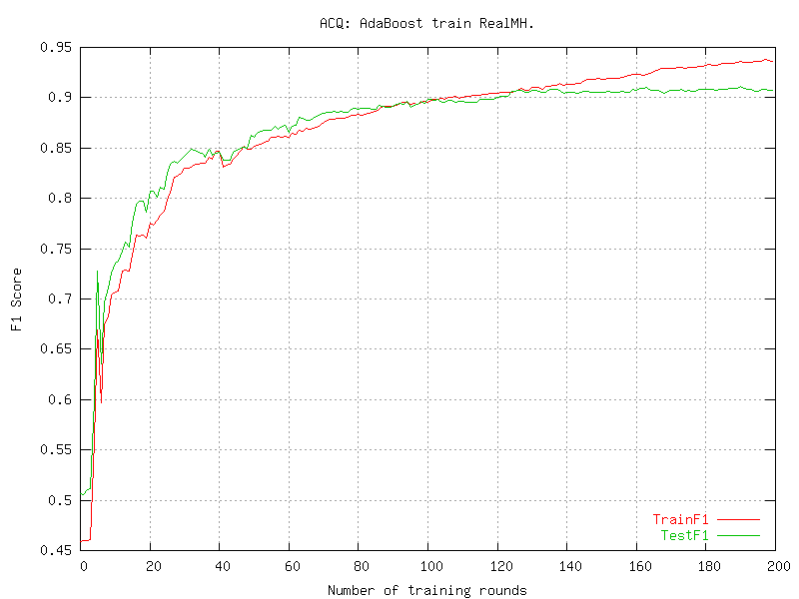
Balanced dataset
Typical behavior

Slide 20
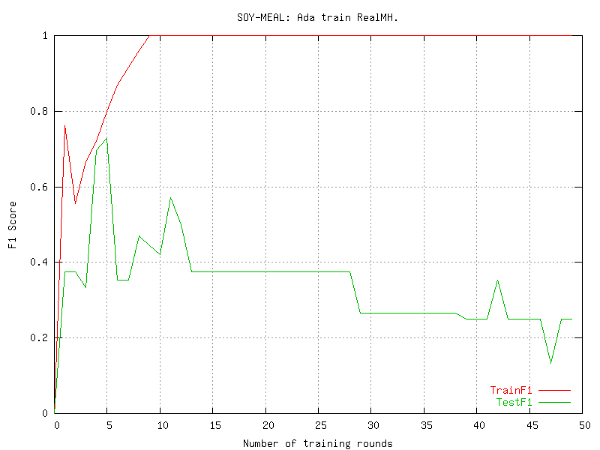
Unbalanced Dataset
AdaBoost overfits

Slide 21
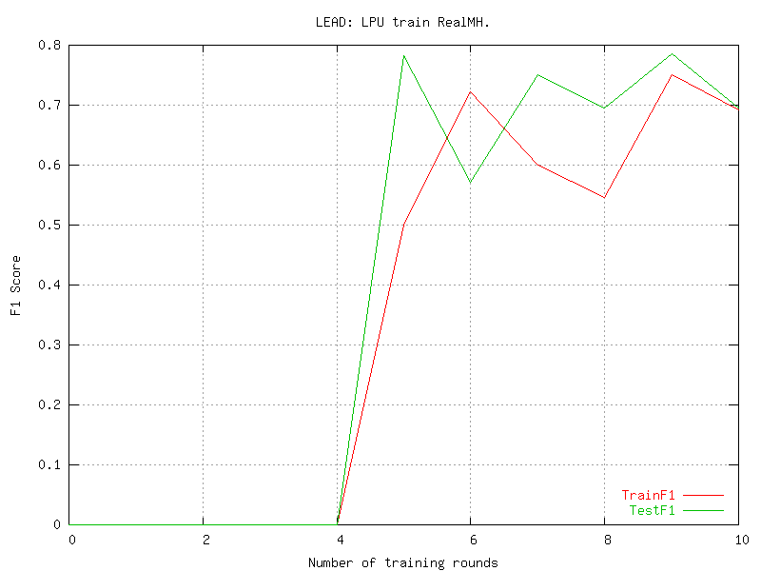
Unbalanced
dataset
LPUBoost
Few iterations (10)
Stop after no suitable feature is left

Slide 22
Reuters categories
Category (size) | Ada | U | LP | LPU | SVM
EARN (2877) | 0.97 | 0.97 | 0.97 | 0.91 | 0.98
ACQ (1650) | 0.91 | 0.94 | 0.88 | 0.84 | 0.94
MONEY-FX (538) | 0.65 | 0.70 | 0.63 | 0.65 | 0.76
INTEREST (347) | 0.65 | 0.69 | 0.59 | 0.66 | 0.65
CORN (181) | 0.81 | 0.87 | 0.82 | 0.83 | 0.80
GNP (101) | 0.78 | 0.80 | 0.64 | 0.66 | 0.81
CARCASS (50) | 0.49 | 0.65 | 0.63 | 0.65 | 0.52
COTTON (39) | 0.68 | 0.89 | 0.95 | 0.95 | 0.68
MEAL-FEED (30) | 0.59 | 0.77 | 0.65 | 0.81 | 0.45
PET-CHEM (20) | 0.03 | 0.16 | 0.03 | 0.19 | 0.17
LEAD (15) | 0.20 | 0.67 | 0.24 | 0.45 | 0
SOY-MEAL (13) | 0.30 | 0.73 | 0.35 | 0.38 | 0.21
GROUNDNUT (5) | 0 | 0 | 0.22 | 0.75 | 0
PLATINUM (5) | 0 | 0 | 0.20 | 1.00 | 0.32
POTATO (3) | 0.53 | 0.53 | 0.29 | 0.86 | 0.15
NAPHTHA (2) | 0 | 0 | 0.20 | 0.89 | 0
AVERAGE | 0.47 | 0.59 | 0.52 | 0.72 | 0.46
even
uneven
F1 on test set

Slide 23
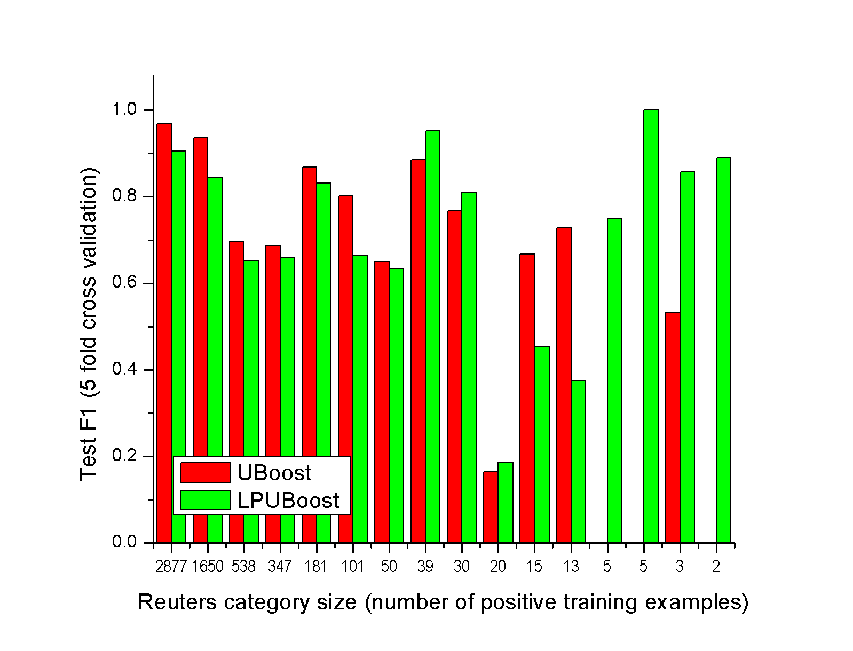
LPUBoost vs. UBoost

Slide 24
Most important features
(stemmed words)
Category size
LPU model size (number of features / words)
EARN (2877) – 50: ct, net, profit, dividend, shr
INTEREST (347) – 70: rate, bank, company, year, pct
CARCASS (50) – 30: beef, pork, meat, dollar, chicago
SOY-MEAL (13) – 3: meal, soymeal, soybean
GROUNDNUT (5) – 2: peanut, cotton (F1=0.75)
PLATINUM (5) – 1: platinum (F1=1.0)
POTATO (3) – 1: potato (F1=0.86)

Slide 25
Computational efficiency
AdaBoost and UBoost are the fastest – the simplest
LPBoost and LPUBoost are a little slower
  LP computation takes much of the time but since LPUBoost chooses fewer weak hypotheses the times get comparable to those of AdaBoost

Slide 26
Conclusions
LPUBoost is suitable for text categorization for highly unbalanced datasets
All benefits (well-defined stopping criteria, unequal loss function) show up
No overfitting: it is able to find simple (small) and complicated (large) hypotheses

