Slide 1
Semantic text features from small world graphs
Jure Leskovec,
IJS + CMU
John Shawe-Taylor,
Southampton

Slide 2
Introduction
We usually treat text documents as bags of words – sparse vectors of word counts
To measure document similarity we use cosine similarity (the inner product)
Bag-of-words does not capture any semantics
Word frequencies follow a power-law distribution
The IDF weighting compensates for skewed distribution
To reach over the bag of words people have proposed various techniques: LSI & friends, string kernels, semantic kernels, ...
In small world graphs we also observe power laws
We investigate a few first steps in creating ad-hoc small world graphs to model word generation and hence measure feature similarity

Slide 3
The general idea
Given a set of text units (documents, paragraphs)
Organize them into the a tree or a graph, where each node contains a set of “semantically related” features (words)
We use the topology to measure feature similarity

Slide 4
Toy example
Child “extends” the vocabulary of a parent
We expect to find increasingly fine grained terminology as we move down the tree (graph)
Each node contains a set of (semantically related) words
Analogy to OpenDirectory – a taxonomy of web pages
Note we are not trying to construct a taxonomy but just exploit the structure to measure feature similarity
“stop-words”
Stats
EE
CS
AI
ML
Robotics

Slide 5
The algorithms
We present the following 3 algorithms for creating the topologies
  Basic Tree
  Optimal Tree
  Basic Graph

Slide 6
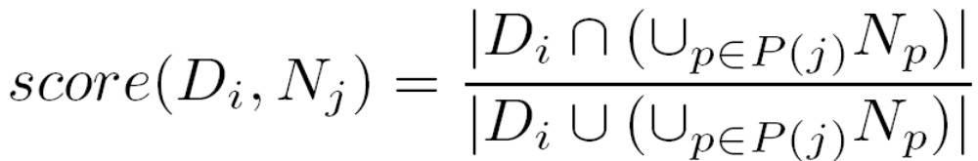

Algorithm 1: Basic Tree
Take the documents in random order
For each document create a node in a tree
Create a link to parent node N_{j} where we maximize:
We tested various score functions. The suggested one performed best.
Each node contains words that are new for the path from the root to the node:
where:
P(j): parents of N_{j}

Slide 7
Algorithm 1: Basic Tree (2)
The algorithm:
  Compare a blue node to all nodes in the tree
  We measure the score between the words in a new node and the words on a path from a white node to the root of the tree
  Create a link to a node with the highest score

Slide 8
Basic Tree: variations
Introduce a stop words node
We experimented with several stop words collections (8, 425, 523 English stop words).
We use 8 stop words:
  and, an, by, from, of, the, with
Also add the words that occur in more than 80% of the nodes
Usually there are about 20 stop words in the stop-words node

Slide 9
Algorithm 2: Optimal Tree
The tree created by Basic Tree depends on the ordering of the documents
We can use a greedy algorithm:
  Start with a stop words node
  From the pool of documents pick a document with maximal score
  Create a node for it
  Link to parent as in Basic Tree

Slide 10
Algorithm 3: Basic Graph
Hierarchies are in reality graphs
For example we expect Machine Learning to extend vocabulary of both Statistics and Computer Science
Algorithm:
  Start with a stop-words node (we remove it after the graph is built)
  Node contains words that are new for the whole graph built so far
  We link a new node to all nodes where:
threshold=0.05

Slide 11

Feature similarity measure
Having 2 documents composed of words
Document similarity is the similarity between all pairs of words in the 2 documents (expensive O(N²))
Having a topology over the features we do not treat features as independent
We use graph (weighted/unweighted) shortest paths as a feature distance measure
Given a matrix S where S_{ij} is a similarity of features i and j. The distance between documents x and z is given by:

Slide 12
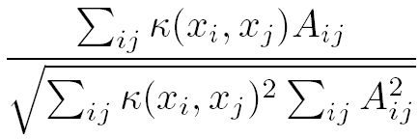
Experimental setup
Reuters corpus Volume 1
  800,000 documents, 103 categories
We consider 1000 random documents
10 fold cross validation
Evaluate the quality of representation with the kernel alignment:
where: A_{ij}=1 if documents i and j are from the same category
Compare distances with-in the class vs. the distances across the class

Slide 13
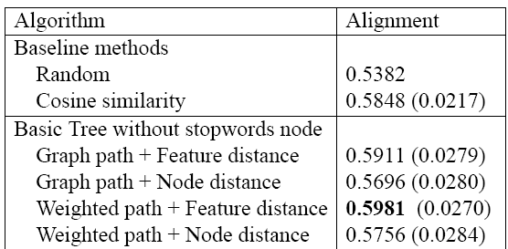
Experiments (1)
Node distance: since nodes in a graph represent documents, we can measure similarity directly by using shortest paths.
Standard
deviation

Slide 14
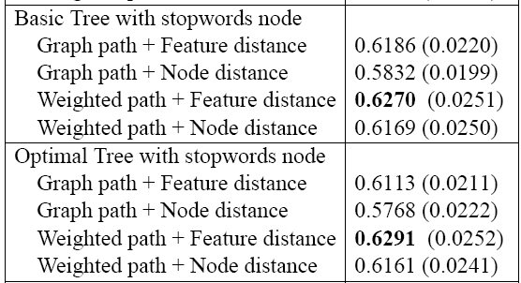
Experiments (2)
Random: 0.538, Cosine bag of words: 0.585, Basic tree: 0.598
Average
Alignment
Standard
deviation

Slide 15
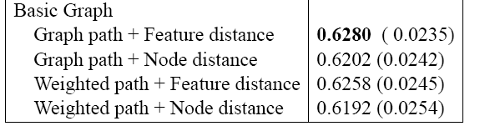
Experiments (3)
Average
Alignment
Standard
deviation

Slide 16
Experimental Results
Summary of experiments:
  Random: 0.538
  Cosine: 0.585
  Basic tree: 0.591
  Basic tree + stop-words node: 0.627
  Optimal tree + stop-words node: 0.629
  Basic graph: 0.628

Slide 17
Experimental Results
Stop-words node improves results
Dependence on document ordering does not degrade performance
Optimal Tree performs best
Feature distance outperforms Node distance
Using weighted (edge weight = 1–score) shortest paths always improves performance by 1.5%
Using paragraphs to build graphs does worse

Slide 18
Conclusions and Future directions
We presented the first steps towards building a topology to better measure of document similarity
Probabilistic generation mechanism for documents based on the graph structure
  We expect to get power law degree distribution
  This could also motivate the choice of document similarity measure in a more principled way

