Slide 1


The dynamics of viral marketing
Jure Leskovec, Carnegie Mellon University
Lada Adamic, University of Michigan
Bernardo Huberman, HP Labs
School of Information
University of Michigan

Slide 2
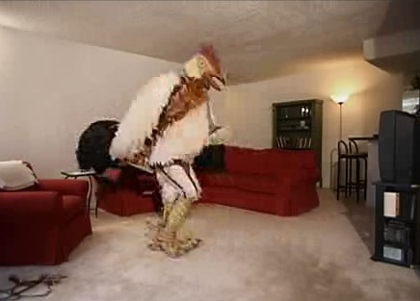
Using online networks for viral marketing
Burger King’s subservient chicken

Slide 3
The dynamics of Viral Marketing
Outline
  prior work on viral marketing & information diffusion
  incentivised viral marketing program
  cascades and stars
  network effects
  product and social network characteristics

Slide 4
Information diffusion
Studies of innovation adoption
  hybrid corn (Ryan and Gross, 1943)
  prescription drugs (Coleman et al. 1957)
Models (very many)
  Rogers, ‘Diffusion of Innovations’
  Watts, Information cascades, 2002

Slide 5
Motivation for viral marketing
viral marketing successfully utilizes social networks for adoption of some services
  hotmail gains 18 million users in 12 months,
  spending only $50,000 on traditional advertising
  gmail rapidly gains users although referrals are the only way to sign up
customers becoming less susceptible to mass marketing
mass marketing impractical for unprecedented variety of products online
  Google AdSense helps sellers reach buyers with targeted advertising
  but how do buyers get good recommendations?

Slide 6
The web savvy consumer and personalized recommendations
> 50% of people do research online before purchasing electronics
personalized recommendations based on prior purchase patterns and ratings
  Amazon, “people who bought x also bought y”
  MovieLens, “based on ratings of users like you…”
Is there still room for viral marketing?

Slide 7


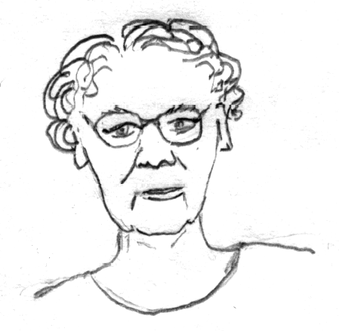
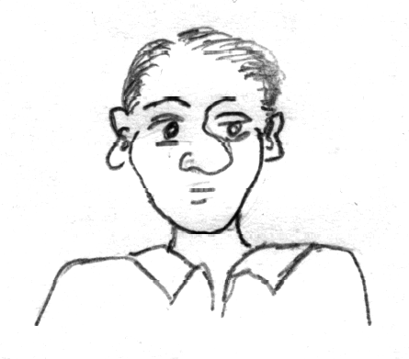
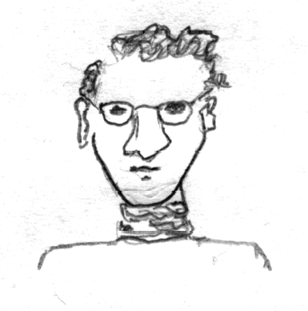
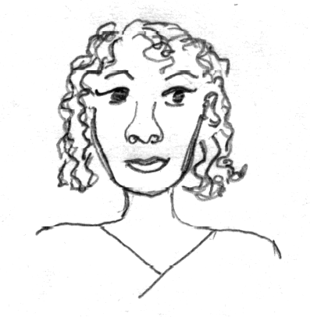
Is there still room for viral marketing next to personalized recommendations?
We are more influenced by our friends than strangers
68% of consumers consult friends and family before purchasing home electronics
(Burke 2003)

Slide 8


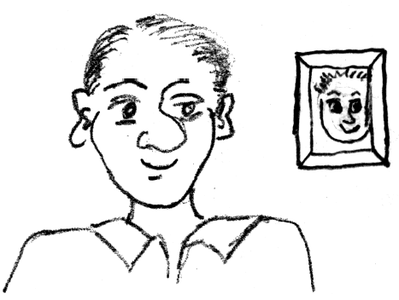

Incentivised viral marketing
(our problem setting)
Senders and followers of recommendations receive discounts on products
10% credit
10% off
Recommendations are made to any number of people at the time of purchase
Only the recipient who buys first gets a discount

Slide 9
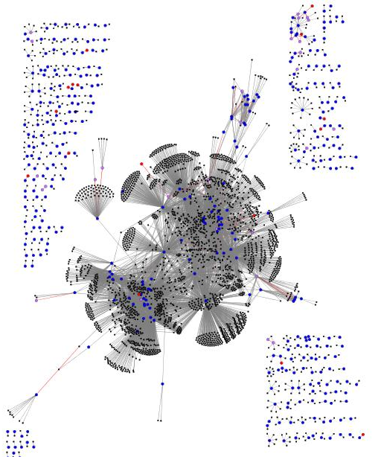
Product recommendation network
purchase following a recommendation
customer recommending a product
customer not buying a recommended product

Slide 10
the data
large anonymous online retailer (June 2001 to May 2003)
15,646,121 recommendations
3,943,084 distinct customers
548,523 products recommended
Products belonging to 4 product groups:
  books
  DVDs
  music
  VHS

Slide 11
summary statistics by product group
 | products | customers | recommenda-tions | edges | buy + get discount | buy + no discount
Book | 103,161 | 2,863,977 | 5,741,611 | 2,097,809 | 65,344 | 17,769
DVD | 19,829 | 805,285 | 8,180,393 | 962,341 | 17,232 | 58,189
Music | 393,598 | 794,148 | 1,443,847 | 585,738 | 7,837 | 2,739
Video | 26,131 | 239,583 | 280,270 | 160,683 | 909 | 467
Full | 542,719 | 3,943,084 | 15,646,121 | 3,153,676 | 91,322 | 79,164
people
recommendations
high
low

Slide 12
viral marketing program not spreading virally
94% of users make first recommendation without having received one previously
size of giant connected component increases from 1% to 2.5% of the network (100,420 users) – small!
some sub-communities are better connected
  24% out of 18,000 users for westerns on DVD
  26% of 25,000 for classics on DVD
  19% of 47,000 for anime (Japanese animated film) on DVD
others are just as disconnected
  3% of 180,000 home and gardening
  2-7% for children’s and fitness DVDs

Slide 13
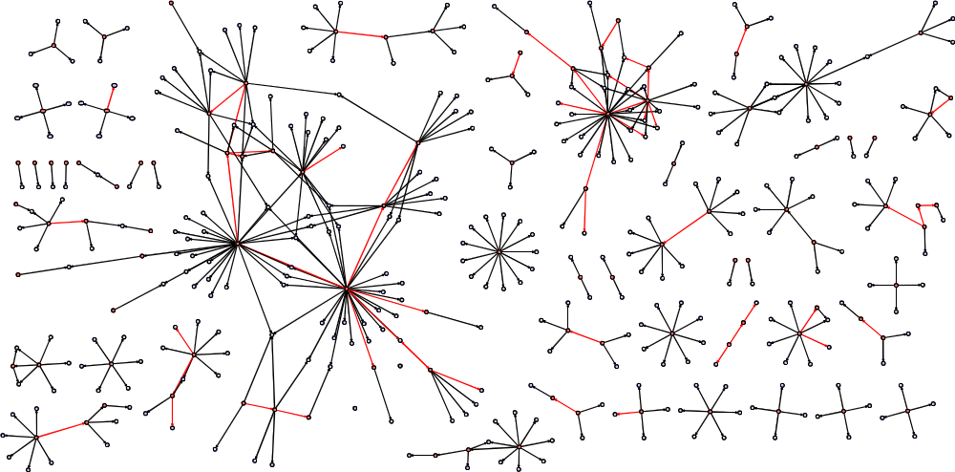
medical study guide recommendation network

Slide 14
measuring cascade sizes
delete late recommendations
count how many people are in a single cascade
exclude nodes that did not buy
steep drop-off
books
10
6
-4.98
= 1.8e6 x
10
4
2
very few large cascades
10
10
0
10
0
10
1
10
2

Slide 15
cascades for DVDs
DVD cascades can grow large
possibly as a result of websites where people sign up to exchange recommendations
shallow drop off – fat tail
~ x
-1.56
10
4
2
a number of large cascades
10
10
0
10
0
10
1
10
2
10
3

Slide 16
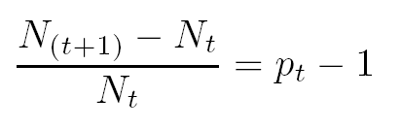
simple model of propagating recommendations
(ignoring for the moment the specific mechanics of the recommendation program of the retailer)
Each individual will have p_{t} successful recommendations. We model p_{t} as a random variable.
At time t+1, the total number of people in the cascade,
  N_{t+1} = N_{t} * (1+p_{t})
Subtracting from both sides, and dividing by N_{t}, we have

Slide 17
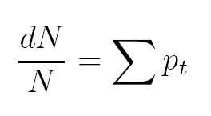
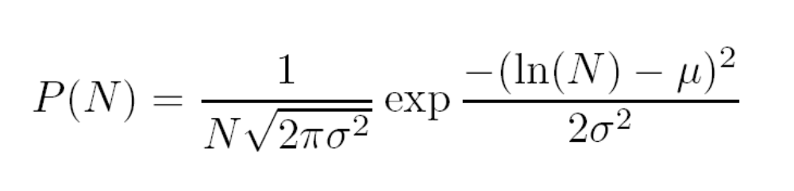
simple model of propagating recommendations
(continued)
Summing over long time periods
The right hand side is a sum of random variables and hence normally distributed.
Integrating both sides, we find that N is lognormally distributed
if σ large resembles power-law

Slide 18
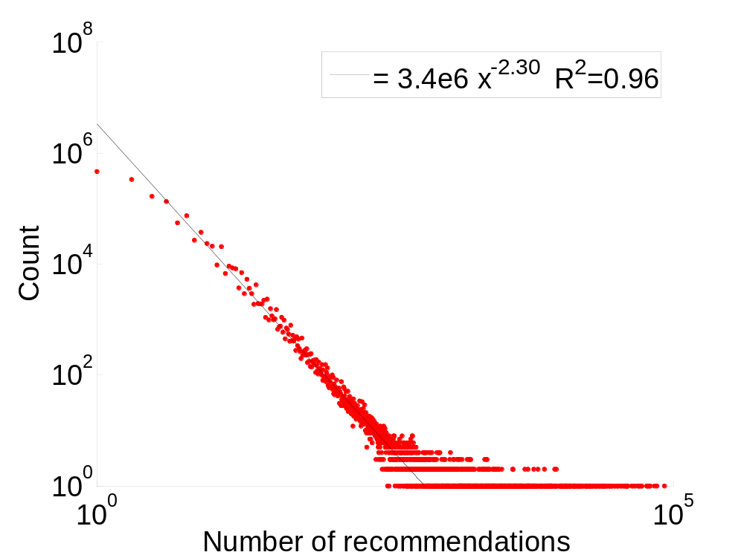
participation level by individual
very high variance
The most active person made 83,729 recommendations
and purchased 4,416 different items!

Slide 19
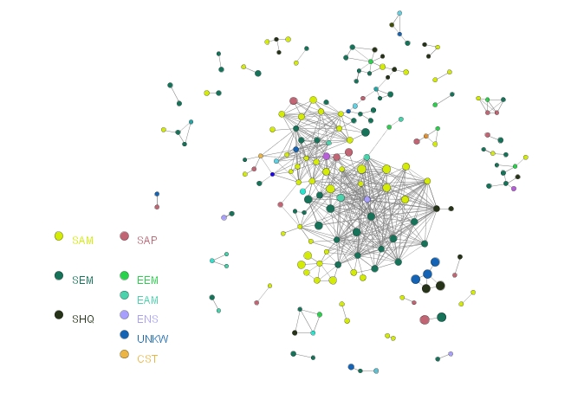
Network effects

Slide 20
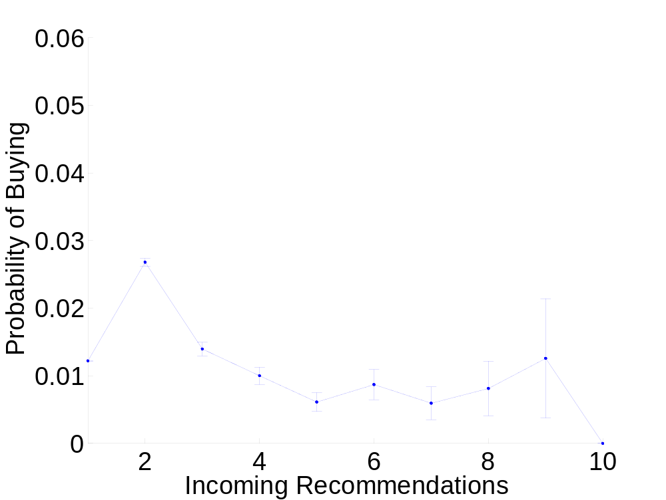
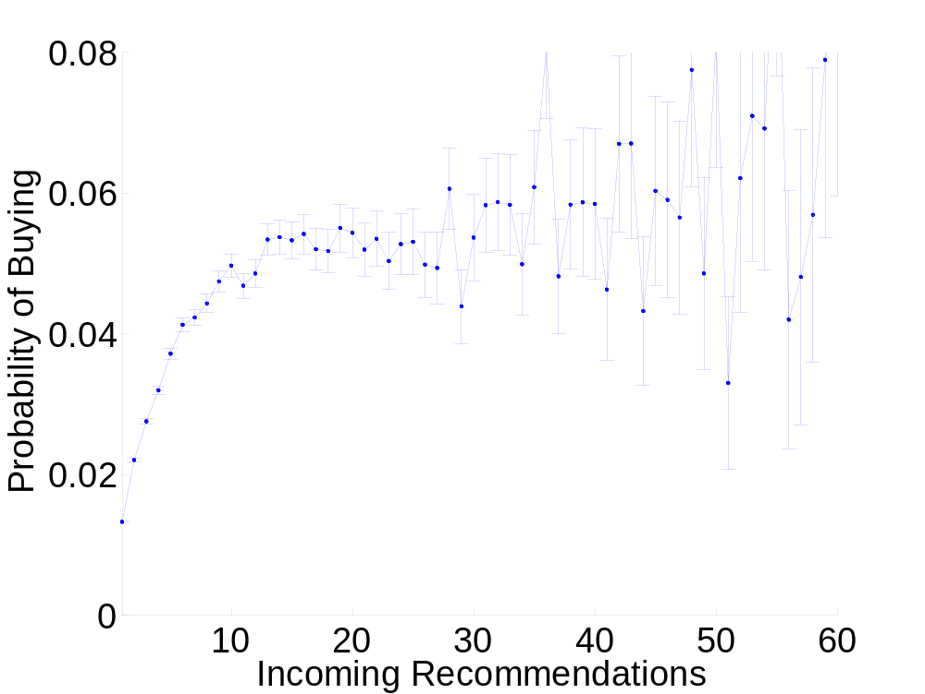
does receiving more recommendations increase the likelihood of buying?
BOOKS
DVDs

Slide 21
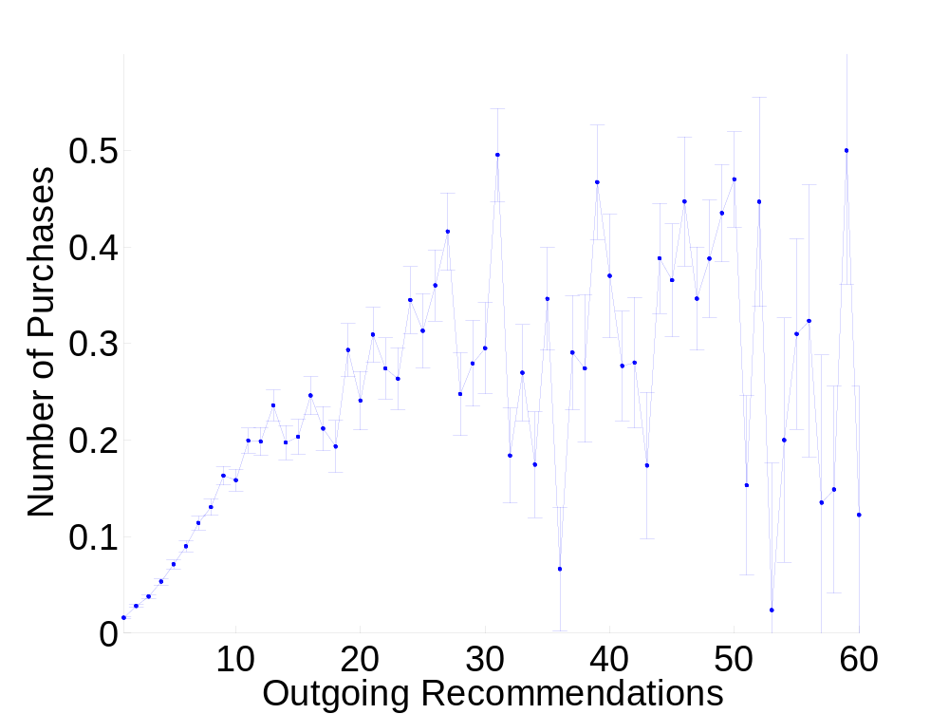
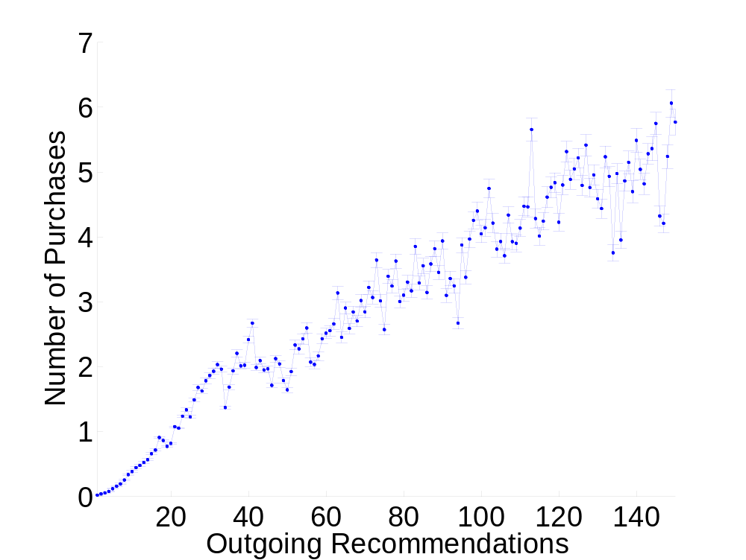
does sending more recommendations influence more purchases?
BOOKS
DVDs

Slide 22
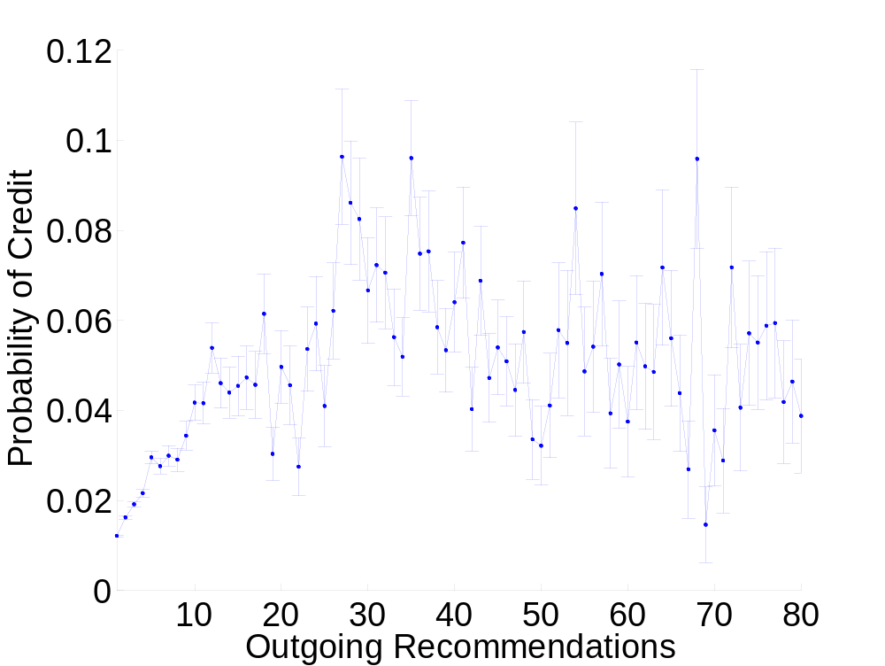
the probability that the sender gets a credit with increasing numbers of recommendations
consider whether sender has at least one successful recommendation
controls for sender getting credit for purchase that resulted from others recommending the same product to the same person
probability of receiving a credit levels off for DVDs

Slide 23
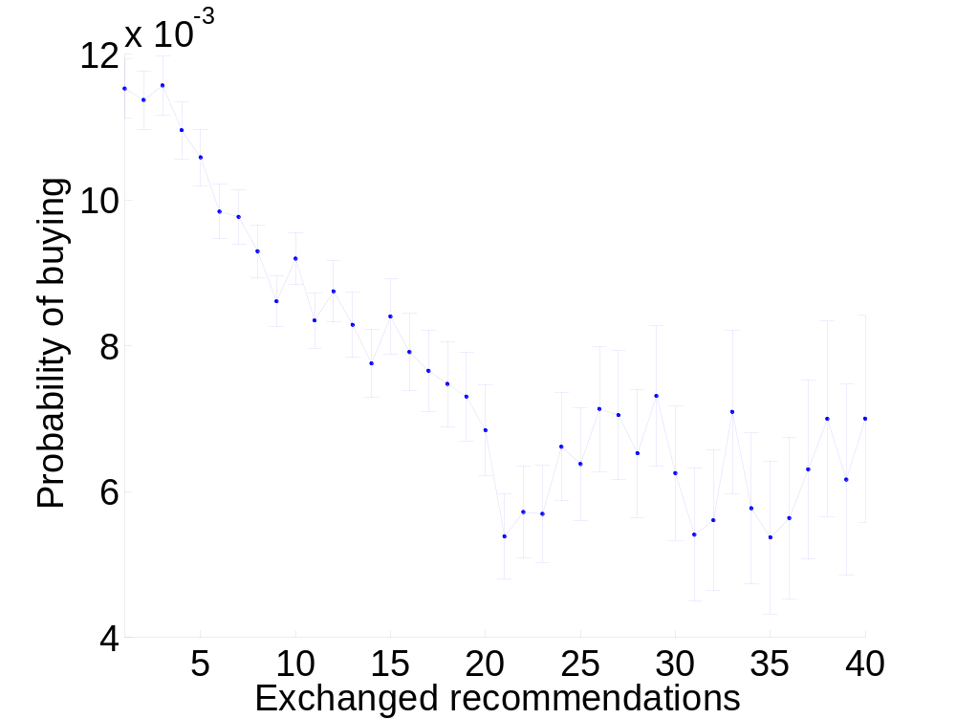
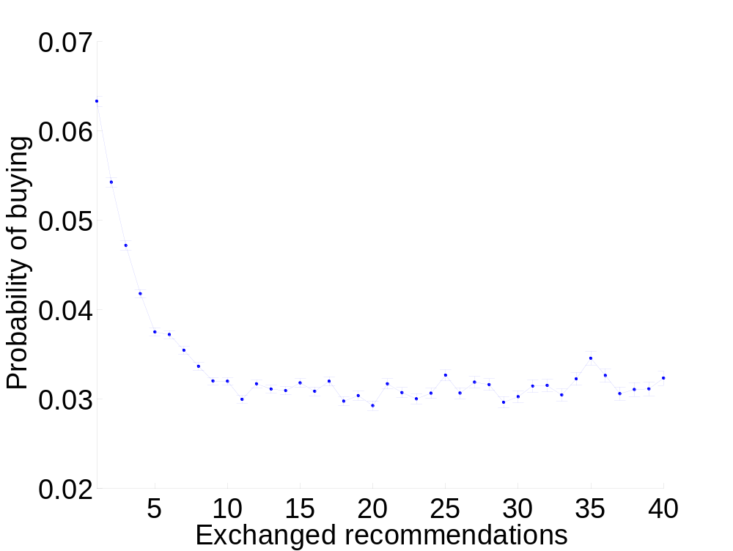
Multiple recommendations between two individuals weaken the impact of the bond on purchases
BOOKS
DVDs

Slide 24
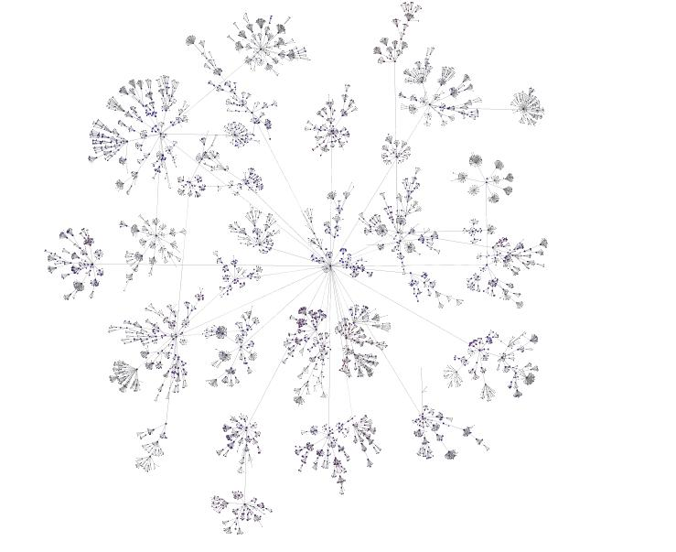
product and social network characteristics influencing recommendation effectiveness

Slide 25
recommendation success by book category
consider successful recommendations in terms of
  av. # senders of recommendations per book category
  av. # of recommendations accepted
books overall have a 3% success rate
  (2% with discount, 1% without)
lower than average success rate (significant at p=0.01 level)
  fiction
    romance (1.78), horror (1.81)
    teen (1.94), children’s books (2.06)
    comics (2.30), sci-fi (2.34), mystery and thrillers (2.40)
  nonfiction
    sports (2.26)
    home & garden (2.26)
    travel (2.39)
higher than average success rate (statistically significant)
  professional & technical
    medicine (5.68)
    professional & technical (4.54)
    engineering (4.10), science (3.90), computers & internet (3.61)
    law (3.66), business & investing (3.62)

Slide 26
anime DVDs
47,000 customers responsible for the 2.5 out of 16 million recommendations in the system
29% success rate per recommender of an anime DVD
giant component covers 19% of the nodes
Overall, recommendations for DVDs are more likely to result in a purchase (7%), but the anime community stands out

Slide 27
regressing on product characteristics
Variable | transformation | Coefficient
const |  | -0.940 ***
# recommendations | ln(r) | 0.426 ***
# senders | ln(n_{s}) | -0.782 ***
# recipients | ln(n_{r}) | -1.307 ***
product price | ln(p) | 0.128 ***
# reviews | ln(v) | -0.011 ***
avg. rating | ln(t) | -0.027 *
R² |  | 0.74
significance at the 0.01 (***), 0.05 (**) and 0.1 (*) levels

Slide 28
products most suited to viral marketing
small and tightly knit community
  few reviews, senders, and recipients
  but sending more recommendations helps
pricey products
rating doesn’t play as much of a role

Slide 29
Conclusions
Overall
incentivized viral marketing contributes marginally to total sales
occasionally large cascades occur
Observations for future diffusion models
purchase decision more complex than threshold or simple infection
influence saturates as the number of contacts expands
links user effectiveness if they are overused
Conditions for successful recommendations
professional and organizational contexts
discounts on expensive items
small, tightly knit communities

Slide 30
For more information
the paper:
  http://www.cs.cmu.edu/~jure/pubs/viral-market.pdf
my publications:
  http://www.cs.cmu.edu/~jure/pubs/
Lada’s publications:
  http://www-personal.umich.edu/~ladamic
Bernardo Huberman’s Information Dynamics Lab at HP:
  http://www.hpl.hp.com/research/idl

Slide 31
Extras

Slide 32
pay it forward
product category | number of buy bits | forward recommendations | percent
Book | 65,391 | 15,769 | 24.2
DVD | 16,459 | 7,336 | 44.6
Music | 7,843 | 1,824 | 23.3
Video | 909 | 250 | 27.6
Total | 90,602 | 25,179 | 27.8

Slide 33
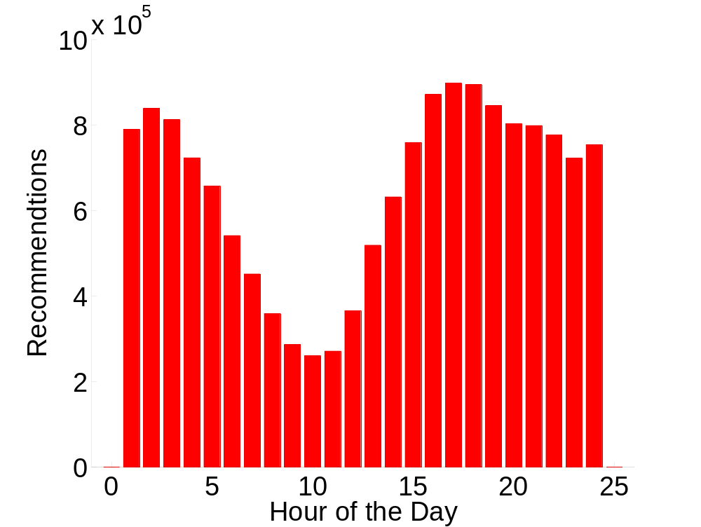
when recommendations are sent

Slide 34
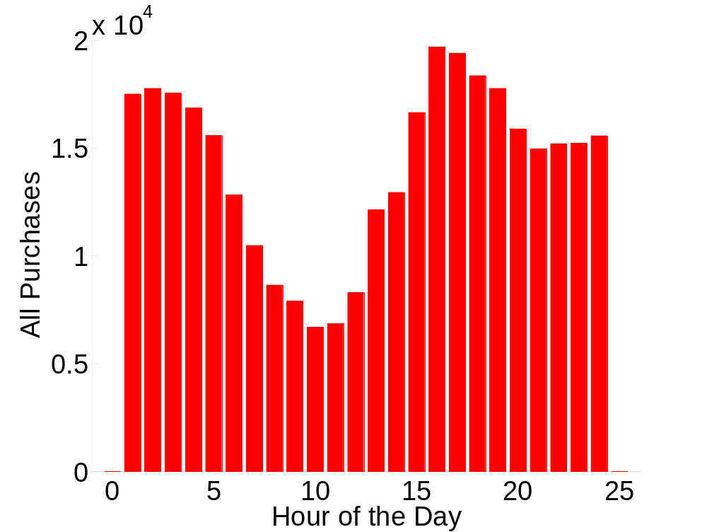
when purchases are made

Slide 35
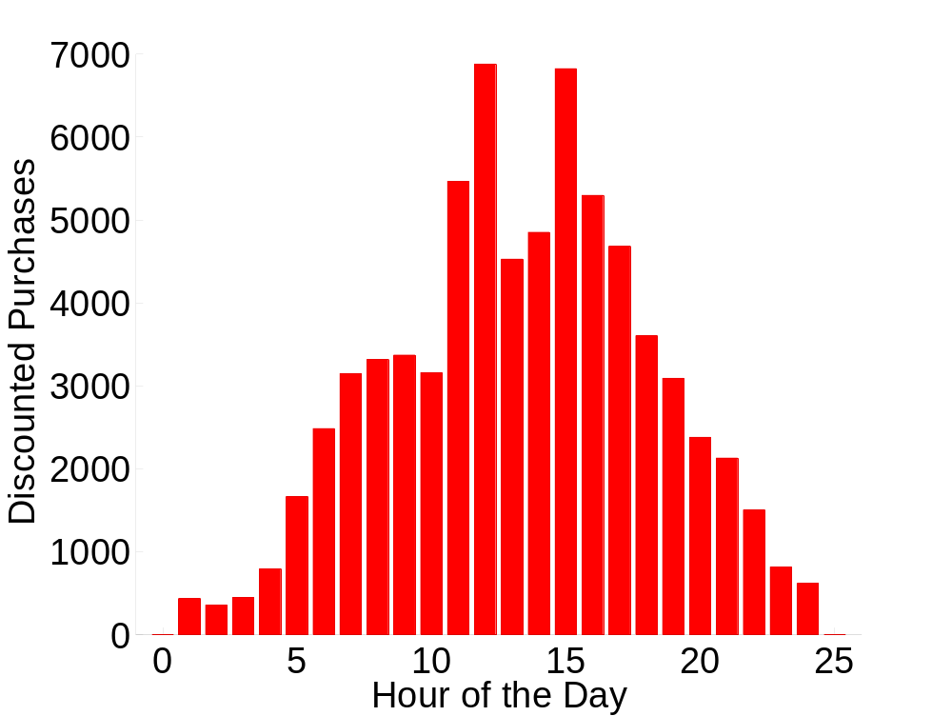
when discounts are to be had

Slide 36
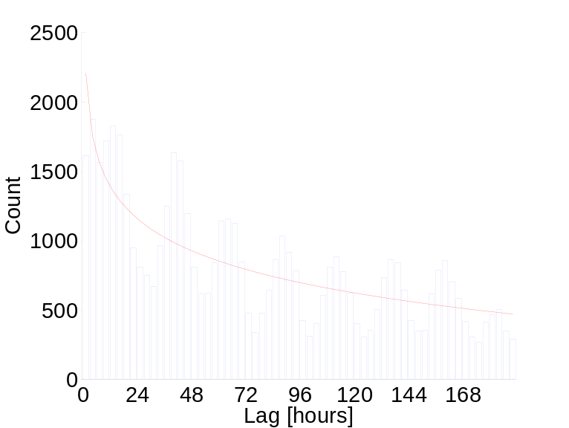
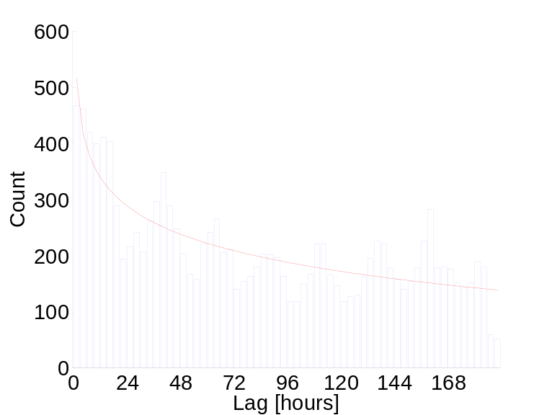
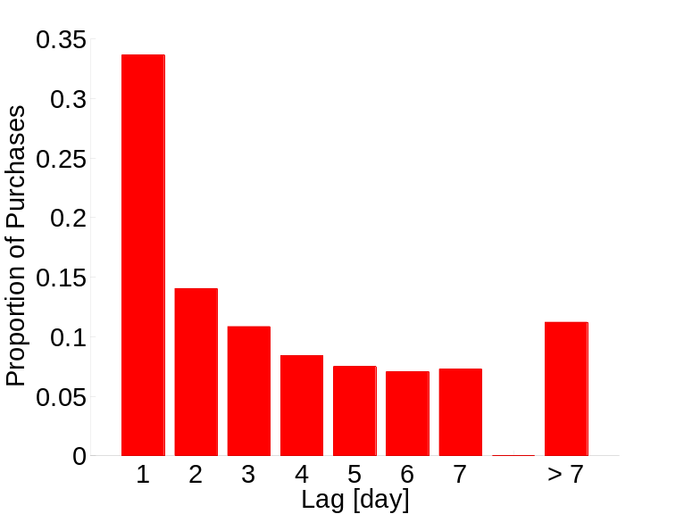
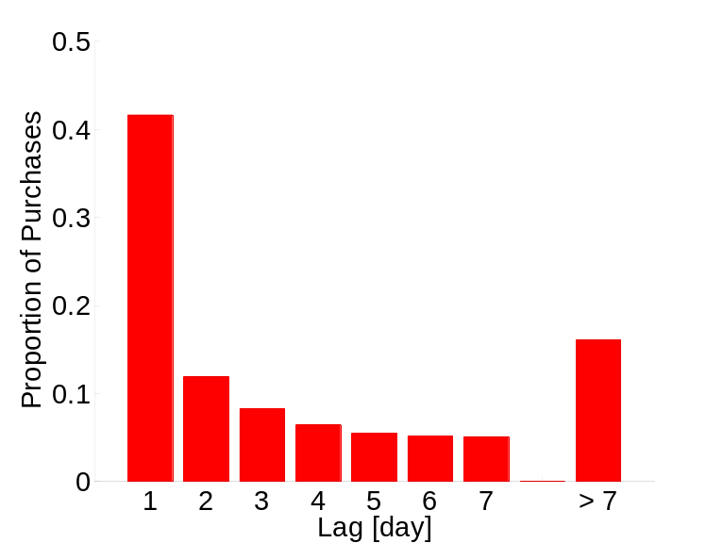
lag between time of recommendation and time of purchase
Book
DVD
daily periodicity
40% of those who buy
buy within a day
but > 15% wait more
than a week

Slide 37
observations
purchases and recommendations follow a daily cycle
customers are most likely to purchase within a day of receiving a recommendation
acting on a recommendation at atypical times increases the likelihood of receiving a discount

