Slide 2
Use this slide as a section separator
Presenter’s Name

Slide 3
PowerPoint Tips
Avoid using clipart and non-professional images. Find Lewis photos online at lewisu.edu/photogallery.
Avoid dissolves, spins & other transitions.
Keep fonts consistent: Calibri
Keep colors consistent:
Maroon (RGB 141/25/25)
Blue (RGB 0/81/114)

Slide 4
How to edit the footer
Go to Insert > Header and Footer
Make sure to uncheck “Date and Time”
Make sure to check “Footer”
Type in a footer title
Click Apply to All for consistent footer throughout the PowerPoint

Slide 5
Multiple Slide Options
This PowerPoint template has several slide layout options to choose from:
Title Slide
Section Title Slide
Title and Content
Two Content
Other slide layout options include:
Comparison (This slide layout)
Title Only
Content with Caption
Picture with Caption

Slide 6
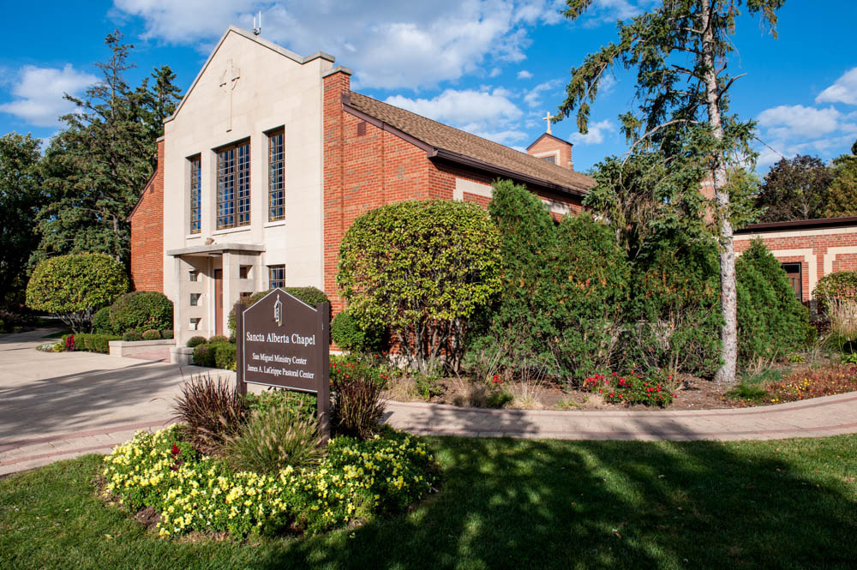
PowerPoint Tip: Use Colorful Photos
Access the Lewis University online photo gallery at:
lewisu.edu/photogallery

Slide 7
Section Separator
Presenter’s Name

Slide 8
Use Charts for Impact

