Slide 1
Establishing Resources
Microsoft Project 2013
Lesson 2

Slide 2
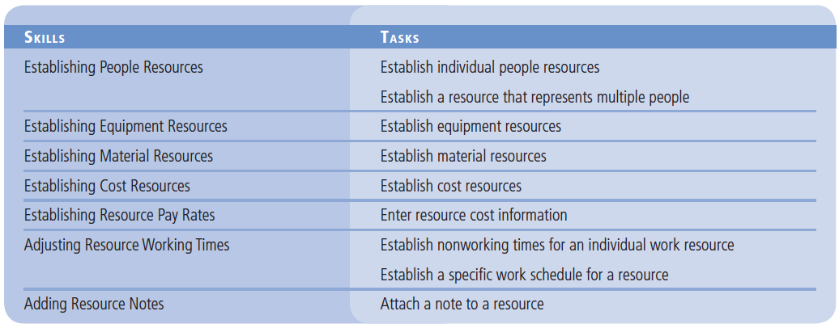
Objectives

Slide 3
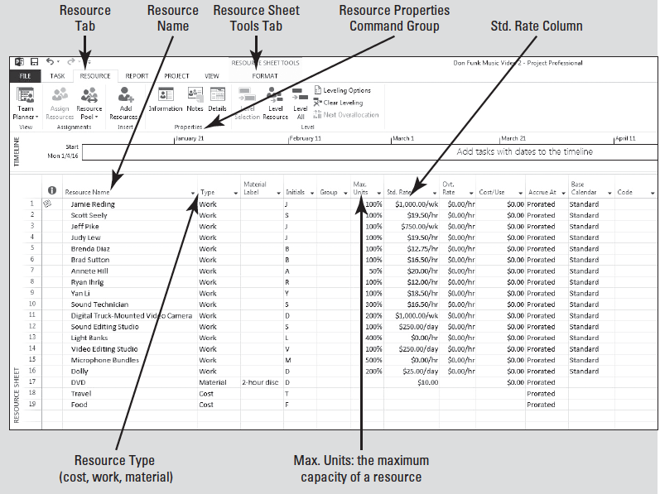
Software Orientation
You have several views available when working in Microsoft Project. One view you will use in this lesson is the Resource Sheet view, as shown at right.

Slide 4
Software Orientation
In this lesson, you establish your project resources—which are the people, equipment, materials, and money used to complete the tasks in a project.
Your screen may be different if default settings have been changed or if other preferences have been set. Use this figure as a reference for this lesson.

Slide 5
Establishing People Resources
When you set up people resources in Microsoft Project, you are able to track
who is available to work,
the type of work they can do, and
when they are available to do it.
In this section, you learn how to establish and enter people resources in Project 2013.

Slide 6
Establishing Individual People Resources
People resources can be in the form of
individuals,
individuals identified by their job function or title, or
groups of individuals with a common skill.
In this exercise, you practice setting up resource information for the individual people who will perform the tasks on the project.

Slide 7
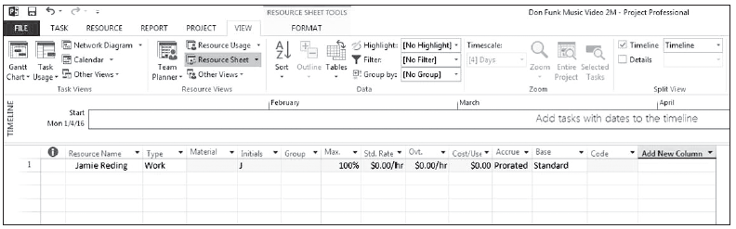
Step by Step: Establish Individual People Resources
GET READY. Open Don Funk Music Video 2M.
1. Click the View tab, then in the Resource Views group, select Resource Sheet to open the Resource Sheet view.
2. In the Resource Sheet view, click the empty cell directly below the Resource Name column heading.
3. Type Jamie Reding and press Enter. Project adds Jamie Reding as a work resource and automatically enters additional, default information. Your screen should look similar to the figure below.
Notes:
Another Way: If your resource information for your own project exists on your network, such as in a Microsoft Outlook address book, you can quickly import the resource information into Microsoft Project. This saves the time and effort of retyping the information and reduces the possibility of data entry errors.

Slide 8
Step by Step: Establish Individual People Resources
4. Enter the remaining resource names into the Simple Resource Sheet. Enter the first column of names (Scott Seely, Jeff Pike, etc.), then the second column.
Scott Seely Brad Sutton
Jeff Pike Annette Hill
Judy Lew Ryan Ihrig
Brenda Diaz Yan Li
Your screen should look similar to the figure on the next slide.

Slide 9
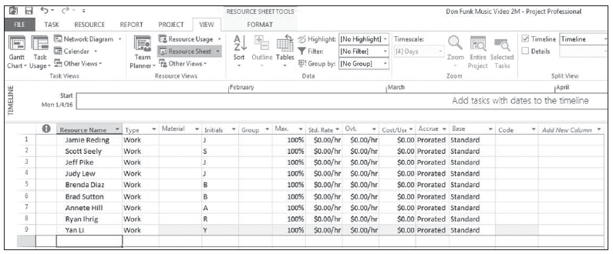
Step by Step: Establish Individual People Resources

Slide 10
Step by Step: Establish Individual People Resources
5. SAVE the file as Don Funk Music Video 2.
PAUSE. LEAVE the project schedule open to use in the next exercise.
You are beginning to set up some of the basic resource information for the people who will work on this project. As you are entering this information, keep in mind two important aspects of resources: availability and cost.

Slide 11
Establish Individual People Resources
Availability determines when and how much of a resource’s time can be assigned to work on tasks.
Cost refers to how much money will be needed to pay for the resources on a project.
Although setting up resource information in Microsoft Project may take a little extra time and effort. Entering this information will provide you with more control over your project.

Slide 12
Establish Individual People Resources
You will work with three types of resources in Microsoft Project:
work resources,
material resources, and
cost resources.
Work resources are the people and equipment that do work to accomplish the tasks of the project. Work resources use time to accomplish tasks.
You will learn about material resources and cost resources later in this lesson.

Slide 13
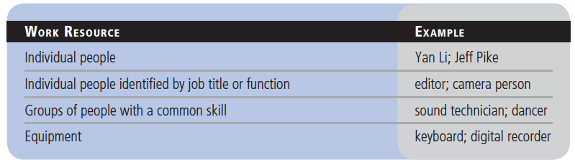
Establish Individual People Resources
Work resources can be in many different forms:

Slide 14
Establishing a Group Resource
When establishing your resources, use resource names that will make sense to you and anyone else using the project schedule.
In the previous exercise, you set up resources that were individuals.
Now, you will set up a single resource that represents multiple people, sometimes called a Generic Resource.

Slide 15
Step by Step: Establish a Resource That Represents Multiple People
USE the project schedule you saved in the previous exercise.
1. Click the blank Resource Name field below the last resource, type Sound Technician and then press Tab.
2. In the Type field, make sure that Work is selected. Press Tab four times to move to the Max. Units field.
You may only see a portion of the field name. To see the entire field name, expand the row just as you would in Excel. Place the cursor on the bottom of the header row in the ID column (just above resource 1). Click and drag the row down.
3. In the Max. Units field for the sound technician, type or select 300%, to indicate that you will have three sound technicians devoting 100% of their working time to this project, and then press Enter.
Notes:
Take Note: Maximum Units refers to the maximum capacity of a resource to accomplish tasks. The default value for maximum units is 100%. For example, specifying that a resource has 75% maximum units means that 75 percent of the resource’s time is available to work on tasks assigned to it. Microsoft Project will warn you if you assign a resource to more tasks than it can accomplish at its maximum units.

Slide 16
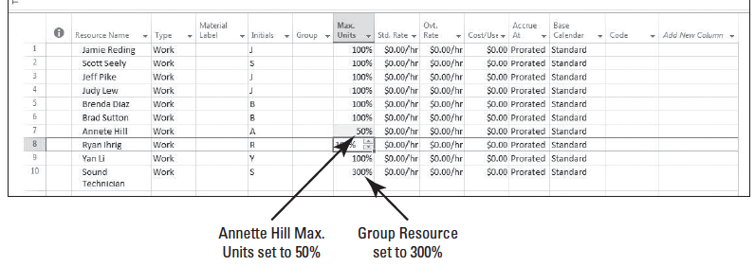
Step by Step: Establish a Resource That Represents Multiple People
4. Click the Max. Units field for Annette Hill, type or select 50% and then press Enter. This represents that she is only available part time on this project. Your screen should look similar to the figure below.
5. SAVE the project schedule.
PAUSE. LEAVE the project schedule open to use in the next exercise.
Notes:
Another Way: You can also enter maximum units as a decimal rather than a percentage. To change to this format, click File on the ribbon, then Options, and then click the Schedule option. In the Show assignment units as a box, select Decimal.

Slide 17
Step by Step: Establish a Resource That Represents Multiple People
In this exercise, you established a group resource. The resource named Sound Technician does not represent a single person. It actually represents a group of people called sound technicians.
By setting the Max. Units for this resource at 300%, you are indicating that three sound technicians will be available to work full time on every workday.
You might not know specifically who the sound technicians will be at this point, but you can still proceed with more planning.
Keep in mind if you use a group resource, a single resource calendar will be assigned to that resource name. Therefore, it is beneficial to have all of the people represented by the resource name work the same hours.

Slide 18
Establishing Equipment Resources
Setting up equipment resources in Microsoft Project is very similar to setting up people resources.
There are key differences, however, in the way equipment resources can be scheduled.
You don’t need to track every piece of equipment that will be used in your project. It will be helpful, though, to track equipment resources when you need to schedule and track equipment costs or when the equipment might be needed by multiple people at the same time.
In this exercise, you learn how to establish the equipment resources for your project.

Slide 19
Step by Step: Establish Equipment Resources – another method
USE the project schedule you created in the previous exercise.
1. In the Resource Sheet, click the next empty cell in the Resource Name column.
2. Click the Resource tab and then click the Information button in the Properties group; the Resource Information dialog box appears.
3. If it is not already displayed, click the General tab in the Resource Information dialog box.
4. In the Resource Name field, type Digital Truck-Mounted Video Camera.
Notes:
Another Way: You can also activate the Resource Information dialog box by double-clicking a resource name or an empty cell in the Resource Name column.

Slide 20
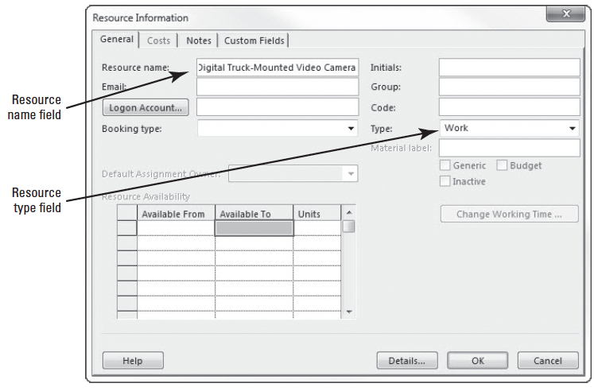
Step by Step: Establish Equipment Resources
5. In the Type field, select Work from the drop-down menu. Your screen should look similar to the figure at right. Notice that the Resource Information dialog box contains many of the same fields as the Resource Sheet.

Slide 21
Step by Step: Establish Equipment Resources
6. Click OK. The Resource Information dialog box closes and the resource has been added. Notice that Microsoft Project has automatically wrapped the text in the Resource Name field. Note that the Max. Units field is set to the default of 100%.
7. In the Max. Units field for the Digital Truck-Mounted Video Camera, type 200 or press the arrows until the value shown is 200%, and then press Enter. This indicates that you will have two truck cameras available every workday.
8. Add the following additional equipment resources to the project schedule. You can use the Resource Information dialog box to enter your information, but entering it directly in Resource Sheet view is faster. Make sure that Work is selected in the Type field for each resource.

Slide 22
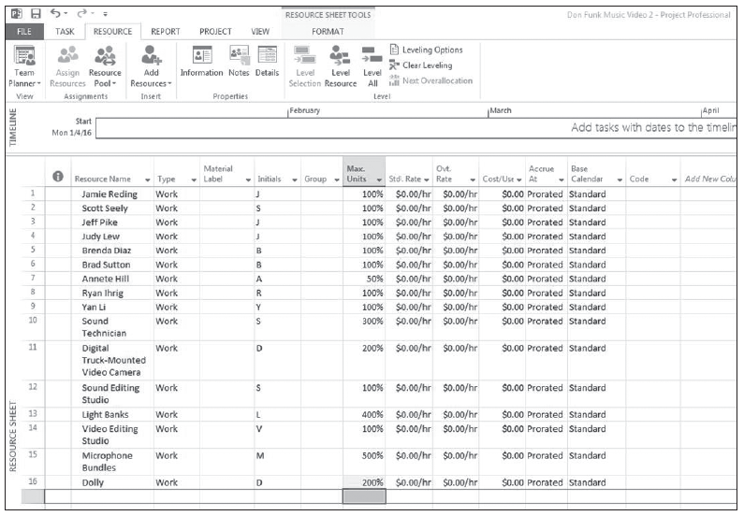
Step by Step: Establish Equipment Resources
Resource Name Max. Units
Sound Editing Studio 100%
Light Banks 400%
Video Editing Studio 100%
Microphone Bundles 500%
Dolly 200%
Your screen should look similar to the figure below.

Slide 23
Step by Step: Establish Equipment Resources
9. SAVE the project schedule.
PAUSE. LEAVE the project schedule open to use in the next exercise.
Equipment resources tend to be more specialized than people resources. For example, a microphone can’t be used as a video recorder, but an audio technician might be able to fill in as an “extra” in a video shoot.
Also, some equipment resources might work 24 hours a day, but most people resources don’t work more than 8 or 12 hours a day.

Slide 24
Establishing Material Resources
Just as you established people and equipment resources in your project schedule, you can also set up material resources in Microsoft Project to track the rate of use of the particular resource and its related cost.
Just a note: Depending on the depth of your planning, Microsoft Project can provide an accurate Bill of Material (BOM) for your project’s material resources.

Slide 25
Establishing Material Resources
Material resources are consumable items used up as the tasks in a project are completed.
Unlike work resources (including human resources and equipment resources), material resources have no effect on the total amount of work scheduled to be performed on a task. But they do have an effect on project cost.
For your music video project, DVDs are the consumable that interests you most.
In this exercise, you practice entering material resources for your project.

Slide 26
Step by Step: Establish Material Resources
USE the project schedule you created in the previous exercise.
1. In the Resource Sheet, click the next empty cell in the Resource Name column.
2. Type DVD and press Tab.
3. In the Type field, click the arrow and select Material, then press Tab. Notice that some of the fields (columns), such as Max. Units, Ovt. Rate and Calendar, are not available when you change to a material type resource.

Slide 27
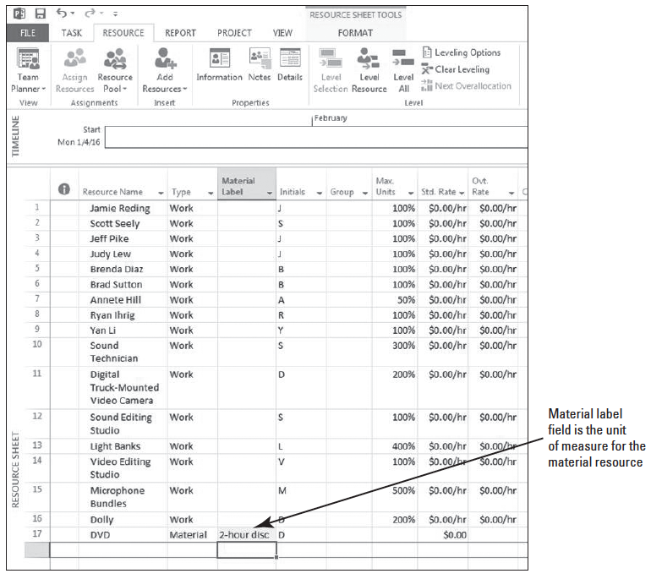
Step by Step: Establish Material Resources
4. In the Material Label field, type 2-hour disc and press Enter. This means you will use 2-hour discs as the unit of measure to track consumption during the project. Your screen should look similar to the figure at right.

Slide 28
Step by Step: Establish Material Resources
5. SAVE the project schedule.
PAUSE. LEAVE the project schedule open to use in the next exercise.
Just a note: Depending on the project management approach of your organization, you may or may not be required to track project material resources.
Bear in mind that if the project requires material and these are not entered into the software, the final cost, as calculated by the software, will not be a true reflection of the project estimate.

Slide 29
Establishing Cost Resources
Cost resources are financial obligations to your project.
A cost resource enables you to apply a cost to a task by assigning a cost item (such as travel) to that task.
The cost resource has no relationship to the work assigned to the task, but assigning cost resources gives you more control when applying various types of costs to tasks within your project.
A cost resource is a resource that doesn’t depend on the amount of work on a task or the duration of a task.
Unlike fixed costs, you can apply as many cost resources to a task as necessary.
In this exercise, you add cost resources to the resource sheet for your project.

Slide 30
Step by Step: Establish Cost Resources
USE the project schedule you created in the previous exercise.
1. In the Resource Sheet, click the next empty cell in the Resource Name column.
2. Type Travel and then press Tab.
3. In the Type field, click the arrow and select Cost. The travel resource has now been established as a cost resource. Just as with a material resource, some fields are not available with a cost resource.
4. In the blank Resource Name field below Travel, type Food and press Tab.

Slide 31
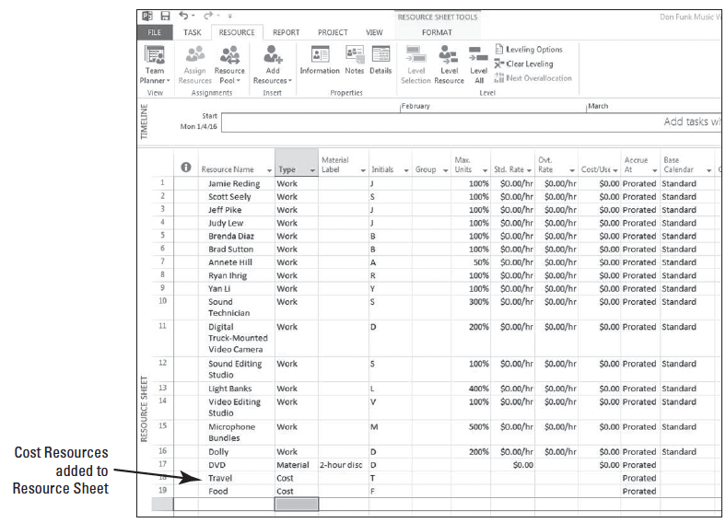
Step by Step: Establish Cost Resources
5. In the Type field, select Cost and press Enter. Your screen should look like the figure at right.
6. SAVE the project schedule.
PAUSE. LEAVE the project schedule open to use in the next exercise.
Notes:
Take Note: Cost resources differ from fixed costs in that cost resources are created as a type of resource and then assigned to a task. Also, unlike work resources, cost resources cannot have a calendar applied to them and therefore do not affect the scheduling of the task. The dollar value of cost resources doesn’t depend on the amount of work done on the task to which they are assigned.

Slide 32
Establishing Resource Pay Rates
Although you might not track costs on small or personal projects, managing cost information is a key part of most project managers’ job descriptions.
When you enter the cost information for resources, tracking the finances of a project becomes a more manageable task.

Slide 33
Entering Resource Cost Information
Knowing resource cost information will help you take full advantage of the cost management features of Microsoft Project.
In this exercise, you practice entering cost information for both work and material resources.

Slide 34
Step by Step: Enter Resource Cost Information
USE the project schedule you created in the previous exercise.
1. In the Resource Sheet, click the Std. (Standard) Rate field for resource 1, Jamie Reding.
2. Type 1000/w and press Enter. Jamie’s standard weekly rate of $1,000 per week appears in the Std. rate column.
3. In the Std. Rate column for resource 2, Scott Seely, type 19.50/h and press Enter. Scott’s standard hourly rate of $19.50 appears in the Std. Rate column.

Slide 35
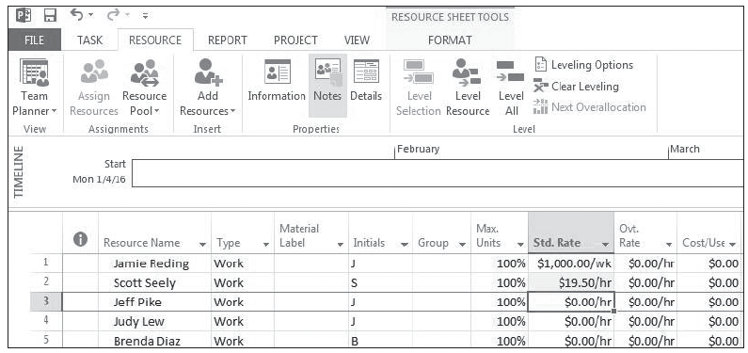
Step by Step: Enter Resource Cost Information
4. Widen the Std. Rate column by moving the mouse pointer to the vertical divider line between the Std. Rate column and Ovt. Rate column. Double-click the divider line. This is called “auto-fitting.” Your screen should look similar to the figure below.

Slide 36
Step by Step: Enter Resource Cost Information
5. Enter the following standard pay rates for the remaining resources:
Resource Name Standard Rate
Jeff Pike 750/w
Judy Lew 19.50/h
Brenda Diaz 12.75/h
Brad Sutton 16.50/h
Annette Hill 20.00/h
Ryan Ihrig 12.00/h
Yan Li 18.50/h
Sound Technician 16.50/h
Digital Truck-Mounted Video Camera 1000/w
Sound Editing Studio 250/d
Light Banks 0/h
Video Editing Studio 250/d
Microphone Bundles 0/h
Dolly 25/d
DVD 10

Slide 37
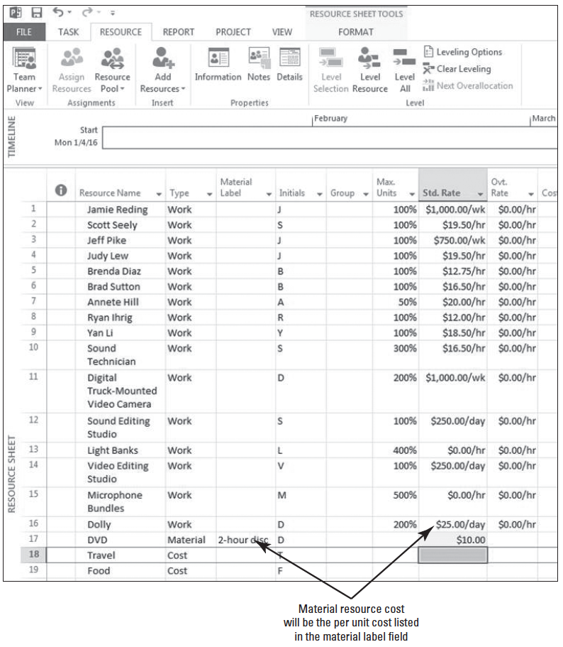
Step by Step: Enter Resource Cost Information
6. Your screen should look similar to Figure 2-10.
7. SAVE the project schedule.
PAUSE. LEAVE the project schedule open to use in the next exercise.
Notes:
Take Note: Notice that you didn’t enter a rate (weekly, hourly, or daily) for the cost of the DVD. For a material resource, the standard rate is per unit of consumption. For this exercise, that is a 2-hour DVD. Also note that you did not assign a cost to the cost resources; this is done when the cost resources are assigned to a task (covered in Lesson 3).

Slide 38
Step by Step: Enter Resource Cost Information
In the real world, it is often difficult to get cost information for people resources because this information is usually considered confidential.
As a project manager, it is important that you are aware of the limitations of your project schedule because of the information available to you, and that you communicate these limitations to your project team and management.

Slide 39
Step by Step: Enter Resource Cost Information
Some suggested methods of inserting rates costs without using actual pay rates:
Use publicly available salary data such as from the Federal Bureau of Labor and Statistics.
Ask for an average salary rate from the accounting department for various skill sets (e.g., electrician and administrative).
As a project manager, tracking and managing cost information may be a significant part of your project responsibilities.

Slide 40
Step by Step: Enter Resource Cost Information
Understanding the cost details of your project will allow you to stay on top of such key information as:
The expected total cost of the project
Resource costs over the life of the project
Possible cost savings from using one resource versus another
The rate of spending in relation to the length of the project
These and other cost limits often drive the scope of your project and may become critical to project decisions that you will make.

Slide 41
Adjusting Resource Working Times
Microsoft Project 2013 uses resource working and nonworking times to schedule the tasks.
You should define these times prior to assigning them to tasks. Resource working times apply only to people and equipment (work) resources–not to material resources.
Now that you have entered resources and their associated pay rates in your project schedule, you can specify the working and nonworking times for some of these resources.

Slide 42
Establishing Nonworking Times
When you establish work resources in your project schedule, a resource calendar is automatically created for each resource to define the resource’s working and nonworking time.
The resource calendar provides default working times for an entire project.
Typically, you will need to make changes to the individual resource calendars to reflect vacation, flex-time work schedules, or conference attendance.
In this exercise, you establish nonworking times for your individual work resources.

Slide 43
Step by Step: Establish Nonworking Times for an Individual Work Resource
USE the project schedule you created in the previous exercise.
1. Click the Project tab, then click Change Working Time. The Change Working Time dialog box appears.
2. In the For Calendar box, select Jamie Reding. Jamie Reding’s resource calendar appears in the Change Working Time dialog box.
3. Slide the button next to the calendar until the calendar is on January, 2016.
4. Select the dates January 28 and 29.
5. In the first Name field under the Exceptions tab, type Vacation Days.

Slide 44
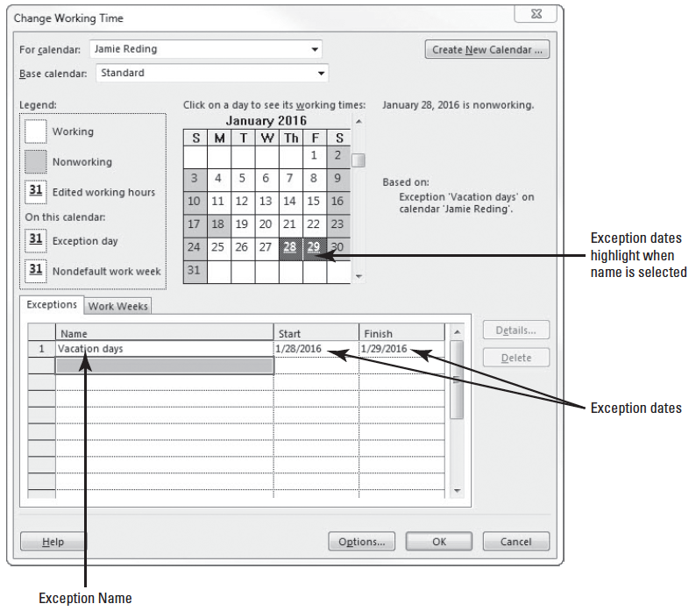
Step by Step: Establish Nonworking Times for an Individual Work Resource
6. Press Enter. The Start field displays 1/28/2016 and the Finish field displays 1/29/2016. Microsoft Project will not schedule Jamie Reding to work on these two days. Your screen should look similar to the figure at right.
7. Click OK to close the Change Working Time dialog box.
8. SAVE the project schedule.
PAUSE. LEAVE the project schedule open to use in the next exercise.
Notes:
Cross Ref: Refer back to Lesson 1 for a quick refresher on the types of calendars used by Microsoft Project.
Take Note: Keep in mind that when you make changes to the project calendar, the changes are reflected in all resource calendars which are based on the project calendar. However, changes you make to the working times of an individual resource are not reflected in the project calendar.

Slide 45
Establishing Specific Work Schedules
In addition to specifying exception times for resources, you can also set up a specific work schedule for any given resource.
To practice establishing working times for your project’s work resources, in this exercise you make a change to the resource calendar for an individual resource.

Slide 46
Step by Step: Establish a Specific Work Schedule for a Resource
USE the project schedule you created in the previous exercise.
1. Click the Project ribbon and then click Change Working Time to open the Change Working Time dialog box.
2. In the For Calendar box, select Scott Seely. Scott works a scheduled commonly called 4-10’s, which means he works 4 days a week, 10 hours per day.
3. Click the Work Weeks tab, and then click the Details button. The Details dialog box appears.

Slide 47
Step by Step: Establish a Specific Work Schedule for a Resource
4. In the Select day(s) box, click and drag to select Monday through Thursday.
5. Select the radio button next to Set day(s) to these specific working times.
6. On line 1 of the Working Times box, click the 8:00 AM box and type 7:00 AM.
7. On line 2 of the Working Times box, click the 5:00 PM box and type 6:00 PM.

Slide 48
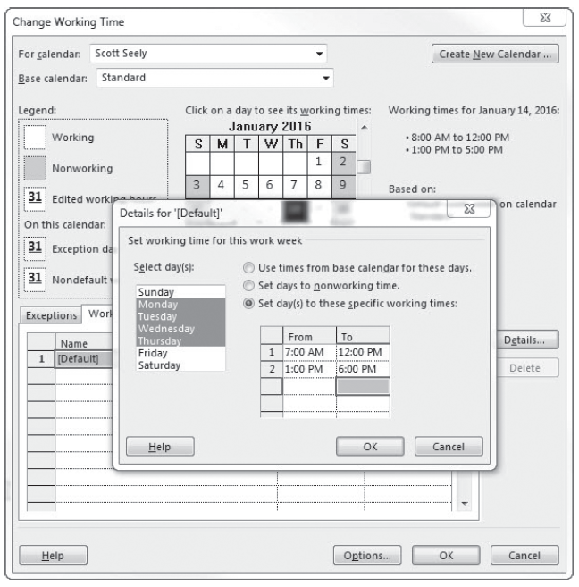
Step by Step: Establish a Specific Work Schedule for a Resource
8. Press Enter to set your changes. Your screen should look similar to the figure at right.
9. In the Select day(s) box, click Friday.
10. Select the radio button next to Select Set days to nonworking time.

Slide 49
Step by Step: Establish a Specific Work Schedule for a Resource
11. Click OK to close the Details dialog box. Microsoft Project can now schedule Scott Seely to work as early as 7:00 AM and as late as 6:00 PM on Monday through Thursday, but it will not schedule him to work on Friday.
12. Click any Friday in the Change Working Time dialog box. Note that these days are set to nonworking time.

Slide 50
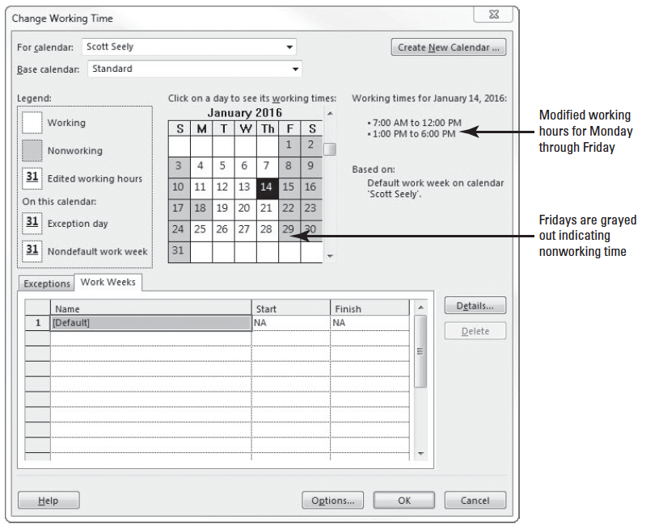
Step by Step: Establish a Specific Work Schedule for a Resource
13. Click any one day of the week, Monday–Thursday. Note the working times for these days. Your screen should look similar to the figure at right.
14. Click OK to close the Change Working Time dialog box.
15. SAVE the project schedule.
PAUSE. LEAVE the project schedule open to use in the next exercise.

Slide 51
Step by Step: Establish a Specific Work Schedule for a Resource
If you need to edit several resource calendars in the same way (to handle a flex-time schedule or night shift, for example), you might find it easier to assign a different base calendar to this group of resources.
A base calendar can be used as a task calendar, a project calendar, or resource calendar and specifies default working and nonworking times.
Assigning a different base calendar is quicker than editing each individual’s resource calendar, and it allows you to make future project-wide changes to a single base calendar (rather than editing each resource calendar again).

Slide 52
Step by Step: Establish a Specific Work Schedule for a Resource
You can change a resource’s base calendar by opening the Change Working Time dialog box from the Tools menu.
In the For Calendar box, select the desired resource and then in the Base Calendar box, select the desired base calendar.
For a group of resources that will be using the same calendar, you can change the calendar directly in the Base Calendar column of the Entry table in the Resource Sheet view.
Microsoft Project includes three base calendars: Standard, 24 Hours, and Night Shift.
You can customize these or use them as a basis for your own base calendar.
Notes:
Cross Ref: You will create a new base calendar in lesson 4.
Another Way: You can also change a resource’s base calendar in the Resource Sheet View by clicking the arrow in the Base Calendar field of that resource.

Slide 53
Adding Resource Notes
At times, you may want to provide the details regarding how (and why) a resource is scheduled a certain way.
You can add this additional information about a resource by attaching a note.
In this exercise, you learn how to attach a scheduling note to a resource in Project 2013.

Slide 54
Step by Step: Attach a Note To a Resource
USE the project schedule you created in the previous exercise. Make sure you are still in the Resource Sheet view of the Don Funk Music Video 2 file.
1. In the Resource Name column, select the name of the resource 1, Jamie Reding.
2. On the ribbon, click the Resource tab, then click the Resource Notes button in the Properties command group on the ribbon. The Resource Information dialog box is displayed with the Notes tab visible.
3. In the Notes box, type Jamie on vacation Jan 28 and 29; available for consult at home if necessary and click OK. A note icon appears in the indicator column.

Slide 55
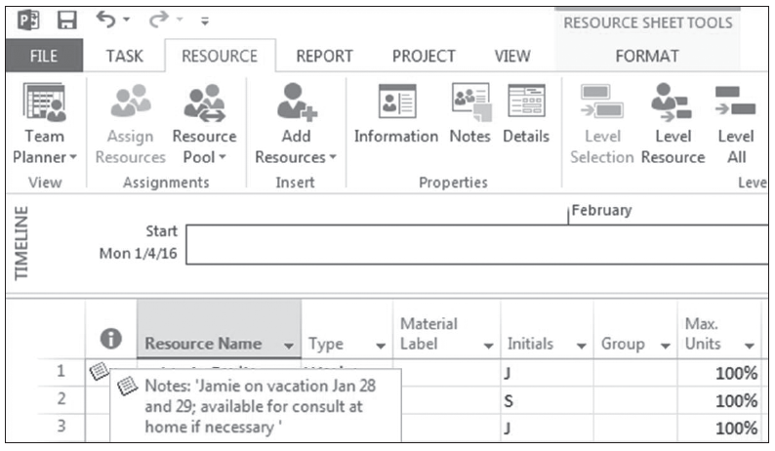
Step by Step: Attach a Note To a Resource
4. Point to the note icon in the Resource sheet. The note appears in a ScreenTip (double-click the icon to display the full text of longer notes). Your screen should look similar to the figure at right.
5. SAVE the project schedule.
6. CLOSE the Don Funk Music Video 2 file.
PAUSE. If you are continuing to the next lesson, keep Project open. If not continuing to additional lessons, CLOSE Project.

Slide 56
Skill Summary

