Slide 1
Resource and Task Assignments
Microsoft Project 2013
Lesson 3

Slide 2
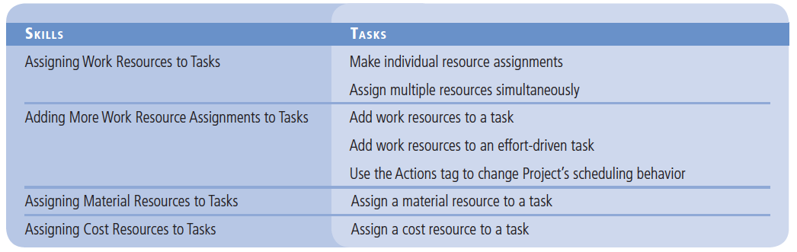
Objectives

Slide 3
Software Orientation
In Microsoft Project, when you assign resources to a task, you can use the Assign Resources dialog box.
You activate the Assign Resources dialog box via the Assign Resources button located in the Assignments group on the Resource ribbon.
Your Assign Resources dialog box should look similar to the figures on the next two slides, depending upon whether the Resource List options are collapsed or expanded.

Slide 4
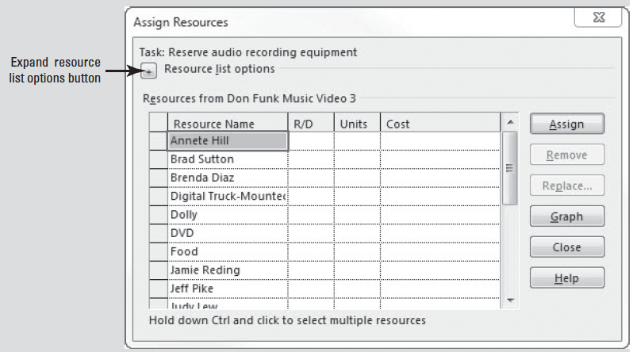
Software Orientation

Slide 5
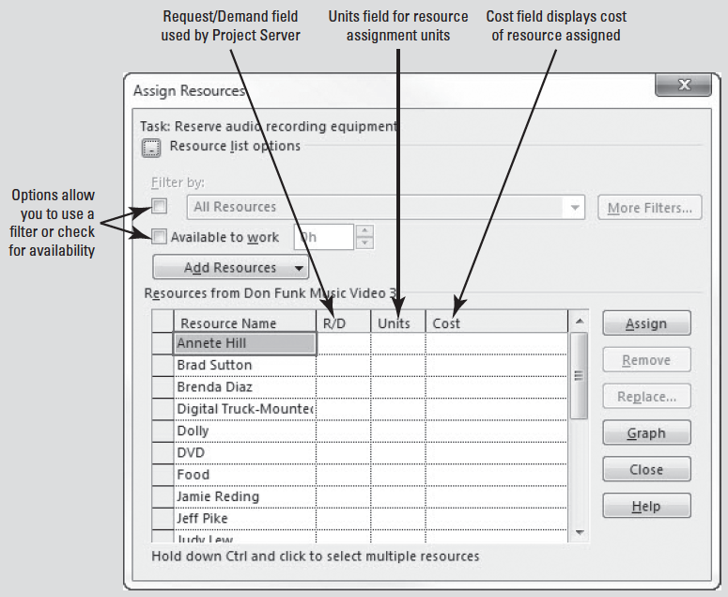
Software Orientation

Slide 6
Software Orientation
You can expand the Resource list options by clicking on the button marked with a plus sign next to Resource list options heading.
You can collapse the expanded list by clicking the button, now marked with a minus sign, once again.
In this lesson you will use the Assign Resources dialog box and other methods to assign resources.

Slide 7
Assigning Work Resources to Tasks
Microsoft Project provides you with various options for assigning resources to tasks.
You can assign individual resources to a task or multiple resources to a task at one time.
Once assigned, you can track the resource working on the task.
Microsoft Project also lets you see whether resource assignments affect task duration.

Slide 8
Making Individual Resource Assignments
An assignment is the matching of a specific resource to a particular task, to either perform work or as a material or cost.
Depending on your perspective, you might call it a resource assignment or you might call it a task assignment.
In the previous lessons, you mapped out tasks and resources for your project schedule. In this exercise, you learn how to assign work resources to the tasks they will perform.

Slide 9
Step by Step: Make Individual Resource Assignments
GET READY. OPEN Don Funk Music Video 3M. SAVE the file as Don Funk Music Video 3.
1. Click the Resource tab and then click the Assign Resources button in the Assignments group. The Assign Resources dialog box appears.

Slide 10
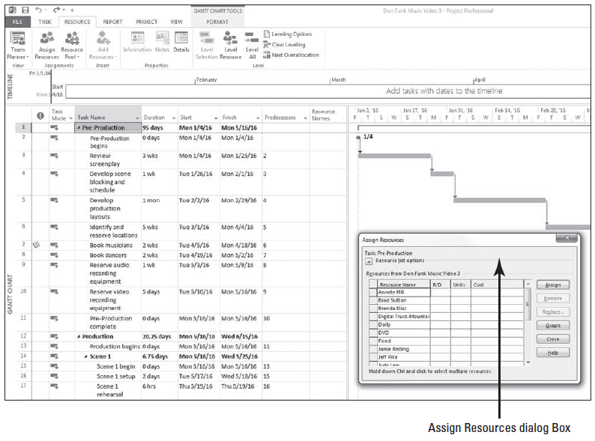
Step by Step: Make Individual Resource Assignments
2. If the Assign Resources dialog box is covering the task name column, drag the dialog box into the middle of the screen. Your screen should look similar to the figure at right.
3. In the Task Name column of the Gantt Chart view, click the name of task 3, Review screenplay.

Slide 11
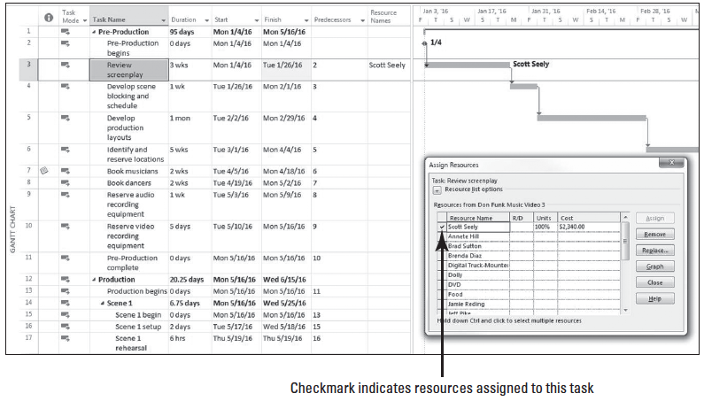
Step by Step: Make Individual Resource Assignments
4. In the Resource Name column of the Assign Resources dialog box, scroll down and click Scott Seely and then click the Assign button. In the Assign Resource dialog box, a check appears next to Scott Seely’s name, indicating that you have assigned him to the task of reviewing the screenplay. Your screen should look similar to the figure above.
Notes:
Another Way: You can also assign resources via the Resources tab on the Task Information dialog box. To access this dialog box, double click on the task you want to assign resources.

Slide 12
Step by Step: Make Individual Resource Assignments
5. In the Task Name column, click the name of task 5, Develop production layouts.
6. In the Assign Resources dialog box, click Jeff Pike and then click the Assign button. A check appears next to Jeff’s name to show that you have assigned him to task 5.
7. SAVE the project schedule.
PAUSE. LEAVE the project schedule open to use in the next exercise.

Slide 13
Assigning Multiple Resources Simultaneously
You have just assigned one resource to a task.
In this exercise, you will practice assigning multiple resources simultaneously to a task.
Notes:
Take Note: Resources are sorted alphabetically in the Assign Resources dialog box. Once the resource has been assigned, it is moved to the top of the list.

Slide 14
Step by Step: Assign Multiple Resources Simultaneously
USE the project schedule you created in the previous exercise.
1. In the Task Name column, click the name of task 4, Develop scene blocking and schedule.
2. In the Assign Resources dialog box, scroll down and click the name cell for Scott Seely. Scroll up or down in the list until the name Judy Lew is visible. Hold down Ctrl, then click the name cell for Judy Lew.
3. Release the Ctrl key and then click the Assign button. Check marks appear next to the names of Scott Seely and Judy Lew, indicating you have assigned them both to task 4.
4. Close the Assign Resources dialog box.
Notes:
Take Note: If you want to remove or un-assign a resource from a task in the Assign Resources dialog box, click the resource you want removed and then click the Remove button.

Slide 15
Step by Step: Assign Multiple Resources Simultaneously
5. Move the center divider to the right to allow the Resource Names column to be visible.
6. Click once on the Resource Names cell for task 6, Identify and reserve locations. Then click the sub-menu arrow at the right of the cell.

Slide 16
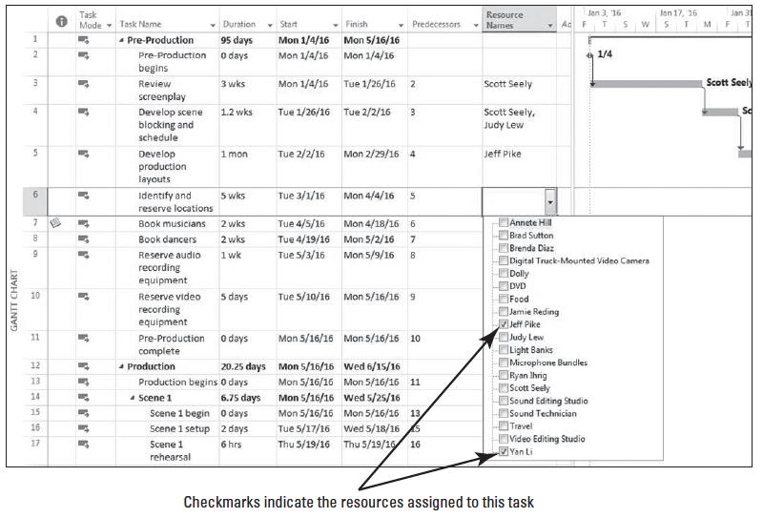
Step by Step: Assign Multiple Resources Simultaneously
7. In the drop-down list, select the checkboxes for Jeff Pike and Yan Li. Your screen should look similar to the figure below.

Slide 17
Step by Step: Assign Multiple Resources Simultaneously
8. Press Enter.
9. SAVE the project schedule.
PAUSE. LEAVE the project schedule open to use in the next exercise.
You may have noticed that the duration of task number 4 changed from 1 week to 1.2 weeks when you assigned Scott and Judy to the task.
Bear in mind that Microsoft Project is using the resource calendars to schedule the tasks.
The duration is extended by .2 weeks (1 day) due to the fact that Scott works Monday thru Thursday.
The last 8 hours of his portion of the work will not be completed until the following week.
Notes:
Cross Ref: Recall that in Lesson 2 you learned that Max. Units referred to the maximum capacity of a resource to accomplish tasks.

Slide 18
Step by Step: Assign Multiple Resources Simultaneously
The capacity of a resource to work when you assign that resource to a task is measured in units.
Units are recorded in the Max. Units field on the Resource Sheet view.
One full-time resource has 100% (or 1.0) resource units.
As you are assigning resources, you need to be careful that you do not over-allocate a resource, by assigning it more work than can be done within the normal work capacity of the resource. This may happen if you assign a resource to a task with more units than the resource has available.

Slide 19
Step by Step: Assign Multiple Resources Simultaneously
Another possibility is that you assign the resource to multiple tasks with schedules that overlap and with combined units that exceed those of the resource.
Keep in mind that Microsoft Project assumes that all of a resource’s work time can be allotted to an assigned task unless you specify otherwise.
If the resource has less than 100 percent maximum units, Microsoft Project assigns the value of the resource’s maximum units.

Slide 20
Adding More Work Resource Assignments to Tasks
Microsoft Project’s default method of scheduling is considered non-effort driven. This means that as you assign resources to a task, the duration remains constant and the work value is calculated.
The most obvious effect of this scheduling method is that, as you add or remove resources, the work value changes and therefore the costs change.

Slide 21
Adding Work Resources to a Task
You have started to define resource assignments for several tasks in your project schedule. Now you will assign additional resources to those tasks.
To view work information in each task, you will use a split view.
Pay close attention to the results in relation to task duration and work in the split view.

Slide 22
Step by Step: Add Work Resources to a Task
USE the project schedule you created in the previous exercise.
1. Click the View tab. In the Split View group on the ribbon, select the Details checkbox. The Task Form view appears in the bottom part of your screen.
2. Click the name of task 3, Review screenplay. In the Task Form pane at the bottom of your screen, note the Work value of this task–120 hours.
3. In the Task Form view single-click the first cell below Scott Seely’s name. Click the sub-menu arrow at the right of this cell, then select Jeff Pike.

Slide 23
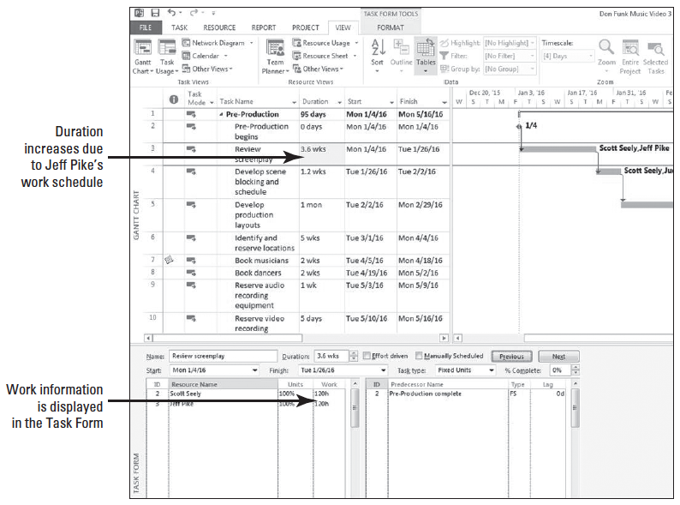
Step by Step: Add Work Resources to a Task
4. At the top of the Task Form portion of the screen, click the OK button. Microsoft Project assigns Jeff Pike to task 3. Your screen should look similar to the figure at right.

Slide 24
Step by Step: Add Work Resources to a Task
5. SAVE the project schedule.
PAUSE. LEAVE the project schedule open to use in the next exercise.
Work is the total amount of effort expended to complete a task. Microsoft Project calculates work using a work formula: Work = Duration * Units.
While you have the option of entering and displaying work in different units, by default, work is expressed in hours.

Slide 25
Step by Step: Add Work Resources to a Task
Notice that when you added Jeff to task 3, Microsoft Project calculated his work using the formula above.
Jeff ’s schedule is 5 days/week, 8 hours/day and the task was three weeks in duration (or 15 days @ 8 hours each day).
Therefore, Work = 120 hours of duration * 1 full time resource = 120 hours of work. The total work of the task doubled with the addition of this one resource.
Notice also that Project automatically highlighted the duration, which changed as a result of adding Jeff, based on his work schedule.

Slide 26
Step by Step: Add Work Resources to an Effort-Driven Task
USE the project schedule you created in the previous exercise.
1. Click the name of task 5, Develop production layouts. Jeff Pike is the only resource currently assigned to this task, work is calculated at 160 hours and the duration is 1 month. You’d like to assign an additional resource and reduce the task’s duration.
2. In the Task Form screen click the check box for Effort driven.
Notes:
Take Note: Although effort-driven scheduling is not the default for tasks you create in Microsoft Project, you can change this setting for all new tasks in a project schedule. On the Ribbon bar, click File, then select Options. On the Project Option dialog box, select Schedule. Navigate down to Scheduling options for this project and clear or select the New tasks are Effort driven check box. To change effort-driven scheduling for a single task or group of tasks, select the desired task(s). Click the Task ribbon and then in the Properties group, select the Information button. Select the Advanced tab of the Multiple Task Information dialog box. Clear or select the Effort driven check box.

Slide 27
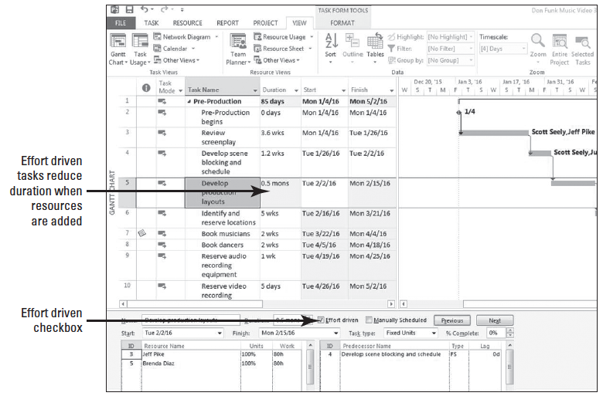
Step by Step: Add Work Resources to an Effort-Driven Task
3. Click once in the blank cell below Jeff Pike. From the drop-down menu, select Brenda Diaz. Then click the OK button at the upper portion of the Task Form screen. Your screen should look similar to the fgure above.

Slide 28
Step by Step: Add Work Resources to an Effort-Driven Task
4. Notice that the duration has been changed to .5 months and the total work (160 hours) has now been evenly distributed between Jeff Pike and Brenda Diaz. In this instance you applied effort-driven scheduling, which tells Microsoft Project to hold the work value constant and change the duration when resources are added or removed.
5. SAVE the project schedule.
PAUSE. LEAVE the project schedule open to use in the next exercise.

Slide 29
Step by Step: Add Work Resources to an Effort-Driven Task
Similar to the work formula but in the context of duration, the duration formula is used in effort-driven scheduling.
The formula is Duration = Work / Units. In an effort-driven task, the work value is held steady and the variable is units.
In the example you used in the previous exercise, 160 hours was the work value with one resource assigned. When you assigned Brenda Diaz to the task (a second full-time resource) the duration formula was applied as: Duration = 160 / 2 (units @ full time). So, Duration = 80 hours or .5 months.

Slide 30
Using the Actions Tag to Change Project’s Scheduling Behavior
Now that you have assigned resources to tasks that are both effort-driven and non-effort driven, in this exercise you will learn how to use the Actions tag to change how Project behaves.
An Actions tag is an indicator that signals the user of a change, additional information, formatting options, etc.
In Project 2013, the Actions tag appears mainly when changes to units, duration, or work occurs.
The Actions tag will appear only when certain methods are used to apply changes, such as adding resources with the Assign Resources dialog box.
The Actions tag only remains available until you perform your next action.

Slide 31
Step by Step: Use the Actions Tag to Change Project’s Scheduling Behavior
USE the project schedule you created in the previous exercise.
1. In the Gantt Chart portion of the view, click on the name of task 5, Develop production layouts. You’d like to assign an additional resource and reduce the task’s duration.
2. Click the Resource tab and then click the Assign Resources button in the Assignments group. The Assign Resources dialog box appears.
3. In the Resource Name column of the Assign Resources dialog box, locate and click Annete Hill. Hold down Ctrl then locate and click Brad Sutton. Release the Ctrl key.
4. Click the Assign button. These two resources are added to the task. In addition, an Actions tag appears to the left of the task name column.

Slide 32
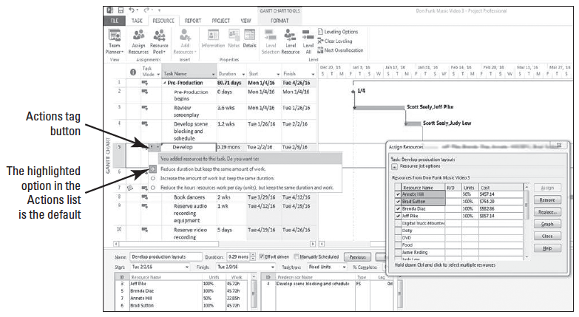
Step by Step: Use the Actions Tag to Change Project’s Scheduling Behavior
5. Click the Actions tag button. A list of options regarding how you want to handle this additional resource is displayed. Your screen should look similar to the figure below.
6. Select Increase the amount of work but keep the same duration.
Notes:
Troubleshooting: Microsoft Project will only display the Actions tag under certain circumstances. For example, if you assigned resources in the Task Form on an effort-driven task, the Actions tag would not appear in the Gantt Chart portion of the view.

Slide 33
Step by Step: Use the Actions Tag to Change Project’s Scheduling Behavior
7. Click the name of task 6, Identify and reserve locations. Notice in the Task Form screen that the Effort driven check box is NOT checked for this task. Take note of the work data in the Task Form pane (400 hours total).
8. In the Resource Name column of the Assign Resources dialog box, click Annete Hill.
9. Scroll down until Ryan Ihrig’s name is visible. Hold down Ctrl, click Ryan Ihrig. Release the Ctrl key then click the Assign button.
Microsoft Project assigns Annete and Ryan to the task. Because this task is using the default settings, Microsoft Project increases the total work value and keeps the task duration constant.
However, you do not want the additional resources to change the task’s work. You have determined that this task does not require a full-time effort because these two additional resources will take over some of the administrative functions.

Slide 34
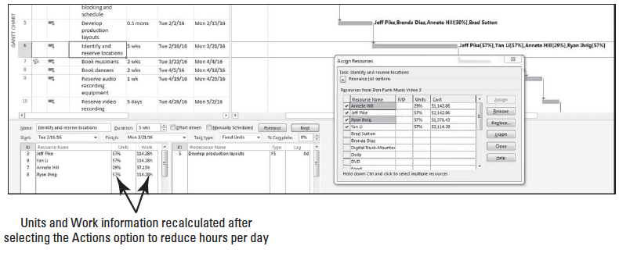
Step by Step: Use the Actions Tag to Change Project’s Scheduling Behavior
10. Click the Actions tag button. Select: Reduce the hours resources work per day (units), but keep the same duration and work. Your screen should look similar to the figure below. Microsoft Project calculates the work values for each resource, keeps the task’s duration at 5 weeks and adjusts the units for each resource.
11. Click the Close button in the Assign Resources dialog box.

Slide 35
Step by Step: Use the Actions Tag to Change Project’s Scheduling Behavior
12. SAVE the project schedule.
PAUSE. LEAVE the project schedule open to use in the next exercise.
Using effort-driven scheduling, Microsoft Project will maintain that work amount as the total effort required to perform that task until you tell it otherwise.
In this mode, Microsoft Project performs the work calculation at the FIRST work resource assignment, regardless of the number of work resources assigned (i.e., a single resource or multiple resources).

Slide 36
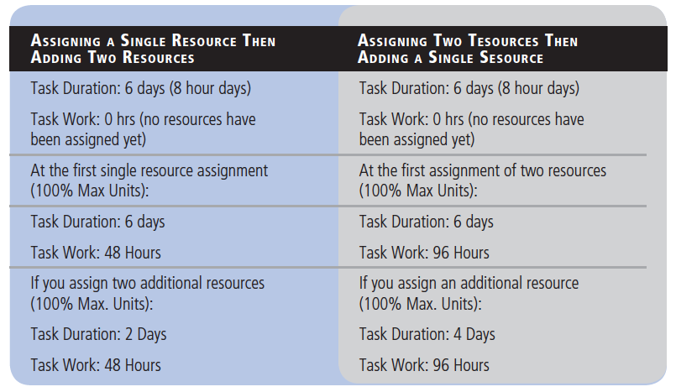
Step by Step: Use the Actions Tag to Change Project’s Scheduling Behavior
Here is an example using the same task duration and different approaches of assigning the same total number of resources
Notes:
Cross Ref: You can find more information on the work formula in Lesson 4.

Slide 37
Step by Step: Use the Actions Tag to Change Project’s Scheduling Behavior
In general, if you have one resource working full-time on a task, the amount of work (effort) will match the duration.
If your resource is not working full-time, or if you assign more than one resource to a task, then work and duration will not be equal.
You can now see the benefit of creating task relationships rather than setting start or finish dates.
Because effort-driven scheduling results in decreased task durations, Microsoft Project adjusts the start dates of successor tasks that did not have a constraint such as a start or finish date.
It is important to remember that effort-driven scheduling adjusts task duration only if you add or delete resources from a task. Whether or not to use effort-driven scheduling is a topic for discussion with your organization. It has both benefits and risks.
Notes:
Troubleshooting: Exercise caution when determining the extent to which effort-driven scheduling should apply to the tasks in your project. Although applying more resources to your tasks may reduce their duration on paper, this may not be possible in a real-world situation. For example, if one resource could complete a task in 20 hours, could 20 resources complete the task in one hour? What about 40 resources in 30 minutes? In reality, the resources would probably get in each other’s way, and productivity may even decrease. Additional coordination might be needed. For complex tasks, a resource might need specialized training before it could be productive. There is no exact rule about when you should or should not apply effort-driven scheduling. As a project manager, you need to review the requirements of your project tasks and use your best reasoning.

Slide 38
Assigning Material Resources to Tasks
In this exercise, you will assign material resources to tasks.
Most projects use at least some material resources.
When you assign material resources to tasks, Microsoft Project can track their consumption and cost.

Slide 39
Step by Step: Assign a Material Resource to a Task
USE the project schedule you created in the previous exercise.
1. In the Task Name column, click the name of task 6, Identify and reserve locations.
2. Click the Resource tab and then click the Assign Resources button in the Assignments group. The Assign Resources dialog box appears.
3. In the Assign Resources dialog box, click once in the Units field for the DVD resource. Type 8, and then click the Assign button.
4. If the Assign Resources dialog box is covering the scroll bars for the Gantt bar portion of your screen, drag the dialog box into the middle of the screen.

Slide 40
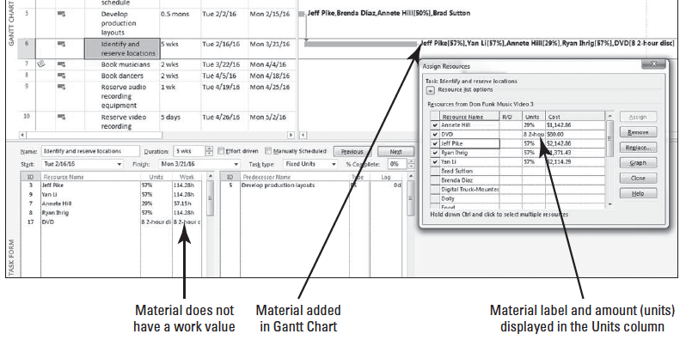
Step by Step: Assign a Material Resource to a Task
5. Scroll the Gantt bar portion of your screen so that the right end of the bar for task 6 is visible. You will use eight DVDs while identifying locations for this video. Remember that a DVD is a material resource and cannot do work, so assigning it to a task does not affect the task’s duration. Your screen should look similar to the figure below.

Slide 41
Step by Step: Assign a Material Resource to a Task
6. In the Assign Resources dialog box, click Close.
7. SAVE the project schedule.
PAUSE. LEAVE the project schedule open to use in the next exercise.
When you assign a material resource to a task, there are two ways in which you can handle their consumption and cost:
Assign a fixed unit quantity of the material resource. This is what you did in the preceding exercise. Microsoft Project then multiplied the unit cost of the resource by the number of units to calculate the total cost.
Assign a variable rate quantity of the material resource. For example, if two DVDs will be used per day, you would enter 2/day as the assignment unit. Microsoft Project will adjust the quantity and cost of the resource as the duration of the task changes. You will assign a material resource using this method in Lesson 6.
Notes:
Cross Ref: You will learn more about resource consumption rates in Lesson 6.

Slide 42
Assigning Cost Resources to Tasks
A cost resource is another type of resource that you can assign to a task.
A cost resource represents a financial obligation to your project.
Once you assign the cost resource to the task, you can then assign the cost for the resource.
In this exercise, you assign cost resources to two different tasks.

Slide 43
Step by Step: Assign a Cost Resource to a Task
USE the project schedule you created in the previous exercise.
1. Click the Assign Resources button in the Assignments group. The Assign Resources dialog box appears.
2. Scroll up or down in the Gantt view and in the Task Name column, click the name of task 17, Scene 1 rehearsal.
3. In the Resource Name column of the Assign Resources dialog box, click Food and then click the Assign button.
4. In the Cost column for the Food resource, type 500 and press Enter. During the Scene 1 rehearsal, $500 of food will be used to feed the crew and performers working on this task.
5. Click on the name of task 25, Scene 2 rehearsal.

Slide 44
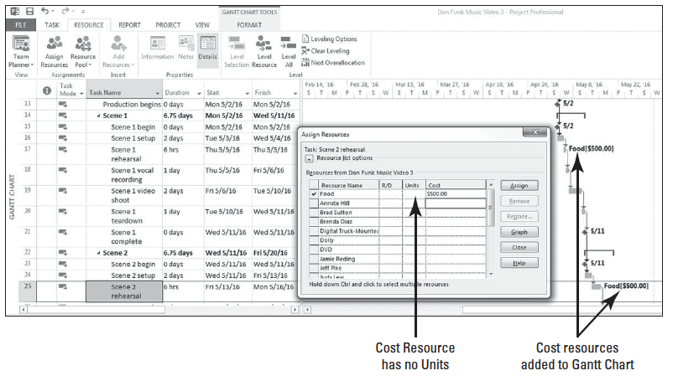
Step by Step: Assign a Cost Resource to a Task
6. In the Resource Name column of the Assign Resources dialog box, click Food and then click the Assign button.
7. In the Cost column for the Food resource, type 500 and press Enter. Your screen should look similar to the figure below.

Slide 45
Step by Step: Assign a Cost Resource to a Task
8. In the Assign Resources dialog box, click Close.
9. SAVE and then CLOSE the Don Funk Music Video 3 file.
PAUSE. If you are continuing to the next lesson, keep Project open. If you are not continuing to additional lessons, CLOSE Project.

Slide 46
Skill Summary

