Slide 1
Fine-Tuning Tasks
Microsoft Project 2013
Lesson 5

Slide 2
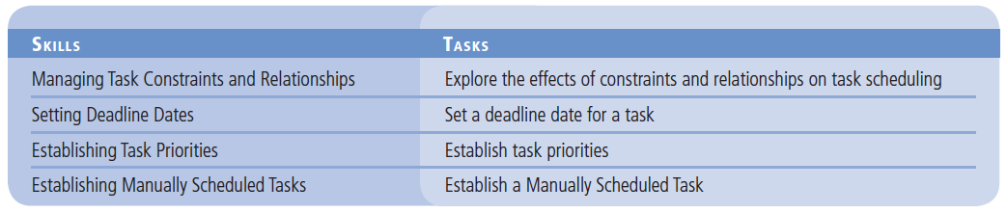
Objectives

Slide 3
Software Orientation
The General tab of the Task Information dialog box provides general information about the selected task and allows you to make changes and updates to the task.
On the General tab, you can edit the task name, update the duration and the percent complete, change the priority, and modify the start and finish dates (see the figure on the next slide).

Slide 4
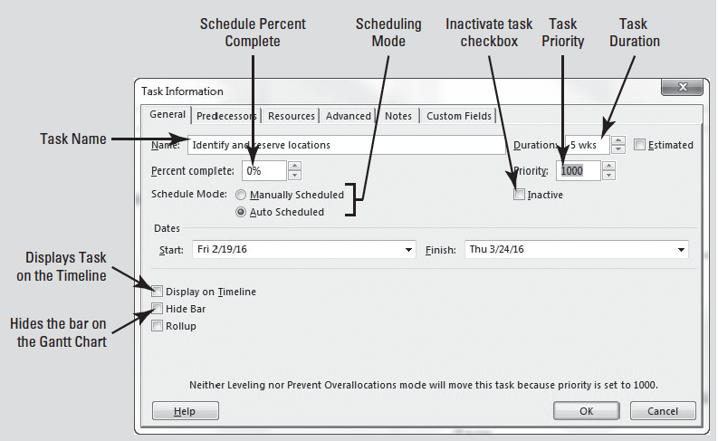
Software Orientation

Slide 5
Managing Task Constraints and Relationships
As you are building a project schedule, you will usually use both task relationships and constraints within the schedule.
You can control how Microsoft Project schedules these elements.
Recall that Microsoft Project alerts you to conflicts between relationships and constraints so that you can maintain control over the rules that Microsoft Project follows.
It is important to make sure that you understand the effects of the constraints you apply on the overall project schedule–not just on the task to which you have applied the constraint.

Slide 6
Exploring Effects of Constraints and Relationships
In this exercise, you review two of the basic elements of scheduling, constraints and task relationships, and learn how you can control the actions of Microsoft Project when there is a conflict between a constraint and a task relationship.
Microsoft Project always honors constraint dates over task relationships by default, even if this causes negative float (slack).

Slide 7
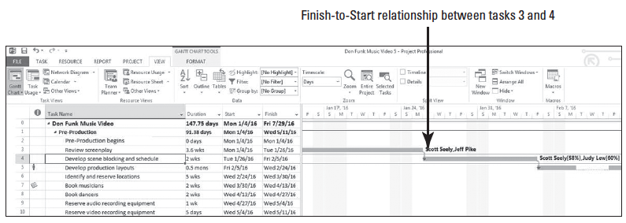
Step by Step: Explore the Effects of Constraints and Relationships on Task Scheduling
GET READY. OPEN the Don Funk Music Video 5M project schedule. SAVE the file as Don Funk Music Video 5.
1. In the Gantt Chart view, review the finish-to-start relationship between tasks 3 and 4. Your screen should look similar to the figure below. Assume you have just been told that task 4, Develop scene blocking and schedule, must begin no later than Wednesday, January 20, 2016.

Slide 8
Step by Step: Explore the Effects of Constraints and Relationships on Task Scheduling
2. In the Task Name column, select the name of task 4, Develop scene blocking and schedule.
3. On the Task ribbon, in the Properties group, click the Information button. The Task Information dialog box appears.
4. Click the Advanced tab.
5. In the Constraint Type box, select Start No Later Than. In the Constraint Date box, type or select 1/20/16.
What is another way?

Slide 9
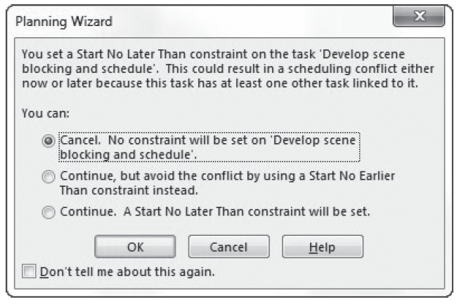
Step by Step: Explore the Effects of Constraints and Relationships on Task Scheduling
6. Click OK to close the dialog box. The Planning Wizard appears, notifying you of a scheduling conflict between the constraint you just applied to task 4, and the existing task relationship between tasks 3 and 4. Your screen should look similar to the figure above.
7. In the You Can selection list, click Continue. A Start No Later Than constraint will be set.

Slide 10
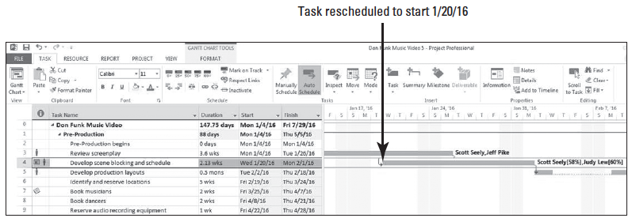
Step by Step: Explore the Effects of Constraints and Relationships on Task Scheduling
8. Click OK.
9. A second alert appears. Click Continue. Allow the scheduling conflict, and then click OK. Microsoft Project applies the SNLT constraint to task 4 and reschedules it to start on Wednesday, as shown in the figure below. Microsoft Project would reschedule task 4 to avoid the negative slack between tasks 3 and 4, but this SNLT constraint prevents Microsoft Project from doing so.
Notes:
Take Note: Notice also that the red human icon appears in the indicators column, notifying you that this action also causes and resource over allocation on both tasks.

Slide 11
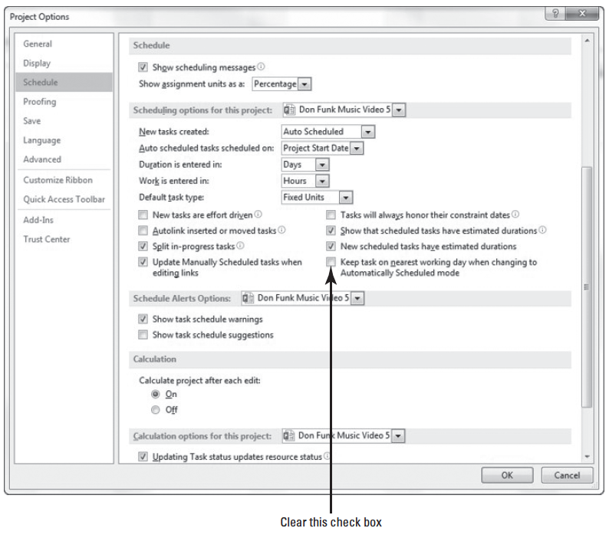
Step by Step: Explore the Effects of Constraints and Relationships on Task Scheduling
10. Click the File tab and then click Options.
11. Select the Schedule options then navigate to the Scheduling options for this project: section. Your screen should look similar to the figure at right.

Slide 12
Step by Step: Explore the Effects of Constraints and Relationships on Task Scheduling
12. Clear the Tasks will always honor their constraint dates check box, and then click OK. A calendar alert icon appears in the indicators column for task 4.
13. Rest the mouse pointer on the calendar alert icon in the indicators column. A Screen-Tip appears. Now Microsoft Project honors the task relationship over the constraint. Microsoft Project preserves the constraint information, but does not honor the constraint. If the scheduling conflict is removed (by a change in task duration, for example), Microsoft Project would then honor the constraint. Your screen should look similar to the figure on the next slide.

Slide 13
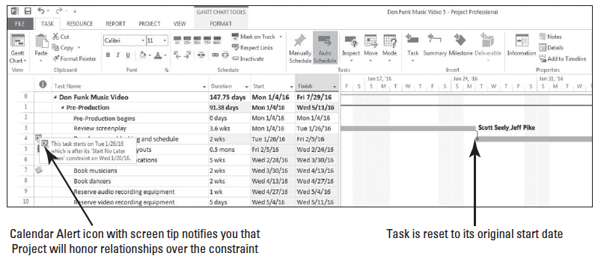
Step by Step: Explore the Effects of Constraints and Relationships on Task Scheduling

Slide 14
Step by Step: Explore the Effects of Constraints and Relationships on Task Scheduling
14. Click the File tab again and then click Options. Select the Schedule options then navigate to the Scheduling options for this project: section.
15. Click the Tasks will always honor their constraint dates check box on the Schedule tab, and then click OK. This restores the default behavior to Microsoft Project, and task 4 is rescheduled to honor its constraint date.
16. SAVE the project schedule.
PAUSE. LEAVE Project open to use in the next exercise.
It is a good idea to develop a consistent strategy for using constraints and relationships in your projects. Using the default behavior of honoring constraint dates is recommended.
Notes:
Cross Ref: For a review of task constraints and negative slack, refer back to Lesson 4. The best way to prevent negative float is through the use of leads and lags, which will be discussed in detail in Lesson 13, Project Schedule Optimization.

Slide 15
Setting Deadline Dates
A deadline is a date value you enter for a task that indicates the latest date by which you want the task to be completed.
The deadline date itself does not constrain the task. When you enter a deadline date, Microsoft Project displays a deadline marker on the Gantt Chart and alerts you if the task’s finish date moves beyond the deadline.
Assigning a deadline date to a task, rather than a semi-flexible or inflexible constraint, allows the most flexibility in scheduling tasks with commitments.
Rather than using semi-flexible or inflexible constraints, a better approach to scheduling is to use the default As Soon As Possible (ASAP) constraint and then enter a deadline for the task.
In this exercise, you enter a deadline date for a task rather than entering a constraint.

Slide 16
Step by Step: Set a Deadline Date for a Task
USE the project schedule you created in the previous exercise.
1. Press the F5 key; the Go To dialog box appears.
2. In the ID box, type 27 and then click OK. Microsoft Project displays task 27. You want to make sure that the pre-production tasks conclude by May 11, 2016, so you will enter a deadline date for this milestone.
3. Double-click the task name of task 27, Pre-Production Complete. The Task Information dialog box appears.
4. Click the Advanced tab if it is not already selected.

Slide 17
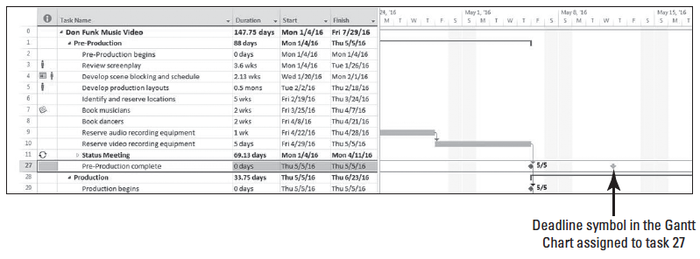
Step by Step: Set a Deadline Date for a Task
5. In the date box next to Deadline, type or select 5/11/16, then click OK. Microsoft Project inserts a deadline marker in the chart portion of the Gantt Chart view. Your screen should look similar to the figure below. To remove a deadline from a task, clear the Deadline field on the Advanced tab of the Task Information dialog box.
Notes:
Take Note: If the scheduled completion of a task moves past the deadline date, Microsoft Project displays a missed deadline indicator in the Indicators column.

Slide 18
Step by Step: Set a Deadline Date for a Task
6. Double-click the name of task 28, Production. The Task Information dialog box appears. Click the Advanced tab if it is not already selected.
7. In the dropdown date box next to Deadline, type or select 6/28/16, then click OK. Microsoft Project inserts a deadline date marker for the summary task. Scroll the chart portion of the Gantt Chart view to the right to view the marker.
8. SAVE the project schedule.
PAUSE. LEAVE Project open to use in the next exercise.

Slide 19
Establishing Task Priorities
Task priority is a numeric ranking between 0 and 1000 of a task’s importance (with 1000 being most important).
Microsoft Project uses task priorities to determine which tasks can be delayed in order to resolve periods of resource over allocation.
The default task priority Microsoft Project assigns is 500.
Task priorities only affect the schedule during resource leveling and have no meaning regarding the urgency or importance of a task beyond resource leveling.

Slide 20
Step by Step: Establish Task Priorities
USE the project schedule you created in the previous exercise.
1. In the Task Name column, select the name of task 6, Identify and reserve locations.
2. On the Task ribbon, click the Information button, located in the Properties group. The Task Information dialog box appears.
3. Click the General tab if it is not already selected.

Slide 21
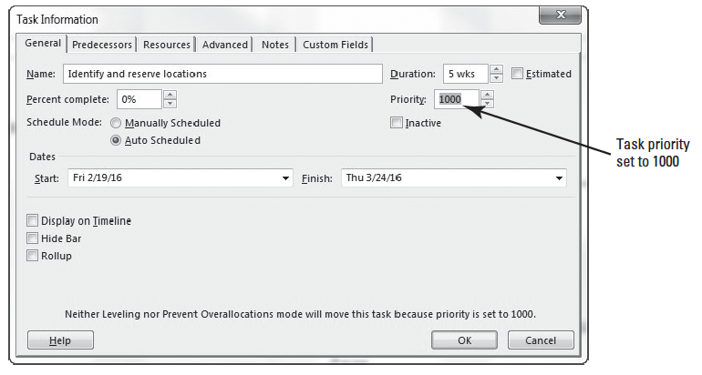
Step by Step: Establish Task Priorities
4. In the Priority box, type or select 1000. Your screen should look similar to the figure below. A message at the bottom of the Task Information dialog box states the task will not be moved through either Resource Leveling or the Prevent Over allocations mode.

Slide 22
Step by Step: Establish Task Priorities
5. Click OK to close the dialog box. Microsoft Project adjusts the task’s priority. Note that there is no visual indicator for the adjusted priority, and the effect of the new task’s priority is only apparent after resource leveling.
6. SAVE the project schedule.
PAUSE. LEAVE Project open to use in the next exercise.
In this exercise, you set the priority for a task, giving it the highest priority possible in Microsoft Project (1000). A task with a priority of 1000 is never delayed by leveling.
Notes:
Another Way: To simultaneously adjust the priority of multiple tasks, select the desired tasks by clicking and holding the Ctrl key. Click the Task Information button, click the General tab, and enter the desired priority in the priority box. Note that because you have selected multiple tasks, this dialog box is now labeled “Multiple Task Information.”

Slide 23
Step by Step: Establish Task Priorities
Resource leveling is the process of delaying a resource’s work on a task to resolve an over allocation.
Depending on the options you choose, resource leveling might delay the start date of an assignment or an entire task, or split up the work on a task.
Resource leveling evaluates several factors to determine how to resolve resource over allocation.
One of the factors evaluated during resource leveling is task priorities.
Task priority is a numeric ranking between 0 and 1000 of a task’s importance and appropriateness for leveling.

Slide 24
Step by Step: Establish Task Priorities
When you level resources, Microsoft Project will delay a task with a lower priority before delaying a task with a higher priority in order to resolve a resource over allocation:
Tasks with priority 0 are leveled first, so they are likely to be delayed by leveling.
Tasks with priority 1000 are never delayed by leveling. Assign this task priority carefully, as it limits Microsoft Project’s capabilities to resolve resource over allocations.
Notes:
Cross Ref: You can find more information about resource leveling in Lesson 6.

Slide 25
Establish Manually Scheduled Tasks
Some tasks require the project manager to schedule manually, without regard to predecessors or other project constraints.
You will use the new feature, Manual Scheduling, for this action.
In this exercise, you practice establishing a manually scheduled task.
For the purpose of this exercise, note that you have just been informed that your audio team and video team have met and they are unsure about the outcome of the fine editing tasks.
The task of dubbing the audio to the video is dependent on one but not both of these tasks. After meeting with the team, you decide to change the scheduling mode of task 70 to manual scheduling.

Slide 26
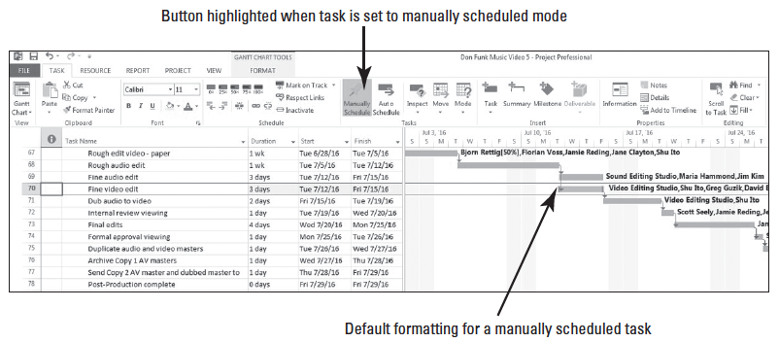
Step by Step: Establish a Manually Scheduled Task
USE the project schedule you created in the previous exercise.
1. Press the F5 key to produce the Go To dialog box. In the ID box, type 70 and click OK.
2. On the Task ribbon, in the Tasks group, click the Manually Schedule button. Note that the Gantt bar has changed to the default formatting of a manually scheduled task. Your screen should look similar to the figure below

Slide 27
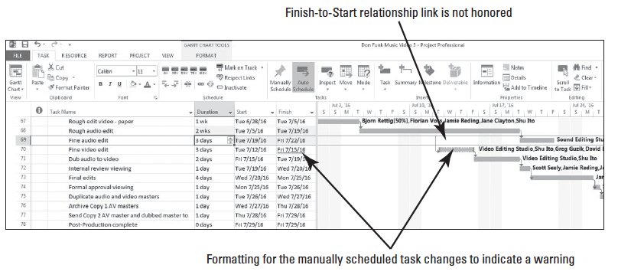
Step by Step: Establish a Manually Scheduled Task
3. Click in the duration cell of task 68, Rough audio edit. You have just been informed that this task will now take 2 weeks instead of one. Type 2w and press Enter. Notice that task 70 did not move from its original start date. Your screen should look like the figure below.

Slide 28
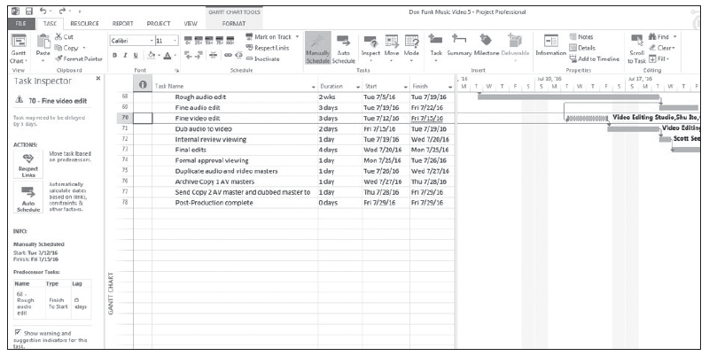
Step by Step: Establish a Manually Scheduled Task
4. Position the mouse pointer over the Gantt bar of the manually scheduled task. Notice that it displays a warning at the top of the ScreenTip. Right-click the Gantt bar of the manually scheduled task and select Fix in Task Inspector. Your screen should look like the figure below.
Notes:
Another Way: You can also activate the task inspector by selecting the Inspect button on the Task ribbon.

Slide 29
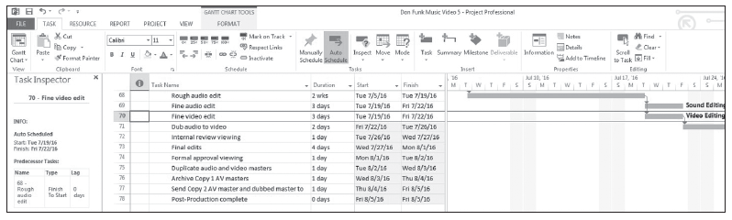
Step by Step: Establish a Manually Scheduled Task
5. Review the various options and information in the Task Inspector pane. After reviewing this information, you have decided that manually scheduling this task is not the best option. In the Task Inspector pane, under the ACTIONS: section, click the Auto Schedule button. Microsoft Project returns the task to the auto-scheduled mode. Your screen should look like the figure below.
Notes:
Take Note: You can change the mode of how new tasks are entered by selecting the Task tab then the Mode button and then Auto Schedule.

Slide 30
Step by Step: Establish a Manually Scheduled Task
6. Single-click the duration cell for task 68, Rough audio edit. Type 1w and press Enter.
7. SAVE the project schedule, and then close the file.
PAUSE. If you are continuing to the next lesson, keep Project open. If you are not continuing to additional lessons, CLOSE Project.

Slide 31
Step by Step: Establish a Manually Scheduled Task
Manually scheduled tasks are tasks that must be manually scheduled, calculated, and set by the operator.
These require much more attention by the project manager and may be needed at certain points of your project. They can allow you more scheduling flexibility, but they should be used sparingly.
Microsoft Project treats manually scheduled tasks much differently than auto scheduled tasks.
In fact, certain features available with auto scheduled tasks are not available with manually scheduled tasks.
For example, Overtime, Actual Overtime, & Remaining Overtime cannot be tracked with manually scheduled tasks. You also cannot use task constraints or work contouring.

Slide 32
Step by Step: Establish a Manually Scheduled Task
When using manually scheduled tasks, Microsoft Project treats non-working times differently.
If you use a manually scheduled task during normal working hours, on normal working days, you would not even know the difference. However, start a manually scheduled task on a non-work day, outside of normal, non-work hours, and then you notice the difference.
In essence, the system creates an exception on the calendar to close the gap between the manually scheduled task’s start and the next working time.
You should fully understand all of the pros and cons of using manually scheduled tasks before using them in your schedules.
The table on the next slide summarizes the difference between auto and manual scheduling.

Slide 33
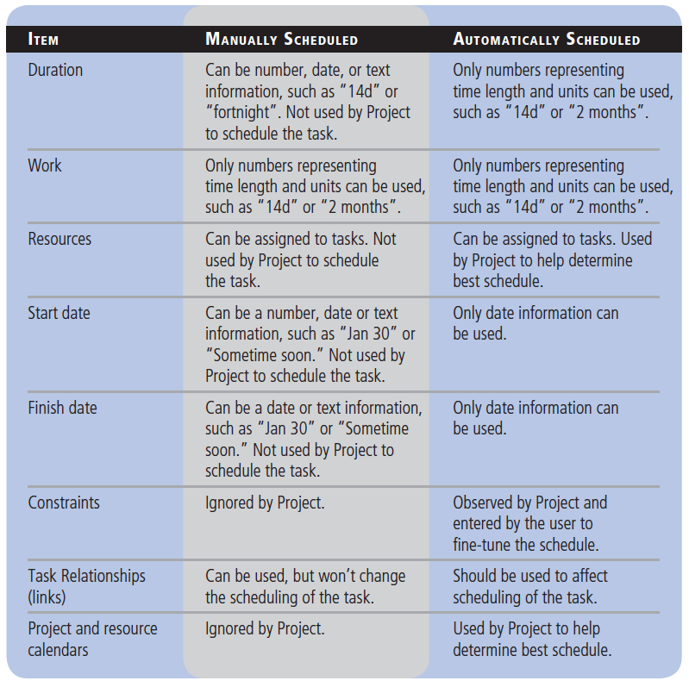
Step by Step: Establish a Manually Scheduled Task

Slide 34
Skill Summary

