Slide 1
Fine-Tuning Resources
Microsoft Project 2013
Lesson 6

Slide 2
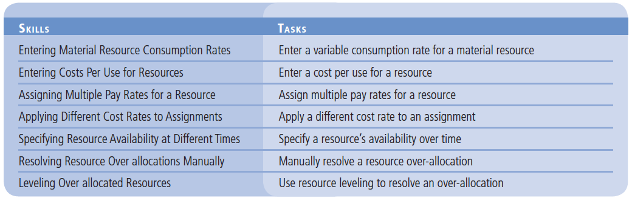
Objectives

Slide 3
Entering Material Resource Consumption Rates
To accurately calculate the cost of a material resource, you also need to know its consumption rate, or how quickly it is used up.

Slide 4
Step by Step: Enter a Variable Consumption Rate for a Material Resource
GET READY. OPEN the Don Funk Music Video 6M project. SAVE the file as Don Funk Music Video 6.
1. Press the F5 key. The Go To dialog box appears. Type 35 in the ID box, and then click OK. Microsoft Project displays task 35, Scene 1 video shoot. This is the first of several scenes that requires DVDs to be recorded. You have determined that the initial estimates for DVD consumption were incorrect. Because for each hour of work you will only be recording for 30 minutes, you have determined that the correct consumption rate for the DVD resource is 0.25 DVD/hour (the DVDs record 2 hours of filming).

Slide 5
Step by Step: Enter a Variable Consumption Rate for a Material Resource
2. Click the Resource tab and then click the Assign Resources button. The Assign Resources dialog box appears.
3. In the Assign Resources dialog box, click the Units field for DVD. Type 0.25/h and then press Enter. Microsoft Project changes the consumption rate of DVDs for this task to 0.25 per hour.

Slide 6
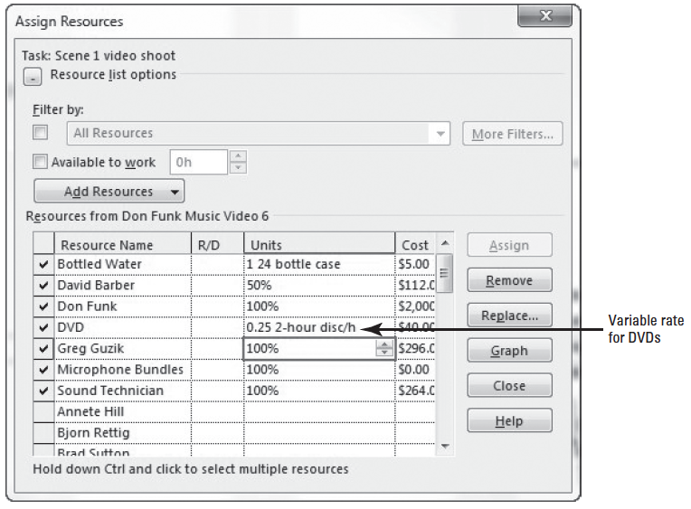
Step by Step: Enter a Variable Consumption Rate for a Material Resource
4. Double-click the column divider between the Units and Cost columns to expand the Units column. The Assign Resources dialog box should look similar to the figure at right.
5. Click the Close button in the Assign Resources dialog box. You will now verify the cost and work values of the DVD assignment to task 35.

Slide 7
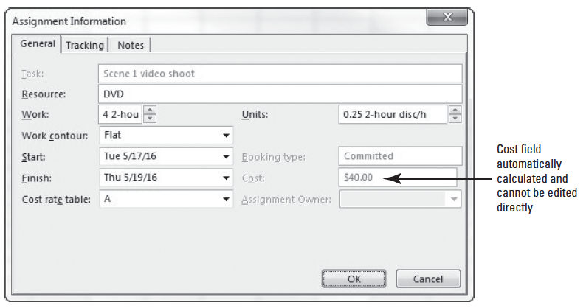
Step by Step: Enter a Variable Consumption Rate for a Material Resource
6. On the ribbon, click the down-arrow under the Team Planner button. Click Task Usage.
7. Double-click the DVD resource assignment under task 35, Scene 1 video shoot. The Assignment Information dialog box appears.
8. Select the General tab, if it is not already selected. Note the Work, Units, and Cost fields. The Assignment Information box should look similar to the figure at right.

Slide 8
Step by Step: Enter a Variable Consumption Rate for a Material Resource
9. Click OK to close the Assignment Information dialog box.
10. SAVE the project schedule.
PAUSE. LEAVE Project open to use in the next exercise.
In this exercise, you have just assigned a variable consumption rate to a material resource. As you have seen in Microsoft Project, you can assign two types of consumption rates:
A fixed consumption rate means that an absolute quantity of the resources will be used, no matter the duration of the task to which the material is assigned. For example, filling a swimming pool requires a fixed amount of water to be used.

Slide 9
Step by Step: Enter a Variable Consumption Rate for a Material Resource
A variable consumption rate means that the amount of the material resource consumed is dependent upon the duration of the task. When shooting DVDs, as in this exercise, you will use more DVDs in six hours than in four.
After you enter a variable consumption rate for a material resource’s assignment, Microsoft Project calculated the total quantity and cost of the material resource consumed, based on the task’s duration.
An advantage of using a variable rate of consumption is that as the duration of the task changes, so do the calculated amount and cost of the material resource, since the rate is tied to the task’s duration.

Slide 10
Entering Costs Per Use for Resources
In addition to its pay or consumption rate, a resource can also have a cost associated with each use.
In this exercise, you enter a per-use cost for a material resource. Any resource can have a cost per use, in place of or in addition to the costs derived from their pay rates (work resources) or consumption rates (material resources).
You can also specify whether the per-use cost should accrue at the beginning or end of the task to which it is assigned.

Slide 11
Step by Step: Enter a Cost Per Use for a Resource
USE the project schedule you created in the previous exercise.
1. On the Resource ribbon, click the down-arrow under Team Planner button, then select the Resource Sheet.
2. On the Resource Sheet, select resource 11, Digital Truck-Mounted Video Camera.
3. On the ribbon, click the Information button, located in the Properties group. The Resource Information dialog box appears.
4. Select the Costs tab.

Slide 12
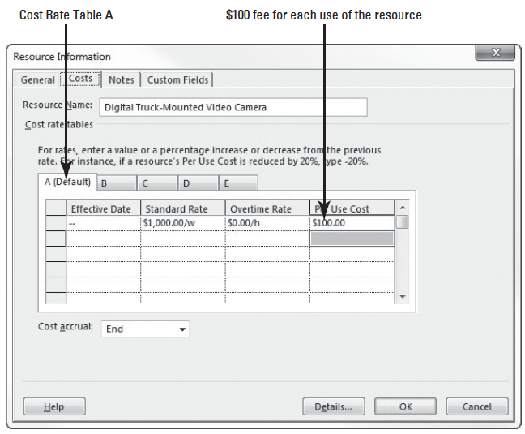
Step by Step: Enter a Cost Per Use for a Resource
5. Under Cost rate tables, select the A (Default) tab if it is not already selected. The Digital Truck-Mounted Video Camera has a $100 maintenance fee for every time you use it.
6. In the first row under the Per Use Cost column, type 100, and then press Enter.
7. Select End from the Cost accrual dropdown box. Your screen should look similar to the figure at right.

Slide 13
Step by Step: Enter a Cost Per Use for a Resource
8. Click OK to close the Resource Information dialog box.
9. SAVE the project schedule.
PAUSE. LEAVE Project open to use in the next exercise.

Slide 14
Assigning Multiple Pay Rates for a Resource
Sometimes, the same work resource may perform different tasks with different pay rates.
Microsoft Project enables you to enter multiple pay rates for a single resource.
In this exercise, you enter a second cost rate table for a resource.
A cost rate table is resource pay rates that are stored on the Costs tab of the Resource Information dialog box. For a given resource you can enter up to five cost rate tables.
Each table has 25 possible entry lines (125 lines total in the five tables) so you can assign dates at which the new cost rate takes effect.
After you assign a resource to a task, you can specify which rate table should apply.

Slide 15
Step by Step: Assign Multiple Pay Rates for a Resource
USE the project schedule you created in the previous exercise. Because Yan Li’s rate differs depending on whether he is working on sound production tasks or administrative tasks, you need to enter a second rate for him.
1. In the Resource Sheet view, click the name of resource 9, Yan Li.
2. On the ribbon, click the Information button. The Resource Information dialog box appears.
3. Click the Costs tab, if it is not already selected. Each tab of the Cost Rate table corresponds to one of the five pay rates a resource can have.
4. Under Cost rate tables, click the B tab.
5. Select the default entry of $0.00/h in the field directly below the Standard Rate column heading, type 15/h, and then press Enter.
Notes:
Another Way: You can also double-click the Resource Name field to activate the Resource Information dialog box.

Slide 16
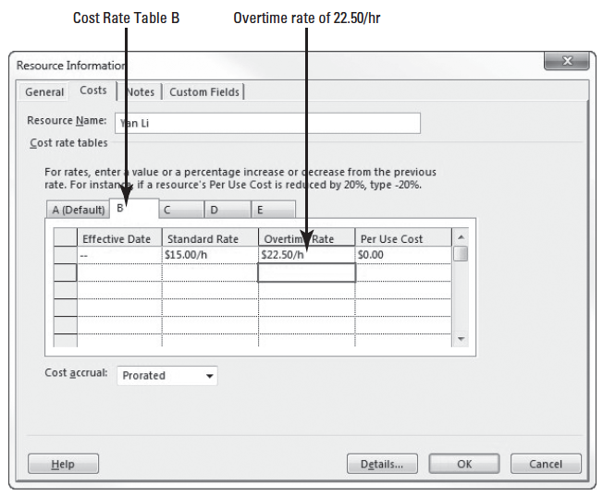
Step by Step: Assign Multiple Pay Rates for a Resource
6. In the Overtime Rate field, type 22.50/h, and then press Enter. Your screen should look similar to the figure at right.
Notes:
Take Note: When you enter a pay rate, if you do not key in the currency symbol, Microsoft Project will supply it for you.

Slide 17
Step by Step: Assign Multiple Pay Rates for a Resource
7. Click OK to close the Resource Information dialog box. Note that on the Resource Sheet, Yan Li’s standard pay rate is still $18.50 per hour. This was the value in Rate Table A, which is the default rate table. This value will be used for all of Yan Li’s task assignments unless you specify a different rate table.
8. SAVE the project schedule.
PAUSE. LEAVE Project open to use in the next exercise.

Slide 18
Applying Different Cost Rates to Assignments
Microsoft Project enables you to enter as many as five different pay rates for a resource.
These pay rates may be applied to different assignments as necessary.

Slide 19
Step by Step: Apply a Different Cost Rate to an Assignment
USE the project schedule you created in the previous exercise.
1. On the Resource ribbon, click the down-arrow under the Team Planner button, and then click Task Usage.
2. Press the F5 key. Type 6 in the ID box, and then click OK.
3. Click the View tab. Verify the Cost table is selected by clicking the Tables button, located in the Data group, and then select Cost.
4. Under task 6, click the row heading directly to the left of Yan Li so that Yan Li’s entire assignment is selected.

Slide 20
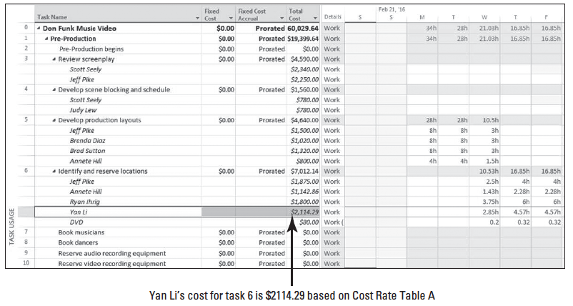
Step by Step: Apply a Different Cost Rate to an Assignment
5. Move the center divider in the table portion (on the left) of the Task Usage view to the right until the Total Cost column is visible. You can see that the total cost of Yan’s assignment to this task is $2114.29. Your screen should look similar to the figure below.

Slide 21
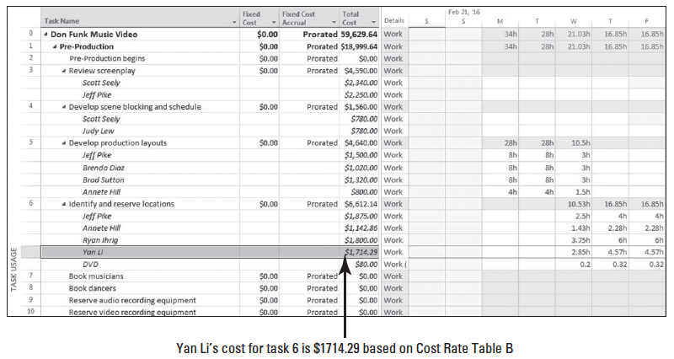
Step by Step: Apply a Different Cost Rate to an Assignment
6. Double-click Yan Li’s name. The Assignment Information dialog box appears.
7. Click the General tab, if it is not already selected.
8. In the Cost rate table box, type or select B, and then click OK. Microsoft Project applies Yan Li’s Cost Rate Table B to the assignment. The new cost of the assignment, $1,714.29, is reflected in the total cost column. Your screen should look similar to the figure above.
Notes:
Another Way: If you find that you are changing cost rate tables frequently, it is quicker to display the Cost Rate Table field directly in the Resource Usage or Task Usage view. To add the Cost Rate Table Field, right-click a column heading, then select Insert Column. Select Cost Rate Table from the dropdown list.

Slide 22
Step by Step: Apply a Different Cost Rate to an Assignment
9. SAVE the project schedule.
PAUSE. LEAVE Project open to use in the next exercise.
In this exercise, you applied an alternate rate table for a resource to reflect a different pay rate for different work.
You can set up as many as five pay rates per resource. This enables you to assign different pay rates to different assignments for a resource.
By default, Microsoft Project uses cost rate table A, but you can specify any time another rate table should be used.

Slide 23
Specifying Resource Availability at Different Times
Sometimes, as you are working on a project schedule, you will find that a resource will have varying availability.
To control this availability, Microsoft Project uses Max. Units, or the maximum capacity of a resource, to accomplish tasks.

Slide 24
Step by Step: Specify a Resource’s Availability Over Time
USE the project schedule you created in the previous exercise.
1. On the ribbon, click the Resource Sheet button.
2. In the Resource Name column, double-click click the name of resource 32, electrician. The Resource Information dialog box appears.
3. Click the General tab, if it is not already selected. You originally planned that there would be three electricians available for the entire video production, but you have just determined that there will only be two electricians available from May 1–May 20, 2016.

Slide 25
Step by Step: Specify a Resource’s Availability Over Time
4. Under Resource Availability, in the first row of the Available From column, leave NA (Microsoft Project’s term for a null field, or a field that is blank).
5. In the Available To cell in the first row, key or select 4/30/16.
6. In the Available From cell in the second row, key or select 5/1/16.
7. In the Available To cell in the second row, key or select 5/20/16.
8. In the Units cell in the second row, key or select 200%.
9. In the Available From cell in the third row, key or select 5/21/16.

Slide 26
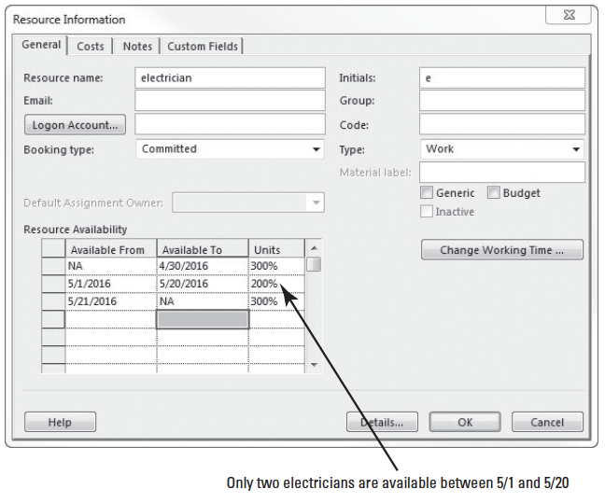
Step by Step: Specify a Resource’s Availability Over Time
10. Leave the Available To cell in the third row blank. Microsoft Project will fill this with NA.
11. In the Units cell in the third row, type or select 300%, and then press Enter. Your screen should look similar to the figure at right.

Slide 27
Step by Step: Specify a Resource’s Availability Over Time
12. Click OK to close the Resource Information dialog box.
13. SAVE the project schedule.
PAUSE. LEAVE Project open to use in the next exercise.
In this exercise, you set resource availability over time using the Resource Availability grid on the General tab of the Resource Information dialog box. Recall from Lessons 3 and 4 that a resource’s capacity to work is measured in units.
Notes:
Take Note: Microsoft Project will display 200% in the Max. Units field only when the current date (based on your computer’s system clock) is within the May 1–May 20 range. At other times it will display 300%.

Slide 28
Step by Step: Specify a Resource’s Availability Over Time
The Max. Units value stored in Microsoft Project is the maximum capacity of a resource to accomplish tasks.
A resource’s calendar determines when a resource is available to work.
However, the resource’s capacity to work (measured in units and limited by their Max. Units value) determines how much that resource can work within those hours without becoming over-allocated.
You can set different Max. Units values to be applied over different time periods for any resource.
Setting a resource’s availability over time enables you to control exactly what a resource’s Max. Units value is at any time.

Slide 29
Resolving Resource over-allocations Manually
A resource is over-allocated when it is scheduled for work that exceeds its maximum capacity to work.
You can manually resolve this situation within the project schedule.

Slide 30
Step by Step: Manually Resolve a Resource over-allocation
USE the project schedule you created in the previous exercise.
1. On the View ribbon, click the down-arrow to the right of the Resource Sheet button, click More Views, select Resource Allocation, and then click the Apply button. Microsoft Project switches to the Resource Allocation view. This is a split view that displays the Resource Usage view in the top pane and the Leveling Gantt view in the bottom pane.

Slide 31
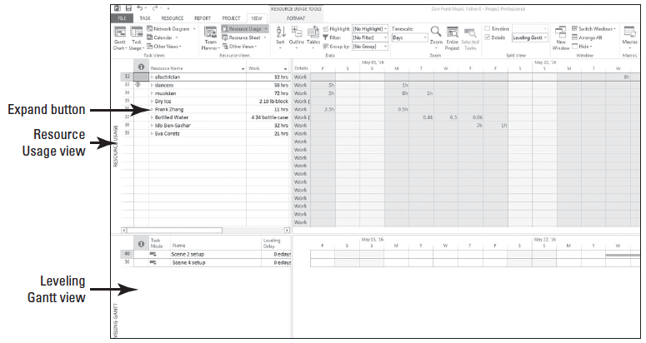
Step by Step: Manually Resolve a Resource over-allocation
2. On the ribbon, in the Zoom group, click the down-arrow in the Timescale box and select days. Your screen should look similar to the figure below.
3. In the Resource Usage view, scroll vertically through the Resource Name column so that you can see the names. The names you see formatted in red are over-allocated resources.

Slide 32
Step by Step: Manually Resolve a Resource over-allocation
4. In the Resource Name column, navigate (scroll) to and select the name of resource 26, Greg Guzik.
5. Click the expand button next to Greg Guzik’s name to display his assignments. Scroll down to see the assignments, if necessary.

Slide 33
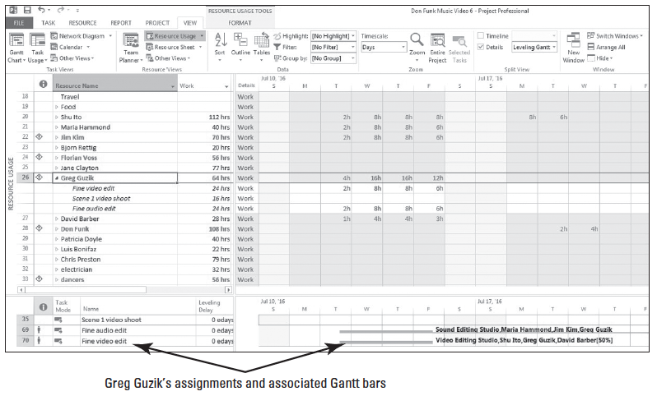
Step by Step: Manually Resolve a Resource over-allocation
6. Press the F5 key. Type 7/15/16 in the Date box, and then click OK. The Leveling Gantt pane shows the task bars for two of Greg Guzik’s assignments. Your screen should look similar to figure at right.
© 2014, John Wiley & Sons, Inc.
Microsoft Official Academic Course, Microsoft Project 2013
33

Slide 34
Step by Step: Manually Resolve a Resource over-allocation
In the upper pane, you see that Greg is assigned full-time to two tasks that both start on Tuesday, July 12. He is over-allocated for most of the duration of both tasks.
In the lower pane, you can see the Gantt bars for the two tasks that have caused Greg to be over-allocated during this time. For tasks 69 and 70, Greg is assigned eight hours of work on both Wednesday and Thursday, and six hours of work on Friday.
This results in 16 hours of work on two days, and 12 hours of work on another–beyond Greg’s capacity to work. In addition, Greg is assigned four hours of work on Tuesday, performing two tasks at the same time.

Slide 35
Step by Step: Manually Resolve a Resource over-allocation
However, this assignment is NOT shown in red. This is because the default over-allocation setting is set to look for over-allocations on a “Day-by-Day” basis. Since Greg has 8 hours of availability that day, it does not see this as an over-allocation.
7. In the Resource Name column, double-click Greg’s first assignment, Fine video edit. The Assignment Information dialog box appears.
8. Click the General tab, if it is not already selected.

Slide 36
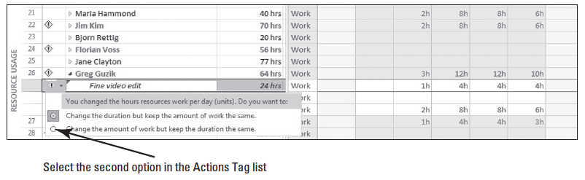
Step by Step: Manually Resolve a Resource over-allocation
9. In the Units box, select 50%, and then click OK to close the Assignment Information dialog box.
10. Click the Actions button. Review the options in the list that appears. Your screen should look similar to the figure below.
Notes:
Note that Greg’s daily work assignments on this task are reduced, but the task duration is increased. You want to reduce the work, but not increase the duration of the task. Also note the Actions button that has been activated next to the name of the assignment.

Slide 37
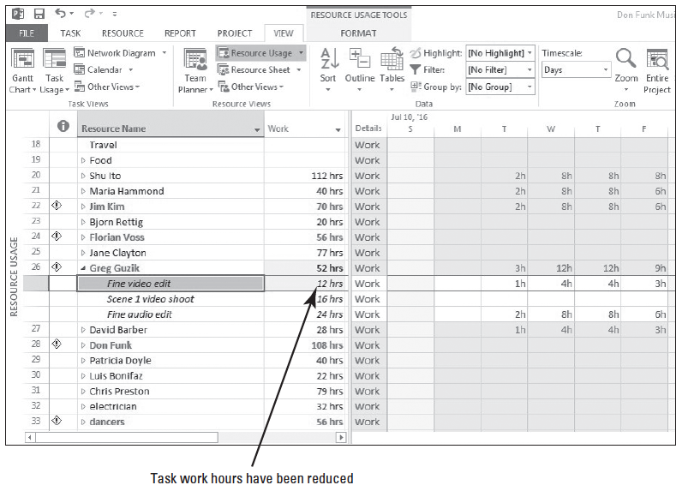
Step by Step: Manually Resolve a Resource over-allocation
11. Click Change the amount of work but keep the duration the same in the Actions option list. Microsoft Project reduces Greg’s work assignments on the task and restores the task to its original duration. Your screen should look similar to the figure at right. Notice that Greg is still over-allocated, so now you will reduce the assignment units on his second task.

Slide 38
Step by Step: Manually Resolve a Resource over-allocation
12. In the Resource Name column, double-click Greg’s second assignment, Fine audio edit. The Assignment Information dialog box appears.
13. Click the General tab if it is not already visible.
14. In the Units box, type or select 50%, and then click OK to close the Assignment Information dialog box.

Slide 39
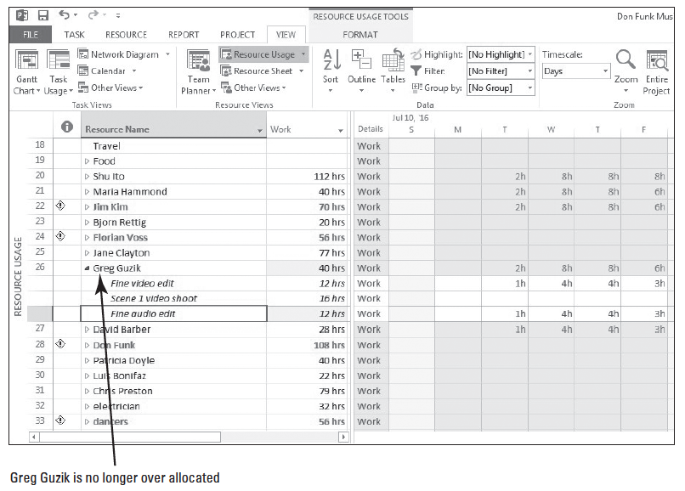
Step by Step: Manually Resolve a Resource over-allocation
15. Click the Actions button. Click Change the amount of work but keep the duration the same in the Actions option list. Greg’s assign- ments on Wednesday and Thursday are reduced to eight hours each day. You have manually changed Greg’s assignments to reduce his work and resolve his over-allocation. He is now fully allocated on Wednesday through Friday. Your screen should look similar to the figure above.

Slide 40
Step by Step: Manually Resolve a Resource over-allocation
16. SAVE the project schedule.
PAUSE. LEAVE Project open to use in the next exercise.
In this exercise, you have manually resolved a resource over-allocation. Recall from Lesson 4 that a resource’s capacity to work is called allocation, and a resource is said to be in one of three states:
Under allocated: The work assigned to the resource is less than the resource’s maximum capacity.
Fully allocated: The total work of a resource’s task assignments is exactly equal to that resource’s work capacity.
Over-allocated: A resource is assigned to do more work than can be done within the normal work capacity of the resourceter.

Slide 41
Step by Step: Manually Resolve a Resource over-allocation
Manually editing an assignment is one way to resolve a resource over-allocation, but there are several other options.
You can replace the over-allocated resource with another resource using the Replace button in the Assign Resources dialog box.
You can reduce the value in the Units field in the Assignment Information or Assign Resources dialog box.
If the over-allocation is not extreme (for instance, 9 hours of work assigned in a normal 8-hour workday), you can just allow the over-allocation to remain in the schedule.

Slide 42
Step by Step: Manually Resolve a Resource over-allocation
In Microsoft Project 2013, over-allocations are also noted when you have assigned a work resource to working times outside their normal working hours.
Recall from Lesson 4 you assigned a Task Calendar for the overnight beach filming. This resulted in an over-allocation for the work resources assigned to that task.
They are not truly over-allocated by definition. It is simply the software’s way of notifying you that you have resources assigned work which is outside their normal working hours.

Slide 43
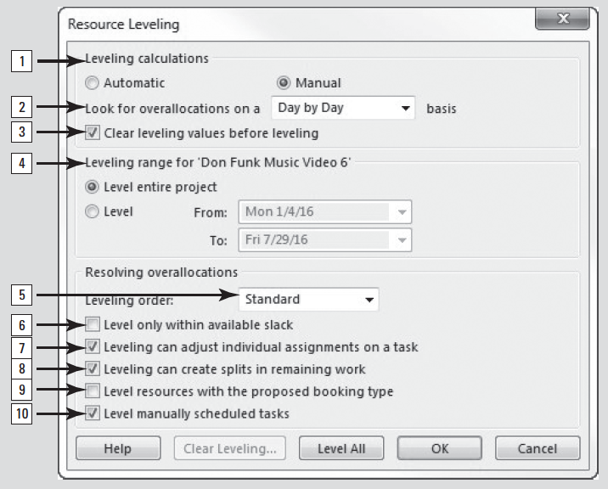
Software Orientation
The Resource Leveling dialog box allows you to specify the rules and options that control how Microsoft Project performs resource leveling (see figure).

Slide 44
Software Orientation
The options in the Resource Leveling Dialog box are as follows:
Leveling calculations. These selections determine whether Microsoft Project levels resources constantly (Automatic) or only when you tell it to do so (Manual). Automatic leveling occurs as soon as a resource becomes over-allocated.
Look for over-allocations on a . . . ..basis. This determines the timeframe in which Microsoft Project will look for over-allocations. If a resource it is over-allocated at the level you choose here, its name will be formatted in red. If a resource is not over-allocated at the level you choose, there will be no indication of any over-allocation.
Clear leveling values before leveling. There are times when you may have to level resources repeatedly to get the results you want. (You might level day by day, and then hour by hour, for example.) If the Clear leveling values before leveling is selected, Microsoft Project removes any existing delays from all tasks before leveling.

Slide 45
Software Orientation
Leveling range for . . . . This selection determines whether you level the entire project or only those assignments that fall within a date range you specify. Leveling within a date range is advantageous when you have started tracking actual work and you want to level only the remaining assignments in a project.
Leveling order. This setting allows you to control the priority Microsoft Project uses to determine which tasks it should delay to resolve a resource conflict. There are three options: ID Only; Standard; and Priority, Standard. The ID Only option delays tasks according to their ID numbers only. Use this option when your project schedule has no task relationships or constraints. The Standard option delays tasks according to their predecessor relationships, start dates, task constraints, slack, priority, and IDs. The Priority, Standard option looks at the task’s priority value before other standard criteria.

Slide 46
Software Orientation
Level only within available slack. Clearing this setting allows Microsoft Project to extend the project’s finish date, if necessary, to resolve resource over-allocations. Selecting this setting would prevent Microsoft Project from extending the project’s finish date in order to resolve resource over-allocations. Instead, Project would only use the free slack of tasks, which may or may not be adequate to fully resolve resource over-allocations.
Leveling can adjust individual assignments to work on a task. This setting allows Microsoft Project to add leveling delay (or, if Leveling can create splits in remaining work is selected, to split work on assignments) independently of any other resources assigned to the same task. This could cause resources to start and finish work on a task at different times.
Leveling can create splits in remaining work. This allows Microsoft Project to split work on a task in order to resolve an over-allocation.

Slide 47
Software Orientation
Level resources with the proposed booking type. Use this option only when Microsoft Project 2013 is being used in an enterprise environment, such as Project Server 2013. Using this option allows Microsoft Project to level resources in projects, connected to Project Server 2013, that have a proposed booking type. Deselecting this option will cause the software to ignore all resources that have a proposed booking type.
Level manually schedule tasks. If your project contains manually scheduled tasks which have over-allocated resources, selecting this option allows the software to split or delay these tasks. Leave this option selected if you want to maintain control and manually resolve over-allocations on the manually scheduled tasks.

Slide 48
Leveling over-allocated Resources
To avoid an over-allocation situation, you can cause a resource’s work on a specific task to be delayed through a process known as resource leveling.

Slide 49
Step by Step: Use Resource Leveling to Resolve an over-allocation
USE the project schedule you created in the previous exercise.
1. On the ribbon, in the Split View group, deselect the Details checkbox.
2. On the ribbon, click Resource Sheet, located in the Resource Views group. The Resource Sheet view appears. Take note of the resource names that appear in red and have the over-allocated icon in the Indicators column.
3. Click on the Resource tab. In the Level group, select Leveling Options. The Resource Leveling dialog box appears.
Notes:
Take Note: Depending on previous uses of the Resource Leveling dialog box in Microsoft Project, the options you are selecting in steps 4 through 13 may already be selected for you.

Slide 50
Step by Step: Use Resource Leveling to Resolve an over-allocation
4. In the Resource Leveling dialog box, under Leveling calculations, select Manual, if it is not already selected.
5. In the Look for over-allocations on a . . . .. basis box, select Day by Day.
6. Select the Clear leveling values before leveling box.
7. Under Leveling range for, select Level entire project.
Notes:
Take Note: All of the settings in the Resource Leveling dialog box apply to all project schedules with which you work in Microsoft Project–NOT just the active project schedule. It might sound easier to use automatic leveling, but it will make frequent adjustments to project schedules whether you want them to occur or not. Because of this, it is recommended that you always have Manual Leveling calculations selected.
Troubleshooting: In most projects, leveling in detail more precise than Day by Day can result in unrealistically precise adjustments to assignments.

Slide 51
Step by Step: Use Resource Leveling to Resolve an over-allocation
8. Under Resolving over-allocations, in the Leveling order box, select Standard.
9. Clear the Level only within available slack check box.
10. Select the Leveling can adjust individual assignments on a task check box.
11. Select the Leveling can create splits in remaining work check box.
12. Clear the Level resources with the proposed booking type check box.

Slide 52
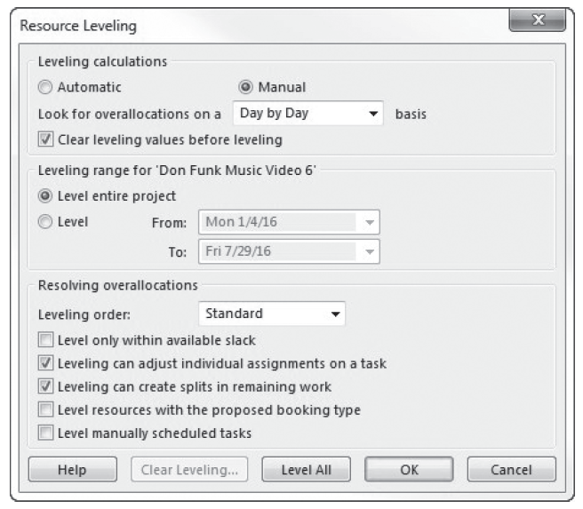
Step by Step: Use Resource Leveling to Resolve an over-allocation
13. Clear the Level manually scheduled tasks check box. Your screen should look similar to the figure at right.
14. Click the Level All button.
Notes:
Take Note: If you select OK after setting the options, Microsoft Project will not perform leveling, unless you have selected Automatic leveling.

Slide 53
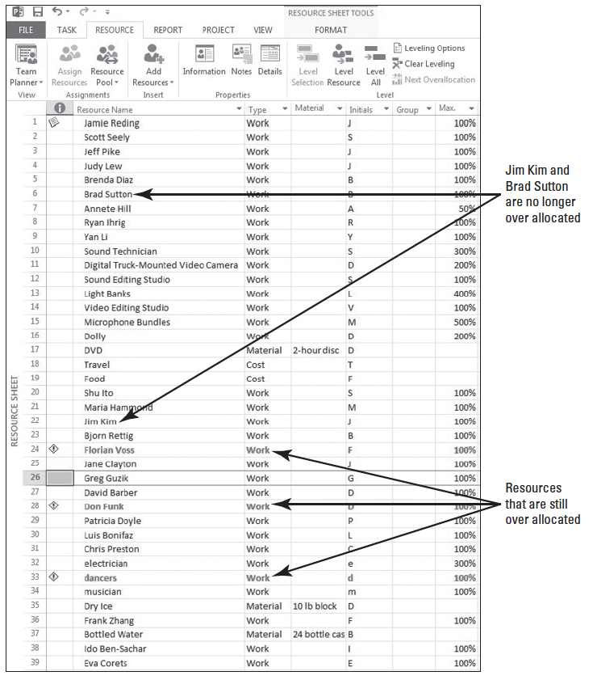
Step by Step: Use Resource Leveling to Resolve an Over-Allocation
15. Microsoft Project levels over- allocated resources. Notice that resource 6, Brad Sutton and resource 22, Jim Kim no longer are over-allocated. Some resources may still be formatted in red, meaning they are still over-allocated, probably due to being assigned work during their normal non- working times. Your screen should look similar to the figure at right.

Slide 54
Step by Step: Use Resource Leveling to Resolve an Over-Allocation
16. On the ribbon, click the down-arrow under the Team Planner button. Select More Views, select Leveling Gantt, and then click Apply. Microsoft Project displays the Leveling Gantt view.
17. Press the F5 key. Type 60 in the ID box. Your screen should look similar to the figure on the next slide.

Slide 55
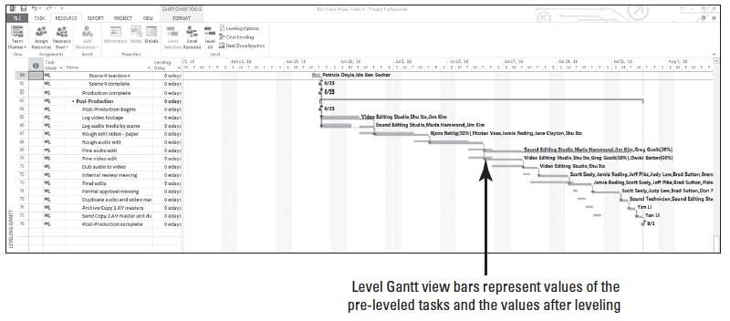
Step by Step: Use Resource Leveling to Resolve an Over-Allocation
Notice that each task now has two bars. The tan bar on the top represents the pre-leveled task. The light blue bar on the bottom represents the leveled task. For this project, the effect leveling had was to extend the finish date by about three days. You can see all of the pre-leveled start, duration, and finish values for any task by pointing to the desired tan bar. The solid teal line to the right of any light blue bar represents the float (slack) for that task.

Slide 56
Step by Step: Use Resource Leveling to Resolve an Over-Allocation
18. SAVE the project schedule, and then CLOSE the file.
PAUSE. If you are continuing to the next lesson, keep Project open. If not continuing to additional lessons, CLOSE Project.
In this exercise, you used resource leveling to resolve over-allocations. Recall that resource leveling is the process of delaying or splitting a resource’s work on a task to resolve an over-allocation.
Notes:
Take Note: Even though the effects of resource leveling might sometimes be significant, resource leveling never changes who is assigned to tasks, or the total work or assignment unit values of those assignments.

Slide 57
Step by Step: Use Resource Leveling to Resolve an Over-Allocation
The options in the Resource Leveling dialog box enable you to set parameters about how Microsoft Project resolves resource over-allocations. Depending on your options, Microsoft Project might try to level resources by delaying the start date of an assignment or task or splitting the work on the task.
Resource leveling can only do a few things: it adds delays to tasks, it splits tasks, and it adjusts resource assignments. It does this by following a complex set of rules and options that you specify. Resource leveling is very useful for fine tuning, but it can’t replace the judgment of a good project manager.
Resource leveling will work with all of this information as it exists in your project schedule, but it still might not be possible to resolve all over-allocations within the timeframe you want without changing more basic task and resource information.

Slide 58
Skill Summary

