Slide 1
Project Information: Sorting, Grouping, and Filtering
Microsoft Project 2013
Lesson 7

Slide 2
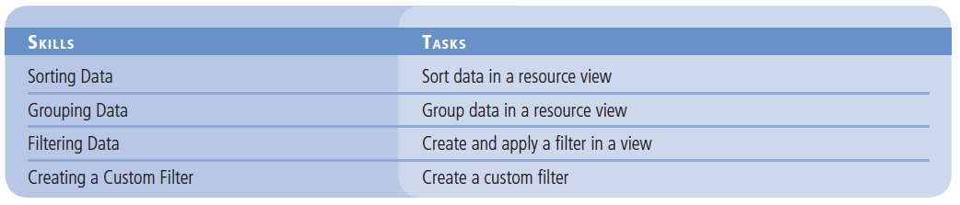
Objectives

Slide 3
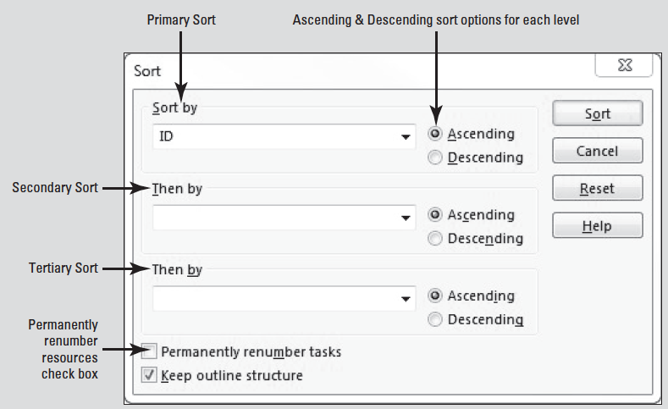
Software Orientation
In Microsoft Project, you can use the Sort dialog box to sort task or resource information in the current view by a specified field or fields (see figure below).

Slide 4
Software Orientation
The Sort dialog box enables you to select up to three fields for three levels of sorts within sorts, to choose whether the view should be sorted in ascending or descending order, and to indicate whether items should be permanently renumbered according to the sort.

Slide 5
Sorting Data
It is easiest to review and utilize data in Microsoft Project when you have it organized to fit your needs.
The simplest way to reorganize task and resource data in Project is by sorting.

Slide 6
Step by Step: Sort Data in a Resource View
GET READY. OPEN Don Funk Music Video 7M. SAVE the file as Don Funk Music Video 7.
1. Click the View tab, and then click Resource Sheet. The Resource Sheet view appears. The default table in the Resource Sheet view is the Entry table. However, you want to look at the cost per resource, which is not displayed in the Entry table.
2. On the ribbon, click the Tables button in the Data group and then select Summary. The Summary table appears in the Resource Sheet view.

Slide 7
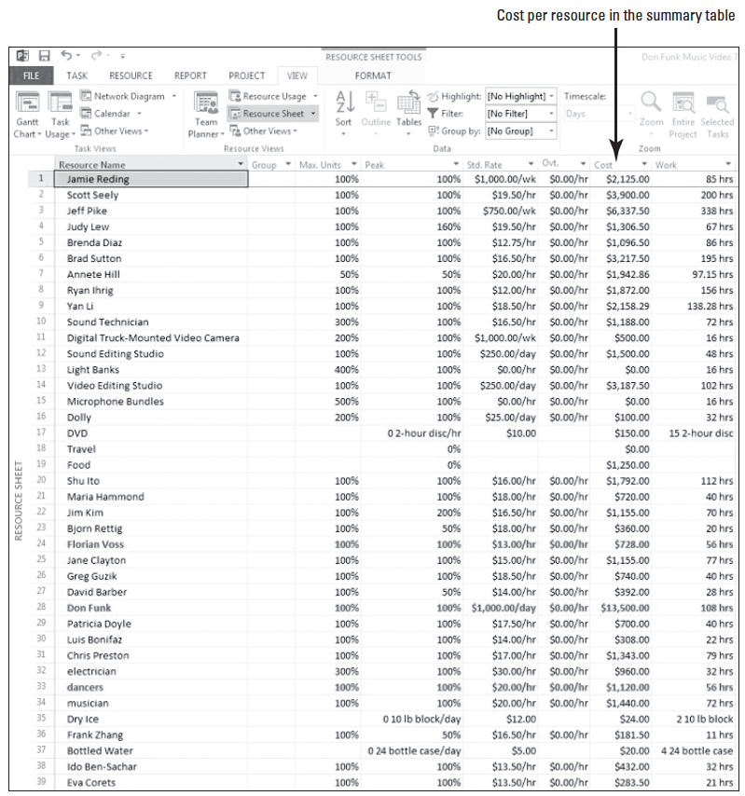
Step by Step: Sort Data in a Resource View
3. Auto-fit the columns so the data can be easily read. Your screen should look similar to the figure at right.

Slide 8
Step by Step: Sort Data in a Resource View
4. On the ribbon, click the Sort button in the Data group and then click Sort By. The Sort dialog box appears (as shown in the figure on slide 3).
5. In the Sort by section, select Cost from the dropdown menu. Next to that, click Descending. Make sure that the Permanently renumber resources check box at the bottom of the Sort dialog box is NOT checked.
Notes:
Take Note: Notice that in the Sort box, you can utilize up to three nested levels of sort criteria. Also, you can sort by any field, not just the fields that are visible in the active view.
Troubleshooting: The Permanently renumber resources check box (or when in a task view, Permanently renumber tasks) is a Project-level setting. If you check this box, Project will permanently renumber resources or tasks in ANY Microsoft Project file in which you sort. Since you may not want to permanently renumber tasks or resources every time you sort, it is a good idea to have this option turned off.

Slide 9
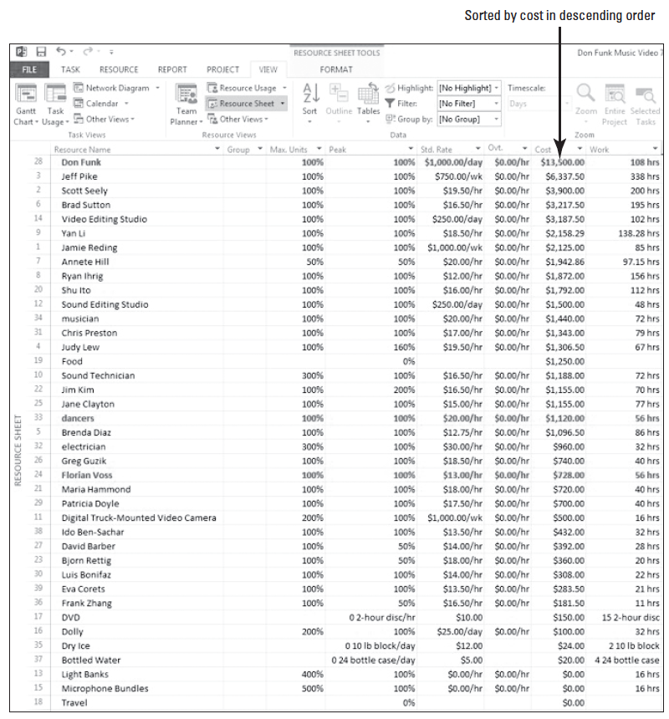
Step by Step: Sort Data in a Resource View
6. Click the Sort button. The Summary table is sorted from the highest to lowest value in the Cost column. This sort enables you to look at resource costs across the entire project. Your screen should look similar to the figure at right.
Notes:
Take Note: When you sort data in your project, the sort applies to the active view, no matter which table is currently displayed in the view. For example, if you sort the Task Usage view by finish date while the Entry table is visible, and then switch to the Cost table, you will see that the tasks are still sorted by finish date in the Cost column.

Slide 10
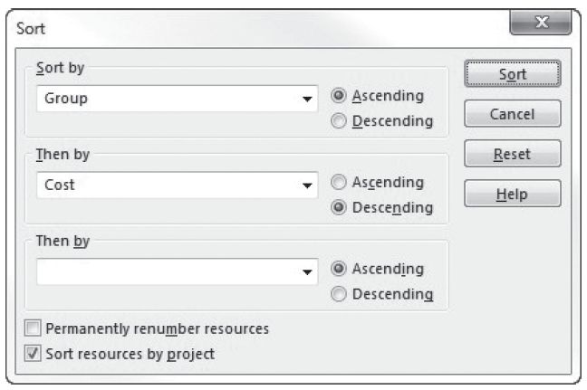
Step by Step: Sort Data in a Resource View
7. On the ribbon, click Sort, and then click Sort by. The Sort dialog box appears.
8. In the Sort by section, select Group from the dropdown menu. Next to that, click Ascending.
9. In the Then by section, select Cost from the drop- down menu. Then click the radio button next to Descending. Make sure the Permanently renumber resources box is not checked. Your screen should look similar to the figure above.

Slide 11
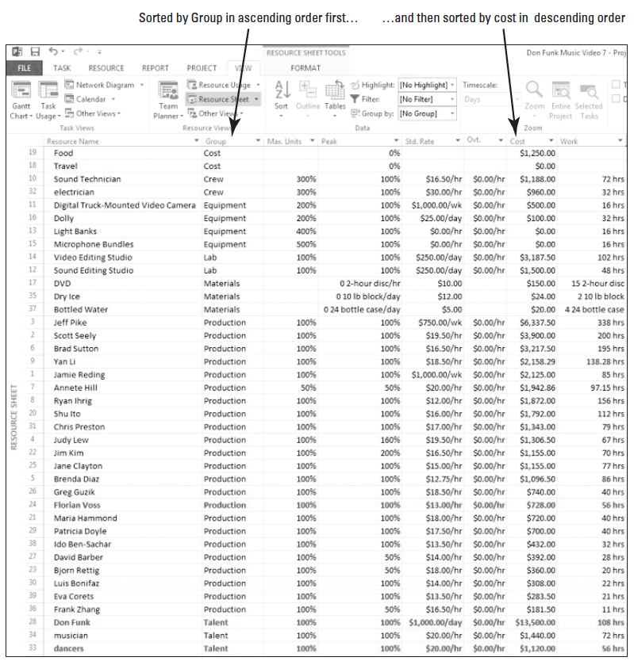
Step by Step: Sort Data in a Resource View
10. Click the Sort button. The Resource Sheet view is sorted to display resources sorted first | by Group (Equipment, Talent, etc.) and then by Cost within each group. Your screen should look similar to the figure at right.

Slide 12
Step by Step: Sort Data in a Resource View
When you sort data in this way, it is easy to identify the most and least expensive resources in each group on your project. You can sort your data in any way that is beneficial to the analysis of your project. The sort order you most recently specified will remain in effect until you re-sort the view. Now you will restore the data to its original order.
© 2014, John Wiley & Sons, Inc.
Microsoft Official Academic Course, Microsoft Project 2013
12

Slide 13
Step by Step: Sort Data in a Resource View
11. On the Quick Access Toolbar, click the Undo button one time. The Undo button reverses the last sort you performed, restoring the data to the original sort order (by Cost only).
12. Now click the Undo button again. The data is restored to the original order in the Summary table of the Resource Sheet view (as displayed previously on slide 7). The Multiple Level Undo enables you to undo actions or sets of actions while you are working on your project schedule.
13. SAVE the project schedule.
PAUSE. LEAVE the project schedule open to use in the next exercise.
Notes:
Another Way: You can also “unsort” your data by clicking the Sort button on the View ribbon, and then clicking By ID.

Slide 14
Step by Step: Sort Data in a Resource View
You have just performed several sorts on your project data to allow you to more closely examine certain aspects of your project.
A sort is a way of ordering task or resource information in a view by the criteria you specify. You can sort tasks or resources using predefined criteria, or you can create your own sort order with up to three levels (a group within a group within a group).
If you need to sort data in a view with more than three criteria, start by sorting your least important factors first and then sort by your three most important factors.

Slide 15
Step by Step: Sort Data in a Resource View
Except for one instance, sorting does not change the actual data of your project schedule, but rather just reorders your data.
Sorting allows you to arrange data in an order that answers a question you may have, or in a way that makes more sense or is more user-friendly to your project team.
Note that there is no visual indicator that a task or resource view has been sorted other than the order in which the rows of data appear.
Furthermore, unlike grouping and filtering, which you will learn about later in this lesson, you cannot save custom sort settings that you have specified.
The one instance in which the actual data of your project is changed by sorting is the option that Project offers to renumber resource or task IDs after sorting.

Slide 16
Step by Step: Sort Data in a Resource View
Once resources or tasks are renumbered by sorting, you can’t restore their original numeric order.
Sometimes, you might want to permanently renumber tasks or resources. For instance, at the beginning of a project, you might enter resource names as they are needed on the project.
When you are finished entering resources, you might want to sort them alphabetically and permanently renumber them.
The Multiple Level Undo function you used in this exercise is a very valuable new tool in Microsoft Project. As you saw, this feature allows you to easily undo sets of actions you have performed in Microsoft Project.

Slide 17
Step by Step: Sort Data in a Resource View
You can undo changes that you purposely made (as in this exercise), or reverse “mistakes” that you make while working on your project schedule.
However, the functionality of Multiple Level Undo doesn’t stop there. It enables you to make, undo, and redo changes to views, data, and options–giving you the ability to experiment with different scenarios without causing permanent undesired effects.
You can test several approaches to resolving a problem or optimizing a project schedule in order to fully understand the implications of each choice. (You can also use the Visual Change Highlighting as you are making changes to see the effects of your actions.)
A word of caution regarding the Multiple Level Undo feature–it will not undo all actions. For example, if you save a file, the undo feature cache is cleared and you cannot undo the save.

Slide 18
Grouping Data
Another way to organize, view, and analyze the data in your project schedule is through grouping.
Grouping enables you to organize the task and resource criteria in your schedule according to various criteria that you select.
Similar to sorting, grouping only changes the way data is displayed–it does not change the data itself.

Slide 19
Step by Step: Group Data in a Resource View
USE the project schedule you created in the previous exercise.
On the View ribbon, click the down-arrow in the Group By box, (currently is has No Group) and then click Resource Group.
Microsoft Project reorganizes the data into resource groups and presents it in an expanded outline form. It also adds summary costs by group. Your screen should look similar to the figure on the next slide. The summary data rows are set off with a colored background (yellow in this case).

Slide 20
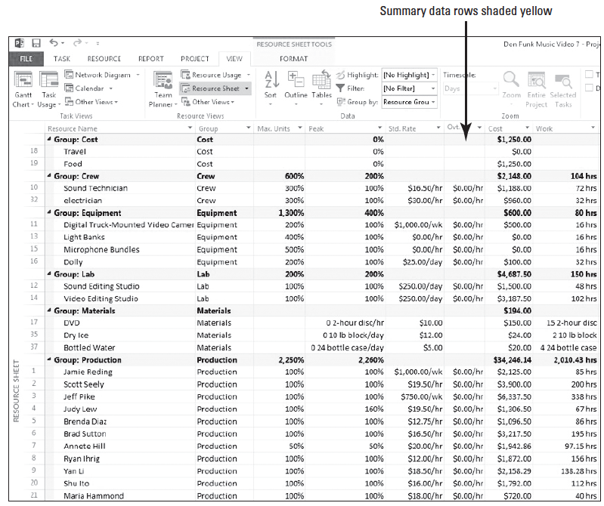
Step by Step: Group Data in a Resource View
Because the data in the summary rows is derived from subordinate data, this cannot be changed directly. To have more control over how your data is presented, you can create custom groups.

Slide 21
Step by Step: Group Data in a Resource View
2. On the View ribbon, click the down-arrow in the Group By box, (currently it has Resource Group) and then click More Groups. The More Groups dialog box appears, displaying all of the predefined groups for tasks and resources available to you. You will create a new group that is similar to the Resource Group.
3. Select Resource Group (if it is not already selected), and then click the Copy button. The Group Definition dialog box appears.
4. In the Names box, key Resource Groups by Cost.
5. In the Field Name column, click the first empty cell below Group.

Slide 22
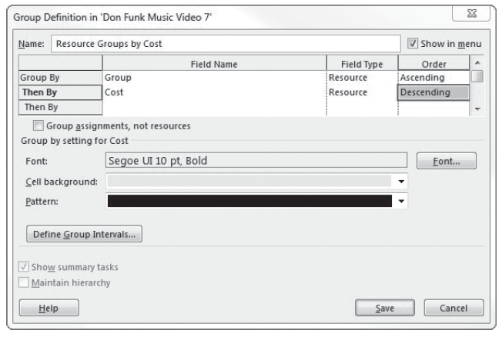
Step by Step: Group Data in a Resource View
6. Type or select Cost.
7. In the Order column for the Cost field, click Ascending to select it and then select Descending from the dropdown menu. The resources will be sorted within their groups by descending cost. The Group Definition dialog box should look similar to the figure above.

Slide 23
Step by Step: Group Data in a Resource View
8. In the Group Definition dialog box, click the Define Group Intervals button. The Define Group Intervals dialog box appears.
9. In the Group on box, select Interval from the dropdown menu.
10. Type 500 in the Group interval box, and then click the OK button.
11. Click the Save button in the Group Definition dialog box to close it. Resource Groups by Cost appears as a new group in the More Groups dialog box.
12. Click the Apply button in the More Groups dialog box. Microsoft Project applies the new group to the Resource Sheet view.
13. Right-click the Resource Name column heading then select Field Settings. The Field Settings dialog box appears. You want to widen the Resource Name column.

Slide 24
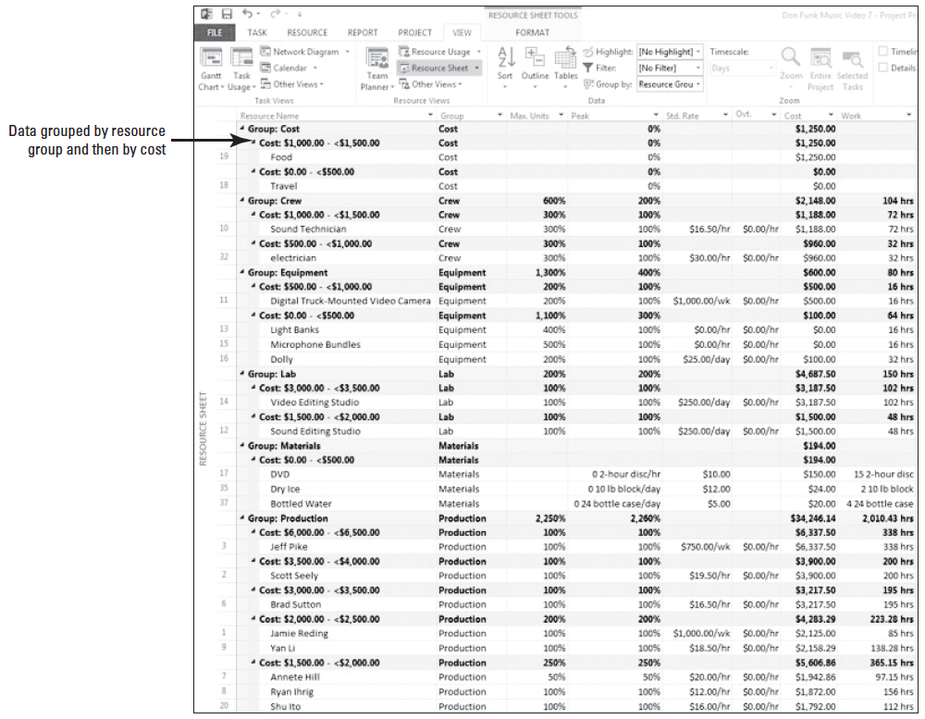
Step by Step: Group Data in a Resource View
14. Click the Best Fit button in the Field Settings dialog box. The Resource Name column is widened. If needed, scroll to the top of the view. Your screen should look similar to the figure at right. The resources are grouped by Resource Group (the yellow shaded cells) and within each group by cost values at $500 increments (the blue shaded cells).
Notes:
Another Way: You can also auto fit any column by placing the cursor on the right side dividing line and double-clicking.

Slide 25
Step by Step: Group Data in a Resource View
15. After you have reviewed the groupings you created, click the down-arrow in the Group By box, (currently it has Resource Groups by Cost) in the Data group, and then click [No Group]. Microsoft Project removes the groupings, restoring the original data. Displaying or removing a group has no effect on the data in the project.
16. SAVE the project schedule.
PAUSE. LEAVE the project schedule open to use in the next exercise.

Slide 26
Step by Step: Group Data in a Resource View
In this exercise, you have just reorganized your project data using grouping.
A group is a way to reorder task or resource information in a table and to display summary values for each group according to various criteria you can choose.
Grouping goes a step beyond sorting in that grouping your project data will add summary values, called “roll-ups,” at customized intervals.
Grouping the data in a project schedule enables you to view your information from a variety of perspectives. It also allows for a more detailed level of data analysis and presentation.

Slide 27
Step by Step: Group Data in a Resource View
In your role as project manager, your project schedule helps you track the work and costs associated with your project.
By using grouping, you also have the ability to look at more details–to understand not just what is happening on your project, but also why.
As with sorting, grouping does not change the fundamental structure of your project schedule but rather just reorganizes and summarizes it. Also like sorting, grouping applies to all tables you can display in the view.
You can use any of the predefined groups, customize these predefined groups, or create your own.

Slide 28
Filtering Data
The feature called filtering allows you to look only at specific task or resource data that meet specific criteria.
Filtering hides task or resource data that does not meet the criteria you specify and displays only the data in which you are interested.
You can use a predefined filter, AutoFilters, or create a custom filter.
In this exercise, you will create a filter that allows you to focus on tasks related to the video shoot.

Slide 29
Step by Step: Create and Apply a Filter in a View
USE the project schedule you created in the previous exercise.
1. On the View ribbon, click the Gantt Chart button in the Task Views group. The Gantt Chart view appears.

Slide 30
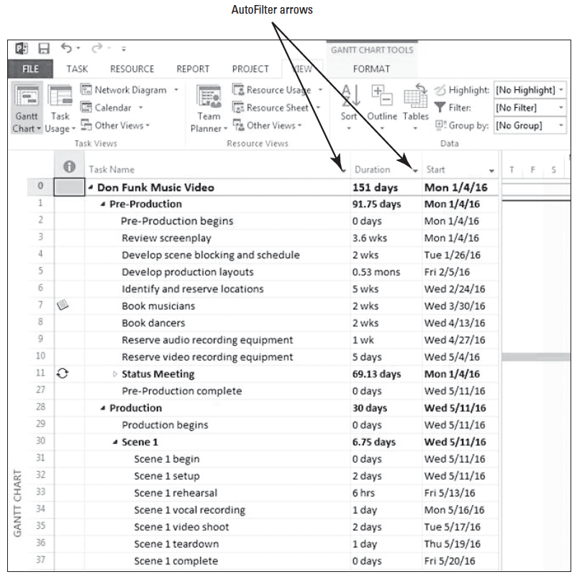
Step by Step: Create and Apply a Filter in a View
2. The AutoFilter is on by default in the task and resource views. You can see small, chevron-style arrows on the right side of each column heading. You can use these arrows to select the AutoFilter option you want to use. Adjust the width of the Gantt Chart so that the Task Name, Duration, and Start columns are visible. Your screen should look like the figure at right.
Notes:
Take Note: To turn the AutoFilter off or on, click the down-arrow in the (No Filter) box in the Data Group, then select Display AutoFilter.

Slide 31
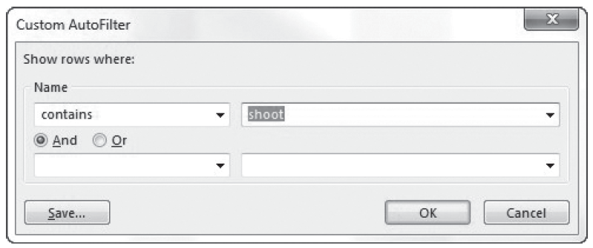
Step by Step: Create and Apply a Filter in a View
3. Click the AutoFilter arrow in the Task Name column heading and point to Filters, then click Custom. . . . The Custom AutoFilter dialog box appears. You want to see just the tasks that contain the letter-string of “shoot”, so you need to set up the Custom AutoFilter this way.
4. In the Name section, select contains from the dropdown list in the first box if it is not already visible. In the adjacent box, type shoot. The Custom AutoFilter dialog box should look similar to the figure below.

Slide 32
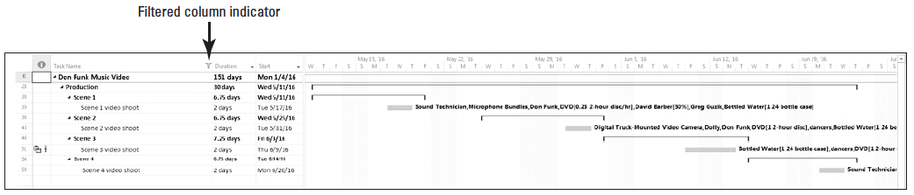
Step by Step: Create and Apply a Filter in a View
5. Click the OK button to apply the filter and close the Custom AutoFilter dialog box. Microsoft Project filters the task list to show only the tasks that contain the word “shoot”, as well as their summary tasks. Your screen should look similar to the figure below. Note on the right side of the Task Name column there is a small “funnel” that appears. This is a visual indicator that an AutoFilter has been applied to this column in this view.

Slide 33
Step by Step: Create and Apply a Filter in a View
6. On the ribbon, click the down-arrow in the Filter box in the Data group, (currently has No Filter) and then select Clear Filter. The AutoFilter is cleared and all the tasks in the project schedule are displayed.
7. SAVE the project schedule.
PAUSE. LEAVE the project schedule open to use in the next exercise.
Notes:
Another Way: You can also use the F3 key to clear all filters.

Slide 34
Step by Step: Create and Apply a Filter in a View
In this exercise, you created and applied a filter to the project schedule to enable you to look at only the tasks dealing with scene shoots.
A filter is a tool that enables you to see or highlight in a table only the task or resource information that meets criteria you choose.
Filtering doesn’t change the data in your project schedule–it only changes the data’s appearance.
There are two ways to apply filters to a view: predefined filters or an AutoFilter.

Slide 35
Step by Step: Create and Apply a Filter in a View
Predefined or custom filters allow you to see or highlight only the task or resource information that meets the criteria of the filter. For example, the Milestones filter displays only tasks that are milestones.
Some predefined filters, such as the Date Range filter, require you to enter criteria (a date) to set up the filter.
Notes:
Take Note: If a task or a resource sheet view has a filter applied to it, the name of the filter will be displayed in the Filter box on the View ribbon.

Slide 36
Step by Step: Create and Apply a Filter in a View
AutoFilters are used for more informal or impromptu filtering.
An AutoFilter is a quick way to view only the task or resource information that meets the criteria you choose.
When the AutoFilter feature is turned on, small down arrows are visible adjacent to the column heading name.
Clicking the arrow activates a list of criteria that can be used to filter the data. The criteria are appropriate for the type of data in the column.

Slide 37
Step by Step: Create and Apply a Filter in a View
Stop Here
You can also apply multiple column filters. For example, you want to display all tasks that are more than one week in duration, and starts between 2/1/16 and 3/30/16.
You would apply an AutoFilter of “1 week or longer” to the duration column and then apply an AutoFilter of “Between” 2/1/16 and 3/30/16 to the start column.

Slide 38
Creating a Custom Filter
In the previous exercise, you used AutoFilter to apply a filter to the data of interest.
Now, you will create a custom filter that can be used without entering the filtering criteria each time.

Slide 39
Step by Step: Create a Custom Filter
USE the project schedule you created in the previous exercise.
1. On the View ribbon, click the down-arrow in the Filter box in the Data group, (currently has No Filter), then select More Filters. The More Filters dialog box appears. This dialog box shows you all of the predefined filters for tasks or resources that are available to you.
2. Click the New button. The Filter Definition dialog box appears.
3. In the Name box, type Unfinished Shoots.
Notes:
Another Way: You can also click the down-arrow in the (No Filter) box in the Data group and then select New Filter.

Slide 40
Step by Step: Create a Custom Filter
4. In the first row of the Field Name column, type or select Name.
5. In the first row of the Test column, type or select contains.
6. In the first row of the Value(s) column, type shoot. You have now finished entering the first criterion for the filter. Next you will enter the second criterion.
7. In the second row of the And/Or column, select And.
8. In the second row of the Field Name column, type or select Actual Finish.
9. In the second row of the Actual finish column, type or select equals.

Slide 41
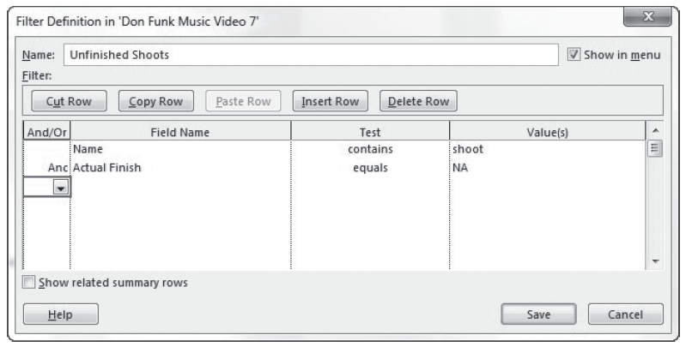
Step by Step: Create a Custom Filter
10. In the second row of the Value(s) column, type NA. “NA” is how Microsoft Project marks fields that do not yet have a value. In other words, any shooting task that does not yet have a value must be uncompleted. Your screen should look similar to the figure below.

Slide 42
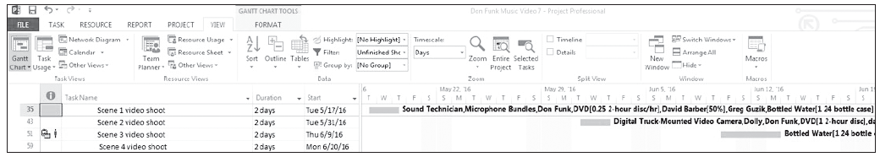
Step by Step: Create a Custom Filter
11. Click the Save button to close the Filter Definition dialog box.
12. Locate and select the Unfinished Shoots filter in the list, if necessary. Click the Apply button. Microsoft Project applies the new filter to your project schedule in the Gantt Chart view. Your screen should look similar to the figure below.
Notes:
Take note of the gaps in the task IDs. This is one visual way you can tell that a filter has been applied. The tasks are filtered to show uncompleted tasks (and since you haven’t started tracking actual work yet, all the shooting tasks are currently uncom- pleted). Also note that the related summary tasks have not been displayed. This is because we did not tell the filter to display them.

Slide 43
Step by Step: Create a Custom Filter
13. On the View ribbon, click the down-arrow in the Filter box in the Data group, (currently has Unfinished Shoots%I%) and then select [No Filter]. Microsoft Project removes the filter.
14. SAVE the project schedule. CLOSE the project schedule.
PAUSE. If you are continuing to the next lesson, keep Project open. If you are not continuing to additional lessons, CLOSE Project.
In this exercise, you learned how to create and apply a custom filter.

Slide 44
Step by Step: Create a Custom Filter
A custom filter works in the same way as a predefined filter, except that you have selected the filtering criterion rather than Microsoft Project.
Remember that after filtering, you might see gaps in the task or resource ID numbers.
The data has not been deleted–it is only hidden until you remove the filter.
Also, as with sorting and grouping, the filtering applies to all the tables you can display in the active view.
Some views that do not support tables, such as the Calendar view, do support filtering but not AutoFilters.

Slide 45
Skill Summary

