Slide 1
Project Schedule Tracking Fundamentals
Microsoft Project 2013
Lesson 9

Slide 2
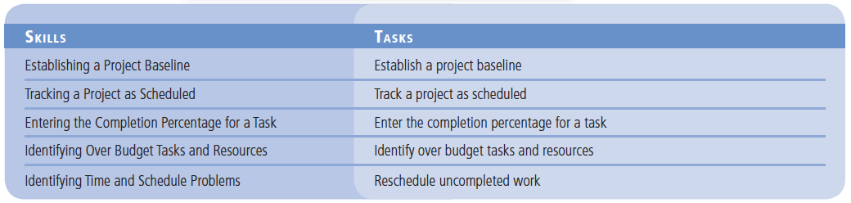
Objectives

Slide 3
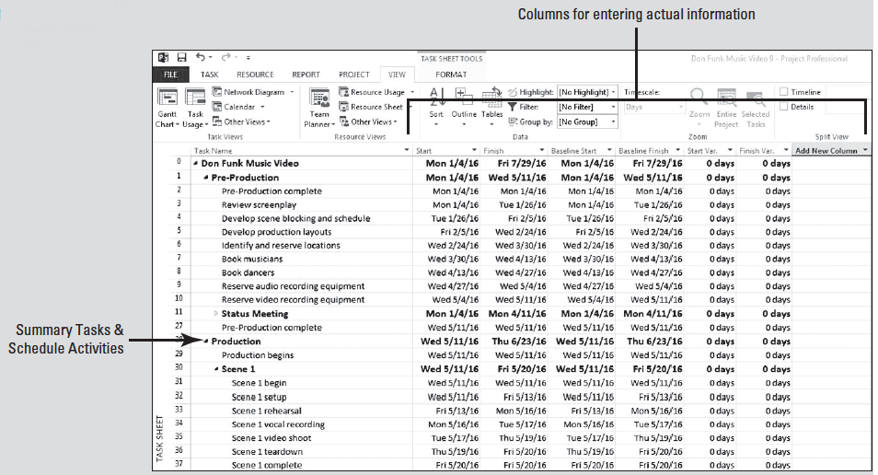
Software Orientation
The Variance Table can be used to review baseline information in table format.

Slide 4
Software Orientation
On the Variance Table, you can also see the variance between the baseline start and the planned or actual start of a task. In other words, this table shows you if the project is ahead of schedule or behind schedule, on a task-by-task basis.

Slide 5
Establishing a Project Baseline
In order to evaluate how well a project is progressing, it is important to review how well it was originally planned.
The schedule baseline is the project schedule that has been approved by the project sponsor.
The baseline is saved and then referred to later to track project progress.
In project management, by definition, a baseline is the approved version of the scope, schedule and budget of a project.
In Microsoft Project, a baseline is a “snap-shot” of these key values, such as the planned start and finish dates (schedule), planned costs (budget) and the tasks (scope), at a given point in time.

Slide 6
Step by Step: Establish a Project Baseline
GET READY. Before you begin these steps, launch Microsoft Project.
1. OPEN the Don Funk Music Video 9M project schedule from the data files for this lesson.
2. SAVE the file as Don Funk Music Video 9 in the solutions folder for this lesson as directed by your instructor.
3. Click the Project tab. In the Schedule group, click the Set Baseline button and then select Set Baseline.
4. The Set Baseline dialog box appears. You will accept all of the default settings in this dialog box by clicking OK. Microsoft Project saves the baseline, although there is no indication in the Gantt Chart view that anything has changed. In the next few steps, you will explore some of the changes caused by saving the baseline.
Notes:
Cross Ref: You will go deeper into the Set Baseline dialog box in Lesson 11.
Take Note: You can save up to eleven baselines in a single project schedule. The baselines are named Baseline (the first baseline you would normally save) and Baseline 1 through Baseline 10. Saving multiple baselines is helpful if your project duration is especially long or if you have approved scope/schedule changes. You can save multiple baselines to record different sets of baseline values and later compare these against each other and against actual values.

Slide 7
Step by Step: Establish a Project Baseline
5. On the ribbon, click the View tab and then click the down-arrow under Gantt Chart. Select More Views, and the More Views dialog box appears.
6. In the More Views box, select Task Sheet and click Apply. Using this view, there is more room to see the fields in the table because the Gantt Chart is not shown. Now you will switch to a different table in the Task Sheet view.
7. On the ribbon, click Tables, and then click Variance. The Variance table appears. This table includes both the Scheduled and Baseline columns so that you can compare them easily. Your screen should look similar to the figure on the next slide.

Slide 8
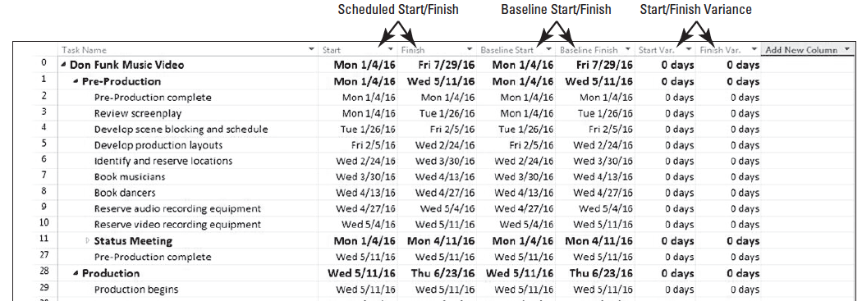
Step by Step: Establish a Project Baseline
Note that at this point, the values in the Start and Baseline Start, as well as the values in the Finish and Baseline Finish, are identical. This is because no actual work has occurred and no changes to the scheduled work have been made. Once actual work has been recorded or schedule adjustments have been made, the scheduled values may differ from the baseline values. Any differences would be displayed in the Variance column.
Notes:
Troubleshooting: If any column displays pound signs (####), double-click between the column titles to widen the column.

Slide 9
Step by Step: Establish a Project Baseline
8. SAVE the project schedule.
PAUSE. LEAVE Project open to use in the next exercise.
In this exercise, you learned how to save a baseline for your project schedule.
You must save a baseline before you begin tracking project progress.
The table on the following slide lists the specific values saved in the baseline, which include the task, resource, and assignment fields, as well as the timephased fields–task, resource, and assignment values distributed over time.

Slide 10
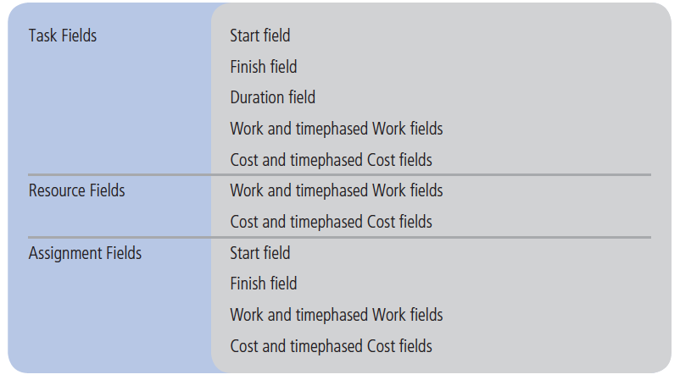
Step by Step: Establish a Project Baseline

Slide 11
Step by Step: Establish a Project Baseline
You should save a baseline when:
You have developed the project schedule as much as possible. (You can still add tasks, resources, or an assignment after the work has begun. This is usually not avoidable.)
Your project has been approved and accepted by the project sponsor.
You have not started to enter actual values, such as a percentage of completion for the task.

Slide 12
Step by Step: Establish a Project Baseline
The first phase of a project focuses on project planning—developing and communicating the details of a project before actual work begins.
When work begins, so does your next phase of project management: tracking project progress.
Tracking refers to all of the collecting, entering, and analyzing of actual project performance data, such as actual work values on tasks (usually expressed in hours), actual resource costs, and actual durations.
These details, collectively, are often called actuals and can be recorded in a Microsoft Project file.

Slide 13
Step by Step: Establish a Project Baseline
Accurately tracking project performance and comparing it against the baseline helps you to answer questions such as:
Are tasks starting and finishing as planned? If not, what will be the impact on the finish date?
Are resources completing the proper amount of the scope? Are they doing unapproved work (scope creep)?
Are resources requiring more or less than the scheduled amount of time to complete tasks?
Are tasks being completed above or below scheduled cost?

Slide 14
Step by Step: Establish a Project Baseline
There are several ways to track progress in Microsoft Project, depending on the level of detail or control required by you, the stakeholders, and the project sponsor—the individual or organization that provides financial support and supports the project team within the larger organization.
Because tracking requires more work from you and possibly from the resources working on the project, you need to determine the level of detail you need.
In this lesson, we will examine the following different levels of tracking:

Slide 15
Step by Step: Establish a Project Baseline
Project work as scheduled. This works best if everything in the project occurs exactly as it was scheduled.
Record each task’s percentage of completion. You can do this at precise values or at increments such as 25%, 50%, 75%, and 100%.
Record the actuals. The actual start, actual finish, actual work, and actual and remaining duration for each task or assignment are recorded.
Track assignment-level work by time period. You record actual work values by day, week, or other time interval that you select. This is the most detailed level of tracking. This is rarely used as a method of tracking project progress as it is too costly and time consuming for the added benefit of detailed information.
You can apply a combination of these approaches within a single project, as different parts of a project may have different tracking needs.

Slide 16
Tracking a Project as Scheduled
Once a baseline has been saved for a project schedule, the work done on the project can be tracked against the baseline values.
The simplest approach to tracking is to report that the actual work is proceeding as planned.
You record project actuals by updating work to the current date.

Slide 17
Step by Step: Track a Project as Scheduled
USE the project schedule you created in the previous exercise.
1. On the ribbon, click Gantt Chart. The Gantt Chart view appears.
2. Move the vertical divider bar to a point just to the right of the Start column.
3. Click on the Project tab, and then click Update Project in the Status group. The Update Project dialog box appears.
4. Make sure the Update work as complete through option is selected. In the adjacent date box, type or select February 12, 2016, and then click OK. Microsoft Project records the actual work for the tasks that were scheduled to start before February 12. It also draws progress bars in the Gantt bars for those tasks to show this progress visually.

Slide 18
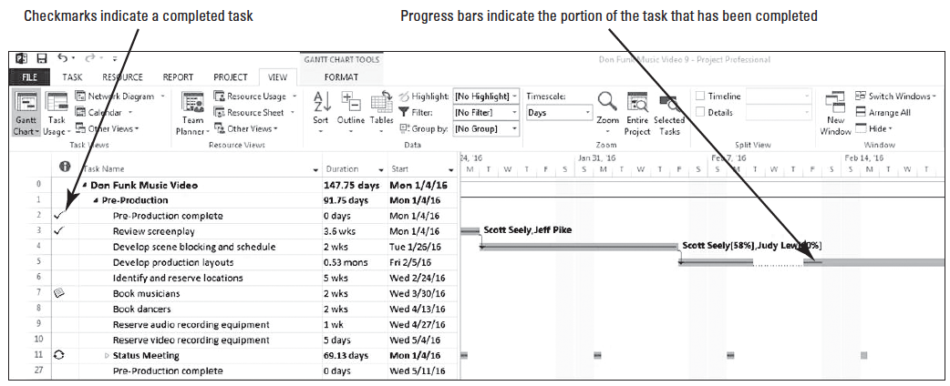
Step by Step: Track a Project as Scheduled
5. Select the name of task 5, Develop production layouts. Click the Task tab, and then click Scroll to Task in the Editing group. Your screen should look similar to the figure below.
6. SAVE the project schedule.
PAUSE. LEAVE the project schedule open to use in the next exercise.

Slide 19
Step by Step: Track a Project as Scheduled
In this exercise, you updated the project to show that work had occurred as scheduled through a certain date.
This date is sometimes called the data date or status date—the date up to or through which all progress information is collected and entered for a project.
The progress bar in the Gantt Chart view shows how much of each task has been completed.

Slide 20
Step by Step: Track a Project as Scheduled
A check mark appears in the Indicators column for tasks 2 and 3 to indicate these tasks have been completed.
In addition, a progress bar is drawn through the entire length of these tasks’ Gantt bars.
Because only a portion of task 5 has been completed by February 12, the progress bar for this task only extends to February 12, and no check mark appears in the Indicators column.
Also notice that because some of the recurring status meetings have been completed by February 12, progress bars appear in the summary Gantt bars for these tasks.

Slide 21
Entering the Completion Percentage for a Task
As you continue to make progress on your project, it is important to record the work that has been done on a task.
There are many ways to record this work. One of the quickest ways is to record the completion percentage of the task.

Slide 22
Step by Step: Enter the Completion Percentage for a Task
USE the project schedule you created in the previous exercise.
1. Click the View tab, click the Tables button, and then select the Work table from the list.
2. Slide the vertical divider bar between the table and the Gantt bar chart so that more of the table columns are visible. You may need to auto fit the columns to see all the data. Notice the Work and % Work Complete columns. You will enter task completion percentages in the % Work Complete column.
3. In the % Work Complete column for Task 5, type or select 100, and then [press Enter]. Microsoft Project extends the progress bar through the length of the Gantt bar for task 5 and records the actual work for the task as scheduled.

Slide 23
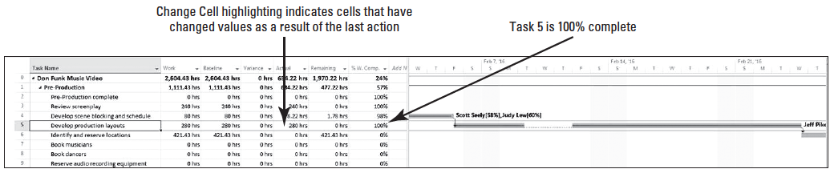
Step by Step: Enter the Completion Percentage for a Task
4. Select Task 5 again. On the ribbon, click Selected Tasks in the Zoom group. Your screen should look similar to the figure below.
Notes:
Take Note: You can also use the schedule percent complete buttons to quickly update tasks that are 0%, 25%, 50%, 75%, and 100% complete. The schedule percent complete buttons are located in the Schedule group on the Task tab. Select the task you want to update, and then click the appropriate percentage button.

Slide 24
Step by Step: Enter the Completion Percentage for a Task
5. In the % Work Complete field for Task 6, type or select 50, and then [press Enter]. Microsoft Project records the actual work for the task as scheduled, calculates the remaining work, and then updates the progress line through 50% of the Gantt bar.
6. Scroll the Gantt Chart to see the Gantt bar for Task 6.
7. SAVE the project schedule.

Slide 25
Step by Step: Enter the Completion Percentage for a Task
8. CLOSE the project schedule. In the next exercise, you will use an updated version of the Don Funk Music Video 9 project schedule to simulate the passage of time.
PAUSE. LEAVE Microsoft Project open to use in the next exercise.
Notes:
Take Note: You can view a task’s completion percentage and other tracking information by pointing to a progress bar in a task’s Gantt bar. A ScreenTip will appear.

Slide 26
Step by Step: Enter the Completion Percentage for a Task – start here on tues
There are several ways you can quickly record task progress as a percentage:
Use one of the % complete fields in either the Work or Tracking tables.
Use the preset buttons for recording 0%, 25%, 50%, 75%, and 100% completion on a task.
Use the Update Tasks dialog box (on the Task ribbon, click the down-arrow to the right of the Mark on Track button, and then click Update Tasks).
Use the General tab of the Task Information dialog box (by double-clicking the task you want to update) to update the Percent Complete field.

Slide 27
Step by Step: Enter the Completion Percentage for a Task
Using the last two methods, you can also enter any percentage you want.
When you use any of these methods to enter a percentage other than 0% complete, Microsoft Project changes the task’s actual start date to match its scheduled start date. It also calculates actual duration, remaining duration, actual costs, and other values, based on the percentage you enter.
In deciding to use “percent complete” as a method of tracking progress, understand that there are four types of percent complete:
Physical % Complete: based on some physical measurement. For example, if you are constructing a two-mile road, and you complete one mile of it, you are physically 50% complete.

Slide 28
Step by Step: Enter the Completion Percentage for a Task
Work % Complete: based on the planned amount of work. For example, if you planned to spend 10,000 hours of effort building a two mile road, and you spent 4000 hours to build the first mile, you are only 40% work % complete, even though you are 50% physically complete.
Cost % Complete: based on the approved budget. For example, if the total approved budget for a two-mile road was $468,000, and you have spent $140,000 to build the first mile, you are only about 29.9% cost % complete, even though you have completed half of the total road.
Schedule % Complete: based on planned duration. For example, if a two-mile road project was planned for 120 days, and you built the first mile in 30 days, you are 25% schedule % complete, even though you have completed half the total road.

Slide 29
Identifying Over-Budget Tasks and Resources
So far, you have focused on a project’s schedule as a key part of the overall success of the project.
However, another critical piece of information is the cost variance, or how the actual costs compare to the projected costs.

Slide 30
Step by Step: Identify Over-Budget Tasks and Resources
GET READY. To identify Over- Budget Tasks and resources, perform the following steps.
1. OPEN the Don Funk Music Video 9MA project schedule.
2. SAVE the file as Don Funk Music Video 9A.
3. On the ribbon, click the Project tab, and then click Project Information in the Properties group. The Project Information Dialog box appears.

Slide 31
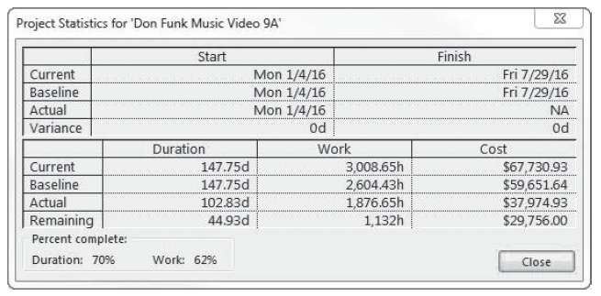
Step by Step: Identify Over- Budget Tasks and Resources
4. Click the Statistics button. The Project Statistics dialog box appears. Your screen should look similar to the figure below.

Slide 32
Step by Step: Identify Over- Budget Tasks and Resources
The Cost column displays the current, baseline, actual, and remaining cost values for the entire project.
The current cost is the sum of the actual and remaining (estimated) cost values.
The baseline cost is the total planned (estimated) cost of the project when the baseline was saved.
The actual cost is the cost that has been incurred so far (after the indicated total work has been completed).
The remaining cost is the difference between the current cost and actual cost.

Slide 33
Step by Step: Identify Over- Budget Tasks and Resources
It is obvious that some cost variance has occurred, but it is not possible to tell from the Project Statistics dialog box when or where the variance occurred.
5. Click the Close button. The Project Statistics dialog box closes.
6. On the ribbon, click View. Click the Tables button and then click Cost. The Cost table appears in the Task Sheet view. Move the vertical divider so you can see all the available columns. Take a moment to review the columns in the Cost table. Note that although costs are not scheduled in the same sense that work is scheduled, costs (except fixed costs) are derived from the scheduled work.
Notes:
Another Way: To change the table, you can also right-click on the upper left corner of the active table and click Cost in the short-cut menu that appears.

Slide 34
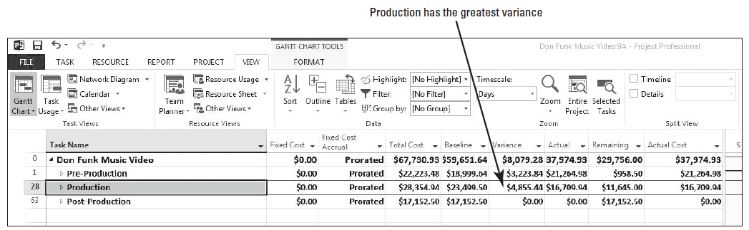
Step by Step: Identify Over- Budget Tasks and Resources
7. Click the Task Name column heading. Click the Outline button in the Data group, and then select Level 1. Microsoft Project collapses the task list to display only the first level of summary tasks (which in this case correspond to the major phases of the project). Your screen should look similar to the figure below.

Slide 35
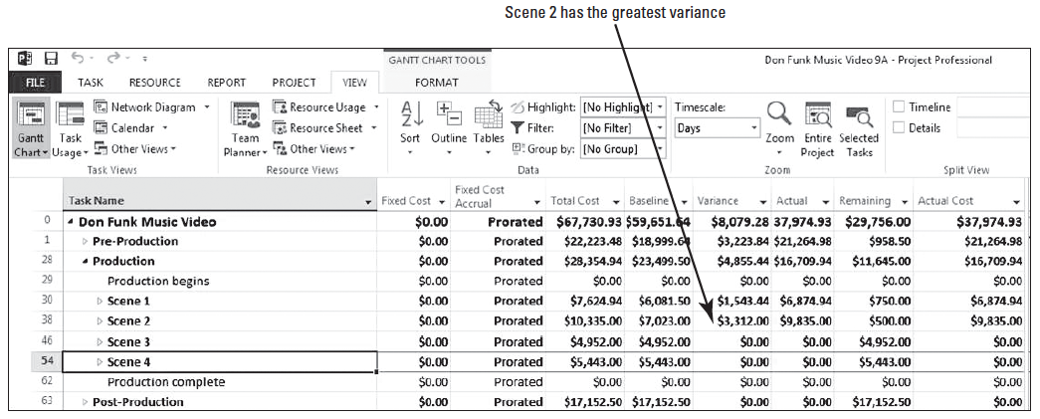
Step by Step: Identify Over- Budget Tasks and Resources
8. Click the expand button next to Task 28, Production. Using the collapse button, hide the subtasks for scenes 1 through 4. Your screen should look similar to the figure below. Although Scenes 1 and 2 both had some variance, Scene 2 had the greater variance, so you will focus on that scene.

Slide 36
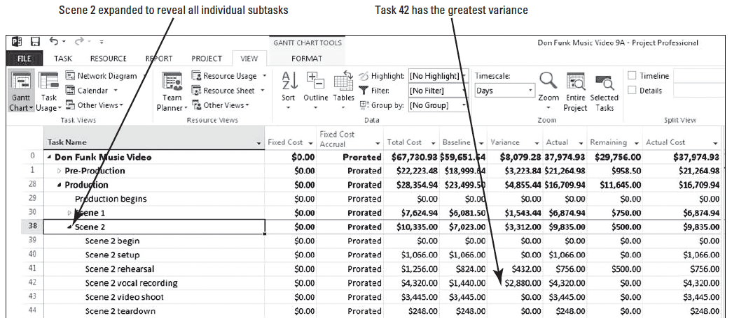
Step by Step: Identify Over- Budget Tasks and Resources
9. Click the expand button next to summary Task 38, Scene 2. Microsoft Project expands the Scene 2 summary task to show all of the subtasks. Your screen should look similar to the figure below.
10. Click the Task Name column heading.
Notes:
Take note of the variance column. It shows that most of the Scene 2 variance can be tracked to Task 42, Scene 2 vocal recording.

Slide 37
Step by Step: Identify Over- Budget Tasks and Resources
11. Click the Outline button and then select Show Subtasks button on the Formatting toolbar. Microsoft Project expands all of the summary tasks to show all of the tasks in the project.
12. On the View ribbon, in the Data group, click the down-arrow next to the Filter: selection box. Select More Filters from the list. The More Filters dialog box appears.
Notes:
Another way to look for tasks that are over budget is with a filter.

Slide 38
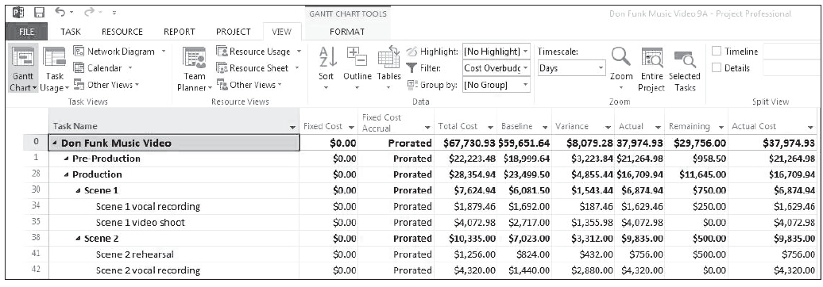
Step by Step: Identify Over- Budget Tasks and Resources
13. Select the Cost Overbudget filter and click Apply. Microsoft Project applies the filter to the task list to show only those tasks that had actual and scheduled costs greater than their baseline costs. Your screen should look similar to the figure below.
14. SAVE the project schedule.

Slide 39
Step by Step: Identify Over- Budget Tasks and Resources
15. CLOSE the project schedule. In the next exercise, you will use an updated version of the Don Funk Music Video 9 to simulate the passage of time.
PAUSE. LEAVE Microsoft Project open to use in the next exercise.
Project managers and stakeholders often focus on the project schedule (Did tasks start and finish on time?). For projects such as this one that include cost information, cost variance is another critical indicator of overall project health.
In Microsoft Project, evaluating cost variance enables you to make incremental budget adjustments for individual tasks to avoid exceeding your project’s overall budget.

Slide 40
Identifying Time and Schedule Problems
In complex projects, it is very likely that there will be some schedule variance.
The project manager must control the project by identifying, understanding, and correcting the problem.

Slide 41
Step by Step: Reschedule Uncompleted Work
GET READY. To reschedule uncompleted work, perform the following tasks:
1. OPEN the Don Funk Music Video 9MB project schedule from the data files for this lesson.
2. SAVE the file as Don Funk Music Video 9B in the solutions folder for this lesson as directed by your instructor.

Slide 42
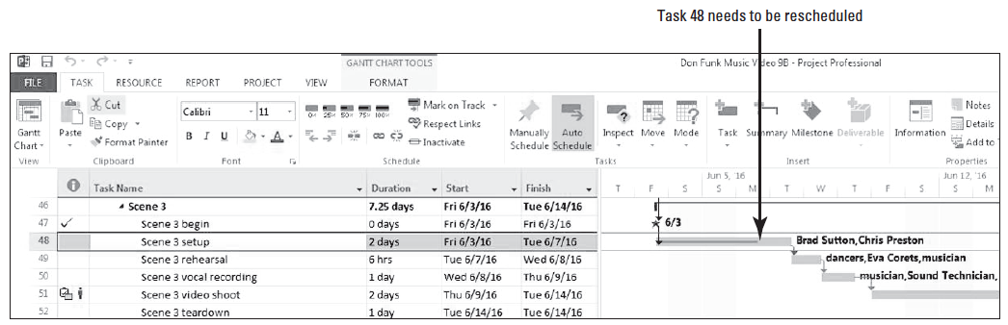
Step by Step: Reschedule Uncompleted Work
3. [Press the F5 key]. Type 46 in the ID box, and then click OK. The Gantt Chart view scrolls to display the Gantt bar for Task 46, Scene 3. At this point in the project, the first two scheduled scenes have been completed. This task has one day of actual work completed and one day of scheduled work remaining. Your screen should look similar to the figure below.

Slide 43
Step by Step: Reschedule Uncompleted Work
You have just been informed that late on the afternoon of June 6, a lightning strike caused a nearby electrical transformer to short-circuit and repairs will not be completed until Thursday, June 9. You will not be able to resume work in the studio until Friday, June 10.
5. On the ribbon, click the Project tab, and then click Update Project. The Update Project dialog box appears.
6. Select the Reschedule uncompleted work to start after: option, and in the date box type or select 06/09/16.

Slide 44
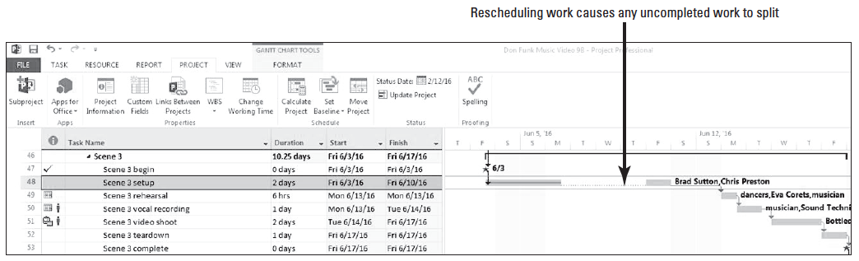
Step by Step: Reschedule Uncompleted Work
7. Click OK to close the Update Project dialog box. Microsoft Project splits Task 48 so that the incomplete portion is delayed until Friday, June 10. Your screen should look similar to the figure below. Note that although the duration of Task 48 remains at two days, its finish and subsequent start dates for successor tasks have been pushed out. Remember that duration is the number of work periods required to complete a task, not elapsed time.
Notes:
Take Note: It is possible to disable the ability of Microsoft Project to reschedule uncompleted work on tasks that are showing any actual work. Click the File tab then select Options. In the Options dialog box, click the Schedule tab. In the section that reads Scheduling options for this project, clear the Split in-progress tasks check box.

Slide 45
Step by Step: Reschedule Uncompleted Work
8. SAVE the project schedule. CLOSE the project schedule.
PAUSE. If you are continuing to the next lesson, keep Project open. If you are not continuing to additional lessons, CLOSE Project.
Depending upon the length and complexity of your project, as a project manager you may see one or many of these types of interruptions.
When you reschedule incomplete work, you specify the date after which work can resume.
Microsoft Project handles tasks in relation to the scheduled restart date in the following ways:
If the task does not have any actual work recorded for it prior to the rescheduled date and there is no constraint in place, the entire task is rescheduled to begin after that date.

Slide 46
Step by Step: Reschedule Uncompleted Work
If the task has some actual work recorded prior to but not after the rescheduled date, the task is split so that all remaining work starts after the rescheduled date. The actual work is not affected.
If the task has some actual work recorded for it prior to as well as after the rescheduled date, the task is not affected.
Keep in mind that when you address a problem by rescheduling a task, you may create other issues or problems in the remainder of the project. This is why project management is an iterative process: a change in one part of the schedule–be it a time, cost, or scope change–can, and usually does, affect the schedule elsewhere.
When changing or correcting the schedule due to unforeseen delays, such as the scenario in this exercise, you should also place a note in the notes field of the affected task(s) stating why the task has been changed. These become helpful when looking for explanations regarding why the project is not performing to the baseline.

Slide 47
Skill Summary

