Slide 1
Advanced Project Schedule Tracking
Microsoft Project 2013
Lesson 11

Slide 2
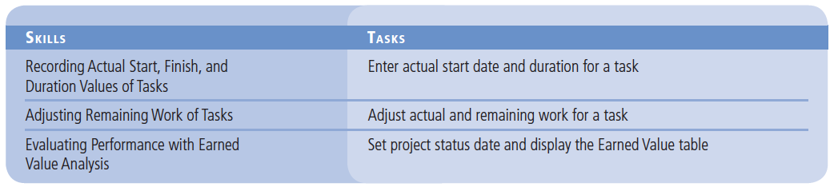
Objectives

Slide 3
Software Orientation
The Earned Value table displays several schedule indicator and cost indicator values that are useful in measuring the project’s progress and forecasting its outcome through earned value analysis.

Slide 4
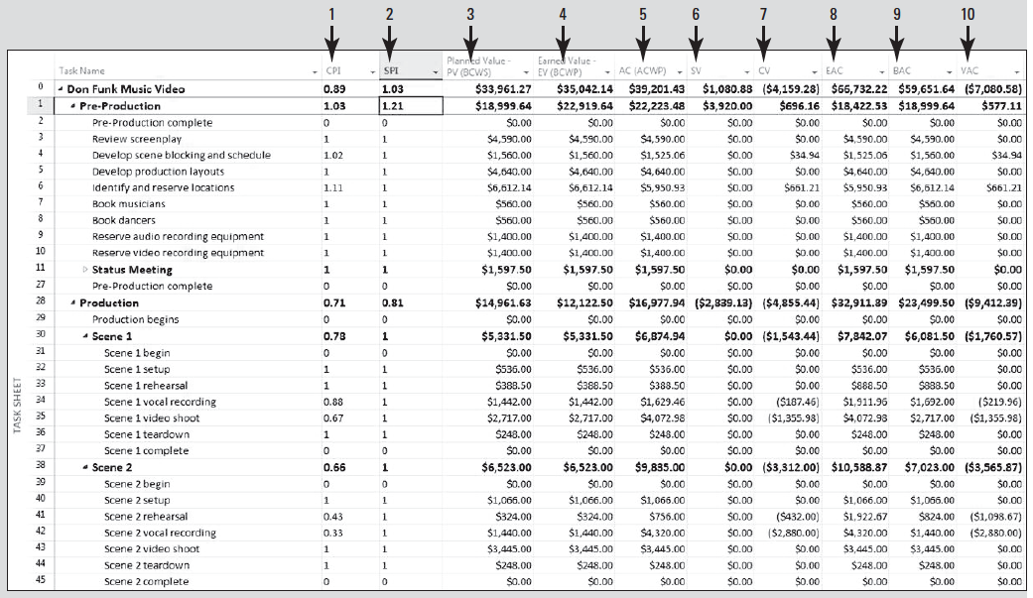
Software Orientation

Slide 5
Software Orientation
The columns in the Earned Value table are:
CPI–Cost Performance Index, the ratio of budgeted to actual cost—calculated as EV divided by AC. EV/AC
2. SPI–Schedule Performance Index, the ratio of performed to scheduled work—calculated as EV divided by PV. EV/PC
3. Planned Value-PV (or BCWS–budgeted cost of work scheduled)—the value of the work scheduled to be completed as of the status date.

Slide 6
Software Orientation
The columns in the Earned Value table are:
4. Earned Value-EV (or BCWP–budgeted cost of work performed)—the portion of the budgeted cost that should have been spent to complete each task’s actual work performed up to the status date.
5. AC–(ACWP) Actual Cost–the actual cost incurred to complete each task’s actual work up to the status date.

Slide 7
Software Orientation
6. SV–Schedule Variance, the difference between the budgeted cost of work performed and the budgeted cost of work scheduled.
BCWP(4) – BCWS(3)
EV(4) – PV(3)
7. CV–Cost Variance, the difference between the budgeted and actual cost of work performed.
BCWP(4) – ACWP(5)
EV(4) – AC(5)

Slide 8
Software Orientation
8. EAC–Estimate at Completion, the expected total cost of a task based on performance up to the status date.
9. BAC–Budget at Completion, the total planned cost.
10. VAC–Variance at Completion, the difference between the BAC (Budgeted at Completion) or baseline cost and EAC (Estimated at Completion). BAC - EAC
Once the details of the project schedule have been finalized and work has started, the project manager can begin to track progress on the project by recording actual start, finish, and duration values.

Slide 9
Step by Step: Enter Actual Start Date and Duration for a Task
GET READY. Before you begin these steps, launch Microsoft Project.
1. OPEN the Don Funk Music Video 11MA project schedule.
2. SAVE the file as Don Funk Music Video 11A.
3. Navigate to and select Task 7, Book musicians. On the Task ribbon, click the Scroll to Task button. Assume this Task started one day ahead of schedule, so you need to record this.

Slide 10
Step by Step: Enter Actual Start Date and Duration for a Task
4. On the ribbon, click the down-arrow next to the Mark on Track button and select Update Tasks. The Update Tasks dialog box appears.
5. Under the Actual label, in the Start box, type or select March 25, 2016.
6. In the Actual dur box, type or select 2w, and then click OK to close the Update Tasks dialog box.

Slide 11
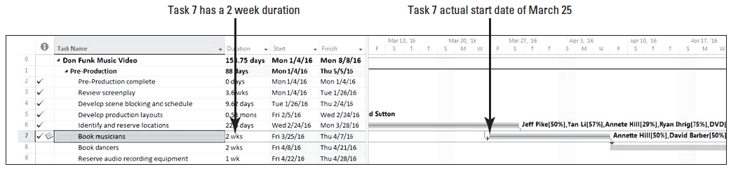
Step by Step: Enter Actual Start Date and Duration for a Task
7. The Planning Wizard dialog box appears. Select Continue. Allow the scheduling conflict. Click OK. Microsoft Project records the actual start date and work for Task 7. Your screen should look similar to the figure below.
8. In the Task Name column, select the name of Task 8, Book dancers. You need to record that Task 8 started on time but took three days longer to complete.

Slide 12
Step by Step: Enter Actual Start Date and Duration for a Task
9. On the ribbon, click the down-arrow next to the Mark on Track button and select Update Tasks. The Update Tasks dialog box reappears.
10. In the Actual dur box, key 13d, and then click OK. The Planning Wizard dialog box appears again. Select Continue. Allow the scheduling conflict. Click OK.

Slide 13
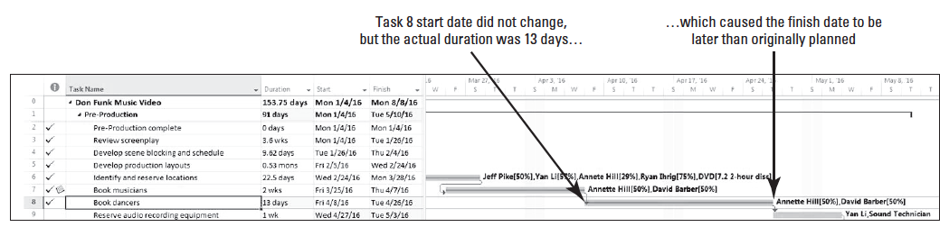
Step by Step: Enter Actual Start Date and Duration for a Task
11. Click the Scroll to Task button or scroll so that the Gantt bar for Task 8 is visible in the center of the Gantt Chart. Your screen should look similar to the figure below.
Microsoft Project records the actual duration of the task. Microsoft Project assumes that the task started as scheduled because you did not specify an actual start date. However, the actual duration that you entered causes Microsoft Project to calculate a finish date that is later than the originally scheduled finish date.

Slide 14
Step by Step: Enter Actual Start Date and Duration for a Task
Next you will record that Task 9 was completed as scheduled and that task 10 took longer than scheduled to complete.
12. In the Task Name column, select the name of Task 9, Reserve audio recording equipment.
13. On the ribbon, click the 100% Complete button in the schedule group. Microsoft Project updates Task 9 as 100% complete.
14. In the Task Name column, select the name of Task 10, Reserve video recording equipment. Click the down-arrow next to the Mark on Track button and select Update Tasks. The Update Tasks dialog box reappears.

Slide 15
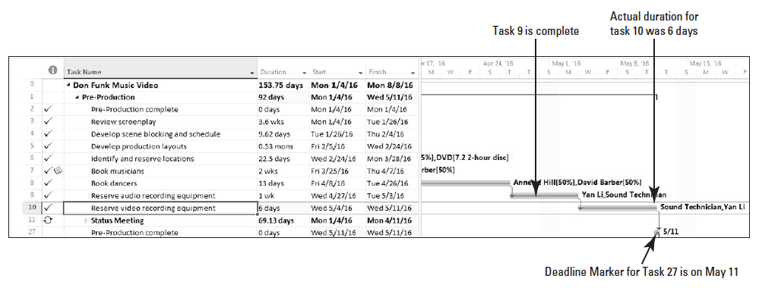
Step by Step: Enter Actual Start Date and Duration for a Task
15. In the Actual duration box, type or select 6d, and then click OK. Microsoft Project records the actual duration of the task.
16. On the ribbon, click the Scroll to Task button. Microsoft Project scrolls the Gantt bar chart so that the bar for Task 10 is visible. Your screen should look similar to the figure below. You can see that the Pre-Production phase of the Don Funk Music Video project has met its deadline of May 11, 2016.

Slide 16
Step by Step: Enter Actual Start Date and Duration for a Task
17. SAVE the project schedule, and then CLOSE the file.
PAUSE. LEAVE Project open to use in the next exercise.
In this exercise, you entered actual start dates and durations for several tasks. Remember, as you learned in Lesson 9, tracking actuals is essential to a well-managed project.
As the project manager, you need to know how well the project team is performing and when to take corrective action.

Slide 17
Step by Step: Enter Actual Start Date and Duration for a Task
When you enter actual start, finish, or duration values, Microsoft Project updates the schedule and calculates the task’s percentage of completion. When doing this, Microsoft Project uses the following rules:
When you enter a task’s actual start date, different from its planned start date, Microsoft Project recalculates the scheduled finish date.
When you enter a task’s actual finish date, Microsoft Project moves the scheduled finish date to match the actual finish dates and assigns a completion percentage of 100%.
When you enter an actual duration for a task that is less than the scheduled duration, Microsoft Project subtracts the actual duration from the scheduled duration to determine the remaining duration.

Slide 18
Step by Step: Enter Actual Start Date and Duration for a Task
When you enter a task’s actual duration that is equal to the scheduled duration, Microsoft Project sets the task to 100% complete.
When you enter an actual duration for a task that is longer than the scheduled duration, Microsoft Project adjusts the scheduled duration to match the actual duration and sets the task to 100%.
Evaluating the status of a project is not always easy or straightforward. Keep in mind the following issues:

Slide 19
Step by Step: Enter Actual Start Date and Duration for a Task
For many tasks, it is difficult to evaluate a percentage of completion. For example, when is a design engineer 75% finished designing a new production process, or a computer engineer 50% finished coding a new software upgrade? Often, reporting work in progress is a best guess and therefore carries an inherent risk.
The portion of a task’s duration that has elapsed does not always equate to a percentage accomplished. For example, a front-loaded task might require a lot of effort initially, so that when 50% of its duration has elapsed, much more than 50% of its total work will have been completed.
The resources assigned to a task might have different criteria for what determines the task’s completion than does the project manager–or the resources assigned to successor tasks.

Slide 20
Step by Step: Enter Actual Start Date and Duration for a Task
To avoid or minimize these and other problems that arise in project implementation, a good project manager needs to carry out good project planning and communication.
Determining how you will track project progress is a decision made during planning, and this information will be clearly communicated to all team members.
No matter how much planning is done, projects almost always have variance from the baseline.

Slide 21
Step by Step: Adjust Actual and Remaining Work for a Task
While tracking actual values, it is also possible to adjust the work or duration remaining on a task.
GET READY. You will now use an updated version of the Don Funk Music Video project to simulate the passage of time.
1. OPEN the Don Funk Music Video 11MB project schedule.
2. SAVE the file as Don Funk Music Video 11B.

Slide 22
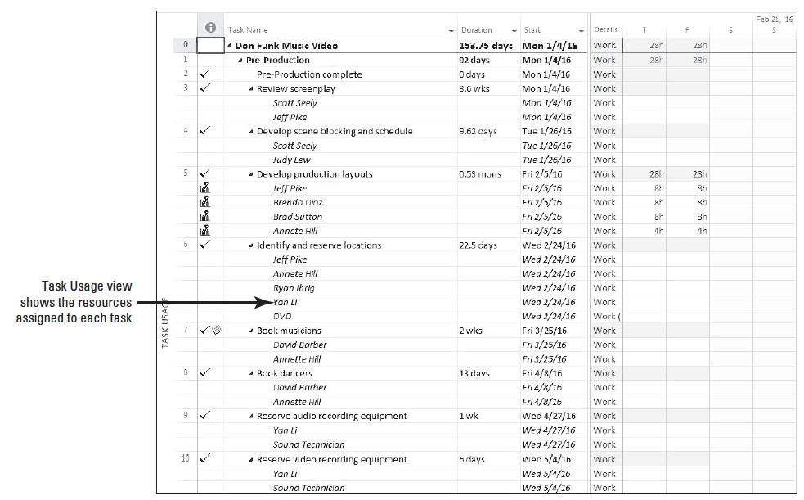
Step by Step: Adjust Actual and Remaining Work for a Task
3. Click on the View tab, and then click Task Usage. The Task Usage view appears. Your screen should look similar to the figure at right.
4. [Press the F5 key.] In the ID box, type 40, and then click OK. Microsoft Project scrolls the time-scaled portion of the view to display the scheduled work information for task 40.

Slide 23
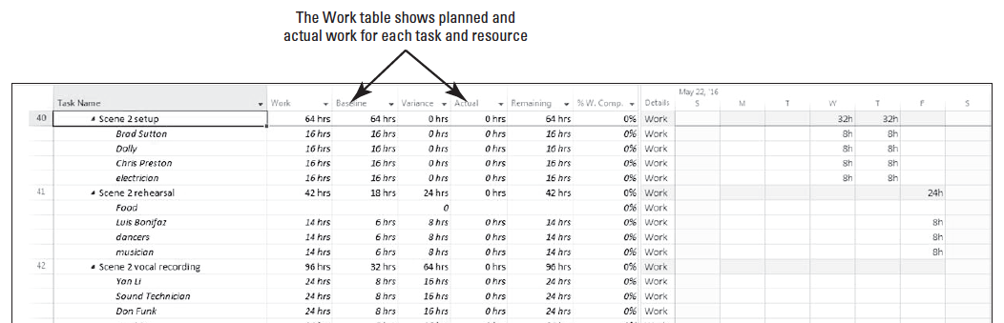
Step by Step: Adjust Actual and Remaining Work for a Task
5. On the ribbon, click the Tables button and select the Work table. Microsoft Project displays the Work table in the Task Usage view.
6. Click and drag the vertical divider bar between the Work table and the Task Usage grid to the right until you can see all the columns in the Work table. Your screen should look similar to the figure below.
Notes:
Take Note: The mouse pointer changes to a two-headed arrow (pointing left and right) when it is in the correct position to drag the vertical divider bar.

Slide 24
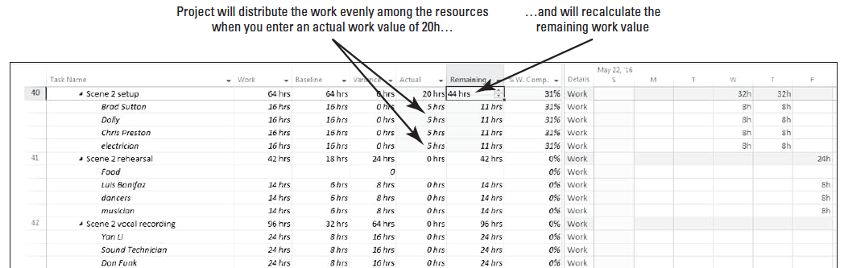
Step by Step: Adjust Actual and Remaining Work for a Task
7. In the Actual column for Task 40, type 20h, and then [press Tab]. Change highlighting (the light blue shaded cells) shows that several things have occurred. Because you entered the actual work at the task level, Microsoft Project distributed it equally among the assigned resources. Also, the remaining work value is recalculated. Your screen should look similar to the figure below.

Slide 25
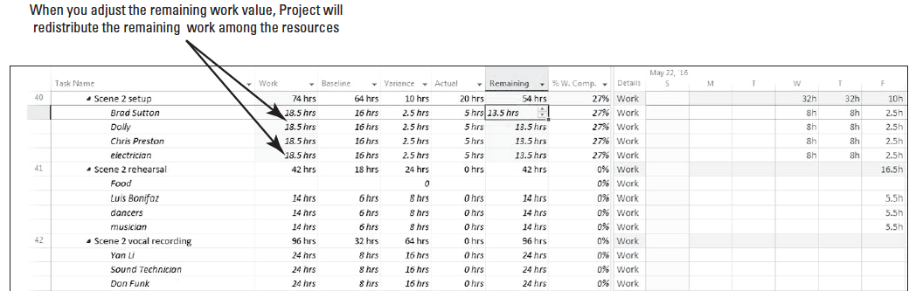
Step by Step: Adjust Actual and Remaining Work for a Task
8. In the Remaining column for Task 40, type 54h and [press Enter]. Notice that the new remaining work value was equally distributed among the assigned resources. Your screen should look similar to the figure below.
9. SAVE the project schedule.
PAUSE. LEAVE Project open to use in the next exercise.

Slide 26
Step by Step: Adjust Actual and Remaining Work for a Task
In addition to adjusting work, as you track actuals you can also adjust duration and start and finish dates. Remember that only an incomplete task can have a remaining work or duration value. For example:
A task that was scheduled for 40 hours is partially completed. The resources have performed 30 hours of work and expect to finish the entire task after working 6 more hours.
As you learned in this lesson, you would enter 30 hours of actual work and 6 hours of remaining work using the Work table.

Slide 27
Step by Step: Adjust Actual and Remaining Work for a Task
A task that was scheduled for four days duration is partially complete. Two days have elapsed, and the resources working on the task estimate they will need three additional days to complete the task.
You can enter the actual and remaining duration via the Update Tasks dialog box (on the Task ribbon, select the down-arrow next to Mark on Track, and then click Update Tasks).

Slide 28
Step by Step: Adjust Actual and Remaining Work for a Task
It is important to remember that whenever you enter actual work values, Microsoft Project calculates actual cost values, by default, and you are not able to enter actual costs directly.
If you want to enter actual cost values yourself, click the File tab, then select Options, then click the Schedule option. In the section under Calculation, set the option to OFF.
In the section for Calculation options for this project, deselect the option that reads Actual costs are always calculated by Project.

Slide 29
Step by Step: Adjust Actual and Remaining Work for a Task end of part 1
Once you turn off automatic calculation, you can enter or import task-level or assignment-level actual costs in the Actual Cost field.
This field is available in several locations, such as the Cost table.
You can also enter actual cost values on a daily or any other interval in any usage view, such as the Task Usage view.
Exercise caution, though, any time you enter costs manually: entering actual costs for tasks or assignments prevents Microsoft Project from calculating costs based on resource rates and task progress.

Slide 30
Evaluating Performance with Earned Value Analysis
Earned value analysis is used to measure a project’s progress in terms of both schedule and cost as well as to help predict its outcome.
Earned value can be used on any project, in any industry, to objectively track project progress.

Slide 31
Step by Step: Set Project Status Date and Display the Earned Value Table
USE the project schedule (11B) you created in the previous exercise.
1. Click the View tab. In the Task Views group select Other Views then select Task Sheet.
2. Click the Project tab. Click the calendar icon in the Status date field.
3. In the Select date box, type or select 6/30/16, and then click OK.
4. Click the View tab. Click the Tables button then select More Tables. The More Tables dialog box appears.

Slide 32
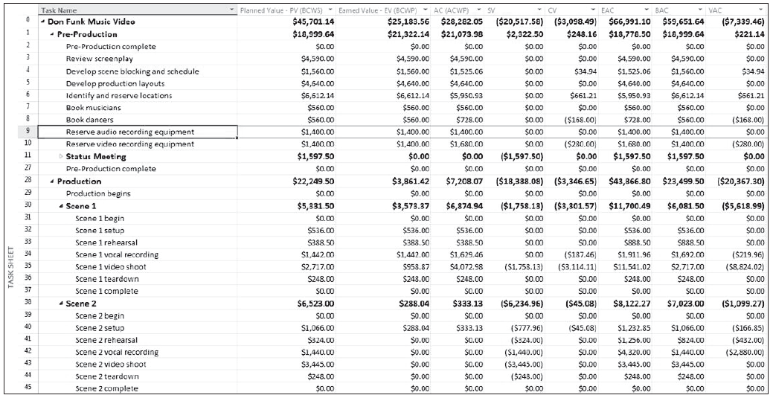
Step by Step: Set Project Status Date and Display the Earned Value Table
5. In the Tables list, select Earned Value, and then click Apply. Microsoft Project displays the Earned Value table in the Task Sheet view. If necessary, double-click between column headings to display all values. Your screen should look like the figure below.
Notes:
Take Note: To see more information about any field, point to the column heading, and read the ToolTip that appears. Press the F1 key for additional information.

Slide 33
Step by Step: Set Project Status Date and Display the Earned Value Table
6. Right-click the name of the Planned Value–PV column and select Insert Column.
7. Key SPI and [press Enter]. Microsoft Project displays the SPI column in the Earned Value table.
8. Right-click the name of the SPI column and select Insert Column.
9. Key CPI and [press Enter]. Microsoft Project displays the CPI column in the Earned Value table.

Slide 34
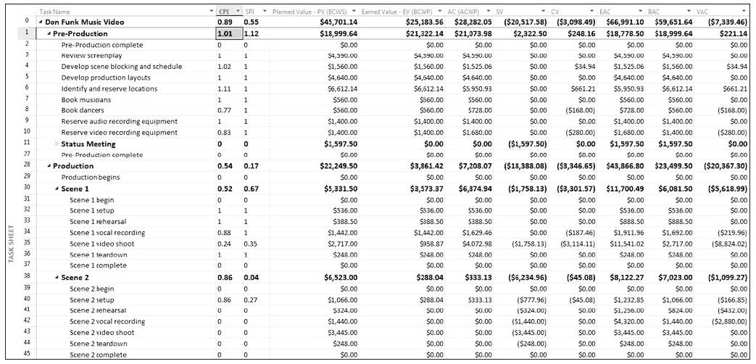
Step by Step: Set Project Status Date and Display the Earned Value Table
10. Auto-fit the two columns you just added to the table. Your screen should look similar to the figure below.
11. SAVE the project schedule.

Slide 35
Step by Step: Set Project Status Date and Display the Earned Value Table
PAUSE. LEAVE Project and your project schedule open so that you can refer to it as you are reading the exercise discussion later in the text.
In this exercise, you set the project status date, displayed the Earned Value table and added the Cost Performance Index (CPI) and the Schedule Performance Index (SPI) columns.
The status date is the date you want Microsoft Project to use when calculating the earned value numbers.
Looking at task and resource variance throughout a project’s duration is a key project management activity.
Unfortunately, variance does not give you the true picture of a project’s long-term health. For example, a task might be over-budget and ahead of schedule (possibly not good) or over-budget and behind schedule (definitely not good).

Slide 36
Step by Step: Set Project Status Date and Display the Earned Value Table
Looking at schedule and budget variance by themselves does not tell you very much about performance trends that may continue throughout the project.
Instead, earned value analysis gives you a more complete picture of overall project performance in relation to both time and cost.
Earned value analysis is used to measure the project’s progress and help forecast its outcome. It focuses on schedule and budget performance in relation to baseline plans.

Slide 37
Step by Step: Set Project Status Date and Display the Earned Value Table
The key difference between earned value analysis and simpler budget/schedule analysis can be thought of in this way:
“What are the current performance results we are getting?” is the question answered by simple variance analysis.
“Are we getting our money’s worth for the current performance results we are getting?” is the question answered by earned value analysis.
Although the difference is subtle, it is important. Earned value analysis allows you to look at project performance in a more detailed way. It allows you to identify two important things: the true cost of project results to date, and the performance trend that is likely to continue for the rest of the project.

Slide 38
Step by Step: Set Project Status Date and Display the Earned Value Table
Review the project schedule and steps you performed in this exercise. In order for Microsoft Project to calculate the earned value amounts for a project schedule, you must first do the following:
Save a baseline so that Microsoft Project can calculate the budgeted cost of the work scheduled before you start tracing actual work. (The baseline was already saved when you opened the file for this lesson.)
Record actual work on tasks or assignments. (You did this in previous exercises in this lesson.)
Set the status date so that Microsoft Project can calculate actual project performance up to a certain point in time. If you do not specify a status date, Microsoft Project uses the current date.

Slide 39
Step by Step: Set Project Status Date and Display the Earned Value Table
Earned value analysis uses the following three key values to generate all other schedule indicator and cost indicator values:
The planned value (PV) or budgeted cost of work scheduled (BCWS). This is the value of the work scheduled to be completed as of the status date. Microsoft Project calculates this value by adding up all the time-phased baseline values for tasks up to the status date.
The actual cost (AC) or actual cost of work performed (ACWP) is the actual cost incurred to complete each task’s actual work up to the status date.

Slide 40
Step by Step: Set Project Status Date and Display the Earned Value Table
The earned value (EV) or budgeted cost of work performed (BCWP). This is the portion of the budgeted cost that should have been spent to complete each task’s actual work performed up to the status date. This value is called earned value because it is literally the value earned by the work performed.
The earned value schedule and the cost variances are directly related. The earned value cost indicator fields are in one table. The earned value schedule indicators are in another table. A third table combines the key fields of both schedule and cost indicators.
Using the above key values, Microsoft Project can also calculate some other important indicators of project performance:

Slide 41
Step by Step: Set Project Status Date and Display the Earned Value Table
The project’s cost variance, or CV, is the difference between the earned value and the actual cost.
The project’s schedule variance, or SV, is the difference between the earned value and the planned value.
It might seem strange to think of being ahead of or behind schedule in terms of dollars. However, keep in mind that dollars buy work, and work drives tasks to be completed. You will find that viewing both cost and schedule variance in the same unit of measure makes it easier to compare the two, as well as other earned value numbers that are also measured in dollars.

Slide 42
Step by Step: Set Project Status Date and Display the Earned Value Table
Finally, there are two other earned value numbers that are very helpful indicators:
The Cost Performance Index, or CPI, is the ratio of earned value to actual cost, or EV (BCWP) divided by AC (ACWP).
The Schedule Performance Index, or SPI, is the ratio of earned value to planned value, or EV (BCWP) divided by PV (BCWS).

Slide 43
Step by Step: Set Project Status Date and Display the Earned Value Table
The CPI and SPI allow you to evaluate a project’s performance and compare the performance of multiple projects in a consistent way. In the Don Funk Music Video, the CPI and SPI provide information about each task and phase in the project and about the project as a whole:
The CPI for the Don Funk Music Video project (as of the status date) is .97. You can interpret this as for every dollar’s worth of work that has been paid for, 97 cents worth of work was actually accomplished.
The SPI for the Don Funk Music Video project (as of the status date) is .98. This can be interpreted as that for every dollar’s worth of work that was planned to be accomplished, 98 cents worth of work was actually accomplished. You can also look at this as schedule efficiency, that is, you are progressing at 98% of your planned schedule.

Slide 44
Step by Step: Set Project Status Date and Display the Earned Value Table
Although the SPI and CPI are slightly different for the Don Funk Music Video project, keep in mind that these ratios can change as work is completed and other factors change.
Earned value analysis is one of the more complicated things you can do in Microsoft Project, but it provides very valuable project status information. This illustrates why it is a good idea to enter task and resource cost information into a project schedule any time you have it.

Slide 45
Skill Summary

