Slide 1
Integrating Microsoft Project with Other Programs
Microsoft Project 2013
Lesson 12

Slide 2
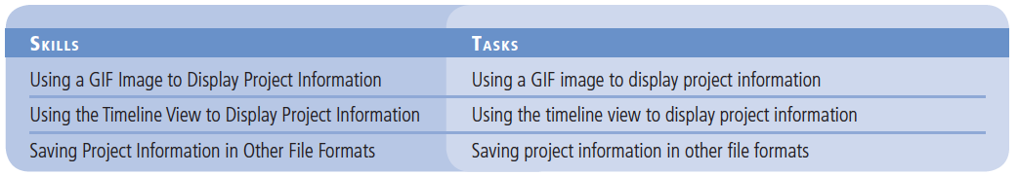
Objectives

Slide 3
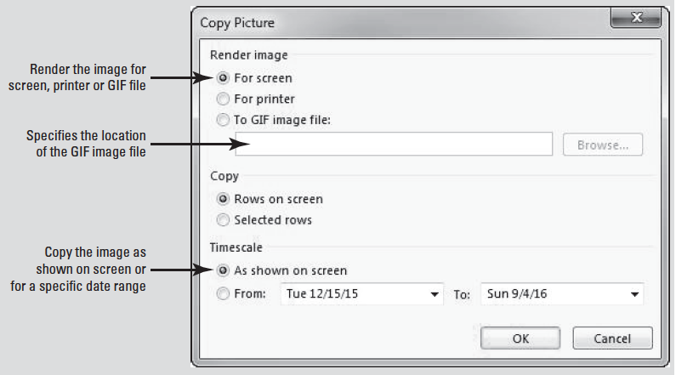
Software Orientation
The Copy Picture feature enables you to copy images and create snapshots of a view.
In the Copy Picture dialog box, you can render the image for screen, printer, or to a GIF file. You can also copy the entire view visible on the screen or just selected rows of a table, as well as a specified range of time.

Slide 4
Using a GIF Image to Display Project Information
It is often useful to copy project information from Microsoft Project into other programs and formats in order to communicate project details to stakeholders.

Slide 5
Step by Step: Use a Gif Image to Display Project Information
GET READY. Before you begin these steps, launch Microsoft Project.
1. OPEN the Don Funk Music Video 12M project schedule from the data files for this lesson.
2. SAVE the file as Don Funk Music Video 12 in the solutions folder for this lesson as directed by your instructor.
3. On the ribbon, click the View tab. Point to the Filter selection box, click the down-arrow and then select Summary Tasks. Microsoft Project filters the Gantt Chart to show only summary tasks.

Slide 6
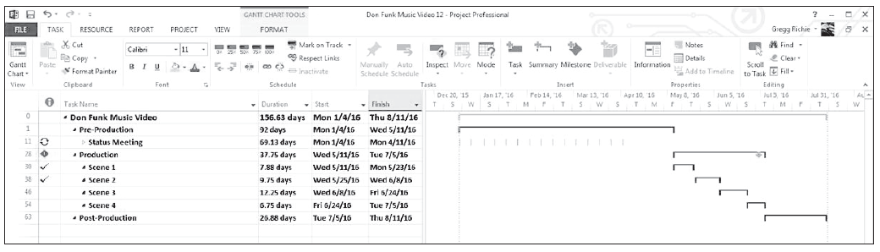
Step by Step: Use a Gif Image to Display Project Information
4. On the ribbon, in the Zoom group, click Entire Project. Your screen should look similar to the figure below.
5. Click the Task tab, and then click the down-arrow next to the Copy button. Select the Copy Picture button. The Copy Picture dialog box appears.

Slide 7
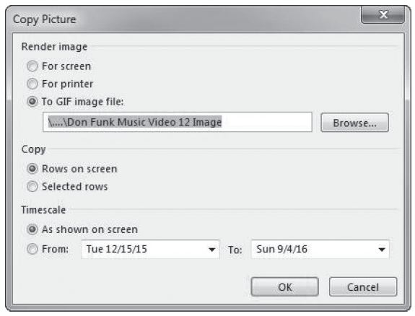
Step by Step: Use a Gif Image to Display Project Information
6. In the Copy Picture dialog box, under the Render image label, click To GIF image file. The Microsoft Project default suggests that you save the file in the same location as the practice file and with the same name, except with a GIF extension. (Save your file as Don Funk Music Video 12 Image in the location specified by your instructor.) Your screen should look similar to the figure above.

Slide 8
Step by Step: Use a Gif Image to Display Project Information
7. Click OK to close the Copy Picture dialog box. The GIF image is saved.
8. Open Microsoft Word and begin with a blank document. Click the Insert tab and then select Picture(s).
Notes:
Take Note: When you take a snapshot of a view, the Copy Picture dialog box enables you to select how you want to render the image. The first two options, for screen and for printer, copy the image to the Windows clipboard. The To GIF image file option enables you to save the image as a GIF file.

Slide 9
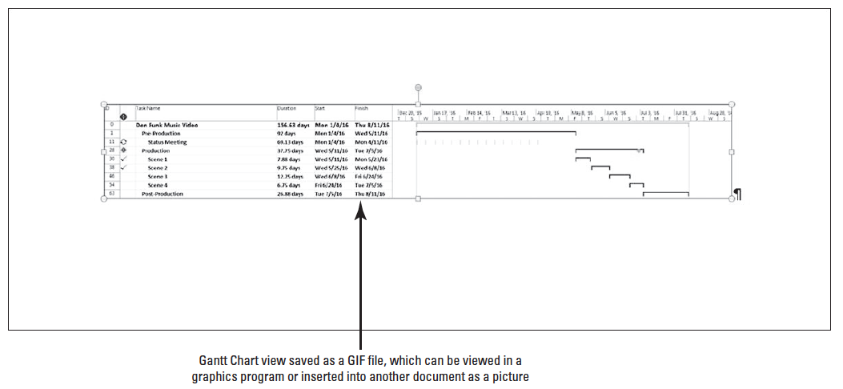
Step by Step: Use a Gif Image to Display Project Information
9. Locate the GIF image named Don Funk Music Video 12 Image in the location where your instructor directed you to save it earlier. Select the GIF image, and then click Insert. Your screen should look similar to the figure below.
Notes:
Troubleshooting: The Copy Picture feature is unavailable when a form view, such as the Task Form or Relationship Diagram view, is displayed.

Slide 10
Step by Step: Use a Gif Image to Display Project Information
10. CLOSE the program you used to display the GIF file without saving the changes. If the view does not automatically return to Microsoft Project, select Don Funk Music Video 12 from the Project button at the bottom of your screen.
11. SAVE the project schedule.
PAUSE. LEAVE Project open to use in the next exercise.
Notes:
Take Note: In addition to saving GIF images of views in Microsoft Project, you can also save Microsoft Project data as an XML file for publishing to the Web or to an intranet site.

Slide 11
Step by Step: Use a Gif Image to Display Project Information
In this exercise, you made a copy of a view in Microsoft Project to display in another program.
As you learned in previous lessons, communicating project details to resources, managers, and other stakeholders is a very important part of being a successful project manager.
Making a copy of parts of your project to share with stakeholders is one way to effectively communicate your progress.
Microsoft Project supports the standard copy and paste functionality of most Microsoft Windows programs. As you saw in this exercise, it also has an additional feature, called Copy Picture, which enables you to take a snapshot of a view.

Slide 12
Step by Step: Use a Gif Image to Display Project Information
With Copy Picture, you have several options when taking snapshots of the active view:
You can copy the entire view that is visible on the screen, or just selected rows of a table in a view.
You can copy a range of time that you specify or show on the screen.
With either of these options, you can copy onto the Windows Clipboard an image that is optimized for pasting into another program for onscreen viewing (such as in Microsoft PowerPoint) or for printing (such as Microsoft Word). As you did in this exercise, you can also save the image to a Graphics Interchange Format (GIF) file. Once you save the image to a GIF file, you can then use it in any program that supports the GIF format. You can also use it with HTML content on a Web page.

Slide 13
Using the Timeline View to Display Project Information
There are times when you may need to present high-level information from a project schedule in order to communicate an overview to stakeholders.
While there are several methods and options available to transfer text and graphic images, Microsoft Project’s new feature called the Timeline View can present high-level information clearly.

Slide 14
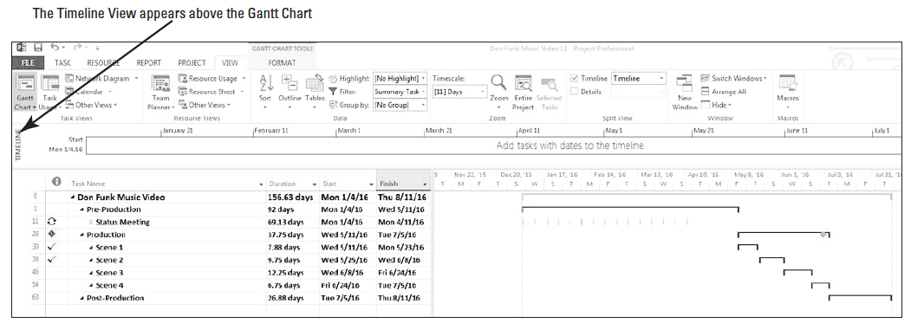
Step by Step: Use the Timeline View to Display Project Information
USE the project schedule you created in the previous exercise.
1. Click the View tab. In the Split View group, select the check box next to Timeline. The Timeline view appears above the Gantt Chart view. Your screen should look like the figure below. The Timeline View appears above the Gantt Chart.

Slide 15
Step by Step: Use the Timeline View to Display Project Information
2. Select all visible summary tasks. Place your cursor on the selected cells and right-click. From the menu, select Add to Timeline. Note that the Status meetings were not added to the timeline.

Slide 16
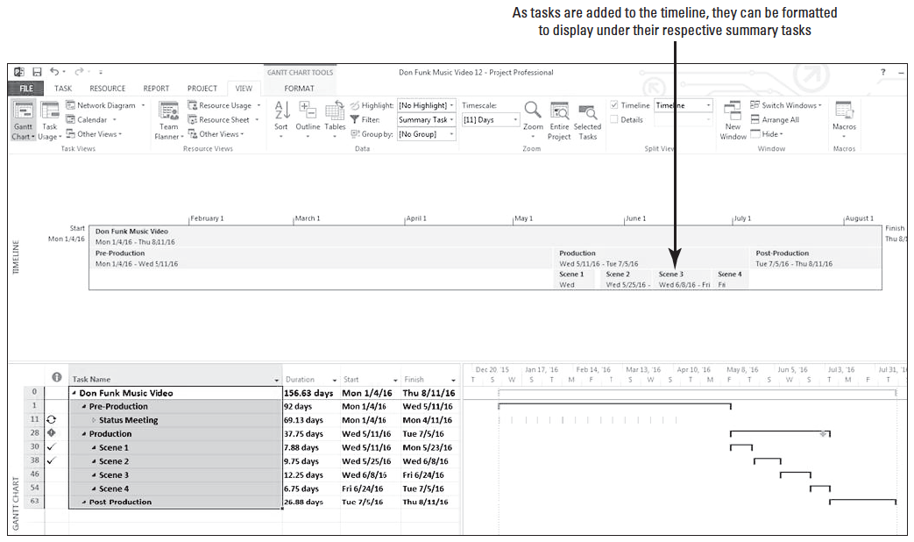
Step by Step: Use the Timeline View to Display Project Information
3. You will be formatting the Timeline view area. Use your mouse to expand the timeline area in a similar way you move the vertical divider bar between the Gantt Chart and the table area. Your screen should look like the figure above.
Notes:
Another Way: You can use the Existing Tasks button to add or remove tasks from the timeline.

Slide 17
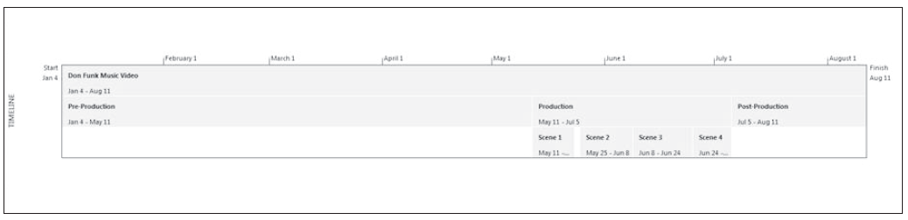
Step by Step: Use the Timeline View to Display Project Information
4. Click in the Timeline view area to activate that window. Click the Format tab under the Timeline Tools tab.
5. Note that the dates listed for each of the Scene Summary tasks are not completely visible. On the ribbon, in the Show/Hide group, click the down-arrow for the Text Lines: box and select 2.
6. On the ribbon, select the Date Format button. From the list, select the option that displays date in Month/Day format. Your screen should look like the figure below.

Slide 18
Step by Step: Use the Timeline View to Display Project Information
7. Depending on your screen resolution, Scenes 1 and 4 may still not show the starting and ending dates. On the Timeline, click the Scene 1 box. Then on the ribbon, in the Current Selection group, click Display as Callout.
8. Repeat step 7 for Scene 4. By default, Microsoft Project displays the tasks above the Timeline. Notice now the dates are visible.
9. Place your cursor on the Scene 1 task box above the Timeline and then drag it to below the timeline.

Slide 19
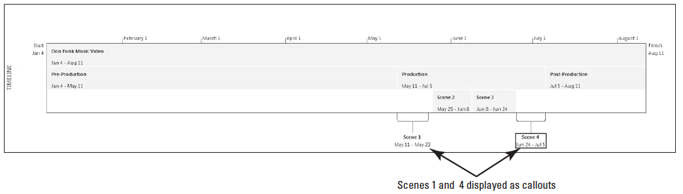
Step by Step: Use the Timeline View to Display Project Information
10. Repeat step 9 for Scene 4. Your screen should look similar to the figure below.
11. Now that you have the timeline formatted and displaying the information you want, you will copy it for presentation. On the ribbon, select the Copy Timeline button. From the list, select For Presentation.

Slide 20
Step by Step: Use the Timeline View to Display Project Information
12. Open Microsoft PowerPoint. Start with a new blank presentation. Right-click the first slide and select Layout. From the list, select Blank.
13. Insert the timeline view you just copied by [pressing Ctrl-V] or clicking the Paste button on the Home ribbon.
14. CLOSE the PowerPoint document without saving the changes.
Notes:
Take Note: You can also paste the image into an e-mail message or a variety of other types of documents.

Slide 21
Step by Step: Use the Timeline View to Display Project Information
15. In Microsoft Project, click the View tab. On the ribbon, clear the check box for the Timeline view. Microsoft removes the split window with the Timeline area.
16. [Press the F3 key] to clear the Summary Tasks filter.
17. SAVE the project schedule.
PAUSE. LEAVE Project open to use in the next exercise.
In this exercise, you made a snapshot of a Timeline view and pasted the image into a blank PowerPoint presentation that you are preparing for Don Funk’s agent.

Slide 22
Step by Step: Use the Timeline View to Display Project Information
In general, you can copy and paste data to and from Microsoft Project using the various copy and paste commands in Microsoft Project (Copy, Copy Picture, Copy Cell, Paste, Paste Special, etc.).
When you copy data from Microsoft Project, you can choose one of two options to achieve your desired results:
You can copy text (such as task names or dates) from a table and paste it as text into the destination program. Using a Copy command enables you to edit data in the destination program.
You can copy a graphic image of a view from Microsoft Project and paste it as a graphic image in the destination program (as you did in this exercise). You can create a graphic image of a view or part of a view using the Copy Picture command. Using the Copy Picture command results in an image that can only be edited with a graphics editing program (such as Microsoft Paint).

Slide 23
Step by Step: Use the Timeline View to Display Project Information
When you paste data into Microsoft Project from other programs, you also have two options to achieve your desired results:
You can paste text (such as a task list) into a table in Microsoft Project. For example, you could paste a series of resource names that are organized in a vertical column from Microsoft Excel to the Resource Name column in Microsoft Project.
You can paste a graphic image or an OLE object from another program into a graphical portion of a Gantt Chart view; to a task, resource, or assignment note; to a form view, such as the Task form view; or even to the header, footer, or legend of a view or report.
Notes:
Take Note:OLE is a protocol that allows you to transfer information, such as a chart or text (as an OLE object), to documents in different programs.

Slide 24
Step by Step: Use the Timeline View to Display Project Information
Be careful when pasting text as multiple columns.
First, make sure that the order of the information in the source program matches the order of columns in the Microsoft Project table. (You can rearrange the order of the columns in the source program to match the order of the columns in Microsoft Project or vice versa.)
Second, make sure that the columns in the source program support the same type of data as do the columns in Microsoft Project (text, currency, numbers, etc.).
Notes:
Cross Ref: For more information about printing views and reports, go back to Lesson 9.

Slide 25
Saving Project Information In Other File Formats
You can import/export information from your project schedule from/to sources outside Microsoft Project.
You can import/export in XML format, as a Microsoft Database file, or import/export directly from/to Excel.
By using import/export maps to specify how the data will be used, Microsoft Project prepares the data for either importing or exporting.

Slide 26
Step by Step: Save Project Information in Other File Formats
USE the project schedule you created in the previous exercise.
You have been asked to provide project cost information to the accounting department, which does not have or use Microsoft Project. You need to provide task level details on planned cost and actual costs for your project in Microsoft Excel format.
1. On the View ribbon, in the Task Views group, click the Other Views button, and then click More Views. The More Views dialog box appears.
2. In the dialog box, locate and select the Task Sheet view. Click the Apply button.

Slide 27
Step by Step: Save Project Information in Other File Formats
3. Click the Tables button and select the Cost table.
4. Click the File tab and select Save as. (Save your file in the location specified by your instructor.)
5. Click the down-arrow next to the Save as type: box and select Excel Workbook.
6. In the Filename: box, key Music Video Task Costs. Then click the Save button. The Export Wizard appears.
7. Click the Next button. The Export Wizard–Data page appears. Ensure Selected Data is selected.
8. Click the Next button. The Export Wizard–Map page appears. The Export Wizard uses maps to organize the way that data is structured when exporting from Microsoft Project.

Slide 28
Step by Step: Save Project Information in Other File Formats
9. Make sure that New Map is selected, and then click the Next button. The Export Wizard–Map Options page appears.
10. Select the Tasks check box. Make sure that the Export includes headers check box is also selected. (Headers means column headings, in this case.)
11. Click the Next button. The Export Wizard–Task Mapping page appears. This is where you select the table that will be used for the export and specify how you want to map the data from the source worksheet to the fields in Microsoft Project.

Slide 29
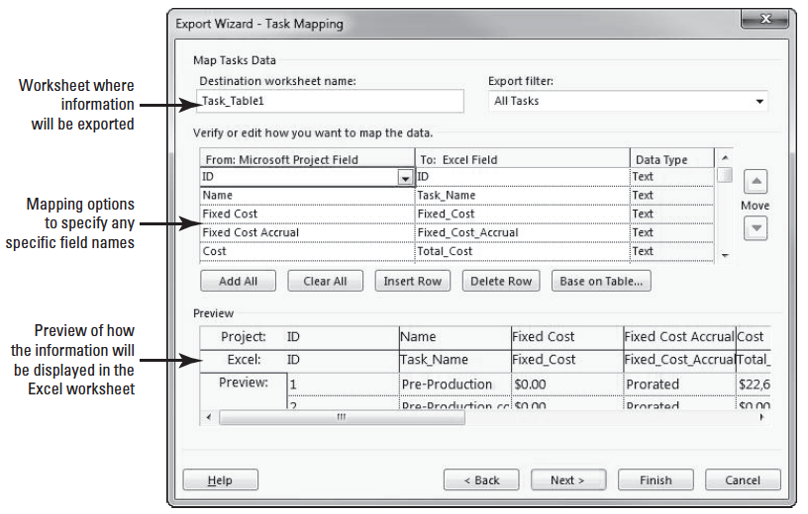
Step by Step: Save Project Information in Other File Formats
12. In the dialog box, select the Base on Table button. Microsoft Project displays a list of tables in the project file. Select the Cost table and click OK. Microsoft Project uses the column (field) names from the cost table, and then suggests the Microsoft Excel header row names in the preview area. Review the fields on this screen. Your screen should look similar to the figure above.

Slide 30
Step by Step: Save Project Information in Other File Formats
13. Click the Next button. The Import Wizard–End of Map Definition page appears. On this screen, you have the opportunity to save the settings for the new import map, if you desire. This is useful when you anticipate importing similar data into Microsoft Project in the future. For now, you will skip this step. Click the Finish button.
14. Locate the Excel Workbook file named Music Video Task Costs in the location where your instructor directed you to save it earlier, and open it.

Slide 31
Step by Step: Save Project Information in Other File Formats
In Microsoft Excel, auto-fit the columns to display all the data. Note that the formatting is not in currency. Actually the numbers are stored as text. Using the features of Excel, convert columns C and E through I, currently stored as text, to a number.
Then format the columns of Fixed Costs, Total Costs, Baseline, Variance, Actual and Remaining to the currency format.
Format the column headers by changing them to a bold font. Your screen should look similar to the figure on the next slide.

Slide 32
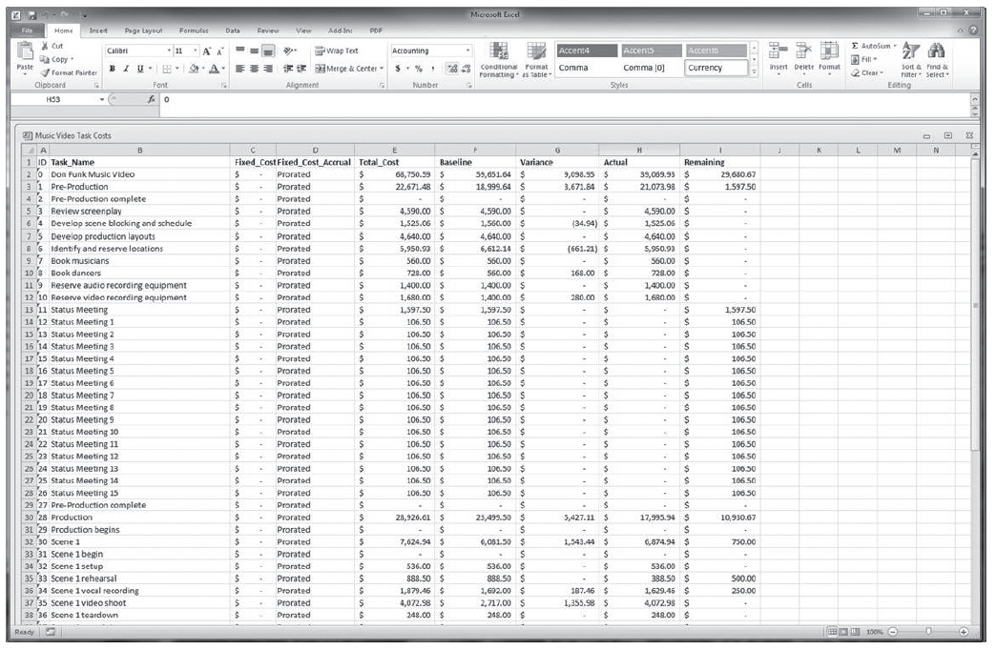
Step by Step: Save Project Information in Other File Formats

Slide 33
Step by Step: Save Project Information in Other File Formats
16. SAVE the Excel file in the solutions folder as directed by your instructor. CLOSE the Excel file.
17. SAVE the Don Funk Music Video 12 project schedule, and then CLOSE this file.
PAUSE. If you are continuing to the next lesson, keep Project open. If you are not continuing to additional lessons, CLOSE Project.
In this exercise, you saved information from the cost table in Microsoft Project into an Excel workbook and then set up an export map to control how the data is exported to Microsoft Excel.

Slide 34
Step by Step: Save Project Information in Other File Formats
As you gain experience as a project manager, you may need to export data from a Microsoft Project schedule to a variety of sources. As you saw in this exercise, you exported an existing table to a spreadsheet.
Microsoft Project uses export maps when saving data to other file formats. An export map specifies the exact data to export and how to structure it.
You could also import information such as resource costs from a database or a resource list from a document.
Microsoft Project uses import maps when opening data from another file format in Microsoft Project.

Slide 35
Step by Step: Save Project Information in Other File Formats
The import map specifies the exact data to import and how to structure it.
In fact, the same maps are used for both opening and saving data, so they are often referred to as import/export maps, or data maps.
Data maps allow you to specify how you want individual fields in the source program’s file to correspond to individual fields in the destination program. Once you set up an import/export map, you can use it over and over again.
When importing information from other file formats, Microsoft Project has a security setting that may prevent you from opening legacy or non-default file formats.
Notes:
Troubleshooting: If you are working independently (outside of this lesson) and are trying to import an Excel file, but you are unable to view saved Microsoft Excel files from the Microsoft Project Open dialog box, you may need to save your files as Microsoft Excel 97-2003 files rather than Excel Workbook (2007–2013) files.

Slide 36
Step by Step: Save Project Information in Other File Formats
Depending on the default settings in your version of Microsoft Project, you may see a Microsoft Office Project dialog box with the following message when you try to open a file:
“You are trying to open a file saved in an older file format. Your settings do not allow you to open files saved in older file formats. To change your settings, navigate to the ‘Security’ tab in the Options dialog box.”
In order to change your settings, click the File tab, then select Options. In the Options dialog box, click the Trust Center option. In the Microsoft Project Trust Center section, click the Trust Center Settings button. Click the Legacy Formats option, then select Prompt when loading files with legacy or non default file format. and click OK. Click OK to close the Options dialog box.
Notes:
Troubleshooting: When creating a Microsoft Project file from a SharePoint list, your organization must use SharePoint 2013 or SharePoint Server 2013 to utilize this functionality. Also, the list must be a Task List rather than a simple List.

Slide 37
Skill Summary

