Slide 1
Advanced Project Schedule Formatting
Microsoft Project 2013
Lesson 14

Slide 2
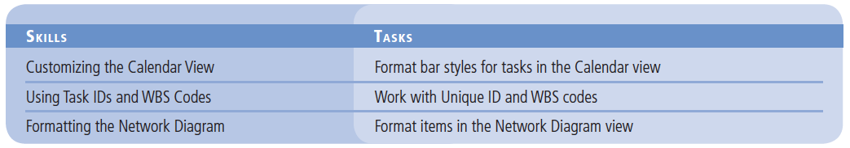
Objectives

Slide 3
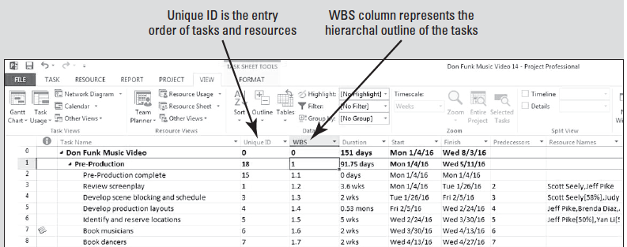
Software Orientation
Unique IDs are unique identifiers that track the order in which you enter tasks and resources.
WBS codes are numeric representations of the outline hierarchy of a project.

Slide 4
Step by Step: Format Bar Styles for Tasks in the Calendar View
The Calendar view is one of the simplest views available in Microsoft Project 2013. It can be customized in several different ways.
GET READY. Before you begin these steps, launch Microsoft Project.
1. OPEN the Don Funk Music Video 14M project schedule from the data files for this lesson.
2. SAVE the file as Don Funk Music Video 14 in the solutions folder for this lesson as directed by your instructor.

Slide 5
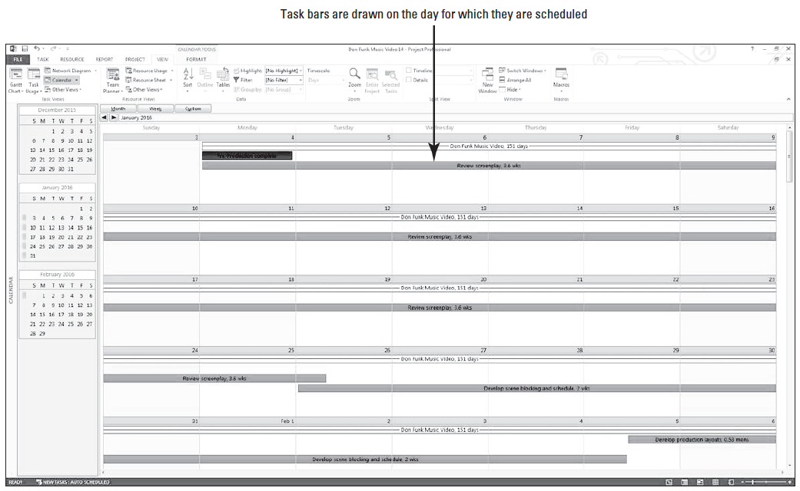
Step by Step: Format Bar Styles for Tasks in the Calendar View
3. On the ribbon, click the View tab, and then click the Calendar button. The Calendar view appears. Your screen should look similar to the figure below.

Slide 6
Step by Step: Format Bar Styles for Tasks in the Calendar View
The Calendar view displays approximately four weeks at a time (depending on your screen resolution) and looks similar to a month-at-a-glance calendar. Task bars are drawn on the days for which tasks are scheduled.
4. On the ribbon, under Calendar Tools, click the Format tab, and then click Bar Styles. The Bar Styles dialog box appears.
5. In the Task type box, click Summary.
6. In the Bar type box, click Line. Summary tasks will be shown with a line.
7. In the Task type box, click Critical.
8. In the Pattern box, click the second option, the solid bar.
9. In the Color box, click Red. Critical tasks will be shown with a solid red bar.

Slide 7
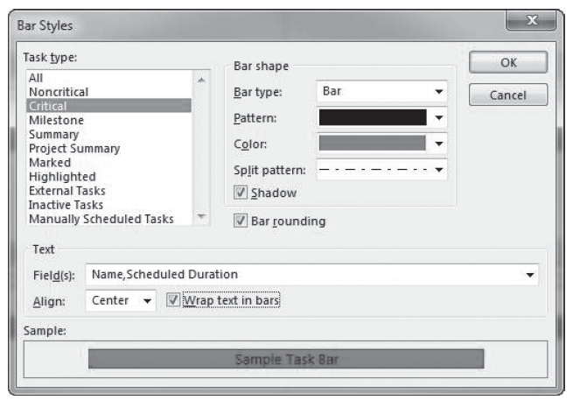
Step by Step: Format Bar Styles for Tasks in the Calendar View
10. Make sure that the check boxes for Shadow, Bar rounding, and Wrap text in bars are selected. Your screen should look similar to the figure t right.
11. Click OK to close the Bar Styles dialog box.
12. You will see a message from the Planning Wizard notifying you that some Gantt bars may be different heights. Click OK.

Slide 8
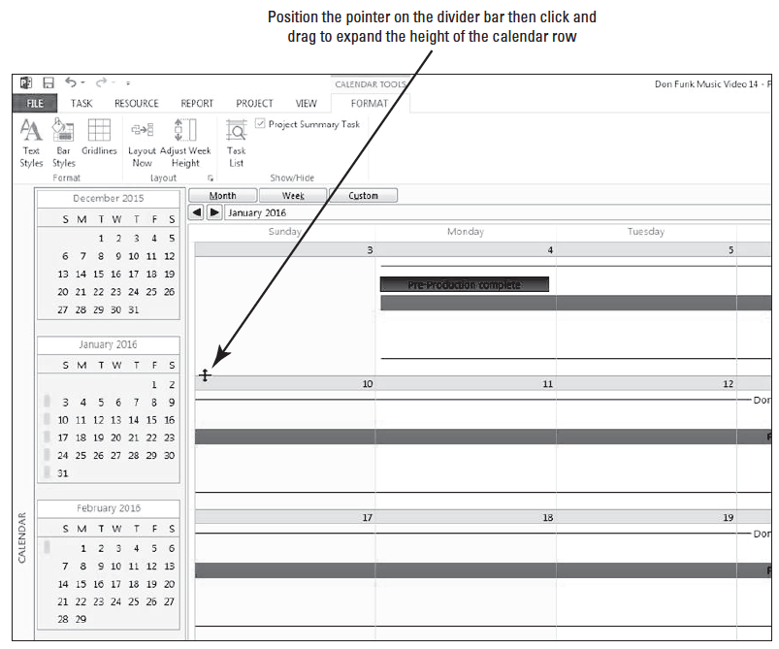
Step by Step: Format Bar Styles for Tasks in the Calendar View
13. Move your pointer to the horizontal divider between the first and second visible weeks of the calendar. Your pointer will change to a small, horizontal bar with per- pendicular arrows. Your screen should look like the figure at right.
14. Click and hold to drag the line downward to the approximate horizontal center of the screen to show only two weeks at a time.

Slide 9
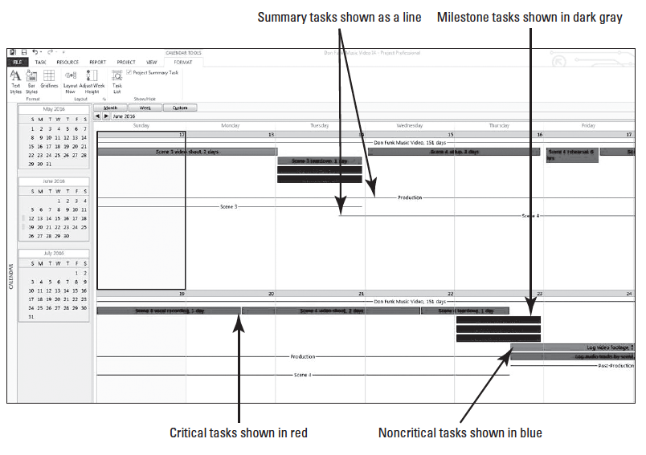
Step by Step: Format Bar Styles for Tasks in the Calendar View
15. [Press the F5 key.] In the Date box (not the ID box), type or select 06/12/16, and then click OK. The Calendar view now displays a section of the project where critical, noncritical and summary tasks are located using the revised formatting. Also note the dark gray tasks are the milestones. Your screen should look similar to the figure above.

Slide 10
Step by Step: Format Bar Styles for Tasks in the Calendar View
16. SAVE the project schedule.
PAUSE. LEAVE Project open to use in the next exercise.
In this exercise, you reformatted two of the bar styles in the Calendar view.
The Calendar view is one of the simplest views available in Microsoft Project, and it offers several formatting options.
This view is often used for reporting schedule information with resources or other stakeholders who prefer a more traditional monthly or weekly view rather than a detailed view such as the Gantt Chart.

Slide 11
Using Task IDs and WBS Codes
Microsoft Project organizes and tracks the tasks entered into a project schedule using several unique identifiers: Task IDs, Unique IDs, and Work Breakdown Structure (WBS) codes.
You can structure the Task Sheet view so that columns for these identifiers are displayed.

Slide 12
Step by Step: Work with Unique ID and WBS Codes
USE the project schedule you created in the previous exercise.
1. On the ribbon, click the View tab. Then in the Task Views Group, click the Other Views button, and then click More Views.
2. In the More Views dialog box, select Task Sheet, and then click the Apply button. The project appears in the Task Sheet view.
3. Right-click the Duration column heading. On the menu, click Insert Column.

Slide 13
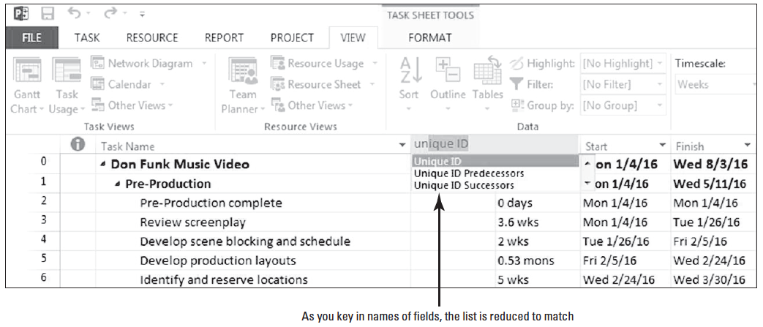
Step by Step: Work with Unique ID and WBS Codes
4. From your keyboard, type un. Three fields appear at the top of the column. Your screen should look similar to the figure below.
5. In the list that remains, click Unique ID. Microsoft Project inserts the Unique ID column to the left of the Task Name column.

Slide 14
Step by Step: Work with Unique ID and WBS Codes
The Unique ID column indicates the order in which the tasks were entered into the project. Cutting and pasting a task causes its Unique ID value to change. You can see that the tasks in this project were entered in a different order than they are currently displayed.
6. Right-click the Duration column heading again. On the menu, click Insert Column.
Notes:
Another Way: You can also insert a column by clicking the Format tab and selecting the Insert Column button.

Slide 15
Step by Step: Work with Unique ID and WBS Codes
7. From your keyboard, type WBS. Three fields appear at the top of the column.
8. In the list that remains, click WBS. Microsoft Project inserts the WBS column to the left of the Task Name column. WBS codes represent the hierarchy of summary and subtasks in the project.
The WBS numbering system is standard in project management. You can see that in the WBS structure, the top-level summary tasks are sequentially numbered with a single digit, the second-level summary or subtasks add a period and a second digit to the first digit, and so on.
Notes:
Take Note: If you ever want to reorder tasks to reflect the order in which they were entered, you can sort the Task Sheet by Unique ID.

Slide 16
Step by Step: Work with Unique ID and WBS Codes
9. Place your cursor on the right dividing line between the WBS column heading and the Duration column heading, then double-click to auto-fit the column. Repeat the same procedure for the Unique ID column. Your screen should look similar to the figure on the next slide.
10. In the Task ID column (the left-most column), select 7 and 8. This selects the entire rows for the tasks “Book musicians” and “Book dancers.”

Slide 17
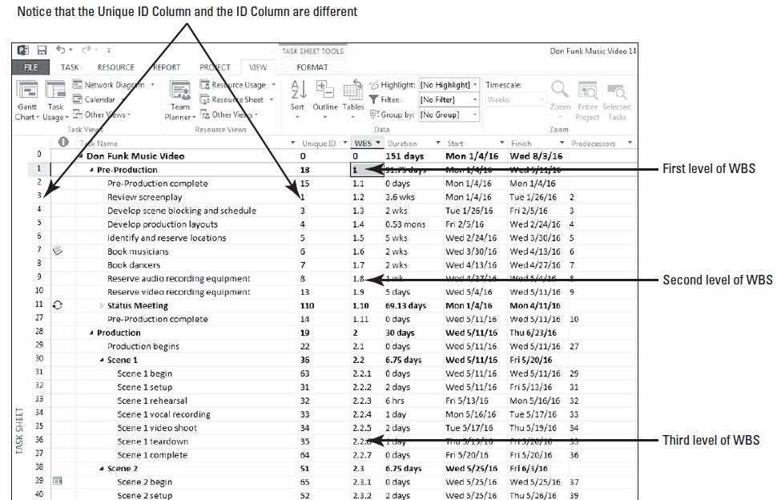
Step by Step: Work with Unique ID and WBS Codes

Slide 18
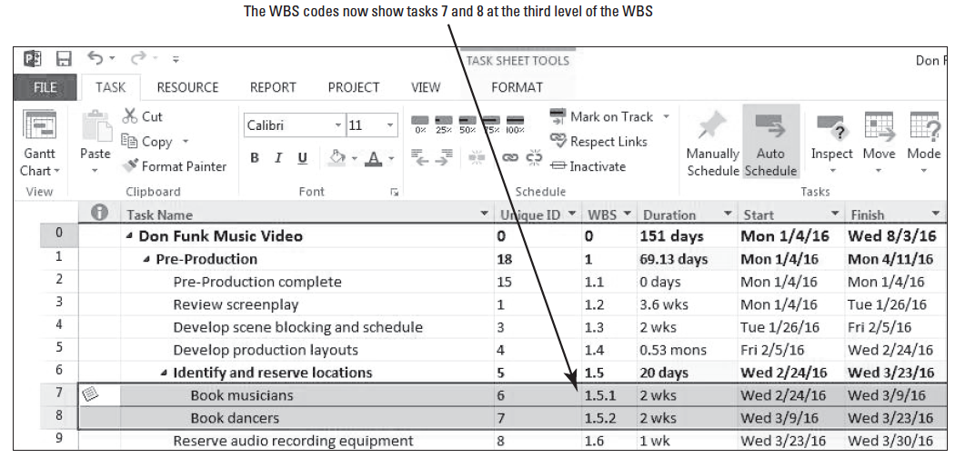
Step by Step: Work with Unique ID and WBS Codes
11. On the ribbon, click the Task tab. In the Schedule group, click the Indent button. Microsoft Project makes tasks 7 and 8 subtasks of Task 6. Your screen should look similar to the figure below.
Notes:
Note that the Task and Unique ID values for these tasks are not affected, but the WBS codes were changed. The WBS codes for tasks 7 and 8 now list them at the third level of the project hierarchy. In addition, the other tasks in the 1.x branch of the WBS are renumbered. For example, “Reserve audio recording equipment” is renumbered from 1.8 to 1.6.

Slide 19
Step by Step: Work with Unique ID and WBS Codes
12. Click any cell in the table area to deselect tasks 7 and 8. Now select the entire row of task 7, Book Musicians, by clicking the Task ID. On the ribbon, click Cut. Microsoft Project cuts the selected task to the Windows Clipboard. Your screen should look similar to the figure on the next slide.
Notes:
Note that the Task IDs are renumbered, the Unique IDs are unchanged, and only the WBS codes in the Pre-Production phase are renumbered. The WBS codes in the other phases of the project are unaffected because that part of the project hierarchy did not change.

Slide 20
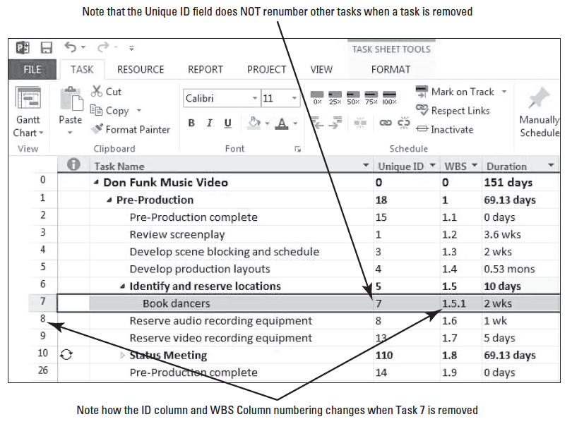
Step by Step: Work with Unique ID and WBS Codes

Slide 21
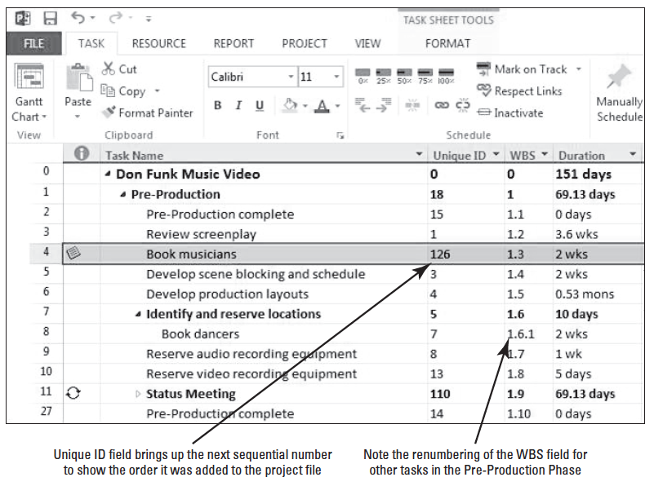
Step by Step: Work with Unique ID and WBS Codes
13. Select Task 4. On the ribbon, click the Paste button. Click OK if a warn- ing message is dis- played. Microsoft Project pastes the task you previously cut back into the task list. Your screen should look similar to the figure at right.
Notes:
Note again, the Task IDs and the WBS codes in the Pre-Production phase are renumbered. The Unique ID for the pasted task is then updated with the next sequential number to specify when it was added to the project.

Slide 22
Step by Step: Work with Unique ID and WBS Codes
14. On the quick access toolbar, click the Undo button thrice. The task list is restored to its original order.
15. SAVE the project schedule.
PAUSE. LEAVE Project open to use in the next exercise.
Each task in a Microsoft Project schedule has a unique identifier, called the Task ID.
Microsoft Project assigns sequential ID numbers to each task that you enter. When you insert, move, or delete a task, Microsoft Project updates the ID numbers so that the numbers always reflect the current task order.
The Task ID column appears (by default) on the left side of most task tables in Microsoft Project. Note that resources have Resource IDs assigned to them, and that they behave like a Task ID.
Notes:
Take Note: If you want to preserve Unique ID values when you rearrange tasks, drag and drop tasks rather than cutting and pasting them.

Slide 23
Step by Step: Work with Unique ID and WBS Codes
Microsoft Project also tracks the order in which you enter tasks and resources.
The Unique ID task and resource fields store this entry order.
If tasks or resources are reorganized, and you later need to see their original entry order, you can view this in the Unique ID field.
Although these identifiers uniquely identify each task, they do not give you any information about the task’s place in the hierarchy of the project structure.
For example, you can’t tell if a task is a summary or a subtask by simply looking at a Task ID.

Slide 24
Step by Step: Work with Unique ID and WBS Codes
A better way to show the hierarchy of a project structure is to display the outline numbers or work breakdown structure (WBS) codes of tasks–the numeric representations of the outline hierarchy of a project.
You can change WBS codes to include any combination of letters and numbers that you desire, but outline numbers are numeric only and are generated by Microsoft Project.
When working with these codes, the mask, or appearance, defines the format of the code–the order and number of alphabetic, numeric, and alphanumeric strings in a code and the separators between them.

Slide 25
Step by Step: Work with Unique ID and WBS Codes
Initially, outline numbers and WBS codes of tasks are identical. Microsoft Project also stores the Predecessor and Successor values for tasks’ Unique IDs and WBS codes.
Because the WBS codes indicate the place of every task in the project hierarchy, it is common to use WBS codes instead of Task ID or names when referencing tasks between team members on a project.
If you are working on a complex project, the WBS or standard outline options available in Microsoft Project may not be sufficient for your report or analysis requirements.

Slide 26
Step by Step: Work with Unique ID and WBS Codes https://www.simonsezit.com/article/using-project-2010-work-breakdown-structure-wbs-codes-part-1/
If this occurs, you can investigate Microsoft Project’s capabilities to handle custom outline numbers to identify a hierarchy within a project schedule.
https://www.simonsezit.com/article/using-project-2010-work-breakdown-structure-wbs-codes-part-1/

Slide 27
Step by Step: Work with Unique ID and WBS Codes
You can define a custom outline number that links different outline levels of a project’s structure with different levels of the organization’s structure. (The top level might be a regional division, the second level a business unit, and the third level a local team.)
To define a custom WBS code, follow these steps:
On the Project tab, click WBS→Define Code.
You could also use custom outline numbers to associate different outline levels of a project’s WBS with internal cost centers or job tracking codes.
After you have applied a custom outline number to your project schedule, you can group, sort, and filter tasks and resources by their outline numbers. You can apply up to ten levels of a custom outline number for tasks and ten for resources in a single level.

Slide 28
Formatting the Network Diagram
In traditional project management, a Network Diagram is a standard way for representing project activities and their relationships in a flowchart format.
In this lesson, you apply and format the Network Diagram.
The Network Diagram is a standard way of representing the logical order of project activities and their relationships.
Tasks are represented as boxes, or nodes, and the link lines represent the relationships between the nodes.
The Network Diagram is not a time-scaled view like the Gantt Chart. Rather, it shows project activities in a flowchart format so that you can focus on the relationships between activities rather than on their durations.

Slide 29
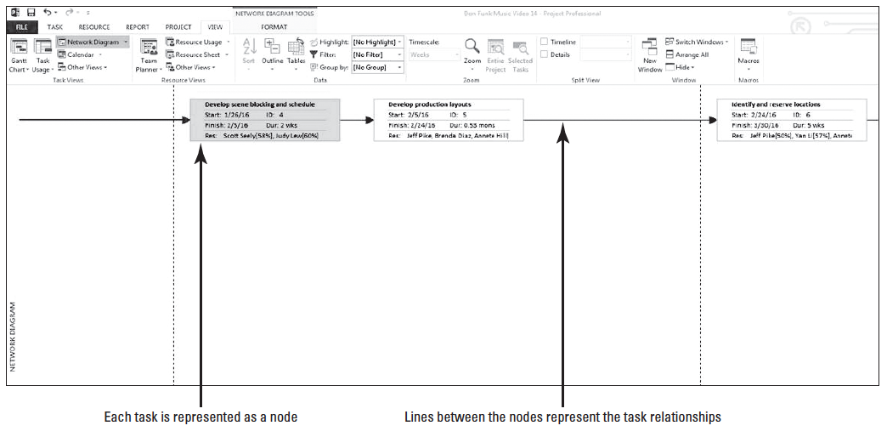
Step by Step: Format Items in the Network Diagram View
USE the project schedule you created in the previous exercise.
1. On the ribbon, click the View tab, and then click Network Diagram. The Network Diagram view appears. Your screen should look similar to the figure below.

Slide 30
Step by Step: Format Items in the Network Diagram View
The focus of the Network Diagram is task relationships and sequencing (rather than durations).
Each task is represented as a box, or node, containing several pieces of information about the task.
The relationships between tasks are represented as lines and arrows.
You will note that not much information is visible. You can zoom in and out by using the zoom slider at the lower right corner of the screen.

Slide 31
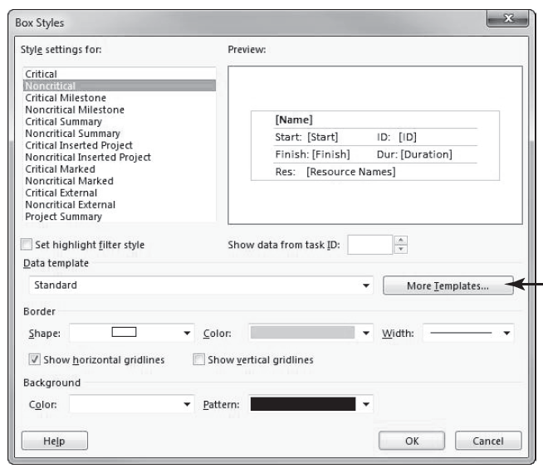
Step by Step: Format Items in the Network Diagram View
2. On the ribbon, click the Format tab, and then click Box Styles. The Box Styles dialog box appears. Your screen should look similar to the figure t right.

Slide 32
Step by Step: Format Items in the Network Diagram View
3. Click More Templates. The Data Templates dialog box appears.
4. In the Templates in “Network Diagram” list, make sure that Standard is selected, and then click the Copy button. The Data Template Definition dialog box appears. You will add the WBS code value to the lower right corner of the node.
5. In the Template name box, type Standard 1 WBS.
6. Below Choose cell(s), click the empty cell below Duration and to the right of Resource Names.

Slide 33
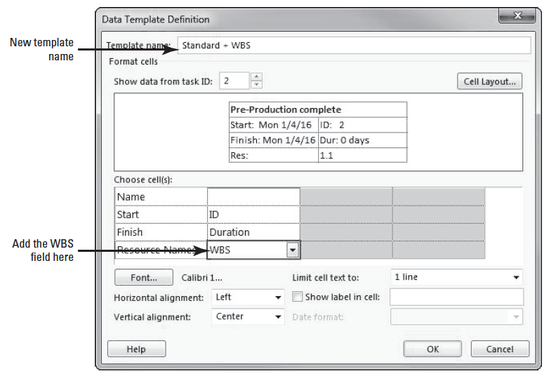
Step by Step: Format Items in the Network Diagram View
7. In the dropdown list that becomes active, type or select WBS. This will add the WBS code to the standard box style in the Network Diagram. Your screen should look similar to the figure at right.

Slide 34
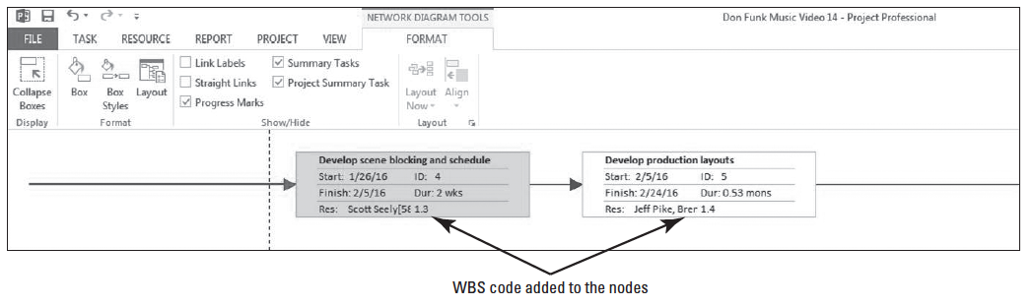
Step by Step: Format Items in the Network Diagram View
8. Click OK to close the Data Template Definition box. Click Close to close the Data Templates dialog box.
9. In the Box Styles dialog box, under Style settings for, select both Critical and Noncritical.
10. In the Data template box, click Standard 1 WBS, and then click OK to close the Box Styles dialog box. Microsoft Project applies the revised box style to the critical and noncritical task nodes in the Network Diagram. Your screen should look similar to the figure below.

Slide 35
Step by Step: Format Items in the Network Diagram View
Microsoft Project adds the WBS code to the nodes for critical and noncritical tasks. Scroll left and right to review some of the other nodes in the Network Diagram. As you can see, the node representing other types of tasks, such as summary tasks, are not affected. If you want to apply the new template to other task types, you would do so in the Box Styles dialog box.
11. SAVE the project schedule.
PAUSE. LEAVE Project open to use in the next exercise.

Slide 36
Skill Summary

