Slide 1


Google Data Analyst Specialist CLS ONL2_DAT1_G2
Project Idea 6
UK Train Rides
(Outstanding)

Slide 2


Supervised by:
Dr. Yasser A. Rahman
Prepared by: Elite Team
1) Ahmed Hussein Ali Mustafa.
2) Fatma Alzahraa Galal. Abd-elsalam Soliman.
3) Heba Tallah Talaat Ezzat Ibrahim.
4) Kareman Mohamed Mahmoud Awad.

Slide 3
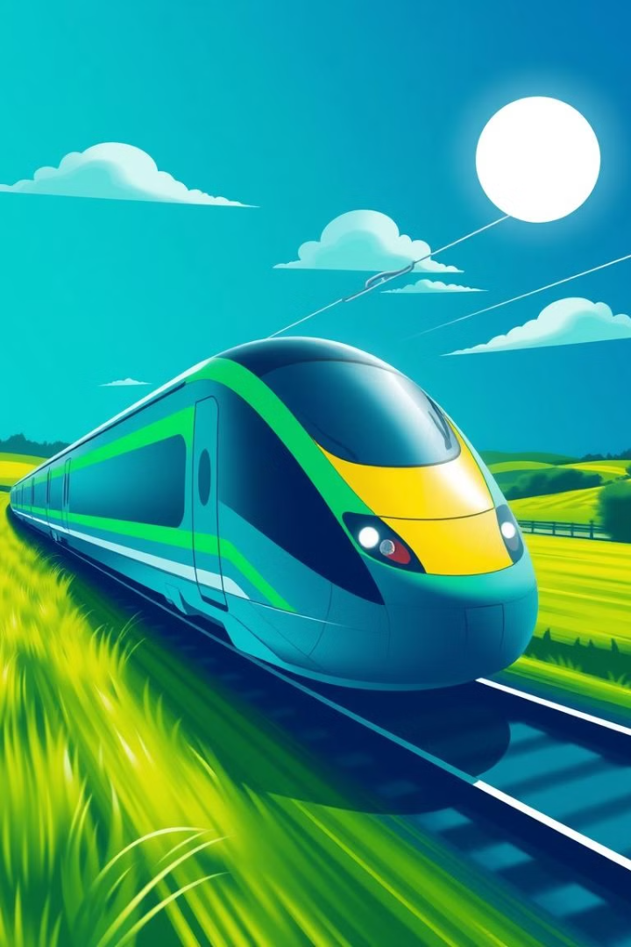

Introduction
The UK railway network is vital for transportation. Our analysis of train ticket data from January to April 2024 focuses on operational efficiency, financial performance, customer behavior, and route analysis. The goal is to uncover insights that can optimize pricing, enhance customer experience, and improve operations.

Slide 4

Results & Insights:
● Operational Efficiency
● Financial Analysis
● Customer Behavior
● Route Analysis
● Demographic Insights
Selected Tools:
Excel, Power Bi, Tableau, python and SQL.

Slide 5
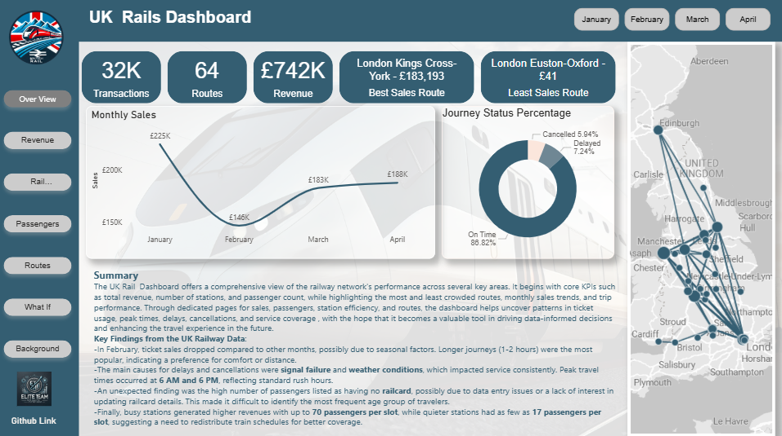

Slide 6
Operational Efficiency
Key Findings
Delay Causes
Total Journeys: 31,653
Weather Conditions: 927 delayed
On-Time Journeys: 27,481 (86.82%)
Technical Issues: 472 delayed
Delayed Journeys: 2,292 (7.24%)
Signal Failure: 451 delayed
Cancelled Journeys: 1,880 (5.94%)
Staffing Issues: 355 delayed
Traffic Congestion: 87 delayed

Slide 7
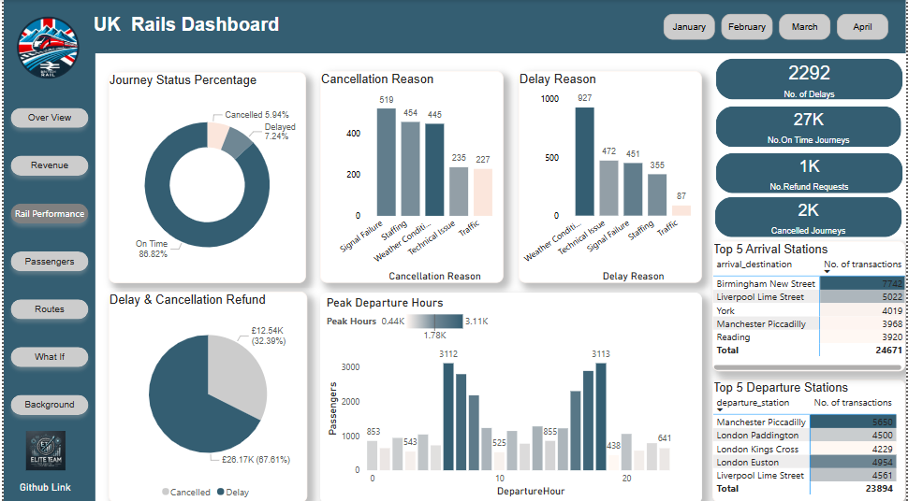

Slide 8
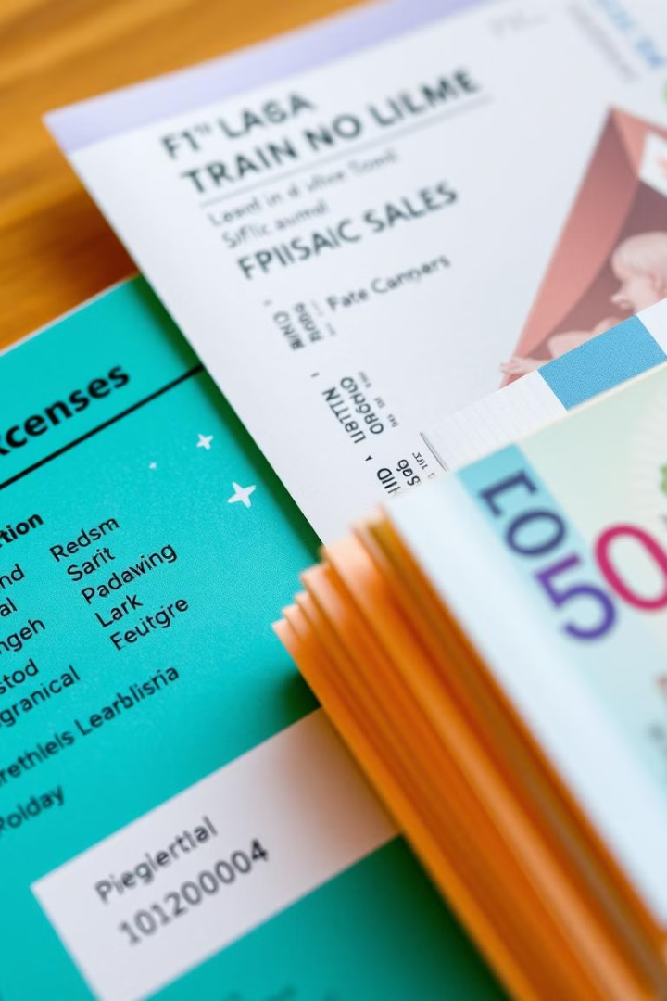
Financial Analysis
£703K
82.5%
Total Revenue
Standard Class
Generated from ticket sales
Percentage of total passenger count
18.5K
5.2%
Online Tickets
Refund Tickets
Tickets purchased online
Percentage of tickets refund
The total revenue from ticket sales is £703,219, with Standard Class tickets representing 82.50% of the passenger count. A total of 18,521 tickets were purchased online, surpassing the 13,132 tickets bought at stations. The most profitable route is Liverpool Lime Street to London Euston, generating £113,451.

Slide 9
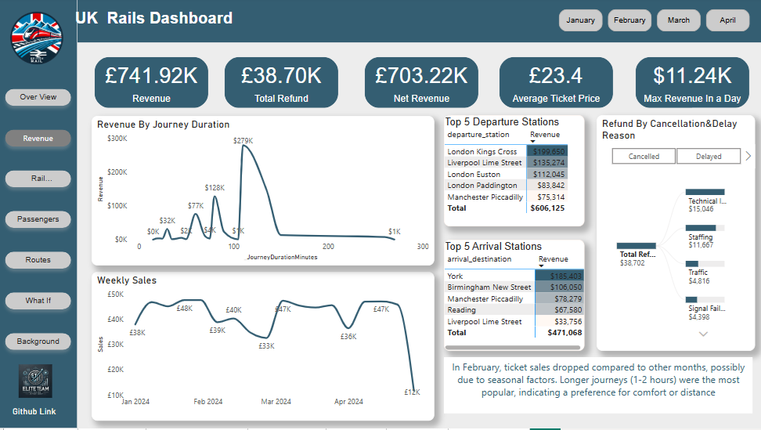

Slide 10




Customer Behavior
Crowded Stations
Ticket Preferences
Purchase Behavior
Birmingham New Street, Manchester Piccadilly
Advance tickets are most popular (55.46%)
Passengers prefer buying tickets in advance
Birmingham New Street and Manchester Piccadilly are the most crowded stations. Advance tickets are the most popular, accounting for 55.46% of total passengers. Most passengers prefer buying tickets in advance to secure lower prices, indicating a price-sensitive customer base.

Slide 11




Demographic Insights
Rail Card Usage
Payment Methods
20,921 passengers traveled without a rail card.
Credit card payments accounted for 60.46% of transactions.
20,921 passengers traveled without a rail card, indicating a potential market for rail card promotions. Credit card payments accounted for 60.46% of transactions, highlighting the preference for credit cards among passengers. Understanding these demographics can inform targeted marketing strategies.

Slide 12
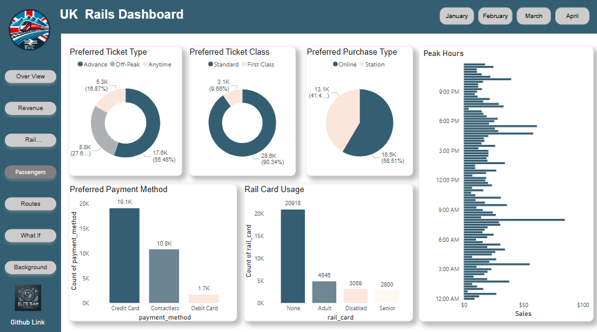

Slide 13
Route Analysis
Most Popular Route
Highest Revenue Route
Lowest Revenue Route
Manchester Piccadilly → Liverpool Lime Street (4,628 trips)
London Kings Cross → York (£183,459)
London Euston → Oxford (£41)
6AM
Peak revenue hours
(1911 trips ) 110712£
Manchester Piccadilly to Liverpool Lime Street is the most popular route with 4,628 trips. London Kings Cross to York generates the highest revenue at £183,459. The lowest revenue route is London Euston to Oxford, with a total revenue of only £41. These insights help identify key areas for route optimization.

Slide 14
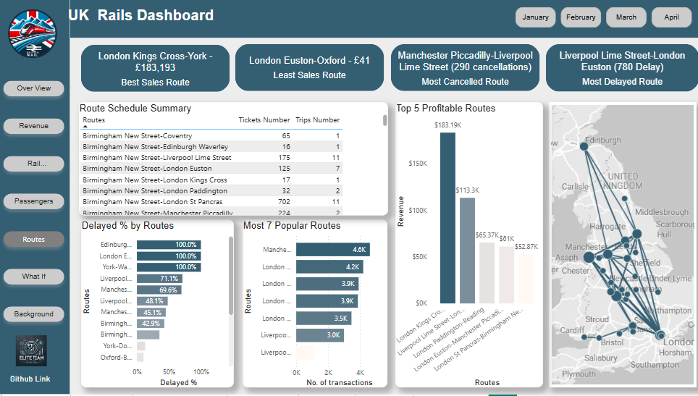

Slide 15
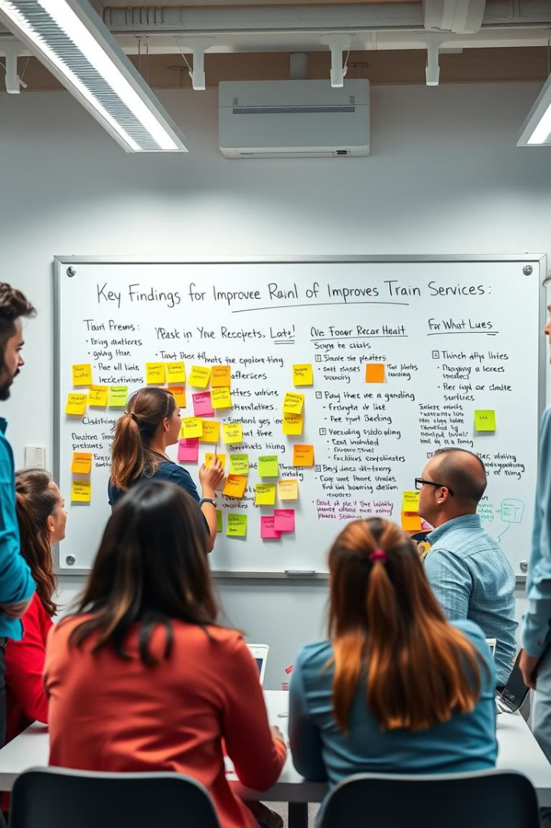
Key Findings & Recommendations
1
Improve Delay Management
Invest in infrastructure and contingency planning.
2
Optimize Low-Revenue Routes
Adjust pricing or reduce frequency.
3
Enhance Peak Hour Pricing
Implement dynamic pricing models.
4
Boost Online Sales
Through digital marketing and promotions.
Key recommendations include improving delay management through infrastructure investments, optimizing low-revenue routes by adjusting pricing, enhancing peak hour pricing with dynamic models, and boosting online ticket sales through digital marketing. These strategies aim to enhance service and increase revenue.

Slide 16
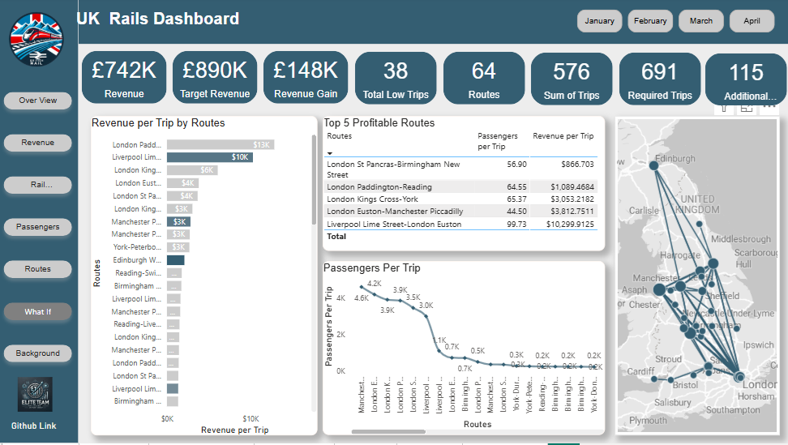

Slide 17
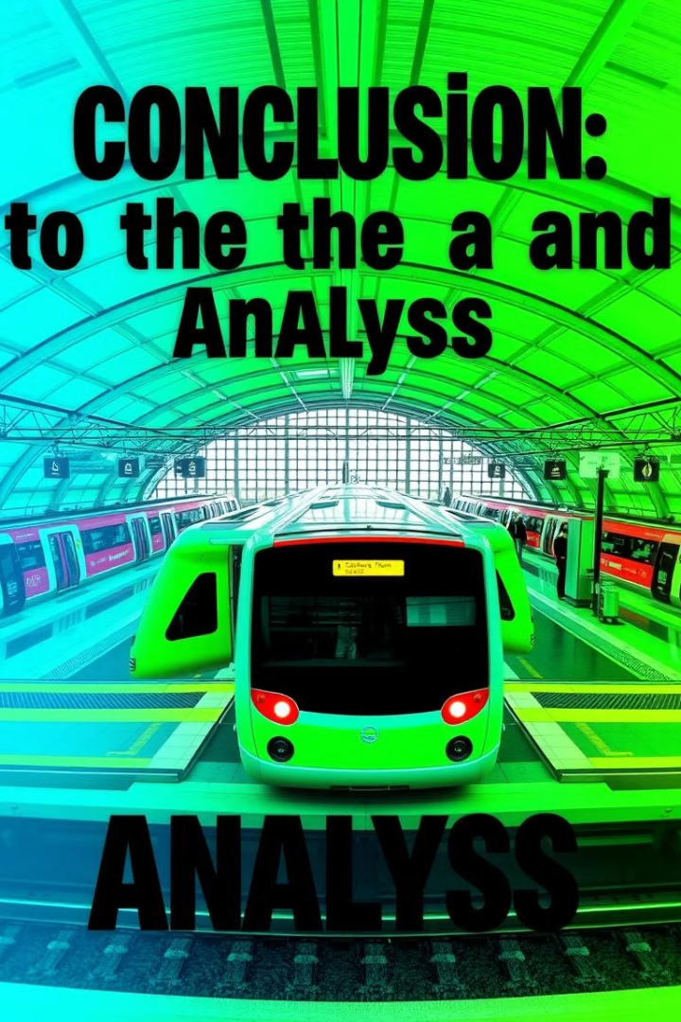
Conclusion
Our analysis provides valuable insights into train punctuality, revenue trends, customer preferences, and route profitability.
By leveraging these findings, UK rail operators can enhance service efficiency, optimize pricing strategies, and improve passenger satisfaction. These improvements will lead to a better overall experience.

Slide 18
Project Idea 6
UK Train Rides
Q & A
📢 We’re happy to discuss!

Slide 19
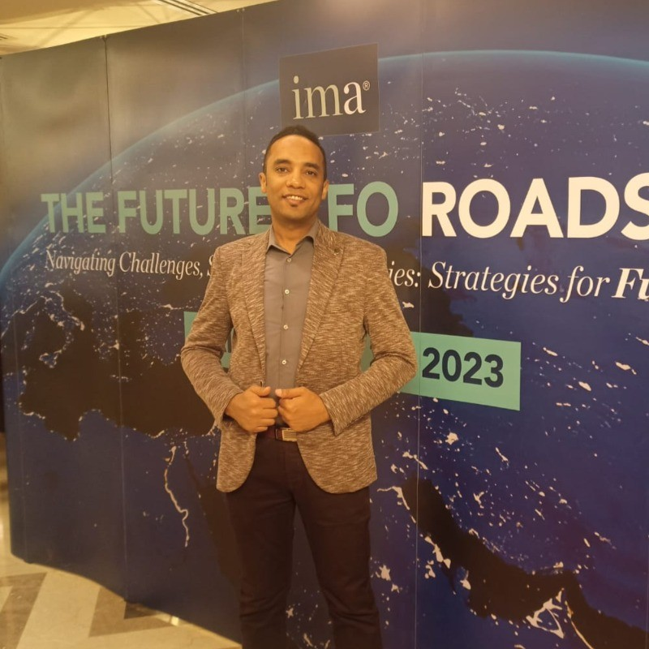



Google Data Analyst Specialist CLS ONL2_DAT1_G2
Elite Team
Ahmed Hussein
Fatma Alzahraa
Kareman Mohamed
Heba Tallah Talaat

Slide 20
Google Data Analyst Specialist CLS ONL2_DAT1_G2
Thanks

