Slide 1
Algorithm
Md. Shakil Ahmed
Senior Software Engineer
Astha it research & consultancy ltd.
Dhaka, Bangladesh

Slide 2
Introduction
Topic Focus:
Algorithm
Recursive Function
Graph Representation
DFS
BFS
All-pairs shortest paths
Single-Source Shortest Paths
Tree
BST
Heap(Min & Max)
Greedy
Backtracking
Hashing & Hash Tables

Slide 3
Algorithm
In mathematics and computer science, an algorithm is a step-by-step procedure for calculations. Algorithms are used for calculation, data processing.
Example
Algorithm Largest Number
Input: A non-empty list of numbers L.
Output: The largest number in the list L.
Algorithm
largest ← L₀
for each item in the list (Length(L)≥1), do
if the item > largest,
then largest ← the item
return largest

Slide 4
Recursive Functions
A recursive function is a function that makes a call to itself.
Example:
int main()
{
main();
return 0;
}
What is the problem of this recursive function?
=> Infinity recursion!

Slide 5
Recursive Functions
To prevent infinite recursion
We need an if-else statement where one branch makes a recursive call
And the other branch does not. The branch without a recursive call is usually the base case.

Slide 6
Recursive Functions
Is it a correct recursive function?
int Sum(int i)
{
if(i==0)
return 0;
else
return i + Sum(i+1);
}

Slide 7
Recursive Functions
Sum 0 to N integer by a recursive function? Where N is a position integer.
int Sum(int N)
{
if(N==1)
return 1;
return N + Sum(N-1);
}

Slide 8
Recursive Functions
Convert a loop to a recursive function.
Loop
for ( <init> ; <cond> ; <update> )
<body>
Recursive Function
void recHelperFunc( int loopVar )
{
if ( <cond> )
{
<body>
<update>
recHelperFunc( loopVar );
}
}

Slide 9
Recursive Functions
Problem
You have to find, how many .txt file in a folder. You have to find nested folder .txt file also.
Example:
\A\1.txt
\A\B\2.txt
\A\B\C\3.txt
\A\B\C\D\4.txt

Slide 10
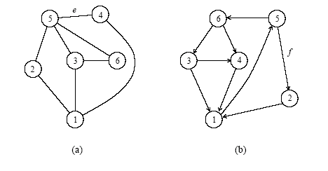
Graph
a) An undirected graph and (b) a directed graph.

Slide 11
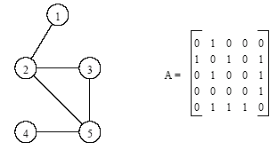
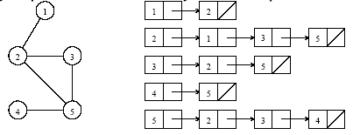
Definitions and Representation
An undirected graph and its adjacency matrix representation.
An undirected graph and its adjacency list representation.

Slide 12
Matrix Representation
bool[][] A = new bool[6][];
for (int i = 1; i <= 5; i++)
{
A[i] = new bool[6];
}
A[1][2] = true;
A[2][1] = true;
A[2][3] = true;
A[3][2] = true;
A[3][5] = true;
A[5][3] = true;
A[2][5] = true;
A[5][2] = true;
A[4][5] = true;
A[5][4] = true;

Slide 13
Adjacency list representation
List<List<int>> connection = new List<List<int>>();
for (int i = 0; i <= 5; i++)
connection.Add(new List<int>());
connection[1].Add(2);
connection[2].Add(1);
connection[2].Add(3);
connection[3].Add(2);
connection[3].Add(5);
connection[5].Add(3);
connection[5].Add(2);
connection[2].Add(5);
connection[5].Add(4);
connection[4].Add(5);

Slide 14
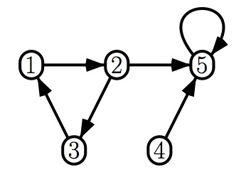
Directed graph
bool[][] A = new bool[6][];
for (int i = 1; i <= 5; i++)
{
A[i] = new bool[6];
}
A[1][2] = true;
A[2][3] = true;
A[2][5] = true;
A[3][1] = true;
A[5][5] = true;
A[4][5] = true;

Slide 15
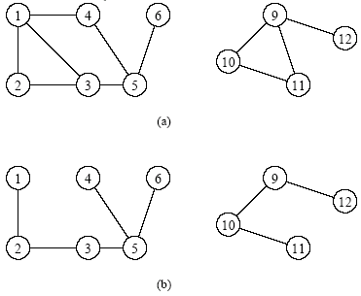
Depth-First Search
Depth-first search is a systematic way to find all the vertices reachable from a source vertex, s.
Historically, depth-first was first stated formally hundreds of years ago as a method for traversing mazes.
The basic idea of depth-first search is this: It methodically explore every edge. We start over from different vertices as necessary. As soon as we discover a vertex, DFS starts exploring from it

Slide 16
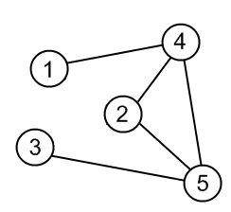
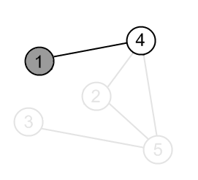
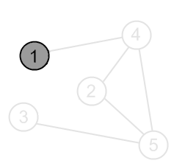
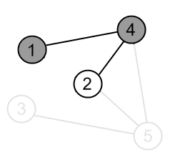
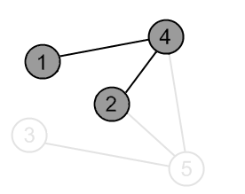
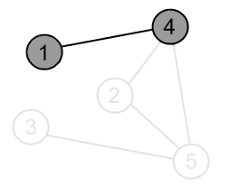
Depth-First Search

Slide 17
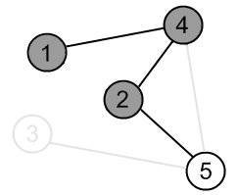
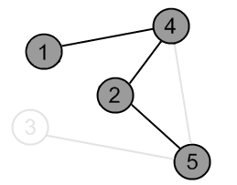
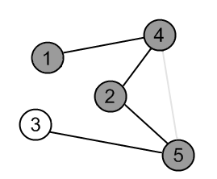
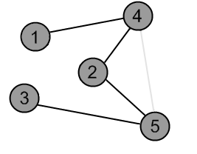
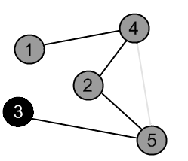
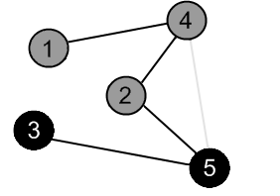
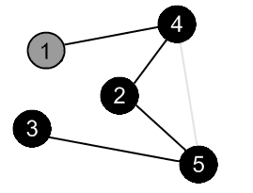
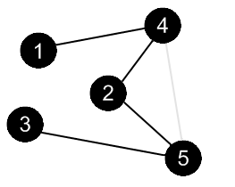
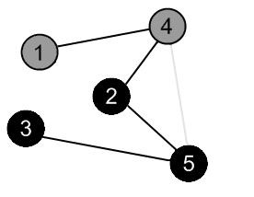

Slide 18
Depth-First Search
procedure DFS(G,v):
label v as explored
for all edges e in G.incidentEdges(v) do
if edge e is unexplored then
w ← G.opposite(v,e)
if vertex w is unexplored then
label e as a discovery edge
recursively call DFS(G,w)

Slide 19
DFS Source Code
bool[] visit;
List<List<int>> connection = new List<List<int>>();
void DFS(int nodeNumber)
{
visit[nodeNumber] = true;
for (int i = 0; i < connection[nodeNumber].Count; i++)
if (visit[connection[nodeNumber][i]] == false)
DFS(connection[nodeNumber][i]);
}
visit = new bool[6];
for (int i = 1; i <= 5; i++)
visit[i] = false;
DFS(1);

Slide 20
Practical Problem
In facebook 2 people is not friend & they has no mutual friend! But are they connected by 2 or 3 or more level mutual friend?
Bool found = false;
void DFS(int userId, int targetUserId){
visit[userId] = true;
if(userId==targetUserId)
found = true;
else
for (int i = 0; i < connection[userId].Count; i++)
{
if (visit[connection[userId][i]] == false)
DFS(connection[userId][i]);
if(found==true)
break;
}
}

Slide 21
Problem
There is a grid N X N. In the grid there is a source cell ‘S’, a destination cell ‘D’, some empty cell ‘.’ & some block ‘#’. Can you go from source to the destination through the empty cell? From each cell you can go an empty cell or the destination if the cell share a side.
5
S....
####.
.....
.####
....D

Slide 22
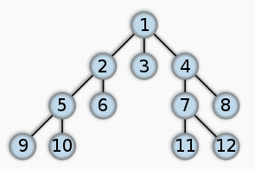
Breadth-first search
In graph theory, breadth-first search (BFS) is a graph search algorithm that begins at the root node and explores all the neighboring nodes.
Then for each of those nearest nodes, it explores their unexplored neighbor nodes, and so on, until it finds the goal.

Slide 23
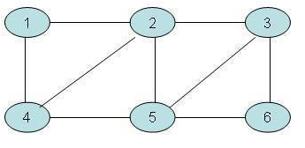
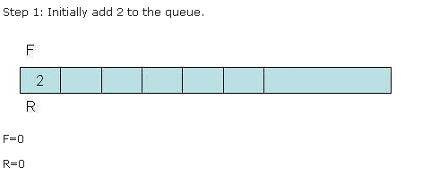
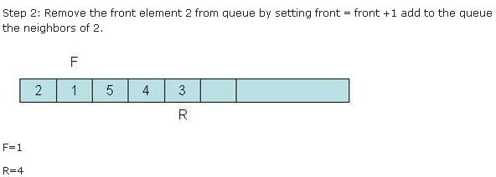
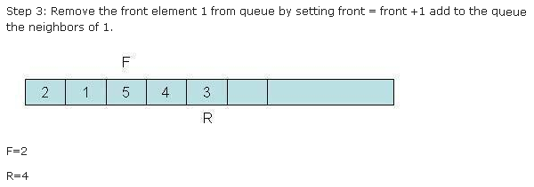
More BFS

Slide 24
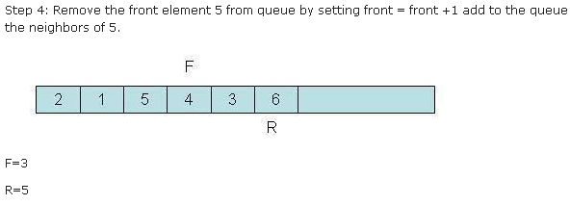
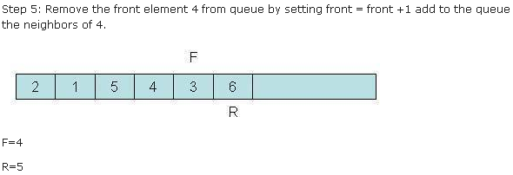
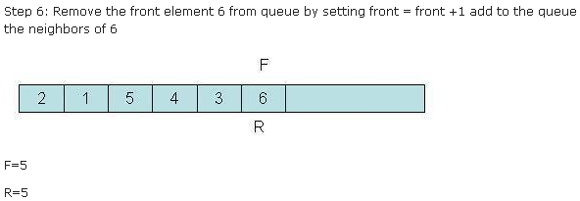
More BFS

Slide 25
BFS Pseudo-Code
Step 1: Initialize all nodes to ready state (status = 1)
Step 2: Put the starting node in queue and change its status to the waiting state (status = 2)
Step 3: Repeat step 4 and 5 until queue is empty
Step 4: Remove the front node n of queue. Process n and change the status of n to the processed state (status = 3)
Step 5: Add to the rear of the queue all the neighbors of n that are in ready state (status = 1), and change their status to the waiting state (status = 2).
[End of the step 3 loop]
Step 6: Exit

Slide 26
BFS Source Code
int[] Level = new int[6];
for (int i = 1; i <= 5; i++)
Level[i] = -1;
List<int> temp = new List<int>();
int source = 1;int target = 5;
Level[source] = 0;
temp.Add(source);
while (temp.Count != 0)
{
int currentNode = temp[0];
if (currentNode == target)
break;
temp.RemoveAt(0);
for (int i = 0; i < connection[currentNode].Count; i++)
if (Level[connection[currentNode][i]] == -1)
{
Level[connection[currentNode][i]] = Level[currentNode] + 1;
temp.Add(connection[currentNode][i]);
}
}

Slide 27
Practical Problem
In facebook 2 people is not friend & they has no mutual friend! But they can connected by 2 or 3 or more level mutual friend? Which is the minimum level of their connection?

Slide 28
Problem
There is a grid N X N. In the grid there is a source cell ‘S’, a destination cell ‘D’, some empty cell ‘.’ & some block ‘#’. Find the minimum number of cell visit to go from source to the destination through the empty cell? From each cell you can go an empty cell or the destination if the cell share a side.
5
S....
#.##.
.....
.###.
....D

Slide 29
DFS vs. BFS
DFS Process
F
B
A
start
E
G
D
C
destination
C
DFS on C
D
Call DFS on D
B
DFS on B
B
B
Return to call on B
A
DFS on A
A
A
A
G
Call DFS on G
found destination - done!
Path is implicitly stored in DFS recursion
Path is: A, B, D, G
D
B
A

Slide 30
DFS vs. BFS
F
B
A
start
E
BFS Process
G
D
C
destination
rear
front
rear
front
rear
front
rear
front
A
B
D
C
D
Initial call to BFS on A
Add A to queue
Dequeue A
Add B
Dequeue B
Add C, D
Dequeue C
Nothing to add
rear
front
G
found destination - done!
Path must be stored separately
Dequeue D
Add G

Slide 31
All-pairs shortest paths
The Floyd-Warshall Algorithm is an efficient algorithm to find all-pairs shortest paths on a graph.
That is, it is guaranteed to find the shortest path between every pair of vertices in a graph.
The graph may have negative weight edges, but no negative weight cycles (for then the shortest path is undefined).

Slide 32
Floyd-Warshall
for (int k = 1; k =< V; k++)
for (int i = 1; i =< V; i++)
for (int j = 1; j =< V; j++)
if ( ( M[i][k]+ M[k][j] ) < M[i][j] )
M[i][j] = M[i][k]+ M[k][j]
Invariant: After the kth iteration, the matrix includes the shortest paths for all pairs of vertices (i,j) containing only vertices 1..k as intermediate vertices

Slide 33
2
b
a
-2
Initial state of the matrix:
1
-4
3
c
1
d
e
 | a | b | c | d | e
a | 0 | 2 | - | -4 | -
b | - | 0 | -2 | 1 | 3
c | - | - | 0 | - | 1
d | - | - | - | 0 | 4
e | - | - | - | - | 0
4
M[i][j] = min(M[i][j], M[i][k]+ M[k][j])

Slide 34
2
b
a
-2
Floyd-Warshall - for All-pairs shortest path
1
-4
3
c
1
d
e
4
 | a | b | c | d | e
a | 0 | 2 | 0 | -4 | 0
b | - | 0 | -2 | 1 | -1
c | - | - | 0 | - | 1
d | - | - | - | 0 | 4
e | - | - | - | - | 0
Final Matrix Contents

Slide 35
Problem
In the Dhaka city there are N stations. There require some money to go from one station to another station. You have to find minimum money to go from 1 station to all other station.
Example:
5 5
1 2 10
1 3 2
2 3 7
3 4 3
4 2 3

Slide 36
Single-Source Shortest Paths
For a weighted graph G = (V,E,w), the single-source shortest paths problem is to find the shortest paths from a vertex v ∈ V to all other vertices in V.
Dijkstra's algorithm maintains a set of nodes for which the shortest paths are known.
It grows this set based on the node closest to source using one of the nodes in the current shortest path set.

Slide 37
Single-Source Shortest Paths: Dijkstra's Algorithm
function Dijkstra(Graph, source)
for each vertex v in Graph: // Initializations
dist[v] := infinity ;
previous[v] := undefined ;
end for ;
dist[source] := 0 ;
Q := the set of all nodes in Graph ;
while Q is not empty:
u := vertex in Q with smallest distance in dist[] ;
if dist[u] = infinity:
break ;
end if ;

Slide 38
remove u from Q ;
for each neighbor v of u:
alt := dist[u] + dist_between(u, v) ;
if alt < dist[v]:
dist[v] := alt ;
previous[v] := u ;
end if ;
end for ;
end while ;
return dist[] ;
end Dijkstra.

Slide 39
Example
u
v
∞
1
∞
10
9
2
3
s
0
4
6
5
7
∞
∞
2
x
y
Comp 122, Fall 2003
Single-source SPs - <number>

Slide 40
Example
u
v
10
1
∞
10
9
2
3
s
0
4
6
5
7
5
∞
2
x
y
Comp 122, Fall 2003
Single-source SPs - <number>

Slide 41
Example
u
v
8
1
14
10
9
2
3
s
0
4
6
5
7
5
7
2
x
y
Comp 122, Fall 2003
Single-source SPs - <number>

Slide 42
Example
u
v
8
1
13
10
9
2
3
s
0
4
6
5
7
5
7
2
x
y
Comp 122, Fall 2003
Single-source SPs - <number>

Slide 43
Example
u
v
8
1
9
10
9
2
3
s
0
4
6
5
7
5
7
2
x
y
Comp 122, Fall 2003
Single-source SPs - <number>

Slide 44
Example
u
v
8
1
9
10
9
2
3
s
0
4
6
5
7
5
7
2
x
y
Comp 122, Fall 2003
Single-source SPs - <number>

Slide 45
Dijkstra Source Code
public class pair
{
public int Node, Value;
}
public class PairComparer : Comparer<pair>
{
public override int Compare(pair x, pair y)
{
return Comparer<double>.Default.Compare(x.Value, y.Value);
}
}
List<List<pair>> connection = new List<List<pair>>();
for (int i = 0; i <= 5; i++)
connection.Add(new List<pair>());
connection[1].Add(new pair { Node = 2, Value = 10 });
connection[1].Add(new pair { Node = 3, Value = 5 });
connection[2].Add(new pair { Node = 4, Value = 1 });
connection[2].Add(new pair { Node = 3, Value = 2 });
connection[3].Add(new pair { Node = 2, Value = 3 });
connection[3].Add(new pair { Node = 4, Value = 9 });
connection[3].Add(new pair { Node = 5, Value = 2 });
connection[4].Add(new pair { Node = 5, Value = 4 });
connection[5].Add(new pair { Node = 4, Value = 6 });
connection[5].Add(new pair { Node = 1, Value = 7 });

Slide 46
int[] distance = new int[6];
int source = 1;
for (int i = 0; i <= 5; i++)
distance[i] = 2000000000;
SortedSet<pair> priorityQueue = new SortedSet<pair>(new PairComparer());
distance[source] = 0;
priorityQueue.Add(new pair { Node = 1, Value = 0 });
while (priorityQueue.Count != 0)
{
var item = priorityQueue.FirstOrDefault();
priorityQueue.Remove(item);
if (distance[item.Node] == item.Value)
{
for (int i = 0; i < connection[item.Node].Count; i++)
{
if (distance[connection[item.Node][i].Node] > item.Value + connection[item.Node][i].Value)
{
distance[connection[item.Node][i].Node] = item.Value + connection[item.Node][i].Value;
priorityQueue.Add(new pair { Node = connection[item.Node][i].Node, Value = distance[connection[item.Node][i].Node] });
}
}
}
}
for (int i = 1; i <= 5; i++)
Console.WriteLine(distance[i]);

Slide 47
Problem
Currently you are in Dhaka city. You are waiting in the beily road, You want to go mirpur. There are many way to go to mirpur. You want to go the shortest distance.
Example
5 10 1 5
1 2 10
1 3 5
2 4 1
2 3 2
3 2 3
3 4 9
3 5 2
4 5 4
5 4 6
5 1 7

Slide 48

Natural Tree

Slide 49
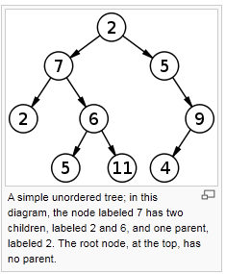
Tree structure

Slide 50
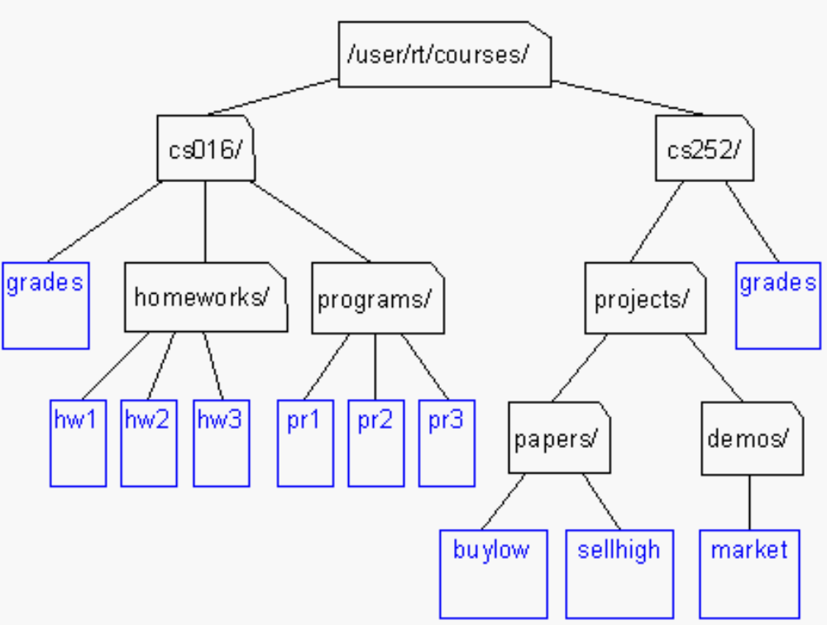
Unix / Windows file structure

Slide 51
Definition of Tree
A tree is a finite set of one or more nodes
such that:
There is a specially designated node called
the root.
The remaining nodes are partitioned into n>=0 disjoint sets T1, ..., Tn, where each of these sets is a tree.
We call T1, ..., Tn the subtrees of the root.

Slide 52
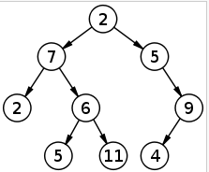
Binary Tree
Each Node can have at most 2 children.

Slide 53
Array Representation 1
With in a single array.
If root position is i then,
Left Child in 2*i+1
Right Child is 2*i+2
For N level tree it needs 2^N – 1 memory space.
If current node is i then it’s parent is i/2.
0 | 1 | 2 | 3 | 4 | 5 | 6 | 7 | 8 | 9 | 10 | 11 | 12 | 13 | 14
2 | 7 | 5 | 2 | 6 | -1 | 9 | -1 | -1 | 5 | 11 | -1 | -1 | 4 | -1

Slide 54
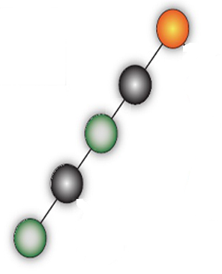
Array Representation 1
Advantage ->
Good in Full Or Complete Binary tree
Disadvantage
If we use it in normal binary tree then it may be huge memory lose.

Slide 55
Array Representation 2
Use 3 Parallel Array
 | 0 | 1 | 2 | 3 | 4 | 5 | 6 | 7 | 8
Root | 2 | 7 | 5 | 2 | 6 | 9 | 5 | 11 | 4
Left | 1 | 3 | -1 | -1 | 6 | 8 | -1 | -1 | -1
Right | 2 | 4 | 5 | -1 | 7 | -1 | -1 | -1 | -1
If you need parent
 | 0 | 1 | 2 | 3 | 4 | 5 | 6 | 7 | 8
Root | 2 | 7 | 5 | 2 | 6 | 9 | 5 | 11 | 4
Left | 1 | 3 | -1 | -1 | 6 | 8 | -1 | -1 | -1
Right | 2 | 4 | 5 | -1 | 7 | -1 | -1 | -1 | -1
Parent | -1 | 0 | 0 | 1 | 1 | 2 | 4 | 4 | 5

Slide 56
Object Representation
public class Tree
{
public int data;
public Tree LeftChild, RightChild, Parent;
}
data
left
data
right
left
right

Slide 57
Preorder Traversal (recursive version)
public void preorder(Tree Node)
{
if (Node!=null)
{
Console.WriteLine(Node.data);
preorder(Node.LeftChild);
preorder(Node.RightChild);
}
}

Slide 58
Inorder Traversal (recursive version)
public void inorder(Tree Node)
{
if (Node!=null)
{
inorder(Node.LeftChild);
Console.WriteLine(Node.data);
inorder(Node.RightChild);
}
}

Slide 59
Postorder Traversal (recursive version)
public void postorder(Tree Node)
{
if (Node!=null)
{
postorder(Node.LeftChild);
postorder(Node.RightChild);
Console.WriteLine(Node.data);
}
}

Slide 60
Binary Search Tree
All items in the left subtree are less than the root.
All items in the right subtree are greater or equal to the root.
Each subtree is itself a binary search tree.

Slide 61
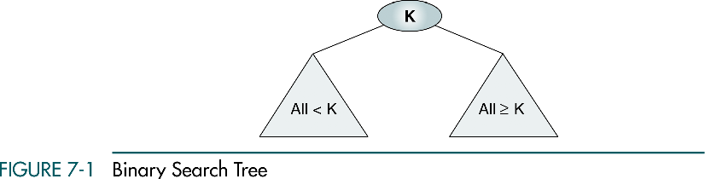
Binary Search Tree

Slide 62

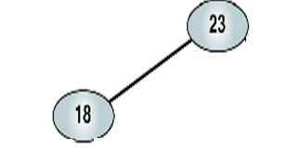
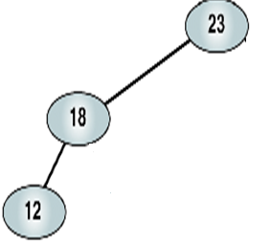
Binary Search Tree
Elements => 23 18 12 20 44 52 35
1st Element
2nd Element
3rd Element

Slide 63
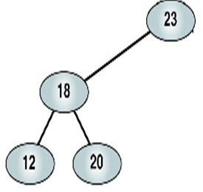
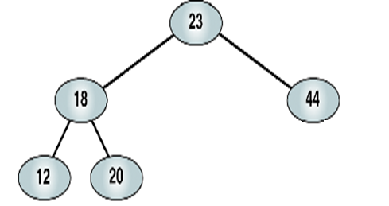
Binary Search Tree
4th Element
5th Element

Slide 64
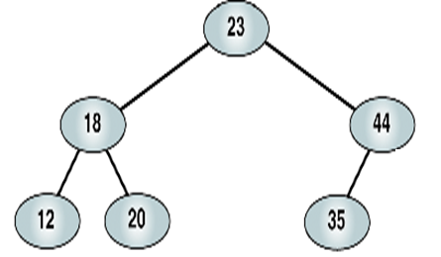
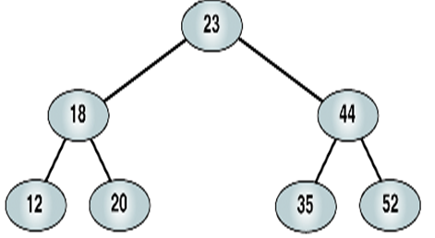
Binary Search Tree
6th Element
7th Element

Slide 65
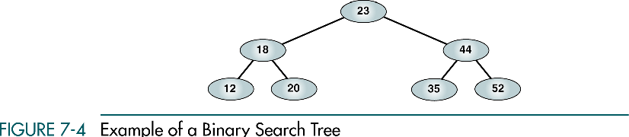
Binary Search Tree

Slide 66
Binary Search Tree
public Tree Root = null;
public void AddToBST(Tree Node,int value){
if (Node == null)
{
Node = new Tree();
Node.data = value;
Root = Node;
}
else if (Node.data > value)
{
if (Node.LeftChild != null)
AddToBST(Node.LeftChild, value);
else
{
Tree child = new Tree();
child.data = value;
child.Parent = Node;
Node.LeftChild = child;
}
}
else if (Node.data < value)
{
if (Node.RightChild != null)
AddToBST(Node.RightChild, value);
else
{
Tree child = new Tree();
child.data = value;
child.Parent = Node;
Node.RightChild = child;
}
}
}
AddToBST(Root,10);
AddToBST(Root,5);
AddToBST(Root,20);
AddToBST(Root,30);

Slide 67
Binary Search Tree
public Tree SearchInBST(Tree Node, int value)
{
if (Node == null)
return null;
if (Node.data == value)
return Node;
if (Node.data > value)
SearchInBST(Node.LeftChild, value);
if (Node.data < value)
SearchInBST(Node.RightChild, value);
return null;
}
Tree searchResult = SearchInBST(Root, 10);
Tree searchResult1 = SearchInBST(Root, 20);
Tree searchResult2 = SearchInBST(Root, 100);

Slide 68
Problem
The task is that you are given a document consisting of lowercase letters. You have to analyze the document and separate the words first. Words are consecutive sequences of lower case letters. After listing the words, in the order same as they occurred in the document, you have to number them from 1, 2, ..., n. After that you have to find the range p and q (p ≤ q) such that all kinds of words occur between p and q (inclusive). If there are multiple such solutions you have to find the one where the difference of p and q is smallest. If still there is a tie, then find the solution where p is smallest.
Example:
a b c c a d b b a a c c
Output: 4 7

Slide 69
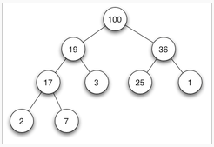
Heap (data structure)
It can be seen as a binary tree with two additional constraints:
The shape property: the tree is a complete binary tree. that is, all levels of the tree, except possibly the last one (deepest) are fully filled, and, if the last level of the tree is not complete, the nodes of that level are filled from left to right.
The heap property: each node is greater than or equal to each of its children according to a comparison predicate defined for the data structure.

Slide 70

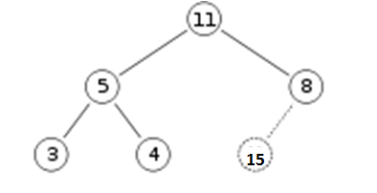
Max Heap Insert

Slide 71

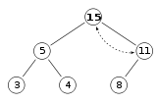
Max Heap Insert

Slide 72


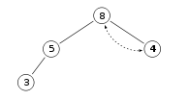
Max Heap Delete

Slide 73
Source Code
List<int> elements;
public void PushElement(int x) {
elements.Add(x);
int root = elements.Count - 1;
while (root != 0)
{
int newRoot = (root - 1) / 2;
if (elements[newRoot] < elements[root])
{
int z = elements[newRoot];
elements[newRoot] = elements[root];
elements[root] = z;
root = newRoot;
}
else
break;
}
}

Slide 74
Source Code
public int PopElement(){
int value = elements[0];
elements.RemoveAt(0);
if (elements.Count > 0){
int x = elements[elements.Count - 1];
elements.RemoveAt(elements.Count - 1);
elements.Insert(0, x);
int root = 0;
while (2 * root + 1 < elements.Count)
{
if (2 * root + 2 < elements.Count && elements[2 * root + 2] > elements[2 * root + 1] && elements[2 * root + 2] > elements[root])
{
x = elements[root];
elements[root] = elements[2 * root + 2];
elements[2 * root + 2] = x;
root = 2 * root + 2;
}

Slide 75
Source Code
else if (elements[2 * root + 1] > elements[root])
{
x = elements[root];
elements[root] = elements[2 * root + 1];
elements[2 * root + 1] = x;
root = 2 * root + 1;
}
else
break;
}
}
return value;
}

Slide 76
Problem
Implement Min Heap for string.

Slide 77
Greedy Algorithm
A greedy algorithm is an algorithm that, at each step, is presented with choices, these choices are measured and one is determined to be the best and is selected.

Slide 78
Greedy algorithms do
Choose the largest, fastest, cheapest, etc...
Typically make the problem smaller after each step or choice.
Sometimes make decisions that turn out bad in the long run

Slide 79
Greedy algorithms don't
Do not consider all possible paths
Do not consider future choices
Do not reconsider previous choices
Do not always find an optimal solution

Slide 80
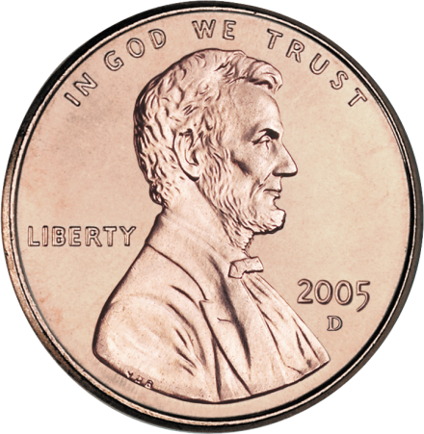

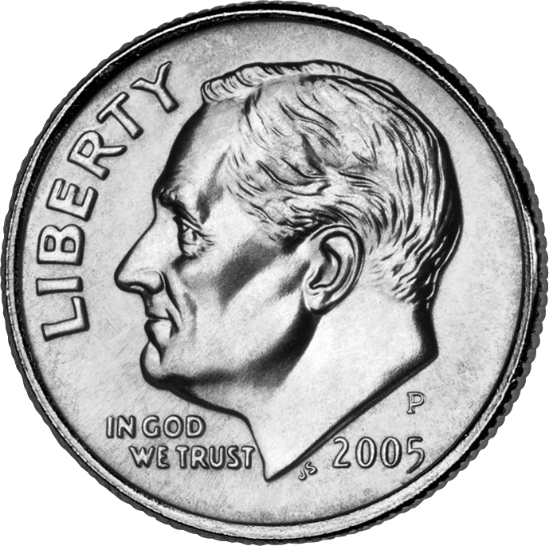

A simple problem
Find the smallest number of coins whose sum reaches a specific goal
Input:
The total to reach and the coins usable
Output:
The smallest number of coins to reach the total

Slide 81
A greedy solution
Make a set with all types of coins
Choose the largest coin in set
If this coin will take the solution total over the target total, remove it from the set. Otherwise, add it to the solution set.
Calculate how large the current solution is
If the solution set sums up to the target total, a solution has been found, otherwise repeat 2-5

Slide 82
Problem
Roma has got a list of the company's incomes. The list is a sequence that consists of n integers. The total income of the company is the sum of all integers in sequence. Roma decided to perform exactly k changes of signs of several numbers in the sequence. He can also change the sign of a number one, two or more times.
Now, we have to find the maximum total income that we can obtain after exactly k changes.
Example :
3 2
-1 -1 1
Output
3

Slide 83
Source Code
int k = 2;
List<int> elements = new List<int>() { -1, -1, 1 };
elements.Sort();
for (int i = 0; i < elements.Count; i++)
{
if (elements[i] >= 0 || k == 0)
break;
elements[i] = -elements[i];
k--;
}
if (k % 2 == 1)
{
elements.Sort();
elements[0] = -elements[0];
}

Slide 84
Problem
There is a number N. You have to find largest palindrome number which is less than or equal to N.
Input
19
278
Output
11
272

Slide 85
Backtracking
Backtracking is a refinement of the brute force approach, which systematically searches for a solution to a problem among all available options.
It does so by assuming that the solutions are represented by vectors (v₁, ..., v_{m}) of values and by traversing, in a depth first manner, the domains of the vectors until the solutions are found.

Slide 86
Algorithm
boolean solve(Node n)
{
if n is a leaf node
{
if the leaf is a goal node,
return true
else
return false
}
else
{
for each child c of n
{
if solve(c) succeeds,
return true
}
return false
}
}

Slide 87
BACKTRACKING (Contd..)
The problem is to place eight queens on an 8 x 8 chess board so that no two queens attack i.e. no two of them are on the same row, column or diagonal.
Strategy : The rows and columns are numbered
through 1 to 8.
The queens are also numbered through 1 to 8.
Since each queen is to be on a different row without loss of generality, we assume queen i is to be placed on row i .

Slide 88
BACKTRACKING (Contd..)
The solution is an 8 tuple (x₁,x₂,.....,x₈) where xi is the column on which queen i is placed.
The explicit constraints are :
S_{i} = {1,2,3,4,5,6,7,8} 1 ≤ i ≤ n or 1 ≤ x_{i} ≤ 8 i = 1,.........8
The solution space consists of 8⁸ 8- tuples.

Slide 89
BACKTRACKING (Contd..)
The implicit constraints are :
(i) no two x_{i}s can be the same that is, all queens must be on different columns.
(ii) no two queens can be on the same diagonal.
reduces the size of solution space from 8⁸ to 8! 8 – tuples.
Two solutions are (4,6,8,2,7,1,3,5) and (3,8,4,7,1,6,2,5)

Slide 90
BACKTRACKING (Contd..)
 | 1 | 2 | 3 | 4 | 5 | 6 | 7 | 8
1 |  |  |  | Q
2 |  |  |  |  |  | Q
3 |  |  |  |  |  |  |  | Q
4 |  | Q
5 |  |  |  |  |  |  | Q
6 | Q
7 |  |  | Q
8 |  |  |  |  | Q

Slide 91
BACKTRACKING (Contd..)
Example : 4 Queens problem
1
1
. . 2
1
2
1
2
3
. . . .
1
1
2
3
. , 4

Slide 92
BACKTRACKING (Contd..)
1
x₁ = 1 x₁=2
2 6
x₂= 3 4 x₂ = 4
3 4 7
B 2
5 x₃ = 1
B 8
x₄ = 3
Solution 9

Slide 93
Source Code Of 8 Queens
void Backtrack()
{
if (elements.Count == 8)
{
for (int i = 0; i < 8; i++)
Console.Write(elements[i] + " ");
Console.WriteLine();
}
else
{
for (int i = 0; i < 8; i++)
if (Check(i))
{
elements.Add(i);
Backtrack();
elements.RemoveAt( elements.Count - 1);
}
}
}
elements = new List<int>();
Backtrack();
List<int> elements;
bool Check(int index)
{
for (int i = 0; i < elements.Count; i++)
{
if (index == elements[i] || Math.Abs(index - elements[i]) == elements.Count - i)
return false;
}
return true;
}

Slide 94
BACKTRACKING
Problem
You have N pieces of money But you have need exactly T amount of money! How you can get it?
Example: N = 12, money amounts are 546, 123, 456, 34, 67, 37, 3, 5, 9, 126, 459 & 1. But you need 200 amount of money! How it possible?
=> Solve it using backtracking.

Slide 95
Hashing & Hash Tables
In computing, a hash table (also hash map) is a data structure used to implement an associative array, a structure that can map keys to values. A hash table uses a hash function to compute an index into an array of buckets or slots, from which the correct value can be found.
A hash function is any algorithm or subroutine that maps large data sets of variable length, called keys, to smaller data sets of a fixed length. For example, a person's name, having a variable length, could be hashed to a single integer. The values returned by a hash function are called hash values, hash codes, hash sums, checksums or simply hashes.

Slide 96
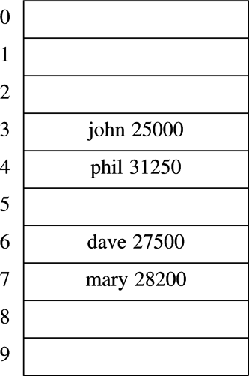
Hash table: Main components
key
value
Hash index
h(“john”)
“john”
TableSize
key
Hash
function
Hash table
(implemented as a vector)
How to determine … ?
Notes:
Cpt S 223
Washington State University

Slide 97
Hash Table
Hash table is an array of fixed size TableSize
Array elements indexed by a key, which is mapped to an array index (0…TableSize-1)
Mapping (hash function) h from key to index
  E.g., h(“john”) = 3
key
Element value
Notes:
Cpt S 223
Washington State University

Slide 98
Hash Function - Effective use of table size
Simple hash function (assume integer keys)
  h(Key) = Key mod TableSize
For random keys, h() distributes keys evenly over table
  What if TableSize = 100 and keys are ALL multiples of 10?
  Better if TableSize is a prime number
Notes:
Cpt S 223
Washington State University

Slide 99
Different Ways to Design a Hash Function for String Keys
A very simple function to map strings to integers:
Add up character ASCII values (0-255) to produce integer keys
    E.g., “abcd” = 97+98+99+100 = 394
    ==> h(“abcd”) = 394 % TableSize
Potential problems:
Anagrams will map to the same index
    h(“abcd”) == h(“dbac”)
Small strings may not use all of table
    Strlen(S) * 255 < TableSize
Time proportional to length of the string
Notes:
Cpt S 223
Washington State University

Slide 100
Different Ways to Design a Hash Function for String Keys
Approach 2
  Treat first 3 characters of string as base-27 integer (26 letters plus space)
    Key = S[0] + (27 * S[1]) + (27² * S[2])
  Better than approach 1 because … ?
  Potential problems:
  Assumes first 3 characters randomly distributed
    Not true of English
Apple
Apply
Appointment
Apricot
collision
Notes:
Cpt S 223
Washington State University

Slide 101
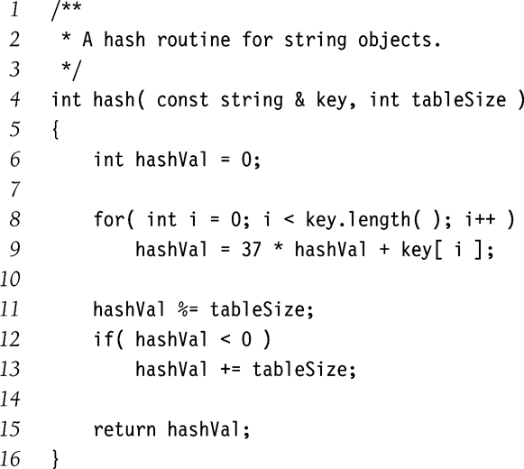
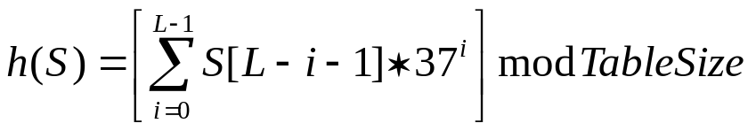
Different Ways to Design a Hash Function for String Keys
Approach 3
  Use all N characters of string as an N-digit base-K number
  Choose K to be prime number larger than number of different digits (characters)
    I.e., K = 29, 31, 37
  If L = length of string S, then
  Use Horner’s rule to compute h(S)
  Limit L for long strings
Problems:
potential overflow larger runtime
Notes:
Cpt S 223
Washington State University

Slide 102
Techniques to Deal with Collisions
“Collision resolution techniques”
Chaining
Open addressing
Double hashing
Etc.

Slide 103
Resolving Collisions
What happens when h(k₁) = h(k₂)?
  ==> collision !
Collision resolution strategies
  Chaining
    Store colliding keys in a linked list at the same hash table index
  Open addressing
    Store colliding keys elsewhere in the table
Notes:
Cpt S 223
Washington State University

Slide 104
Chaining
Collision resolution technique #1
Notes:
Cpt S 223
Washington State University

Slide 105
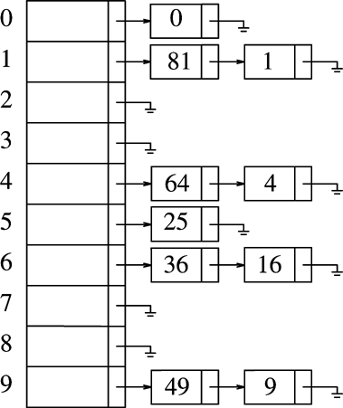
Chaining strategy: maintains a linked list at every hash index for collided elements
Insertion sequence: { 0 1 4 9 16 25 36 49 64 81 }
Hash table T is a vector of linked lists
  Insert element at the head (as shown here) or at the tail
Key k is stored in list at T[h(k)]
E.g., TableSize = 10
  h(k) = k mod 10
  Insert first 10 perfect squares
Notes:
Cpt S 223
Washington State University

Slide 106
Implementation of Chaining Hash Table
List<int>[] elements = new List<int>[8];
public void Insert(int insert){
int key = 7;
int index = insert % key;
elements[index].Add(insert);
}
public bool Search(int value){
int key = 7;
int index = value % key;
for(int i=0;i<elements[index].Count; i++)
if (elements[index][i] == value)
return true;
return false;
}
Insert(135);
Search(135);
Notes:
Cpt S 223
Washington State University

Slide 107
Collision Resolution by Chaining: Analysis
Load factor λ of a hash table T is defined as follows:
  N = number of elements in T (“current size”)
  M = size of T (“table size”)
  λ = N/M (“ load factor”)
    i.e., λ is the average length of a chain
Unsuccessful search time: O(λ)
  Same for insert time
Successful search time: O(λ/2)
Ideally, want λ ≤ 1 (not a function of N)
Notes:
Cpt S 223
Washington State University

Slide 108
Potential disadvantages of Chaining
Linked lists could get long
  Especially when N approaches M
  Longer linked lists could negatively impact performance
Absolute worst-case (even if N << M):
  All N elements in one linked list!
  Typically the result of a bad hash function

Slide 109
Open Addressing
Collision resolution technique #2
Cpt S 223. School of EECS, WSU
Notes:
Cpt S 223
Washington State University

Slide 110
Collision Resolution by
Open Addressing
An “inplace” approach
When a collision occurs, look elsewhere in the table for an empty slot
Advantages over chaining
  No need for list structures
  No need to allocate/deallocate memory during insertion/deletion (slow)
Disadvantages
  Slower insertion – May need several attempts to find an empty slot
  Table needs to be bigger (than chaining-based table) to achieve average-case constant-time performance
    Load factor λ ≈ 0.5
Notes:
Cpt S 223
Washington State University

Slide 111
Linear Probing
i^{th} probe index =
0th probe index
+ i
f(i) = is a linear function of i,
E.g., f(i) = i
  h_{i}(x) = (h(x) + i) mod TableSize
Linear probing:
0th probe
i
occupied
1st probe
occupied
2nd probe
occupied
3rd probe
…
  Probe sequence: +0, +1, +2, +3, +4, …
unoccupied
Populate x here
Continue until an empty slot is found
#failed probes is a measure of performance
Notes:
Cpt S 223
Washington State University

Slide 112
Implementation
int[] elements = new int[8];
public void Insert(int insert){
int key = 7;
int index = insert % key;
for (int i = 0; i < key; i++)
if (elements[(index + i) % key] == -1){
elements[(index + i) % key] = insert;
break;}
}
public bool Search(int value){
int key = 7;
int index = value % key;
for (int i = 0; i < key; i++){
if (elements[(index + i) % key] == -1)
return false;
else if (elements[(index + i) % key] == value)
return true;
}
return false;
}
for (int i = 0; i < 7; i++)
elements[i] = -1;
Insert(135);
Search(135);
Notes:
Cpt S 223
Washington State University

Slide 113
Double Hashing: keep two hash functions h₁ and h₂
Use a second hash function for all tries I other than 0: f(i) = i * h₂(x)
Good choices for h₂(x) ?
  Should never evaluate to 0
  h₂(x) = R – (x mod R)
    R is prime number less than TableSize
Previous example with R=7
  h₀(49) = (h(49)+f(0)) mod 10 = 9 (X)
  h₁(49) = (h(49)+1*(7 – 49 mod 7)) mod 10 = 6
f(1)
Notes:
Cpt S 223
Washington State University

Slide 114
Implementation
public bool Search(int value)
{
int key = 7;
int index = value % key;
int secondKey = 5;
int index2 = secondKey - value % secondKey;
for (int i = 0; i < key; i++)
{
if (elements[(index + i * index2) % key] == -1)
return false;
else if (elements[(index + i * index2) % key] == value)
return true;
}
return false;
}
for (int i = 0; i < 7; i++)
elements[i] = -1;
Insert(135);
Search(135);
int[] elements = new int[8];
public void Insert(int insert)
{
int key = 7;
int secondKey = 5;
int index2 = secondKey - insert % secondKey;
int index = insert % key;
for (int i = 0; i < key; i++)
if (elements[(index + i * index2) % key] == -1)
{
elements[(index + i * index2) % key] = insert;
break;
}
}
Notes:
Cpt S 223
Washington State University

Slide 115
Problem
I will give you some names, if I gave same name again, you have to say it is already used.
=> Implement it using hashing.

Slide 116
Thanks!

