Slide 1
B-Tree & R-Tree
Md. Shakil Ahmed
Senior Software Engineer
Astha it research & consultancy ltd.
Dhaka, Bangladesh

Slide 2

B-Tree

Slide 3
Why do we use B-trees
It was difficult to access a large amount of data from the secondary memory
Many of the algorithms were introduced to make our search very fast, to access the required data from the secondary memory
B-trees are more effective and faster
B-trees are used in many of the database management system

Slide 4
Definition of a B-tree
A B-tree of order m is an m-way tree (i.e., a tree where each node may have up to m children) in which:
  the number of keys in each non-leaf node is one less than the number of its children and these keys partition the keys in the children in the fashion of a search tree
  all non-leaf nodes except the root have at least ⎡m / 2⎤ children
  the root is either a leaf node, or it has from two to m children
  The number m is large than or equal to 2.

Slide 5
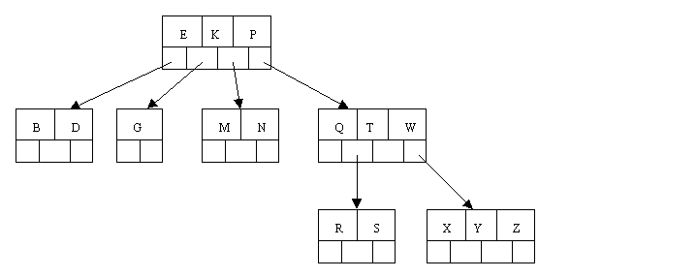
Sample B tree

Slide 6
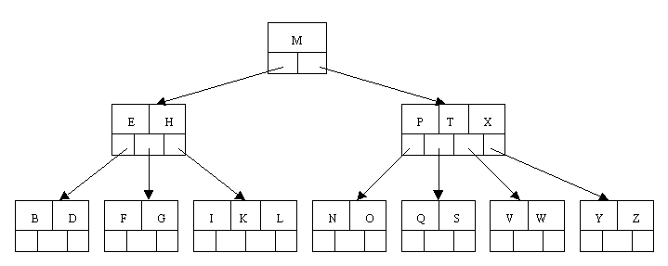
B-tree of order 5
all internal nodes have at least ceil(5 / 2) = ceil(2.5) = 3 children
maximum number of children that a node can have is 5

Slide 7
Insertion
B-tree of order 5:
C N G A H E K Q M F W L T Z D P R X Y S
Order 5 means that a node can have a maximum of 5 children and 4 keys.
All nodes other than the root must have a minimum of 2 keys.

Slide 8
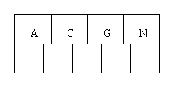
C N G A Order this ACGN
Inserting ACGN

Slide 9
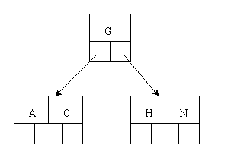
Inserting H

Slide 10
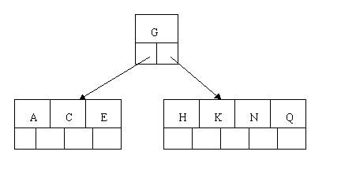
Inserting E, K, and Q proceeds without requiring any splits:

Slide 11
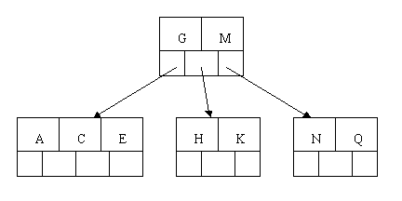
Inserting M requires a split

Slide 12
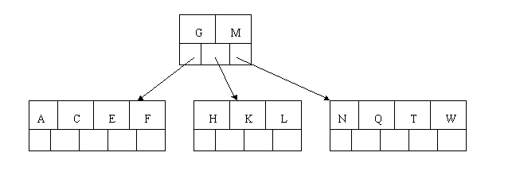
The letters F, W, L, and T are then added without needing any split

Slide 13
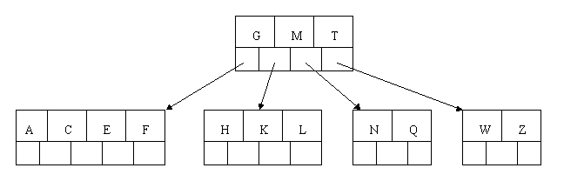
Adding Z

Slide 14
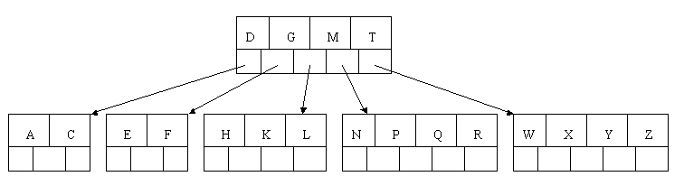
Inserting D

Slide 15
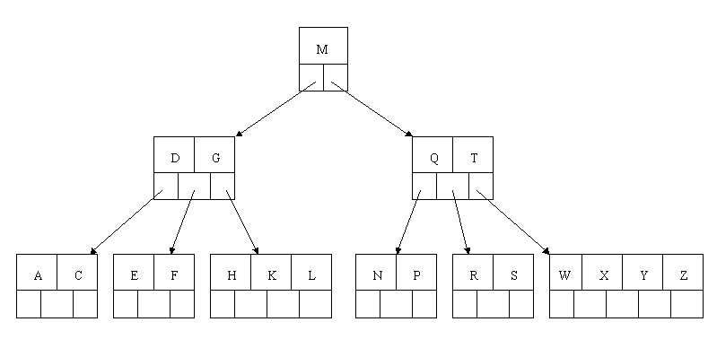
Inserting s

Slide 16
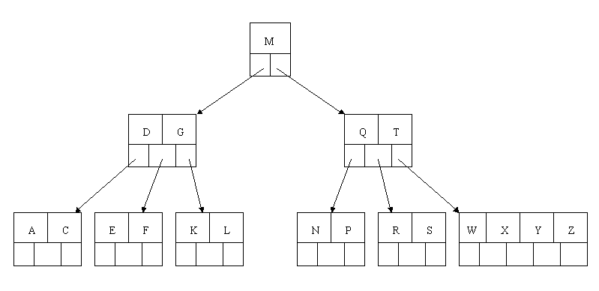
DELETION (H)

Slide 17
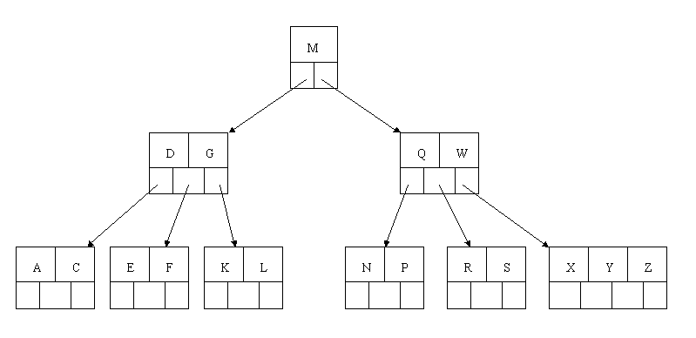
Delete T

Slide 18
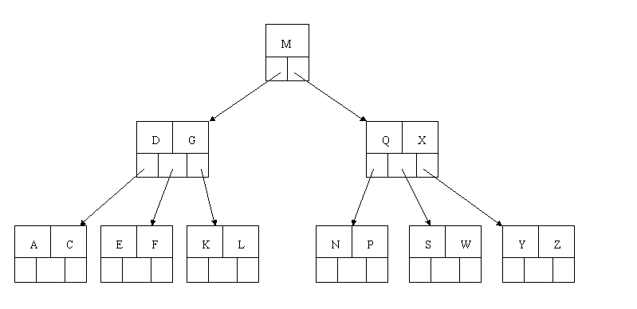
Delete R

Slide 19
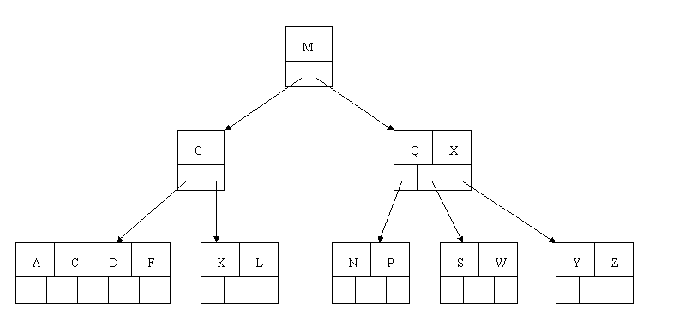
Delete E

Slide 20
R-tree
R-trees are tree data structures used for spatial access methods, for indexing multi-dimensional information such as geographical coordinates, rectangles or polygons.

Slide 21
R-Tree Motivation
y axis
10
m
g
h
8
l
f
k
e
6
i
j
4
d
b
a
2
c
x axis
0
2
4
6
8
10
Range query: find the objects in a given range.
E.g. find all hotels in Boston.
No index: scan through all objects. Inefficient!
B+-tree: only cluster based on one dim. Inefficient!

Slide 22
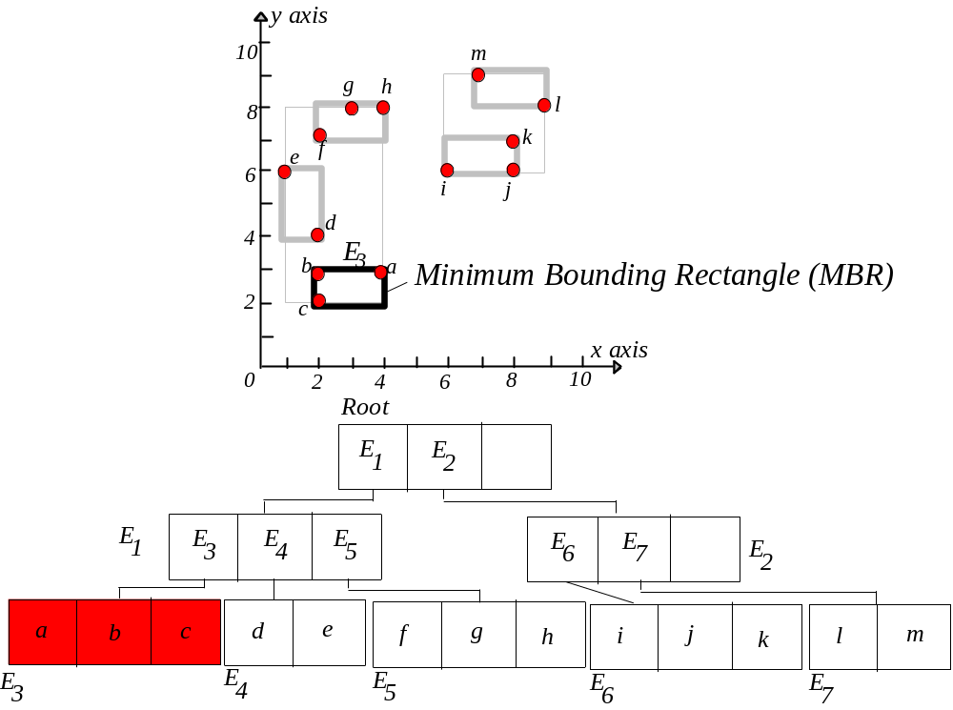
R-Tree: Clustering by Proximity

Slide 23
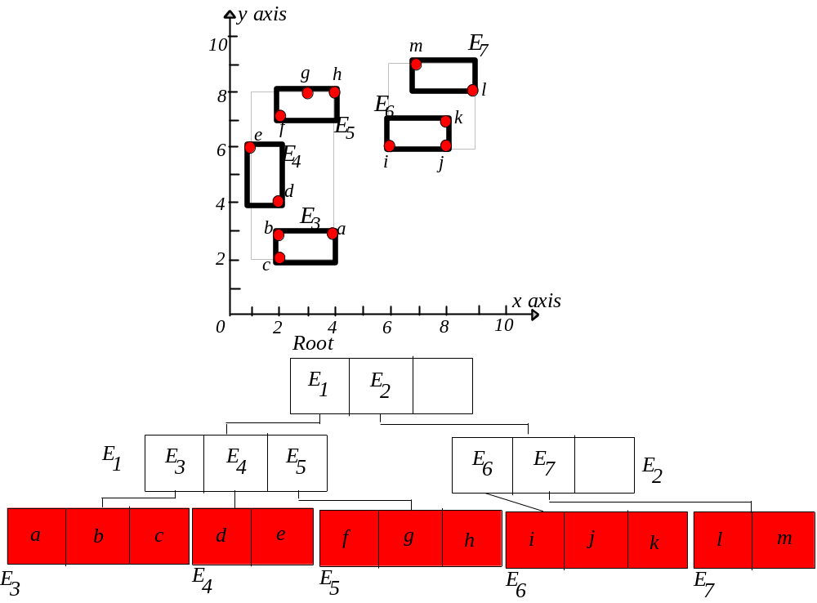
R-Tree

Slide 24
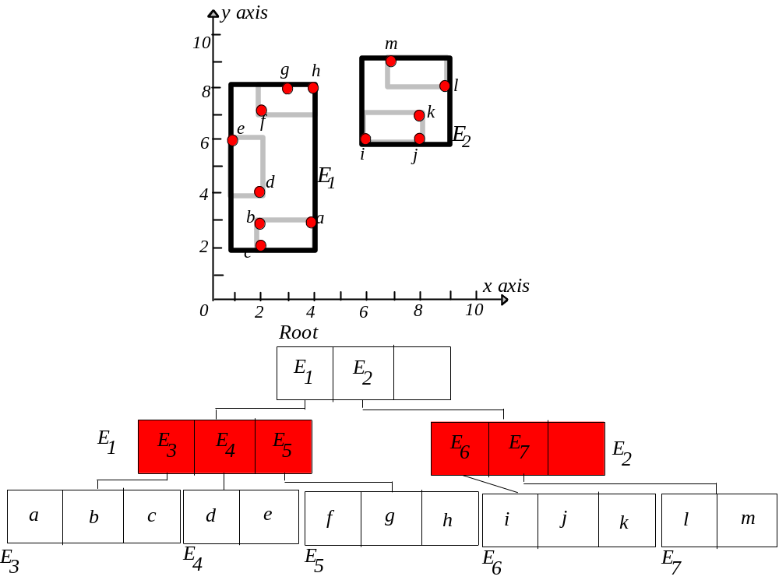
R-Tree

Slide 25
R-Tree
y axis
10
m
g
h
8
l
f
k
e
E
6
i
j
2
d
E
4
1
b
a
2
c
x axis
0
2
4
6
8
10
Root
E
1
E
2
E
1
E
3
E
4
E
5
E
E
E
6
7
2
a
b
c
d
e
f
g
h
i
j
k
l
m
E
3
E
4
E
5
E
E
6
7

Slide 26
Range query (given range Q)
Start at root.
1. If current node is non-leaf, for each
entry <E, ptr>, if box E overlaps Q,
search subtree identified by ptr.
2. If current node is leaf, for every object in
the leaf page, report if contained in Q.

Slide 27
Range Query
y axis
10
m
g
h
8
l
f
k
e
E
6
i
j
2
d
E
4
1
b
a
2
c
x axis
0
2
4
6
8
10
Root
E
1
E
2
E
1
E
3
E
4
E
5
E
E
E
6
7
2
a
b
c
d
e
f
g
h
i
j
k
l
m
E
3
E
4
E
5
E
E
6
7

Slide 28
Range Query
y axis
10
m
g
h
8
l
f
k
e
E
6
i
j
2
d
E
4
1
b
a
2
c
x axis
0
2
4
6
8
10
Root
E
1
E
2
E
1
E
3
E
4
E
5
E
E
E
6
7
2
a
b
c
d
e
f
g
h
i
j
k
l
m
E
3
E
4
E
5
E
E
6
7

Slide 29
Aggregation Query
Given a range, find some aggregate value of objects in this range.
COUNT, SUM, AVG, MIN, MAX
E.g. find the total number of hotels in Massachusetts.
Straightforward approach: reduce to a range query.
Better approach: along with each index entry, store aggregate of the sub-tree.

Slide 30
Aggregation Query
y axis
10
m
g
h
8
l
f
k
e
E
6
i
j
2
d
E
4
1
b
a
2
c
x axis
0
2
4
6
8
10
Root
E :8
E :5
1
2
E
1
E :3
E :2
E :3
E :3
E :2
E
3
4
5
6
7
2
a
b
c
d
e
f
g
h
i
j
k
l
m
E
3
E
4
E
5
E
E
6
7

Slide 31
Aggregation Query
y axis
10
m
g
h
8
l
f
k
e
E
6
i
j
2
d
E
4
1
Subtree pruned!
b
a
2
c
x axis
0
2
4
6
8
10
Root
E :8
E :5
1
2
E
1
E :3
E :2
E :3
E :3
E :2
E
3
4
5
6
7
2
a
b
c
d
e
f
g
h
i
j
k
l
m
E
3
E
4
E
5
E
E
6
7

Slide 32
Insert object o
Start at root and go down to “best-fit” leaf L.
  Go to child whose box needs least enlargement to cover B; resolve ties by going to smallest area child.
If best-fit leaf L has space, insert entry and stop. Otherwise, split L into L1 and L2.
  Adjust entry for L in its parent so that the box now covers (only) L1.
  Add an entry (in the parent node of L) for L2. (This could cause the parent node to recursively split.)

Slide 33
E.g. 1: no split, no enlargement
y axis
insert o
10
m
g
h
8
l
f
k
e
E
6
i
j
2
d
E
4
1
b
a
2
c
x axis
0
2
4
6
8
10
Root
E
1
E
2
E
1
E
3
E
4
E
5
E
E
E
6
7
2
a
b
c
d
e
f
g
h
i
j
k
l
m
o
E
3
E
4
E
5
E
E
6
7

Slide 34
E.g. 2: no split, but enlargement
y axis
insert o
10
m
g
h
8
l
f
k
e
E
6
i
j
2
d
E
4
1
b
a
2
c
x axis
0
2
4
6
8
10
Root
E
1
E
2
E
1
E
3
E
4
E
5
E
E
E
6
7
2
a
b
c
d
e
f
g
h
i
j
k
l
m
o
E
3
E
4
E
5
E
E
6
7

Slide 35
E.g. 2: no split, but enlargement
y axis
insert o
10
m
g
h
8
l
f
k
e
E
6
i
j
2
d
E
4
1
b
a
2
c
x axis
0
2
4
6
8
10
Root
E
1
E
2
E
1
E
3
E
4
E
5
E
E
E
6
7
2
a
b
c
d
e
f
g
h
i
j
k
l
m
o
E
3
E
4
E
5
E
E
6
7

Slide 36
E.g. 3: split
y axis
10
m
g
h
8
l
f
k
e
E
6
i
j
2
d
E
4
1
b
a
insert o
2
c
x axis
0
2
4
6
8
10
Root
E
1
E
2
E
1
E
3
E
4
E
5
E
E
E
6
7
2
a
b
c
d
e
f
g
h
i
j
k
o
l
m
E
3
E
4
E
5
E
E
6
7

Slide 37
E.g. 3: split
y axis
10
m
g
h
8
l
o
k
e
f
E
6
i
j
2
d
E
4
1
b
a
2
c
x axis
0
2
4
6
8
10
Root
E
1
E
2
E
1
E
3
E
4
E
5
E
E
E’
E
6
7
6
2
a
b
c
d
e
f
g
h
i
o
j
k
l
m
E
3
E
4
E
5
E
E
6
7

Slide 38
Thanks!

