Slide 1
Dynamic Programming
Md. Shakil Ahmed
Software Engineer
Astha it research & consultancy ltd.
Dhaka, Bangladesh

Slide 2
Dynamic Programming
Algorithmic technique that systematically records the answers to sub-problems in a table and re-uses those recorded results (rather than re-computing them).
Simple Example: Calculating the Nth Fibonacci number.
Fib(N) = Fib(N-1) + Fib(N-2)

Slide 3
Introduction
Topic Focus:
Unidirectional TSP
Coin Change
LCS
LIS
The Partition Problem
String Partition
TSP (Bitmask)
Matrix-chain multiplication

Slide 4
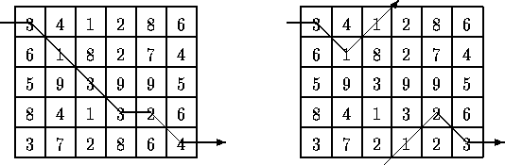

Unidirectional TSP
Output minimal-weight path, and the second line is the cost of a minimal path.
Input:
5 6
3 4 1 2 8 6
6 1 8 2 7 4
5 9 3 9 9 5
8 4 1 3 2 6
3 7 2 8 6 4
Output:
1 2 3 4 4 5
16

Slide 5
Source Code
fix= infinity;
for(i=0;i<n;i++)
for(j=0;j<m;j++)
{
scanf("%lld",&sa[i][j]);
si[i][j]=fix;
t1[i][j]=-1;
}
for(i=0;i<n;i++)
si[i][m-1]=sa[i][m-1];
for(j=m-1;j>0;j--)
for(i=0;i<n;i++)
{
if(si[i][j-1] > si[i][j] + sa[i][j-1] || (si[i][j-1] == si[i][j] + sa[i][j-1] && t1[i][j-1] > i))
{
si[i][j-1]=si[i][j]+sa[i][j-1];
t1[i][j-1]=i;
}
k=i-1;
if(k<0)
k=k+n;
if(si[k][j-1] > si[i][j] + sa[k][j-1] || (si[k][j-1] == si[i][j] + sa[k][j-1] && t1[k][j-1] > i))
{
si[k][j-1]=si[i][j]+sa[k][j-1];
t1[k][j-1]=i;
}

Slide 6
Source Code
k=i+1;
k=k%n;
if(si[k][j-1] > si[i][j] + sa[k][j-1] || (si[k][j-1] == si[i][j] + sa[k][j-1] && t1[k][j-1] > i))
{
si[k][j-1]=si[i][j]+sa[k][j-1];
t1[k][j-1]=i;
}
}
min=fix;
for(i=0;i<n;i++)
if(si[i][0]<min)
{
min=si[i][0];
k=i;
}
printf("%ld",k+1);
j=0;
while(t1[k][j]!=-1)
{
printf(" %ld",t1[k][j]+1);
k=t1[k][j];
j++;
}
printf("\n%lld\n",min);
Sample Problems:
UVA Online Judge: 116.

Slide 7
Coin change
Coin change is the problem of finding the number of ways to make change for a target amount given a set of denominations. It is assumed that there is an unlimited supply of coins for each denomination. An example will be finding change for target amount 4 using change of 1,2,3 for which the solutions are (1,1,1,1), (2,2), (1,1,2), (1,3).

Slide 8
Coin Change Source Code
long s[6], sa[7600]={0}, i, j, k;
s[0]=1;
s[1]=5;
s[2]=10;
s[3]=25;
s[4]=50;
sa[0]=1;
for(j=0;j<=4;j++)
{
for(i=0;i<=7500;i++)
{
if(i+s[j]>7500)
break;
sa[i+s[j]]+=sa[i];
}
}
while(scanf("%ld",&i)==1)
{
printf("%ld\n",sa[i]);
}

Slide 9
Coin change
Sample Problems:
UVA Online Judge: 147, 166, 357, 674, 10306, 10313, 11137, 11517.

Slide 10
The longest common subsequence (LCS) problem
A string : A = b a c a d
A subsequence of A: deleting 0 or more symbols from A (not necessarily consecutive).
e.g. ad, ac, bac, acad, bacad, bcd.
Common subsequences of A = b a c a d and
B = a c c b a d c b : ad, ac, bac, acad.
The longest common subsequence (LCS) of A and B:
a c a d.

Slide 11
The LCS algorithm
Let A = a₁ a₂ … a_{m} and B = b₁ b₂ … b_{n}
Let L_{i,j} denote the length of the longest common subsequence of a₁ a₂ … a_{i} and b₁ b₂ … b_{j.}
L_{i,j} = L_{i-1,j-1} + 1 if a_{i}=b_{j}
max{ L_{i-1,j}, L_{i,j-1} } if a_{i}≠b_{j}
L_{0,0} = L_{0,j} = L_{i,0} = 0 for 1≤i≤m, 1≤j≤n.

Slide 12
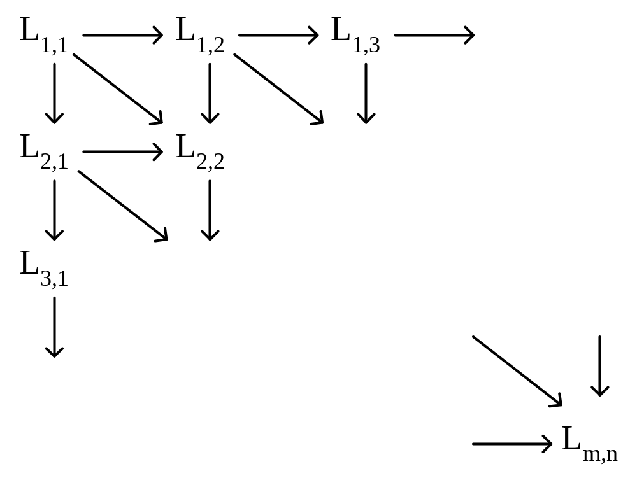
Time complexity: O(mn)
The dynamic programming approach for solving the LCS problem:

Slide 13
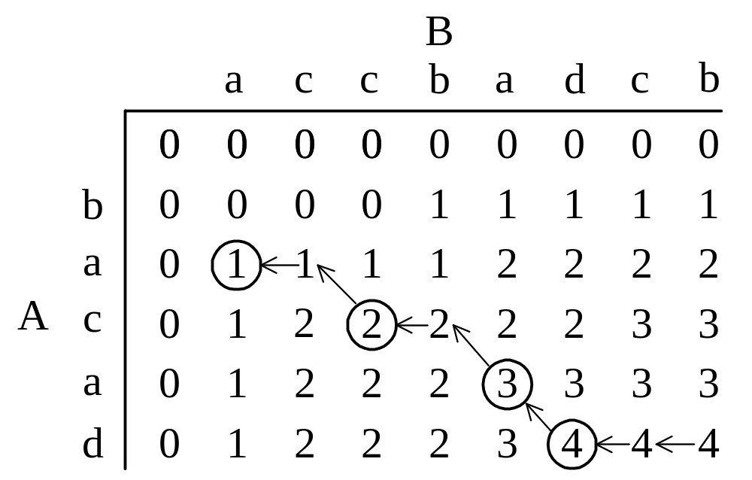
Tracing back in the LCS algorithm
e.g. A = b a c a d, B = a c c b a d c b
After all L_{i,j}’s have been found, we can trace back to find the longest common subsequence of A and B.

Slide 14
LCS Source Code
void LCS(){
for(i=0;i<=m;i++)
for(j=0;j<=n;j++)
{
c[i][j]=0;
b[i][j]='0';
}
for(i=1;i<=m;i++)
for(j=1;j<=n;j++)
{
if(x[i]==y[j])
{
c[i][j]=c[i-1][j-1]+1;
b[i][j]='1';
}
else if(c[i-1][j]>=c[i][j-1])
{
c[i][j]=c[i-1][j];
b[i][j]='2';
}
else
{
c[i][j]=c[i][j-1];
b[i][j]='3';
}
}
}

Slide 15
void printSequence(long int i,long int j)
{
if(i==0||j==0)
return ;
if(b[i][j]=='1')
{
printSequence (i-1,j-1);
printf(“%c”,x[i]);
}
else if(b[i][j]=='2')
printSequence (i-1,j);
else
printSequence (i,j-1);
}
Sample Problems:
UVA Online Judge: 10066, 10405.

Slide 16
Longest Increasing Subsequence
The longest increasing subsequence problem is to find a subsequence of a given sequence in which the subsequence elements are in sorted order, lowest to highest, and in which the subsequence is as long as possible. This subsequence is not necessarily contiguous.
A simple way of finding the longest increasing subsequence is to use the Longest Common Subsequence (Dynamic Programming) algorithm.
Make a sorted copy of the sequence A, denoted as B. O(nlog(n)) time.
Use Longest Common Subsequence on with A and B. O(n²) time.

Slide 17
Simple LIS
function lis_length( a )
n := a.length
q := new Array(n)
for k from 0 to n:
max := 0;
for j from 0 to k, if a[k] > a[j]:
if q[j] > max, then set max = q[j].
q[k] := max + 1;
max := 0
for i from 0 to n:
if q[i] > max, then set max = q[i].
return max;

Slide 18
Simple LIS
Complexity O(n^2)
for(i=0;i<n;i++)
{
scanf(“%ld”,&A[i]);
Len[i]=1;
Pre = -1;
}
Max = 0; Position = 0;
for(i=0;i<n;i++)
{
if(Len[i]>Max)
{
Max = Len[i];
Position = i;
}
for(j=i+1;j<n;j++)
If(A[j]>=A[i] && Len[j]<Len[i]+1)
{
Len[j]=Len[i]+1;
Pre[j]=i;
}
}
For sequence Print:
void Show(long h1)
{
If(Pre[h1]!=-1)
Show(Pre[h1]);
Printf(“%ld\n”,A[h1]);
}
Show(Position);

Slide 19
Efficient LIS
Complexity O(n*log(n))
L = 0
for i = 1, 2, ... n:
binary search for the largest positive j ≤ L
such that X[M[j]] < X[i] (or set j = 0 if no such value exists)
P[i] = M[j]
if j == L or X[i] < X[M[j+1]]:
M[j+1] = i
L = max(L, j+1)

Slide 20
Efficient LIS
long BinarySearch(long left,long right,long value)
{
long mid = (left+right)/2;
while(left<=right)
{
if(temp[mid]==value)
break;
else if(temp[mid]<value)
left = mid+1;
else
right = mid – 1;
mid = (left+right)/2;
}
return mid;
}

Slide 21
Efficient LIS
void LIS(long N)
{ long n=0,i,mid;
for(i=0;i<N;i++)
{
if(n==0)
{ temp[n]=sa[i];tempP[n]=i;
A[i]=1;n++; }
else
{
mid = BinarySearch(0,n-1,sa[i]);
while(mid>0&&temp[mid]>sa[i])
mid–;
if(temp[mid]<sa[i])
{
A[i]=mid+2;P[i]=tempP[mid];
if(mid+1>=n)
{
temp[n]=sa[i]; tempP[n]=i;
n++;
}
else if(temp[mid+1]>sa[i])
{
temp[mid+1]=sa[i];
tempP[mid+1]=i;
}
}
else if(temp[0]>sa[i])
{
temp[0]=sa[i];
tempP[0]=i;
} } }
}

Slide 22
Efficient LIS
void show(long h1)
{
if(P[h1]==-1)
printf(“%ld”,sa[h1]);
else
{
show(P[h1]);
printf(” %ld”,sa[h1]);
}
}
for(i=0;i<n;i++)
{
scanf(“%ld”,&sa[i]);
P[i]=-1;
}
LIS(n);
max = 0;
x = 0;
for(i=0;i<n;i++)
if(A[i]>max)
{
max = A[i];
x = i;
}
printf(“%ld\n”,max);
show(x);

Slide 23
LIS
Sample Problems:
UVA Online Judge: 111, 231, 437, 481, 497, 1196, 10131, 10534, 11456, 11790.

Slide 24
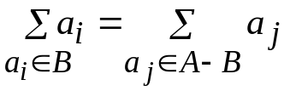
The Partition Problem
Given a set of positive integers, A = {a₁, a₂, …, a_{n}}. The question is to select a subset B of A such that the sum of the numbers in B equals the sum of the numbers not in B, i.e., . We may assume that the sum of all numbers in A is 2K, an even number. We now propose a dynamic programming solution. For 1 ≤ i ≤ n and 0 ≤ j ≤ K,
define P[i, j] = True if there exists a subset of the first i numbers a₁ through a_{i} whose sum equals j; False otherwise.
Thus, P[i, j] = True if either j = 0 or if (i = 1 and j = a₁). When i > 1, we have the following recurrence: P[i, j] = P[i – 1, j] or (P[i – 1, j – a_{i}] if j – a_{i} ≥ 0) That is, in order for P[i, j] to be true, either there exists a subset of the first i – 1 numbers whose sum equals j, or whose sum equals j – a_{i} (this latter case would use the solution of P[i – 1, j – a_{i}] and add the number a_{i}. The value P[n, K] is the answer.

Slide 25
Example: Suppose A = {2, 1, 1, 3, 5} contains 5 positive integers. The sum of these number is 2+1+1+3+5=12, an even number. The partition problem computes the truth value of P[5, 6] using a tabular approach as follows:
Because j ≠ a₁
j
i
0 1 2 3 4 5 6
a₁ = 2 a₂ = 1 a₃ = 1 a₄ = 3 a₅ = 5
T F T F F F F T T T T F F F T T T T T F F T T T T T T T T T T T T T T
P[4,5] = (P[3,5] or P[3, 5 – a₄] )
Always true
The time complexity is O(nK); the space complexity O(K).

Slide 26
The Partition Problem Source Code
sum = 0;
for(i=0;i<n;i++)
sum += A[i];
for(i=0;i<=sum/2;i++)
Flag[i]=0;
Flag[0]=1;
for(i=0;i<n;i++)
for(j=sum/2-A[i];j>=0;j--)
if(Flag[j]==1)
Flag[j+A[i]]=1;
for(i=sum/2;i>=0;i--)
if(Flag[i]==1)
break;
Dif = (sum – i) – i;

Slide 27
String Partition
A string of digits instead of a list of integers. There are many ways to split a string of digits into a list of non-zero-leading (0 itself is allowed) 32-bit signed integers. What is the maximum sum of the resultant integers if the string is split appropriately? A string of at most 200 digits.
Input:
11111111111111111111111111111111111111111111111111111
Output:
5555555666

Slide 28
Source Code
Limit = 2147483647;
Len = strlen(input);
for(i=0;i<=Len;i++)
Max[i]=0;
for(i=0;i<Len;i++)
{
Num = 0;
for(j=i;j<Len;j++)
{
Num = Num * 10 + input[j]-’0’;
if(Num>Limit)
break;
if(Num+Max[i]>Max[j+1])
Max[j+1] = Num+Max[i];
if(j==i&&input[j]==‘0’)
break;
}
}
printf(“%lld\n”,Max[Len]);
Sample Problems:
UVA Online Judge: 11258.

Slide 29
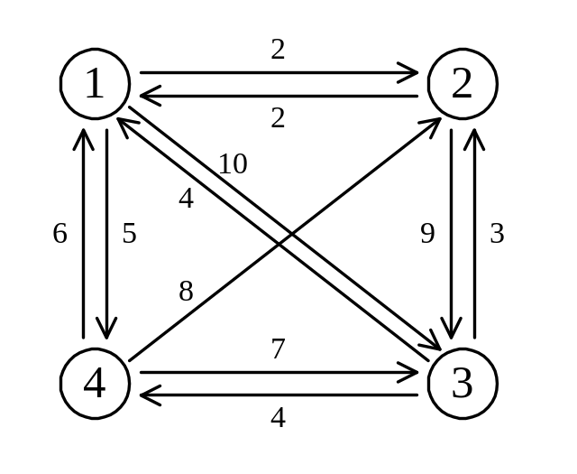
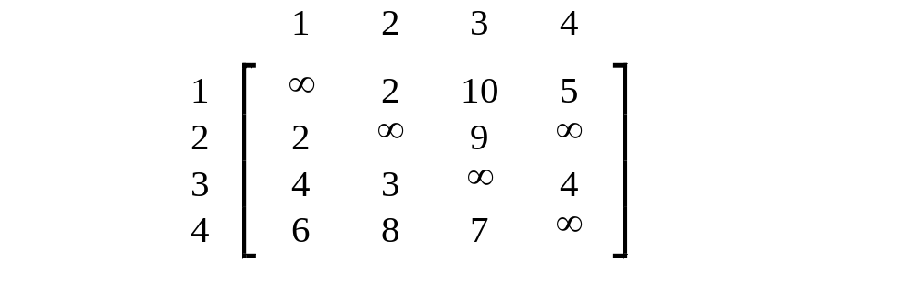
The traveling salesperson (TSP) problem
e.g. a directed graph :
Cost matrix:

Slide 30
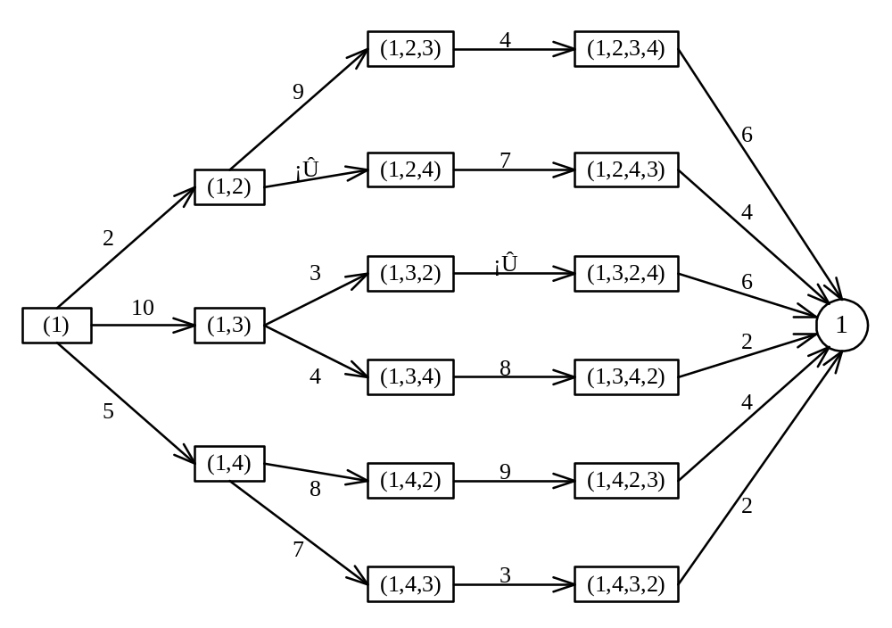
TSP
A multistage graph can describe all possible tours of a directed graph.
Find the shortest path:
(1, 4, 3, 2, 1) 5+7+3+2=17

Slide 31
BIT MASK
you are in node 1, and you have to visit node 2 5 & 10. Now, you have to fine the minimum cost for this operation.
you have to visit l number of node, like l = 3. then node[] = 2, 3, 4
& your source is 1. now you have to find the minimum cost of the tour.
C[][] = cost matrix of the nodes.

Slide 32
BIT MASK Source Code
P[0]=1;
for(i=1;i<=15;i++ )
{
P[i] = P[i-1]*2;
}
source = 1;
for(i=0;i<=P[l];i++)
{
for(j=0;j<l;j++)
{
bit[i][j] = MAX;
}
}
for(i=0;i<l;i++)
{
if( C[ source ][ node[i] ]!=MAX )
{
bit[ P[i] ][i] = C[ source ][ node[i] ];
}
}
for(i=0;i<P[l];i++)
{
for(j=0;j<l;j++)
{
if( bit[i][j]!=MAX )
{
for(k=0;k<l;k++)
{
if( (i%P[k+1])/P[k]==0 )
{

Slide 33
BIT MASK Source Code
if( C[node[j]][node[k]]!=MAX )
{
if( bit[ i+P[k] ][k] > bit[i][j] + C[node[j]][node[k]] )
{
bit[ i+P[k] ][k] = bit[i][j] + C[node[j]][node[k]];
}
}
}
}
}
}
}
int res = MAX;
for(i=0;i<l;i++)
if(bit[P[l]-1][i]!=MAX)
if(res > bit[P[l]-1][i])
res = bit[P[l]-1][i];
printf(“%d\n”,res);

Slide 34
Sample
UVA Online Judge: 10651, 216, 10496, 11813, 10718.

Slide 35
Matrix-chain multiplication
n matrices A₁, A₂, …, A_{n} with size
p₀ × p₁, p₁ × p₂, p₂ × p₃, …, p_{n-1} × p_{n}
To determine the multiplication order such that # of scalar multiplications is minimized.
To compute A_{i} × A_{i+1}, we need p_{i-1}p_{i}p_{i+1} scalar multiplications.
e.g. n=4, A₁: 3 × 5, A₂: 5 × 4, A₃: 4 × 2, A₄: 2 × 5
((A₁ × A₂) × A₃) × A₄, # of scalar multiplications:
3 * 5 * 4 + 3 * 4 * 2 + 3 * 2 * 5 = 114
(A₁ × (A₂ × A₃)) × A₄, # of scalar multiplications:
3 * 5 * 2 + 5 * 4 * 2 + 3 * 2 * 5 = 100
(A₁ × A₂) × (A₃ × A₄), # of scalar multiplications:
3 * 5 * 4 + 3 * 4 * 5 + 4 * 2 * 5 = 160

Slide 36
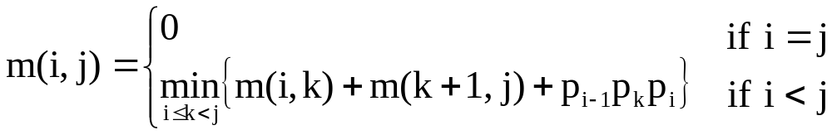
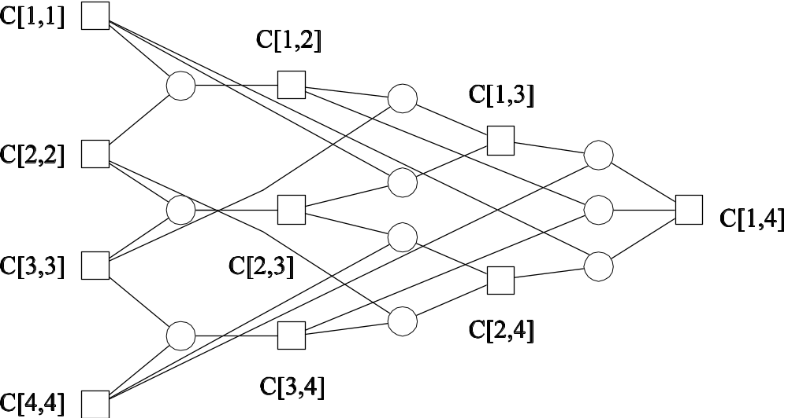
Let m(i, j) denote the minimum cost for computing
A_{i} × A_{i+1} × … × A_{j}
Time complexity : O(n³)
Computation sequence :

Slide 37
Matrix-chain multiplication
// Matrix Ai has dimension p[i-1] x p[i] for i = 1..n
Matrix-Chain-Order(int p[]) {
// length[p] = n + 1
n = p.length - 1;
// m[i,j] = Minimum number of scalar multiplications (i.e., cost)
// needed to compute the matrix A[i]A[i+1]...A[j] = A[i..j]
// cost is zero when multiplying one matrix
for (i = 1; i <= n; i++)
m[i,i] = 0;
for (L=2; L<=n; L++) { // L is chain length
for (i=1; i<=n-L+1; i++) {
j = i+L-1;

Slide 38
Matrix-chain multiplication
m[i,j] = MAXINT;
for (k=i; k<=j-1; k++) {
// q = cost/scalar multiplications
q = m[i,k] + m[k+1,j] + p[i-1]*p[k]*p[j];
if (q < m[i,j])
{
m[i,j] = q;
// s[i,j] = Second auxiliary table that stores k
// k = Index that achieved optimal
cost s[i,j] = k;
}
} } } }

Slide 39
Thanks!

