Slide 1
Graph
Md. Shakil Ahmed
Software Engineer
Astha it research & consultancy ltd.
Dhaka, Bangladesh

Slide 2
Introduction
Topic Focus:
Graph Representation
DFS
BFS
Union Find
Kruskal's algorithm
Floyd-Warshall's Algorithm
Dijkstra's Algorithm
Bipartite graph

Slide 3
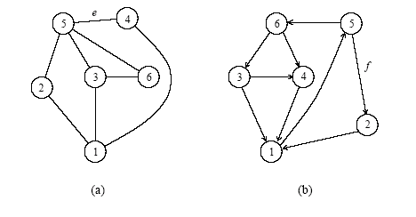
Graph
a) An undirected graph and (b) a directed graph.

Slide 4
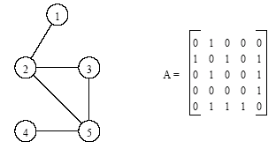
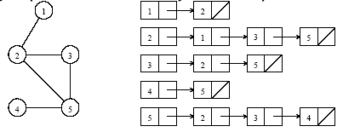
Definitions and Representation
An undirected graph and its adjacency matrix representation.
An undirected graph and its adjacency list representation.

Slide 5
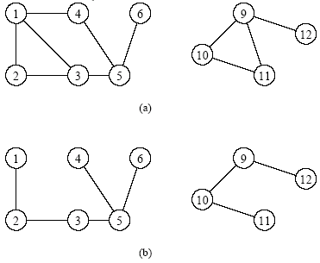
Depth-First Search
Depth-first search is a systematic way to find all the vertices reachable from a source vertex, s.
Historically, depth-first was first stated formally hundreds of years ago as a method for traversing mazes.
The basic idea of depth-first search is this: It methodically explore every edge. We start over from different vertices as necessary. As soon as we discover a vertex, DFS starts exploring from it

Slide 6
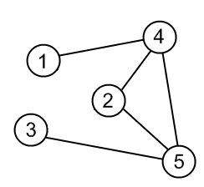
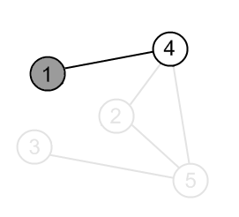
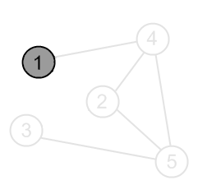
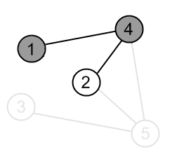
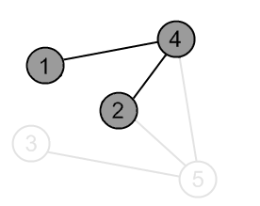
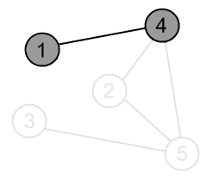
Depth-First Search

Slide 7
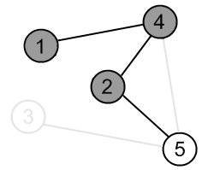
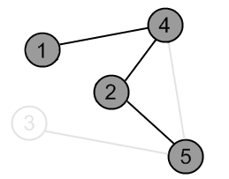
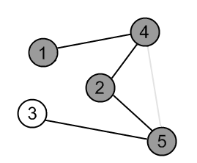
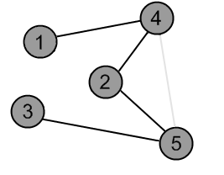
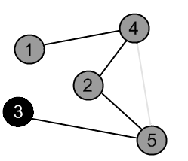
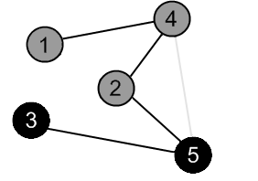
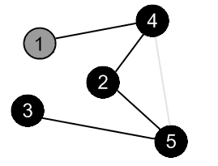
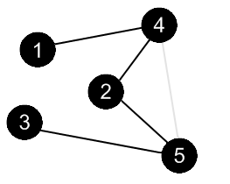
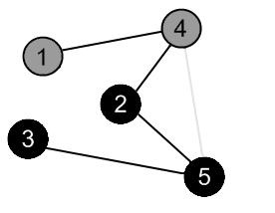

Slide 8
Depth-First Search
procedure DFS(G,v):
label v as explored
for all edges e in G.incidentEdges(v) do
if edge e is unexplored then
w ← G.opposite(v,e)
if vertex w is unexplored then
label e as a discovery edge
recursively call DFS(G,w)

Slide 9
DFS Source Code
void DFS(long node)
{
long i;
printf(“%ld “,node);
visit[node]=1;
for(i=1;i<=n;i++)
if(visit[i]==0&&A[node][i]==1)
DFS(i);
}
visit[]={0};
A[][] = connection matrix.
n = number of nodes, from 1 to n.
source = 1;
DFS(source);

Slide 10
Sample
UVA Online Judge: 260, 352, 469, 572, 776, 784, 871, 1197, 10336, 10946, 11110, 11244, 11470, 11518.

Slide 11
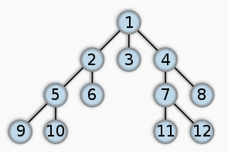
Breadth-first search
In graph theory, breadth-first search (BFS) is a graph search algorithm that begins at the root node and explores all the neighboring nodes.
Then for each of those nearest nodes, it explores their unexplored neighbor nodes, and so on, until it finds the goal.

Slide 12
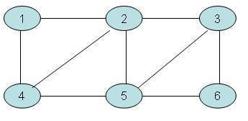
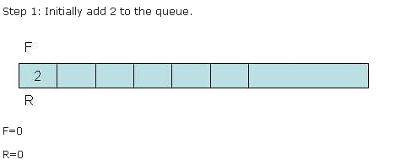
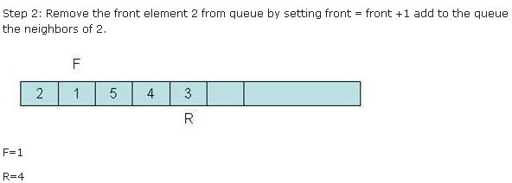
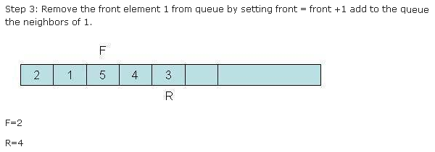
More BFS

Slide 13
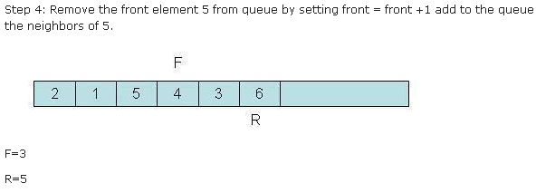
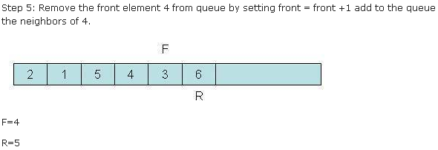
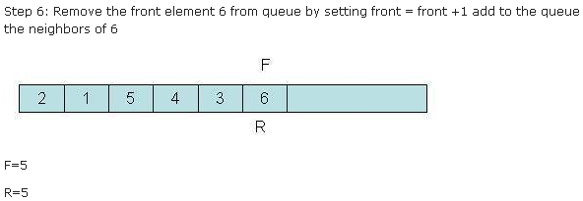
More BFS

Slide 14
BFS Pseudo-Code
Step 1: Initialize all nodes to ready state (status = 1)
Step 2: Put the starting node in queue and change its status to the waiting state (status = 2)
Step 3: Repeat step 4 and 5 until queue is empty
Step 4: Remove the front node n of queue. Process n and change the status of n to the processed state (status = 3)
Step 5: Add to the rear of the queue all the neighbors of n that are in ready state (status = 1), and change their status to the waiting state (status = 2).
[End of the step 3 loop]
Step 6: Exit

Slide 15
BFS Source Code
}
N++;
}
for(i=0;i<M;i++)
printf(“%ld “,temp[i]);
visit[]={0};
A[][] = connection matrix.
n = number of nodes, from 1 to n.
source = 1;
temp[0]=source;
visit[ source ]=1;
N = 0; M = 1;
while(N!=M)
{
for(i=1;i<=n;i++)
if(A[temp[N]][i]==1&&visit[i]==0)
{
visit[i]=1;
temp[M]=i;
M++;

Slide 16
Sample
UVA Online Judge: 336, 383, 429, 439, 532, 567, 627, 762, 924, 10009, 10067, 10422, 10610, 10653, 10959, 10977, 11049, 11101, 11352, 11624, 11974, 12160.

Slide 17
DFS vs. BFS
DFS Process
F
B
A
start
E
G
D
C
destination
C
DFS on C
D
Call DFS on D
B
DFS on B
B
B
Return to call on B
A
DFS on A
A
A
A
G
Call DFS on G
found destination - done!
Path is implicitly stored in DFS recursion
Path is: A, B, D, G
D
B
A

Slide 18
DFS vs. BFS
F
B
A
start
E
BFS Process
G
D
C
destination
rear
front
rear
front
rear
front
rear
front
A
B
D
C
D
Initial call to BFS on A
Add A to queue
Dequeue A
Add B
Dequeue B
Add C, D
Dequeue C
Nothing to add
rear
front
G
found destination - done!
Path must be stored separately
Dequeue D
Add G

Slide 19
Union Find
Union Find is an algorithm which uses a disjoint-set data structure to solve the following problem: Say we have some number of items. We are allowed to merge any two items to consider them equal (where equality here obeys all of the properties of an Equivalence Relation). At any point, we are allowed to ask whether two items are considered equal or not.
Basically a Union Find data structure implements two functions:
union( A, B ) - merge A's set with B's set
find( A ) - finds what set A belongs to

Slide 20
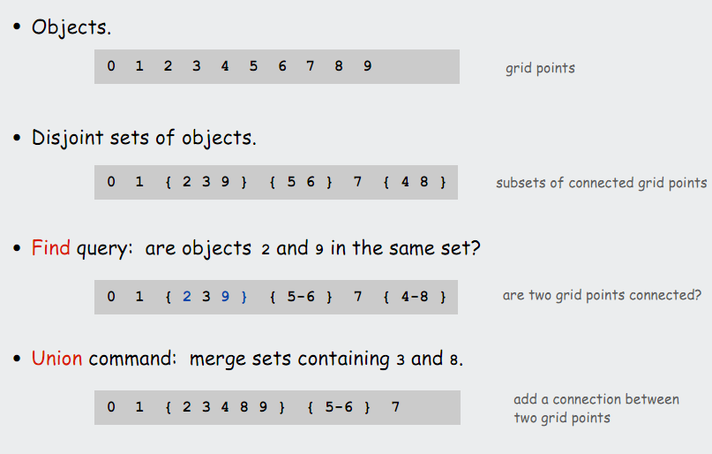
Union Find

Slide 21
Union Find Pseudocode
func find( var element )
while ( element is not the root )
element = element's parent
return element
end func
func union( var setA, var setB )
var rootA = find( setA )
rootB = find( setB )
if ( rootA is equal to rootB )
return
else
set rootB as rootA's parent
end func

Slide 22
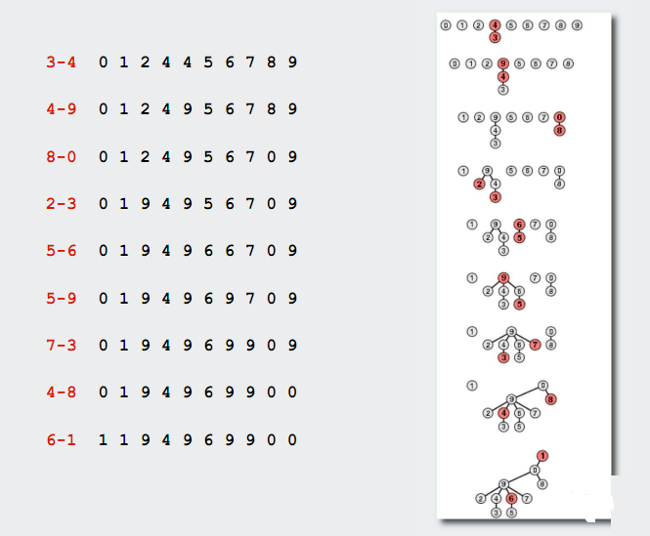
Union Find

Slide 23
Union Find Source Code
long Parent(long h1)
{
if(P[h1]==-1)
return h1;
P[h1] = Parent(P[h1]);
return P[h1];
}
for(i=1;i<=n;i++) // n number of thing
P[i]=-1;
for(i=1;i<=m;i++) // m number of connection
{
scanf(“%ld %ld”,&x,&y);
x1 = Parent(x);
y1 = Parent(y);
if(x1!=y1)
P[x1]=y1;
}
To find, any two members are same or different group
for(i=1;i<=k;i++)
{
scanf(“%ld %ld”,&x,&y);
x1 = Parent(x);
y1 = Parent(y);
if(x1!=y1)
printf(“Different\n”);
else
printf(“Same\n”);
}

Slide 24
Sample
UVA Online Judge: 459, 793, 10158, 10369, 10583, 10608, 10685, 11503.

Slide 25
Minimum Spanning Tree
A spanning tree of an undirected graph G is a subgraph of G that is a tree containing all the vertices of G.
In a weighted graph, the weight of a subgraph is the sum of the weights of the edges in the subgraph.
A minimum spanning tree (MST) for a weighted undirected graph is a spanning tree with minimum weight.

Slide 26
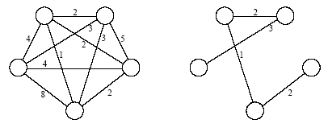
Minimum Spanning Tree
An undirected graph and its minimum spanning tree.

Slide 27
Kruskal's algorithm
Kruskal's algorithm is an algorithm in graph theory that finds a minimum spanning tree for a connectedweighted graph. This means it finds a subset of the edges that forms a tree that includes every vertex, where the total weight of all the edges in the tree is minimized. If the graph is not connected, then it finds a minimum spanning forest (a minimum spanning tree for each connected component).
Kruskal's algorithm is an example of a greedy algorithm.

Slide 28
Kruskal's algorithm Pseudocode
(Sort the edges in an increasing order)
A:={}
while E is not empty do {
take an edge (u, v) that is shortest in E
and delete it from E
if u and v are in different components then
add (u, v) to A
}

Slide 29
The execution of Kruskal's algorithm (Moderate part)
The edges are considered by the algorithm in sorted order by weight.
The edge under consideration at each step is shown with a red weight number.
8
7
b
c
d
9
4
2
a
11
i
14
e
4
7
6
8
10
h
g
f
1
2

Slide 30
8
7
b
c
d
9
4
2
a
11
i
14
e
4
7
6
8
10
h
g
f
1
2
8
7
b
c
d
9
4
2
a
11
i
14
e
4
7
6
8
10
h
g
f
1
2

Slide 31
8
7
b
c
d
9
4
2
a
11
i
14
e
4
7
6
8
10
h
g
f
1
2
8
7
b
c
d
9
4
2
a
11
i
14
e
4
7
6
8
10
h
g
f
1
2

Slide 32
8
7
b
c
d
9
4
2
a
11
i
14
e
4
7
6
8
10
h
g
f
1
2
8
7
b
c
d
9
4
2
a
11
i
14
e
4
7
6
8
10
h
g
f
1
2

Slide 33
8
7
b
c
d
9
4
2
a
11
i
14
e
4
7
6
8
10
h
g
f
1
2
8
7
b
c
d
9
4
2
a
11
i
14
e
4
7
6
8
10
h
g
f
1
2

Slide 34
8
7
b
c
d
9
4
2
a
11
i
14
e
4
7
6
8
10
h
g
f
1
2
8
7
b
c
d
9
4
2
a
11
i
14
e
4
7
6
8
10
h
g
f
1
2

Slide 35
Kruskal's algorithm Source Code
struct T
{
long x;
long y;
long weight;
};
T a[1000009];
int cmp( const void *a, const void *b )
{
T *p = (T *)a;
T *q = (T *)b;
return ( p->weight – q->weight );
}
for(i=1;i<=n;i++) // n number of node
P[i]=-1;
for(i=0;i<m;i++) // m number of edge
scanf(“%ld %ld %ld”,&a[i].x,&a[i].y,&a[i].weight);
qsort(a,m,sizeof(T),cmp);
cost = 0;
for(i=0;i<m;i++)
{
x = Parent(a[i].x);
y = Parent(a[i].y);
if(x!=y)
{
cost+=a[i].weight;
P[x]=y;
}
}
printf(“%ld\n”,cost);

Slide 36
Sample
UVA Online Judge: 544, 908, 10034, 10369, 10048, 10147, 10397, 10600, 10842, 11631, 11710, 11747.

Slide 37
Floyd-Warshall's Algorithm
The Floyd-Warshall Algorithm is an efficient algorithm to find all-pairs shortest paths on a graph.
That is, it is guaranteed to find the shortest path between every pair of vertices in a graph.
The graph may have negative weight edges, but no negative weight cycles (for then the shortest path is undefined).

Slide 38
Floyd-Warshall
for (int k = 1; k =< V; k++)
for (int i = 1; i =< V; i++)
for (int j = 1; j =< V; j++)
if ( ( M[i][k]+ M[k][j] ) < M[i][j] )
M[i][j] = M[i][k]+ M[k][j]
Invariant: After the kth iteration, the matrix includes the shortest paths for all pairs of vertices (i,j) containing only vertices 1..k as intermediate vertices

Slide 39
2
b
a
-2
Initial state of the matrix:
1
-4
3
c
1
d
e
 | a | b | c | d | e
a | 0 | 2 | - | -4 | -
b | - | 0 | -2 | 1 | 3
c | - | - | 0 | - | 1
d | - | - | - | 0 | 4
e | - | - | - | - | 0
4
M[i][j] = min(M[i][j], M[i][k]+ M[k][j])

Slide 40
2
b
a
-2
Floyd-Warshall - for All-pairs shortest path
1
-4
3
c
1
d
e
4
 | a | b | c | d | e
a | 0 | 2 | 0 | -4 | 0
b | - | 0 | -2 | 1 | -1
c | - | - | 0 | - | 1
d | - | - | - | 0 | 4
e | - | - | - | - | 0
Final Matrix Contents

Slide 41
Sample
UVA Online Judge: 104, 125, 186, 436, 523, 821, 10075, 10171, 10793, 10803, 11015.

Slide 42
Single-Source Shortest Paths
For a weighted graph G = (V,E,w), the single-source shortest paths problem is to find the shortest paths from a vertex v ∈ V to all other vertices in V.
Dijkstra's algorithm maintains a set of nodes for which the shortest paths are known.
It grows this set based on the node closest to source using one of the nodes in the current shortest path set.

Slide 43
Single-Source Shortest Paths: Dijkstra's Algorithm
function Dijkstra(Graph, source)
for each vertex v in Graph: // Initializations
dist[v] := infinity ;
previous[v] := undefined ;
end for ;
dist[source] := 0 ;
Q := the set of all nodes in Graph ;
while Q is not empty:
u := vertex in Q with smallest distance in dist[] ;
if dist[u] = infinity:
break ;
end if ;

Slide 44
remove u from Q ;
for each neighbor v of u:
alt := dist[u] + dist_between(u, v) ;
if alt < dist[v]:
dist[v] := alt ;
previous[v] := u ;
end if ;
end for ;
end while ;
return dist[] ;
end Dijkstra.

Slide 45
Example
u
v
∞
1
∞
10
9
2
3
s
0
4
6
5
7
∞
∞
2
x
y
Comp 122, Fall 2003
Single-source SPs - <number>

Slide 46
Example
u
v
10
1
∞
10
9
2
3
s
0
4
6
5
7
5
∞
2
x
y
Comp 122, Fall 2003
Single-source SPs - <number>

Slide 47
Example
u
v
8
1
14
10
9
2
3
s
0
4
6
5
7
5
7
2
x
y
Comp 122, Fall 2003
Single-source SPs - <number>

Slide 48
Example
u
v
8
1
13
10
9
2
3
s
0
4
6
5
7
5
7
2
x
y
Comp 122, Fall 2003
Single-source SPs - <number>

Slide 49
Example
u
v
8
1
9
10
9
2
3
s
0
4
6
5
7
5
7
2
x
y
Comp 122, Fall 2003
Single-source SPs - <number>

Slide 50
Example
u
v
8
1
9
10
9
2
3
s
0
4
6
5
7
5
7
2
x
y
Comp 122, Fall 2003
Single-source SPs - <number>

Slide 51
Dijkstra Source Code
#include <cstdio>
#include <queue>
#include <vector>
using namespace std;
#define MAX 100001
#define INF (1<<20)
#define DEBUG if(0)
#define pii pair< int, int >
#define pb(x) push_back(x)
struct comp {
bool operator() (const pii &a, const pii &b) {
return a.second > b.second;
}
};
priority_queue< pii, vector< pii >, comp > Q;
vector< pii > G[MAX];
int D[MAX];
bool F[MAX];
vector< pii > G[MAX];
int D[MAX];
bool F[MAX];

Slide 52
int main() {
int i, u, v, w, sz, nodes, edges, starting;
scanf("%d %d", &nodes, &edges);
for(i=0; i<edges; i++) {
scanf("%d %d %d", &u, &v, &w);
G[u].pb(pii(v, w));
G[v].pb(pii(u, w)); // for undirected
}
scanf("%d", &starting);
for(i=1; i<=nodes; i++) D[i] = INF;
D[starting] = 0;
Q.push(pii(starting, 0));
// dijkstra
while(!Q.empty()) {
u = Q.top().first;
Q.pop();
if(F[u]) continue;
sz = G[u].size();
for(i=0; i<sz; i++) {
v = G[u][i].first;
w = G[u][i].second;
if(!F[v] && D[u]+w < D[v]) {
D[v] = D[u] + w;
Q.push(pii(v, D[v]));
}
}
F[u] = 1; // done with u
}
for(i=1; i<=nodes; i++)
printf("Node %d, min weight = %d\n", i, D[i]);
return 0;
}

Slide 53
Sample
UVA Online Judge: 10986, 423, 10801, 10917, 10986, 11338, 11813.

Slide 54
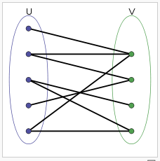
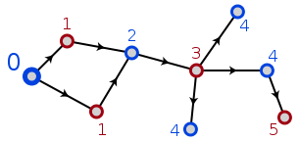
Bipartite graph
In the mathematical field of graph theory, a bipartite graph (or bigraph) is a graph whose vertices can be divided into two disjoint sets U and V such that every edge connects a vertex in U to one in V; that is, U and V are independent sets. Equivalently, a bipartite graph is a graph that does not contain any odd-length cycles.
We can use bfs or dfs for checking Bipartite graph.

Slide 55
Bipartite graph Using DFS
void BiColor(long node)
{
long i;
for(i=1;i<=n;i++)
if(A[node][i]==1)
{
if(color[i]==-1)
{
color[i] = (color[node] + 1 )%2;
BiColor(i);
}
else if(color[i]==color[node])
yes = 0;
if(yes==0)
break;
}
}
color[]={-1};
A[][] = connection matrix.
n = number of nodes, from 1 to n.
yes = 1;
for(i=1;i<=n;i++)
if(color[i]==-1)
{
color[i]=0;
BiColor(i);
}
if(yes==1)
printf(“possible\n”);
else
printf(“not possible\n”);

Slide 56
Sample
UVA Online Judge: 10004, 11080, 11396.

Slide 57
Thanks!

