Slide 1
Segment Tree
Md. Shakil Ahmed
Software Engineer
Astha it research & consultancy ltd.
Dhaka, Bangladesh

Slide 2
Segment Tree
A segment tree is a heap-like data structure that can be used for making update/query operations upon array intervals in logarithmical time.
Query time: O(log n)
Initialize time: O(2 * n)
Update time: O(log n)

Slide 3
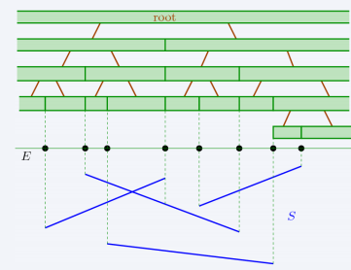

Slide 4
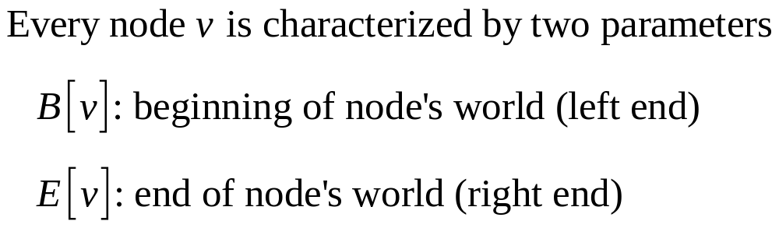
We define the segment tree for the interval [i, j] in the following recursive manner:
the first node will hold the information for the interval [i, j]
if i<j the left and right son will hold the information for the intervals [i, (i+j)/2] and [(i+j)/2+1, j]

Slide 5
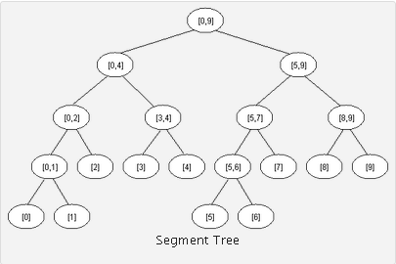

Slide 6
Sample Problem
You are given n (1<=n<=100000) integers & 100000 query. Each query you have to change a value of an element Or you have to given the minimum value of a range.

Slide 7
Initialize
#define NN 200009
int start[NN],end[NN],M[NN],L[NN],R[NN],N,a[NN];
int init(int h1, int h2)
{
if(h1==h2)
{
start[N]=h1;
end[N]=h1;
M[N]=a[h1];
L[N]=-1;
R[N]=-1;
N++;
return N-1;
}

Slide 8
else
{
long h3,h4,h5;
start[N]=h1;
end[N]=h2; h3 = N; N++;
h4 = init(h1,(h1+h2)/2);
h5 = init((h1+h2)/2+1,h2);
L[h3]=h4;
R[h3]=h5;
if(M[L[h3]]<=M[R[h3]])
M[h3]=M[L[h3]];
else
M[h3]=M[R[h3]];
return h3;
}
}

Slide 9
Update
void Update(int root, int h1, int h2)
{
if( start[root]==h1 && end[root]==h1 )
M[root]=h2;
else {
if(h1<=(start[root]+end[root])/2)
Update (L[root],h1,h2);
else
Update (R[root],h1,h2);
if(M[L[root]]<=M[R[root]])
M[root]=M[L[root]];
else
M[root]=M[R[root]];
} }

Slide 10
Query
int rmq(int root, int h1, int h2)
{
if( start[root]==h1&&end[root]==h2 )
return M[root];
else if(h2<=(start[root]+end[root])/2)
return rmq(L[root],h1,h2);
else if(h1>(start[root]+end[root])/2)
return rmq(R[root],h1,h2);
else
{
int h3 = rmq(L[root],h1,(start[root]+end[root])/2);
int h4 = rmq(R[root],(start[root]+end[root])/2+1,h2);
if(h3<h4) return h3; else return h4;
} }

Slide 11
Calling
for(i=0;i<n;i++)scanf(“%d”,&a[i]);
Init(0,n-1);
Update(5,10);
Min = rmq(4,4001);

Slide 12
Using segment trees we get an <O(N), O(logN)> algorithm. Segment trees are very powerful, not only because they can be used for RMQ(Range Minimum Query). They are a very flexible data structure, can solve even the dynamic version of RMQ problem, and have numerous applications in range searching problems.

Slide 13
Sample
UVA Online Judge: 12338, 12299, 12086, 11297.
LightOJ: http://www.lightoj.com/volume_problemcategory.php?user_id=3060&category=Segment%20Tree/Interval%20Tree

Slide 14
Thanks!

