Slide 1
Tree & BST
Md. Shakil Ahmed
Software Engineer
Astha it research & consultancy ltd.
Dhaka, Bangladesh

Slide 2
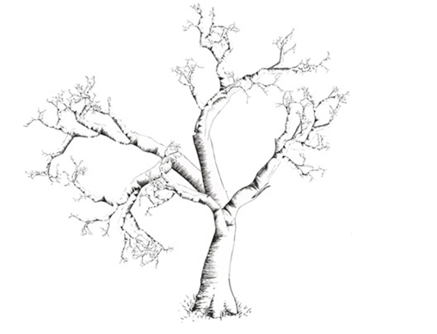
Natural Tree

Slide 3
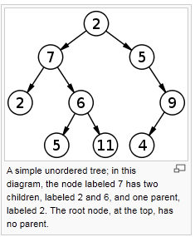
Tree structure

Slide 4
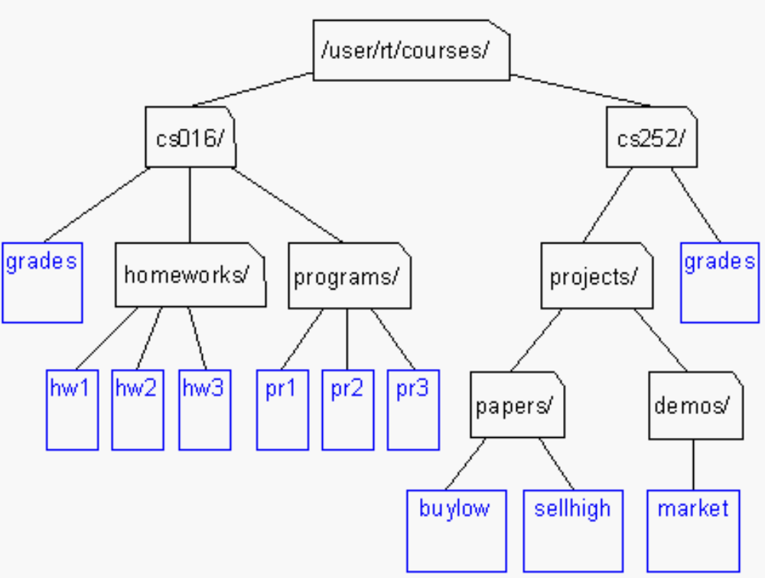
Unix / Windows file structure

Slide 5
Definition of Tree
A tree is a finite set of one or more nodes
such that:
There is a specially designated node called
the root.
The remaining nodes are partitioned into n>=0 disjoint sets T1, ..., Tn, where each of these sets is a tree.
We call T1, ..., Tn the subtrees of the root.

Slide 6
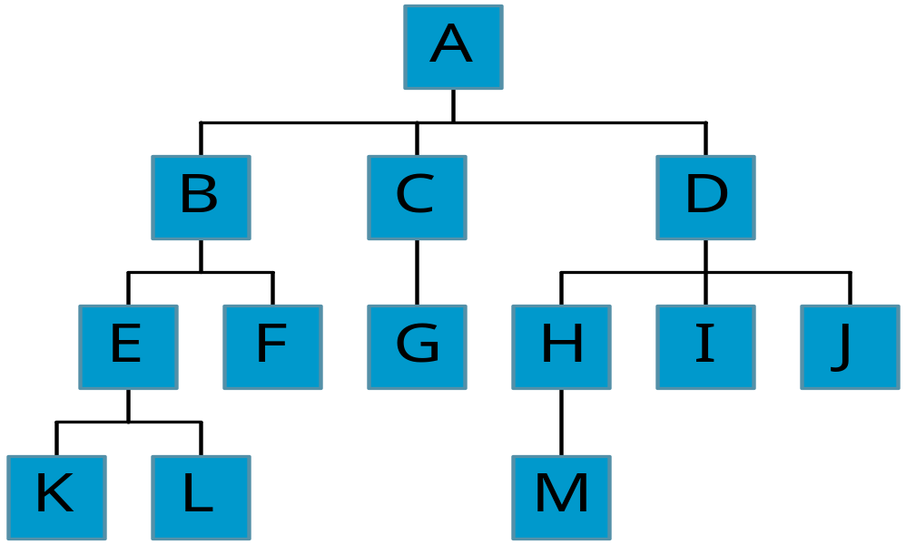
Level and Depth
Level
1
2
3
4
node (13)
degree of a node
leaf (terminal)
nonterminal
parent
children
sibling
degree of a tree (3)
ancestor
level of a node
height of a tree (4)
3
1
2
2
1
2
3
2
2
3
3
3
3
0
0
1
3
0
3
0
0
4
0
4
0
4

Slide 7
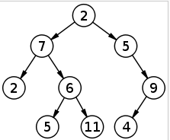
Binary Tree
Each Node can have at most 2 children.

Slide 8
Array Representation 1
With in a single array.
If root position is i then,
Left Child in 2*i+1
Right Child is 2*i+2
For N level tree it needs 2^N – 1 memory space.
If current node is i then it’s parent is i/2.
0 | 1 | 2 | 3 | 4 | 5 | 6 | 7 | 8 | 9 | 10 | 11 | 12 | 13 | 14
2 | 7 | 5 | 2 | 6 | -1 | 9 | -1 | -1 | 5 | 11 | -1 | -1 | 4 | -1

Slide 9
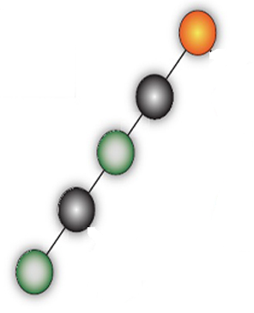
Array Representation 1
Advantage ->
Good in Full Or Complete Binary tree
Disadvantage
If we use it in normal binary tree then it may be huge memory lose.

Slide 10
Array Representation 2
Use 3 Parallel Array
 | 0 | 1 | 2 | 3 | 4 | 5 | 6 | 7 | 8
Root | 2 | 7 | 5 | 2 | 6 | 9 | 5 | 11 | 4
Left | 1 | 3 | -1 | -1 | 6 | 8 | -1 | -1 | -1
Right | 2 | 4 | 5 | -1 | 7 | -1 | -1 | -1 | -1
If you need parent
 | 0 | 1 | 2 | 3 | 4 | 5 | 6 | 7 | 8
Root | 2 | 7 | 5 | 2 | 6 | 9 | 5 | 11 | 4
Left | 1 | 3 | -1 | -1 | 6 | 8 | -1 | -1 | -1
Right | 2 | 4 | 5 | -1 | 7 | -1 | -1 | -1 | -1
Parent | -1 | 0 | 0 | 1 | 1 | 2 | 4 | 4 | 5

Slide 11
Linked Representation
typedef struct tnode *ptnode;
typedef struct tnode {
int data;
ptnode left, right;
};
data
left
data
right
left
right

Slide 12
Preorder Traversal (recursive version)
Linked Representation
void preorder(ptnode ptr)
/* preorder tree traversal */
{
if (ptr) {
printf(“%d”, ptr->data);
preorder(ptr->left);
preorder(ptr->right);
}
}
Array Representation 2
void preorder(int nodeIndex)
{
printf(“%d”, root[nodeIndex]);
if(Left[nodeIndex]!=-1)
preorder(Left[nodeIndex]);
if(Right[nodeIndex]!=-1)
preorder(Right[nodeIndex]);
}

Slide 13
Inorder Traversal (recursive version)
Linked Representation
void inorder(ptnode ptr)
/* inorder tree traversal */
{
if (ptr) {
inorder(ptr->left);
printf(“%d”, ptr->data);
inorder(ptr->right);
}
}
Array Representation 2
void inorder(int nodeIndex)
{
if(Left[nodeIndex]!=-1)
inorder(Left[nodeIndex]);
printf(“%d”, root[nodeIndex]);
if(Right[nodeIndex]!=-1)
inorder(Right[nodeIndex]);
}

Slide 14
Postorder Traversal (recursive version)
Linked Representation
void postorder(ptnode ptr)
/* postorder tree traversal */
{
if (ptr) {
postorder(ptr->left);
postorder(ptr->right);
printf(“%d”, ptr->data);
}
}
Array Representation 2
void postorder(int nodeIndex)
{
if(Left[nodeIndex]!=-1)
postorder(Left[nodeIndex]);
if(Right[nodeIndex]!=-1)
postorder(Right[nodeIndex]);
printf(“%d”, root[nodeIndex]);
}

Slide 15
Binary Search Tree
All items in the left subtree are less than the root.
All items in the right subtree are greater or equal to the root.
Each subtree is itself a binary search tree.

Slide 16
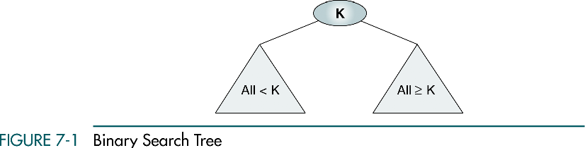
Binary Search Tree

Slide 17

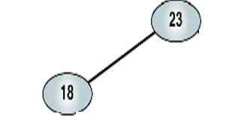
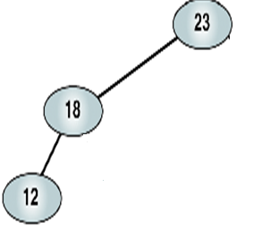
Binary Search Tree
Elements => 23 18 12 20 44 52 35
1st Element
2nd Element
3rd Element

Slide 18
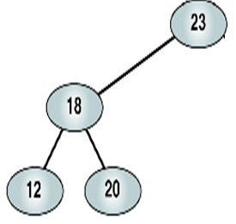
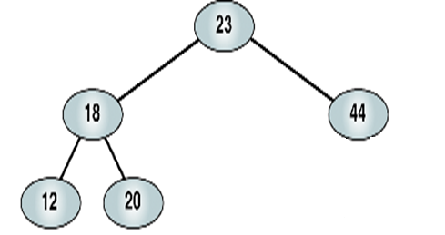
Binary Search Tree
4th Element
5th Element

Slide 19
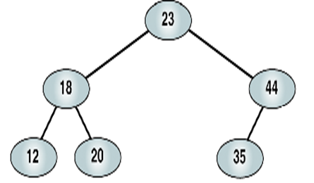
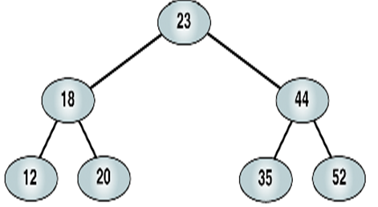
Binary Search Tree
6th Element
7th Element

Slide 20
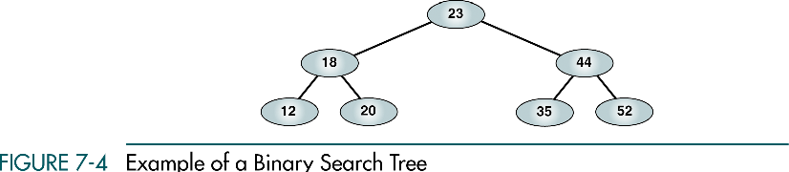
Binary Search Tree

Slide 21
Binary Search Tree
//Array Representation 2
//Generate BST
int N = 0;
int Root[1000000], Left[1000000], Right[1000000];
void AddToBST(int value)
{
if(N==0)
{
Root[N]=value;
Left[N]=-1;
Right[N]=-1;
}
else
{
root = 0;
while(1){
if(Root[root]==value)
break;
else if(Root[root]>value)
{
if(Left[root]!=-1)
root = Left[root];
else
{
Root[N]=value;
Left[N]=-1;
Right[N]=-1;
Left[root]=N;
N++;
break;
}
}

Slide 22
Binary Search Tree
else
{
if(Right[root]!=-1)
root = Right[root];
else
{
Root[N]=value;
Left[N]=-1;
Right[N]=-1;
Right[root]=N;
N++;
break;
}
}
}
}
}
Client Code =>
scanf(“%d”,&n);
for(i=0;i<n;i++)
{
scanf(“%d”,&t);
AddToBST(t);
}

Slide 23
Binary Search Tree
//Array Representation 2
//Search in BST
int SearchInBST(int value)
{
if(N==0)
return -1;
root = 0;
while(1)
{
if(Root[root]==value)
return root;
else if(Root[root]>value)
{
if(Left[root]!=-1)
root = Left[root];
else
return -1;
}
else
{
if(Right[root]!=-1)
root = Right[root];
else
return -1;
}
}
return -1;
}
Client Code =>
scanf(“%d”,&n);
for(i=0;i<n;i++)
{
scanf(“%d”,&t);
Printf(“%d”,SearchInBST(t));
}

Slide 24
Sample
LightOj =>
http://www.lightoj.com/volume_showproblem.php?problem=1087
http://www.lightoj.com/volume_showproblem.php?problem=1097
http://www.lightoj.com/volume_showproblem.php?problem=1293

Slide 25
Thanks!

