Slide 1
Trie Tree
Md. Shakil Ahmed
Software Engineer
Astha it research & consultancy ltd.
Dhaka, Bangladesh

Slide 2
Trie Tree
a trie, or prefix tree, is an ordered tree data structure that is used to store an associative array where the keys are usually strings.

Slide 3
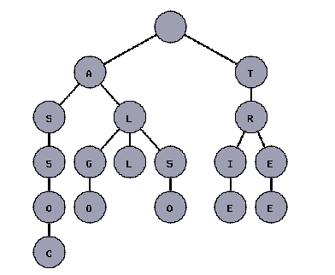
The next figure shows a trie with the words "tree", "trie", "algo", "assoc", "all", and "also."

Slide 4
Use:
countPreffixes. This function will count the number of words in the dictionary that have a string prefix as prefix.
countWords. This function will count the number of words in the dictionary that match exactly with a given string word.

Slide 5
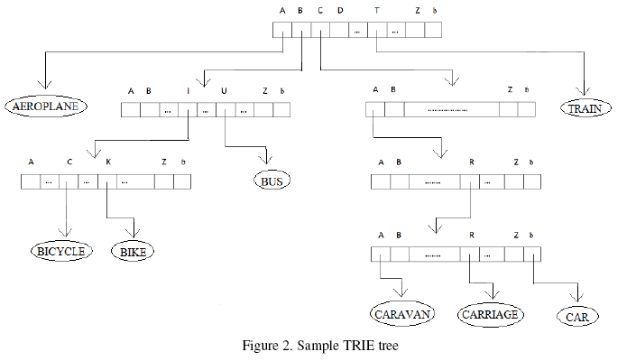

Slide 6
Problem
LightOJ => 1129 - Consistency Checker
no number is the prefix another number in that data set. Let's consider a data set:
1. 123
2. 5123456
3. 123456
In this data set, numbers not consistent, because the first number is the prefix of the third one.
n integer n (1 ≤ n ≤ 10000) denoting the total numbers in their list. Each of the next n lines contains one unique phone number. A number is a sequence of digits and has length from 1 to 10.
Print 'YES' if the list is consistent or 'NO' if it's not.

Slide 7
Source Code
long B[100009],A[100009][10],yes,len,N; char temp[15];
void MakeTree(int root,int h1,int h2) {
if(h1<len)
{ if(A[root][temp[h1]-'0']==-1)
{ if(B[root]==1)
yes = 0;
else{
long i1;
for(i1=0;i1<10;i1++)
A[N][i1]=-1;
B[N]=0;
A[root][temp[h1]-'0']=N; N++;
MakeTree(N-1,h1+1,0);
} }

Slide 8
else
{
if(B[root]==1)
yes = 0;
else
MakeTree(A[root][temp[h1]-'0'],h1+1,1);
}
}
else
{
if(B[root]==1 || h2 == 1)
yes = 0;
B[root]=1;
}
}

Slide 9
Use:
scanf("%ld",&n);
yes = 1;
for(i=0;i<10;i++)
A[0][i]=-1;
B[0]=0;
N=1;
for(i=0;i<n;i++)
{scanf("%s",temp);
len = strlen(temp);
if(yes==1)
MakeTree(0,0,1);
}
if(yes==1)
printf("YES\n");
else
printf("NO\n");

Slide 10
Sample
LightOJ =>
http://www.lightoj.com/volume_showproblem.php?problem=1114
http://www.lightoj.com/volume_showproblem.php?problem=1129
http://www.lightoj.com/volume_showproblem.php?problem=1224

Slide 11
Thanks!

