Slide 1
Optimized Multilayer
Structures with
Phase Change
Materials
Aaron Valdes
James Morris
Mentor: Dr. Veronis

Slide 2
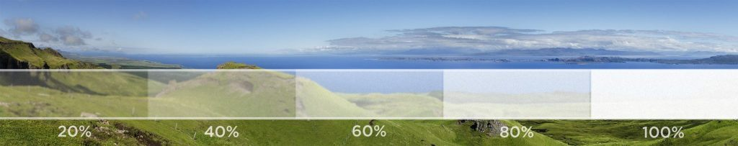
Why?
Absorption is Essential
Efficiency of Fabrication
GST(germanium-antimony-tellurium)
Applications
Privacy glass
Notes:
Have you guys ever wonder how privacy glass works?
Well it all boils down to the idea of switching the transparency of the material from transparent to opaque when you apply an electrical voltage across them
And the most common material for privacy glass is PDLC(Polymer dispersed liquid crystals)
So how does all this stuff that I just mentioned related to optimizing multilayer structures?
Well the simple answer is that on our research we try to come up with combinations of multiple phase change material as a away to obtain the biggest difference in absorption
Why are looking difference?
Well as seen in the clip from the privacy glass, the material is able to change its absorption from probably 20% to 100% which means there was an 80% difference
The phase change material that we are mostly testing is GST(germanium-antimony-tellurium)

Slide 3
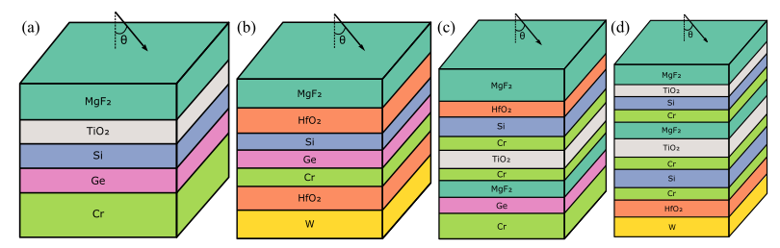
Previous Work
Initial Work
REU Work
Notes:
The main ground work that has been done in this project was done by graduates students of Dr. Veronis
which created a program which is able to not only find the most optimal thickness but also the optimal combination of material and thickness to obtain near-perfect absorption
This was done due via a hybrid optimization algorithm coupled with the transfer matrix method to optimize material composition and the layer thicknesses of the aperiodic multilayer structures.
This innovation led to the previous REU student to expand this application
He worked on optimizing the absorption ratio in multilayer structures when GST switches between its crystalline and amorphous phases
This is where I came in

Slide 4
Brief Result
Replicate Result
Finish previous Work.
Run Simulation
Notes:
My first step in this project was simply being able to run the original code in the HPC computer and seeing if my results match the work of previous students.
Next I created a method to obtain two optimized results for both scenarios, a crystalline state or an amorphous state.
Then I had to implement a fitness function which would obtain the maximum of the difference between the absorption of the crystalline state and the amorphous state
Finally my last step was to run as many simulations as possible to see a pattern and test the accuracy of our data in place of the physical experiments that we would do.

Slide 5
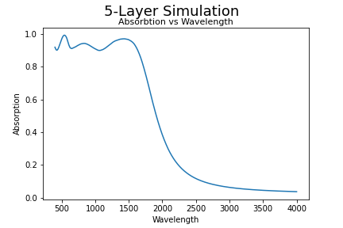
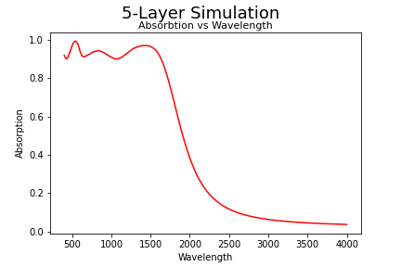
Replicating Results
MGF
1.253654e-07
MGF
1.253654e-07
Hafnium dioxide
3.848252e-08
Hafnium dioxide
3.848252e-08
Silicon
2.478928e-08
Silicon
2.478928e-08
Germanium
2.690276e-08
Germanium
2.690276e-08
Tungsten
Tungsten
8.023038e-07
8.023038e-07
Fig. 3 - Multilayer Structure obtained from the latest simulation
Fig. 4 - Multilayer Structure obtained from the actual paper previously Mentioned
Fig. 1 - Plot of absorption versus wavelength from simulation ran by me
Fig. 2 - Plot of absorption versus wavelength from the actual paper previously mentioned
Notes:
Here is the latest simulation of a 5 multi-layer structure Click
Here is the simulation of the original paper with a 5 multilayer structure
As you can see the spectrums are the same Click
We can observe that the material composition and the layer thicknesses are the same

Slide 6
Finishing Previous Work
Structure | Fitness Function
Crystalline ➡️ Amorphous Amorphous ➡️ Crystalline | Difference between absorption Ratio between absorption
Notes:
To finish the previous work, I created a function that converts all multi-layer structure with GST of any type into either only-amorphous or only-crystalline
Then I devised a fitness function to observe how well each multilayer structure performs based on their difference in the ratio of absorption

Slide 7
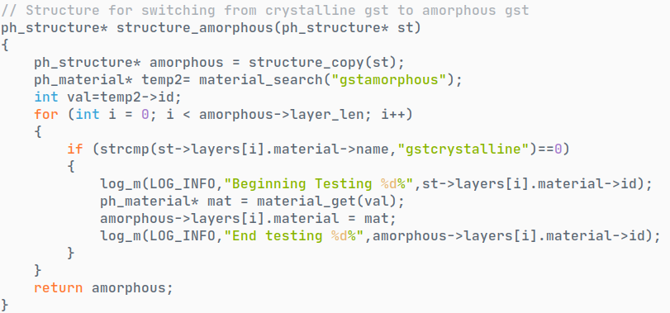
GST(Amorphous)
GST(Amorphous)
GST(Amorphous)
GST(Crystalline)
Germanium
Germanium
Germanium
Germanium
Finding ID of GST Amorphous
GST(Crystalline)
GST(Amorphous)
GST(Crystalline)
GST(Crystalline)
Iterate through all the layers
Tungsten
Tungsten
Tungsten
Tungsten
Molybdenum
Molybdenum
Molybdenum
Molybdenum
Swap layers
Find all GST Crystalline layer
Crystalline ➡️ Amorphous Amorphous ➡️ Crystalline
Notes:
The strategy to convert multi-layer structures with GST of any type into either only-amorphous or only-crystalline ones is by swapping all gst crystalline layers with gst amorphous layers or vice-versa Click
As seen in the code, we first find the material id of gst amorphous, and then we iterate through the layers switching those layers that had crystalline with amorphous Click
And it works in the same manner when switching from amorphous to crystalline Click

Slide 8
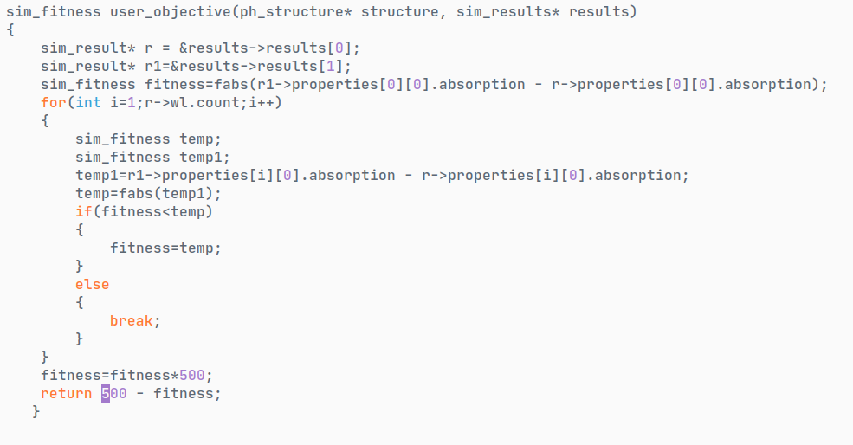
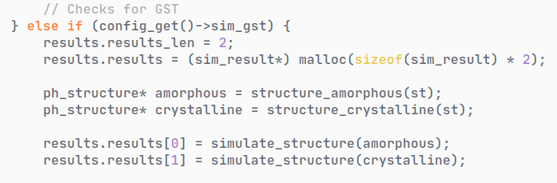
Result0
Result1
Converts to amorphous
GST(Amorphous)
GST(Amorphous)
GST(Amorphous)
GST(Crystalline)
Germanium
Germanium
Germanium
Germanium
GST(Crystalline)
GST(Amorphous)
GST(Crystalline)
GST(Crystalline)
Tungsten
Tungsten
Tungsten
Tungsten
Molybdenum
Molybdenum
Molybdenum
Molybdenum
Simulate
Converts to crystalline
maximum (
for all wavelength:
abs(result1 - result0)
)
Difference Fitness Function
Notes:
As seen in this code, we first convert our original multi-layer structure into two new multi-layers structures constituting of either only-amorphous or only-crystalline
Then we simulate each of those new layers that we created
As you saw from the previous slide, this is the result of the simple conversion of our current multi-layer structure to two different multi-layer structure made of either only-amorphous or only-crystalline
Next we have to simulate each of those new multi-layer structures created
This simulation uses a fitness function that iterates through all the specified wavelength finding the maximum absolute difference of absorption between the two phases
By the way, 500 is an arbitrary value for optimizing result

Slide 9
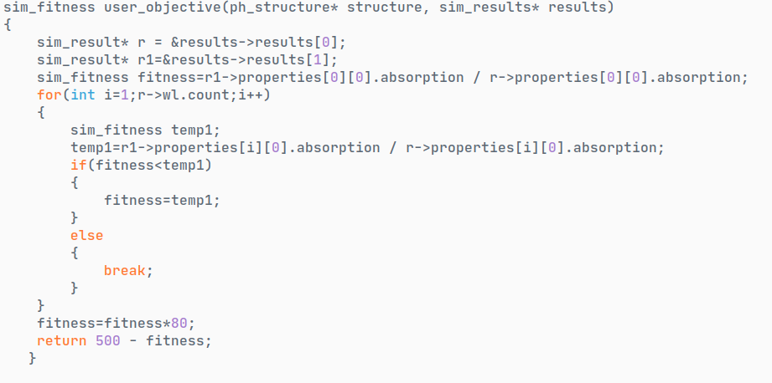
Wavelength Iterator
To get the maximum
maximum (
for all wavelength:
result1/ result0
)
These are arbitrary values
Ratio Fitness Function
Notes:
This fitness function is similar to the previous one except that we are looking for the ratio of absorption
More specifically we are looking for the maximum ratio of the absorption of crystalline over the absorption of amorphous across all the wavelengths

Slide 10
Simulation
Testing | Relevant Result
Are the results consistent? | Difference Fitness Function Ratio fitness Function
Notes:
There were two phases for the simulation
First, testing the code. This was to see if the result is consistent
The second phase was obtaining results of fitness function for the difference and ratio between amorphous and crystalline

Slide 11
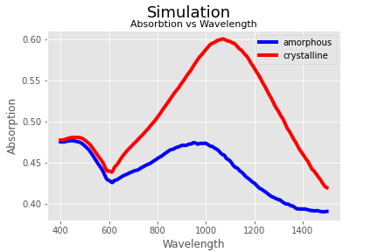
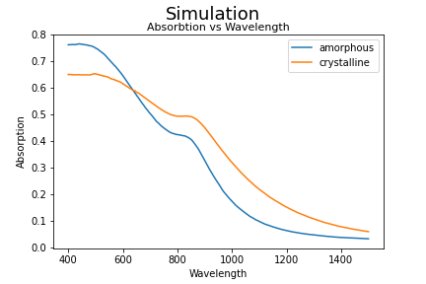
Ratio Fitness Function
Difference Fitness Function
Yes
Fig. 4 - Plot of absorption versus wavelength for 2 layer trial 1
Fig. 5 - Fig. 1 - Plot of absorption versus wavelength for 2 layer trial 1
Fig. 6 - Fig. 1 - Plot of absorption versus wavelength for 2 layer trial 1
Fig. 1 - Fig. 1 - Plot of absorption versus wavelength for 2 layer trial 1
Fig. 1 - Fig. 1 - Plot of absorption versus wavelength for 2 layer trial 2
Fig. 1 - Fig. 1 - Plot of absorption versus wavelength for 2 layer trial 3
Are the results consistent?
Notes:
for the difference fitness function you can see that all the spectra are identical
Which means that our results are consistent
The same happens with the Ratio fitness function , where we are also able to obtain the same spectra for the same amount of layers
Which means that our results are once again consistent

Slide 12
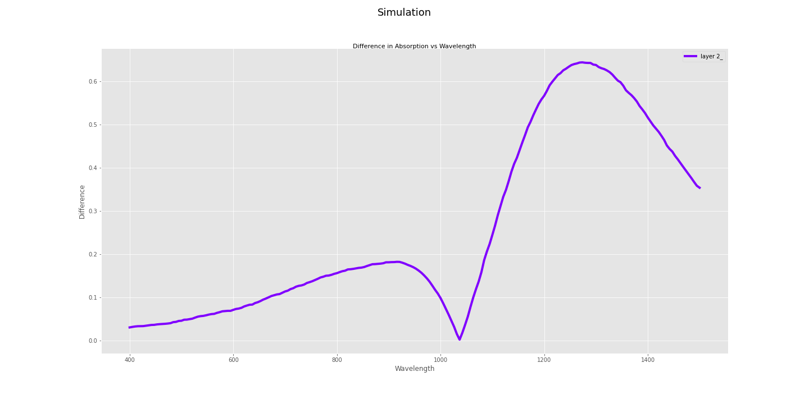
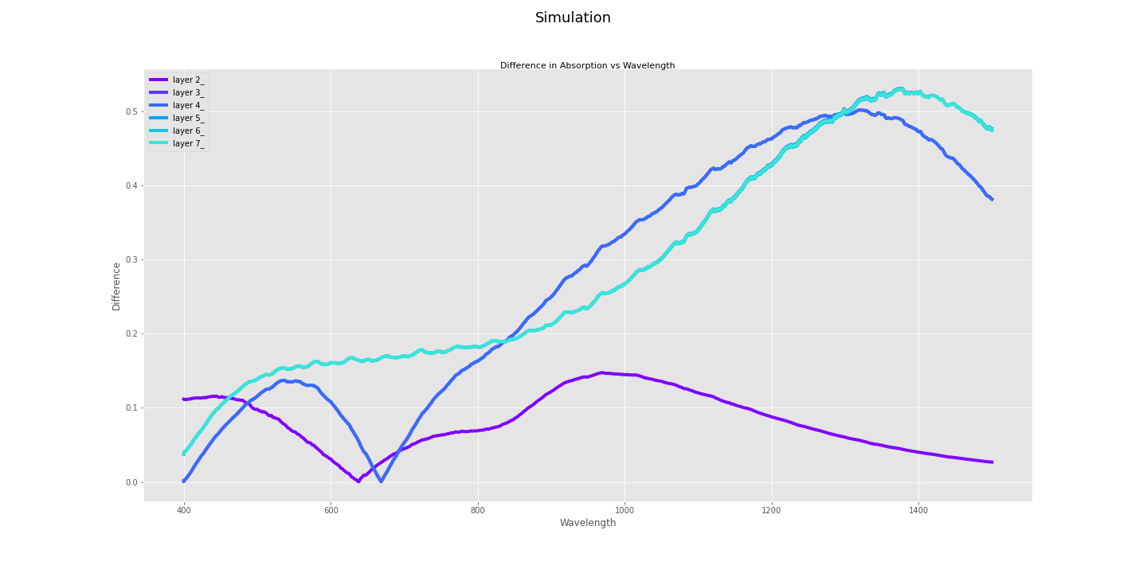
Layer 7
Difference of 0.65
Layer 2
Difference Fitness Function: Relevant Result
Notes:
In this chart we can see how increasing the number of layers increases the difference in absorption between
Amorphous and Crystalline
As you can see, there is a visible difference between having 2 layers and 7 layers
In this graph I present the most optimum result, with 0.65 difference in absorption. This was obtained with 1500000 trials for 2 layers
By the way this are preliminary results because most likely the optimization algorithm has not converged for structures with large number of layers
So what do this preliminary result mean?
In a way, that the result saw a transition from 20% to 80%

Slide 13
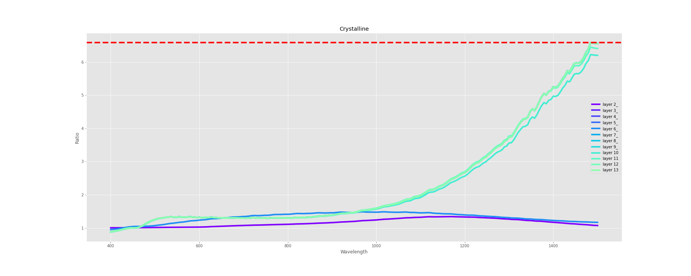
Difference of 0.66
Ratio of 6.64
Ratio Fitness Function: Relevant Result
Notes:
This chart demonstrates the increase in ratio between absorption of crystalline and amorphous structures resulted by increasing the number of layers.
This is the most optimum result produced by the ratio function
The maximum ratio obtained was 6.64 which meant that the absorption for our crystalline structure was 6 times bigger than the absorption of our amorphous structure
Furthermore the combination had the maximum difference of 0.66 which is the highest absorption difference

Slide 14
Conclusion
Preliminary Results
Run more simulations
Notes:
Given the fact that these are preliminary results, we still need to run more simulations as a way to obtain the highest difference in absorption between the two structures as a way to obtain the best combination of materials and thicknesses

Slide 15
Acknowledgements
Mentor: Dr. Veronis
Previous REU Student: James Morris
Initial Collaborators: Chenglong You, Corey T. Matyas
Support: National Science Foundation Award:OAC-1852454
Additional Support: Center for Computation & Technology at Louisiana State University
Reference
C. You, C. T. Matyas, Y. Huang, J. P. Dowling and G. Veronis, "Optimized Multilayer Structures With Ultrabroadband Near-Perfect Absorption," in IEEE Photonics Journal, vol. 12, no. 3, pp. 1-10, June 2020, Art no. 4500810, doi: 10.1109/JPHOT.2020.2994647.

