Slide 1
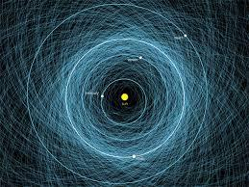


ADN
-
Asteroid Detection Network
A result from #SpaceApps_CL
Anton Rabanus, Andres Parra, and David Rabanus

Slide 2
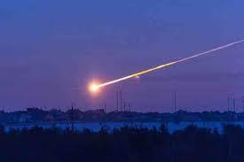
The Challenge
Connect people and institutions to pursue a common goal
Tutorials for robotic observation
Popularize thermal infrared telescopes
Provide access to telescopes to involve in, and support of, remote observations utilizing global telescopes

Slide 3
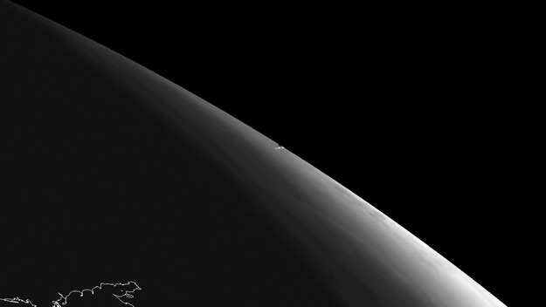
Connect people and institutions
Develop interfaces between existing institutions, i.e. governments, agencies and research organizations, with the public or to facilitate the better use of the “assets“ for this objective. These assets are:
Asset 1) Telescopios en el mundo con capabilidad robótica (e.g. la propiedad GOTO),
Asset 2) Citizens, volunteers for participating,
Asset 3) Large data bases, well maintained, like the one at the Minor Planet Center (MPC), where all the information, ephemeres, light curves, etc. is centralized, verified, and scrutinized.
Asset 4) Potent groups of institutions like IAWN, COPOUS de la ONU

Slide 4
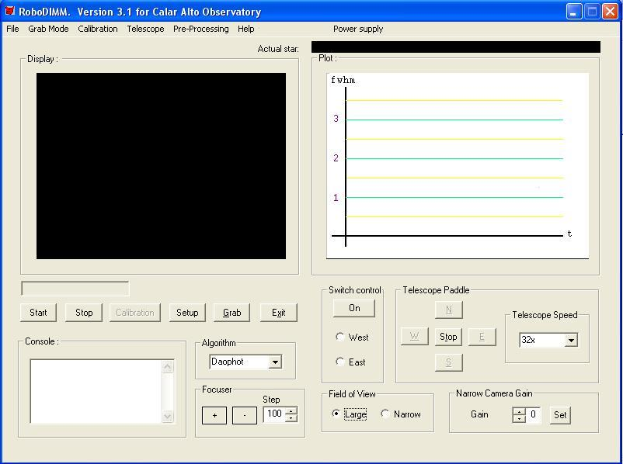
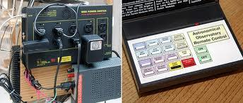
Tutorials for robotic observation
Task 1) Create manuals and pages about robotic observation
Task 2) Explain the essentials of celestial mechanics
Task 3) Educate about existing software tools
Task 4) Provide manuals for ‘roboticizing’ telescopes of amateurs

Slide 5
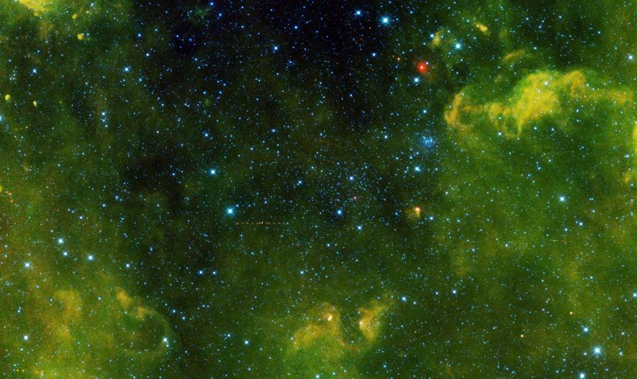
Popularize infrared telescopes
Task 1) Establish access to adequate sites
Task 2) Employ the same technologies as robotic telescopes
Task 3) Provide public access to these infrared telescopes
View high resolution http://www.nasa.gov/jpl/neowise/pia17832/

Slide 6
Provide access to telescopes
The observing time of robotic telescopes shall be distributed among those that want to utilize it. For that purpose, develop a web/smartphone application for distribution (“sales”) of observation time:
Incentivize those that have telescopes to provide access to them
Incentivize those that seek to observe but have no access to, or adequate location, for operating telescopes

Slide 7
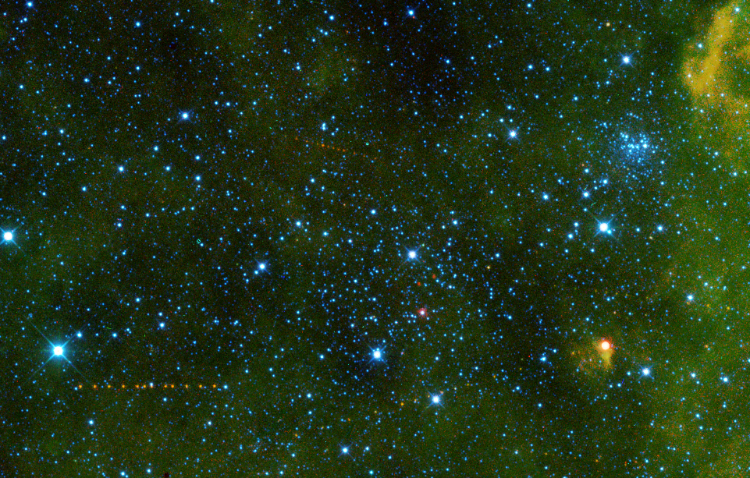
Questions?
Please direct to drabanus@gmail.com

