Slide 1
Ecology 8310 Population (and Community) Ecology
Age-structured populations
Stage-structure populations
Life cycle diagrams
Projection matrices

Slide 2
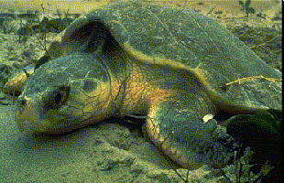
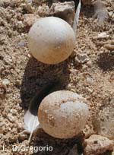
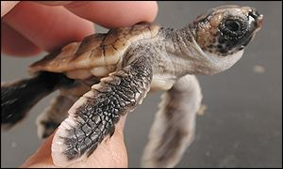
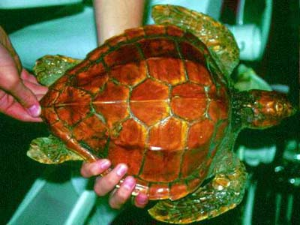
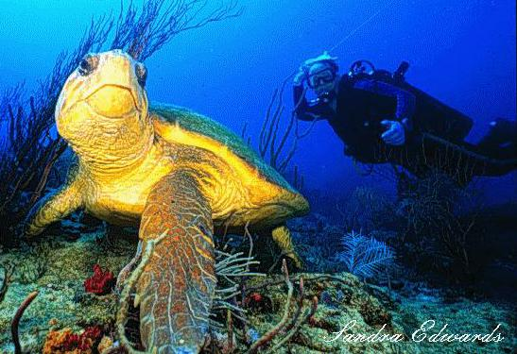
Context: Sea Turtle Conservation
(But first … background)
Notes:
You are a federal biologist, charged with describing the dynamics of sea turtles and using that information to devise regulations/strategies that will aid the sea turtles (e..g, turn around the observed declines in population size). Where do we start? This process is going to take a while. First, we’ll develop the tools from first principles; Then, we’ll apply that information to sea turtles.

Slide 3
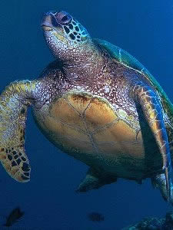
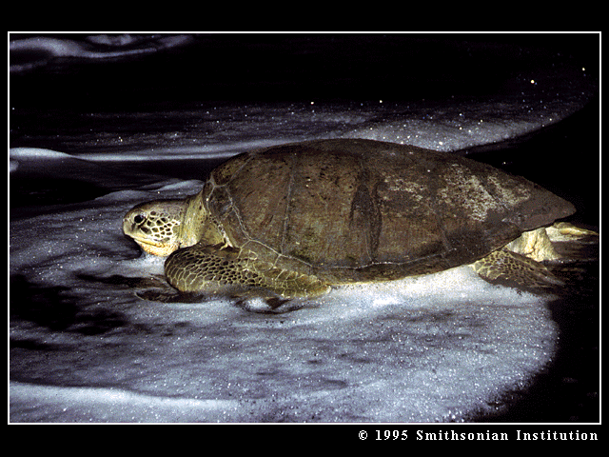
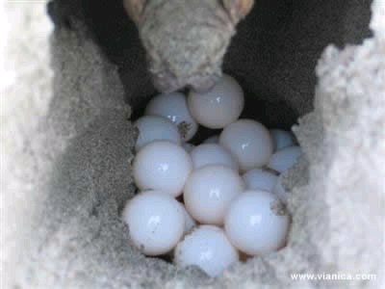
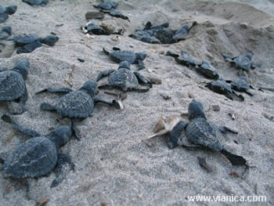
Population
Structure:
From vianica.com
Notes:
A mix of species.

Slide 4
Life Cycle
Diagram:
Age 0
Age 1
Age 2
Age 3
Age-based approach. What now?

Slide 5
Life Cycle
Diagram:
More transitions?
Age 0
Age 1
Age 2
Age 3
Dead
Are we done?

Slide 6
Life Cycle
Diagram:
Add values?
P_{ij} = Per capita transition from group j to i
P₁₃
P₁₄
P₂₁
P₃₂
P₄₃
Group 1, Age 0
Group 2, Age 1
Group 3, Age 2
Group 4, Age 3
1-P₂₁
1-P₃₂
1-P₄₃
1-P₅₄
Dead
Now what?

Slide 7
Life Cycle
Diagram:
Project from time t to time t+1….
P₁₃
P₁₄
P₂₁
P₃₂
P₄₃
Group 1, Age 0
Group 2, Age 1
Group 3, Age 2
Group 4, Age 3
1-P₂₁
1-P₃₂
1-P₄₃
1-P₅₄
Dead

Slide 8
Projections:
n_{x,t} = abundance (or density) of class x at time t.
So, given that we know n_{1,t}, n_{2,t}, ….
And all of the transitions (P_{ij}'s)…
… What is n_{1,t+1}, n_{2,t+1}, n_{3,t+1}, … ?

Slide 9
Projections:
n_{2,t+1} = ??
= P₂₁ x n_{1,t}
P₁₄
P₁₃
P₂₁
P₃₂
P₄₃
Group 1, Age 0
Group 2, Age 1
Group 3, Age 2
Group 4, Age 3
Dead

Slide 10
Projections:
n_{1,t+1} = ??
= (P₁₄ x n_{4,t}) +
(P₁₃ x n_{3,t})
P₁₃
P₁₄
P₂₁
P₃₂
P₄₃
Group 1, Age 0
Group 2, Age 1
Group 3, Age 2
Group 4, Age 3
Dead
Project what?

Slide 11
Is there a way to write this out more formally
(e.g., as in geometric growth model)?

Slide 12
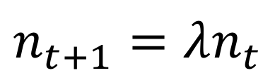
Matrix
algebra:
n_{t+1} = An_{t}
n is a vector of abundances for the groups;
A is a matrix of transitions
Note similarity to:
$$n_{t+1}=λn_{t}$$

Slide 13
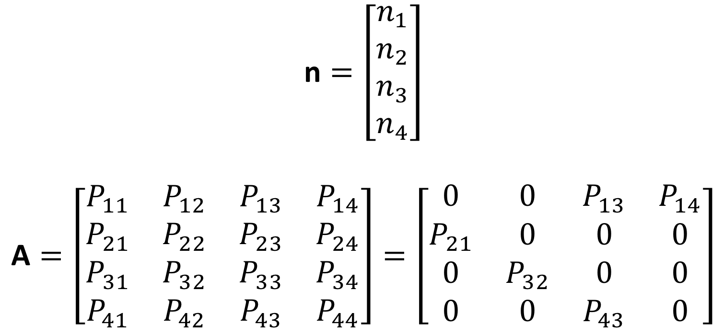
Matrix
algebra:
$$\text{n}=\left[\begin{matrix}n_{1} \\ n_{2} \\ n_{3} \\ n_{4}\end{matrix}\right]$$
$$\text{A}=\left[\begin{matrix}P_{11} & P_{12} & P_{13} & P_{14} \\ P_{21} & P_{22} & P_{23} & P_{24} \\ P_{31} & P_{32} & P_{33} & P_{34} \\ P_{41} & P_{42} & P_{43} & P_{44}\end{matrix}\right]=\left[\begin{matrix}0 & 0 & P_{13} & P_{14} \\ P_{21} & 0 & 0 & 0 \\ 0 & P_{32} & 0 & 0 \\ 0 & 0 & P_{43} & 0\end{matrix}\right]$$

Slide 14
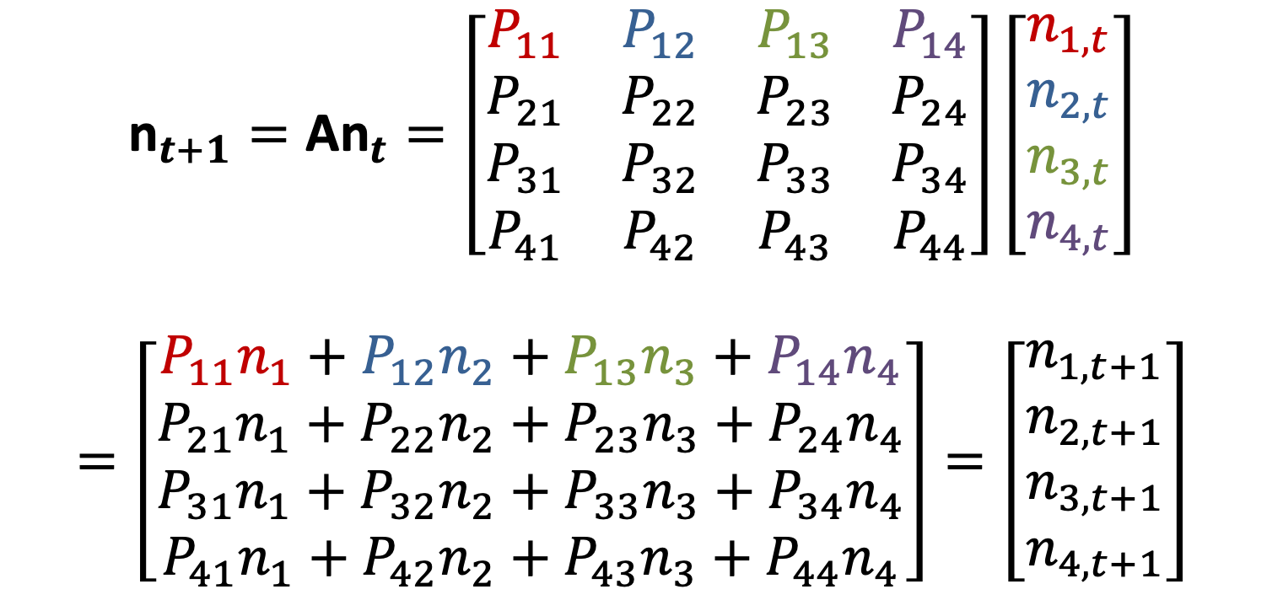
Matrix
algebra:
$${\text{n}}_{t+1}=\text{A}{\text{n}}_{t}=\left[\begin{matrix}P_{11} & P_{12} & P_{13} & P_{14} \\ P_{21} & P_{22} & P_{23} & P_{24} \\ P_{31} & P_{32} & P_{33} & P_{34} \\ P_{41} & P_{42} & P_{43} & P_{44}\end{matrix}\right]\left[\begin{matrix}n_{1,t} \\ n_{2,t} \\ n_{3,t} \\ n_{4,t}\end{matrix}\right]$$
$$=\left[\begin{matrix}P_{11}n_{1}+P_{12}n_{2}+P_{13}n_{3}+P_{14}n_{4} \\ P_{21}n_{1}+P_{22}n_{2}+P_{23}n_{3}+P_{24}n_{4} \\ P_{31}n_{1}+P_{32}n_{2}+P_{33}n_{3}+P_{34}n_{4} \\ P_{41}n_{1}+P_{42}n_{2}+P_{43}n_{3}+P_{44}n_{4}\end{matrix}\right]=\left[\begin{matrix}n_{1,t+1} \\ n_{2,t+1} \\ n_{3,t+1} \\ n_{4,t+1}\end{matrix}\right]$$

Slide 15
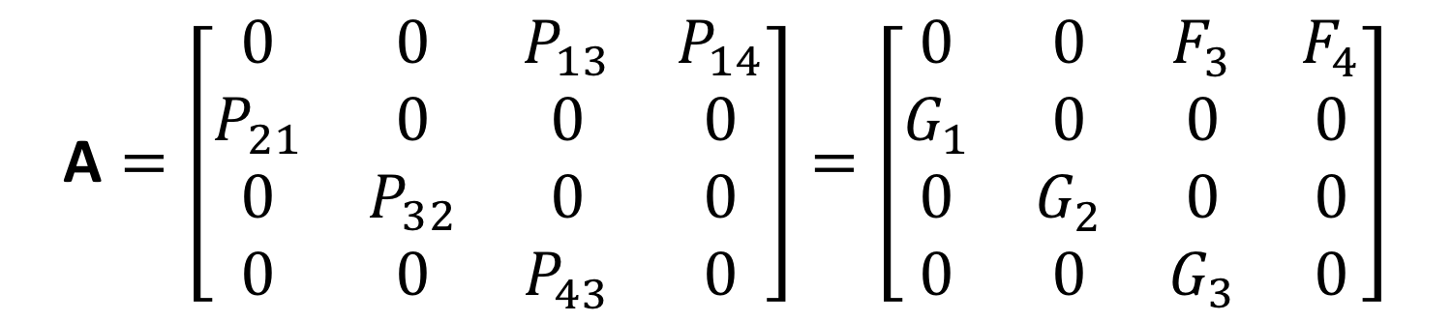
Our age-based
example:
P₁₃
P₁₄
P₂₁
P₃₂
P₄₃
Group 1, Age 0
Group 2, Age 1
Group 3, Age 2
Group 4, Age 3
$$\text{A}=\left[\begin{matrix}0 & 0 & P_{13} & P_{14} \\ P_{21} & 0 & 0 & 0 \\ 0 & P_{32} & 0 & 0 \\ 0 & 0 & P_{43} & 0\end{matrix}\right]=\left[\begin{matrix}0 & 0 & F_{3} & F_{4} \\ G_{1} & 0 & 0 & 0 \\ 0 & G_{2} & 0 & 0 \\ 0 & 0 & G_{3} & 0\end{matrix}\right]$$

Slide 16
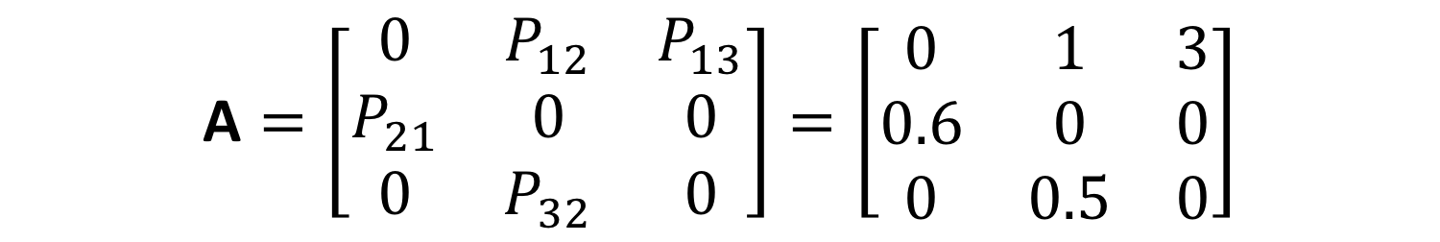
A simpler
example:
P₁₃
P₁₂
P₂₁
P₃₂
Group 1
Group 2
Group 3
$$\text{A}=\left[\begin{matrix}0 & P_{12} & P_{13} \\ P_{21} & 0 & 0 \\ 0 & P_{32} & 0\end{matrix}\right]=\left[\begin{matrix}0 & 1 & 3 \\ 0.6 & 0 & 0 \\ 0 & 0.5 & 0\end{matrix}\right]$$

Slide 17
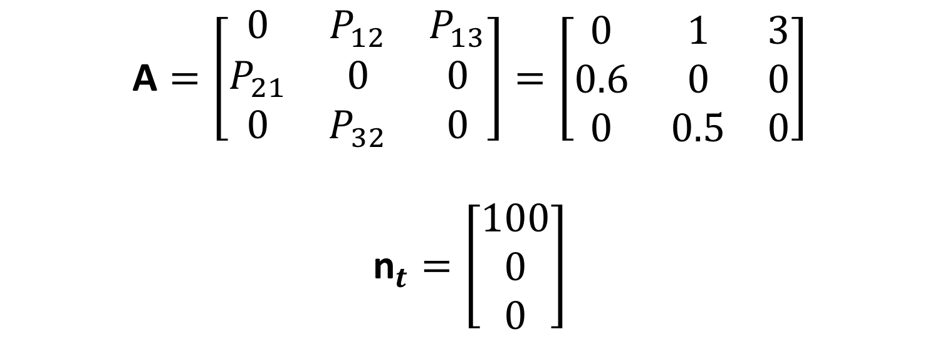
Simple
example:
$$\text{A}=\left[\begin{matrix}0 & P_{12} & P_{13} \\ P_{21} & 0 & 0 \\ 0 & P_{32} & 0\end{matrix}\right]=\left[\begin{matrix}0 & 1 & 3 \\ 0.6 & 0 & 0 \\ 0 & 0.5 & 0\end{matrix}\right]$$
$${\text{n}}_{t}=\left[\begin{matrix}100 \\ 0 \\ 0\end{matrix}\right]$$
What is n_{t+1}?

Slide 18
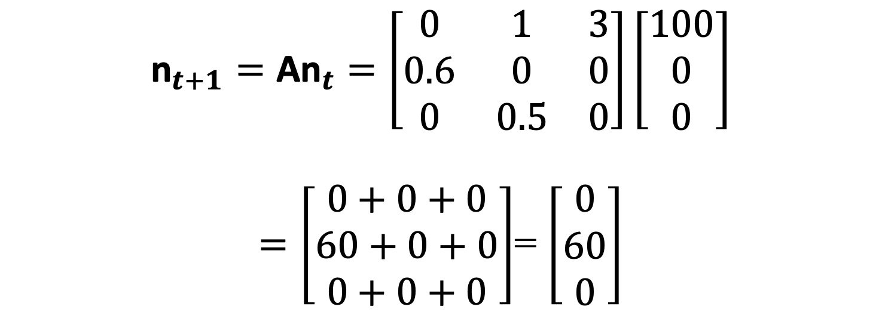
Simple
example:
$${\text{n}}_{t+1}=\text{A}{\text{n}}_{t}=\left[\begin{matrix}0 & 1 & 3 \\ 0.6 & 0 & 0 \\ 0 & 0.5 & 0\end{matrix}\right]\left[\begin{matrix}100 \\ 0 \\ 0\end{matrix}\right]$$
$=\left[\begin{matrix}0+0+0 \\ 60+0+0 \\ 0+0+0\end{matrix}\right]$= $\left[\begin{matrix}0 \\ 60 \\ 0\end{matrix}\right]$

Slide 19
Simple
example:
Time: | 1 | 2 | 3 | 4 | 5 | 6 | 7
n_{1,t} | 100 | 0 | 60 | 90 | 36 | 108 | 103
n_{2,t} | 0 | 60 | 0 | 36 | 54 | 22 | 65
n_{3,t} | 0 | 0 | 30 | 0 | 18 | 27 | 11
N_{t} | 100 | 60 | 90 | 126 | 108 | 157 | 179

Slide 20
Time: | 1 | 2 | 3 | 4 | 5 | 6
n₁ | 100 | 0 | 60 | 90 | 36 | 108
n₂ | 0 | 60 | 0 | 36 | 54 | 22
n₃ | 0 | 0 | 30 | 0 | 18 | 27
N | 100 | 60 | 90 | 126 | 108 | 157
n₁/N | 1.0 | 0 | 0.67 | 0.71 | 0.33 | 0.69
n₂/N | 0 | 1.0 | 0 | 0.29 | 0.50 | 0.14
n₃/N | 0 | 0 | 0.33 | 0 | 0.17 | 0.17
Annual growth rate=(N_{t+1}/N_{t}) | .60 | 1.50 | 1.40 | 0.86 | 1.45 | 1.14

Slide 21
Let's plot this…

Slide 22
Dynamics:
What about a longer timescale?

Slide 23
Dynamics:
Are the age classes growing at similar rates?

Slide 24
Dynamics:
Thus, the composition is constant…

Slide 25
Age
structure:
Constant proportions through time =
Stable Age Distribution (SAD)
If no growth (N_{t}=N_{t+1}), then:
Stationary Age Distribution
Stat. AD is the same as the “survivorship curve”

Slide 26
The right eigenvector of A gives the Stable Age Distribution.

Slide 27
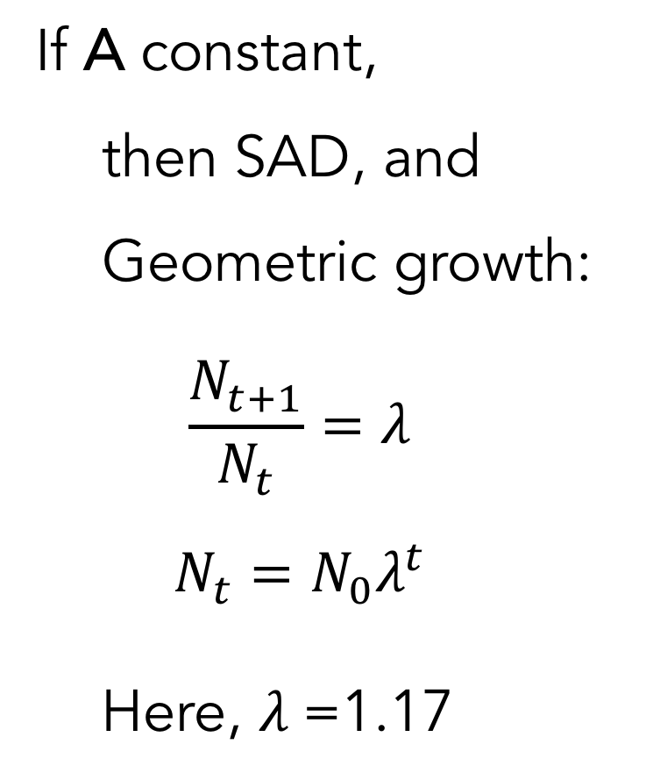
Dynamics:
If A constant,
then SAD, and
Geometric growth:
$$\frac{N_{t+1}}{N_{t}}=λ$$
$$N_{t}={N_{0}λ}^{t}$$
Here, $λ$=1.17

Slide 28
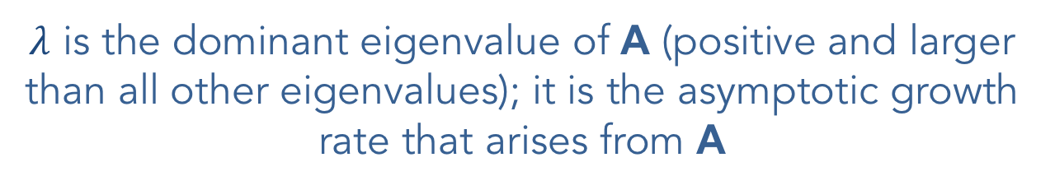
$λ$ is the dominant eigenvalue of A (positive and larger than all other eigenvalues); it is the asymptotic growth rate that arises from A

Slide 29
How do we obtain a survivorship schedule from our transition matrix, A?

Slide 30
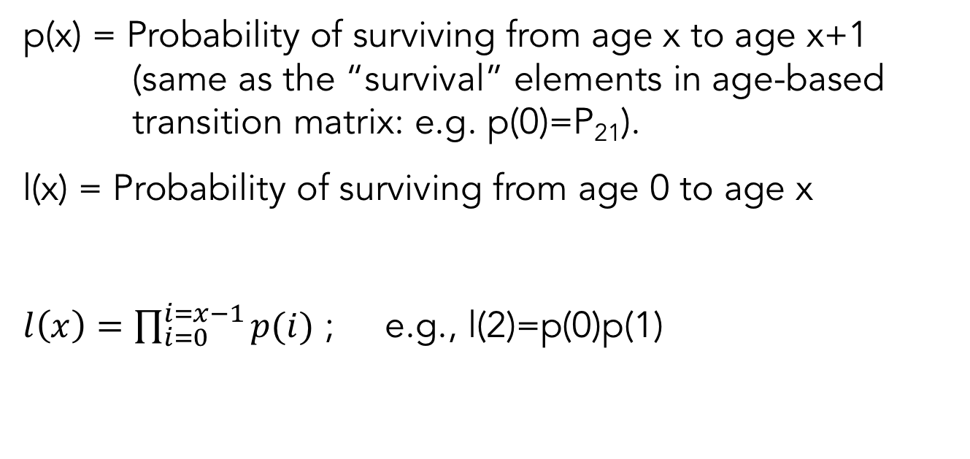
Survivorship
schedule:
p(x) = Probability of surviving from age x to age x+1 (same as the “survival” elements in age-based transition matrix: e.g. p(0)=P₂₁).
l(x) = Probability of surviving from age 0 to age x
$l\left(x\right)=\prod_{i=0}^{i=x−1}{p(i)}$ ; e.g., l(2)=p(0)p(1)

Slide 31
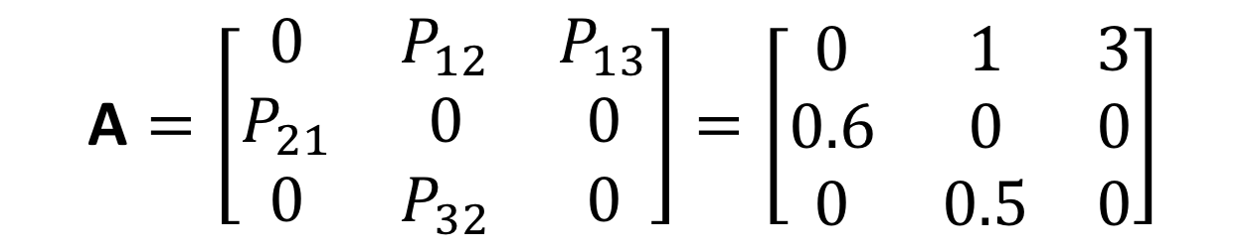
Survivorship
schedule:
Recall:
$$\text{A}=\left[\begin{matrix}0 & P_{12} & P_{13} \\ P_{21} & 0 & 0 \\ 0 & P_{32} & 0\end{matrix}\right]=\left[\begin{matrix}0 & 1 & 3 \\ 0.6 & 0 & 0 \\ 0 & 0.5 & 0\end{matrix}\right]$$
“Group” | Age, x | P_{x+2,x+1}=p(x) | l(x)
1 | 0 | 0.6 | 1.0
2 | 1 | 0.5 | 0.6
3 | 2 | 0.0 | 0.3
4 | 3 | 0.0 | 0.0

Slide 32
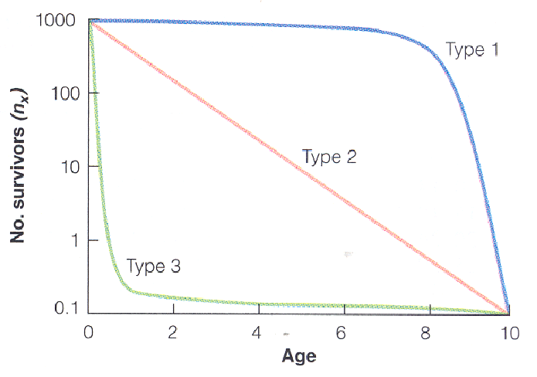
Survivorship
curves:
Age specific survival?

Slide 33
Back to the question:
The age distribution should mirror the survivorship schedule.
Does it?

Slide 34
Survivorship
curves:
Does the age distribution match the survivorship curve?
“Group” | Age, x | l(x) | Stable A.D. | Rescaled AD
1 | 0 | 1.0 | 0.58 | 1.0
2 | 1 | 0.6 | 0.30 | 0.52
3 | 2 | 0.3 | 0.13 | 0.22
Why not?

Slide 35
Survivorship
curves:
The population increases 17% each year
So what was the original size of each cohort? And how does that affect SAD?

Slide 36
Survivorship
curves:
Population Growth!
How can we adjust for growth?
l(x) | Stable A.D. | Adjusted by growth | Rescaled
1.0 | 0.58 | =0.58/1.17² | 1.0
0.6 | 0.30 | =0.30/1.17 | 0.6
0.3 | 0.13 | 0.13 | 0.3

Slide 37
Survivorship
curves:
Static Method: count individuals at time t in each age class and then estimate l(x) as n(x,t)/n(0,t) Caveat: assumes each cohort started with same n(0)!
Cohort Method: follow a cohort through time and then estimate l(x) as n(x,t+x)/n(0,t)

Slide 38
Reproductive
Value:
Contribution of an individual to future population growth
Depends on:
Future reproduction
Pr(surviving) to realize it
Timing (e.g., how soon – so your kids can start reproducing)

Slide 39
Reproductive
Value:
left eigenvector of A
How can we calculate it without doing linear algebra?
Put 1 individual in a stage
Project
Compare future N to what you get when you put the 1 individual in a different stage

Slide 40
Reproductive
Value:
Group (Age class) | N (t=25) | Reproductive Value
1 (0) | 34 | 1.0
2 (1) | 67 | 1.9
3 (2) | 88 | 2.6

Slide 41
Reproductive
Value:
From vianica.com
Scaled to 1 for newborn
Increase from birth to maturation (why?)
May continue to increase after maturation
Eventually it declines (why?)

Slide 42
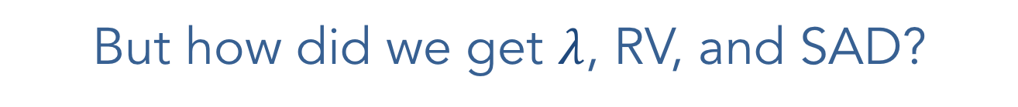
But how did we get $λ$, RV, and SAD?

Slide 43
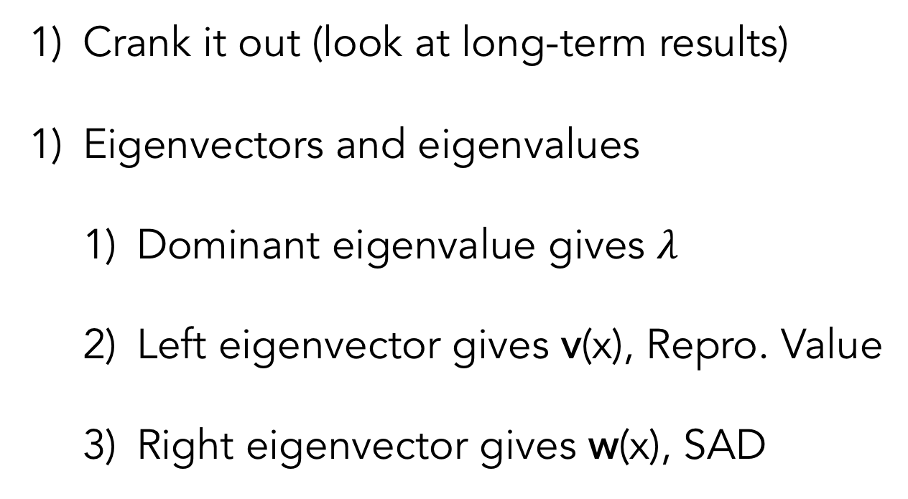
Methods:
Crank it out (look at long-term results)
Eigenvectors and eigenvalues
Dominant eigenvalue gives $λ$
Left eigenvector gives v(x), Repro. Value
Right eigenvector gives w(x), SAD
See Caswell 2001

Slide 44
Issues we've ignored:
Non-age based approaches
Density dependence
Other forms of non-constant A
How you obtain fecundity and survival data (and use it to get A)
Issues related to timing of the projection vs. birth pulses
Sensitivities and elasticities
Linear algebra (how to obtain eigenvectors)

Slide 45
Generalizing
the approach:
Age-structured:
Age 0
Age 1
Age 2
Age 3
Stage-structured:
Stage 1
Stage 2
Stage 3
Stage 4
How will these models differ?

Slide 46
Age-structured:
Age 0
Age 1
Age 2
Age 3
Stage-structured:
Stage 1
Stage 2
Stage 3
Stage 4

Slide 47
To do:
Go back through the previous results for age-structure and think about how they will change for stage-structured populations.
Read Vonesh and de la Cruz (carefully and deeply) for discussion during the next class.
Do HW2.

