Slide 1
Ecology 8310 Population (and Community) Ecology
Predator-prey
Empirical patterns:
Luckinbill's experiments
Huffaker's mites
Lake patterns in phyto-zoop as f(nutrients)
Causes of positive increases in consumer-resource

Slide 2
Tests that inform predator-prey models

Slide 3
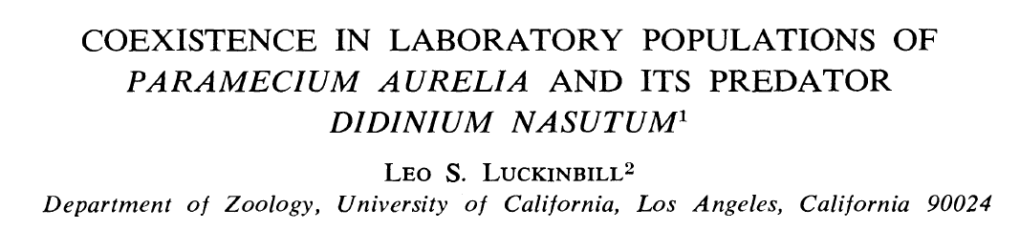
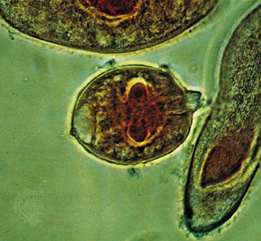
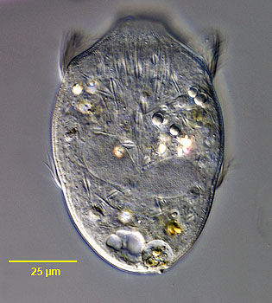
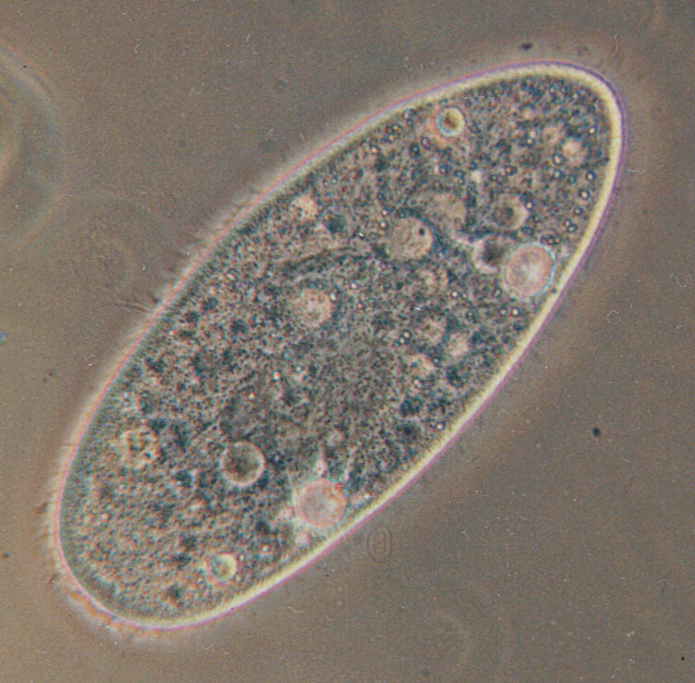
Ecology 54:1320-1327

Slide 4
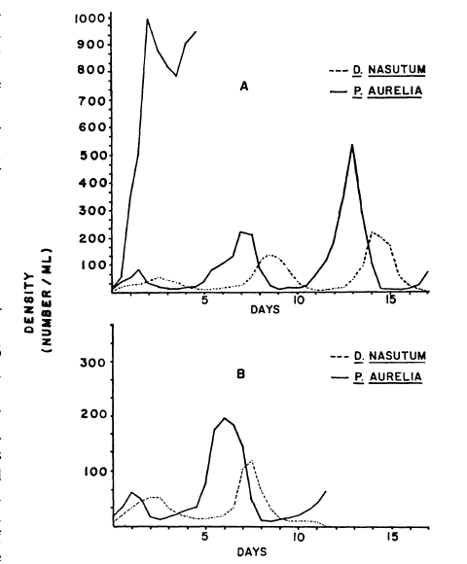
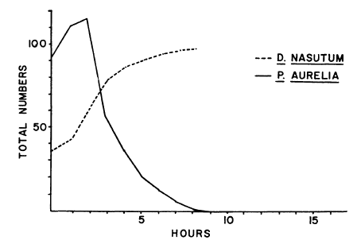
Baseline dynamics:
Paramecium alone
Note extinction after 1-3 predator-prey cycles.

Slide 5
Recall unstable equilibrium in "paradox"

Slide 6
How can we stabilize this system?
dP/Pdt=0
P
Unstable
dN/Ndt=0
N

Slide 7
Reduce predators attack rate
(add cellulose to medium):
dP/Pdt=0
P
dN/Ndt=0
N
Notes:
This also increases equilibrium which might also have a positive effect on persistence.

Slide 8
Reduce prey's K
(reduce food in medium):
dP/Pdt=0
P
dN/Ndt=0
N

Slide 9
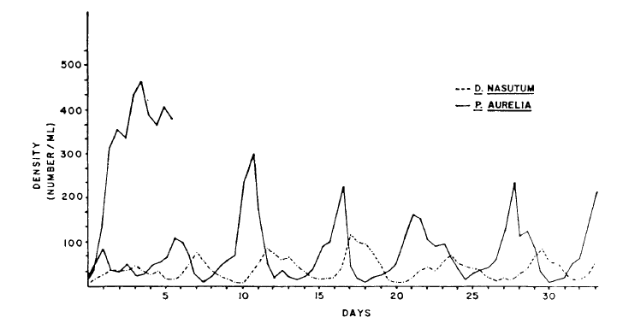
Results:
Increased persistence (stability)!
Paramecium alone
See Harrison (1995, Ecology) for data-model comparison

Slide 10
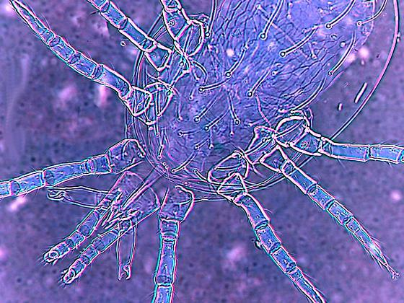
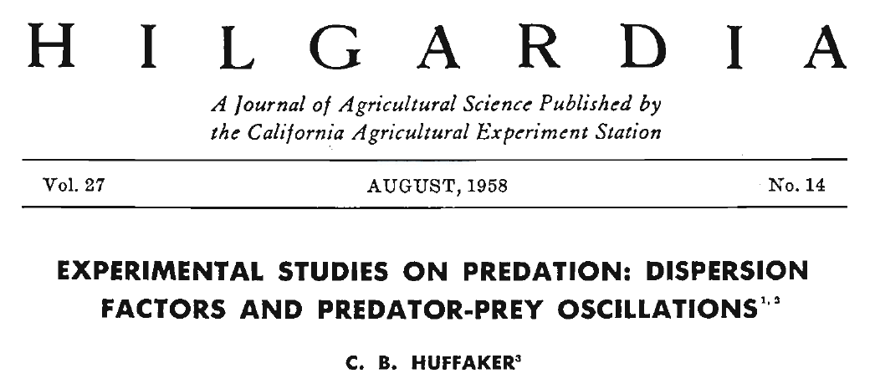
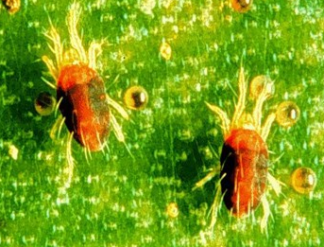
Huffaker's mites:
one predator; one prey
live on oranges

Slide 11
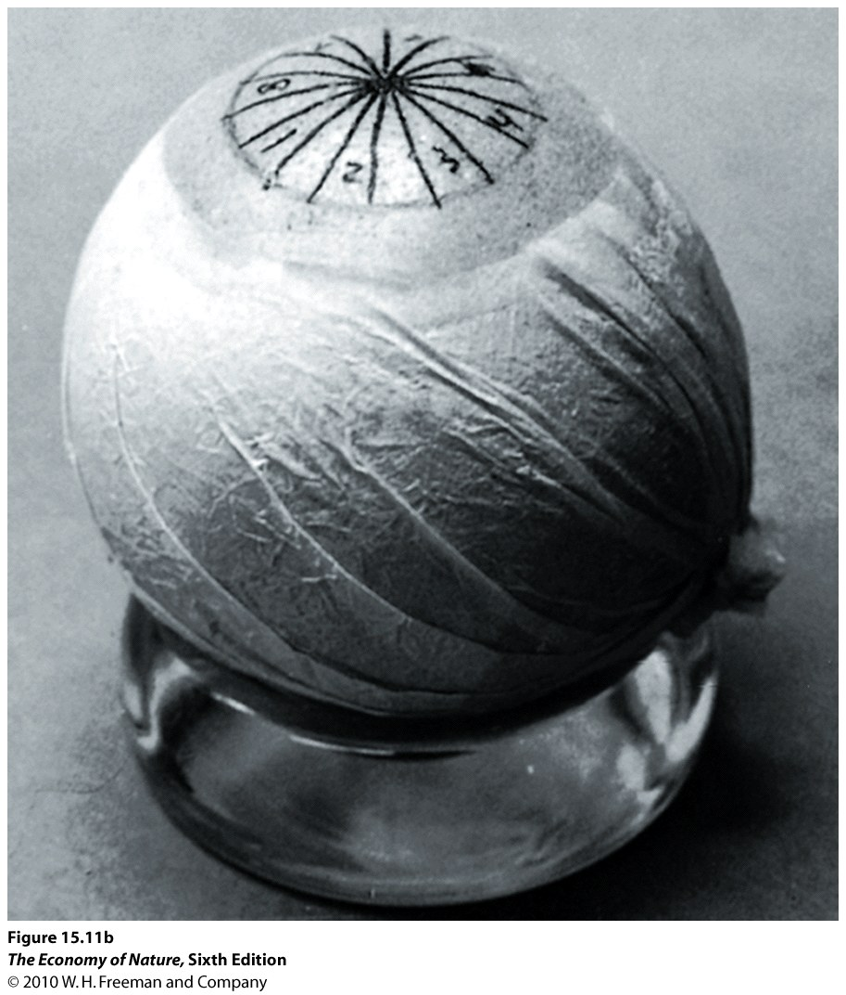
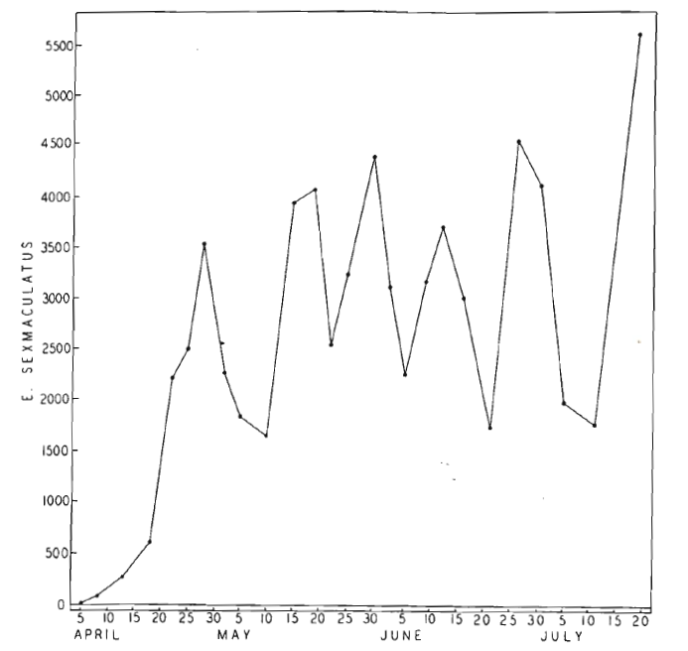
Results:
Without predator: prey persist…

Slide 12
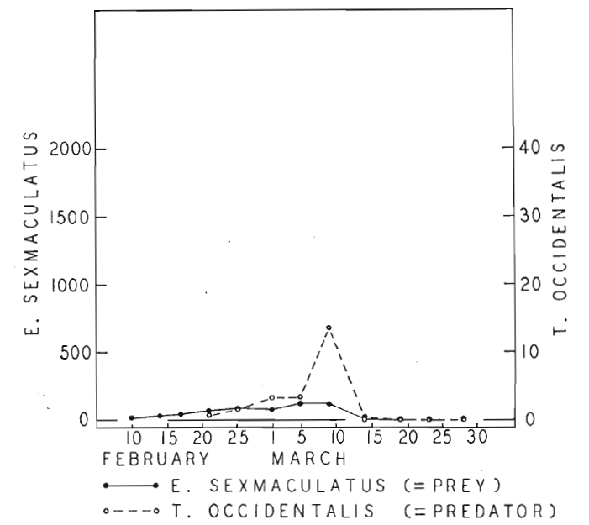
Results:
With predator: extinction

Slide 13
How might the system be modified to facilitate persistence?

Slide 14
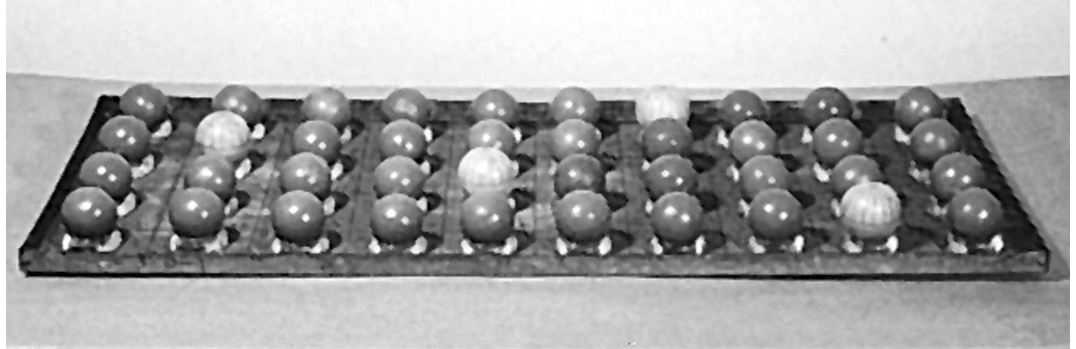
1) Network:
Groups of oranges, coupled by migration…
Many did not work…
2) Reduce predator dispersal ability among patches:
dispersed oranges amid rubber balls, non resource; added barriers to slow down predator movement…

Slide 15
P
P
a_{NP}
a_{PN}
a_{NP}
a_{PN}
Patch network:
N
N
P
P
P
a_{NP}
a_{PN}
a_{NP}
a_{PN}
a_{NP}
a_{PN}
N
N
N

Slide 16
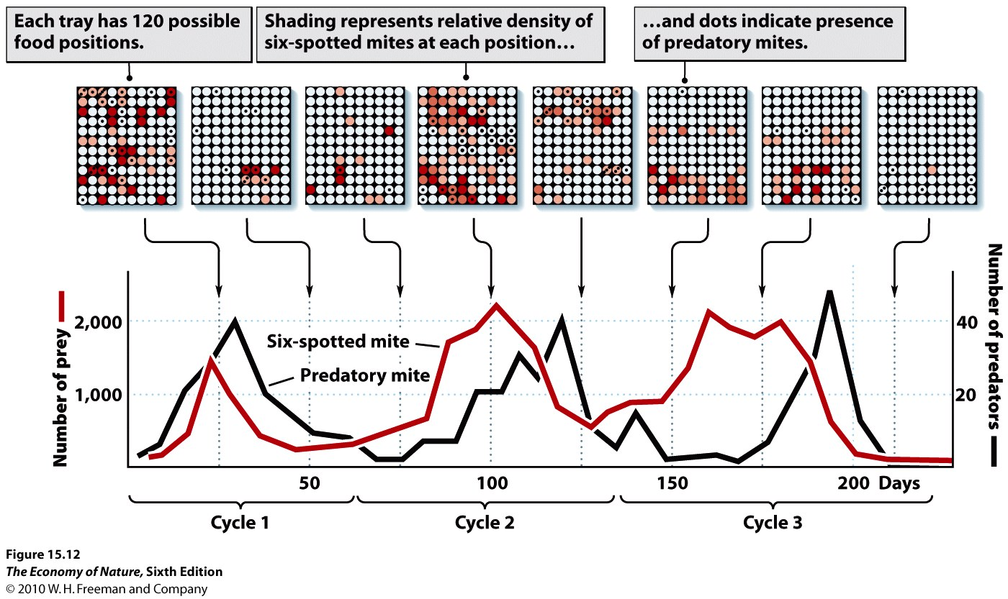
Results:
Patches transition:
none → prey → predator and prey → predator → none

Slide 17
Other data…enrichment in lakes

Slide 18
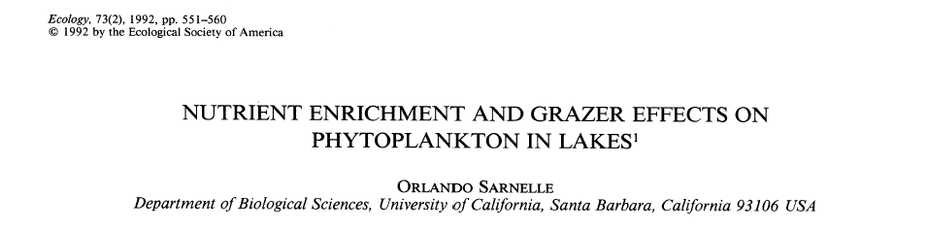
Compared phytoplankton in enclosures with vs. without fish (i.e., phyto only vs. phyto & zoop) in lakes that varied in nutrients (TP)
What do you expect based on LV pred-prey model?

Slide 19
Expectation:
Enrich system: e.g., increase prey’s r and K
No zooplankton
Zooplankton (and no fish)
P (zooplankton)
N (phytoplankton)

Slide 20
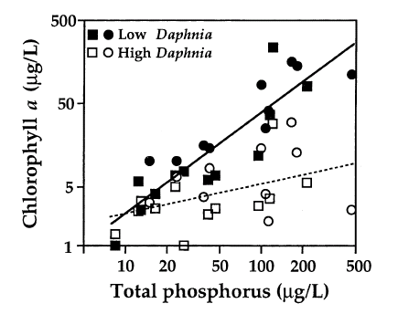
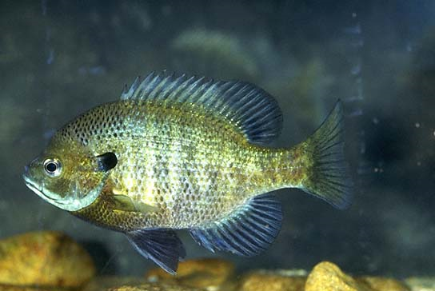

"No" Zoops (with fish)
without fish

Slide 21
Is this the pattern we see in real lakes?

Slide 22
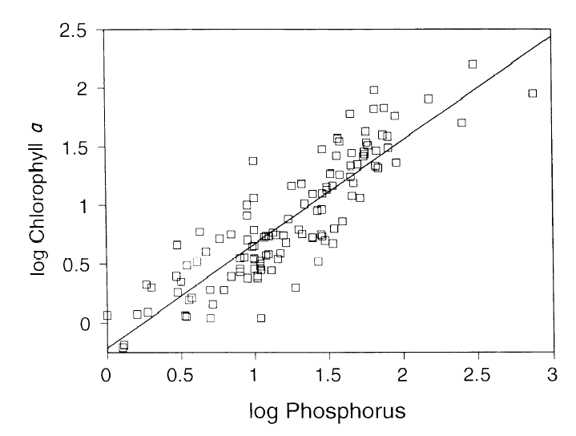
Phytoplankton (algae)

Slide 23
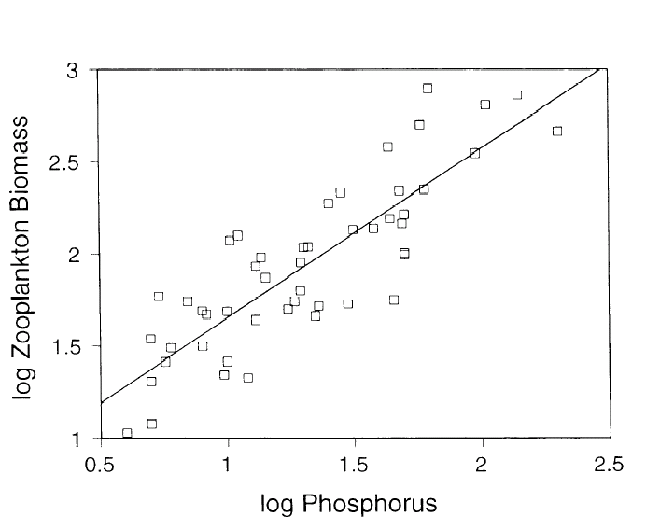
Zooplankton (e.g., Daphnia)

Slide 24
Why the discrepancy?

Slide 25
Ratio dependence . . . Or . . .
Spatial heterogeneity (as we’ve just seen)
Interference among consumers
Consumer stage-structure
Heterogeneity within trophic levels

Slide 26
Expectation:
Effect of interference…
P (zooplankton)
N (phytoplankton)

Slide 27
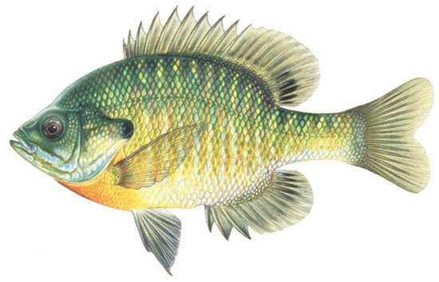

Are there other ways to create this slanted isocline?

Slide 28
Small Bluegill
Large Bluegill
Littoral Invertebrates
Zooplankton

Slide 29
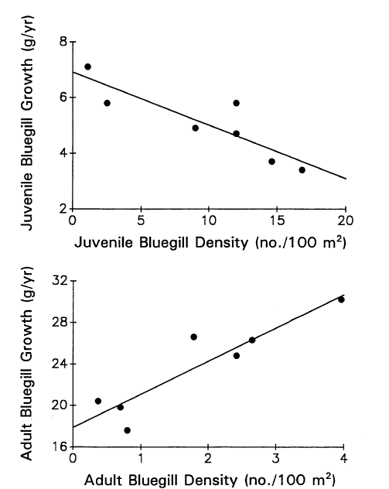

Slide 30
Small Bluegill
Large Bluegill
Littoral Invertebrates
Zooplankton
Notes:
So, "equilibration" arises as a trade-off between juvenile and adult performance.

Slide 31
Juvenile bottleneck:
P (adult density)
N (adult resource)

Slide 32
What about resource heterogeneity?
Notes:
We’ve already discussed spatial heterogeneity as a factor underlying “ratio dependence”.

Slide 33
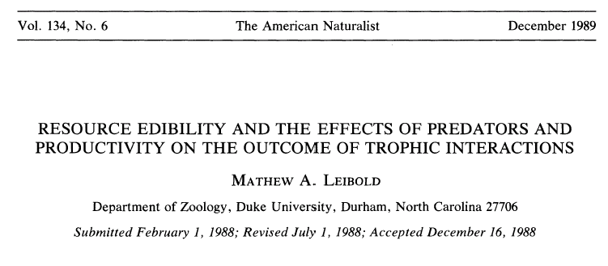

Slide 34
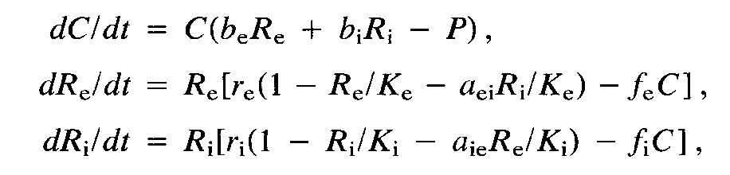
Zooplankton
Edible Algae
Inedible Algae
Nutrients

Slide 35
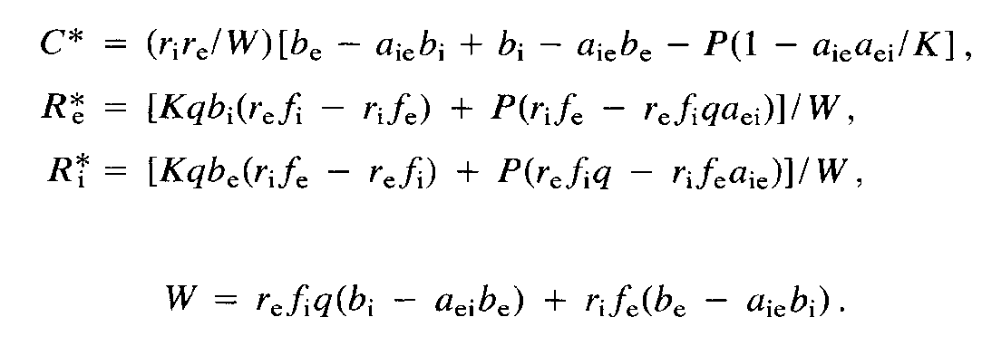
Zooplankton
0
Edible Algae
Inedible Algae
Nutrients

Slide 36
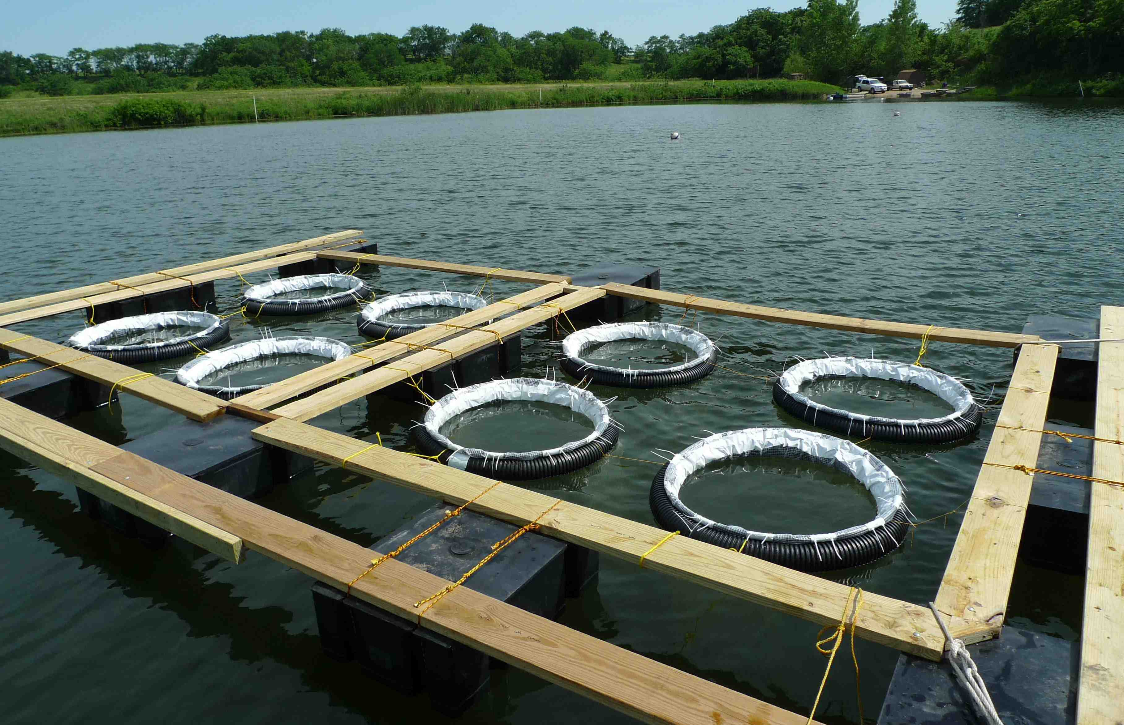
Field experiment (vary nutrients and fish)

Slide 37
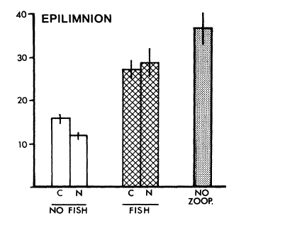
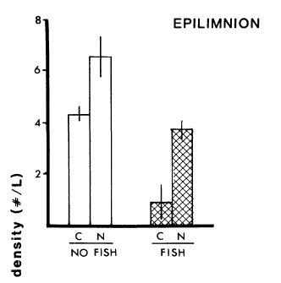
Results:
Microflagellates
Daphnia
Daphnia increase if you: a) remove fish; b) add nutrients
Algal resource is greater with fish
Algal resource does not increase with nutrients.

Slide 38
Data fit simple (not complex) model.
Why?

Slide 39
Synthesize results of other nutrient experiments…
Change in Density | Zoop | Inedible | Edible
Increase | 20 | 7 | 8
No change | 1 | 7 | 5
Decrease | 1 | 0 | 0
Notes:
Result is fuzzy. You see similar pattern in edible and inedible (but not as clean as Leibold's expt: i.e., sometimes they don't change; sometimes they increase.

Slide 40
These systems contain different grazers.

Slide 41
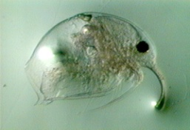
Compare systems with Daphnia vs. smaller grazers (due to their size, they perceive “edibility” differently):
vs.

Slide 42
Change in Density | Zoop | Inedible | Edible
Increase | 10 | 1 | 2
No change | 1 | 6 | 4
Decrease | 0 | 0 | 0
Daphnia systems
(all algae are “edible”)
→ heterogeneity key, but poorly resolved
Change in Density | Zoop | Inedible | Edible
Increase | 10 | 6 | 6
No change | 0 | 1 | 1
Decrease | 1 | 0 | 0
Systems with smaller cladocera (some algae are “inedible”)

Slide 43
Simple models have helped guide our understanding and have pointed to the role of additional biological features
Spatial heterogeneity
Variation in resource vulnerability
Predator interference

