Slide 1
Ecology 8310 Population (and Community) Ecology
Metapopulations
Levins' model
Mainland-island model
Within-patch dynamics
Source – sink dynamics

Slide 2
Closed population
Open population
Regional dynamics
Births,
deaths
N (focal population)
Emigration
Immigration
Notes:
Up until now…closed population, in which N is driven only by internal births and deaths.
If there were others populations in the regional system (click), they had no effect on the dynamics of our focal system.
But what if there was movement of individuals across these geographic barriers, creating additional gains and losses from our focal system?
And what patterns might emerge if we consider the entire collection of populations?

Slide 3
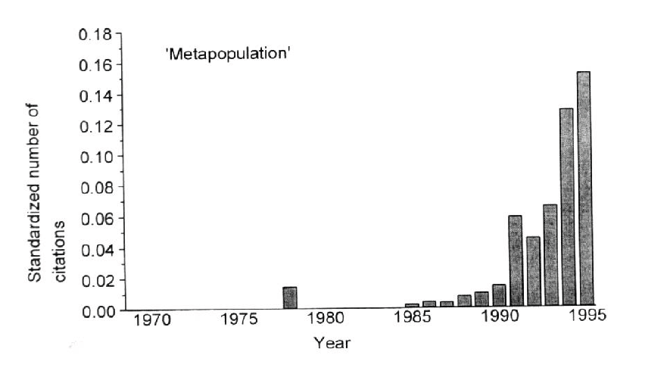
Attribution: Richard Levins (and later, Ilkka Hanski)

Slide 4
Key issues:
Extinction
Local vs. regional persistence
Synchrony and stability

Slide 5
Levins model (aka internal colonization)

Slide 6
Levins' model :
Many identical patches in system (each patch can support a population); intervening matrix is unsuitable
Spatially implicit
Ignores internal dynamics (each patch is either occupied or unoccupied)
Thus, two processes: extinction and colonization

Slide 7
Levins' model:
n = number of patches (assumed very large)
P = proportion of patches occupied
1-P = proportion of unoccupied patches
m = rate of extinction (given occupied) [for example, if you shut down colonization, then P_{t}=P₀e^{-mt}]: e.g., like a death rate.
c = colonization rate (colonists come from from occupied patches and can only colonize if receiving patch is empty) : e.g., like a birth rate
m, c are constant and identical among patches
dP/dt = change via colonization - extinction
dP/dt = cP(1-P) - mP

Slide 8
Levins' model:
Populations wink in and out.
occupied → unoccupied → occupied→…
In absence of other patches, a patch is empty (extinction is forever…)
Recolonization can lead to regional persistence
So, let's look at long-term behavior (P*)

Slide 9
Graphical approach, then mathematical

Slide 10
Levins' model:
dP/dt = cP(1-P) - mP
Rate, cP(1-P) or mP
Initial slope = c
Slope = m
P*
Proportion occupied, P

Slide 11
Vary the extinction rate

Slide 12
Levins' model:
dP/dt = cP(1-P) - mP
Rate, cP(1-P) or mP
P*=0, if slope of extinction curve is > initial slope of colonization curve: i.e., m>c
Proportion occupied, P
Notes:
Note, that red is above blue at P close to 0 when c (initial slope of blue line) > m (slope of red line).

Slide 13
Do some math…

Slide 14
Levins' model:
E.g., equilibrium:
dP/dt = 0 = cP(1-P) - mP
cP(1-P) = mP
P* = 1 – m/c (if c>m)
else
P* = 0 (if m>c)
[Agrees with our graphical approach]

Slide 15
Note that Levins' model is similar to logistic:
Recall:
dN/dt = rN – aN²
= rN(1 – N/K)
dP/dt = cP(1-P) – mP
= (c-m)P – cP²
= (c-m) P (1 – P/(1-m/c))
So: c-m ~ r; P* = (1-m/c) ~ K

Slide 16
Levins' model:
Given this similarity, many insights we already have are still relevant (but in which patches are "individuals"):
equilibrium
stability
"demographic" stochasticity

Slide 17
Levins' model:
Implications:
1) Interpretation of local extinctions
2) Conservation biology

Slide 18


Discussion:
1) Amphibian declines
Established populations are declining

Slide 19
Discussion:
Assume:
Developer is environmentally aware
Target non-occupied sites (to avoid impacts)
What will be the implications (if these sites are part of a meta-population network)?
Notes:
Or contrast a developer who targets sites with extant populations vs. one that targets “empty” sites.

Slide 20
Levins' model:
E.g., equilibrium:
dP/dt = cP(1-D-P) - mP
D = the proportion of patches removed
Then
P* = 1 – m/c – D

Slide 21
Levins' model:
P* = 1 – m/c - D
Removing unoccupied patches reduces the number of occupied patches by the same amount!
The population goes extinct when:
D = 1 – m/c = P*_{without development}
E.g., if 1/3 of patches are occupied, and you destroy half of the empty patches (D=0.5x2/3=1/3) … extinction.

Slide 22
Can we express this graphically?

Slide 23
Levins' model:
dP/dt = cP(1-P-D) - mP
D=0
Rate, cP(1-P-D) or mP
Slope = c (1-D)
D>0
D>1 – m/c
P*
P*
P*
Proportion occupied, P
D
Notes:
What happens as we increase D? 2 effects (intercept on right, which helps reduce P*; and initial slope, which reduces P* and causes the extinction (because it eventually becomes <m).

Slide 24
= "metapopulation meltdown"
Unoccupied sites are essential to the persistence of a metapopulation!

Slide 25
Can we compensate for these effects?

Slide 26
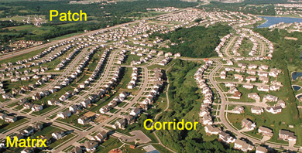
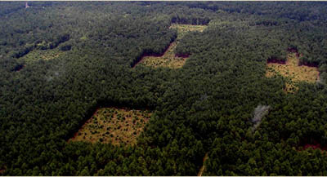
Corridors (increase colonization)
Savannah River Site (DOE): Haddad, Tewskbury, Levey
Notes:
Corridor project

Slide 27
Corridors (increase connectivity)?
dP/dt = cP(1-P) - mP
Large c
Rate, cP(1-P) or mP
Small c
P*
P*
P*
Proportion occupied, P

Slide 28
Island – Mainland model

Slide 29
Island-Mainland model
Same as Levins', except:
Mainland fixed
No internal colonization

Slide 30
Island-Mainland model:
dP/dt = c(1-P) – mP (vs. cP(1-P) in Levins')
dP/dt = 0
P* = c / (c + m)
Note: island populations always persist if c>0 (so long as the mainland exists)

Slide 31
What would this model look like graphically?

Slide 32
Island-Mainland:
dP/dt = cP(1-P) - mP
Rate
dP/dt = c(1-P) - mP
P*
P
Rate, c(1-P) or mP
P*
Proportion occupied, P
Notes:
Ie., islands persist with P*> so long as the mainland sends out more than 0 colonists.

Slide 33
Discussion
Rescue Effect?
Allee Effect?
Patch size?
Distance (isolation)?
Notes:
Rescue: efffect: a reduction in the Pr(exinction) when more sites are occupied b/c the higher input of colonists (to an occupied site) buoys up the local density, preventy effects of demographic stochasticity: So, functionally, m decline as more patches are occupied (e.g., because more propagules means that you don't get pushed to low local density as often due to demo stochasticity; or that you are more likely to receive colonists as you are winking out).
Address this by letting m become a decreasing function of P (so mP decelerates) (i.e., m declines as P increases), so mp is no longer linear, but the slope decreases with increasing P.
Allee: colonizations may not be successful unless there are sufficient number of colonists arriving to an empty patch. In Internal colonization model, this means that colonization initially accelerates with P.
Can we put together a graphical model with Allee? What are the implications?
What if we think about sites that are close vs. far from other islands? (e.g., take a group is islands and move them farther apart….what happens to P*?)

Slide 34
What about within patch dynamics?

Slide 35
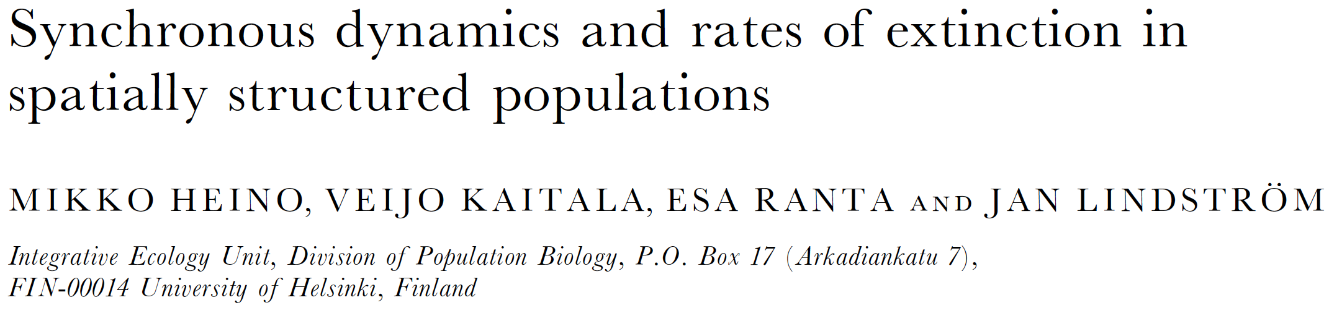


Slide 36
Simulation study:
10 patches
Each patch follows discrete, Ricker dynamics, plus local (environmental) noise, global (environmental) noise, and migration (no demog stoch.)
Migration: either distance-independent (rain) or distance-dependent
Increased r (r<2 is stable, 2<r<2.56 cycles, r>2.56 chaos)
Quantified:
local extinction (arises from local noise)
global extinctions (all 10 patches extinct at same t)
synchrony (correlated temporal pattern among patches)

Slide 37

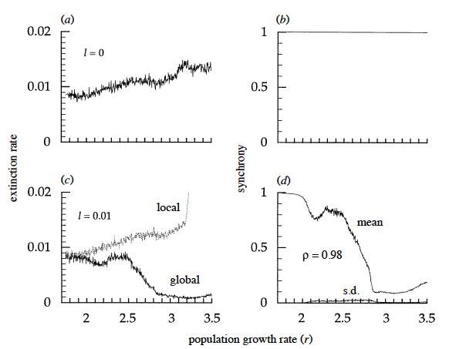
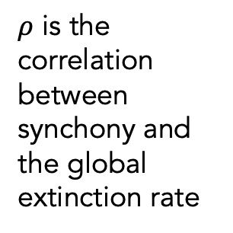
Simulation study: distance-INDEP migration
Local noise absent
(Local=global)
Perfect synchrony – all patches are the same
Local noise present
$ρ$ is the correlation between synchony and the global extinction rate
From Heino et al. 2015 (Proc Roy Soc B)
Notes:
Without local noise and with migrants raining out of the sky (no distance-based migration), all patches come into synchrony. Yes, there are initial transients, but eventually, all patches show THE SAME temporal dynamics. Extinction rises with r due to stochastic extinction. Local extinction rate = global (bc all patches the same). (u is local noise; z is global noise)
L is a measure of local noise Uniform from –L to +L (with mean 0). So L is a measure of local environmental variance.
WITH Local noise (u): Now patches exhibit different dynamics; Initially, synchrony is high, but as we enter chaos, synchrony declines and LOCAL extinction rate DECREASES!
Rho is the correlation between synchrony and global extinction rate.
Mean and sd are for the measure of synchrony

Slide 38
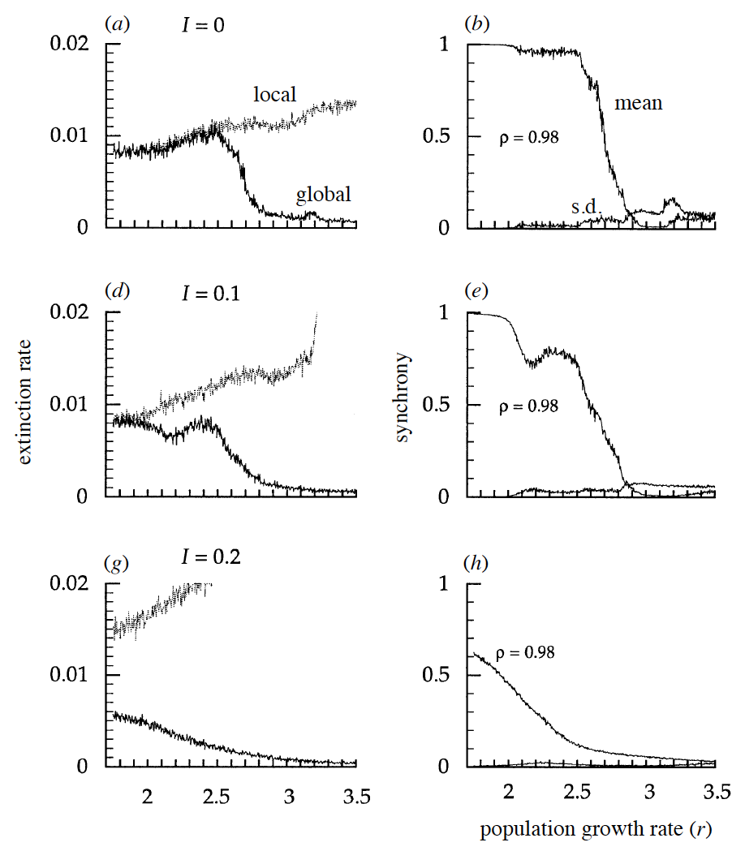
Simulation study:
Distance-DEPEND
migration
Local noise absent
Asynchrony increases persistence
Asynchrony caused by: chaos (similar patches are very different in future), local noise, distance-dependent dispersal (decouples distant patches).
Local noise weak
Local noise stronger
From Heino et al. 2015 (Proc Roy Soc B)
Notes:
Now, we have distance-dep migration (space is explicit)
a,b) local noise absent: local=global, until we get near chaos, then patches diverge from one another -- synch goes down and global ext rate goes down.
d,e) with local noise present but weak: similar pattern, but the globacl ext rate is lower (less synchrony)
g,h) more local noise: even less synchrony and even larger global stability (despite increase in local extinctions).

Slide 39
Discussion
Why does asynchrony stabilize the system?
Notes:
--raise issue of effect of migration when at high vs. low density...

Slide 40
Discussion
What about variation in patch "quality"?

Slide 41
Discussion
Consider a patch with an emigration of m.
What is the average amount of time an individual spends in that patch before emigrating (assuming mortality is nil).
If the mortality rate in that patch is d (and emigration and death are independent), then what is the average time an individual remains in that patch (before dying or leaving)?
Notes:
1/m; 1/m+d

Slide 42
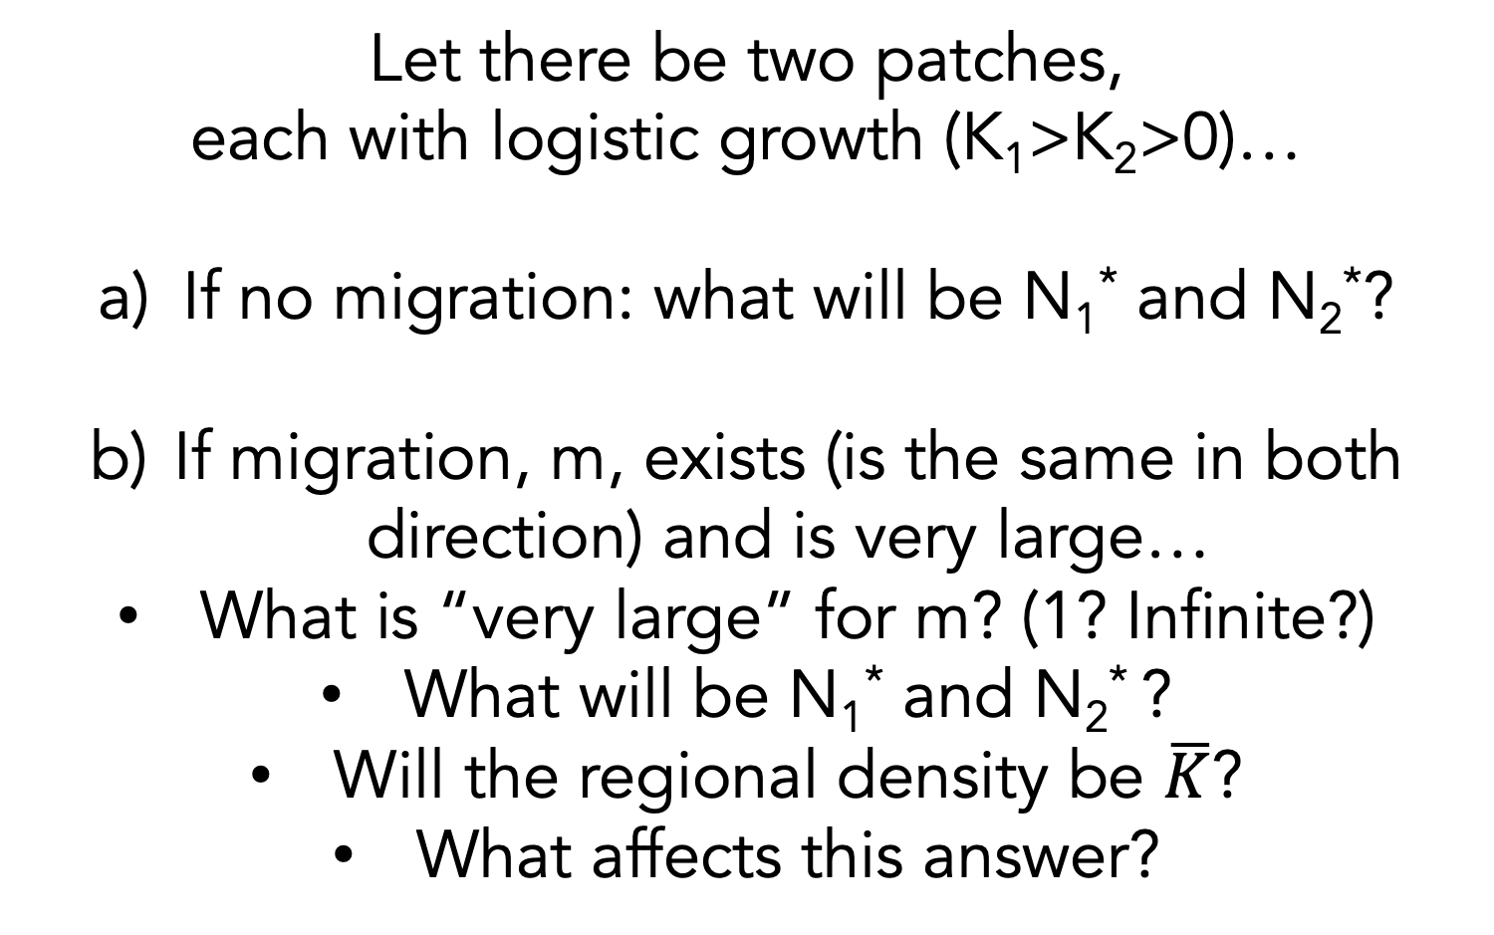
Discussion
Let there be two patches,
each with logistic growth (K₁>K₂>0)…
If no migration: what will be N₁* and N₂*?
If migration, m, exists (is the same in both direction) and is very large…
What is “very large” for m? (1? Infinite?)
What will be N₁* and N₂* ?
Will the regional density be $\overline{K}$?
What affects this answer?
Notes:
(see Holt 1985 TPB). It's hard to say. But we can assert that K1<N1*<N2*<K2.
Assume that emigration gets very large (goes to infinity)…then what? Because it's a well-mixed system, the N's will converge. And w N1=N2, we also know that the migration into and out of a patch are in balance. Thus, we can seek a graphical solution....draw the basics of Holt 1985 – see figure hidden on next slide. can graphically compare the pre capita growth rates.
…From Holt 1985. Curves give dN/Ndt for the two patches. DOT gives the mean of the K's. X gives the density (recall N1=N2) at which the overall growth is 0 (one patch produces at rate Z and the other loses at rate Z) – the dashed line is just the average dN/Ndt (when N1=N2). Thus X gives the average density in the system, which can be either <aveK or >aveK. This depends on the strength of density-dependence. Bottomline: the aveK is biased towards the patch with the stronger den-dep.

Slide 43
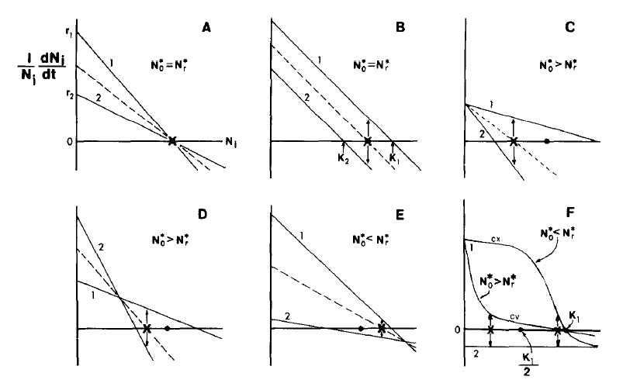
Notes:
From Holt 1985. with m very large. Curves give dN/Ndt for the two patches. DOT gives the mean of the K's. X gives the density (recall N1=N2) at which the overall growth is 0 (one patch produces at rate Z and the other loses at rate Z) – the dashed line is just the average dN/Ndt (when N1=N2). Thus X gives the average density in the system, which can be either <aveK or >aveK: i.e., migration can increase or decrease regional density. This depends on the strength of density-dependence. Bottomline: the N* is biased towards the K of the patch with the stronger den-dep (if growth is logistic: A-E). In F, the effect on regional N (sum of two patches) depends on whether dn/ndt is concave or convex.
Best to do this on board....

Slide 44
Discussion
What if K₁>0 and r₁>0 , but the second patch has r₂=<0 (and both exhibit equal strengths of density-dependence)?
What will be N₁* and N₂* ?
(if per capita migration rates are equal and very large)
Notes:
Go thru a logistic case following Holt 1985 graphical approach in which r<0. What is N1* and N2*.
If m is less than infinite, then again, you get persistence in the patch that can’t persist on it’s own – we call that a sink and is persists only b/c of migration from the other patch (a source). N2*>K2, N1*<K1. If the system is well-mixed, then you can use the Holt approach to work out....

Slide 45
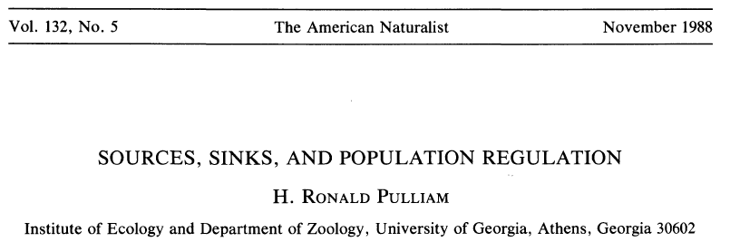
Sources and Sinks
Notes:
What is a source? What is a sink?

Slide 46
Discussion
What is a source?
What is a sink?
What happens to a source (or sink) if you shut off migration?
How can you infer source vs. sink observationally?
E.g., you establish a reserve based on sites where you find the most critters…
Notes:
Lambda><1

Slide 47
Discussion
What about a marine or open system?
What is a sink?
What happens to a source (or sink) if you shut off migration?
How can you infer source vs. sink observationally?

Slide 48
Do HW3 for Tuesday

Slide 49
Go over HW3

