Slide 1
Ecology 8310 Population (and Community) Ecology
A quick review of evolution…
Classic example: Biston betularia
Evolution by natural selection
Population genetics
Quantitative genetics
Breeder's equation
Selection

Slide 2

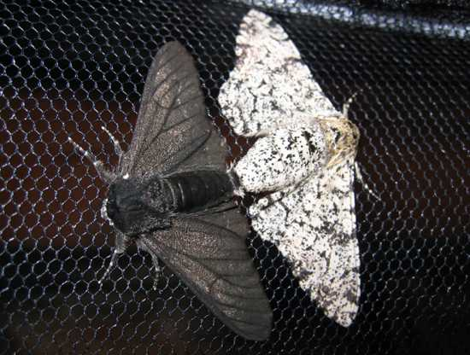
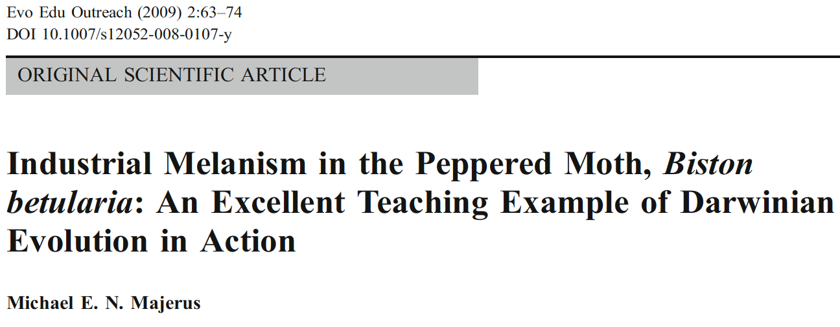
Evolution examples: Biston betularia
Heredity (1955) 9, 323–342
doi:10.1038/hdy.1955.36

Slide 3
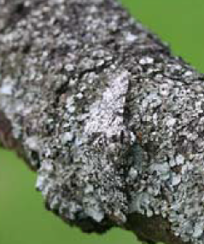
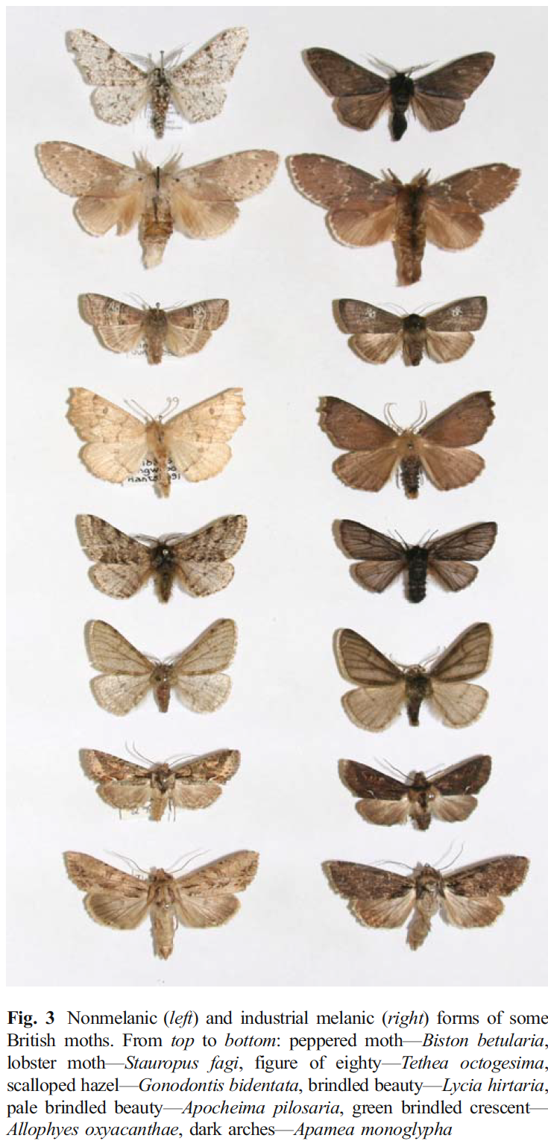
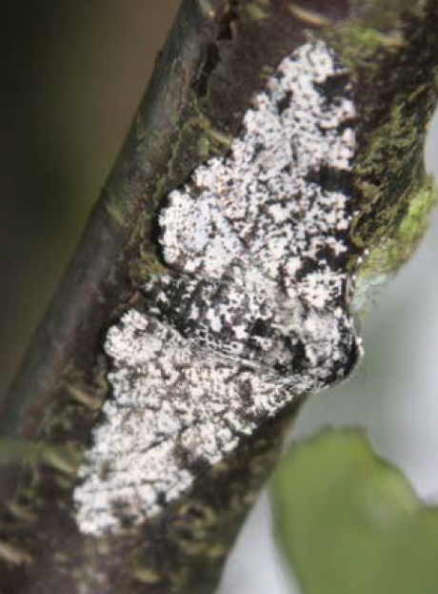
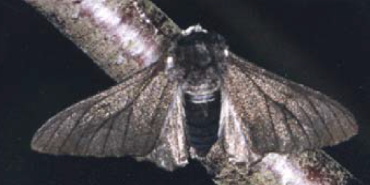
The story:
Non-mellanic morph (typica)
Melanic morph (carbonaria)
Notes:
Classic example with a storied past:
Two form: dark (carbonaria) and light typica, which is "normal"). Dark form described first around Gloucester in 1848. Dark morph became common around industrialized centers of England and by late 1800's was the most common form (98% of moths).
Tutt first proposed this was driven by natural selection caused by increased industrial activities.
Kettlewell performed classic experiments exploring the mechanisms responsible in the 1950s.
Story: Normal situation: trees with lichens; typica blends in.
Industrialization: led to soot deposition on trees, killed lichens, dark branches.
As a result, typical stood out to visual predators (birds); natural selection favored dark morphs after industrialization
Sargent in the 1960's was unable to replicate Kettlewell's finding – leading to controversy, debate, and charges of data fabrication, etc. Fascinating.
Majerus revisited in 2000's and re-affirmed Kettlewell's work – it's stands today as one of the classic examples of evolution by natural selection.
Common pattern across a wide range of British moths.

Slide 4
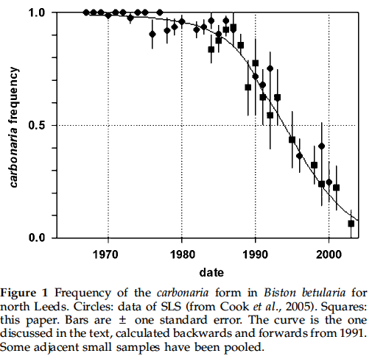
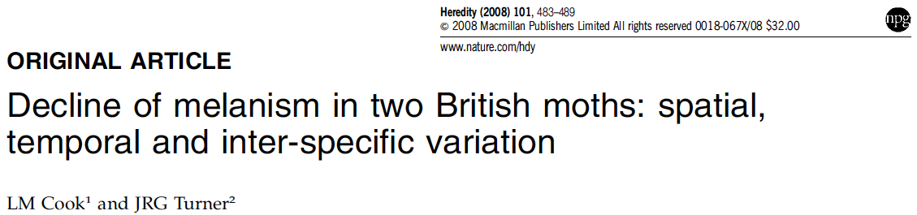
Post-industrialization?
Notes:
So what has happened after industrialization; as we cleaned up our air and put regulations on particulate discharges?

Slide 5
Evolution by natural selection:
What is required?
Phenotypic (trait) variation
Differential survival or reproduction (selection)
Trait must be heritable (additive genetic compon.)
V_{Phenotypic} = V_{Genetic} + V_{environment} + 2Cov(G,E)
V_{Genetic} = V_{Additive} + V_{Dominance} + V_{epistasis}
heritability = h² = V_{Additive} / V_{Phenotypic}
Notes:
So There are two parts here; one is ecological (selection); and one is genetical (the inheritance).
What produces the "variation"? (V(P) = V(G) + V(E) + 2Cov(G,E): so there's a genetic component and an environmental one.
The genetic component can be further partitioned (e.g., additive, dominance, and epistasis).
V(G)=V(Additive) + V(Dominance) + V(Epistasis). Heritability (narrow sense) is V(A)/V(P) [broad H2=Vg/Vp]
Epistasis is the interaction between genes (nonadditivity)

Slide 6
Evolution by other means?
Genetic drift
Mutation
Migration
Genetic drift and natural selection both require variation.
Mutation and migration introduce variation.

Slide 7
Population genetics (few genes)

Slide 8
Population genetics approach:
Single gene involved
carbonaria allele is dominant (A allele)
How can we approach this?
Your homework assignment (HW5)…
Geno-type | Pheno-type | Freq. | Fitness
AA | dark | p² | w₁
Aa | dark | 2pq | w₂
aa | light | q² | w₃
Notes:
This framework works when there is random mating, large popu size (no sampling error), two alleles, discrete generations (non-overlapping), no mutation, no migration, and sexes have equal allelic frequency.
In this case, w1=w2 b/c the phenotype is the same.

Slide 9
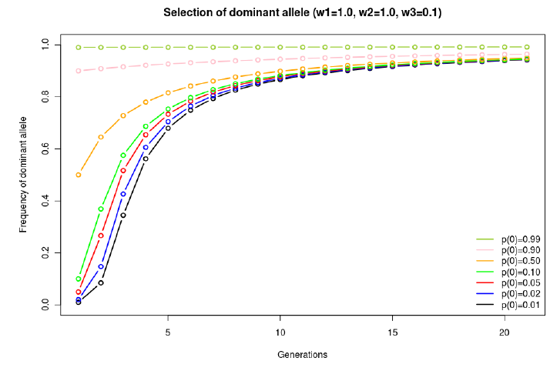
Evolutionary dynamics (e.g., dark envir.):
w_{AA}=w_{Aa}=1.0; w_{aa}=0.1
Notes:
So this is a case with dominance; AA and Aa have the same fitness. aa is inferior.
All curves are the same -- they only differ in the starting frequency.

Slide 10
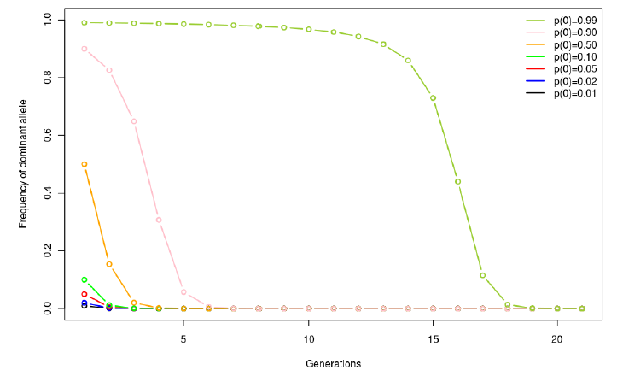
Evolutionary dynamics (e.g., light env.):
w_{AA}=w_{Aa}=0.1; w_{aa}=1.0
Notes:
Now, the homozygous recessive (aa) is the most fit. E.g., This is like the condition when the light morph is favored in the Biston system (when trees are covered in light lichens).
Note that rates at which the allele frequencies change are different here than in the previous slide – you'll explore this in your homework assignment.
ALSO; note that the rate of change is slow when there is very LITTLE PHENOTYPIC VARiATION to act upon (freq near 0 or 1). In general, change is rapid when the phenotypic variation is largest (e.g.,intermediate allelic frequency; not necessarily near .5 b/c phenotypic variation should be greatest when p=0.3, q=0.7 ➔ 50:50 dark:light.

Slide 11
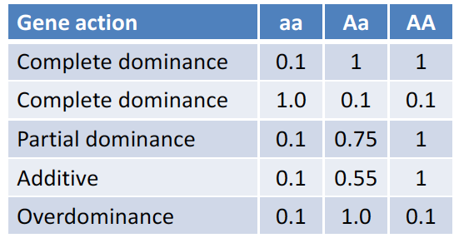
Patterns of "dominance":

Slide 12
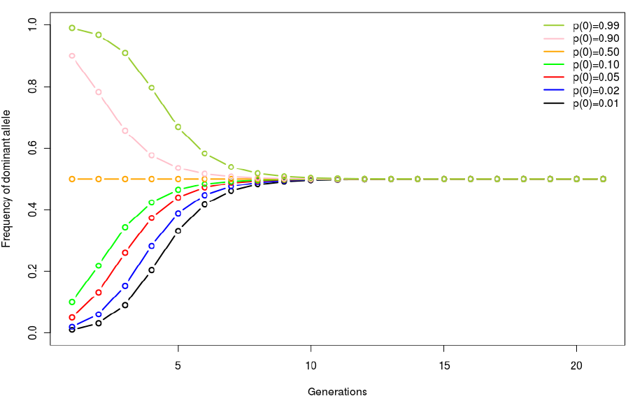
Evolutionary dynamics: overdominance
w_{AA}=0.3; w_{Aa}=1.0; w_{aa}=0.3
Notes:
Overdominance. So now, the heterozygote has the greatest fitness. And we maintain both alleles in the system.

Slide 13
Quantitative (continuously varying) traits
Notes:
Typically the action of many, many genes, each with very small effects.

Slide 14
Response to selection (breeder’s eqn):
h² = Heritability (e.g., from parent-offspring regression)
S = Selection differential or intensity (i.e., difference in mean trait before vs. after selection)
Notes:
Breeder's equation. Captures the two processes of evolution by selection: S (selection differential) and heritability, h2 (additive genetic variance). Both are required to get a response to selection (i.e., evolution via selection). Note that you can have selection, but if there is not heritability, then no evolution.
Notice also that this makes clear that selection ACTS ON THE PHENOTYPE!!!

Slide 15
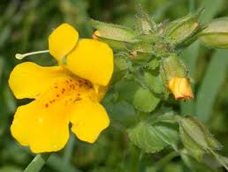
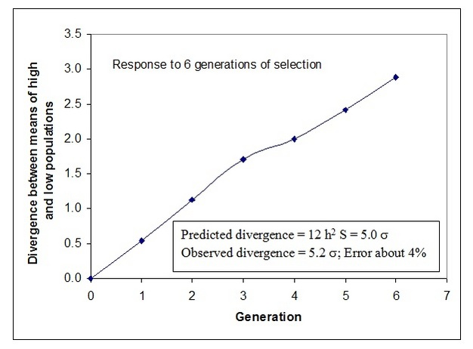
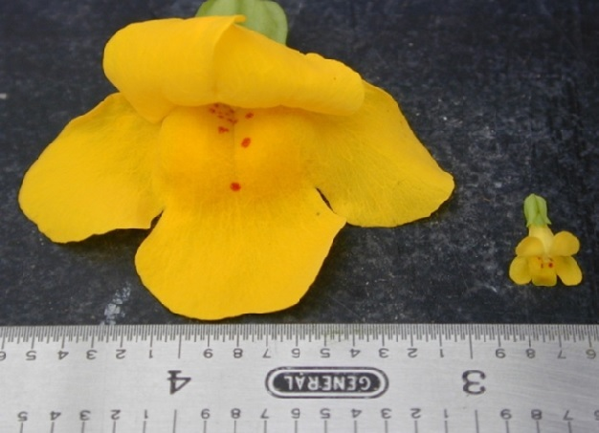
Response to selection:
From Kelly (2008)
Notes:
Mimulus -- Kelly imposed selection: top 20% or bottom 20% of corolla widths were allowed to breed…. Continued for 6 generations. High and Low lines diverged; and rate was approx as expected based on S and heritability.

Slide 16
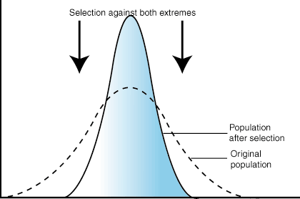
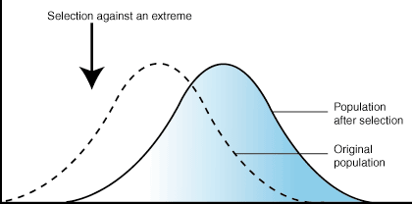
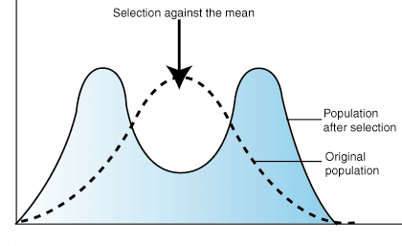
Forms of selection:
Stabilizing
Directional
Disruptive

Slide 17
Toward a better understanding: Selection gradients
Selection differential: change in mean trait following selection
Selection gradient: the relationship between fitness and the trait

Slide 18
Selection gradients:
Stabilizing
Directional
Disruptive
Relative Fitness
Phenotype
Relative Fitness
Phenotype
Relative Fitness
Phenotype
Notes:
Selection Differential only looks at the change in the mean trait value before and after selection; gradient is more comprehensive.

Slide 19
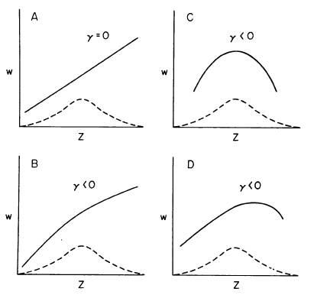

Selection gradients: quantification
Selection differential:
Selection gradients:
$W=β_{0}+β_{1}Z+γZ^{2}$
Which is directional?
Which is stabilizing?
Disruptive?
From Mitchell-Olds and Shaw (1987)
Notes:
Dashed line is distribution of trait before selection
Disruptive would have gamma>0 (bowl shaped)

Slide 20
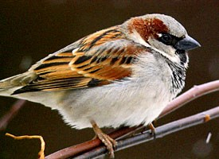
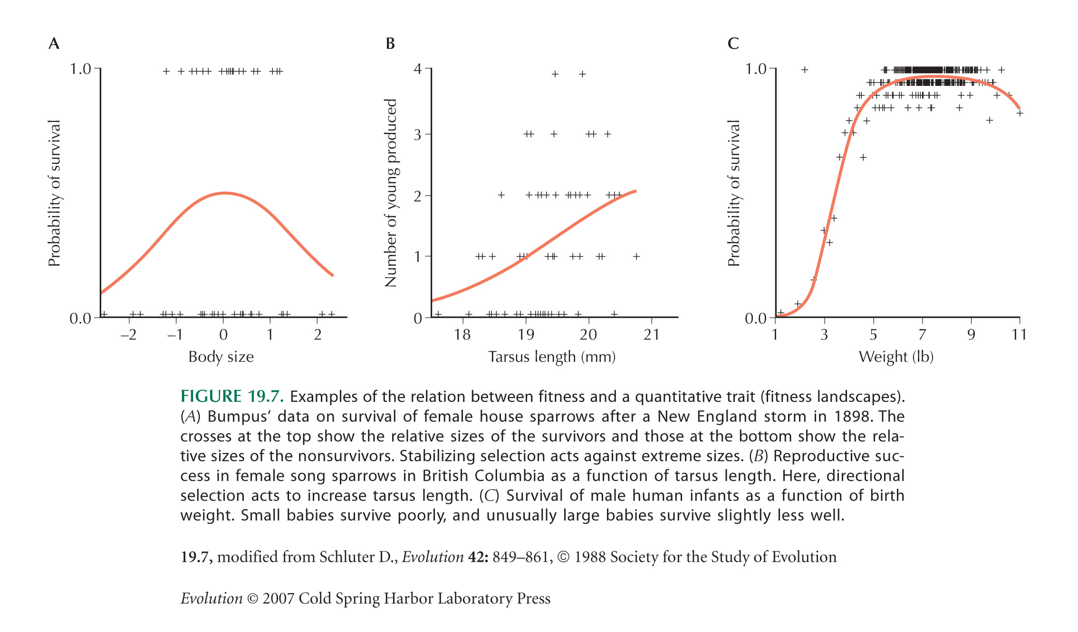
Examples:
Bumpus’ data on house sparrows
Female song sparrows
Human infants

Slide 21
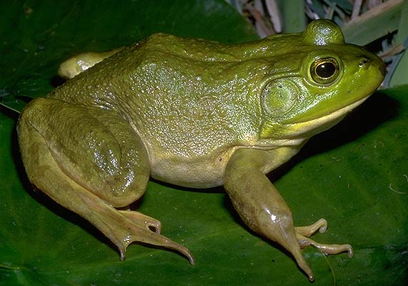
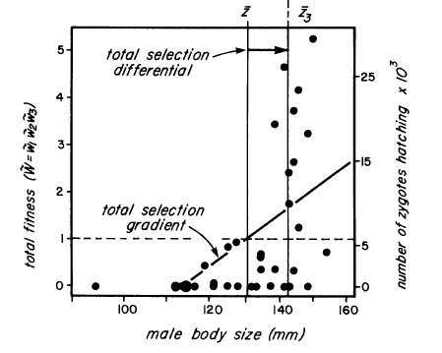
Another example:
From Arnold and Wade 1984 (data from Howard 1979)

Slide 22
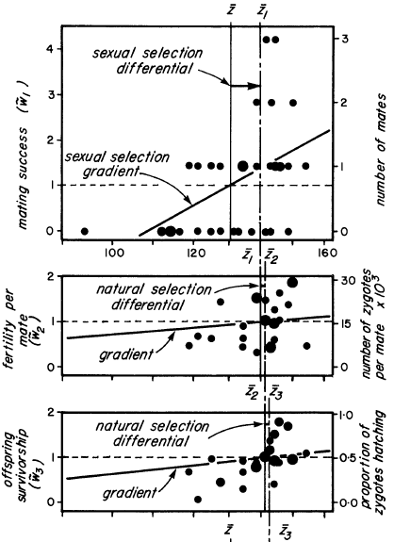
Components
of fitness:
e.g.,
W = mating success
x
fertility/mate
x
offspring survival
Notes:
X axis = male body size

Slide 23
Selection is an ecological process
(the response to selection is a genetic process)
[the combination is evolution by natural selection]

