Slide 1
Ecology 8310 Population (and Community) Ecology
Predator-prey theory
Basics (Lotka-Volterra)
Functional responses and risk
Effect on phase-planes
Dynamics
Paradox of enrichment
Predator interference and ratio dependence

Slide 2
How do predators respond to prey?
Numerical response (demographic and aggregative)
Functional response (feeding rate)
Developmental response (predator ind. growth)
Notes:
Numerical: the classic demographic response in predator-prey models (more prey=lower mortality or higher birth), but has also been extended to include migration (aggregation of preds to locally high densities of prey).
Developmental: Murdoch 1971
Functional: a series of paper by Buzz Holling in 1950's and 1960's

Slide 3


Functional response:
the feeding rate of a predator as f(prey density)

Slide 4
Functional response:
The relationship between a predator’s feeding rate and prey density

Slide 5
This assumes a Type I functional response …

Slide 6
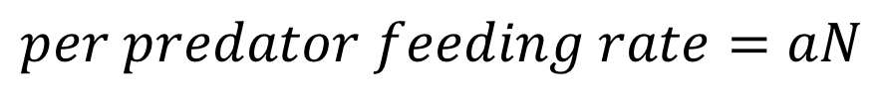
Type I functional response:
$$per predator feeding rate=aN$$
Slope = a
Feeding rate
Prey density , N
Notes:
For our simple predator-prey model, we assumed a TYPE I functional response.
This is pretty unrealistic (for feeding rate to continue to increase as N increases)…

Slide 7
Other options?

Slide 8
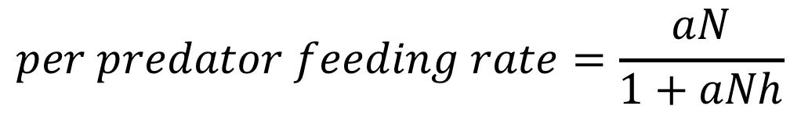
Type II functional response:
$$per predator feeding rate=\frac{aN}{1+aNh}$$
1/h
Slope = a
Feeding rate
Prey density , N
Notes:
Recall our discussions from foraging theory…

Slide 9
Type III functional response:
Slope = a
Feeding rate
Prey density , N
Notes:
e.g., search image formation..

Slide 10
What are the consequences:
e.g., per capita mortality (risk) of prey…

Slide 11
Functional responses:
a
Feeding rate
Per capita mortality rate
Prey density , N
Prey density , N
Notes:
e.g., search image formation..

Slide 12
Functional responses:
a
Feeding rate
Per capita mortality rate
Prey density , N
Prey density , N
Notes:
To help visualize where the per capita mortality rate is maximal for Type III f.r. (It is NOT at the inflection of the functional response).

Slide 13
Let's look at the basic predator-prey model
(which assumes a Type I functional response)

Slide 14
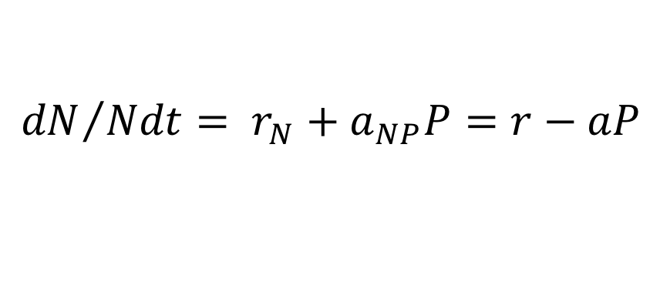
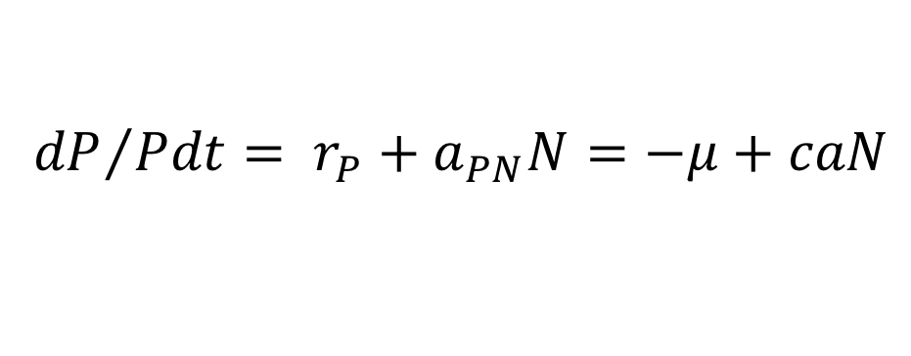
Predation:
P
$${dP}/{Pdt}= r_{P}+a_{PN}N=−μ+caN$$
a_{NP}
a_{PN}
$${dN}/{Ndt}= r_{N}+a_{NP}P=r−aP$$
N
μ is death rate of predator,
a is attack rate
c is conversion efficiency
r is prey growth w/o predation

Slide 15
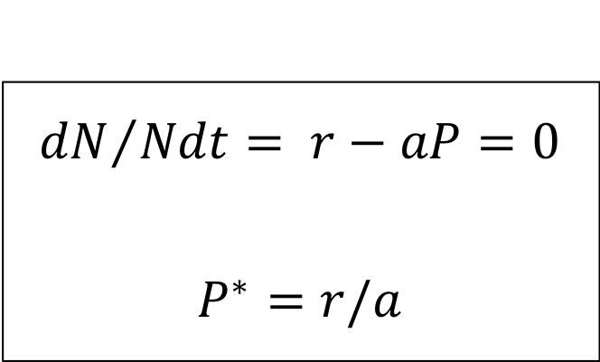
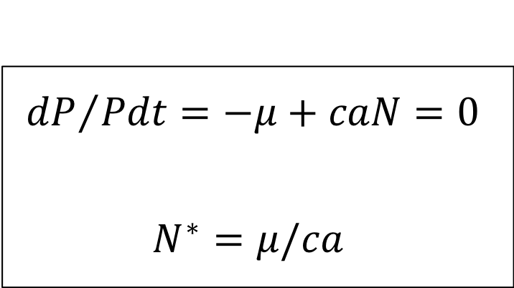
Solve for equilibrium:
$${dP}/{Pdt}=−μ+caN=0$$
$$N^{∗}=μ/ca$$
$${dN}/{Ndt}= r−aP=0$$
$$P^{∗}=r/a$$
Analyze stability:
…maybe later (qualitative for now)

Slide 16
Phase planes:
Putting it together…
dP/Pdt=0
The equilibrium is neutrally stable
r/a
dN/Ndt=0
P
N
μ/ca

Slide 17
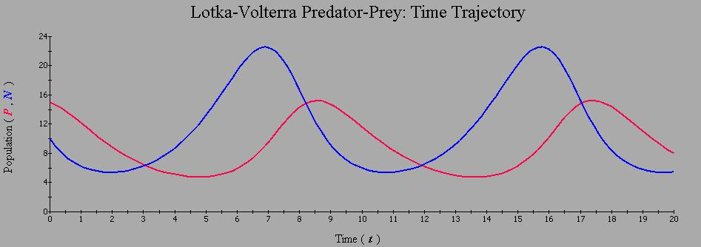
Dynamics:
2
P
3
1
4
Out of phase by ¼ cycle. “Time-lags” (instant. response, but numbers lag).
N
1
1
2
2
2
3
4
3
4
3

Slide 18
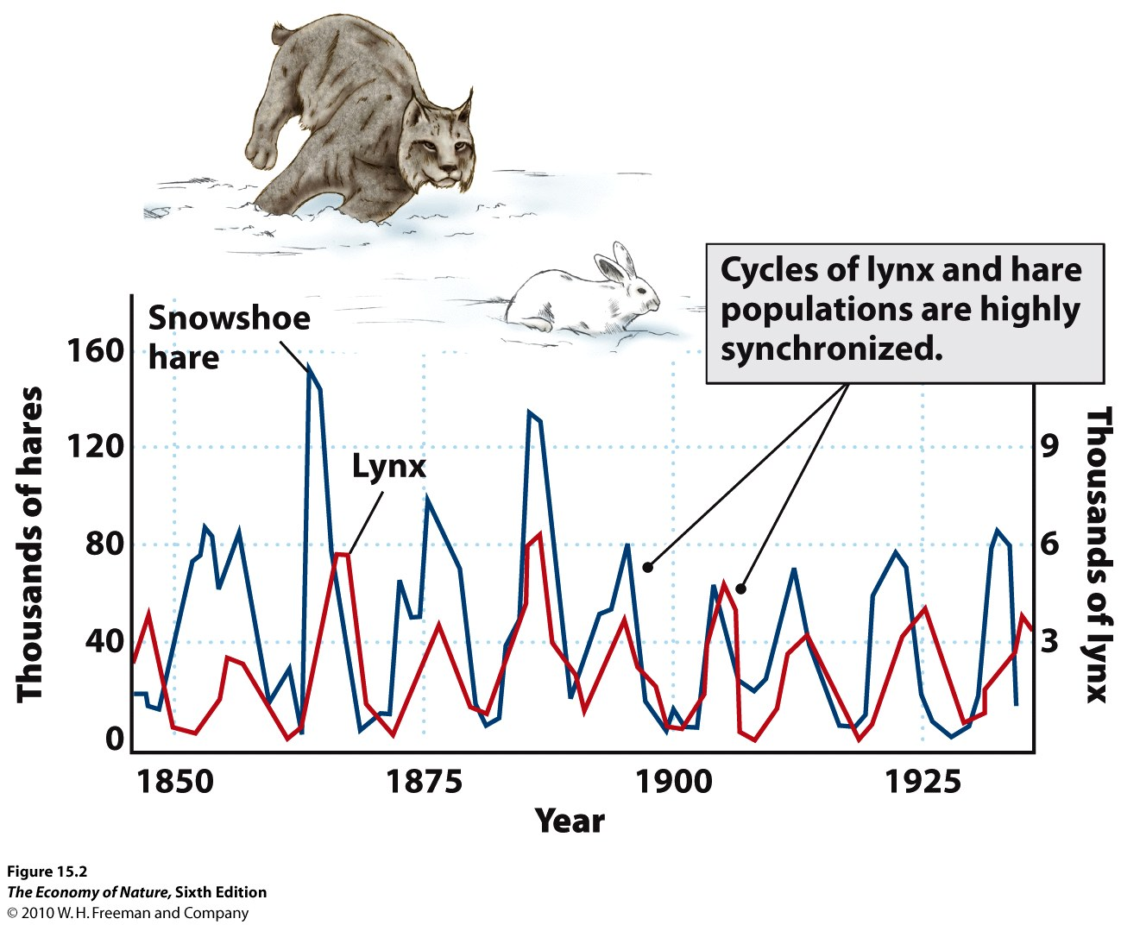
Notes:
Congruence has been very appealing….we'll return to this later when we discuss population cycles specifically.

Slide 19
What if the functional response
wasn’t a Type I?
What is the effect on isoclines
(and stability)?

Slide 20
Effect on prey isocline:
dP/Pdt=0
III: depends
II: destabilizing
P
I: neutral
dN/Ndt=0
N
Note: shape of predator isocline remains the same (but it will shift left/right)
Notes:
Note that a type III fr can stabilize the interaction but only if the equilibrium occurs at low N.

Slide 21
How can we stabilize predator-prey dynamics?
Notes:
Other then a type III functional response (at low N).

Slide 22
P
a_{NP}
a_{PN}
N
Notes:
Are there aspects of the “self feedback loops” (effects of N on N or P on P) that can add stability?
We’ll use the basic LV model as a null case because it is neutrally stable…

Slide 23
Predator interference:
dP/Pdt=0
The equilibrium is stable
r/a
dN/Ndt=0
P
N

Slide 24
Intraspecific competition among prey:
dP/Pdt=0
The equilibrium is stable
r/a
P
dN/Ndt=0
K
N

Slide 25

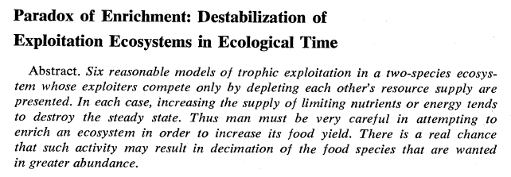


Slide 26
Type II functional response and prey competition
Notes:
Numerical: the classic demographic response in predator-prey models (more prey=lower mortality or higher birth), but has also been extended to include migration (aggregation of preds to locally high densities of prey).
Developmental: Murdoch 1971
Functional: a series of paper by Buzz Holling in 1950's and 1960's

Slide 27
Paradox of enrichment:
dP/Pdt=0
Stable
P
dN/Ndt=0
N

Slide 28
Paradox of enrichment:
Now shift the relative position of the predator isocline:
dP/Pdt=0
Stable limit cycle
P
dN/Ndt=0
N
Notes:
Equilibrium is unstable, but at high prey densities, dens-dep is strong enough to constrain the system and provides a source of stability (neg feedback). This limit cycle is an "attractor".

Slide 29
Note that during periods of low density, demographic stochasticity may cause extinction(s)

Slide 30
So, now enrich such a system …

Slide 31
Paradox of enrichment:
Enrich system: e.g., increase production of prey (r) and its K
What will happen?
P
N

Slide 32
Are there other types of functional responses?

Slide 33
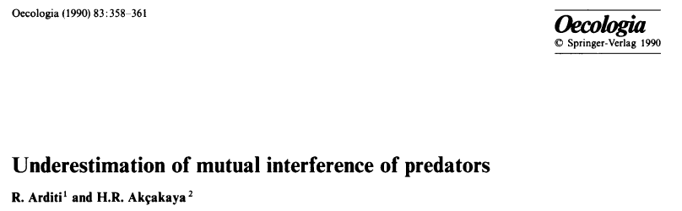
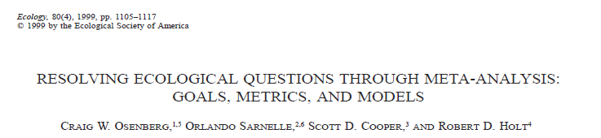
Mutual interference & ratio dependence

Slide 34
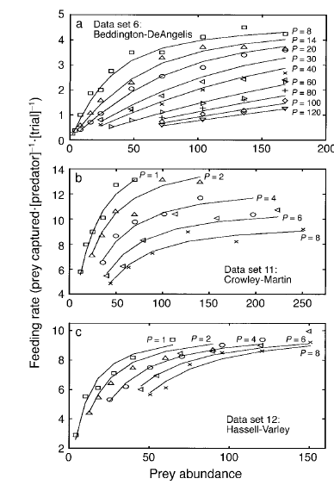
Type II Functional Response (Holling)
Low predator density
Feeding rate
High predator density
Prey density

Slide 35
Hassell-Varley model:
f(N,P) = aNP^{-m} / (1 + ahNP^{-m})
If m=0, then “prey dependent” (Type II funct. res.)
If m=1, then “ratio dependent”
Arditi & Akcakaya (1990)
Osenberg et al. (1999)
DeLong and Vasseur (2011)

Slide 36




Prey-dependent (m=0):
f(N) = aN / (1 + ahN)
Ratio-dependent (m=1):
f(N,P) = a(N/P) / (1 + ah(N/P))

Slide 37
Estimate m : Arditi & Akcakaya (1990)
15 studies: estimated m for each
15/15 led to rejection m=0
3/15 led to rejection of m=1
→ Prey dependence is “wrong” → Ratio dependence is “right”

Slide 38
Re-analyze with meta-analysis
(Osenberg et al. 1999) :
m = 0.72 +/- 0.12 (mean +/- 95% CI)
m ≠ 0
m ≠ 1

Slide 39

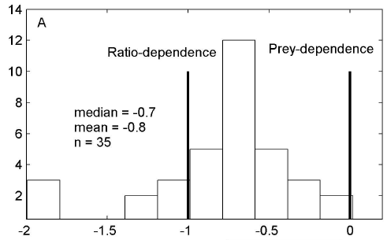
More recent analysis:
Frequency
m

Slide 40
Caveat: study bias
These 15 (or 35) studies were not randomly drawn from all predator-prey systems.

Slide 41
Caveat: depletion
Estimates of "mutual interference" have not accounted for depletion (e.g., Abrams 2015).
What do you expect if you allow prey to deplete in the trials in which you estimate feeding rate?
High predator density
Low predator density
Feeding rate
(per predator)
Initial prey density
Notes:
If you have more predators in the system, the depletion will be greater and you will estimate a lower than actual feeding rate for “that initial density”…

Slide 42
8 preds x 4 prey/pred = 20% depletion
70% depletion
>90% depletion
Thus, these patterns may have been misinterpreted. Feeding rate is intended to measure an "instantaneous" rate, not a long-term feeding rate.

Slide 43
If we accept ratio-dependence, what is its effect on isoclines?
--prey grow logistically without predator
--predator has ratio-dependent func. resp.
--predator incurs a constant mortality rate
Notes:
i.e., let’s ignore possible problems with estimation of the interference parameter…and accept that ratio dependence is “real”.

Slide 44
Predator isocline:
dP/dt=0
P
N
Notes:
It goes through origin: essentially, the feeding rate is constant for a fixed value of N/P; so if you keep N/P the same, the feeding rate is the same. Hence there is a single N/P at which the birth rate balances the death rate. Increasing the predator mortality would reduce the slope of this line.

Slide 45
What about the prey isocline?

Slide 46
Predator isocline:
Assumes a<r
dN/dt=0
dP/dt=0
P
K
N
see Arditi and Ginzburg 2012. How Species Interact
Notes:
dN/dt when P=0 and N=K, and as N decreases, dN/Ndt increases, which requires more Predators to constrain growth of prey. But each predator is becoming much less efficient (because feeding rate decreases as N/P goes down or P/N goes up). In fact, the per capita mortality imposed by the predator population approaches a as P→infinite (i.e., limit of a/(1+ahN/P)) And this critical value of N is the density at which the combined effect of a mortality rate of a and intraspecific competition balance r. In other words, r-a is the growth, and this is negated by the deleterious effect of intraspecific competition.
If a>r then prey isocline is humped and goes through 0,0 and 0,K

Slide 47
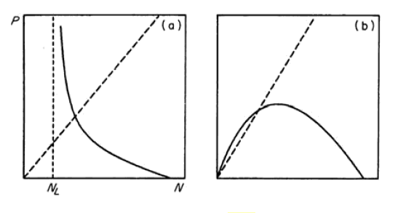
For r>a
For r<a
From Arditi and Ginzburg 2012. How Species Interact

Slide 48
Effect of prey productivity?

Slide 49
Change prey productivity:
Thus P* and N* both increase with increasing productivity (keep this in mind for next lecture)
dP/dt=0
P
dN/dt=0
N
Notes:
Prey growth is logistic with Ratio-Dep functional response

Slide 50

Ideas, once they take root, are hard to kill.…they persist not just in spite of a single inconvenient fact, but in spite of repeated theoretical refutations and whole piles of contrary facts. They are not truly alive—because they are not true—but neither are they dead. They are undead. They are zombie ideas.
-Jeremy Fox (2011, Dynamic Ecology blog)

Slide 51
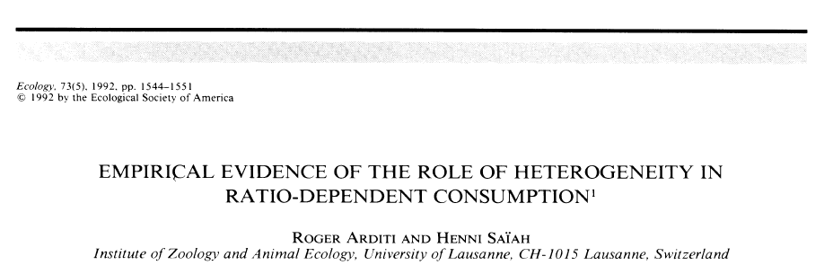
But can ratio dependence explain empirical patterns…
Next week’s discussion paper

